Slide 1


Multiple Force Systems & Equilibrium
P M V Subbarao
Professor & Head
Mechanical Engineering Department
The equilibrium is Curious & universal !!!
By James Black (1786)

Slide 2

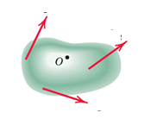
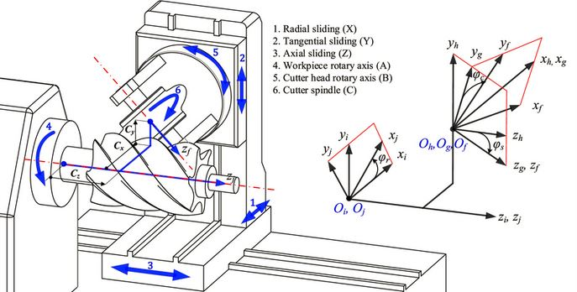




Advanced Force System in 3D
$${\vec{F}}_{1}$$
$${\vec{F}}_{2}$$
An advanced force system deals with a set of forces acting on a 3D body.
The magnitude and directions are as per the real nature of the Mechanical System.
$${\vec{F}}_{3}$$
$${\vec{F}}_{n}$$

Slide 3
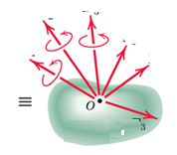
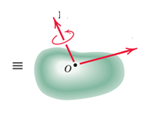
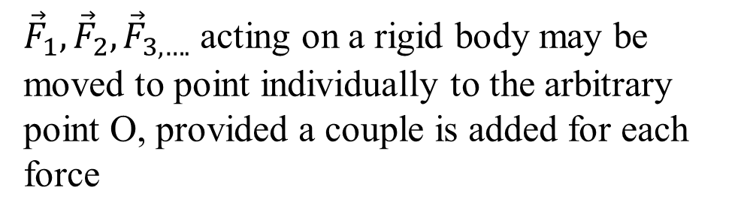













Resultants in 3D
$${\vec{F}}_{1}$$
$${\vec{F}}_{2}$$
${\vec{F}}_{1},{\vec{F}}_{2},{\vec{F}}_{3, ….}$ acting on a rigid body may be moved to point individually to the arbitrary point O, provided a couple is added for each force
$${\vec{F}}_{3}$$
$${\vec{F}}_{n}$$
$${\vec{M}}_{2}$$
$${\vec{M}}_{3}$$
$${\vec{F}}_{1}$$
$${\vec{M}}_{1}$$
$${\vec{F}}_{2}$$
$$\vec{M}$$
$${\vec{F}}_{3}$$
$$\vec{R}$$
$${\vec{F}}_{n}$$

Slide 4
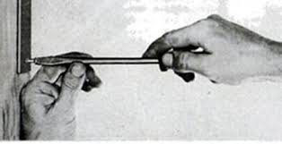
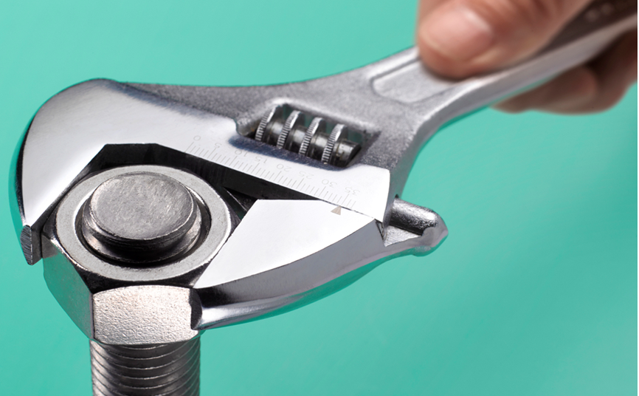
Wrench Resultant
A combination of a resultant force and collinear couple moment will tend to translate and rotate the body about its axis and is referred to as a wrench or screw.
A wrench is the simplest system that can represent any general force and couple moment system acting on a body.

Slide 5
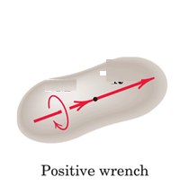
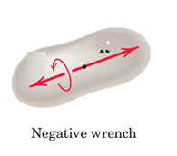

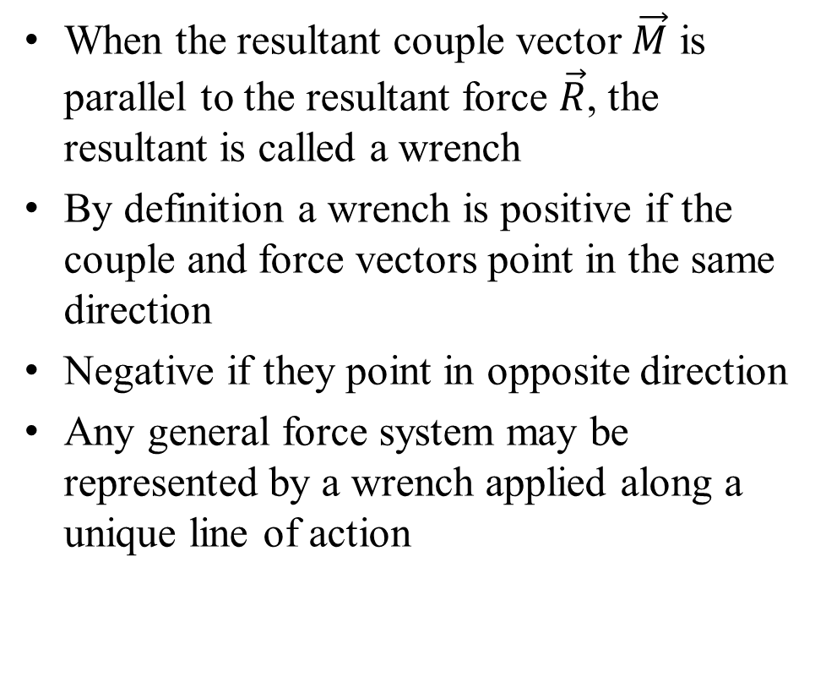



Wrench Resultant
When the resultant couple vector $\vec{M}$ is parallel to the resultant force $\vec{R}$, the resultant is called a wrench
By definition a wrench is positive if the couple and force vectors point in the same direction
Negative if they point in opposite direction
Any general force system may be represented by a wrench applied along a unique line of action
$$\vec{R}$$
$$\vec{M}$$
$$\vec{R}$$
$$\vec{M}$$

Slide 6
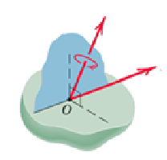
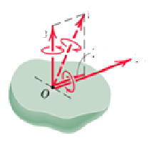


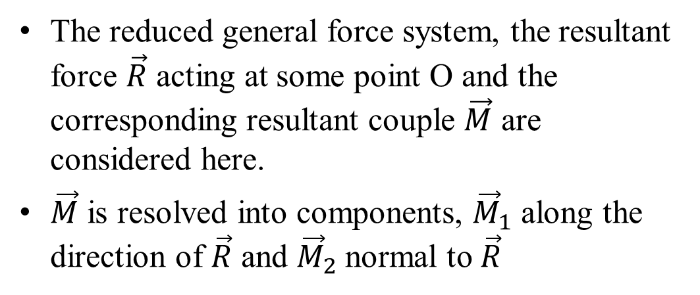



Wrench Resultant
The reduced general force system, the resultant force $\vec{R}$ acting at some point O and the corresponding resultant couple $\vec{M}$ are considered here.
$\vec{M}$ is resolved into components, ${\vec{M}}_{1}$ along the direction of $\vec{R}$ and ${\vec{M}}_{2}$normal to $\vec{R}$
$$\vec{M}$$
$$\vec{R}$$
$$\vec{M}$$
$${\vec{M}}_{2}$$
$$\vec{R}$$
$${\vec{M}}_{1}$$

Slide 7
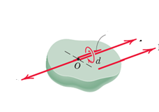
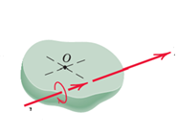

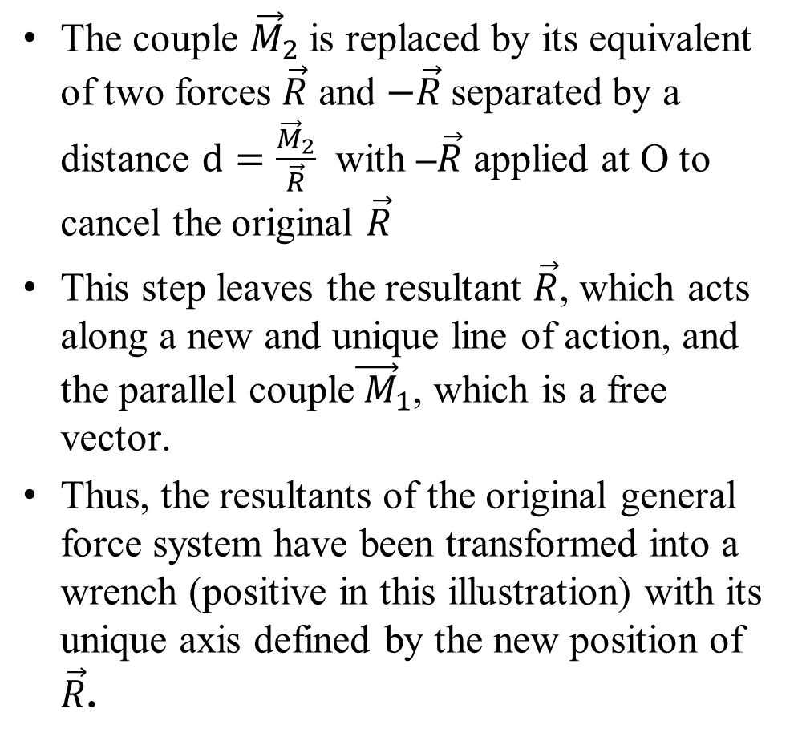





Wrench Resultant
The couple ${\vec{M}}_{2}$is replaced by its equivalent of two forces $\vec{R}$ and $−\vec{R}$separated by a distance $d=\frac{{\vec{M}}_{2}}{\vec{R}}$ with –$\vec{R}$ applied at O to cancel the original $\vec{R}$
This step leaves the resultant $\vec{R}$, which acts along a new and unique line of action, and the parallel couple${\vec{ M}}_{1}$, which is a free vector.
Thus, the resultants of the original general force system have been transformed into a wrench (positive in this illustration) with its unique axis defined by the new position of $\vec{R}$.
$${\vec{M}}_{1}$$
$$\vec{R}$$
$$\vec{R}$$
$$−\vec{R}$$
$$\vec{R}$$
$${\vec{M}}_{1}$$

Slide 8
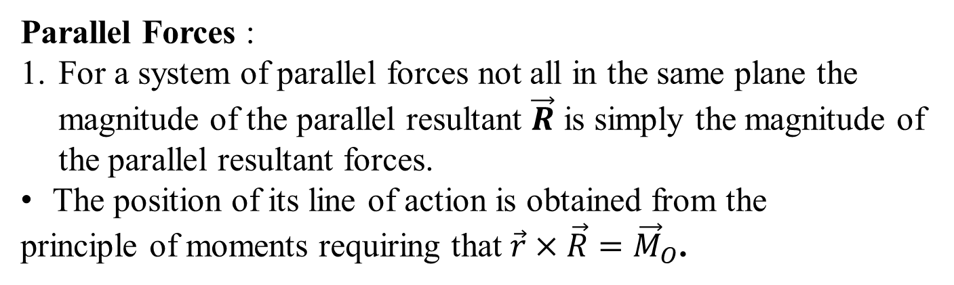
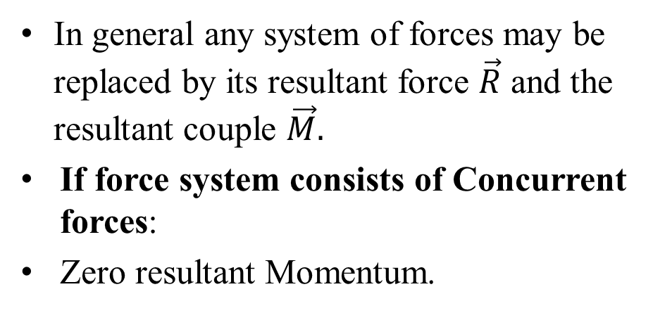


Resultants in 3D
In general any system of forces may be replaced by its resultant force $\vec{R}$ and the resultant couple $\vec{M}.$
If force system consists of Concurrent forces:
Zero resultant Momentum.
$$\vec{M}$$
$$\vec{R}$$
Parallel Forces :
For a system of parallel forces not all in the same plane the magnitude of the parallel resultant $\vec{R}$ is simply the magnitude of the parallel resultant forces.
The position of its line of action is obtained from the
principle of moments requiring that $\vec{r}×\vec{R}={\vec{M}}_{O}$.

Slide 9
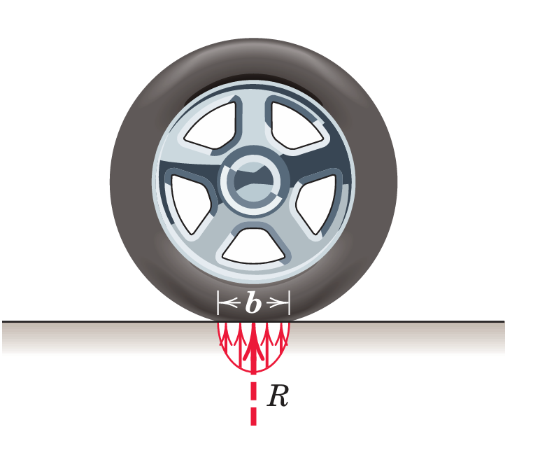
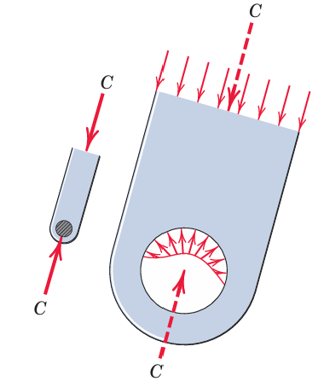
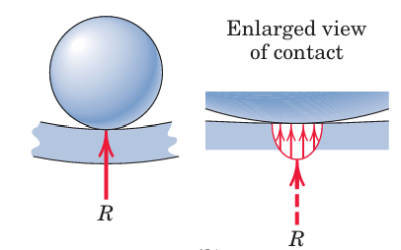
Reality of Force System In Engineering
The Truth, “concentrated” forces do not exist in any real system.
Every external force applied mechanically to a body is distributed over a finite contact area, however small.
Every Mechanical System is having a Finite non-zero life due to the distributed nature for Force System

Slide 10
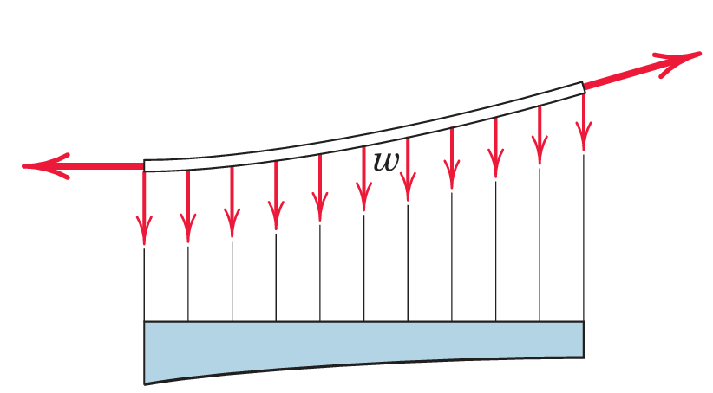
Distributed Nature of Force System
When to account the way force is distributed?
When the forces are applied over a region whose dimensions are not negligible compared with other pertinent dimensions
To find the distribution of internal forces in the material of body near contact location.
To estimate the exact contact location which will have appreciable internal stresses and strain
In such cases, the load is not treated as concentrated, but the actual distribution of forces is considered.

Slide 11
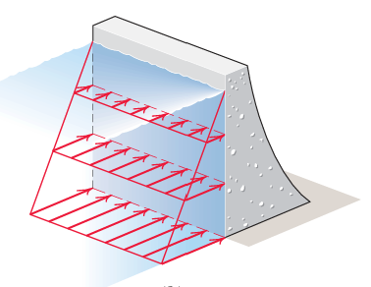
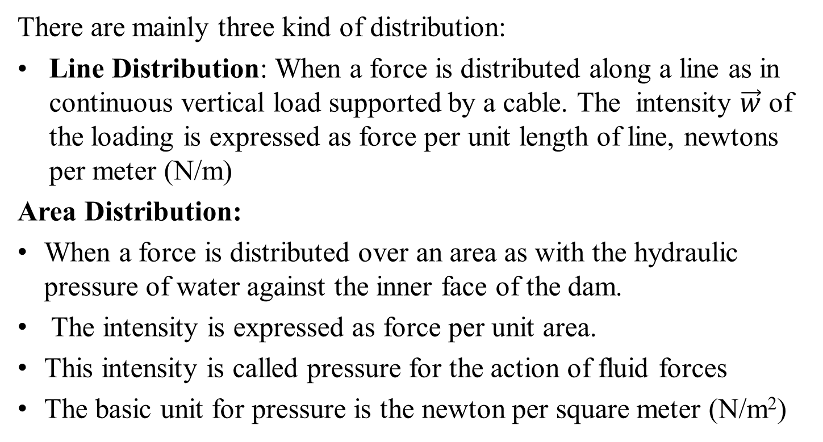
Types Distributed Force System
There are mainly three kind of distribution:
Line Distribution: When a force is distributed along a line as in continuous vertical load supported by a cable. The intensity $\vec{w}$ of the loading is expressed as force per unit length of line, newtons per meter (N/m)
Area Distribution:
When a force is distributed over an area as with the hydraulic pressure of water against the inner face of the dam.
The intensity is expressed as force per unit area.
This intensity is called pressure for the action of fluid forces
The basic unit for pressure is the newton per square meter (N/m²)

Slide 12
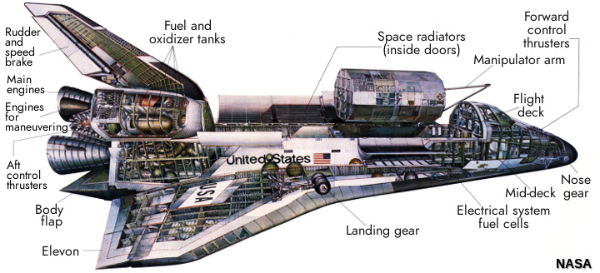
Types Distributed Force System
Volume Distribution:
A force which is distributed over the volume of a body is called a body force.
The most common body force is the force of gravitational attraction, which acts on all elements of mass in a body.
The determination of the forces on the supports of the heavy cantilevered structure for example, would require accounting for the distribution of gravitational force throughout the structure

Slide 13
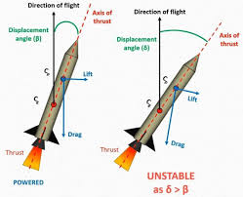
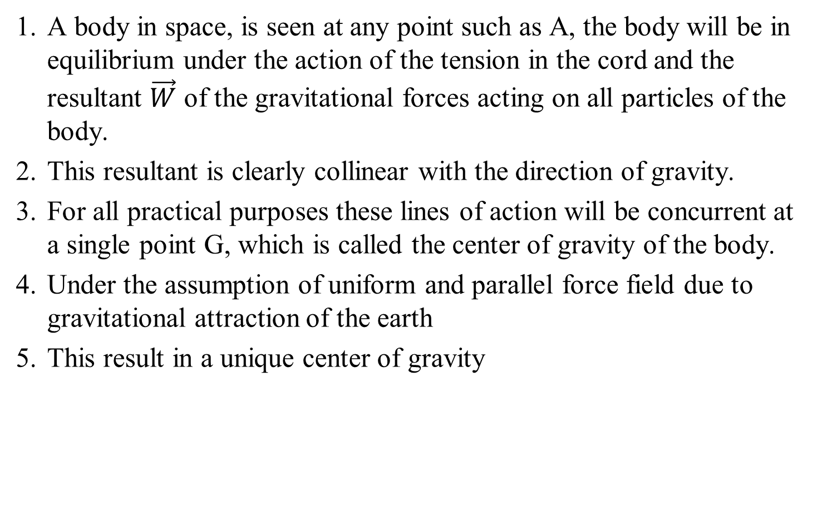
Center of Gravity
A body in space, is seen at any point such as A, the body will be in equilibrium under the action of the tension in the cord and the resultant $\vec{W}$ of the gravitational forces acting on all particles of the body.
This resultant is clearly collinear with the direction of gravity.
For all practical purposes these lines of action will be concurrent at a single point G, which is called the center of gravity of the body.
Under the assumption of uniform and parallel force field due to gravitational attraction of the earth
This result in a unique center of gravity

Slide 14
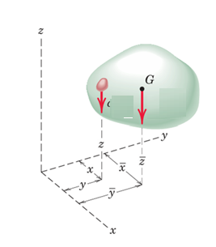
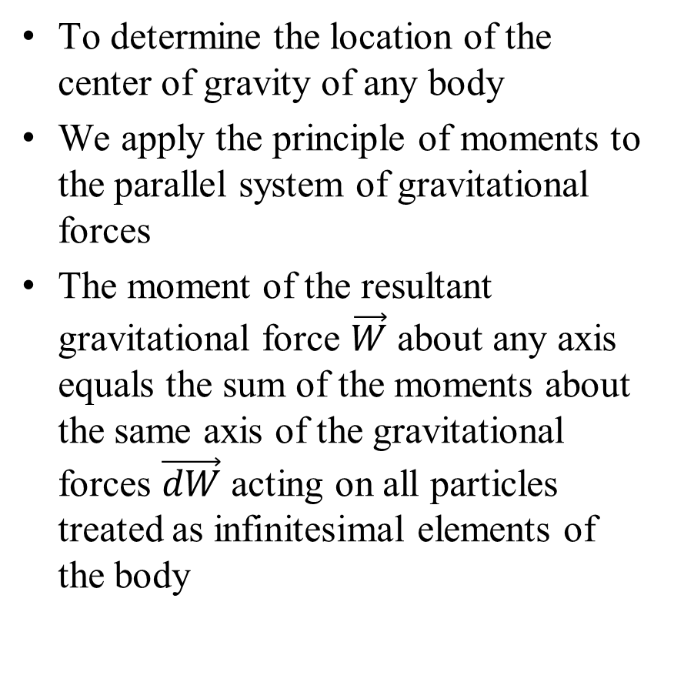


Center of Gravity
To determine the location of the center of gravity of any body
We apply the principle of moments to the parallel system of gravitational forces
The moment of the resultant gravitational force $\vec{W}$ about any axis equals the sum of the moments about the same axis of the gravitational forces $\vec{dW}$ acting on all particles treated as infinitesimal elements of the body
$$\vec{dW}$$
$$\vec{W}$$

Slide 15
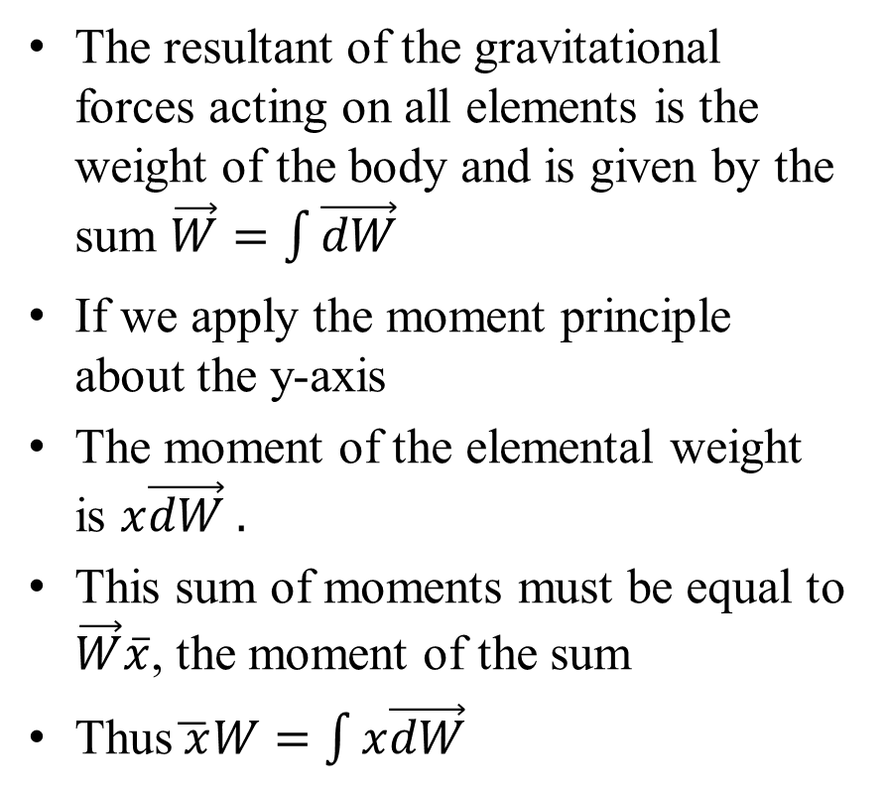
Center of Gravity
The resultant of the gravitational forces acting on all elements is the weight of the body and is given by the sum $\vec{W}=\int{\vec{dW}}$
If we apply the moment principle about the y-axis
The moment of the elemental weight is $x\vec{dW} .$
This sum of moments must be equal to $\vec{W}\overline{x}$, the moment of the sum
Thus$\overline{ x}W=$ $\int{x\vec{dW}}$
$$\vec{dW}$$
$$\vec{W}$$
Similar expression can be obtained for other two components.

Slide 16
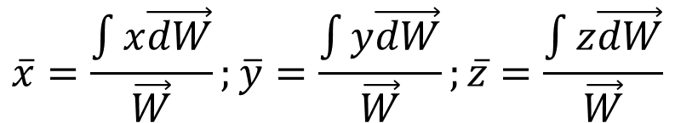
Center of Gravity
We may express the coordinated of the center of gravity as
$$\vec{dW}$$
$$\overline{x}=\frac{\int{x\vec{dW}}}{\vec{W}};\overline{y}=\frac{\int{y\vec{dW}}}{\vec{W}};\overline{z}=\frac{\int{z\vec{dW}}}{\vec{W}}$$
$$\vec{W}$$

Slide 17
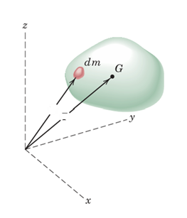


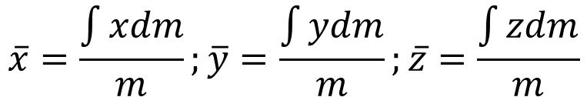
Determination of Center of Mass
We may express the coordinated of the center of mass as
$$\vec{r}$$
$$\overline{x}=\frac{\int{xdm}}{m};\overline{y}=\frac{\int{ydm}}{m};\overline{z}=\frac{\int{zdm}}{m}$$
$$\overline{\vec{r}}$$

Slide 18
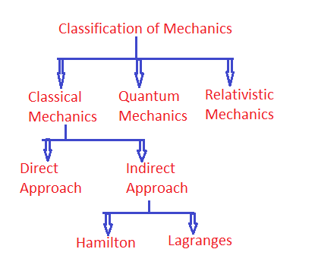
Modern Mechanics

Slide 19
Equilibrium & Statics
The description of the force conditions necessary and sufficient to maintain the equilibrium of engineering structures is a primary requirement in many engineering applications.
An Engineering System is said to in (Mechanical) Equilibrium if and only if the sum of all the forces and moment (about any point) equals zero.
Mechanics deals with Static Equilibrium and Dynamic Equilibrium of engineering systems.

Slide 20
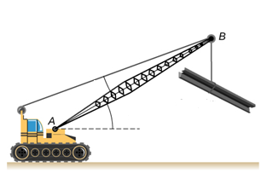


Static Equilibrium
Motion: Stationary, at rest, no velocity, no acceleration.
Forces: Net force is zero, but nothing is moving.
$$T$$
$$W$$

Slide 21
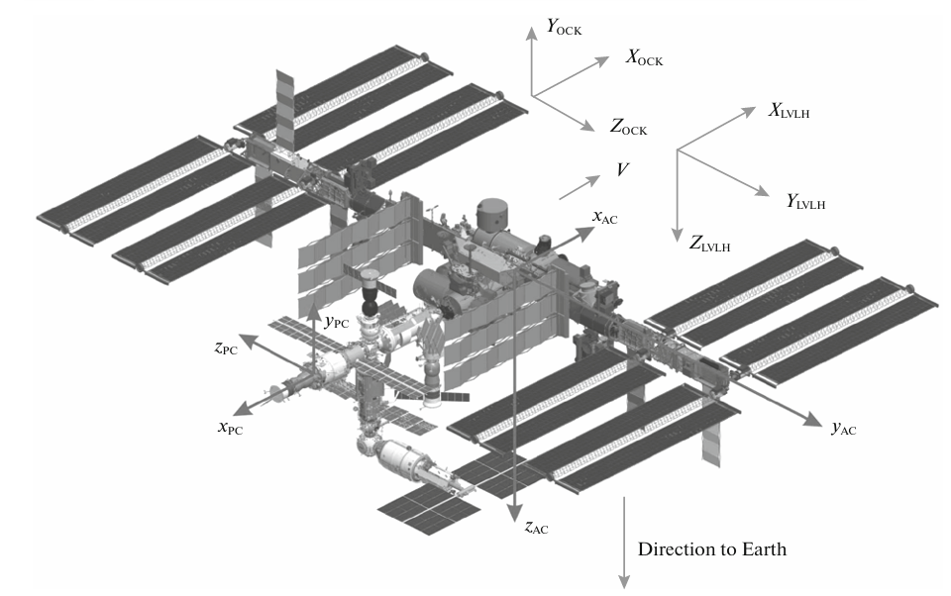
Dynamic Equilibrium
Motion: Constant velocity (zero acceleration), moving steadily.
Forces: Net force is zero, but motion (translation, rotation) occurs.

