Slide 1


Deliberations on Force Vector System
P M V Subbarao
Professor & Head
Mechanical Engineering Department
Vitality Means More to Explore ……..

Slide 2

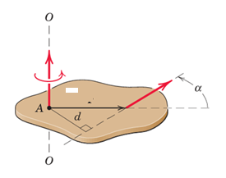

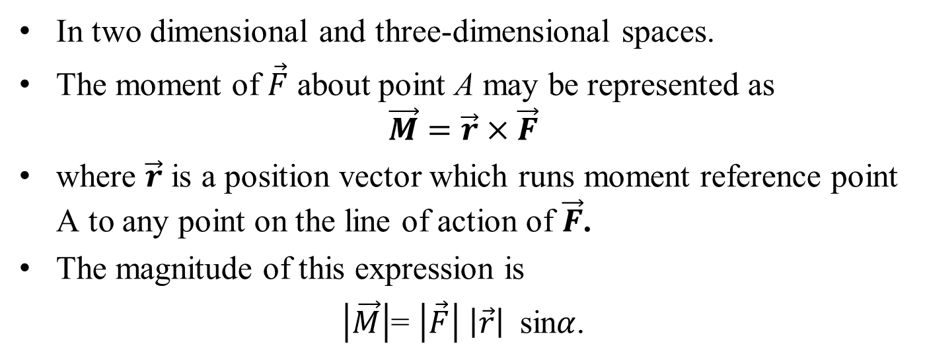


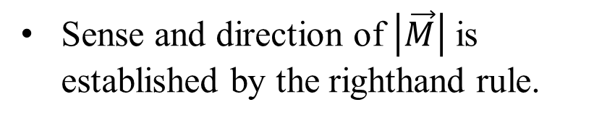
Moment as The cross product
In two dimensional and three-dimensional spaces.
The moment of $\vec{F}$ about point A may be represented as
$$\vec{M}=\vec{r}×\vec{F}$$
where $\vec{r}$ is a position vector which runs moment reference point A to any point on the line of action of $\vec{F}$.
The magnitude of this expression is
$\left|\vec{M}\right|$= $\left|\vec{F}\right| \left|\vec{r}\right|$ sin$α$.
$$\vec{M}$$
$$\vec{F}$$
$$\vec{r}$$
Sense and direction of $\left|\vec{M}\right|$ is established by the righthand rule.

Slide 3
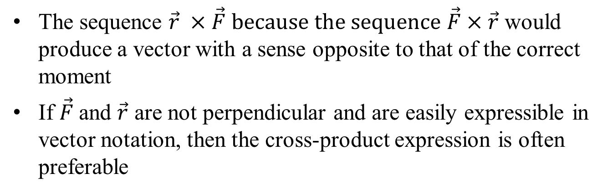



Moment as The cross product
The sequence $\vec{r} ×\vec{F} because the sequence \vec{F}×\vec{r}$ would produce a vector with a sense opposite to that of the correct moment
If $\vec{F}$and $\vec{r}$ are not perpendicular and are easily expressible in vector notation, then the cross-product expression is often preferable
$$\vec{F}$$
$$\vec{M}$$
$$\vec{r}$$

Slide 4
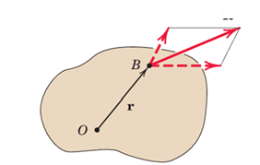


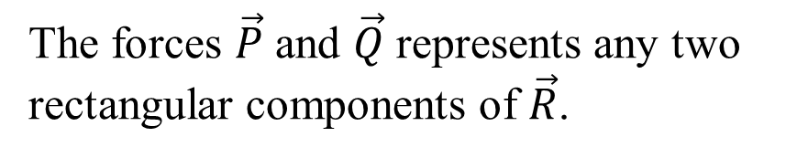
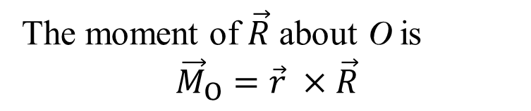
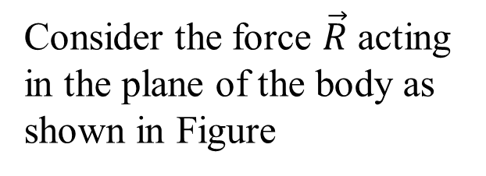

Varignon Theorem
One of the most useful principles of mechanics is Varignon’s theorem
It states that the moment of a force about any point is equal to the sum of moments of the components of the force about the same point
Proof of this theorem:
$$\vec{R}$$
Consider the force $\vec{R}$ acting in the plane of the body as shown in Figure
$$\vec{P}$$
$$\vec{Q}$$
The forces $\vec{P}$ and $\vec{Q}$ represents any two rectangular components of $\vec{R}$.
The moment of $\vec{R}$ about O is
$${\vec{M}}_{O}=\vec{r} ×\vec{R}$$

Slide 5
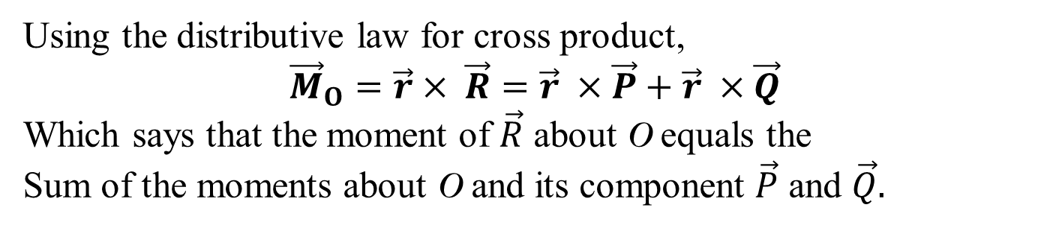

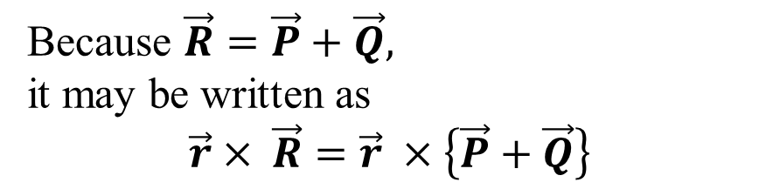
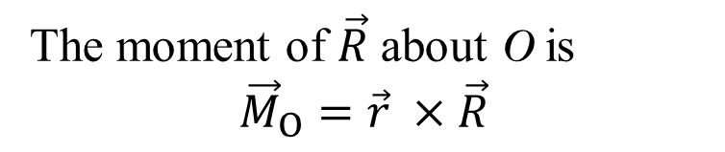


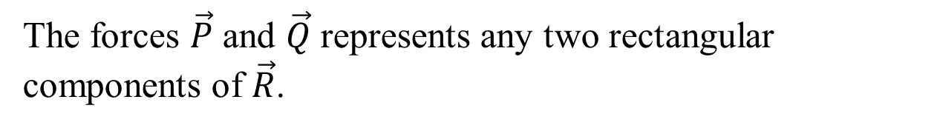

Varignon Theorem
Proof :
The forces $\vec{P}$ and $\vec{Q}$ represents any two rectangular components of $\vec{R}$.
The moment of $\vec{R}$ about O is
$${\vec{M}}_{O}=\vec{r} ×\vec{R}$$
$$\vec{R}$$
$$\vec{R}$$
$$\vec{P}$$
Because $\vec{R}=\vec{P}+\vec{Q},$
it may be written as
$$\vec{r}× \vec{R}=\vec{r} ×\left\{\vec{P}+\vec{Q}\right\}$$
$$\vec{Q}$$
Using the distributive law for cross product,
${\vec{M}}_{O}=\vec{r}× \vec{R}=\vec{r} ×\vec{P}+\vec{r} ×\vec{Q}$
Which says that the moment of $\vec{R}$ about O equals the
Sum of the moments about O and its component $\vec{P}$ and $\vec{Q}.$

Slide 6
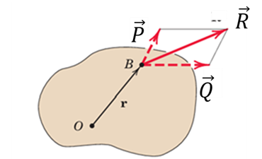
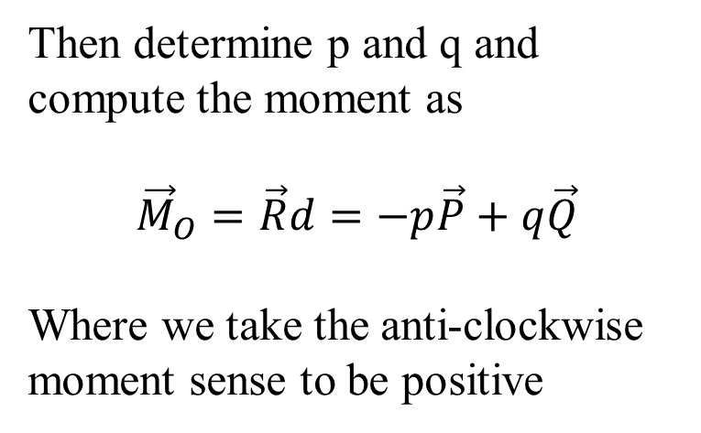
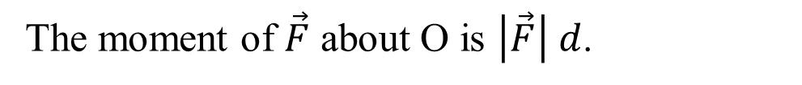
Efficacy of Varignon Theorem
The moment of $\vec{F}$ about O is $\left|\vec{F}\right| d$.
However, if d is more difficult to determine
q
Then determine p and q and compute the moment as
$${\vec{M}}_{O}=\vec{R}d=−p\vec{P}+q\vec{Q}$$
Where we take the anti-clockwise moment sense to be positive
d
p

Slide 7
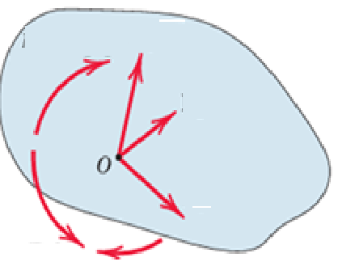
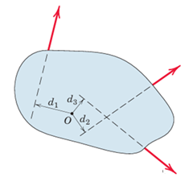
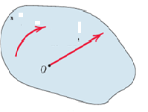
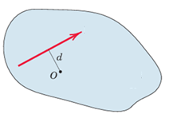

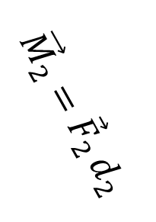

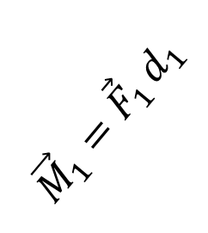
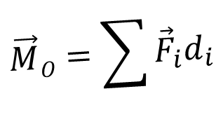
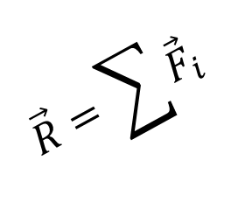
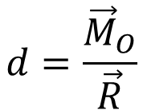





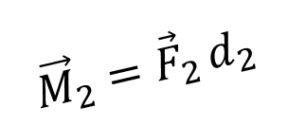
Efficacy of Varignon Theorem
Consider a body with multile forces acting on the body.
$${\vec{F}}_{1}$$
$${\vec{F}}_{1}$$
$${\vec{F}}_{2}$$
$${\vec{M}}_{1}={\vec{F}}_{1 }d_{1}$$
$${\vec{F}}_{2}$$
$${\vec{F}}_{3}$$
$${\vec{M}}_{2}={\vec{F}}_{2 }d_{2}$$
$${\vec{F}}_{3}$$
$$\vec{M}O=\sum{{\vec{F}}_{i}d_{i}}$$
$${\vec{M}}_{2}={\vec{F}}_{2 }d_{2}$$
$$\vec{R}=\sum{{\vec{F}}_{i}}$$
$$\vec{R}$$
$$d=\frac{{\vec{M}}_{O}}{\vec{R}}$$

Slide 8
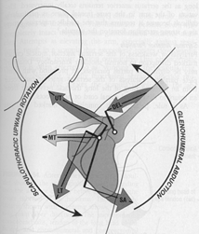
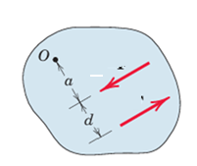


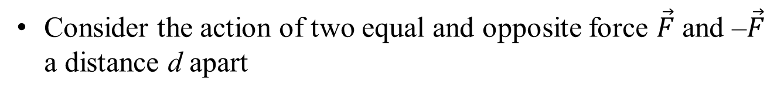
Force Couples
The moment produced by two equal, opposite and non-collinear force is called a couple.
To produce upward rotation of the scapula, or shoulder blade when raising our arms
4 major muscles: Serratus anterior, Lower trapezius, Upper Trapezius, Levator Scapula generate Force couples.
Consider the action of two equal and opposite force $\vec{F}$ and –$\vec{F}$ a distance d apart
$$−\vec{F}$$
$$\vec{F}$$

Slide 9
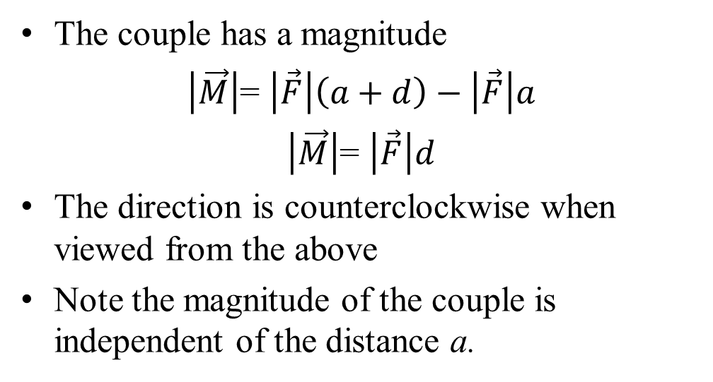
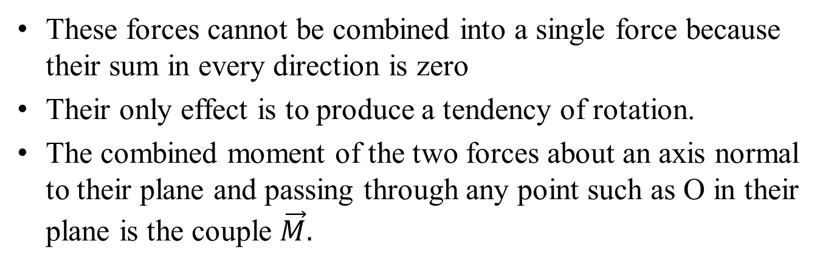


Force Couples
These forces cannot be combined into a single force because their sum in every direction is zero
Their only effect is to produce a tendency of rotation.
The combined moment of the two forces about an axis normal to their plane and passing through any point such as O in their plane is the couple $\vec{M}.$
The couple has a magnitude
$\left|\vec{M}\right|$= $\left|\vec{F}\right|\left(a+d\right)−\left|\vec{F}\right|a$
$\left|\vec{M}\right|$= $\left|\vec{F}\right|d$
The direction is counterclockwise when viewed from the above
Note the magnitude of the couple is independent of the distance a.
$$−\vec{F}$$
$$\vec{F}$$

Slide 10
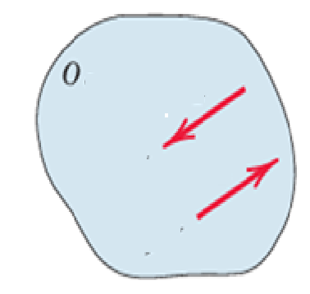

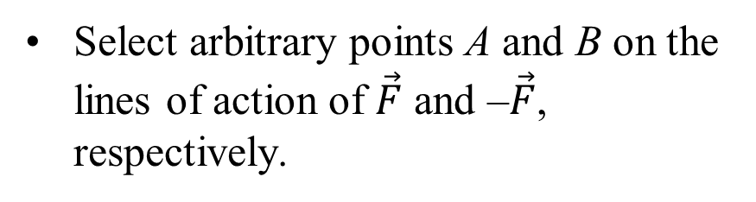




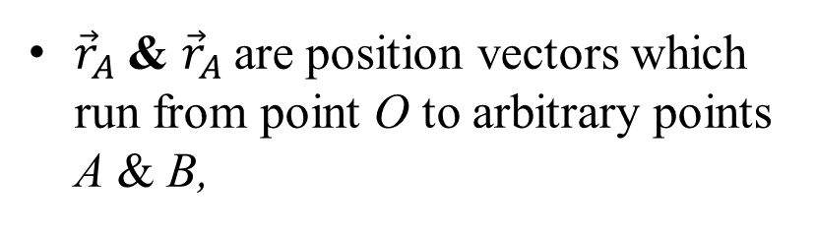

Force Couple : Vector Algebra Method
Select arbitrary points A and B on the lines of action of $\vec{F}$ and –$\vec{F}$, respectively.
$$−\vec{F}$$
$${\vec{r}}_{B}$$
B
${\vec{r}}_{A}$ & ${\vec{r}}_{A}$are position vectors which run from point O to arbitrary points A & B,
$${\vec{r}}_{A}$$
$$\vec{F}$$
A
The combined moment about a point O of the forces forming the couple using vector algebra is given as:
$$\vec{M}= {\vec{r}}_{A}×\vec{F}+{\vec{r}}_{B}×\left(−\vec{F}\right)$$
$$\vec{M}= \left({\vec{r}}_{A}−{\vec{r}}_{B}\right)×\vec{F}$$

Slide 11
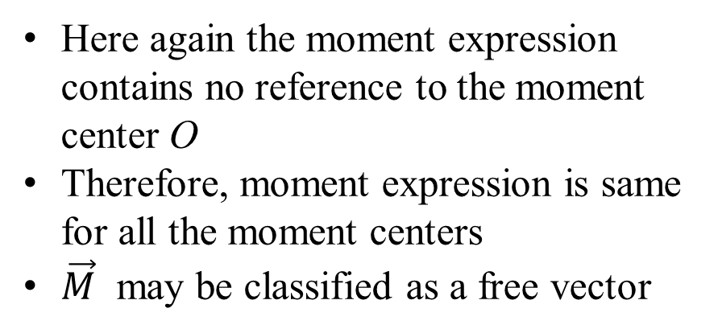

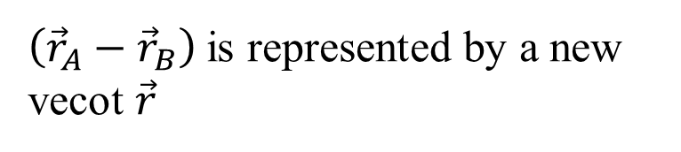


Force Couple : Vector Algebra Method
$$\vec{M}= \left({\vec{r}}_{A}−{\vec{r}}_{B}\right)×\vec{F}$$
$$−\vec{F}$$
$${\vec{r}}_{B}$$
B
$\left({\vec{r}}_{A}−{\vec{r}}_{B}\right)$ is represented by a new vecot $\vec{r}$
$$\vec{r}$$
$$∴\vec{M}= \vec{r}×\vec{F}$$
$${\vec{r}}_{A}$$
$$\vec{F}$$
A
Here again the moment expression contains no reference to the moment center O
Therefore, moment expression is same for all the moment centers
$\vec{M}$ may be classified as a free vector

Slide 12
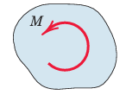
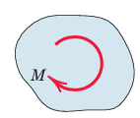
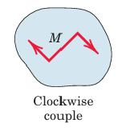
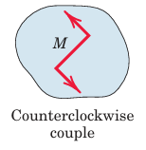
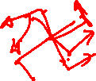

Sense of Force Couple
$$∴\vec{M}= \vec{r}×\vec{F}$$

Slide 13
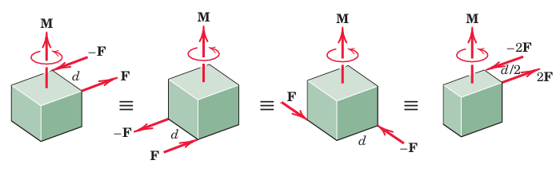
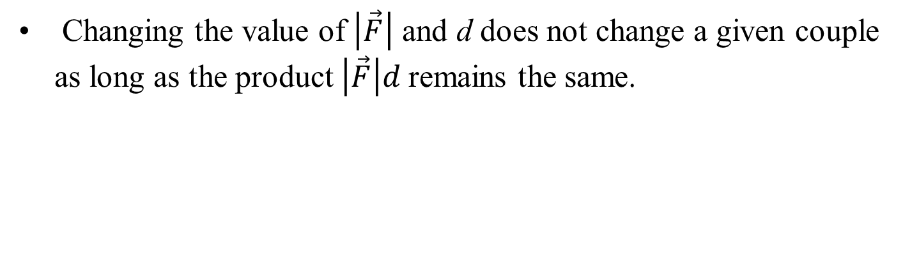
Equivalent Force Couples
Changing the value of $\left|\vec{F}\right|$ and d does not change a given couple as long as the product $\left|\vec{F}\right|d$remains the same.
Follwoing four different configuration of the same couple $\vec{M}$

Slide 14
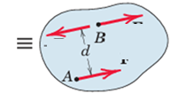
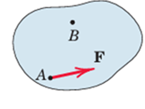

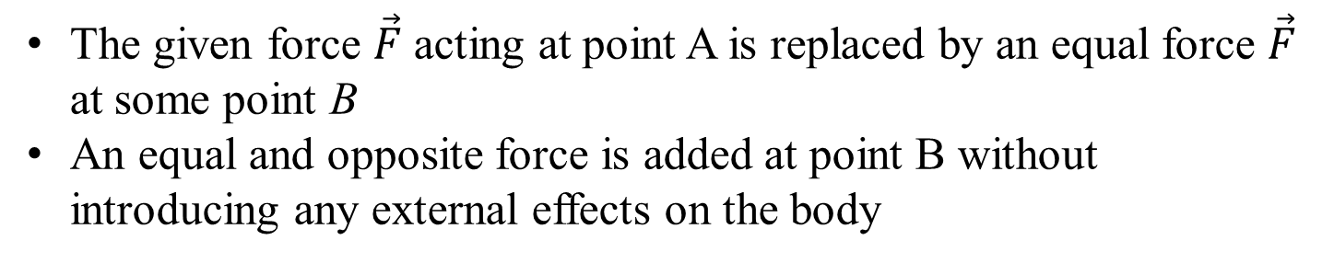




Force - Couple Systems
Effect of a force-couple together acting on a body:
tendency to push or pull the body in the direction of the force and to rotate the body about any fixed axis which does not intersect the line of the force.
$−\vec{F}$
$\vec{F}$
$\vec{F}$
$\vec{F}$
Force-couple dual effect can be generated easily by replacing the given force by an equal parallel force and a couple
The given force $\vec{F}$ acting at point A is replaced by an equal force $\vec{F}$ at some point B
An equal and opposite force is added at point B without introducing any external effects on the body

Slide 15
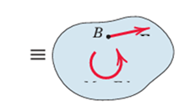
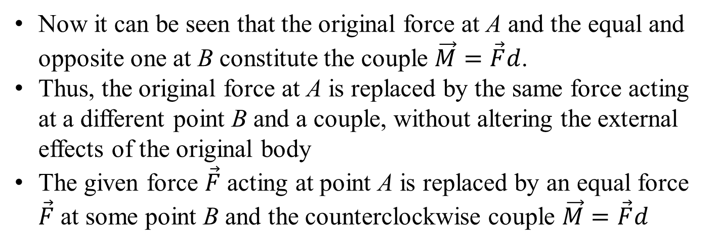






Force - Couple systems
$−\vec{F}$
$\vec{F}$
$\vec{F}$
$\vec{F}$
$\vec{F}$
$\vec{M}=\vec{F}d$
Now it can be seen that the original force at A and the equal and opposite one at B constitute the couple $\vec{M}=\vec{F}d$.
Thus, the original force at A is replaced by the same force acting at a different point B and a couple, without altering the external effects of the original body
The given force $\vec{F}$ acting at point A is replaced by an equal force $\vec{F}$ at some point B and the counterclockwise couple $\vec{M}=\vec{F}d$

Slide 16
Force in 3D Rectangular (Cartesian) Components Space
$\vec{F}=F_{x}\hat{i}$+ $F_{y}\hat{j}+F_{z}\hat{k}$
Direction cosines of $\vec{F}$
$l=cosθ_{x}; m=cosθ_{y}; k=cosθ_{z}$
$F_{x}=l\left|\vec{F}\right|;F_{y}=m\left|\vec{F}\right|; F_{z}=n\left|\vec{F}\right|$
From the Pythagorean theorem
${\vec{F}}^{2}=F_{x}^{2}+F_{y}^{2}+F_{z}^{2}$
implies $l^{2}+m^{2}+n^{2}=1$
Z
$$\hat{k}$$
$$\vec{F}$$
$$F_{z}\hat{k}$$
$$θ_{z}$$
$$θ_{x}$$
$$θ_{y}$$
$$F_{y}\hat{j}$$
Y
$$F_{x}\hat{i}$$
$$\hat{j}$$
X
$$\hat{i}$$

Slide 17
Rectangular (Cartesian) Components in 3D Space
Rectangular Components in 3D
Sometimes useful to remember while solving problems
$F_{x}=\vec{F}.\hat{i}$
$F_{y}=\vec{F}.\hat{j}$
$F_{z}=\vec{F}.\hat{k}$
Z
$$\hat{k}$$
$$\vec{F}$$
$$F_{z}\hat{k}$$
$$θ_{y}$$
$$θ_{x}$$
$$θ_{y}$$
$$F_{y}\hat{j}$$
Y
$$F_{x}\hat{i}$$
$$\hat{j}$$
X
$$\hat{i}$$

Slide 18
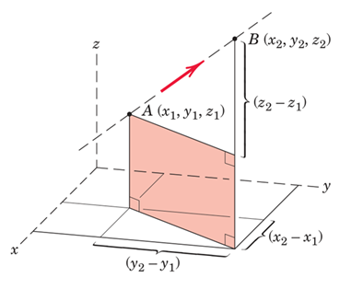
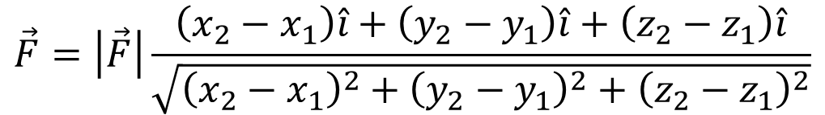
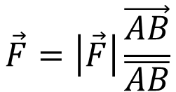


Simple Method to Determine the components of force in 3D
The direction of a force in 3D can also be described by
Two points on the line of action of the force &
By two angles which orient the line of action
$$\vec{F}=\left|\vec{F}\right|{\hat{n}}_{F}$$
$$\vec{F}$$
$$\vec{F}=\left|\vec{F}\right|\frac{\vec{AB}}{\overline{AB}}$$
$$\vec{F}=\left|\vec{F}\right|\frac{\left(x_{2}−x_{1}\right)\hat{i}+\left(y_{2}−y_{1}\right)\hat{i}+\left(z_{2}−z_{1}\right)\hat{i}}{\sqrt{{\left(x_{2}−x_{1}\right)}^{2}+{\left(y_{2}−y_{1}\right)}^{2}+{\left(z_{2}−z_{1}\right)}^{2}}}$$

Slide 19






Simple Method to Determine the components of force in 3D
$F_{xy}=\left|\vec{F}\right| cos$ $∅{; F}_{z}=\left|\vec{F}\right|sin ∅$
$$\vec{F}$$
Then resolve the horizontal component $F_{xy}$ into x and y-components
$F_{x}=F_{xy} cosθ$=$\left|\vec{F}\right|cos∅$cos$θ;$
$${\begin{aligned} \\ F\end{aligned}}_{y}=F_{xy} sinθ\text{=}\left|\vec{F}\right|cos∅ \text{sin}θ$$

Slide 20

Moment in three dimensions
In 3D robotics, the concepts of moment and force couple are used to analyze and describe how forces cause both translation and rotation.
This enables precise control over robot motion and structural stability.
These concepts are fundamental in statics and dynamics to understand the full effect of forces on a robot's links, joints, and overall system

Slide 21





Moment in Three Dimensions
The moment of $\vec{F}$ about the axis through O as
$${\vec{M}}_{O}=\vec{r}×\vec{F}$$
Evaluating the Cross Product
The cross-product expression for ${\vec{M}}_{O}$may be written as
${\vec{M}}_{O}=\left|\begin{matrix}\hat{i} & \hat{j} & \hat{k} \\ r_{x} & r_{y} & r_{z} \\ F_{x} & F_{y} & F_{z}\end{matrix}\right|$
The expansion of the determinant gives
$${\vec{M}}_{O}$$
$$\vec{r}$$
$$\vec{F}$$
$${\vec{M}}_{O}=\left\{r_{y}F_{z}−r_{z}F_{y}\right\}\hat{i}+\left\{r_{x}F_{x}−r_{x}F_{z}\right\}\hat{j}+\left\{r_{x}F_{y}−r_{y}F_{x}\right\}\hat{k}$$

Slide 22





Moment in Three Dimensions
$${\vec{M}}_{O}=\left\{r_{y}F_{z}−r_{z}F_{y}\right\}\hat{i}+\left\{r_{x}F_{x}−r_{x}F_{z}\right\}\hat{j}+\left\{r_{x}F_{y}−r_{y}F_{x}\right\}\hat{k}$$
The scalar magnitudes of these forces
about the positive x-y-z axes
$$\vec{F}$$
$$M_{x}=r_{y}F_{z}−r_{z}F_{y}$$
$$M_{y}=r_{z}F_{x}−r_{x}F_{z}$$
$$M_{z}=r_{x}F_{y}−r_{y}F_{x}$$

Slide 23








Moment about an Arbitrary Axis
The expression for the moment ${\vec{M}}_{λ}$ of $\vec{F}$ about any axis $λ$ through O:
The magnitude of ${\vec{M}}_{λ}$is the dot-product
${\vec{M}}_{O}∙\hat{n}$
This scalar is the magnitude of ${\vec{M}}_{λ}$of $\vec{F}$ about $λ$.
To obtain the vector expression multiply the magnitude by the direction unit vector $\hat{n}.$
$${\vec{M}}_{O}$$
$$\hat{n}$$
$$\vec{F}$$
$${\vec{M}}_{λ}$$
$$\vec{r}$$
$$\left|{\vec{M}}_{λ}\right|=\left|\begin{matrix}r_{x} & r_{y} & r_{z} \\ F_{x} & F_{y} & F_{z} \\ α & β & γ\end{matrix}\right|$$
$${\vec{M}}_{λ}=\left(\vec{r}×\vec{F}∙\hat{n}\right)\hat{n}$$
the scalar triple product

Slide 24








Force Couple in Three-Dimensional Space
In figure two equal and opposite forces $\vec{F}$ and $−\vec{F}$ is acting on a body.
The vector $\vec{r}$ runs from any point B on the line of action of $−\vec{F}$ to any point
A on the line of action of $\vec{F}$
Points A and B are located by position vectors ${\vec{r}}_{A}$and ${\vec{r}}_{B}$from any point O.
The combined moment of the two forces about about O is
$$\vec{M}$$
$$−\vec{F}$$
$$\vec{F}$$
$$\vec{r}$$
$${\vec{r}}_{A}$$
$${\vec{r}}_{B}$$
$$\vec{M}={\vec{r}}_{A}×\vec{F}+{\vec{r}}_{B}×\left(−\vec{F}\right)={(\vec{r}}_{A}−{\vec{r}}_{B})×\vec{F}$$

Slide 25

Couples in Three-Dimensional Space
$$\vec{M}={\vec{r}}_{A}×\vec{F}+{\vec{r}}_{B}×\left(−\vec{F}\right)$$
$={(\vec{r}}_{A}−{\vec{r}}_{B})×\vec{F}$
However, ${\vec{r}}_{A}−{\vec{r}}_{B}$= $\vec{r}$, so that all reference to the moment center disappears
$\vec{M}=\vec{r}×\vec{F}$
Thus, the moment of a couple is the same at all points.
The magnitude is $\left|\vec{M}\right|=\left|\vec{F}\right|d$
$$\vec{M}$$
$$−\vec{F}$$
$$\vec{F}$$
$$\vec{r}$$
$${\vec{r}}_{A}$$
$${\vec{r}}_{B}$$
Moment of a couple is a free vector
Moment of force about a point (which is also a moment about a defined axis through a point) is a sliding vector whose direction is along the axis

Slide 26







Couples in Three-Dimensional Space
Couple vectors obey all the rules which given vector quantities
Thus, the couple vector ${\vec{M}}_{1}$due to ${\vec{F}}_{1}$and ${−\vec{F}}_{1}$may be added as shown to the couple vector ${\vec{M}}_{2}$due to ${\vec{F}}_{2}$ and ${−\vec{F}}_{2}$ to produce the couple $\vec{M}$, which in turn can be produced by $\vec{F}$ and $−\vec{F}$
We can replace a force by its equivalent force couple system
$${\vec{M}}_{1}$$
$${\vec{F}}_{1}$$
$${\vec{F}}_{2}$$
$${\vec{M}}_{2}$$
$${−\vec{F}}_{2}$$

Slide 27


Couples in Three-Dimensional Space
The force acting at point A is replaced by an equal force at point B and the couple $\vec{M}=\vec{r}×\vec{F}.$
By adding the equal and opposite for $\vec{F}$ and $−\vec{F}$ at B, one can obtain the couple compose of –$\vec{F}$ and $\vec{F}$.
$${\vec{M}}_{1}$$
$${\vec{F}}_{1}$$
$${\vec{F}}_{2}$$
$${\vec{M}}_{2}$$
$${−\vec{F}}_{2}$$

Slide 28













Resultants in 3D
$${\vec{F}}_{1}$$
$${\vec{F}}_{2}$$
$${\vec{M}}_{2}$$
$${\vec{M}}_{3}$$
$${\vec{F}}_{3}$$
$${\vec{F}}_{1}$$
$${\vec{M}}_{1}$$
$${\vec{F}}_{2}$$
$$\vec{M}$$
$$\vec{R}$$
$${\vec{F}}_{3}$$

Slide 29




Resultants in 3D
In general any system of forces may be replaced by its resultant force $\vec{R}$ and the resultant couple $\vec{M}.$
If force system consists of Concurrent forces:
Zero resultant Momentum.
$$\vec{M}$$
$$\vec{R}$$
Parallel Forces :
For a system of parallel forces not all in the same plane the magnitude of the parallel resultant $\vec{R}$ is simply the magnitude of the parallel resultant forces.
The position of its line of action is obtained from the
principle of moments requiring that $\vec{r}×\vec{R}={\vec{M}}_{O}$.

Slide 30



Reality of Force System In Engineering
The Truth, “concentrated” forces do not exist in any real system.
Every external force applied mechanically to a body is distributed over a finite contact area, however small.
Every Mechanical System is having a Finite non-zero life due to the distributed nature for Force System

Slide 31

Distributed Nature of Force System
When to account the way force is distributed?
When the forces are applied over a region whose dimensions are not negligible compared with other pertinent dimensions
If on the other hand, we want to find the distribution of internal forces in the material of body near contact location
The contact location will have appreciable internal stresses and strain
In such case, the load is not treated as concentrated but the actual distribution of forces is considered.

Slide 32

Types Distributed Force System
There are mainly three kind of distribution:
Line Distribution: When a force is distributed along a line as in continuous vertical load supported by a cable. The intensity w of the loading is expressed as force per unit length of line, newtons per meter (N/m)
Area Distribution:
When a force is distributed over an area as with the hydraulic pressure of water against the inner face of the dam.
The intensity is expressed as force per unit area.
This intensity is called pressure for the action of fluid forces
The basic unit for pressure is the newton per square meter (N/m²)

Slide 33

Types Distributed Force System
Volume Distribution:
A force which is distributed over the volume of a body is called a body force.
The most common body force is the force of gravitational attraction, which acts on all elements of mass in a body.
The determination of the forces on the supports of the heavy cantilevered structure for example, would require accounting for the distribution of gravitational force throughout the structure

Slide 34


Center of Mass
A body in space, is seen at any point such as A, the body will be in equilibrium under the action of the tension in the cord and the resultant $\vec{W}$ of the gravitational forces acting on all particles of the body.
This resultant is clearly collinear with the direction of gravity,
For all practical purposes these lines of action will be concurrent at a single point G, which is called the center of gravity of the body.
Under the assumption of uniform and parallel force field due to gravitational attraction of the earth
This result in a unique center of gravity

