Slide 1


Newtonian Perspective of Force Vector System
P M V Subbarao
Professor & Head
Mechanical Engineering Department
Vitality of Force Systems……..

Slide 2

Frame of reference
What is a proper reference frame from which to measure the accelerations?
The approach which should be taken to define an inertial or Newtonian reference frame to be any rigid set of coordinate axes;
such that particle motion relative to these axes is described by Newton's laws of motion.
One might consider first a system fixed in the earth.
Such a choice would be adequate for most cases where the distances traveled are short relative to the earth's radius and
the velocities are small compared to the Escape velocity on the earth

Slide 3
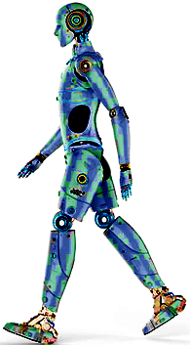


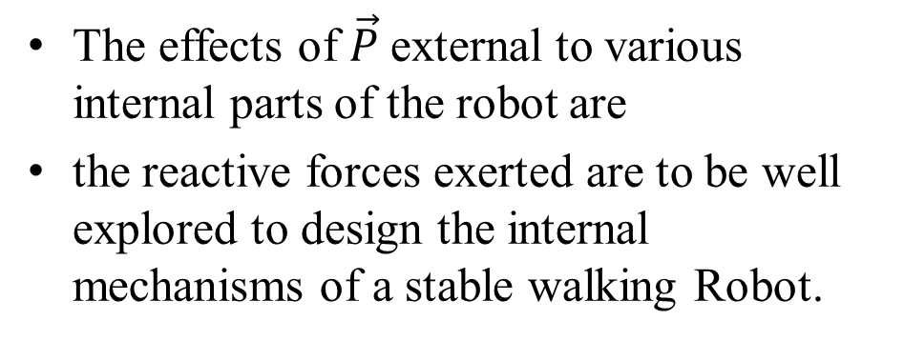
External and Internal Effects
The action of a force can be separated into two effects
External and Internal
The effects of $\vec{P}$external to various internal parts of the robot are
the reactive forces exerted are to be well explored to design the internal mechanisms of a stable walking Robot.
External Force
$$\vec{P}$$

Slide 4
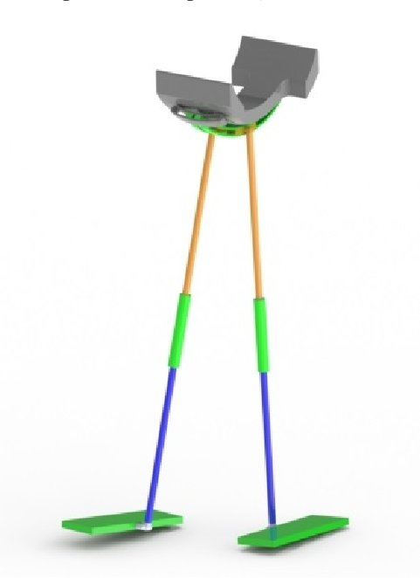
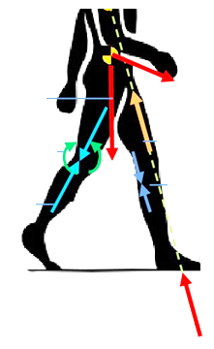
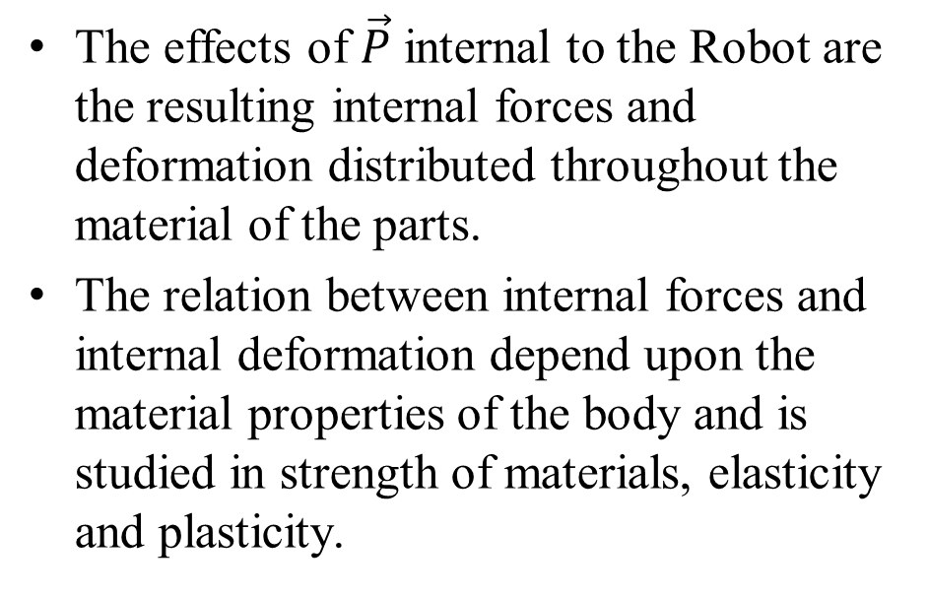

External and Internal effects
The effects of $\vec{P}$ internal to the Robot are the resulting internal forces and deformation distributed throughout the material of the parts.
The relation between internal forces and internal deformation depend upon the material properties of the body and is studied in strength of materials, elasticity and plasticity.
$$\vec{P}$$

Slide 5
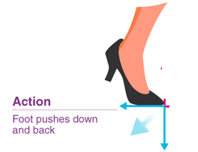
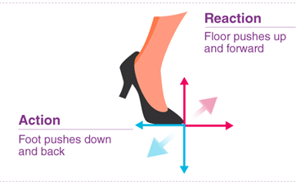
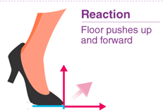
Newton’s Force Classification
Action and reaction:
According to Newton’s third law, the action of a force is always accompanied by an equal and opposite reaction
It is essential to distinguish between the action and the reaction in a pair of forces.
To do so, we first isolate the body in question and then identify the force exerted on that body
(not the force exerted by the body).

Slide 6
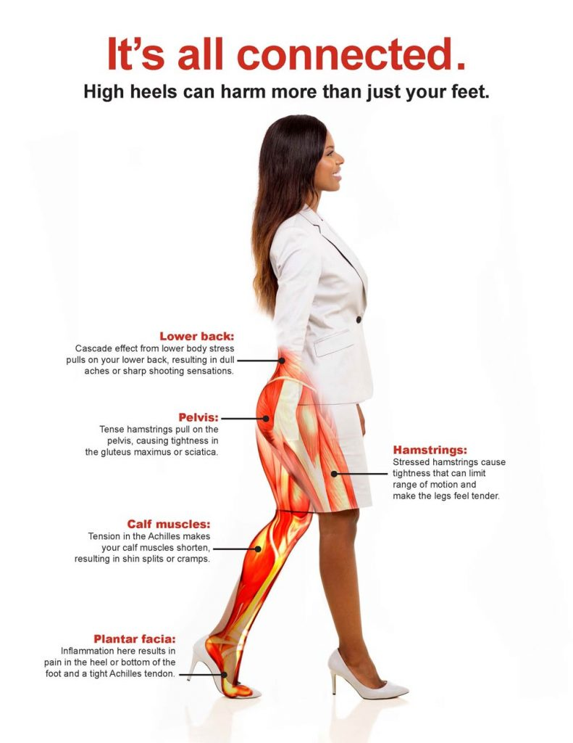

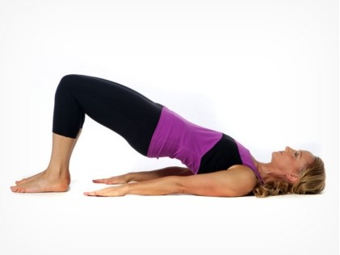
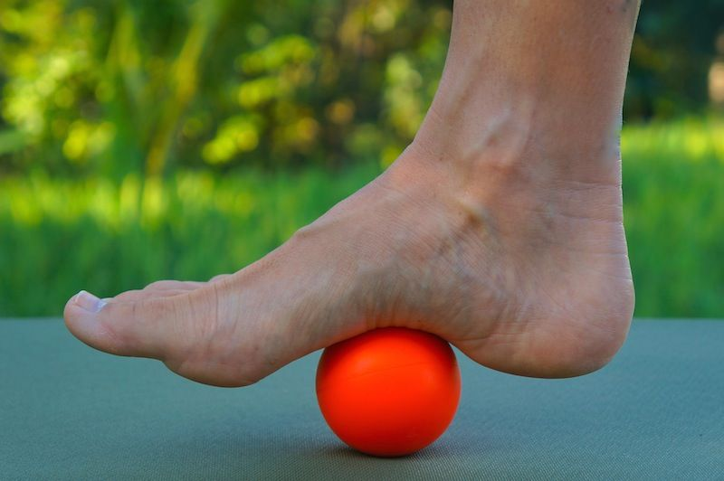
Action & Reaction: Holistic Mechanics

Slide 7
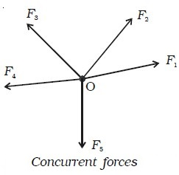
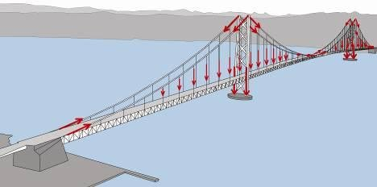






Concurrent forces
Two or more forces are said to be concurrent at a point if their lines of action intersect at that point
$${\vec{F}}_{3}$$
$${\vec{F}}_{2}$$
$${\vec{F}}_{1}$$
$${\vec{F}}_{4}$$
$${\vec{F}}_{5}$$

Slide 8




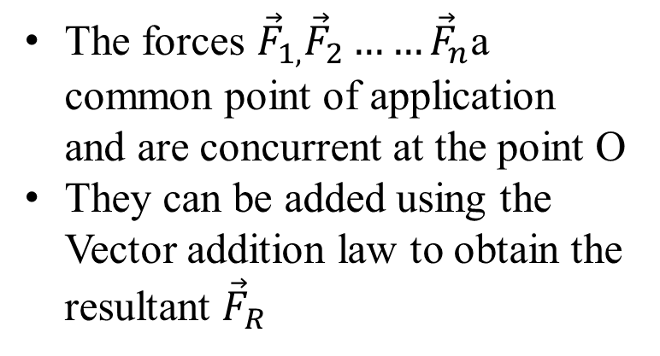

Concurrent forces
Two or more forces are said to be concurrent at a point if their lines of action intersect at that point
The forces ${\vec{F}}_{1,}{\vec{F}}_{2}……{\vec{F}}_{n}$a common point of application and are concurrent at the point O
They can be added using the Vector addition law to obtain the resultant ${\vec{F}}_{R}$
$${\vec{F}}_{3}$$
$${\vec{F}}_{2}$$
$${\vec{F}}_{1}$$
$${\vec{F}}_{4}$$
$${\vec{F}}_{5}$$

Slide 9
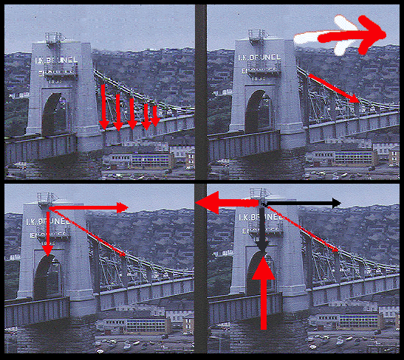
????? Concurrent forces
Two or more forces are said to be concurrent at a point if their lines of action intersect at that point

Slide 10
Coplanar Concurrent forces
There are many ways in which forces can be manipulated.
It is easier to work with a large, complicated system of forces by reducing it to an ever-decreasing number of smaller problems.
This is called the "resolution" of forces or force systems.
This is one way to simplify what may otherwise seem to be an impossible system of forces acting on a body.
Certain systems of forces are easier to resolve than others.
Coplanar force systems have all the forces acting in one plane.
They may be concurrent, parallel, non-concurrent or non-parallel.
All of these systems can be resolved by using graphic statics or algebra.

Slide 11
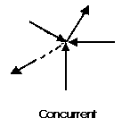
Coplanar Concurrent forces
concurrent coplanar force system is a system of two or more forces whose lines of action ALL intersect at a common point.
However, all of the individual vectors might not actually be in contact with the common point.
These are the simplest force systems to resolve with any one of many graphical or algebraic options.

Slide 12
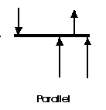
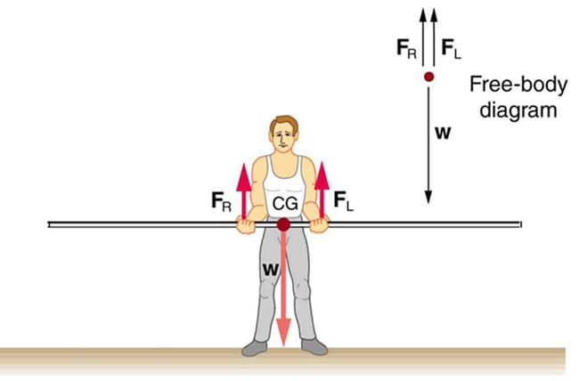
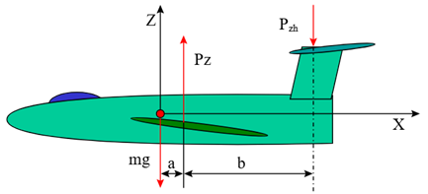
Parallel Coplanar Force System
A parallel coplanar force system consists of two or more forces whose lines of action are ALL parallel.
This is commonly the situation when simple beams are analyzed under gravity loads.
These can be solved graphically but are combined most easily using algebraic methods.

Slide 13
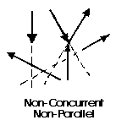
Non-concurrent and Non-parallel system
This system consists of several vectors that do not meet at a single point and none of them are parallel.
These systems are essentially a jumble of forces and take considerable care to resolve.

Slide 14
Coplanar Concurrent forces
Almost any system of known forces can be resolved into a single force called a resultant force or simply a Resultant.
The resultant is a representative force which has the same effect on the body as the group of forces it replaces.
It can be progressively resolving pairs or small groups of forces into resultants.
Then another resultant of the resultants can be found and so on until all of the forces have been combined into one force.
This is one way to save time with the tedious "bookkeeping" involved with many individual forces.

Slide 15
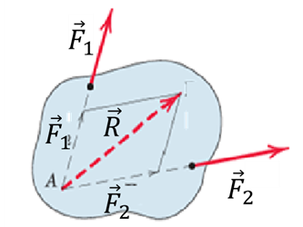
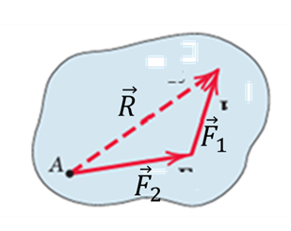
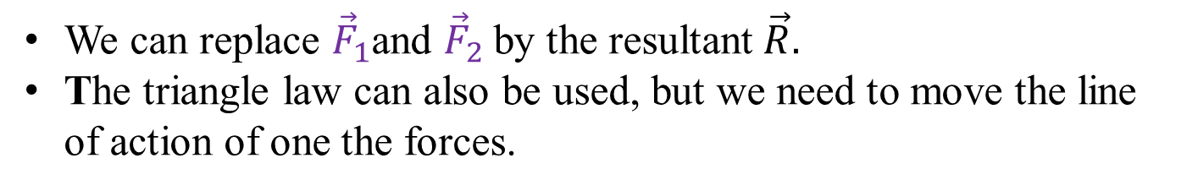
Coplanar Concurrent forces
Resultants can be determined both graphically and algebraically.
Suppose the two concurrent forces lie in the same plane but applied at two different points.
By the principle of transmissibility, we may move them along their lines of action and compete their vector sum.
We can replace ${\vec{F}}_{1}$and ${\vec{F}}_{2}$by the resultant$\vec{R}.$
The triangle law can also be used, but we need to move the line of action of one the forces.

Slide 16
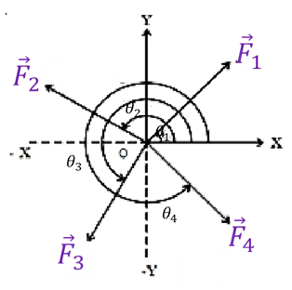
Resultant of Concurrent Forces
Consider a body O, which is acted upon by four forces as shown in Figure.
Let θ₁, θ₂, θ₃ and θ₄ be the angles made by the forces with respect to X-axis.
Each force acting at O can be replaced by its cartesian (rectangular) components F_{1x} and F_{1y}, F_{2x} and F_{2y}, .. etc.,

Slide 17
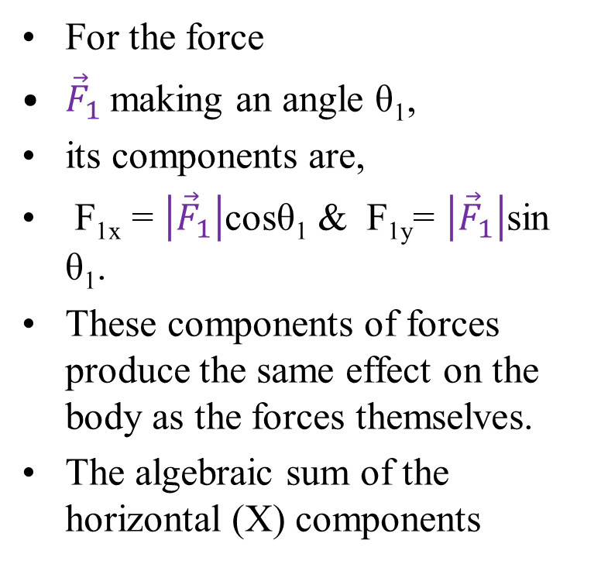

Resultant of Concurrent Forces
For the force
${\vec{F}}_{1}$making an angle θ₁,
its components are,
F_{1x} = $\left|{\vec{F}}_{1}\right|$cosθ₁ & F_{1y}= $\left|{\vec{F}}_{1}\right|$sin θ₁.
These components of forces produce the same effect on the body as the forces themselves.
The algebraic sum of the horizontal (X) components
$$R_{x}=F_{1x}+F_{2x}+F_{3x}+F_{4x}$$

Slide 18
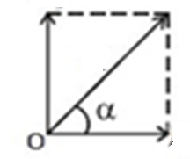




Resultant of Concurrent Forces
The algebraic sum of the vertical (Y) components
$$R_{y}=F_{1y}+F_{2y}+F_{3y}+F_{4y}$$
Use the simple parallelogram law to get final resultant force as:
$$\vec{R}$$
$$R_{y}$$
$$R_{x}$$

Slide 19
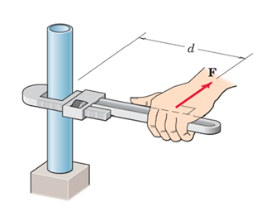

Moment
In addition to move a body in the direction of its application, a force can also tend to rotate a body about an axis
The axis may be any line which neither intersects nor is parallel to the line of action
This rotational tendency is known as the moment
Moment is also referred to as torque
$$\vec{F}$$

Slide 20
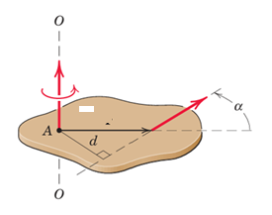

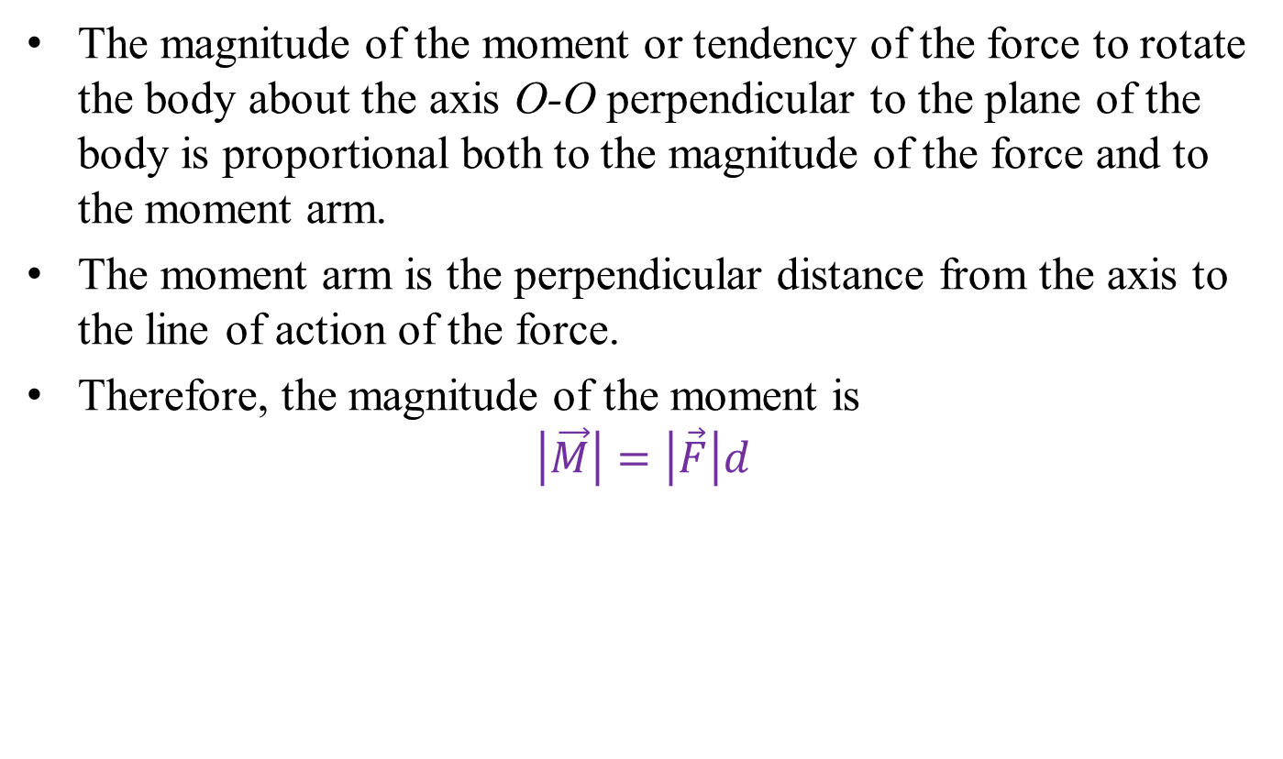


Moment about a point
The magnitude of the moment or tendency of the force to rotate the body about the axis O-O perpendicular to the plane of the body is proportional both to the magnitude of the force and to the moment arm.
The moment arm is the perpendicular distance from the axis to the line of action of the force.
Therefore, the magnitude of the moment is
$$\left|\vec{M}\right|=\left|\vec{F}\right|d$$
$$\vec{M}$$
$$\vec{F}$$
$$\vec{r}$$

Slide 21
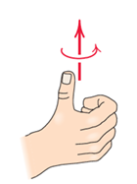
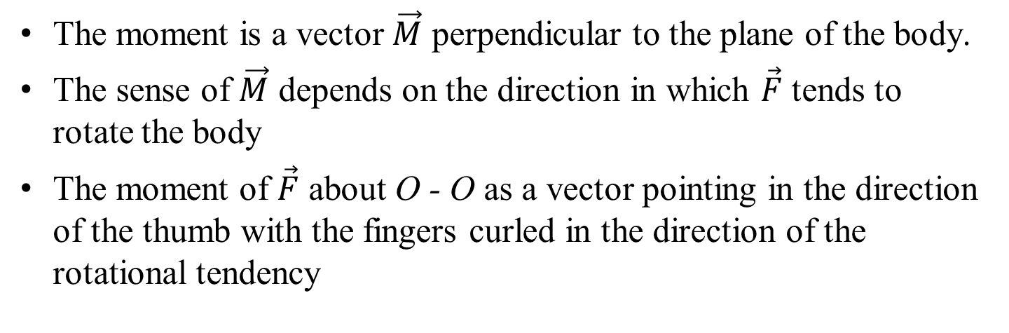

Moment about a point
The moment is a vector $\vec{M}$ perpendicular to the plane of the body.
The sense of $\vec{M}$ depends on the direction in which $\vec{F}$ tends to rotate the body
The moment of $\vec{F}$ about O - O as a vector pointing in the direction of the thumb with the fingers curled in the direction of the rotational tendency
$$\vec{M}$$
$$\vec{M}$$
$$\vec{F}$$
$$\vec{r}$$

Slide 22
Moment about a point
When dealing with forces which all act in a given plane, we customarily speak of the moment about a point.
Moment directions are accounted as
(+) sign for counterclockwise and
(-) sign for clockwise
$$\vec{M}$$
$$\vec{F}$$
$$\vec{r}$$

Slide 23
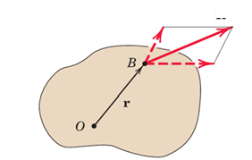


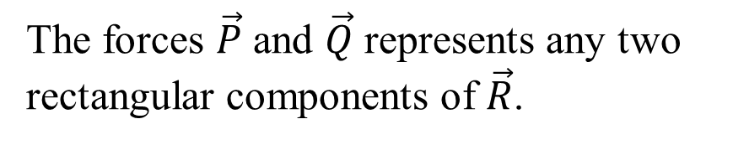
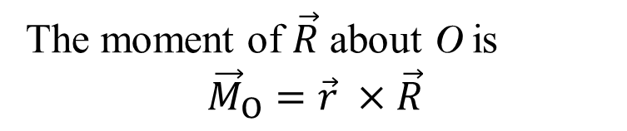
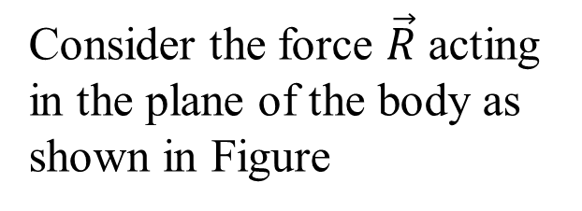

Varignon Theorem
One of the most useful principles of mechanics is Varignon’s theorem
It states that the moment of a force about any point is equal to the sum of moments of the components of the force about the same point
Proof of this theorem:
$$\vec{R}$$
Consider the force $\vec{R}$ acting in the plane of the body as shown in Figure
$$\vec{P}$$
$$\vec{Q}$$
The forces $\vec{P}$ and $\vec{Q}$ represents any two rectangular components of $\vec{R}$.
The moment of $\vec{R}$ about O is
$${\vec{M}}_{O}=\vec{r} ×\vec{R}$$

