Slide 1

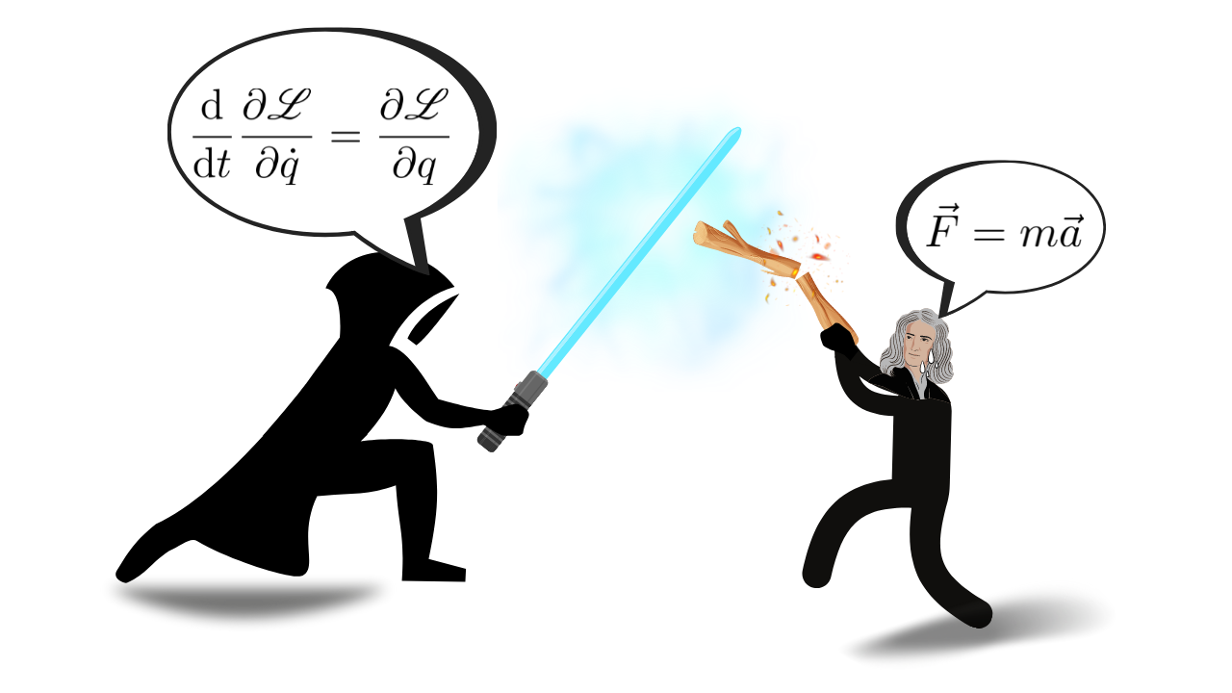

Derivation of Lagrange’s Equations
P M V Subbarao
Professor & Head
Mechanical Engineering Department
Beyond Newton: Deriving Equations of Motion via Energetics

Slide 2

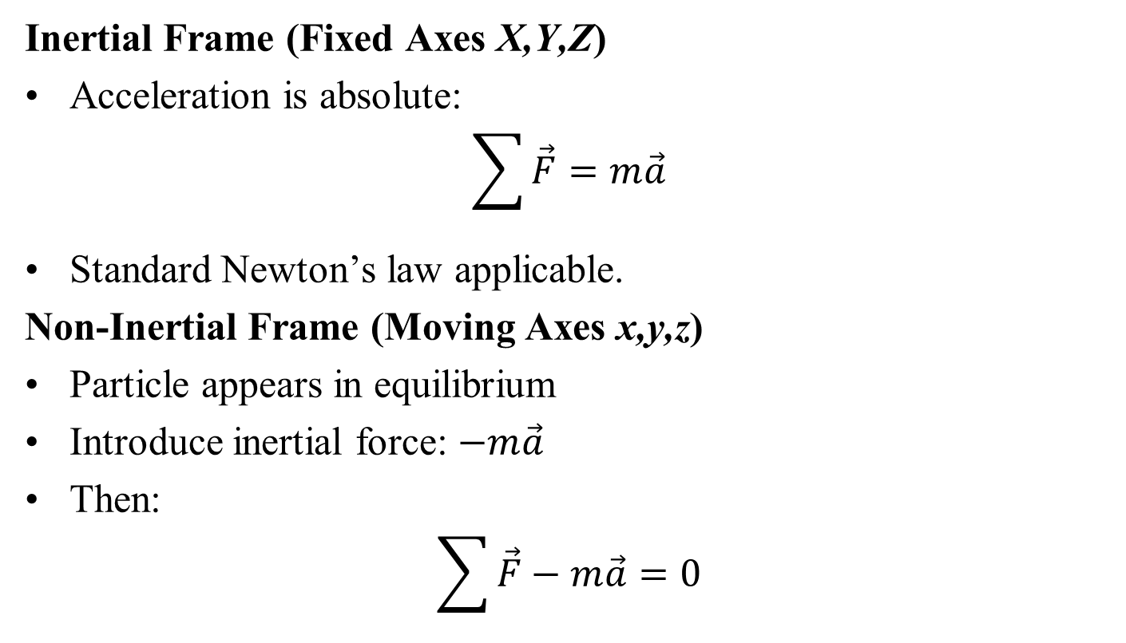
D’Alembert’s Principle : A Simple Bridge
Bridges Newtonian mechanics and Lagrangian mechanics by converting dynamics into a form of virtual work (statics)
Inertial Frame (Fixed Axes X,Y,Z)
Acceleration is absolute:
$$\sum{\vec{F}}=m\vec{a}$$
Standard Newton’s law applicable.
Non-Inertial Frame (Moving Axes x,y,z)
Particle appears in equilibrium
Introduce inertial force: $−m\vec{a}$
Then:
$$\sum{\vec{F}}−m\vec{a}=0$$

Slide 3
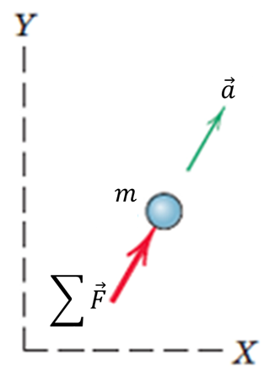
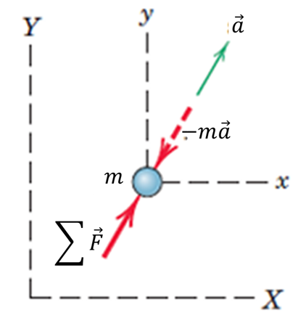
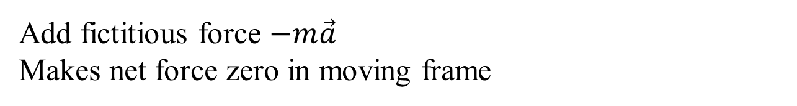
D’Alembert’s Principle
D’Alembert’s Principle
Dynamics → equivalent statics problem
State of dynamic equilibrium
Inertial frame
Moving frame
Add fictitious force $−m\vec{a}$
Makes net force zero in moving frame

Slide 4
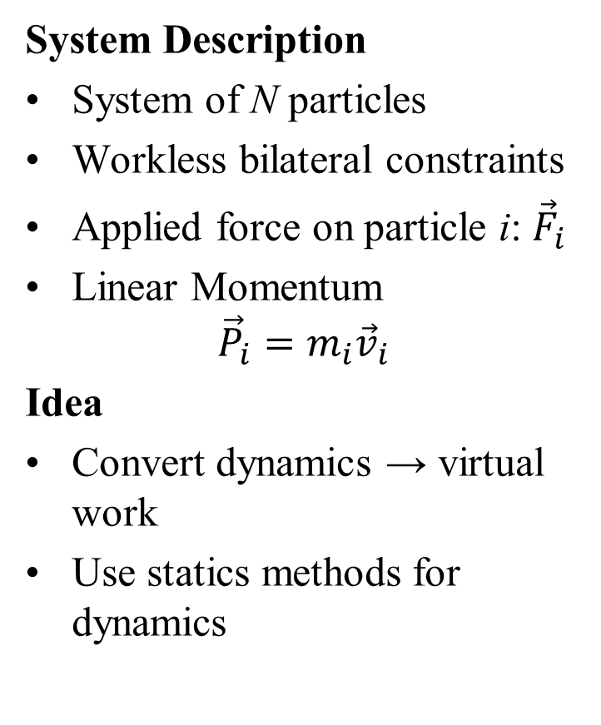
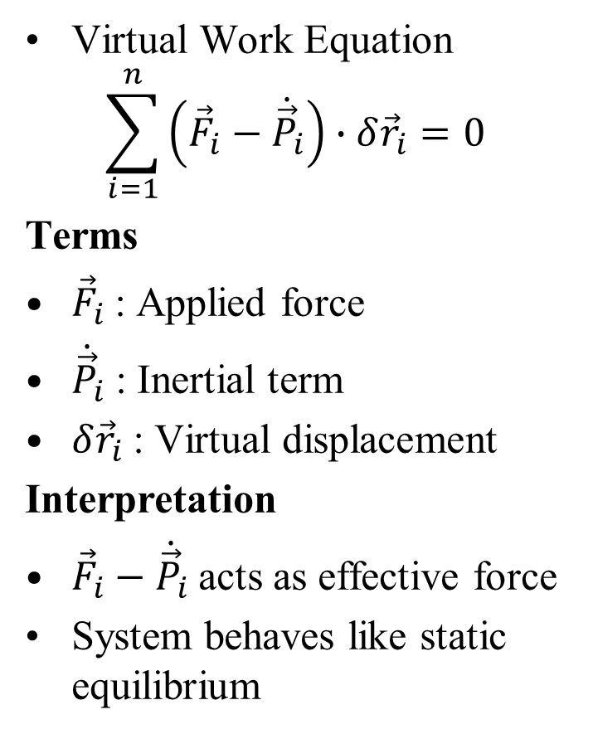
Virtual Work Form of d’Alembert’s Principle
System Description
System of N particles
Workless bilateral constraints
Applied force on particle i: ${\vec{F}}_{i}$
Linear Momentum
$${\vec{P}}_{i}=m_{i}{\vec{v}}_{i}$$
Idea
Convert dynamics → virtual work
Use statics methods for dynamics
Virtual Work Equation
$$\sum_{i=1}^{n}{\left({\vec{F}}_{i}−{\dot{\vec{P}}}_{i}\right)∙δ{\vec{r}}_{i}}=0$$
Terms
${\vec{F}}_{i}$: Applied force
${\dot{\vec{P}}}_{i}$: Inertial term
$δ{\vec{r}}_{i}$: Virtual displacement
Interpretation
${\vec{F}}_{i}−{\dot{\vec{P}}}_{i}$acts as effective force
System behaves like static equilibrium

Slide 5
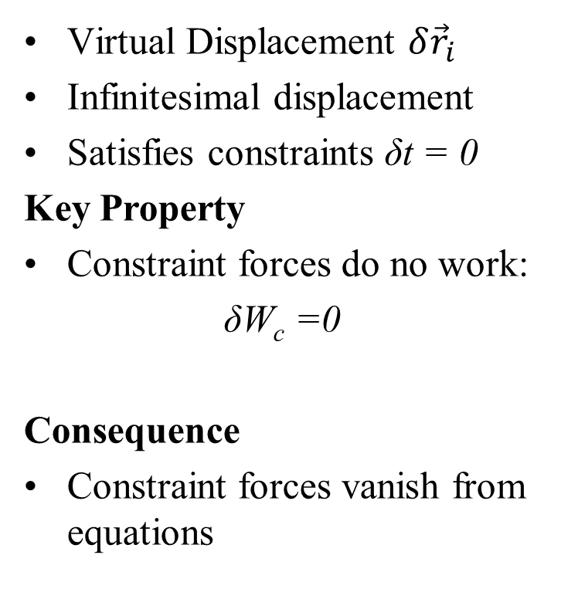
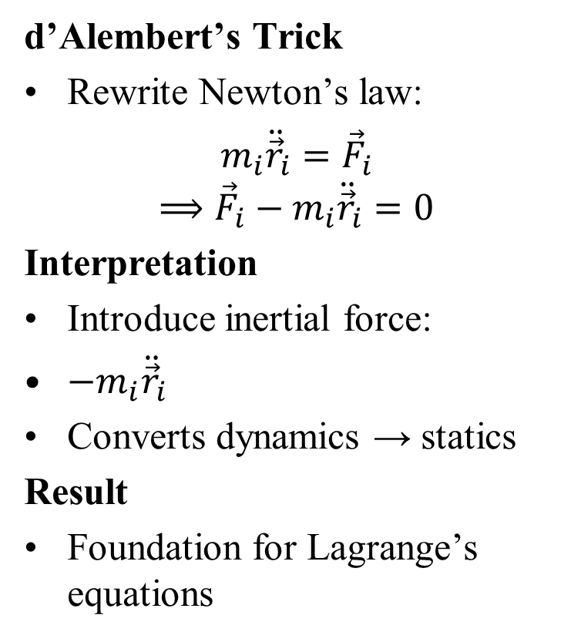
d’Alembert’s Insight on Virtual Displacements
d’Alembert’s Trick
Rewrite Newton’s law:
$m_{i}{\ddot{\vec{r}}}_{i}={\vec{F}}_{i}$
$$⟹{\vec{F}}_{i}−m_{i}{\ddot{\vec{r}}}_{i}=0$$
Interpretation
Introduce inertial force:
$−m_{i}{\ddot{\vec{r}}}_{i}$
Converts dynamics → statics
Result
Foundation for Lagrange’s equations
Virtual Displacement $δ{\vec{r}}_{i}$
Infinitesimal displacement
Satisfies constraints δt = 0
Key Property
Constraint forces do no work:
δW_{c} =0
Consequence
Constraint forces vanish from equations

Slide 6
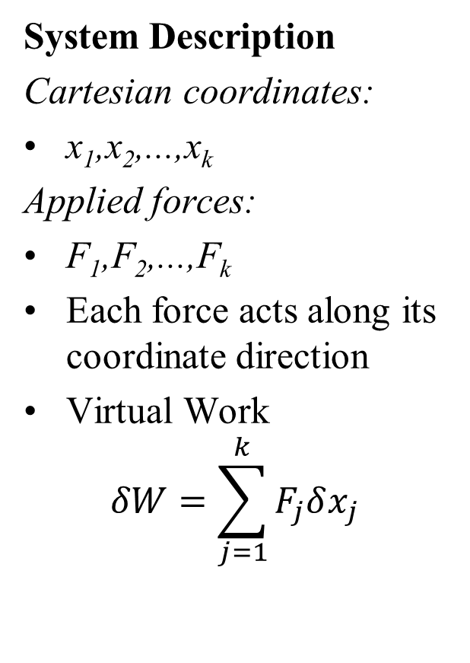
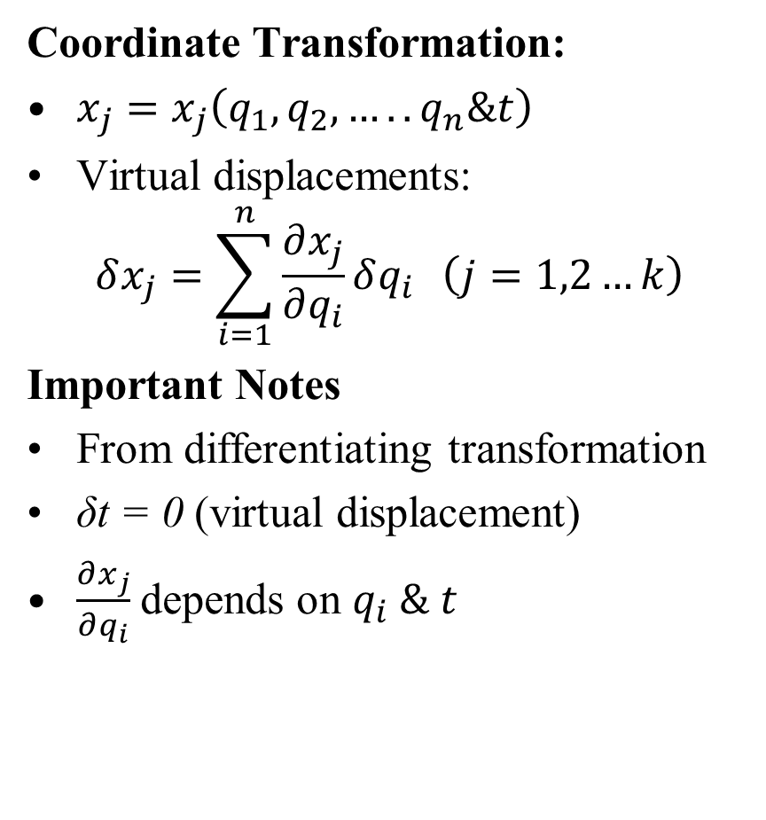
Generalized Forces: Transformation View
System Description
Cartesian coordinates:
x₁,x₂,...,x_{k}
Applied forces:
F₁,F₂,...,F_{k}
Each force acts along its coordinate direction
Virtual Work
$$δW=\sum_{j=1}^{k}{F_{j}δx_{j}}$$
Coordinate Transformation:
$x_{j}=x_{j}\left(q_{1},q_{2}, …..q_{n}\&t\right)$
Virtual displacements:
$$δx_{j}=\sum_{i=1}^{n}{\frac{∂x_{j}}{∂q_{i}}δq_{i}} \left(j=1,2…k\right)$$
Important Notes
From differentiating transformation
δt = 0 (virtual displacement)
$\frac{∂x_{j}}{∂q_{i}}$depends on $q_{i} \& t$

Slide 7
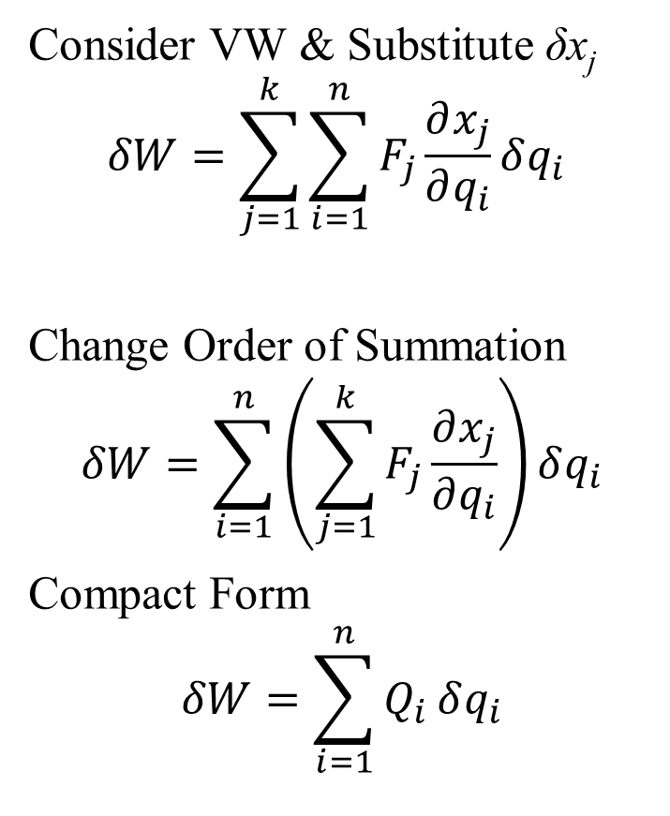
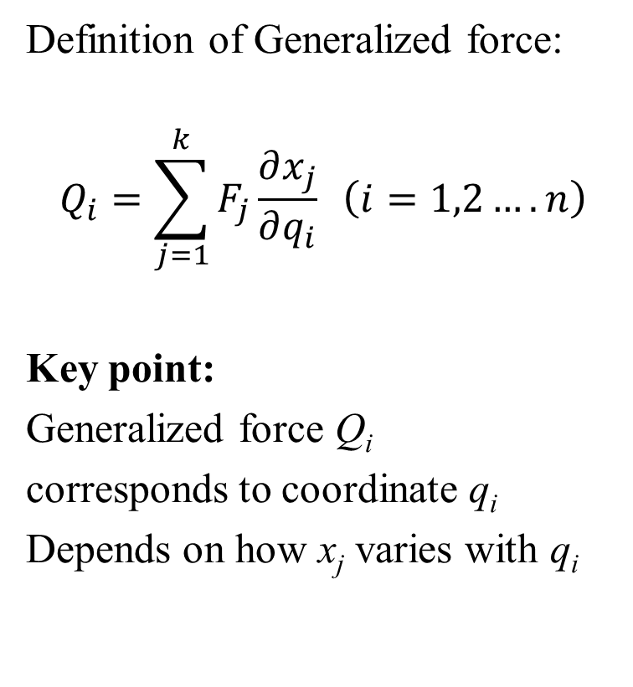
Definition of Generalized Forces
Consider VW & Substitute δx_{j}
$$δW=\sum_{j=1}^{k}{\sum_{i=1}^{n}{F_{j}}}\frac{∂x_{j}}{∂q_{i}}δq_{i}$$
Change Order of Summation
$$δW=\sum_{i=1}^{n}{\left(\sum_{j=1}^{k}{F_{j}\frac{∂x_{j}}{∂q_{i}}}\right)}δq_{i}$$
Compact Form
$$δW=\sum_{i=1}^{n}{Q_{i}}δq_{i}$$
Definition of Generalized force:
$$Q_{i}=\sum_{j=1}^{k}{F_{j}\frac{∂x_{j}}{∂q_{i}} \left(i=1,2….n\right)}$$
Key point:
Generalized force Q_{i}
corresponds to coordinate q_{i}
Depends on how x_{j} varies with q_{i}

Slide 8
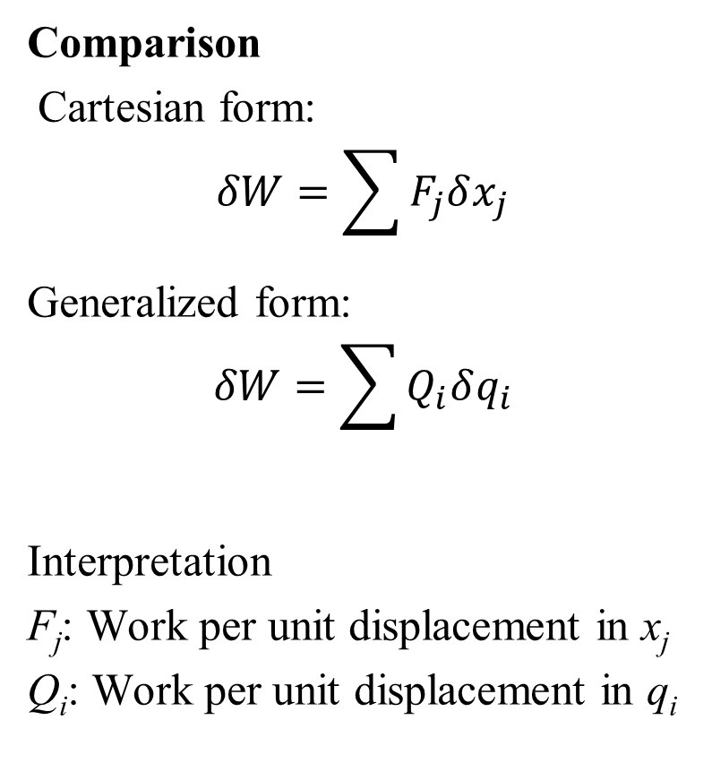
Interpretation of Generalized Forces
Comparison
Cartesian form:
$$δW=\sum{F_{j}δx_{j}}$$
Generalized form:
$$δW=\sum{Q_{i}δq_{i}}$$
Interpretation
F_{j}: Work per unit displacement in x_{j}
Q_{i}: Work per unit displacement in q_{i}
Important Notes
Other coordinates held fixed when defining Q_{i}
Generalized coordinates usually independent With Constraints
If constraints relate
q_{i}: Ignore them while forming virtual displacements
Key Insight
Generalized forces extend force concept to any coordinate system

Slide 9

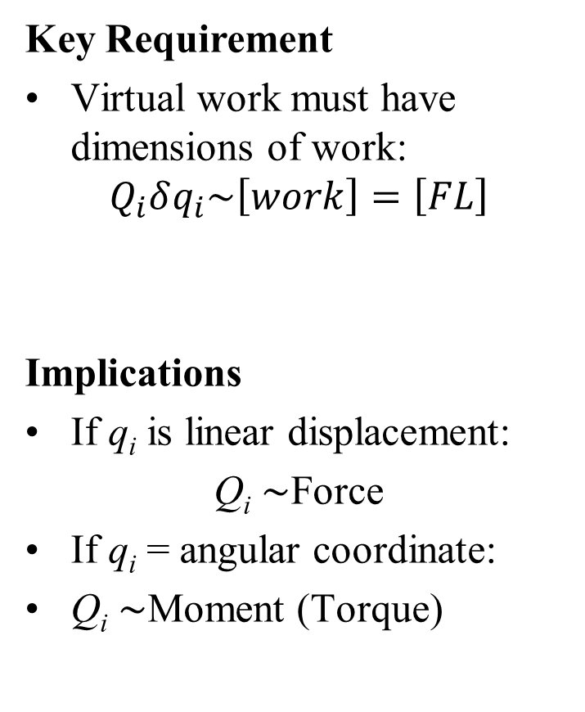
Dimensions of Generalized Forces
Important Observations
Cartesian coordinates are a special case:
x_{j} ⇒ Q_{j} = F_{j}
Ordinary forces are special cases of generalized forces
Conclusion
Generalized forces unify:
Forces (linear) Moments (angular)
All results apply to both ordinary and generalized coordinates
Key Requirement
Virtual work must have dimensions of work:
$$Q_{i}δq_{i}\sim \left[work\right]=\left[FL\right]$$
Implications
If q_{i} is linear displacement:
Q_{i} ∼Force
If q_{i} = angular coordinate:
Q_{i} ∼Moment (Torque)
Anything that happens in this universe is driven by a Generalized Force

Slide 10
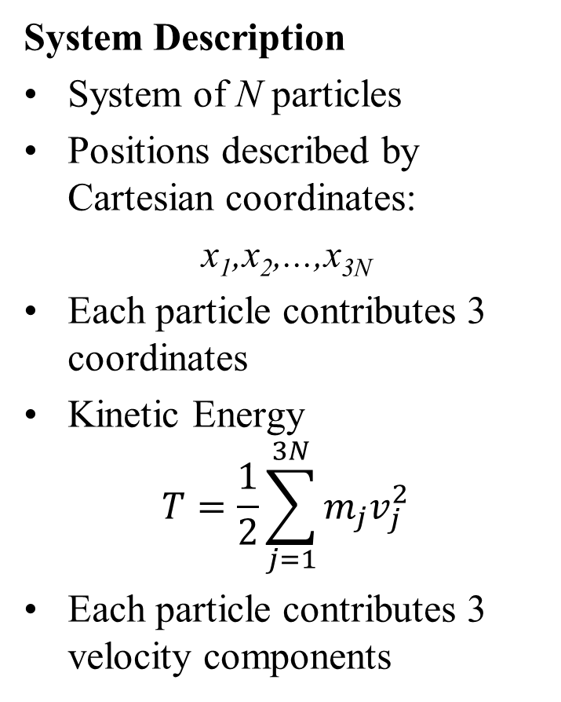
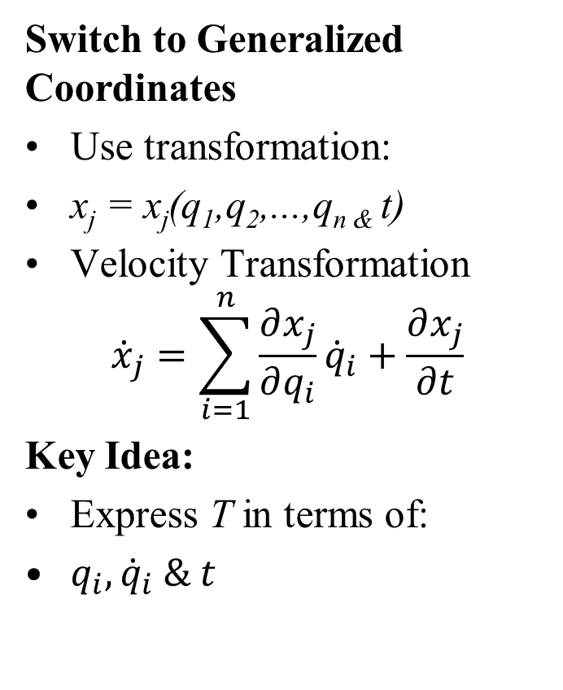
Derivation of Lagrange’s Equations
System Description
System of N particles
Positions described by Cartesian coordinates:
x₁,x₂,...,x_{3N}
Each particle contributes 3 coordinates
Kinetic Energy
$$T=\frac{1}{2}\sum_{j=1}^{3N}{m_{j}v_{j}^{2}}$$
Each particle contributes 3 velocity components
Switch to Generalized Coordinates
Use transformation:
x_{j} = x_{j}(q₁,q₂,...,q_{n &} t)
Velocity Transformation
$${\dot{x}}_{j}=\sum_{i=1}^{n}{\frac{∂x_{j}}{∂q_{i}}{\dot{q}}_{i}+\frac{∂x_{j}}{∂t}}$$
Key Idea:
Express T in terms of:
$q_{i},{\dot{q}}_{i} \& t$

Slide 11
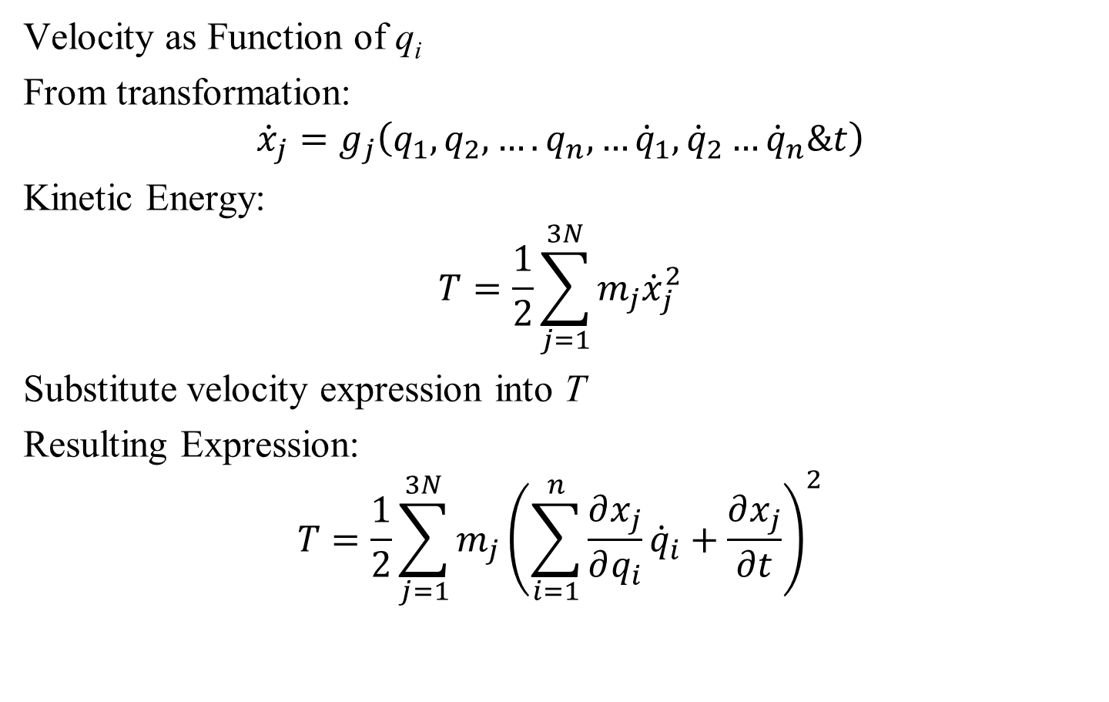
Kinetic Energy in Generalized Coordinates
Velocity as Function of q_{i}
From transformation:
$${\dot{x}}_{j}=g_{j}\left(q_{1},q_{2},….q_{n},…{\dot{q}}_{1},{\dot{q}}_{2}…{\dot{q}}_{n}\&t\right)$$
Kinetic Energy:
$$T=\frac{1}{2}\sum_{j=1}^{3N}{m_{j}{\dot{x}}_{j}^{2}}$$
Substitute velocity expression into T
Resulting Expression:
$$T=\frac{1}{2}\sum_{j=1}^{3N}{m_{j}{\left(\sum_{i=1}^{n}{\frac{∂x_{j}}{∂q_{i}}{\dot{q}}_{i}}+\frac{∂x_{j}}{∂t}\right)}^{2}}$$

Slide 12
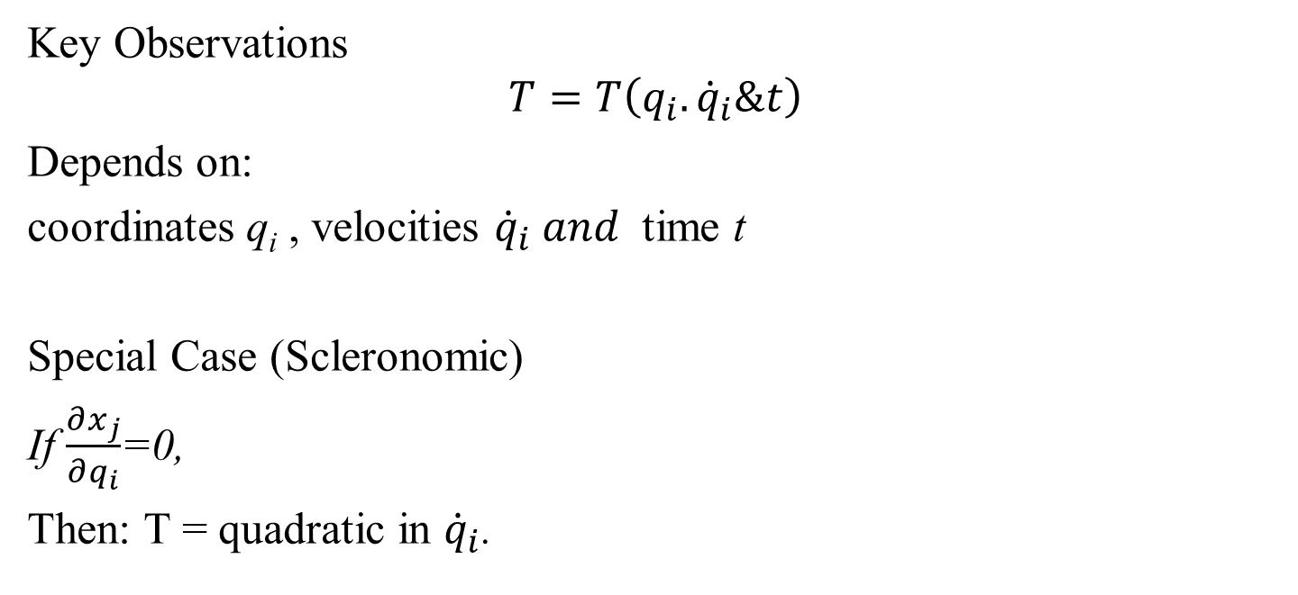
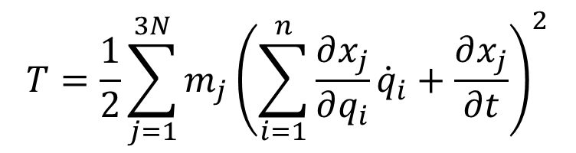
Kinetic Energy in Generalized Coordinates
$$T=\frac{1}{2}\sum_{j=1}^{3N}{m_{j}{\left(\sum_{i=1}^{n}{\frac{∂x_{j}}{∂q_{i}}{\dot{q}}_{i}}+\frac{∂x_{j}}{∂t}\right)}^{2}}$$
Key Observations
$$T=T\left(q_{i}.{\dot{q}}_{i}\&t\right)$$
Depends on:
coordinates q_{i} , velocities ${\dot{q}}_{i} and$ time t
Special Case (Scleronomic)
If $\frac{∂x_{j}}{∂q_{i}}$=0,
Then: T = quadratic in ${\dot{q}}_{i}$.

Slide 13
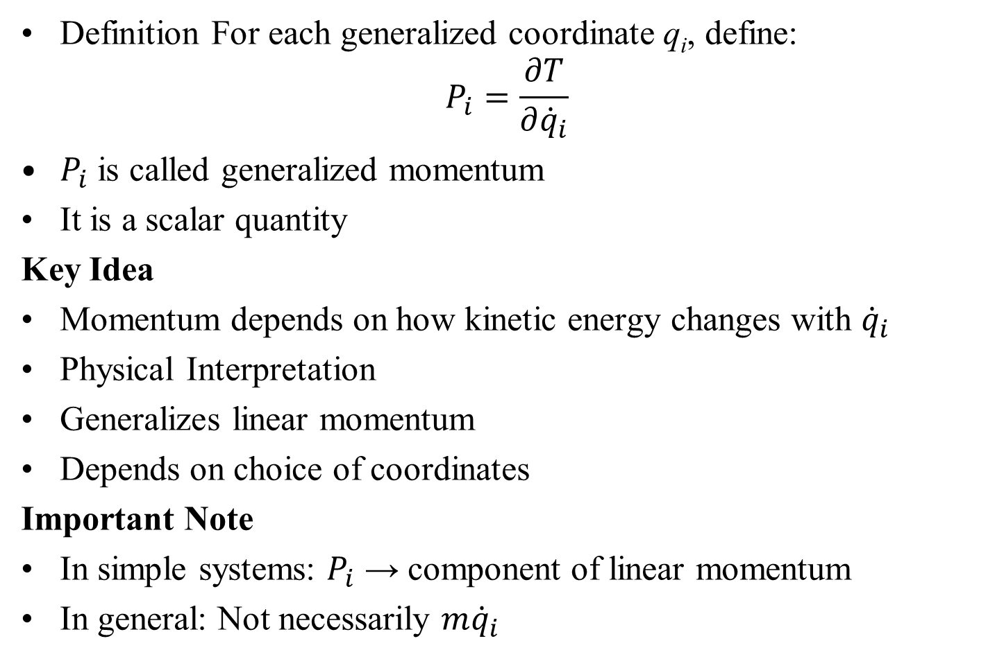
Definition of Generalized Momentum
Definition For each generalized coordinate q_{i}, define:
$$P_{i}=\frac{∂T}{∂{\dot{q}}_{i}}$$
$P_{i}$ is called generalized momentum
It is a scalar quantity
Key Idea
Momentum depends on how kinetic energy changes with ${\dot{q}}_{i}$
Physical Interpretation
Generalizes linear momentum
Depends on choice of coordinates
Important Note
In simple systems: $P_{i}$ → component of linear momentum
In general: Not necessarily $m{\dot{q}}_{i}$

Slide 14
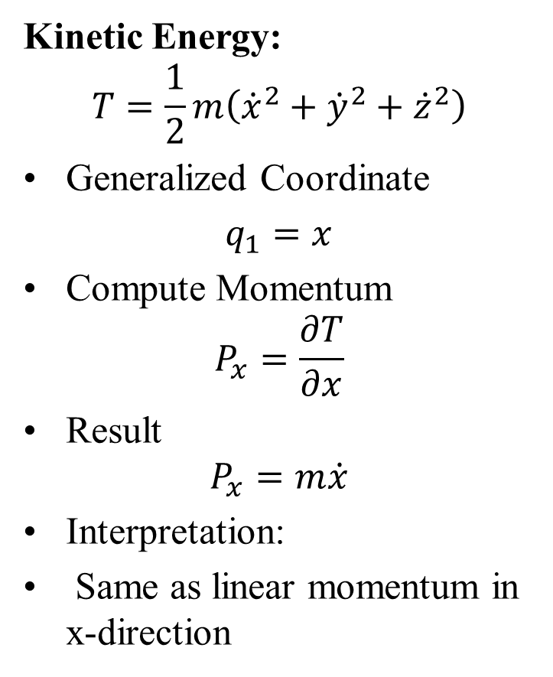
Example: Cartesian Coordinates
Kinetic Energy:
$$T=\frac{1}{2}m\left({\dot{x}}^{2}+{\dot{y}}^{2}+{\dot{z}}^{2}\right)$$
Generalized Coordinate
$q_{1}=x$
Compute Momentum
$$P_{x}=\frac{∂T}{∂x}$$
Result
$$P_{x}=m\dot{x}$$
Interpretation:
Same as linear momentum in x-direction
Shows:
Generalized momentum = ordinary momentum
Key Insight
Cartesian coordinates are a special case
Generalized momentum extends this idea to any coordinate system

Slide 15
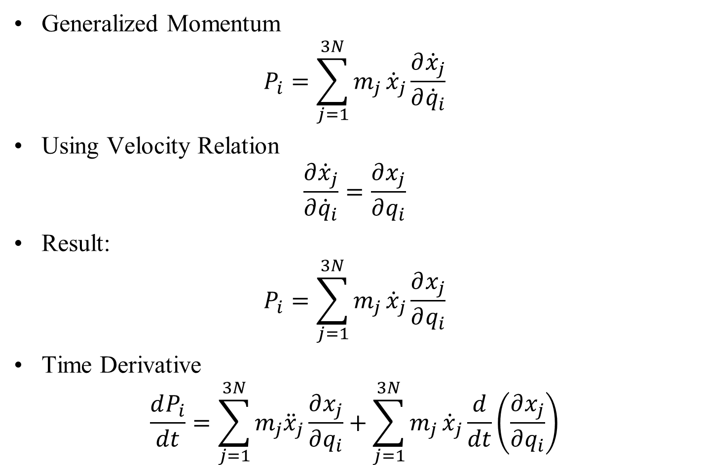
Time Rate of Change of Generalized Momentum
Generalized Momentum
$$P_{i}=\sum_{j=1}^{3N}{m_{j}}{\dot{x}}_{j}\frac{∂{\dot{x}}_{j}}{∂{\dot{q}}_{i}}$$
Using Velocity Relation
$$\frac{∂{\dot{x}}_{j}}{∂{\dot{q}}_{i}}=\frac{∂x_{j}}{∂q_{i}}$$
Result:
$$P_{i}=\sum_{j=1}^{3N}{m_{j}}{\dot{x}}_{j}\frac{∂x_{j}}{∂q_{i}}$$
Time Derivative
$$\frac{dP_{i}}{dt}=\sum_{j=1}^{3N}{m_{j}{\ddot{x}}_{j}}\frac{∂x_{j}}{∂q_{i}}+\sum_{j=1}^{3N}{m_{j}}{\dot{x}}_{j}\frac{d}{dt}\left(\frac{∂x_{j}}{∂q_{i}}\right)$$

Slide 16
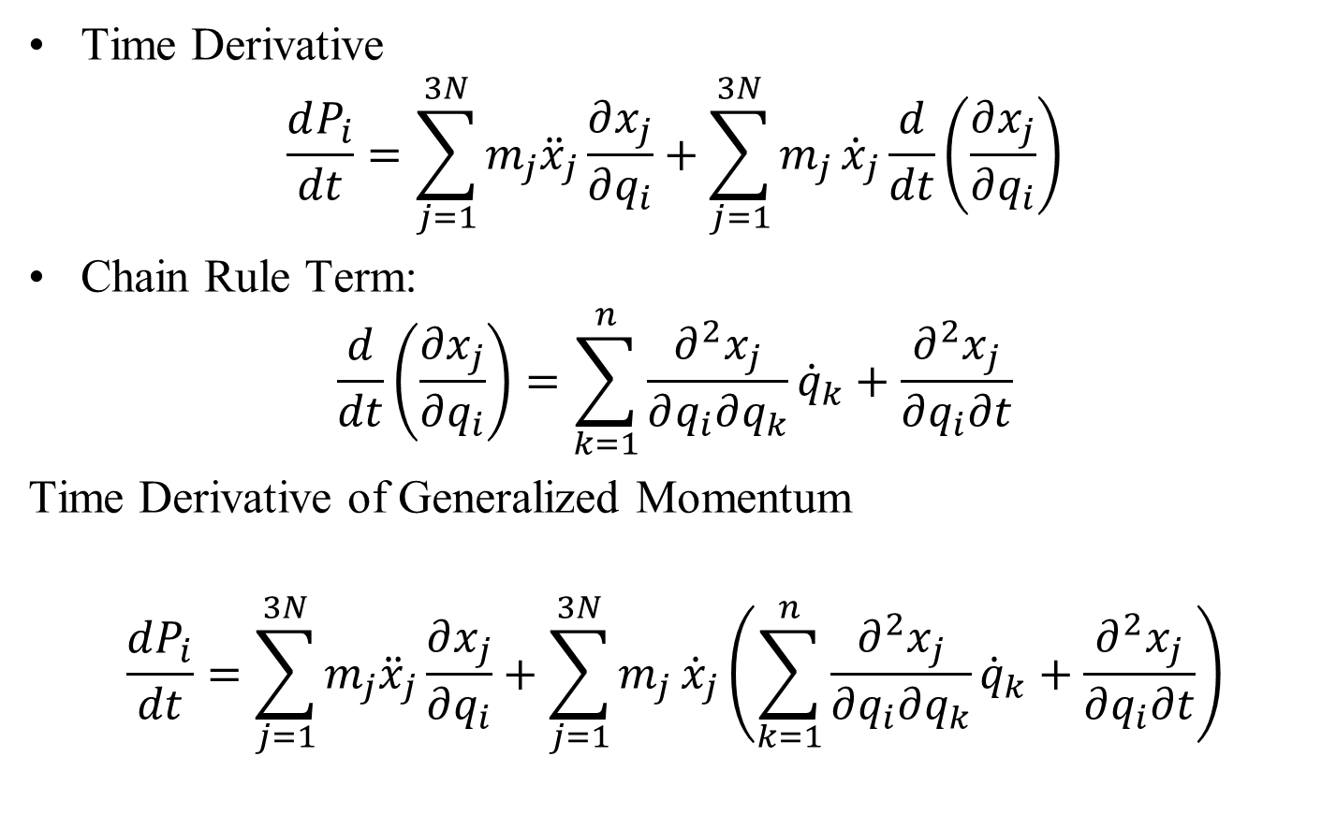
Time Rate of Change of Generalized Momentum
Time Derivative
$$\frac{dP_{i}}{dt}=\sum_{j=1}^{3N}{m_{j}{\ddot{x}}_{j}}\frac{∂x_{j}}{∂q_{i}}+\sum_{j=1}^{3N}{m_{j}}{\dot{x}}_{j}\frac{d}{dt}\left(\frac{∂x_{j}}{∂q_{i}}\right)$$
Chain Rule Term:
$$\frac{d}{dt}\left(\frac{∂x_{j}}{∂q_{i}}\right)=\sum_{k=1}^{n}{\frac{∂^{2}x_{j}}{∂q_{i}∂q_{k}}{\dot{q}}_{k}}+\frac{∂^{2}x_{j}}{∂q_{i}∂t}$$
Time Derivative of Generalized Momentum
$$\frac{dP_{i}}{dt}=\sum_{j=1}^{3N}{m_{j}{\ddot{x}}_{j}\frac{∂x_{j}}{∂q_{i}}}+\sum_{j=1}^{3N}{m_{j}}{\dot{x}}_{j}\left(\sum_{k=1}^{n}{\frac{∂^{2}x_{j}}{∂q_{i}∂q_{k}}{\dot{q}}_{k}}+\frac{∂^{2}x_{j}}{∂q_{i}∂t}\right)$$

Slide 17
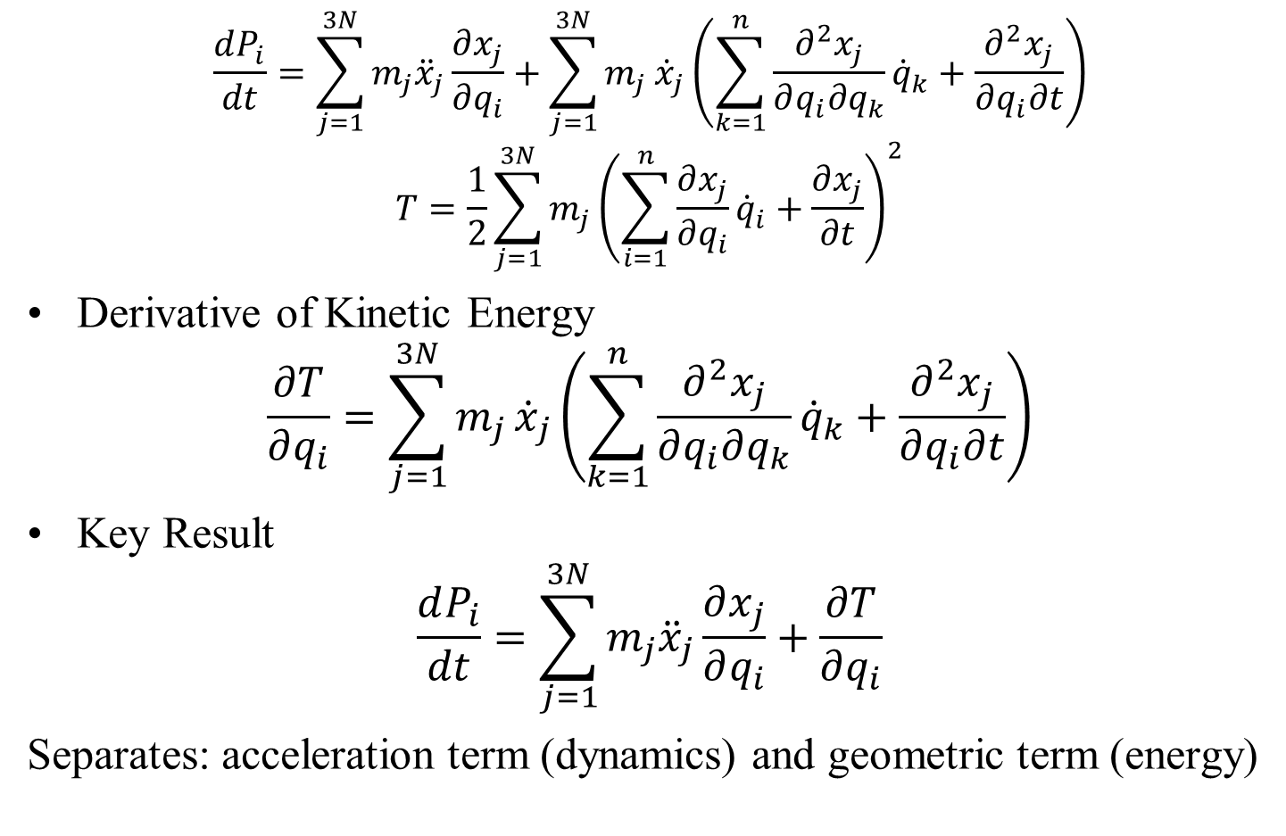
Linking Momentum and Kinetic Energy
$$\frac{dP_{i}}{dt}=\sum_{j=1}^{3N}{m_{j}{\ddot{x}}_{j}\frac{∂x_{j}}{∂q_{i}}}+\sum_{j=1}^{3N}{m_{j}}{\dot{x}}_{j}\left(\sum_{k=1}^{n}{\frac{∂^{2}x_{j}}{∂q_{i}∂q_{k}}{\dot{q}}_{k}}+\frac{∂^{2}x_{j}}{∂q_{i}∂t}\right)$$
$$T=\frac{1}{2}\sum_{j=1}^{3N}{m_{j}{\left(\sum_{i=1}^{n}{\frac{∂x_{j}}{∂q_{i}}{\dot{q}}_{i}}+\frac{∂x_{j}}{∂t}\right)}^{2}}$$
Derivative of Kinetic Energy
$$\frac{∂T}{∂q_{i}}=\sum_{j=1}^{3N}{m_{j}}{\dot{x}}_{j}\left(\sum_{k=1}^{n}{\frac{∂^{2}x_{j}}{∂q_{i}∂q_{k}}{\dot{q}}_{k}}+\frac{∂^{2}x_{j}}{∂q_{i}∂t}\right)$$
Key Result
$$\frac{dP_{i}}{dt}=\sum_{j=1}^{3N}{m_{j}{\ddot{x}}_{j}\frac{∂x_{j}}{∂q_{i}}+\frac{∂T}{∂q_{i}}}$$
Separates: acceleration term (dynamics) and geometric term (energy)

Slide 18
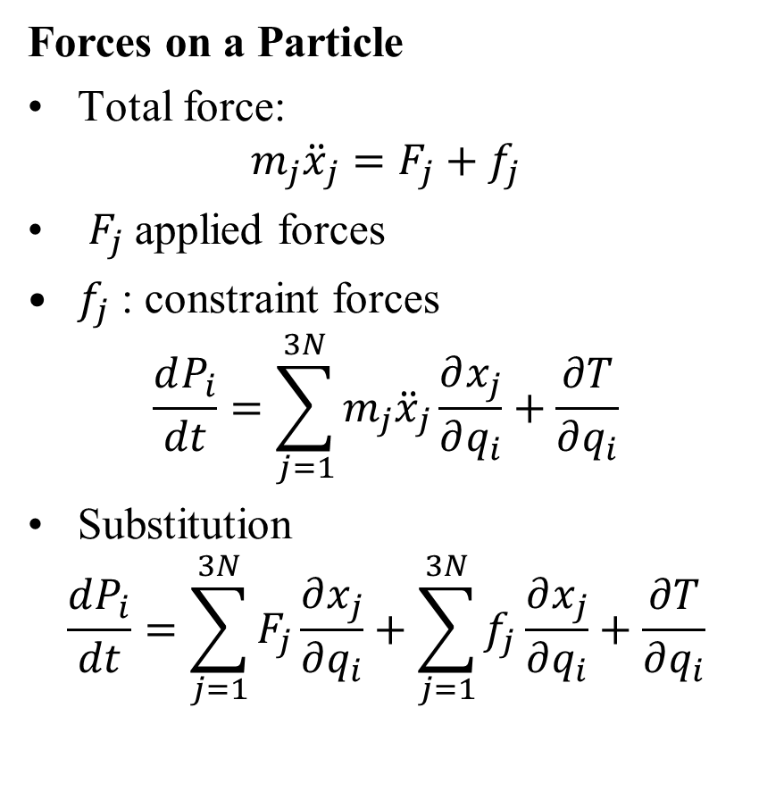

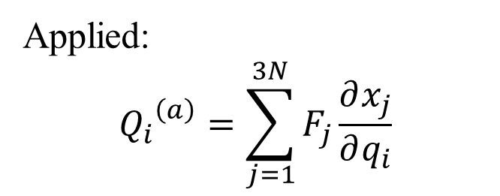
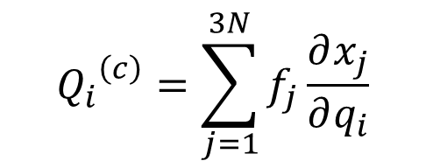
Forces and Generalized Forces
Forces on a Particle
Total force:
$$m_{j}{\ddot{x}}_{j}=F_{j}+f_{j}$$
$F_{j}$applied forces
$f_{j}$: constraint forces
$$\frac{dP_{i}}{dt}=\sum_{j=1}^{3N}{m_{j}{\ddot{x}}_{j}\frac{∂x_{j}}{∂q_{i}}+\frac{∂T}{∂q_{i}}}$$
Substitution
$$\frac{dP_{i}}{dt}=\sum_{j=1}^{3N}{F_{j}\frac{∂x_{j}}{∂q_{i}}}+\sum_{j=1}^{3N}{f_{j}\frac{∂x_{j}}{∂q_{i}}}+\frac{∂T}{∂q_{i}}$$
Generalized Forces
Applied:
$${Q_{i}}^{\left(a\right)}=\sum_{j=1}^{3N}{F_{j}\frac{∂x_{j}}{∂q_{i}}}$$
Constraint:
$${Q_{i}}^{\left(c\right)}=\sum_{j=1}^{3N}{f_{j}\frac{∂x_{j}}{∂q_{i}}}$$
Insight
$$Q_{i}={Q_{i}}^{a}+{Q_{i}}^{\left(c\right)}$$

Slide 19
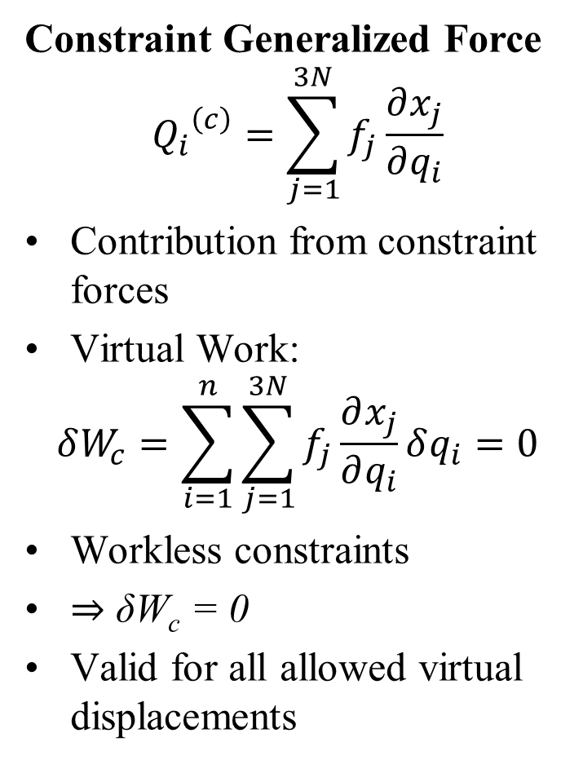
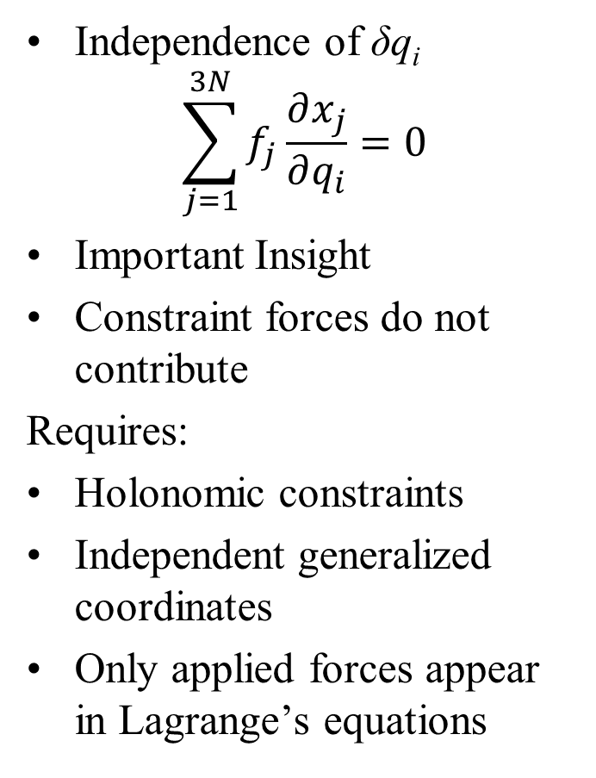
Workless Constraints and Generalized Forces
Constraint Generalized Force
$${Q_{i}}^{\left(c\right)}=\sum_{j=1}^{3N}{f_{j}\frac{∂x_{j}}{∂q_{i}}}$$
Contribution from constraint forces
Virtual Work:
$$δW_{c}=\sum_{i=1}^{n}{\sum_{j=1}^{3N}{f_{j}\frac{∂x_{j}}{∂q_{i}}}δq_{i}=0}$$
Workless constraints
⇒ δW_{c} = 0
Valid for all allowed virtual displacements
Independence of δq_{i}
$$\sum_{j=1}^{3N}{f_{j}\frac{∂x_{j}}{∂q_{i}}}=0$$
Important Insight
Constraint forces do not contribute
Requires:
Holonomic constraints
Independent generalized coordinates
Only applied forces appear in Lagrange’s equations

Slide 20
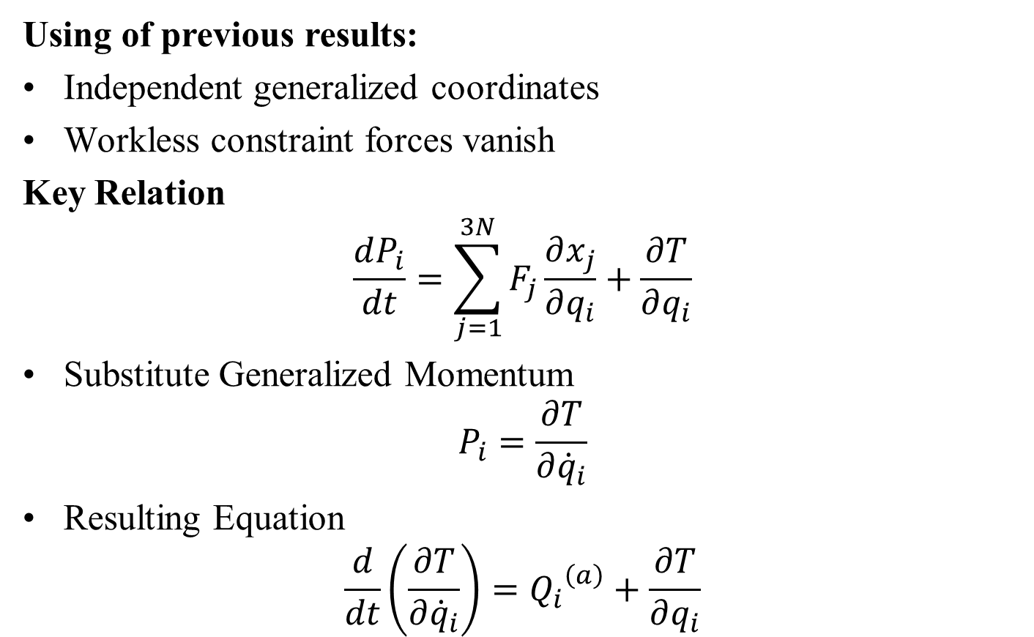
From Generalized Forces to Equations of Motion
Using of previous results:
Independent generalized coordinates
Workless constraint forces vanish
Key Relation
$$\frac{dP_{i}}{dt}=\sum_{j=1}^{3N}{F_{j}\frac{∂x_{j}}{∂q_{i}}}+\frac{∂T}{∂q_{i}}$$
Substitute Generalized Momentum
$$P_{i}=\frac{∂T}{∂{\dot{q}}_{i}}$$
Resulting Equation
$$\frac{d}{dt}\left(\frac{∂T}{∂{\dot{q}}_{i}}\right)={Q_{i}}^{\left(a\right)}+\frac{∂T}{∂q_{i}}$$

Slide 21
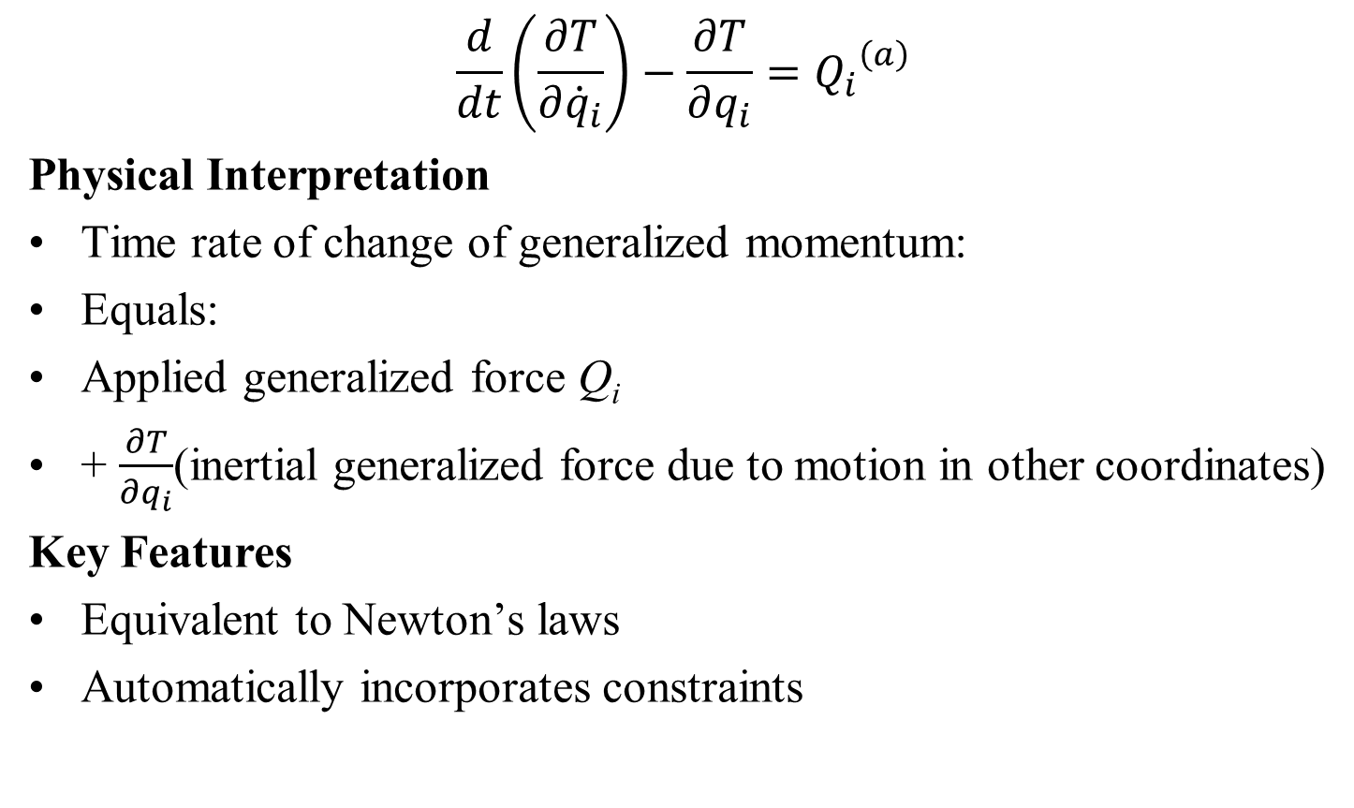
Lagrange’s Equations
$$\frac{d}{dt}\left(\frac{∂T}{∂{\dot{q}}_{i}}\right)−\frac{∂T}{∂q_{i}}={Q_{i}}^{\left(a\right)}$$
Physical Interpretation
Time rate of change of generalized momentum:
Equals:
Applied generalized force Q_{i}
+ $\frac{∂T}{∂q_{i}}$(inertial generalized force due to motion in other coordinates)
Key Features
Equivalent to Newton’s laws
Automatically incorporates constraints

Slide 22
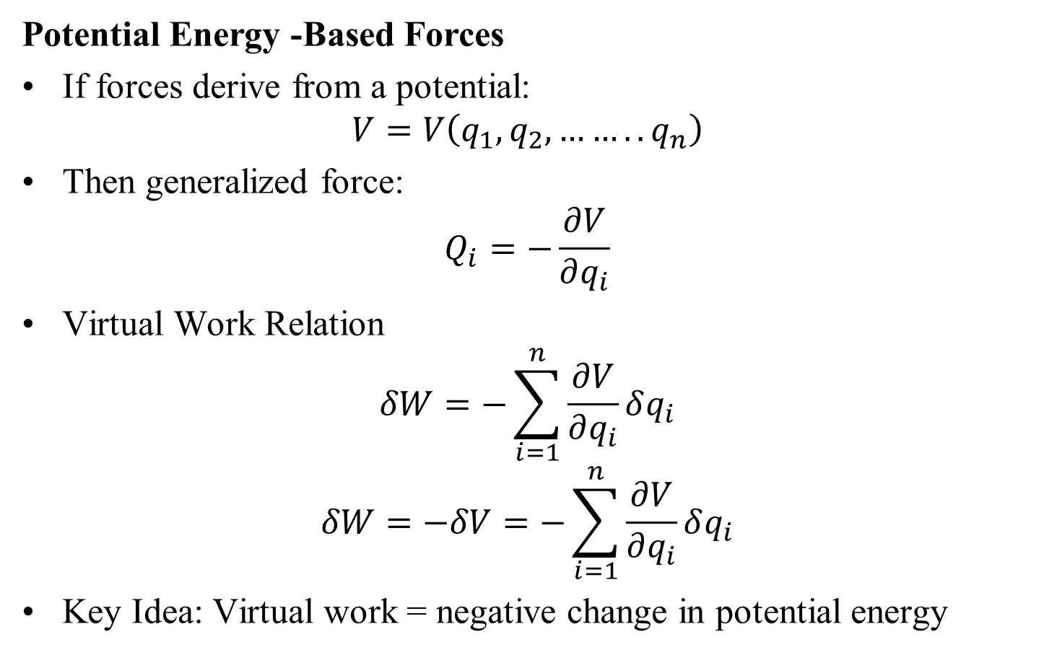
Forces from Potential Energy
Potential Energy -Based Forces
If forces derive from a potential:
$$V=V\left(q_{1},q_{2}, ……..q_{n}\right)$$
Then generalized force:
$$Q_{i}=−\frac{∂V}{∂q_{i}}$$
Virtual Work Relation
$$δW=−\sum_{i=1}^{n}{\frac{∂V}{∂q_{i}}}δq_{i}$$
$$δW=−δV=−\sum_{i=1}^{n}{\frac{∂V}{∂q_{i}}}δq_{i}$$
Key Idea: Virtual work = negative change in potential energy

Slide 23
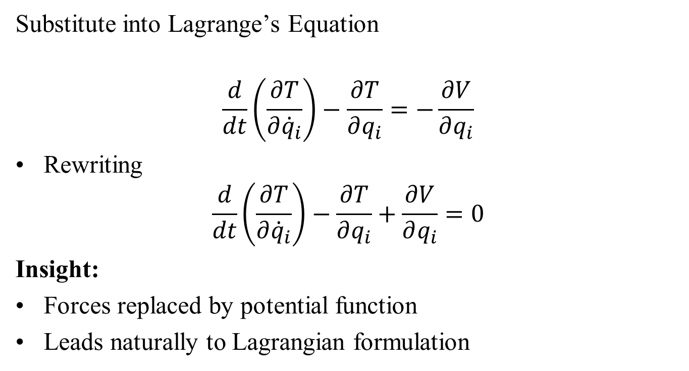
Lagrange’s Equation with Potential Energy
Substitute into Lagrange’s Equation
$$\frac{d}{dt}\left(\frac{∂T}{∂{\dot{q}}_{i}}\right)−\frac{∂T}{∂q_{i}}=−\frac{∂V}{∂q_{i}}$$
Rewriting
$$\frac{d}{dt}\left(\frac{∂T}{∂{\dot{q}}_{i}}\right)−\frac{∂T}{∂q_{i}}+\frac{∂V}{∂q_{i}}=0$$
Insight:
Forces replaced by potential function
Leads naturally to Lagrangian formulation

Slide 24
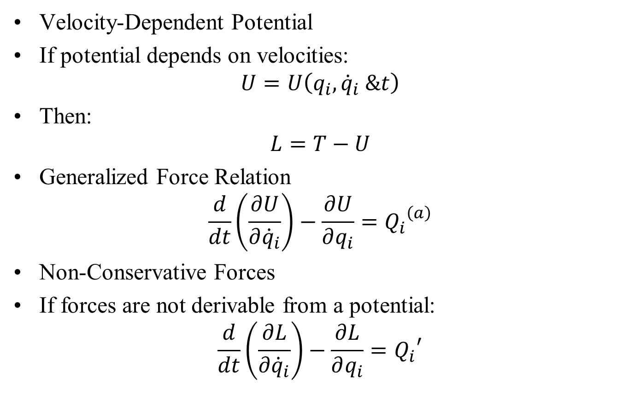
General Form of Lagrange’s Equation
Velocity-Dependent Potential
If potential depends on velocities:
$$U=U\left(q_{i},{\dot{q}}_{i} \&t\right)$$
Then:
$$L=T−U$$
Generalized Force Relation
$$\frac{d}{dt}\left(\frac{∂U}{∂{\dot{q}}_{i}}\right)−\frac{∂U}{∂q_{i}}={Q_{i}}^{\left(a\right)}$$
Non-Conservative Forces
If forces are not derivable from a potential:
$$\frac{d}{dt}\left(\frac{∂L}{∂{\dot{q}}_{i}}\right)−\frac{∂L}{∂q_{i}}={Q_{i}}^{′}$$

