Slide 1

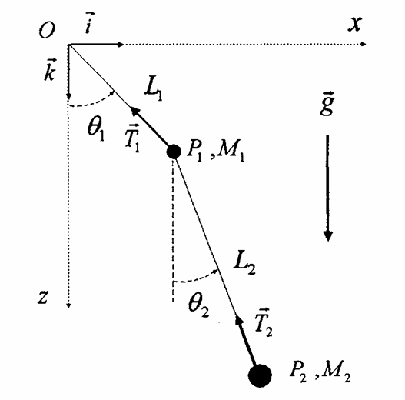
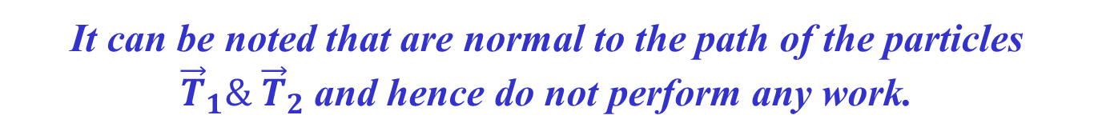
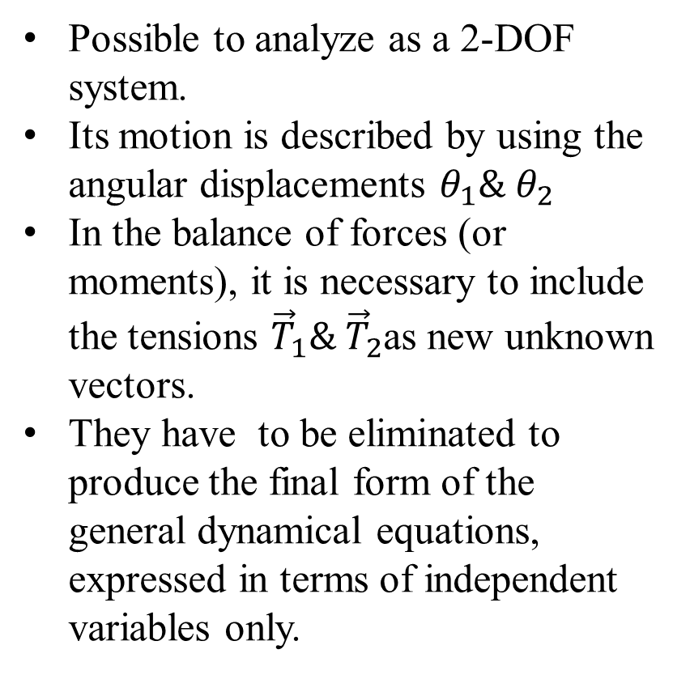
Start with Double Pendulum
Possible to analyze as a 2-DOF system.
Its motion is described by using the angular displacements $θ_{1}\& θ_{2}$
In the balance of forces (or moments), it is necessary to include the tensions ${\vec{T}}_{1}\& {\vec{T}}_{2}$as new unknown vectors.
They have to be eliminated to produce the final form of the general dynamical equations, expressed in terms of independent variables only.
It can be noted that are normal to the path of the particles ${\vec{T}}_{1}\& {\vec{T}}_{2}$and hence do not perform any work.

Slide 2
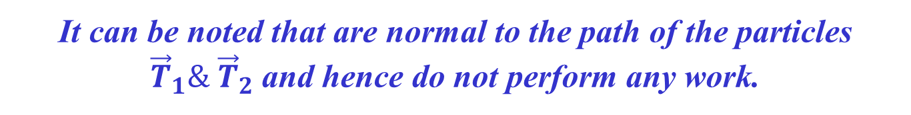
Start with Double Pendulum
It can be noted that are normal to the path of the particles ${\vec{T}}_{1}\& {\vec{T}}_{2}$and hence do not perform any work.
This would remain true in the case of any kinematically admissible motion.
A motion that is consistent with the kinematical constraints imposed on the system.
Therefore, the idea is to establish the equations of motion, starting from a balance of work performed by the forces instead of forces themselves.
This is the aim of analytical mechanics!

Slide 3

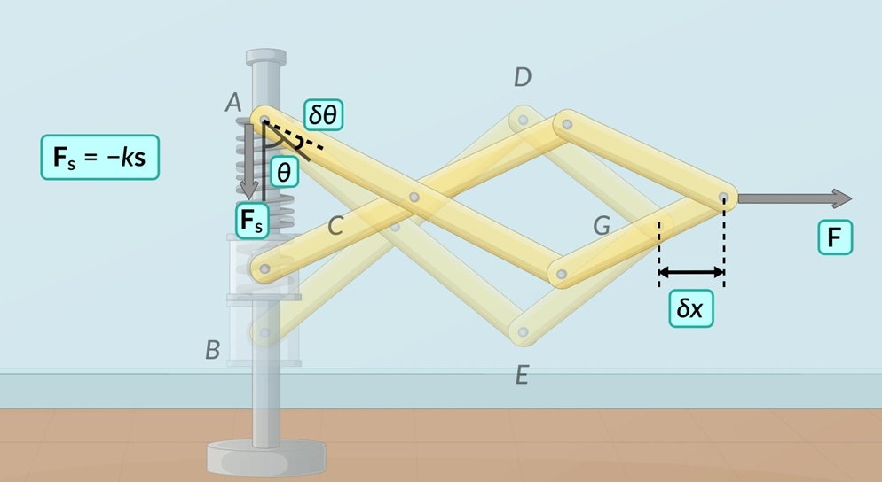

Virtual Displacement & Virtual Work
P M V Subbarao
Professor & Head
Mechanical Engineering Department
A fundamental bridge between Newtonian forces and Lagrangian mechanics

Slide 4
"by founding the analytical mechanics, Lagrange added nothing fundamentally different to Newton's laws, but provided an immensely powerful weapon to solve any mechanical problem on the basis of pure calculation"

Slide 5
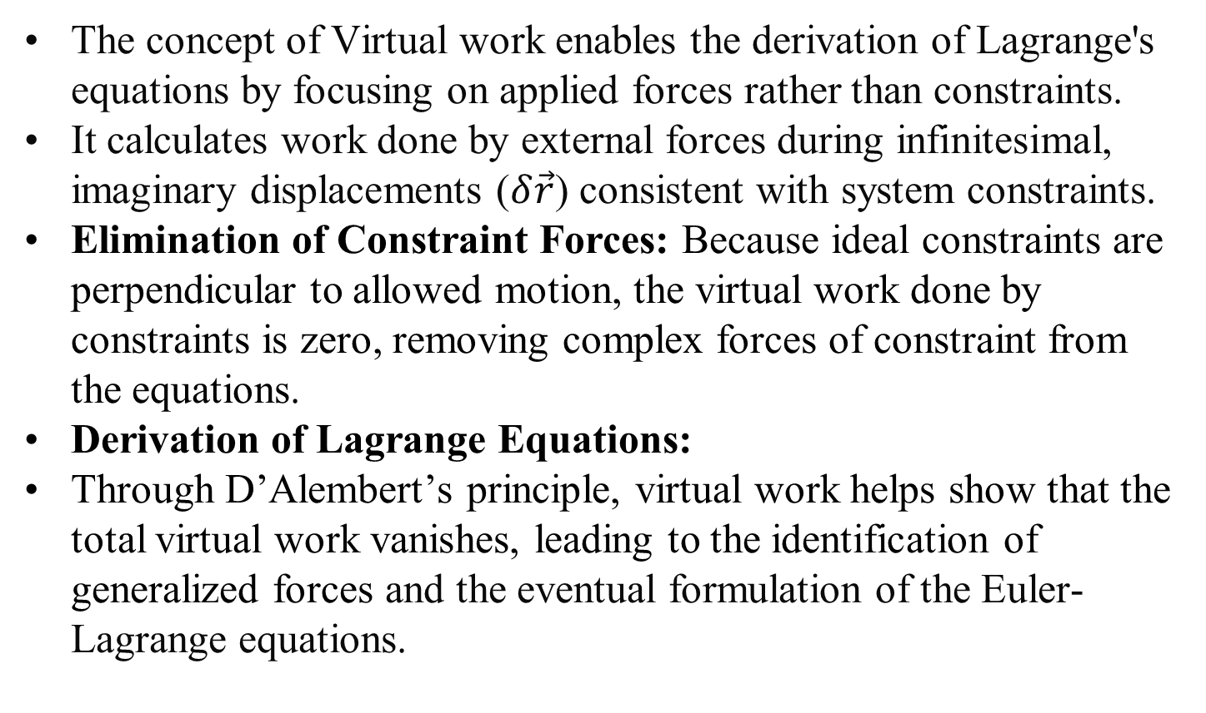
Virtual Work
The concept of Virtual work enables the derivation of Lagrange's equations by focusing on applied forces rather than constraints.
It calculates work done by external forces during infinitesimal, imaginary displacements ($δ\vec{r}$) consistent with system constraints.
Elimination of Constraint Forces: Because ideal constraints are perpendicular to allowed motion, the virtual work done by constraints is zero, removing complex forces of constraint from the equations.
Derivation of Lagrange Equations:
Through D’Alembert’s principle, virtual work helps show that the total virtual work vanishes, leading to the identification of generalized forces and the eventual formulation of the Euler-Lagrange equations.

Slide 6
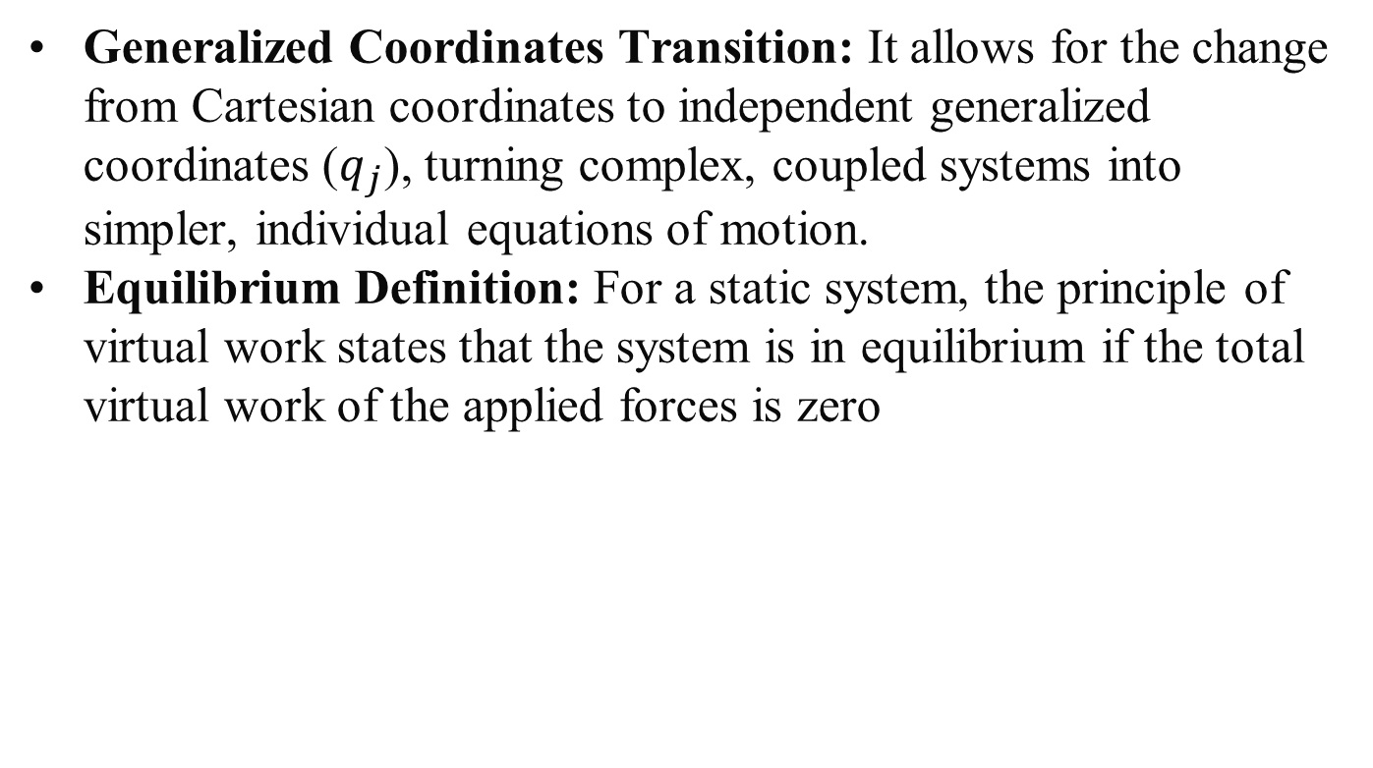
Virtual Work
Generalized Coordinates Transition: It allows for the change from Cartesian coordinates to independent generalized coordinates ($q_{j}$), turning complex, coupled systems into simpler, individual equations of motion.
Equilibrium Definition: For a static system, the principle of virtual work states that the system is in equilibrium if the total virtual work of the applied forces is zero

Slide 7
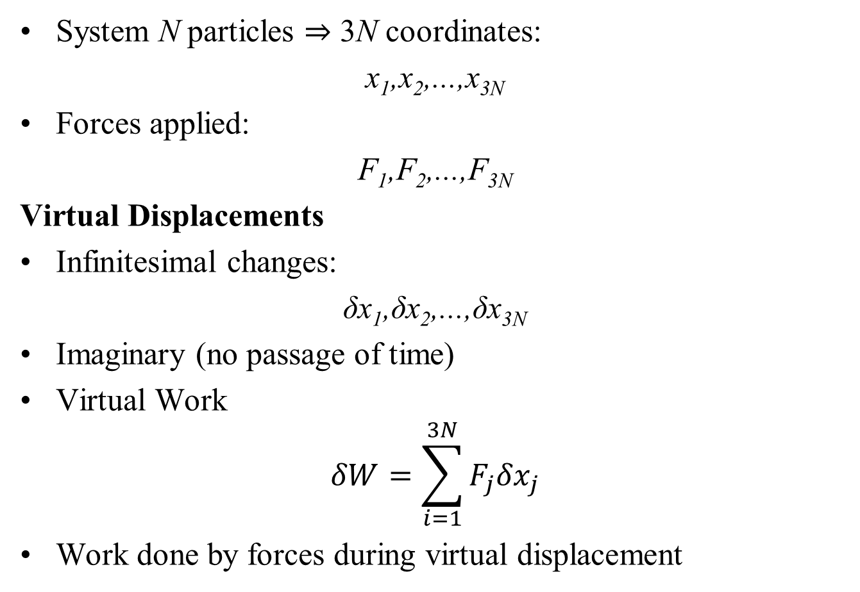
Virtual Displacements and Virtual Work
System N particles ⇒ 3N coordinates:
x₁,x₂,...,x_{3N}
Forces applied:
F₁,F₂,...,F_{3N}
Virtual Displacements
Infinitesimal changes:
δx₁,δx₂,...,δx_{3N}
Imaginary (no passage of time)
Virtual Work
$$δW=\sum_{i=1}^{3N}{F_{j}{δx}_{j}}$$
Work done by forces during virtual displacement

Slide 8
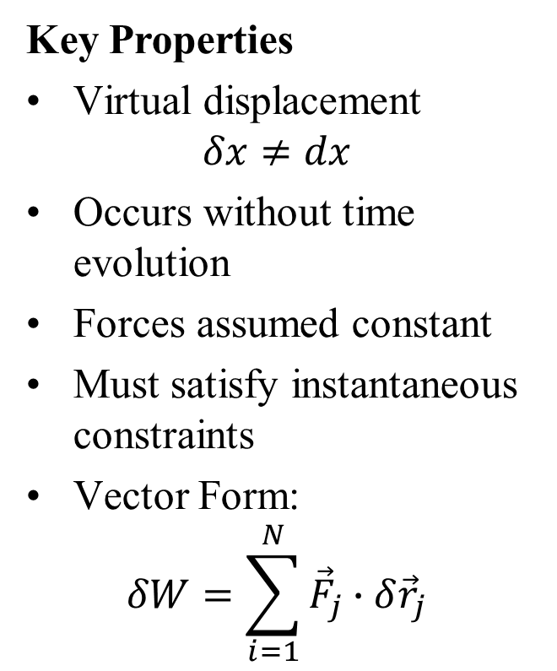
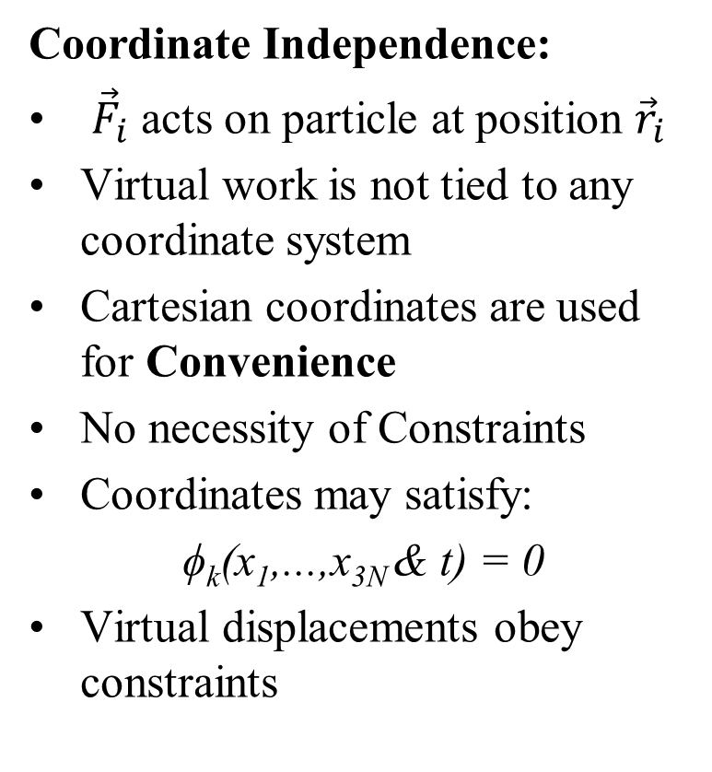
Interpretation of Virtual Work
Key Properties
Virtual displacement
$$δx≠dx$$
Occurs without time evolution
Forces assumed constant
Must satisfy instantaneous constraints
Vector Form:
$$δW=\sum_{i=1}^{N}{{\vec{F}}_{j}∙{δ\vec{r}}_{j}}$$
Coordinate Independence:
${\vec{F}}_{i}$ acts on particle at position ${\vec{r}}_{i}$
Virtual work is not tied to any coordinate system
Cartesian coordinates are used for Convenience
No necessity of Constraints
Coordinates may satisfy:
ϕ_{k}(x₁,...,x_{3N} & t) = 0
Virtual displacements obey constraints

Slide 9
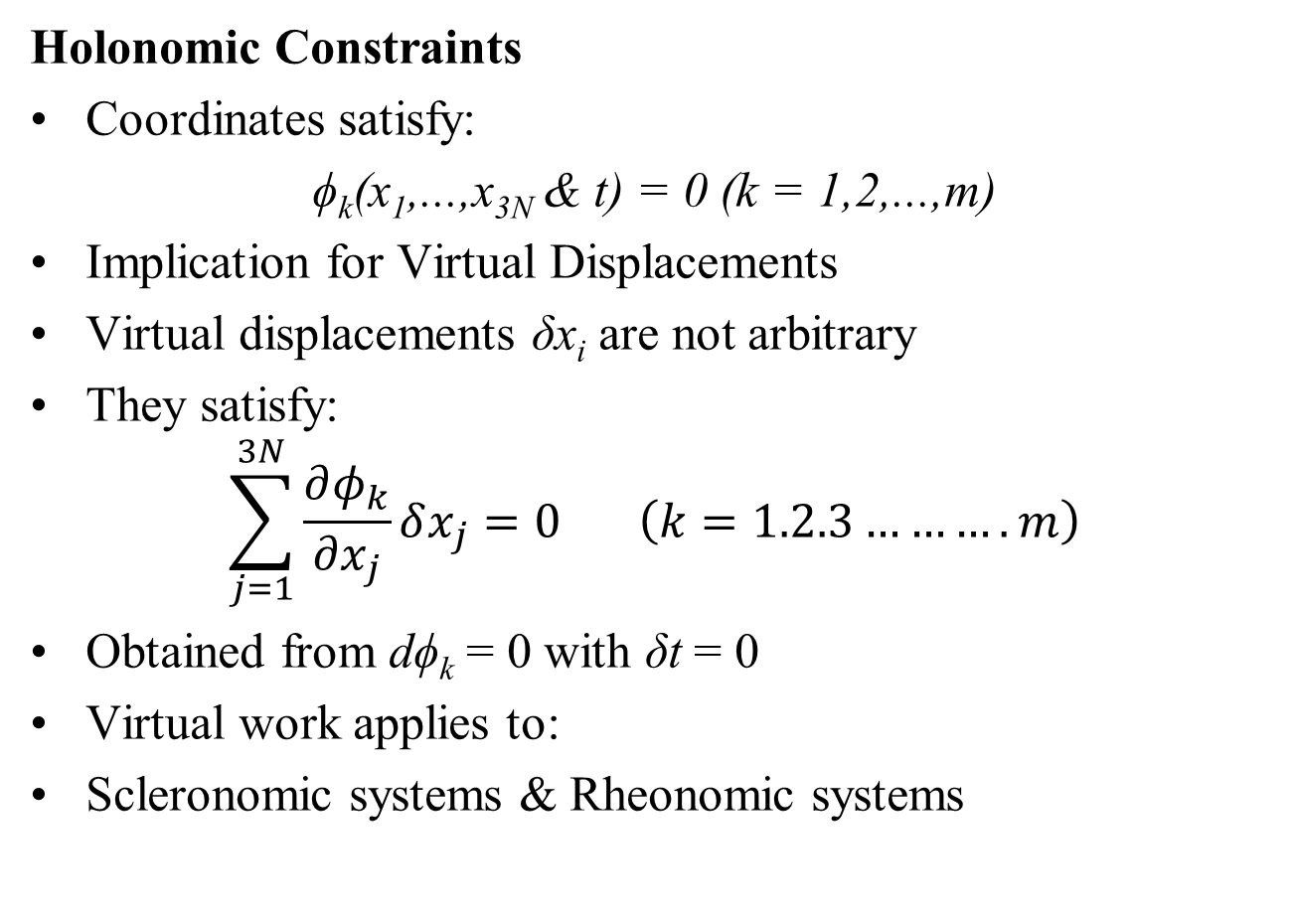
Virtual Displacements with Constraints
Holonomic Constraints
Coordinates satisfy:
ϕ_{k}(x₁,...,x_{3N} & t) = 0 (k = 1,2,...,m)
Implication for Virtual Displacements
Virtual displacements δx_{i} are not arbitrary
They satisfy:
$$\sum_{j=1}^{3N}{\frac{∂φ_{k}}{∂x_{j}}}δx_{j}=0 \left(k=1.2.3……….m\right)$$
Obtained from dϕ_{k} = 0 with δt = 0
Virtual work applies to:
Scleronomic systems & Rheonomic systems

Slide 10
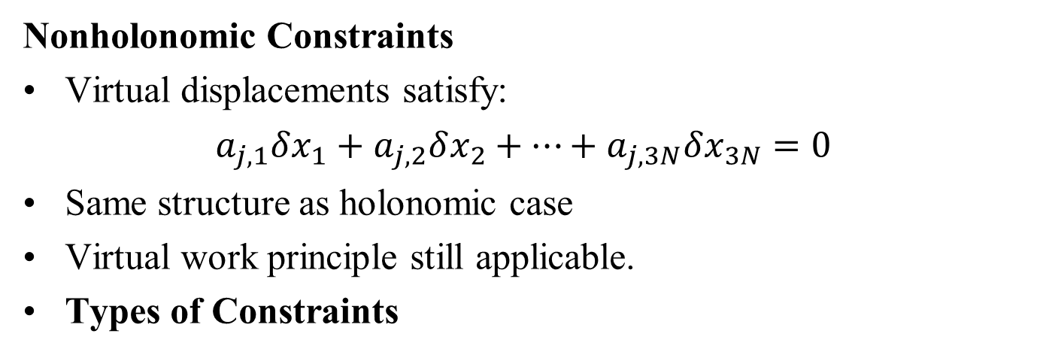
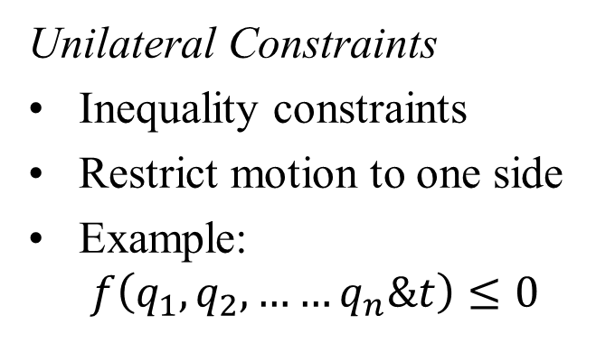
Constraints in Virtual Work
Nonholonomic Constraints
Virtual displacements satisfy:
$a_{j,1}δx_{1}+$ $a_{j,2}δx_{2}+…+a_{j,3N}δx_{3N}=0$
Same structure as holonomic case
Virtual work principle still applicable.
Types of Constraints
Bilateral Constraints
Equality constraints
Allow motion in both directions
Valid for virtual work formulation
Unilateral Constraints
Inequality constraints
Restrict motion to one side
Example:
$$f\left(q_{1},q_{2}, ……q_{n}\&t\right)≤0$$

Slide 11
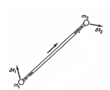
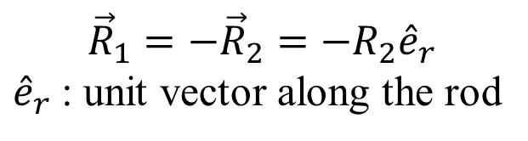



Forces Constraints and Virtual Work
Force Constraints
introduce additional forces
These forces enforce the constraint conditions
Denoted as: R_{i} (constraint force on particle i)
Example:
Two Particles with Rigid Rod
Forces along the rod are:
Equal and opposite Collinear
$${\hat{e}}_{r}$$
$${\vec{R}}_{2}$$
$${\vec{R}}_{1}$$
$${\vec{R}}_{1}=−{\vec{R}}_{2}=−R_{2}{\hat{e}}_{r}$$
${\hat{e}}_{r}$: unit vector along the rod

Slide 12
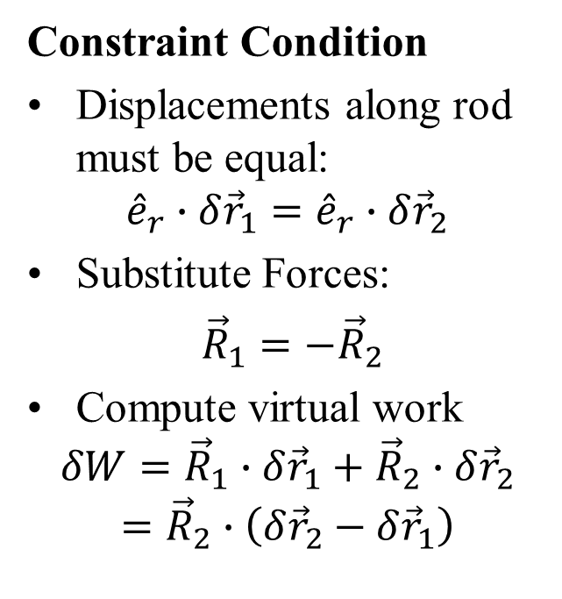
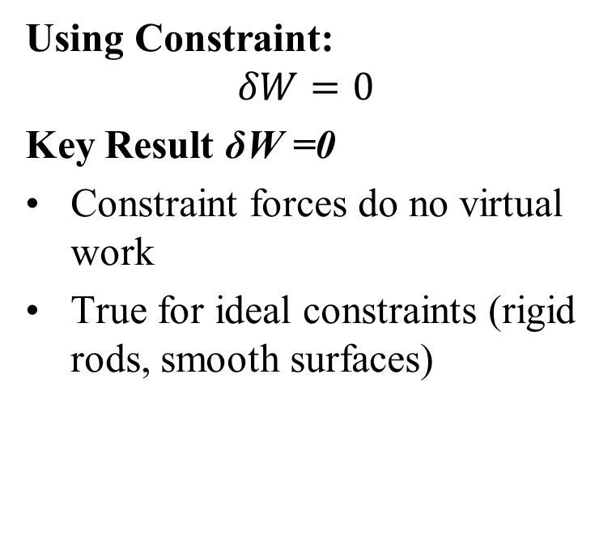
Virtual Work of Constraint Forces
Constraint Condition
Displacements along rod must be equal:
$${\hat{e}}_{r}∙δ{\vec{r}}_{1}={\hat{e}}_{r}∙δ{\vec{r}}_{2}$$
Substitute Forces:
${\vec{R}}_{1}=−{\vec{R}}_{2}$
Compute virtual work
$$δW={\vec{R}}_{1}∙δ{\vec{r}}_{1}+{\vec{R}}_{2}∙δ{\vec{r}}_{2}$$
$$={\vec{R}}_{2}∙\left(δ{\vec{r}}_{2}−δ{\vec{r}}_{1}\right)$$
Using Constraint:
$$δW=0$$
Key Result δW =0
Constraint forces do no virtual work
True for ideal constraints (rigid rods, smooth surfaces)

Slide 13
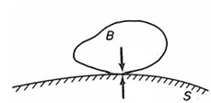
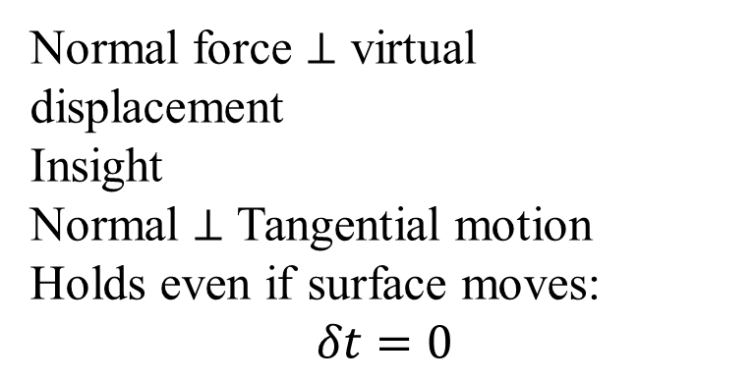
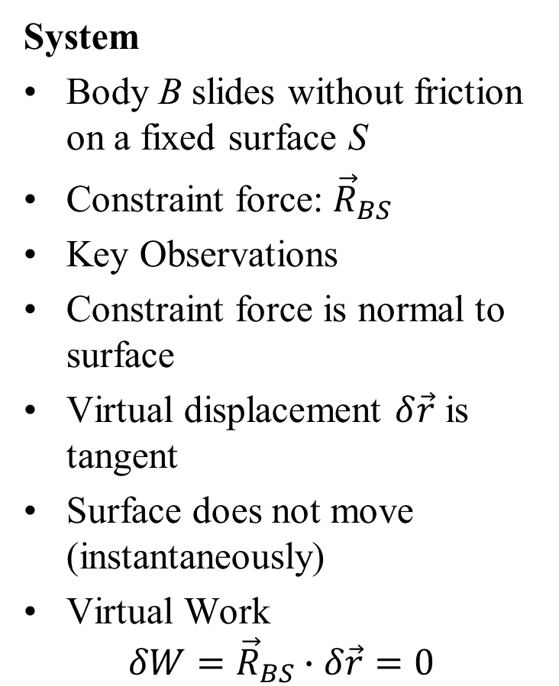


Constraint Forces: Smooth Surface
System
Body B slides without friction on a fixed surface S
Constraint force: ${\vec{R}}_{BS}$
Key Observations
Constraint force is normal to surface
Virtual displacement $δ\vec{r}$ is tangent
Surface does not move (instantaneously)
Virtual Work
$$δW={\vec{R}}_{BS}∙δ\vec{r}=0$$
$${\vec{R}}_{SB}$$
$${\vec{R}}_{BS}$$
Normal force ⊥ virtual displacement
Insight
Normal ⊥ Tangential motion
Holds even if surface moves:
$$δt=0$$

Slide 14
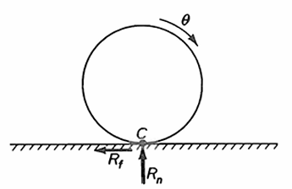
Constraint Forces: Rolling Disk
System
Disk rolling without slipping on a fixed surface
Contact point: C (instantaneous center)
Forces at Contact
Normal force: R_{n}
Friction force: R_{f}
Key Observation
Point C is instantaneously at rest
Constraint force acts through C
Contact point C (instantaneous rest)
Virtual Work
Work at C is negligible (higher order)
Symmetry ⇒ normal force does no work

Slide 15
Workless Constraints
Key Observation
For many systems:
δW_{constraint} = 0
These are called workless constraints
Definition
A workless constraint is a scleronomic constraint such that:
δW =0 for all reversible virtual displacements
Requirements
Constraint must be scleronomic
Virtual displacement must be reversible
Important Note
Rheonomic constraints (moving constraints)
May do work in real motion
But treated as fixed in virtual

Slide 16
Physical Insight: Workless Constraints
Important
Subtlety Constraint forces may do work on individual particles
But net work on system: =0
Key Insight
Workless constraints:
Do not contribute to virtual work
Simplify equations of motion
Example
Rolling disk:
  Particle speeds change
  Kinetic energy changes
Energy transfer via constraint forces
Importance
Useful in:
  Static equilibrium
  Lagrangian mechanics
Avoid explicit calculation of constraint forces

Slide 17
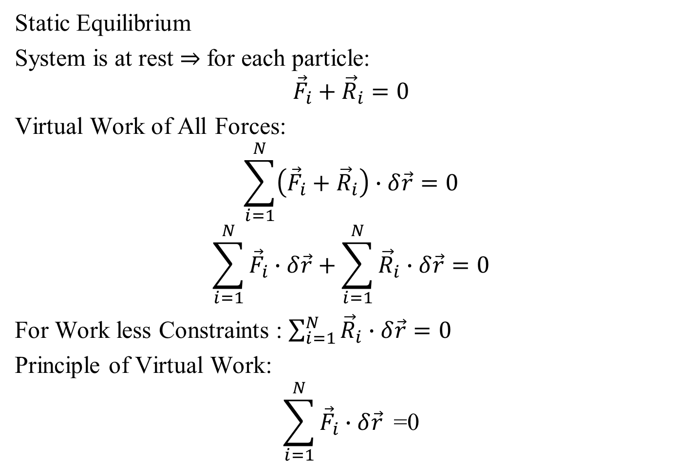
Principle of Virtual Work
Static Equilibrium
System is at rest ⇒ for each particle:
$${\vec{F}}_{i}+{\vec{R}}_{i}=0$$
Virtual Work of All Forces:
$$\sum_{i=1}^{N}{\left({\vec{F}}_{i}+{\vec{R}}_{i}\right)∙δ\vec{r}}=0$$
$$\sum_{i=1}^{N}{{\vec{F}}_{i}∙δ\vec{r}}+\sum_{i=1}^{N}{{\vec{R}}_{i}∙δ\vec{r}}=0$$
For Work less Constraints : $\sum_{i=1}^{N}{{\vec{R}}_{i}∙δ\vec{r}}=0$
Principle of Virtual Work:
$$\sum_{i=1}^{N}{{\vec{F}}_{i}∙δ\vec{r}}\text{ =0}$$

Slide 18
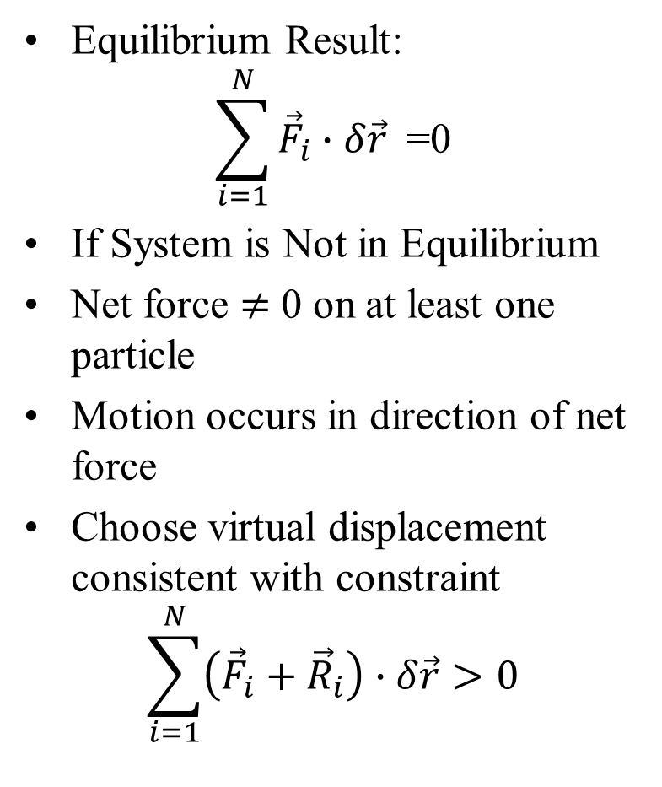
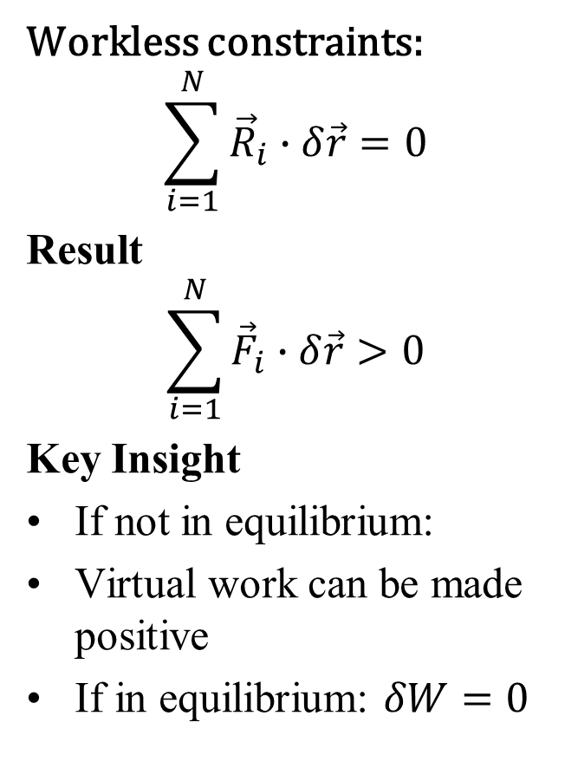
Virtual Work: Beyond Equilibrium
Equilibrium Result:
$$\sum_{i=1}^{N}{{\vec{F}}_{i}∙δ\vec{r}}\text{ =0}$$
If System is Not in Equilibrium
Net force $≠$ 0 on at least one particle
Motion occurs in direction of net force
Choose virtual displacement consistent with constraint
$$\sum_{i=1}^{N}{\left({\vec{F}}_{i}+{\vec{R}}_{i}\right)∙δ\vec{r}}>0$$
Workless constraints:
$$\sum_{i=1}^{N}{{\vec{R}}_{i}∙δ\vec{r}}=0$$
Result
$$\sum_{i=1}^{N}{{\vec{F}}_{i}∙δ\vec{r}}>0$$
Key Insight
If not in equilibrium:
Virtual work can be made positive
If in equilibrium: $δW=0$

Slide 19
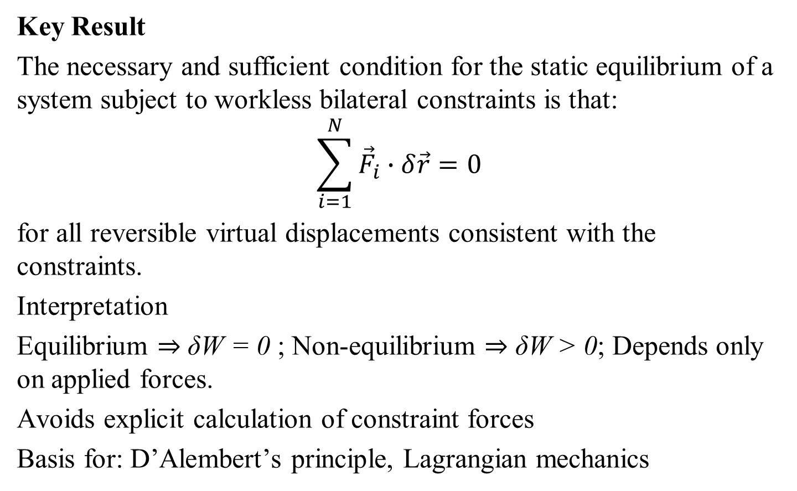
Principle of Virtual Work for Equilibrium
Key Result
The necessary and sufficient condition for the static equilibrium of a system subject to workless bilateral constraints is that:
$$\sum_{i=1}^{N}{{\vec{F}}_{i}∙δ\vec{r}}=0$$
for all reversible virtual displacements consistent with the constraints.
Interpretation
Equilibrium ⇒ δW = 0 ; Non-equilibrium ⇒ δW > 0; Depends only on applied forces.
Avoids explicit calculation of constraint forces
Basis for: D’Alembert’s principle, Lagrangian mechanics

Slide 20
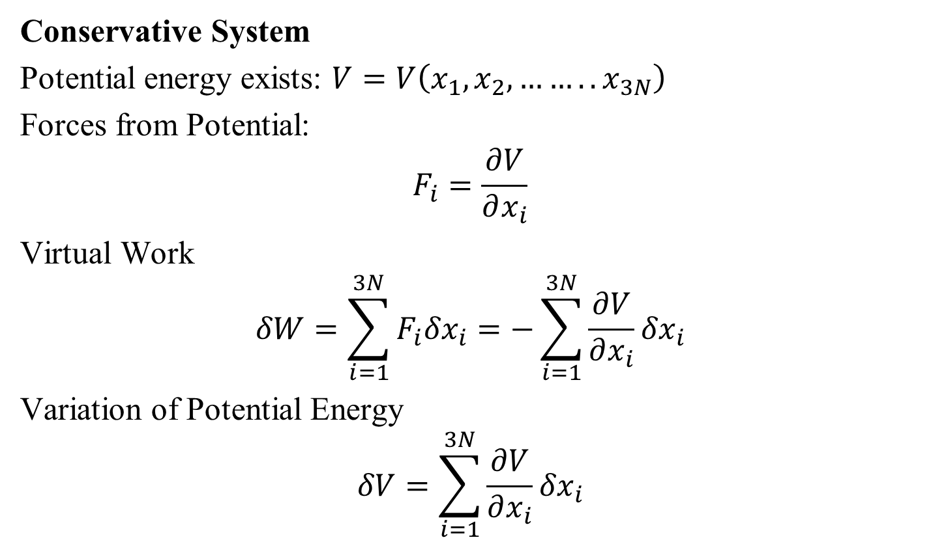
Conservative Forces and Virtual Work
Conservative System
Potential energy exists: $V=V\left(x_{1},x_{2}, ……..x_{3N}\right)$
Forces from Potential:
$$F_{i}=\frac{∂V}{∂x_{i}}$$
Virtual Work
$$δW=\sum_{i=1}^{3N}{F_{i}{δx}_{i}}=−\sum_{i=1}^{3N}{\frac{∂V}{∂x_{i}}}{δx}_{i}$$
Variation of Potential Energy
$$δV=\sum_{i=1}^{3N}{\frac{∂V}{∂x_{i}}}{δx}_{i}$$

Slide 21
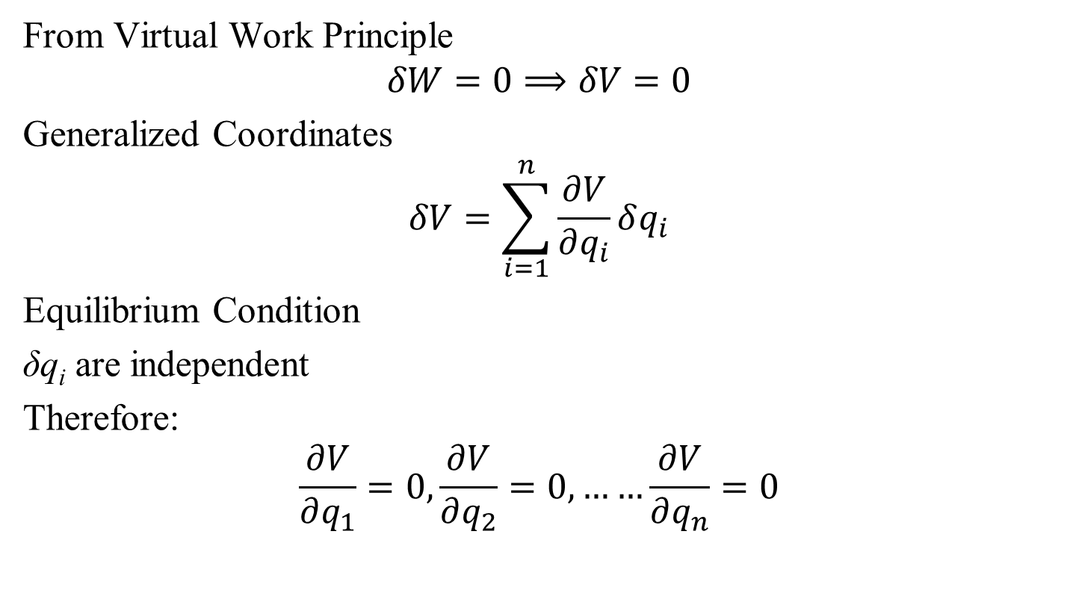
Equilibrium via Potential Energy
From Virtual Work Principle
$$δW=0⟹δV=0$$
Generalized Coordinates
$$δV=\sum_{i=1}^{n}{\frac{∂V}{∂q_{i}}δq_{i}}$$
Equilibrium Condition
δq_{i} are independent
Therefore:
$$\frac{∂V}{∂q_{1}}=0,\frac{∂V}{∂q_{2}}=0, ……\frac{∂V}{∂q_{n}}=0$$

Slide 22
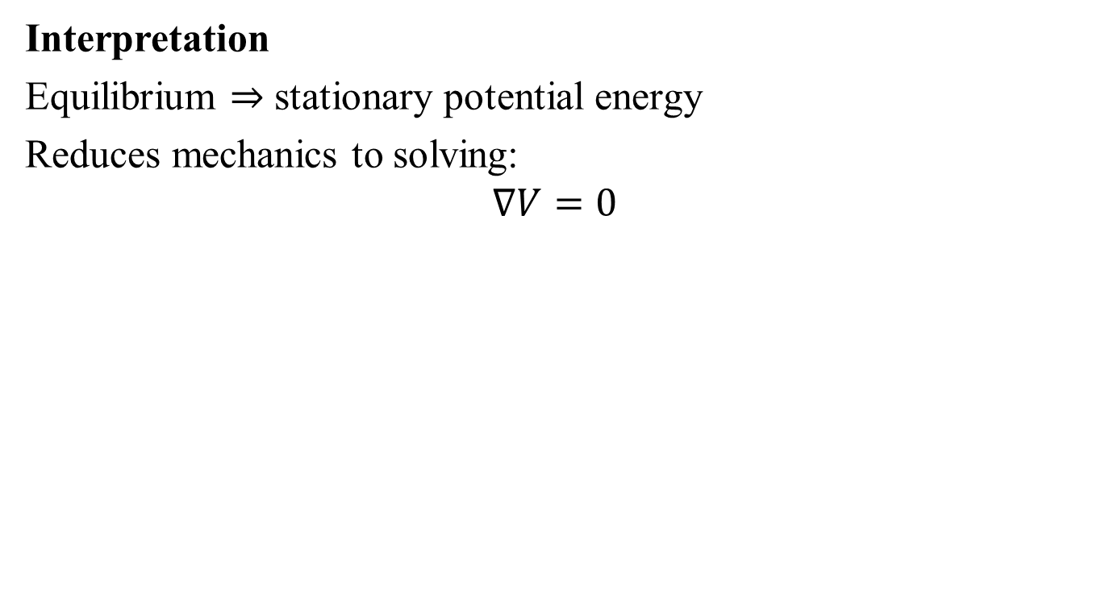
Equilibrium via Potential Energy
Interpretation
Equilibrium ⇒ stationary potential energy
Reduces mechanics to solving:
$$∇V=0$$

Slide 23
How to Guarantee that Virtual Concepts are Reliable??

Slide 24
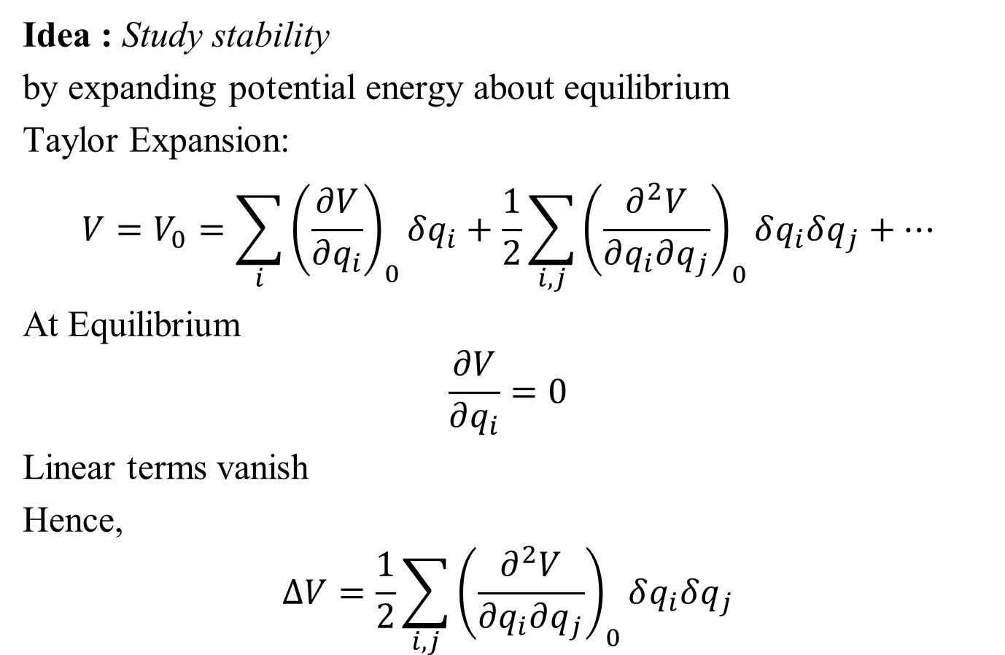
Stability of Equilibrium
Idea : Study stability
by expanding potential energy about equilibrium
Taylor Expansion:
$$V=V_{0}=\sum_{i}{{\left(\frac{∂V}{∂q_{i}}\right)}_{0}δq_{i}}+\frac{1}{2}\sum_{i,j}{{\left(\frac{∂^{2}V}{∂q_{i}∂q_{j}}\right)}_{0}δq_{i}δq_{j}}+…$$
At Equilibrium
$$\frac{∂V}{∂q_{i}}=0$$
Linear terms vanish
Hence,
$$∆V=\frac{1}{2}\sum_{i,j}{{\left(\frac{∂^{2}V}{∂q_{i}∂q_{j}}\right)}_{0}δq_{i}δq_{j}}$$

Slide 25
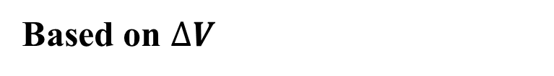
Stability Criteria
Based on $∆V$
Stable Equilibrium
∆V > 0 for all δq_{i}
Potential has a minimum
Unstable Equilibrium
∆V < 0 for some displacement
System moves away
Neutral Equilibrium
∆V = 0 for some directions
Flat potential region
Energy View
Total energy conserved: ∆V +∆T =0
Motion depends on shape of V

