Slide 1


Fundamental Principles of Force Vector System
P M V Subbarao
Professor & Head
Mechanical Engineering Department
Force Systems: The Rules that Rule the Mechanical World ……..

Slide 2

Classification of Force Vectors in Mechanics
Mathematically,
A General vector has direction, magnitude but no location
Two vectors are equal if (if and only if) they have same magnitude and direction.
However, two mathematically equal vectors may produce or be the resultant of different physical effects
Example: Two equal parallel forces when applied in turn to a given rigid body would produce same linear acceleration of its CoM, but may result in different angular accelerations
Vectors in mechanics (physically) can be classified as:
Free Vector
Localized Vector (Sliding Vector as special case)
Bound Vector (Also called Fixed Vector)

Slide 3
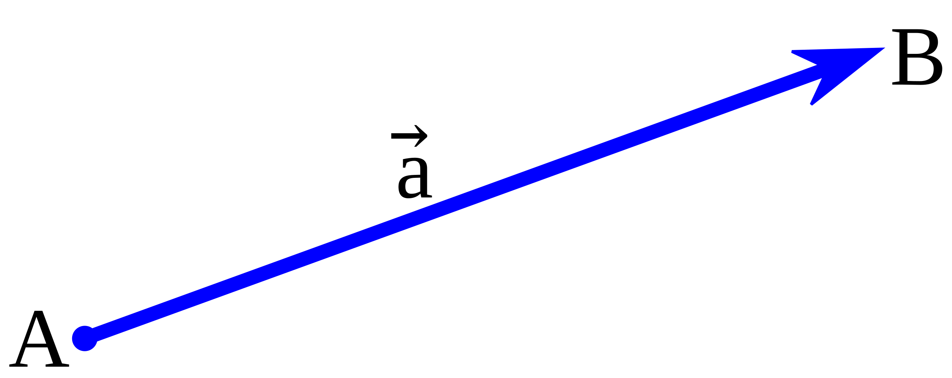

Free Force Vector
A Force vector having no specified location or point of application is known as a Free Vector
The initial point of a free vector can be chosen at convenience.
Free vector is tied neither to a specific point of application nor to a particular line of action
$$\vec{F}$$

Slide 4
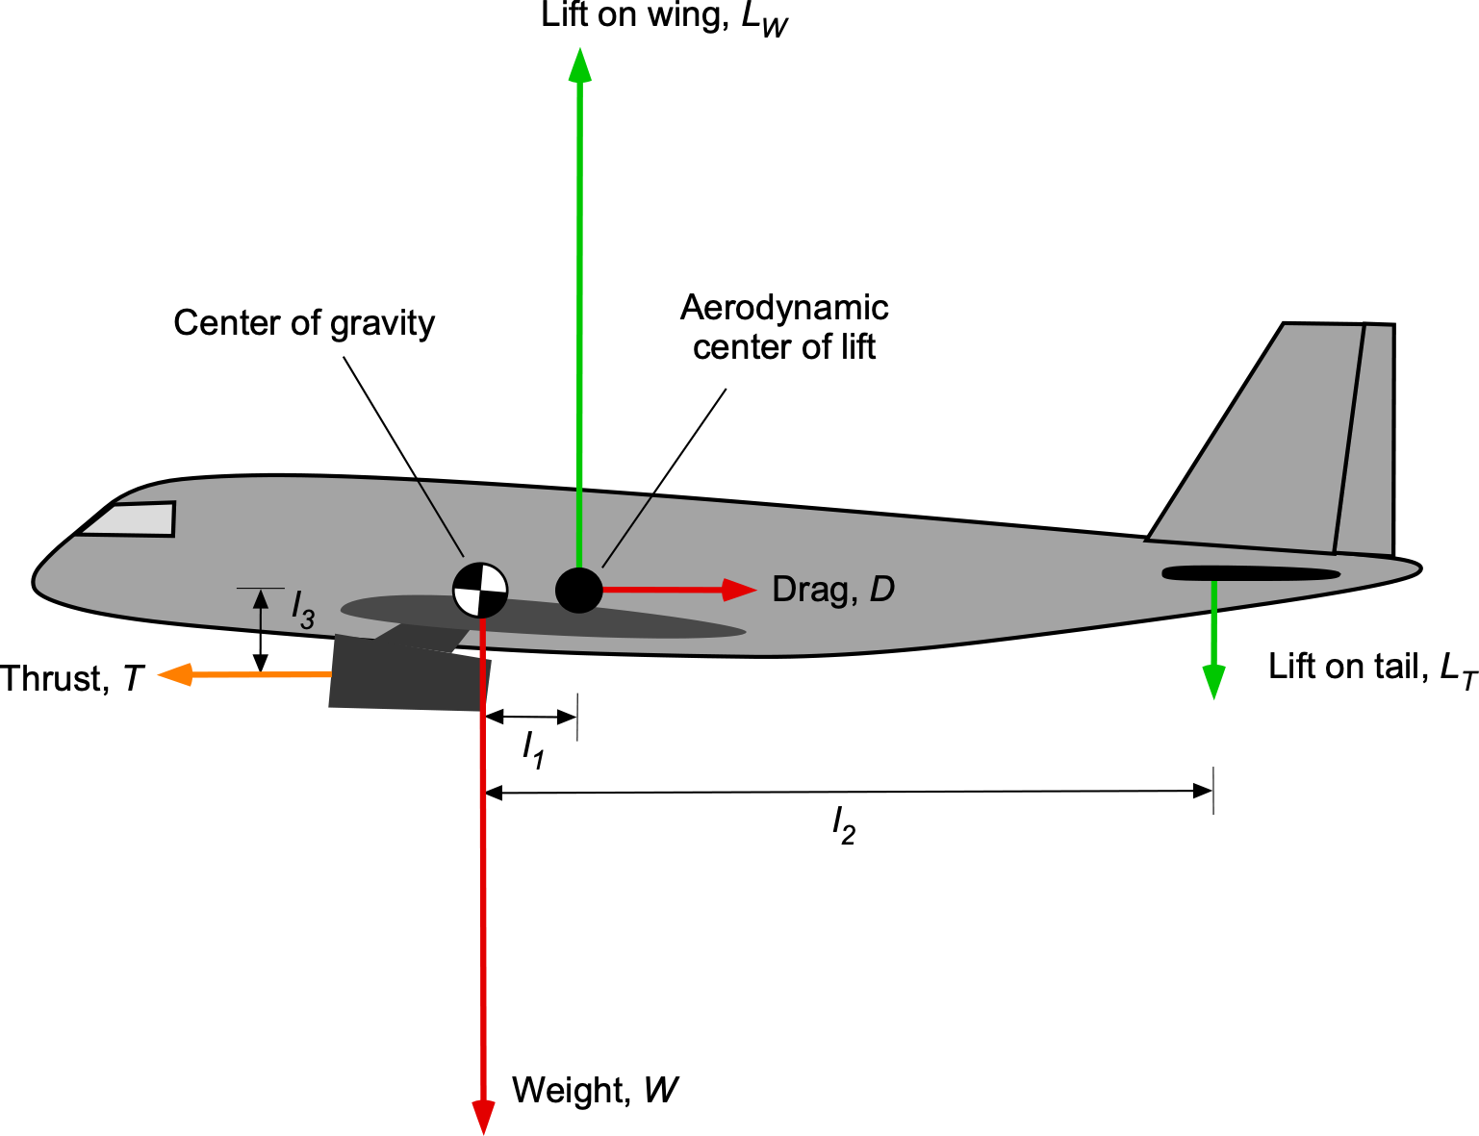
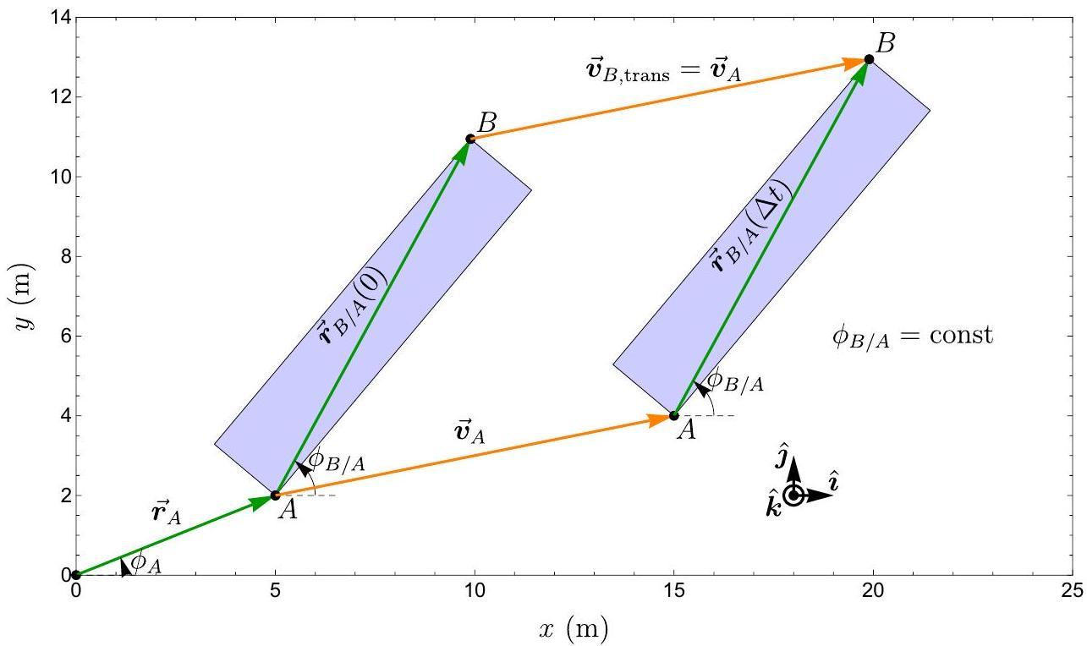
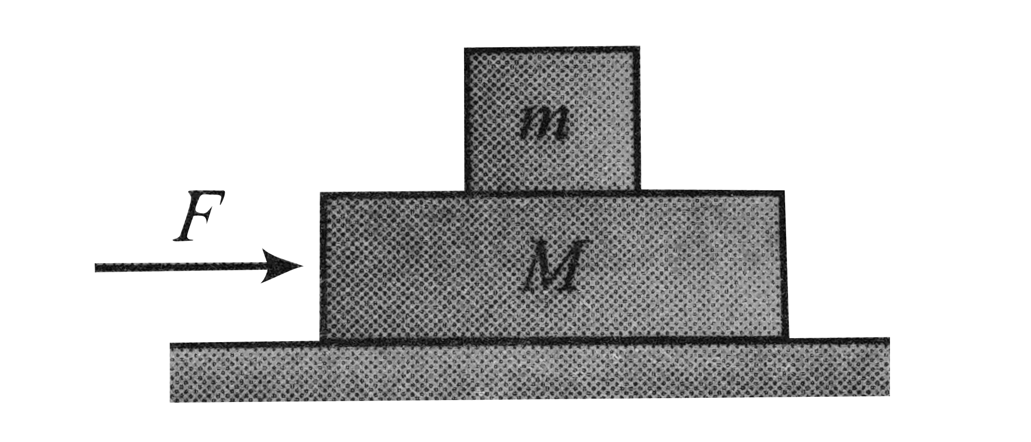

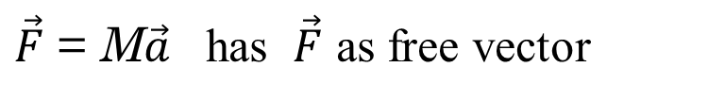
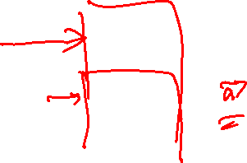
Free Vector
Velocity and Acceleration vectors of a rigid body in translation
All particles have same motion characteristics
Force acting on a body, considering only translation effect.
$\vec{F}$
$\vec{F}$ = M$\vec{a}$ has $\vec{F}$ as free vector

Slide 5
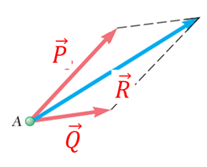
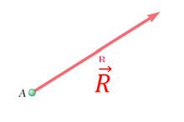
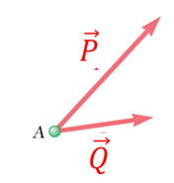
Fundamental principles of Free Vectors
Elementary Mechanics is built on six fundamental principles:
First Principle: The Parallelogram Law for the Addition of Forces.
This states that two forces acting on a particle may be replaced by a single force, called their resultant , obtained by drawing the diagonal of the parallelogram which has sides equal to the given forces.

Slide 6

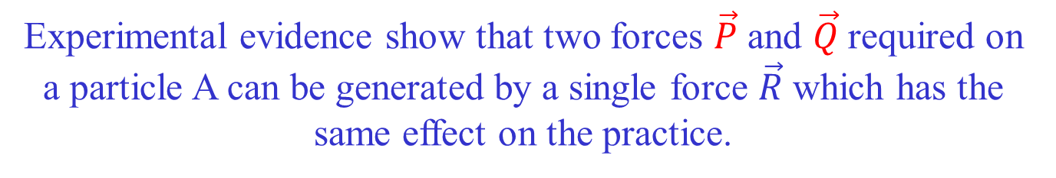
Fundamental principles of Free Force Vectors
First Principle: The Parallelogram Law for the Addition of Forces.
Experimental evidence show that two forces $\vec{P}$ and $\vec{Q}$required on a particle A can be generated by a single force $\vec{R}$ which has the same effect on the practice.

Slide 7
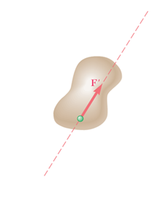
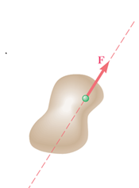

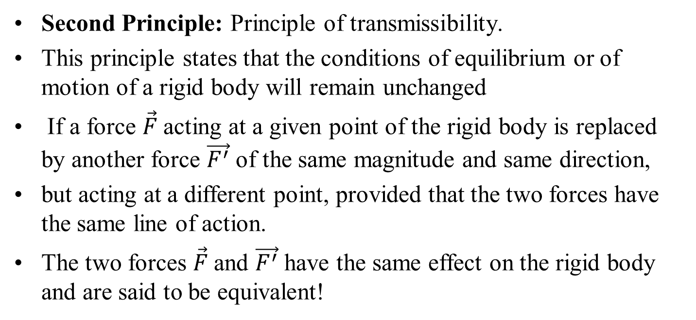

Fundamental principles of Free Force Vectors
Second Principle: Principle of transmissibility.
This principle states that the conditions of equilibrium or of motion of a rigid body will remain unchanged
If a force $\vec{F}$acting at a given point of the rigid body is replaced by another force $\vec{F^{′}}$ of the same magnitude and same direction,
but acting at a different point, provided that the two forces have the same line of action.
The two forces $\vec{F}$and $\vec{F^{′}}$ have the same effect on the rigid body and are said to be equivalent!
$$\vec{F}$$
$\vec{F^{′}}$

Slide 8
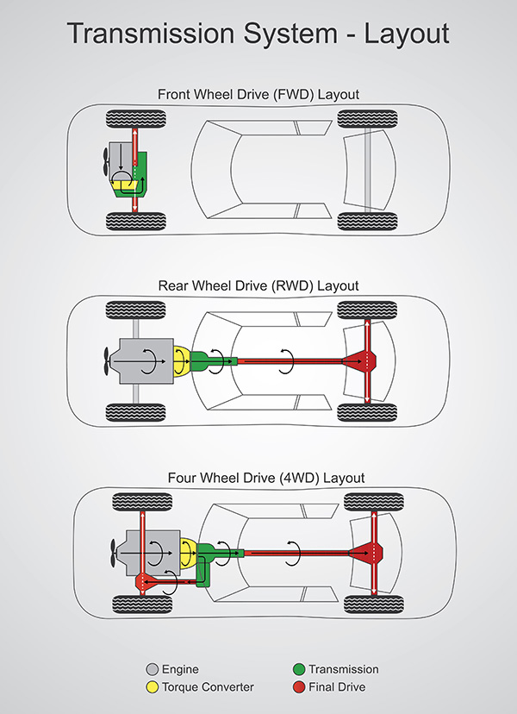
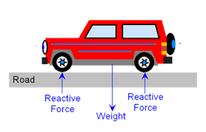


Experimental Evidence for Transmissibility
$$\vec{F}$$
$\vec{F^{′}}$

Slide 9
Next Three Furndamental Principles
Can You Guess ???

Slide 10
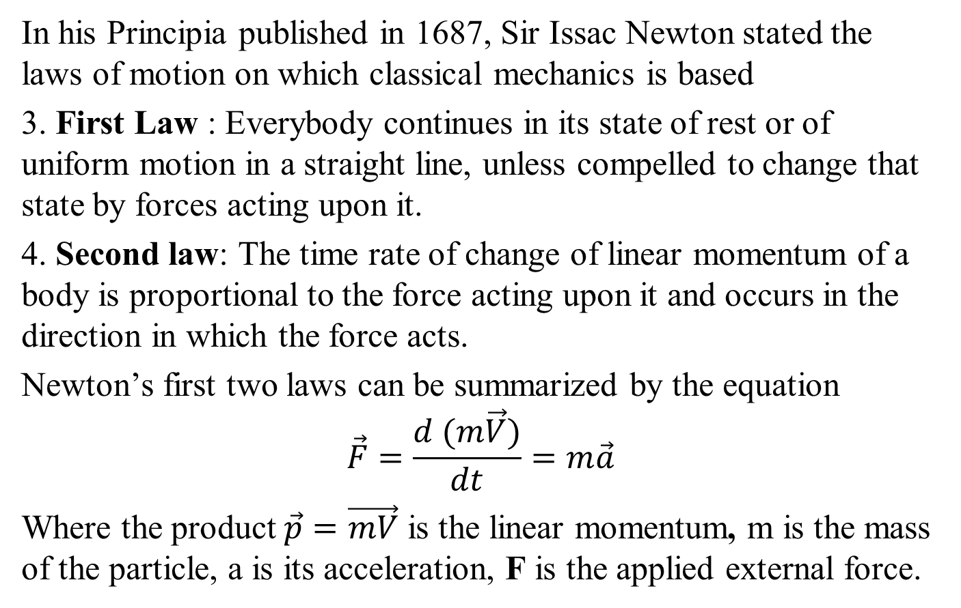
Newton’s Three Fundamental Force Laws
In his Principia published in 1687, Sir Issac Newton stated the laws of motion on which classical mechanics is based
3. First Law : Everybody continues in its state of rest or of uniform motion in a straight line, unless compelled to change that state by forces acting upon it.
4. Second law: The time rate of change of linear momentum of a body is proportional to the force acting upon it and occurs in the direction in which the force acts.
Newton’s first two laws can be summarized by the equation
$$\vec{F}=\frac{d (m\vec{V})}{dt}=m\vec{a}$$
Where the product $\vec{p}=\vec{mV}$ is the linear momentum, m is the mass of the particle, a is its acceleration, F is the applied external force.

Slide 11
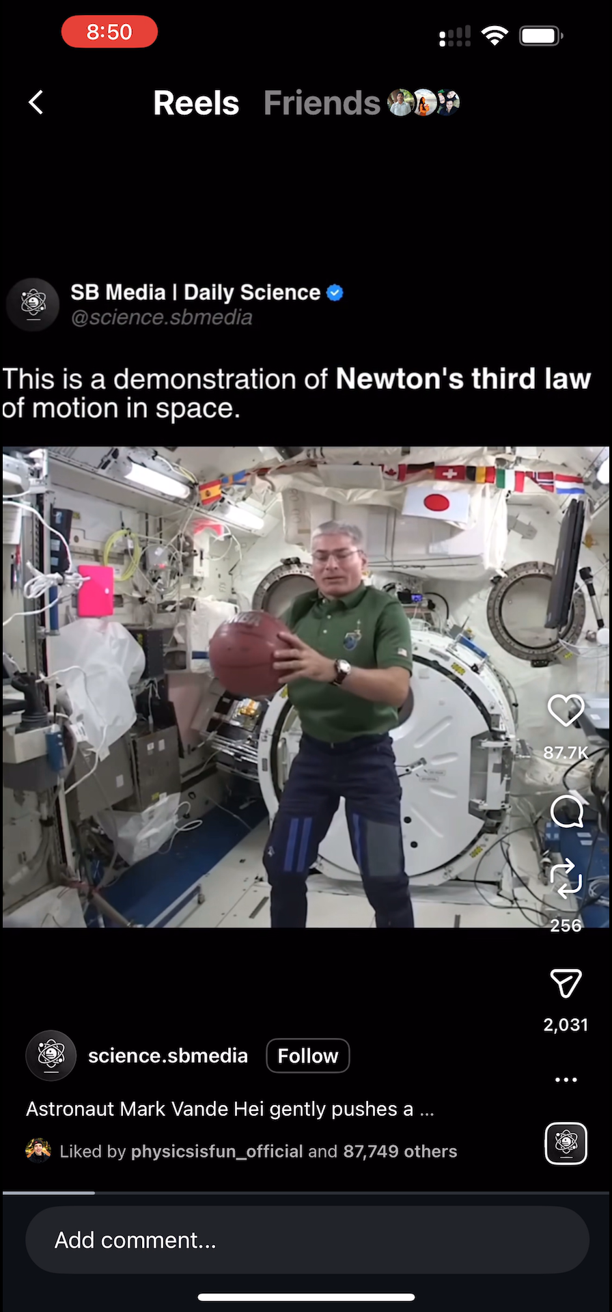
Newton’s Third Law
5. To every action there is an equal and opposite reaction, that is the mutual forces of two bodies acting upon each other are equal in magnitude and opposite in direction.

Slide 12
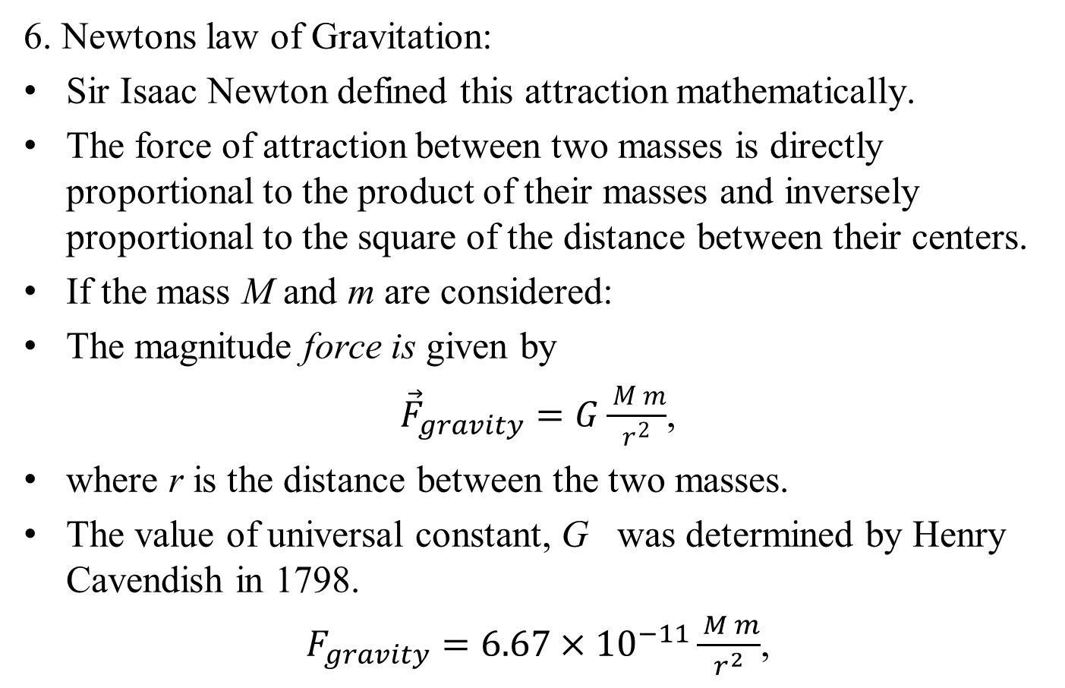
Sixth Fundamental principle of Free Force Vectors
6. Newtons law of Gravitation:
Sir Isaac Newton defined this attraction mathematically.
The force of attraction between two masses is directly proportional to the product of their masses and inversely proportional to the square of the distance between their centers.
If the mass M and m are considered:
The magnitude force is given by
${\vec{F}}_{gravity}=G\frac{ M m}{r^{2}}$,
where r is the distance between the two masses.
The value of universal constant, G was determined by Henry Cavendish in 1798.
$F_{gravity}=6.67×{10}^{−11}\frac{ M m}{r^{2}}$,

Slide 13
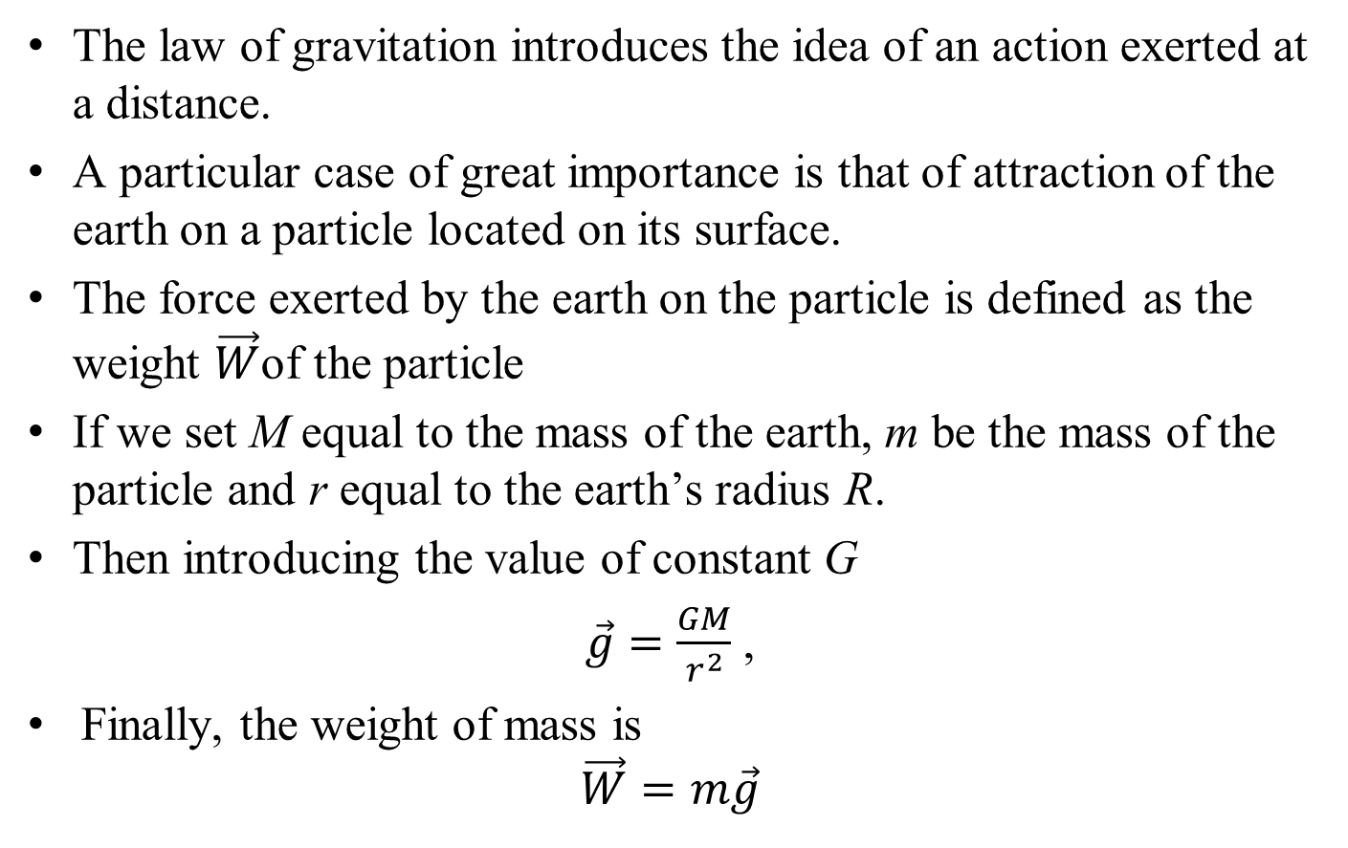
The Weight of A Mass
The law of gravitation introduces the idea of an action exerted at a distance.
A particular case of great importance is that of attraction of the earth on a particle located on its surface.
The force exerted by the earth on the particle is defined as the weight $\vec{W}$of the particle
If we set M equal to the mass of the earth, m be the mass of the particle and r equal to the earth’s radius R.
Then introducing the value of constant G
$\vec{g}=\frac{GM}{r^{2}}$ ,
Finally, the weight of mass is
$$\vec{W}=m\vec{g}$$

Slide 14
Classification of Force Vectors in Mechanics
Vectors in mechanics (physically) can be classified as:
Free Vector
Localized Vector (Sliding Vector as special case)
Bound Vector (Also called Fixed Vector)

Slide 15
Localized Vector
If the initial point of a vector is restricted to a certain set of points, the vector is said to be localized in this set
Localized Vector is independent of precise point of application in this set.
Sliding Vector (also called Line Vector) is a special case of Localized Vector
If the initial point of a vector is restricted to a line, the vector is said to be a Sliding Vector
  Such a line is called Line of Action
A sliding vector is tied only to a specific line of action

Slide 16
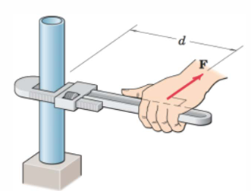
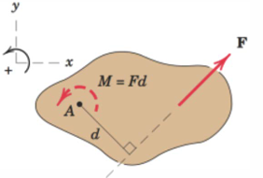
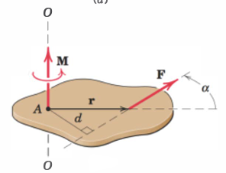
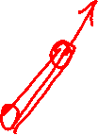
Examples of Localized Vector
When an effect of force on rotational motion of rigid body is considered,
not only direction and magnitude, but also its line of action is important
Example of A Sliding Vector

Slide 17
Examples of Localized Vector
Collinear particles of a rigid body have same velocity component in the direction of line containing them
  Velocity component is a sliding vector
Is Angular Velocity of a rigid body, a free or sliding vector ? (Think!)

Slide 18
Bound Vector
If the initial point of a vector is fixed, then such a vector is called a Bound Vector or Fixed Vector
Bound Vector is tied to a particular point of application
Magnitude, Direction, Point of Application is specified for bound vector.

Slide 19
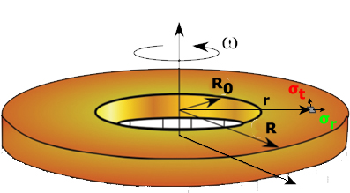
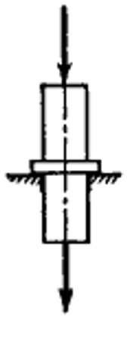


Examples of Bound Vector
Force acting on an elastic body
Elastic deformation dependent upon exact location of force along its line of action.
$$\vec{F}$$
Location of axis of rotation will determine the centrifugal stresses in a disc
$\vec{F^{′}}$

Slide 20
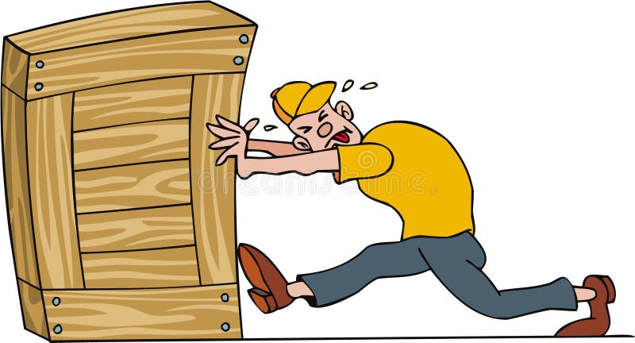
Force Acting on Body
It is a Free Vector, When ?
It is a Sliding Vector, When?
It is a Bound Vector, When?

