Slide 1



Introduction to Lagrangian Mechanics
P M V Subbarao
Professor & Head
Mechanical Engineering Department
Nature's path of least action…..

Slide 2

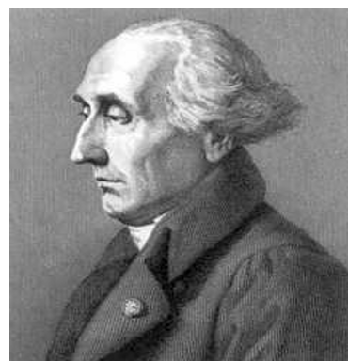
Lagrange as a Historian of Mechanics
Lagrange studied specific problems in mechanics:
The three-body problem related to motion of the earth, sun and moon.
By means of his Analytical Mechanics, he transformed Newtonian mechanics (Newton, 1952) into a branch of analysis, Lagrangian mechanics.
As a part of analytical mechanics, Lagrange created variational calculus and applied to mechanics.
Through this work, rational mechanics was able to fulfill the long desired Cartesian aim of becoming a branch of pure mathematics

Slide 3
Motivation for Lagrangian Mechanics
Classical mechanics often uses Newton’s laws to describe motion.
Given the motion of particles, forces can be determined, and vice versa.
Direct application of Newton’s laws becomes difficult for complex systems.
Equations are vectorial in nature.
Forces and accelerations may be hard to determine.
Constraint forces are especially challenging.
Each problem may require special insight, with no general procedure.

Slide 4
Motivation for Lagrangian Mechanics
Lagrangian mechanics provides:
A more systematic approach
A way to handle constraints efficiently
Equations of motion in a standard, convenient form

Slide 5
Power of Lagranginan Formulation
Scalar vs. Vector Analysis:
Unlike Newtonian mechanics, which requires accounting for all force vectors, the Lagrangian approach uses scalar quantities (kinetic energy and potential energy).
Generalized Coordinates:
One can choose the most convenient coordinates (e.g., angles, distances) for a system, rather than being restricted to Cartesian/cylindrical/spherical coordinates.
Elimination of Constraint Forces:
The method naturally ignores forces of constraint (like reaction forces or tension), reducing the number of equations needed.
Coordinate Invariance:
The equations of motion maintain their form in any coordinate system.

Slide 6
Power of Lagranginan Formulation
Deep Theoretical Insights:
LF directly relates symmetries (e.g., rotation, translation) to conservation laws (e.g., angular momentum, linear momentum) through Noether's theorem.
Broad Applicability:
LF is equally effective for classical mechanics, electromagnetism, general relativity, and quantum field theory.
LF is particularly powerful for complex mechanical systems, robotics (e.g., solving multi-jointed arms), and problems where system symmetry is important.

Slide 7
How to find Number & Type of Lgrangian Coordinates Required to describe a System??

Slide 8
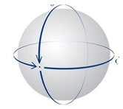
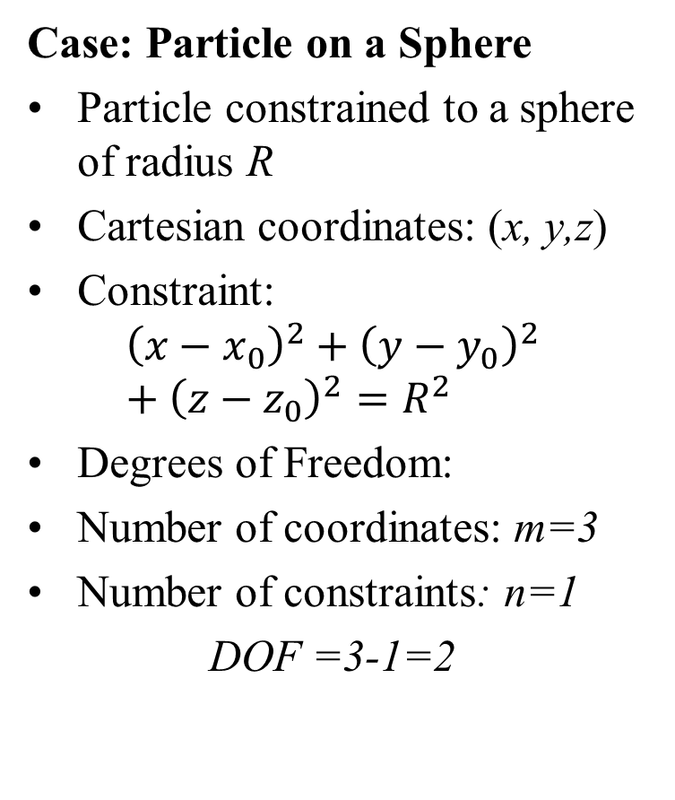
Degrees of Freedom of A System
Case: Particle on a Sphere
Particle constrained to a sphere of radius R
Cartesian coordinates: (x, y,z)
Constraint:
$${\left(x−x_{0}\right)}^{2}+{\left(y−y_{0}\right)}^{2}+{\left(z−z_{0}\right)}^{2}=R^{2}$$
Degrees of Freedom:
Number of coordinates: m=3
Number of constraints: n=1
DOF =3-1=2
Using Spherical Coordinates:
Choose origin at center of sphere
Use (r,θ,ϕ)
Constraint implies: r =R
Hence r is not a variable
Conclusion
θ, ϕ are independent
They automatically satisfy the constraint
Represent the two degrees of freedom

Slide 9
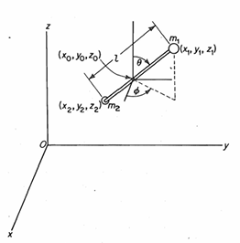
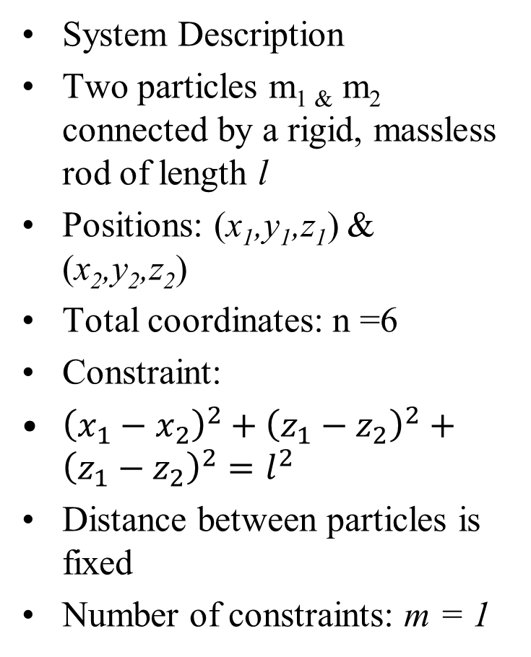
Two-Particle System with Constraint
System Description
Two particles m_{1 &} m₂ connected by a rigid, massless rod of length l
Positions: (x₁,y₁,z₁) & (x₂,y₂,z₂)
Total coordinates: n =6
Constraint:
${\left(x_{1}−x_{2}\right)}^{2}+{\left(z_{1}−z_{2}\right)}^{2}+{\left(z_{1}−z_{2}\right)}^{2}=l^{2}$
Distance between particles is fixed
Number of constraints: m = 1
Degrees of Freedom:
DOF = n−m = 6−1 = 5

Slide 10
Description of Least Action
Alternative Coordinates Describe system using:
Position of a point on rod (e.g., center of mass):
(x₀,y₀,z₀)
Orientation using spherical angles: (θ, ϕ)
Total coordinates: 3 + 2 = 5
No constraints needed in this description
Important Insight
Degrees of freedom depend on the system, not the coordinates
Choice of coordinates may change:
Number of coordinates n
Number of constraints m
But:
n − m = constant
For this system: DOF = 5
Conclusion
Different coordinate choices → same physics
Proper coordinates can eliminate constraints

Slide 11
Generalized Coordinates
Key Idea:
A system configuration can be described using different coordinate sets
No unique coordinate system is required
Infinite possible choices of coordinates
Relation
No. of coordinates = DOF + constraints
Example:
N Particles Cartesian coordinates:
3N coordinates
Alternative: spherical coordinates
Both describe same system configuration

Slide 12
Generalized Coordinates
Coordinate Transformation
Conversion between coordinate sets:
(x,y,z) ↔ (r,θ,ϕ)
Same system → different representations
Transformation preserves physics
Generalized Coordinates
Any set of variables that specifies configuration
Not necessarily geometric
Denoted: q₁,q₂,...,q_{n}
Vary with time: q_{i} = q_{i}(t)

Slide 13
Independent Generalized Coordinates
Independent Coordinates
Choose coordinates that are independent
Automatically satisfy constraints
Number of generalized coordinates:
= Degrees of Freedom
Constraint equations are not necessary.
Advantage
Simplifies system description
Reduces complexity
Eliminates redundant variables
Important Insight
Coordinates can change
Constraints can change
But:
n−m = DOF (constant)
Conclusions:
Generalized coordinates: Provide flexibility
Adapt to system constraints
Best choice:
Independent
Equal to DOF

Slide 14
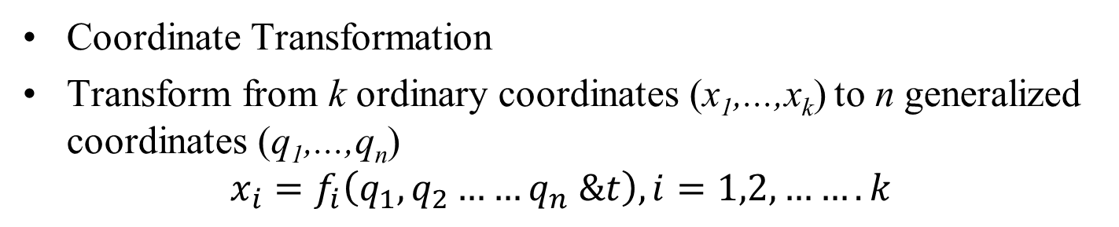
Transformation to Generalized Coordinates
Coordinate Transformation
Transform from k ordinary coordinates (x₁,...,x_{k}) to n generalized coordinates (q₁,...,q_{n})
$$x_{i}=f_{i}\left(q_{1},q_{2}……q_{n} \&t\right), i=1,2,…….k$$
Interpretation
x_{i} → ordinary coordinates q_{i} → generalized coordinates
Constraints:
l on x-coordinates
m on q-coordinates
Key Result
Same physical system described
Degrees of freedom invariant:
Insight
k −l =n−m
Choice of coordinates changes n, m
But n−m remains constant

Slide 15
Classification of Constraints
Definition
Consider a system with n generalized coordinates:
q₁, q₂,...,q_{n}
Suppose there are m constraint equations:
ϕ_{j}(q₁,q₂,...,q_{n} & t) = 0, j = 1,2,...,m
Such constraints are called holonomic constraints
Constraints relate coordinates and possibly time
In principle, can eliminate m variables
Leaves: n−m independent coordinates
Direct elimination may be difficult
Alternative:
Use Lagrange multipliers
Prefer choosing:
Independent generalized coordinates
Number of generalized coordinates: = DoF

Slide 16
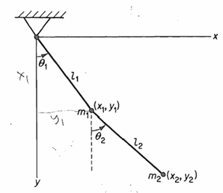
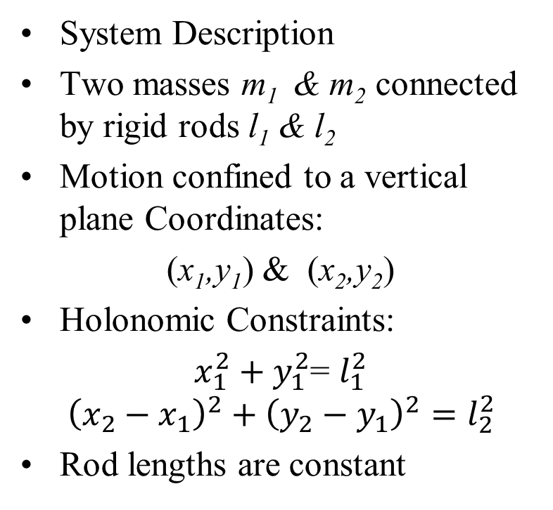
Holonomic Constraints: Double Pendulum
System Description
Two masses m₁ & m₂ connected by rigid rods l₁ & l₂
Motion confined to a vertical plane Coordinates:
(x₁,y₁) & (x₂,y₂)
Holonomic Constraints:
$x_{1}^{2}+y_{1}^{2}$= $l_{1}^{2}$
$${\left(x_{2}−x_{1}\right)}^{2}+{\left(y_{2}−y_{1}\right)}^{2}=l_{2}^{2}$$
Rod lengths are constant
Constraints are scleronomic (time-independent)!

Slide 17
Degrees of Freedom and Coordinate Choice
Degrees of Freedom
Total coordinates: 4
Constraints: 2
Degrees of freedom: 4 −2=2
Types of Constraints
Scleronomic: No explicit time dependence
Rheonomic: Explicitly depend on time
Key Insights
Holonomic constraints reduce variables
Choose independent generalized coordinates
Number of coordinates =
DOF System is conservative
Better Coordinates
Use angles: θ₁, θ₂
Represent orientation of rods
Automatically satisfy constraints
(frictionless + time-independent constraints)

Slide 18
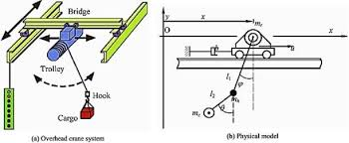
Overhead Cranes

Slide 19
Inequality Constraints
General Form
Constraints may also appear as inequalities:
f(q₁,q₂,...,q_{n}&t) ≤ 0
Example: Particle Inside a Sphere
Particle confined inside a sphere of radius a
Using Cartesian coordinates (x,y,z):
x² +y² +z² −a² ≤ 0
Represents a region constraint (not equality)

Slide 20
Interpretation of Inequality Constraints
Inside the Sphere
If:
x² +y² +z² −a² ≤ 0
Particle moves freely
Degrees of freedom=3
Motion on the Surface
Motion constrained to sphere
Degrees of freedom: =2
Behaves like a holonomic constraint
Key Insight
Inequality constraints:
Restrict region of motion
Do not always reduce DOF
DOF changes when constraint becomes active
At the Boundary
If:
x² +y² +z² −a² ⁼ 0
Particle touches the surface

Slide 21
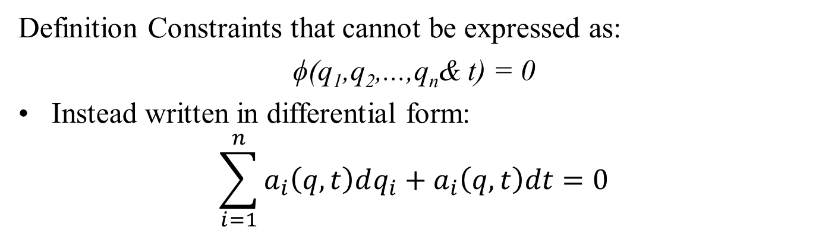
Nonholonomic Constraints
Definition Constraints that cannot be expressed as:
ϕ(q₁,q₂,...,q_{n}& t) = 0
Instead written in differential form:
$$\sum_{i=1}^{n}{a_{i}\left(q,t\right)dq_{i}}+a_{i}\left(q,t\right)dt=0$$
Implication
More coordinates needed than DOF
Constraints involve velocities
Cannot be simplified like holonomic constraints
Key Feature
Not integrable
Cannot reduce to a relation among coordinates

