Slide 1


Work-energy Method for Rigid Bodies
P M V Subbarao
Professor & Head
Mechanical Engineering Department
Energy Centric Design is Essential …..

Slide 2

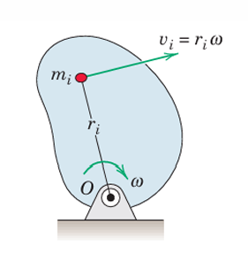

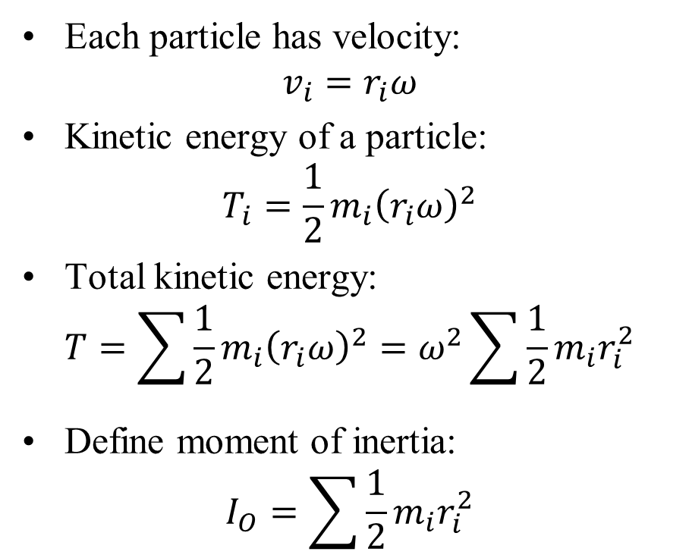
Kinetic Energy: Fixed-Axis Rotation
Consider a rigid body rotating about a fixed axis at O
Each particle has velocity:
$$v_{i}=r_{i}ω$$
Kinetic energy of a particle:
$$T_{i}=\frac{1}{2}m_{i}{\left(r_{i}ω\right)}^{2}$$
Total kinetic energy:
$$T=\sum{\frac{1}{2}m_{i}{\left(r_{i}ω\right)}^{2}}=ω^{2}\sum{\frac{1}{2}m_{i}r_{i}^{2}}$$
Define moment of inertia:
$$I_{O}=\sum{\frac{1}{2}m_{i}r_{i}^{2}}$$
Fixed-Axis Rotation
Final result:
$$T=I_{O}ω^{2}$$

Slide 3
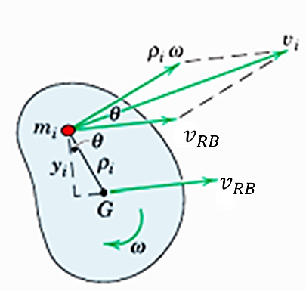
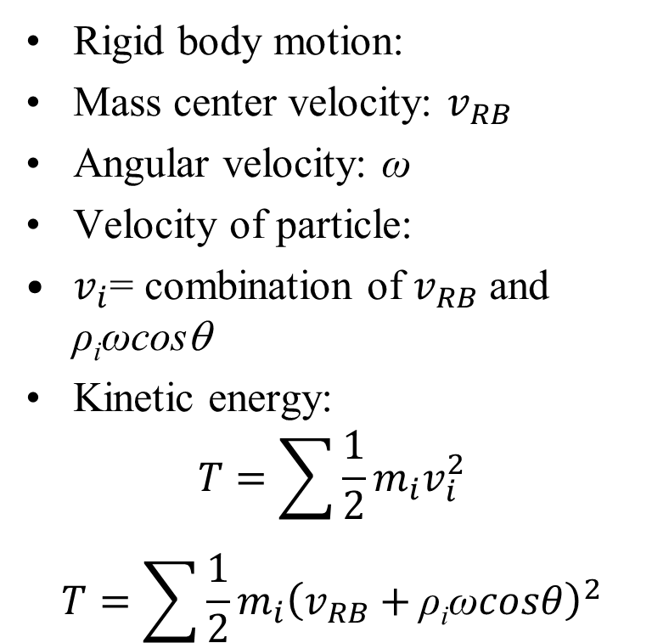
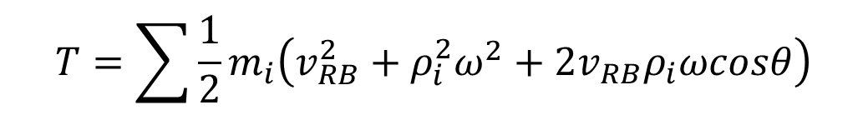
Kinetic Energy: General Plane Motion
Rigid body motion:
Mass center velocity: $v_{RB}$
Angular velocity: ω
Velocity of particle:
$v_{i}$= combination of $v_{RB}$ and ρ_{i}ωcosθ
Kinetic energy:
$$T=\sum{\frac{1}{2}m_{i}v_{i}^{2}}$$
$$T=\sum{\frac{1}{2}m_{i}{\left(v_{RB}+\text{ρ}\text{i}\text{ω}cosθ\right)}^{2}}$$
$$T=\sum{\frac{1}{2}m_{i}\left(v_{RB}^{2}+ρ_{i}^{2}ω^{2}+2v_{RB}ρ_{i}ωcosθ\right)}$$

Slide 4
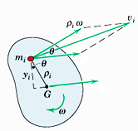

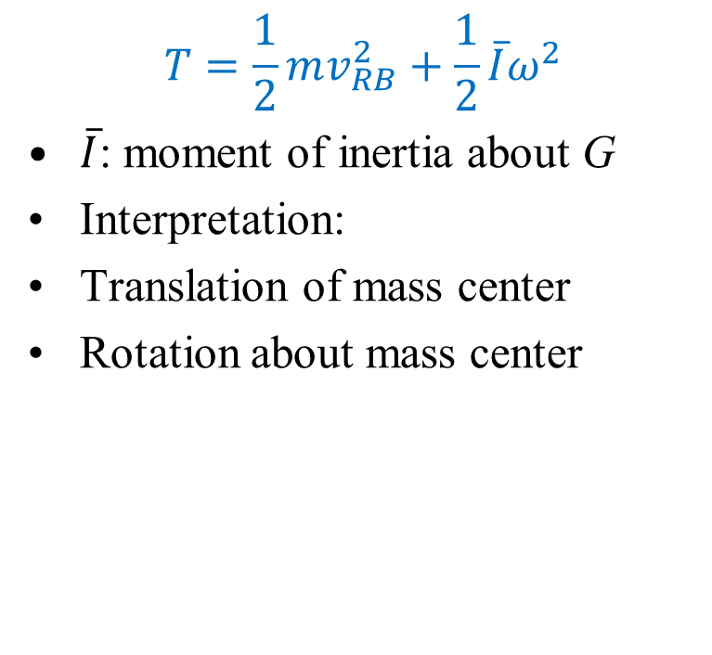

Kinetic Energy: General Plane Motion
$$T=\frac{1}{2}mv_{RB}^{2}+\frac{1}{2}\overline{I}ω^{2}$$
$\overline{I}$: moment of inertia about G
Interpretation:
Translation of mass center
Rotation about mass center
$$v_{RB}$$
$$v_{RB}$$

Slide 5
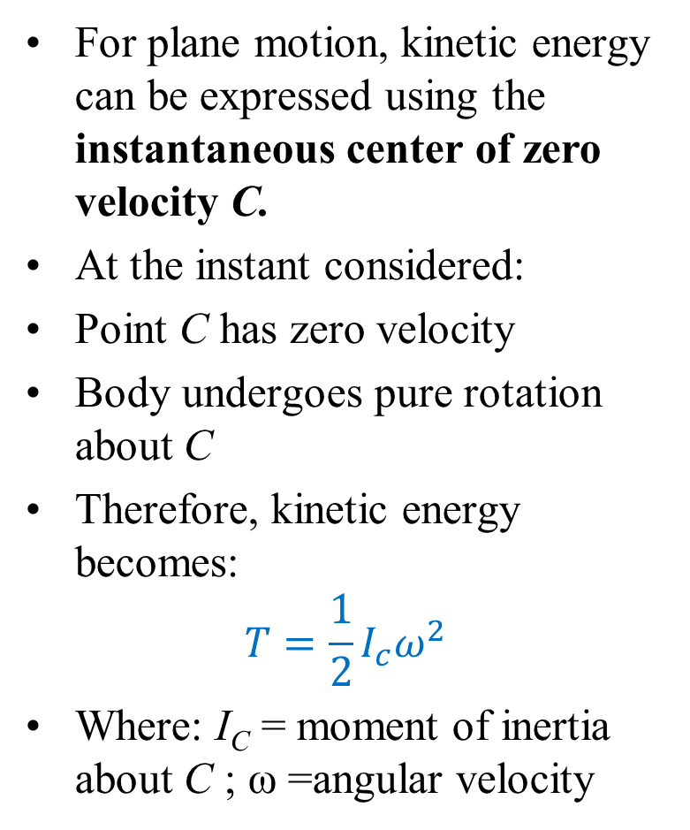
Kinetic Energy via Instantaneous Center
For plane motion, kinetic energy can be expressed using the instantaneous center of zero velocity C.
At the instant considered:
Point C has zero velocity
Body undergoes pure rotation about C
Therefore, kinetic energy becomes:
$$T=\frac{1}{2}I_{c}ω^{2}$$
Where: I_{C} = moment of inertia about C ; ω =angular velocity
Key idea:
Any plane motion can be viewed as:
Instantaneous rotation about C
Advantage:
Simplifies kinetic energy calculation
Important:
Valid only at the instant considered

Slide 6
Impulse–Momentum Equations for Rigid Bodies
Impulse and Momentum
Principles of impulse and momentum were developed for Particle motion
Particularly useful when: Forces vary with time Motion occurs over short time intervals (e.g., impact)
Extended to systems of particles Valid regardless of internal connections
A rigid body is a special case of a general system of mass particles.

Slide 7
Impulse–Momentum Equations for Rigid Bodies
Objective of this section:
Apply impulse–momentum principles to rigid-body plane motion
Key Insight
Impulse–momentum methods are especially powerful when time-based analysis is more convenient than force-based analysis.

Slide 8


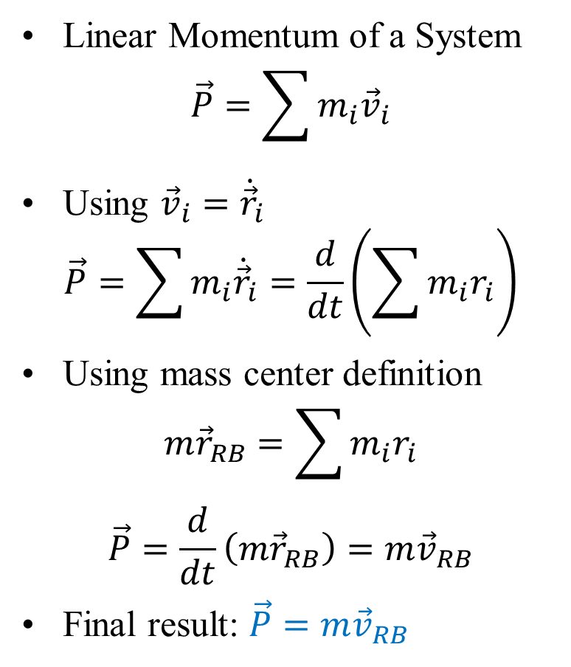









Linear Momentum of a System
Linear Momentum of a System
$$\vec{P}=\sum{m_{i}{\vec{v}}_{i}}$$
Using ${\vec{v}}_{i}={\dot{\vec{r}}}_{i}$
$$\vec{P}=\sum{m_{i}{\dot{\vec{r}}}_{i}}=\frac{d}{dt}\left(\sum{m_{i}r_{i}}\right)$$
Using mass center definition
$$m{\vec{r}}_{RB}=\sum{m_{i}r_{i}}$$
$$\vec{P}=\frac{d}{dt}\left(m{\vec{r}}_{RB}\right)=m{\vec{v}}_{RB}$$
Final result: $\vec{P}=m{\vec{v}}_{RB}$
$${\dot{\vec{ρ}}}_{i}=\vec{ω}×{\vec{ρ}}_{i}$$
$${\vec{v}}_{i}={\dot{\vec{r}}}_{i}$$
$$∙$$
$$m_{i}$$
$$∙$$
$${\vec{v}}_{RB}$$
$${\vec{ρ}}_{i}$$
G
$${\vec{v}}_{RB}={\dot{\vec{r}}}_{RB}$$
$${\vec{r}}_{i}$$
$${\vec{r}}_{RB}$$
$$ω$$
O

Slide 9
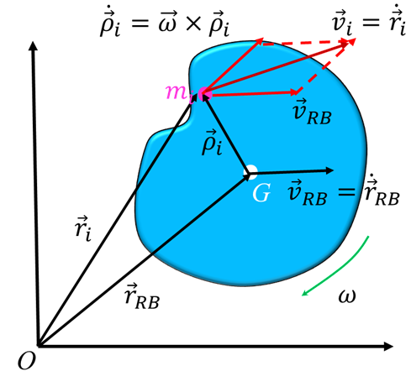
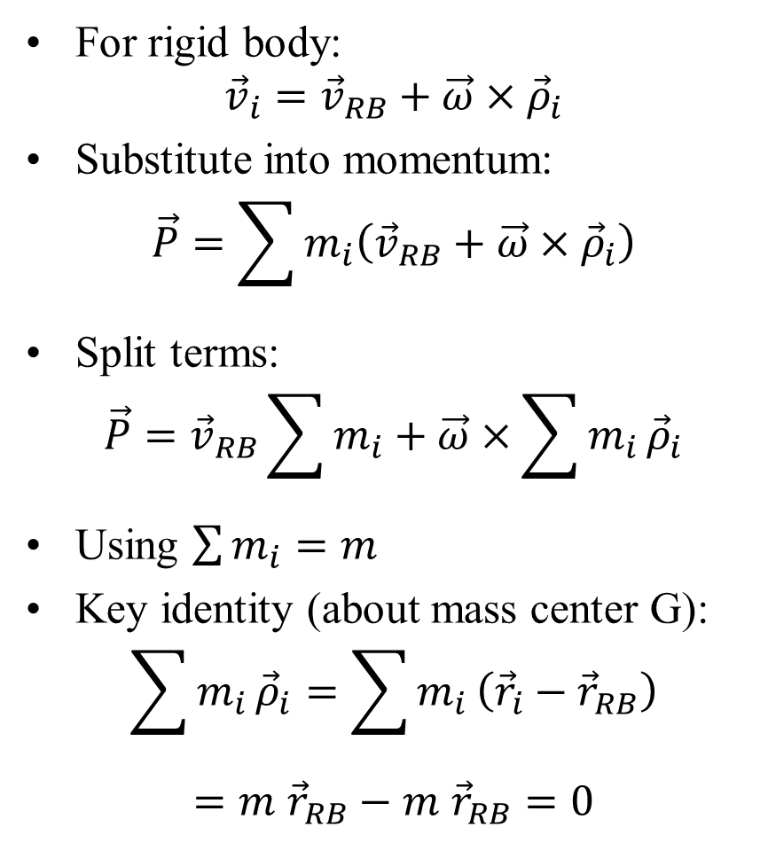

Linear Momentum of a Rigid Body
For rigid body:
$${\vec{v}}_{i}={\vec{v}}_{RB}+\vec{ω}×{\vec{ρ}}_{i}$$
Substitute into momentum:
$$\vec{P}=\sum{m_{i}\left({\vec{v}}_{RB}+\vec{ω}×{\vec{ρ}}_{i}\right)}$$
Split terms:
$$\vec{P}={\vec{v}}_{RB}\sum{m_{i}}+\vec{ω}×\sum{m_{i}}{\vec{ρ}}_{i}$$
Using $\sum{m_{i}}=m$
Key identity (about mass center G):
$$\sum{m_{i}}{\vec{ρ}}_{i}=\sum{m_{i}}\left({\vec{r}}_{i}−{\vec{r}}_{RB}\right)$$
$=m$ ${\vec{r}}_{RB}−m {\vec{r}}_{RB}=0$
Result:
$$\vec{P}=m{\vec{v}}_{RB}$$

Slide 10
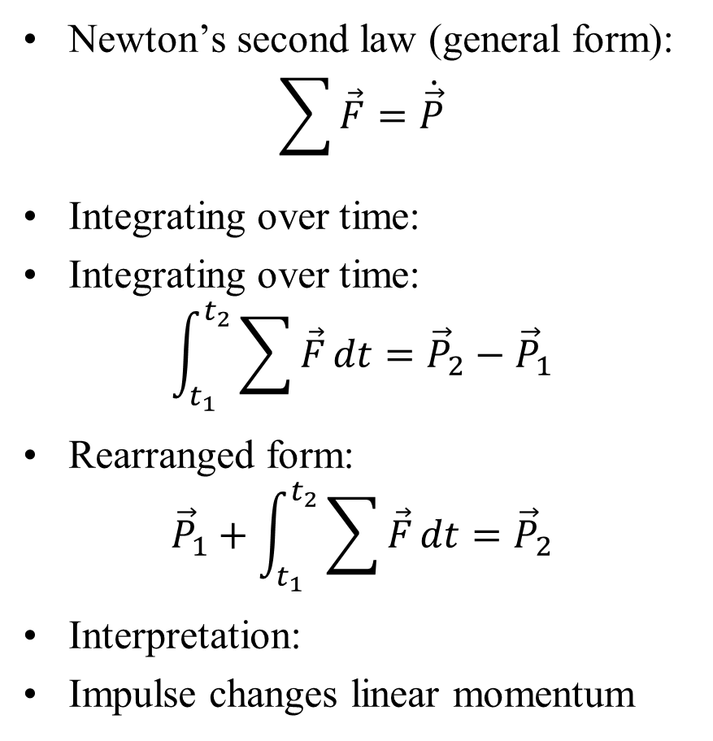
Impulse–Momentum Equation
Newton’s second law (general form):
$$\sum{\vec{F}}=\dot{\vec{P}}$$
Integrating over time:
Integrating over time:
$$\int_{t_{1}}^{t_{2}}{\sum{\vec{F}}}dt={\vec{P}}_{2}−{\vec{P}}_{1}$$
Rearranged form:
$${\vec{P}}_{1}+\int_{t_{1}}^{t_{2}}{\sum{\vec{F}}}dt={\vec{P}}_{2}$$
Interpretation:
Impulse changes linear momentum
Useful for variable forces and impact

Slide 11
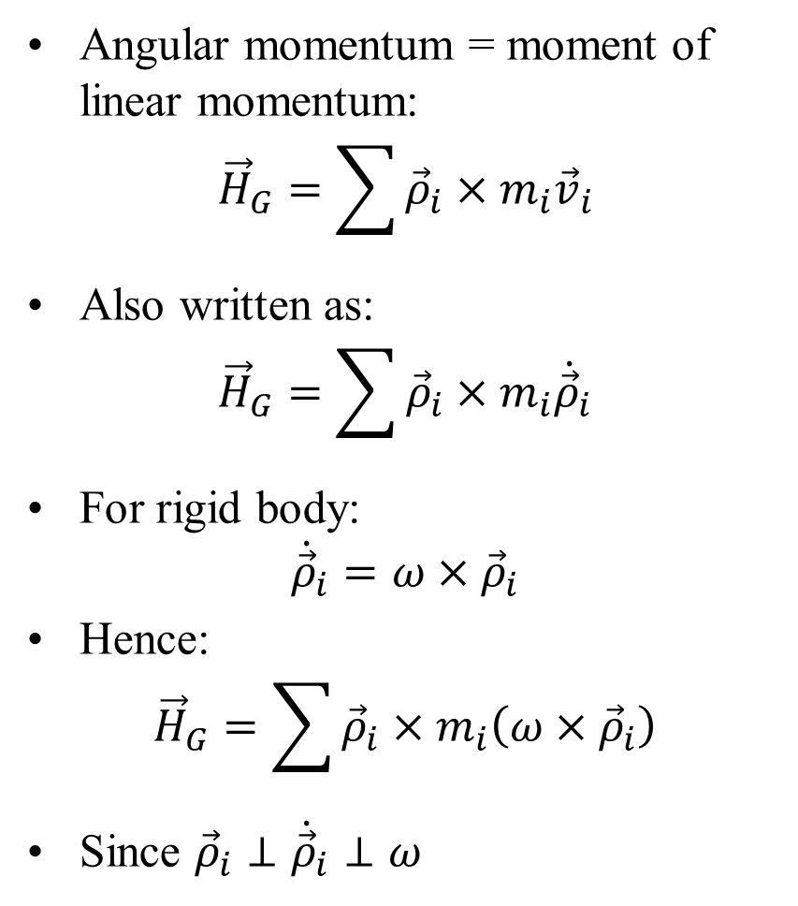
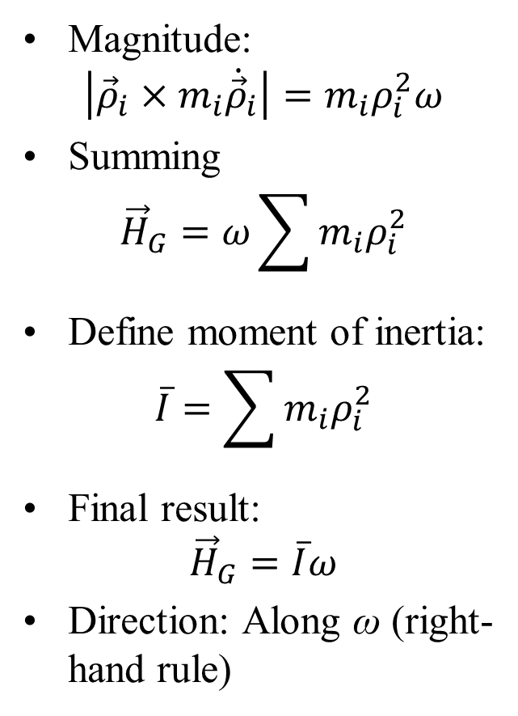
Angular Momentum About Mass Center G
Angular momentum = moment of linear momentum:
$${\vec{H}}_{G}=\sum{{\vec{ρ}}_{i}×m_{i}{\vec{v}}_{i}}$$
Also written as:
$${\vec{H}}_{G}=\sum{{\vec{ρ}}_{i}×m_{i}{\dot{\vec{ρ}}}_{i}}$$
For rigid body:
$${\dot{\vec{ρ}}}_{i}=ω×{\vec{ρ}}_{i}$$
Hence:
$${\vec{H}}_{G}=\sum{{\vec{ρ}}_{i}×m_{i}\left(ω×{\vec{ρ}}_{i}\right)}$$
Since ${\vec{ρ}}_{i}⊥{\dot{\vec{ρ}}}_{i}⊥ω$
Magnitude:
$$\left|{\vec{ρ}}_{i}×m_{i}{\dot{\vec{ρ}}}_{i}\right|=m_{i}ρ_{i}^{2}ω$$
Summing
$${\vec{H}}_{G}=ω\sum{m_{i}ρ_{i}^{2}}$$
Define moment of inertia:
$$\overline{I}=\sum{m_{i}ρ_{i}^{2}}$$
Final result:
$${\vec{H}}_{G}=\overline{I}ω$$
Direction: Along ω (right-hand rule)

Slide 12
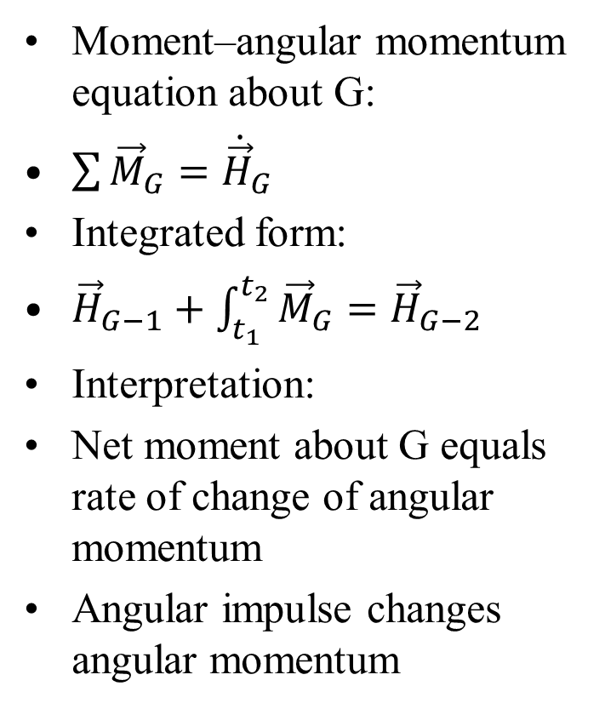
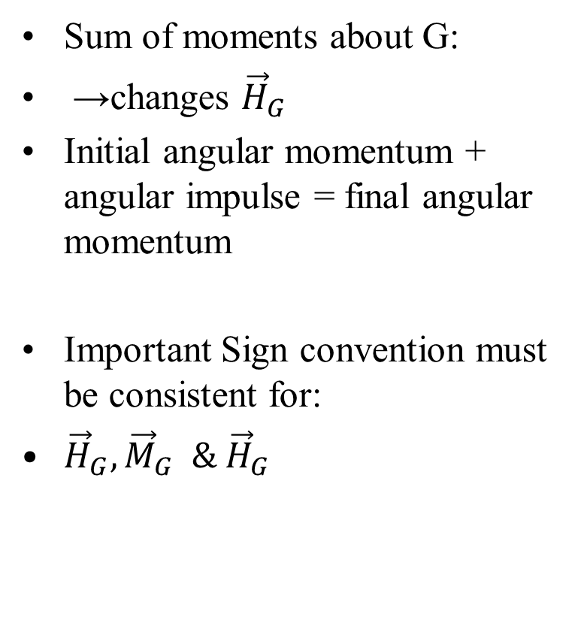
Moment–Angular Momentum Relation
Moment–angular momentum equation about G:
$\sum{{\vec{M}}_{G}}={\dot{\vec{H}}}_{G}$
Integrated form:
${\vec{H}}_{G−1}+\int_{t_{1}}^{t_{2}}{{\vec{M}}_{G}}={\vec{H}}_{G−2}$
Interpretation:
Net moment about G equals rate of change of angular momentum
Angular impulse changes angular momentum
Sum of moments about G:
→changes ${\vec{H}}_{G}$
Initial angular momentum + angular impulse = final angular momentum
Important Sign convention must be consistent for:
${\vec{H}}_{G},{\vec{M}}_{G} \& {\vec{H}}_{G}$

Slide 13

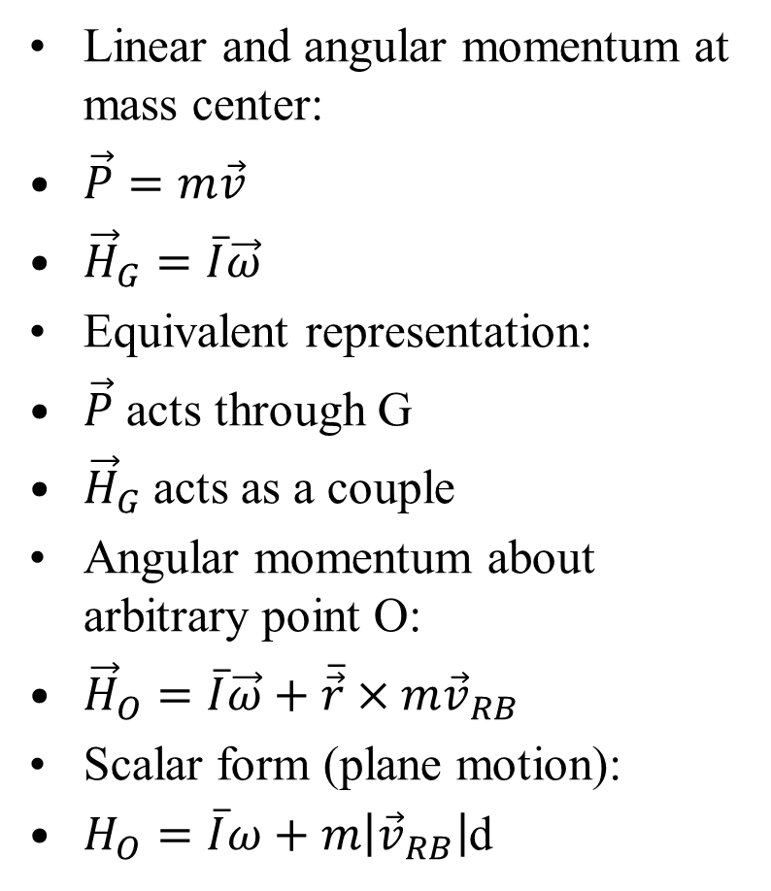



Angular Momentum About an Arbitrary Point O
Linear and angular momentum at mass center:
$\vec{P}=m\vec{v}$
${\vec{H}}_{G}=\overline{I}\vec{ω}$
Equivalent representation:
$\vec{P}$ acts through G
${\vec{H}}_{G}$acts as a couple
Angular momentum about arbitrary point O:
${\vec{H}}_{O}=\overline{I}\vec{ω}+\overline{\vec{r}}×m{\vec{v}}_{RB}$
Scalar form (plane motion):
$H_{O}=\overline{I}ω+m\left|{\vec{v}}_{RB}\right|$d
ω
$$∙$$
$${\vec{v}}_{RB}$$
$${m\vec{v}}_{RB}$$
G
$${\vec{H}}_{G}=\overline{I}\vec{ω}$$
d
O
Valid for:
Any instant O fixed or moving

Slide 14
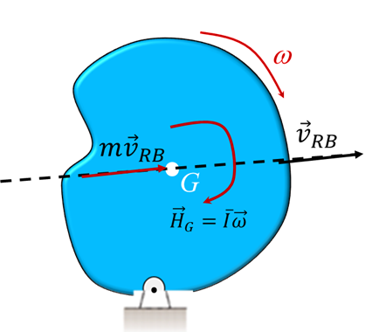
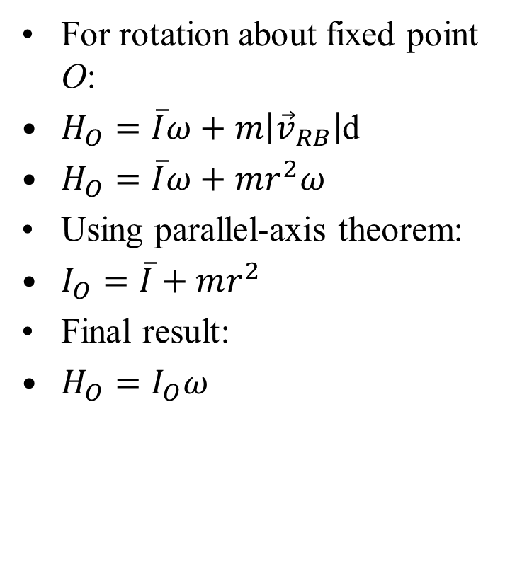
Special Case: Rotation About Fixed Point O
For rotation about fixed point O:
$H_{O}=\overline{I}ω+m\left|{\vec{v}}_{RB}\right|$d
$H_{O}=\overline{I}ω+mr^{2}ω$
Using parallel-axis theorem:
$I_{O}=\overline{I}+mr^{2}$
Final result:
$H_{O}=I_{O}ω$

Slide 15
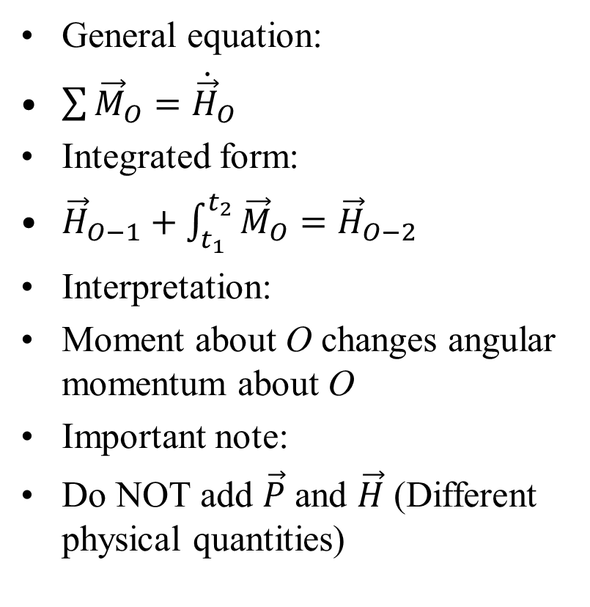
Moment–Angular Momentum About Point O
General equation:
$\sum{{\vec{M}}_{O}}={\dot{\vec{H}}}_{O}$
Integrated form:
${\vec{H}}_{O−1}+\int_{t_{1}}^{t_{2}}{{\vec{M}}_{O}}={\vec{H}}_{O−2}$
Interpretation:
Moment about O changes angular momentum about O
Important note:
Do NOT add $\vec{P}$ and $\vec{H}$ (Different physical quantities)
Key Idea:
Angular momentum about O combines:
Rotation about G
Translation of G

Slide 16
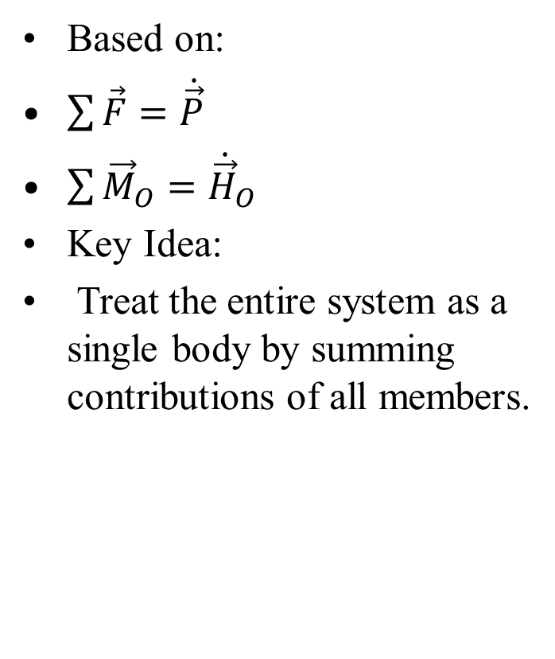
Interconnected Rigid Bodies
Impulse–momentum principles apply to:
Systems of interconnected rigid bodies
Any system of constant mass
Approach:
Write equations for each body
Add them to obtain system equations
Internal forces:
Cancel out in summation Only external forces remain
Based on:
$\sum{\vec{F}=\dot{\vec{P}}}$
$\sum{{\vec{M}}_{O}}={\dot{\vec{H}}}_{O}$
Key Idea:
Treat the entire system as a single body by summing contributions of all members.

Slide 17
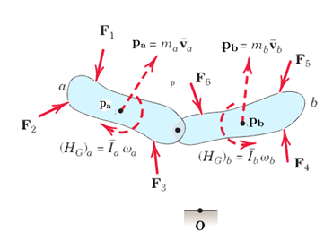
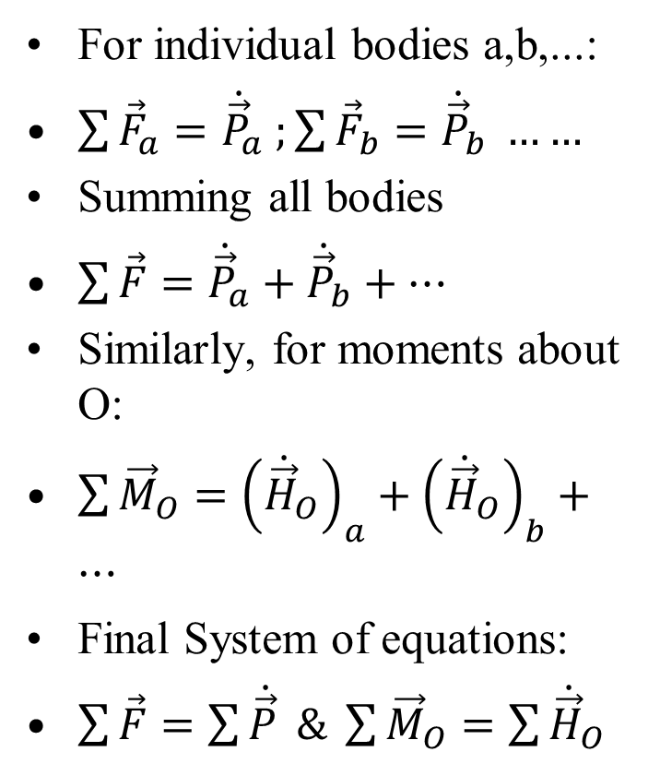
Equations for Multiple Bodies
For individual bodies a,b,...:
$\sum{{\vec{F}}_{a}}={\dot{\vec{P}}}_{a} ;\sum{{\vec{F}}_{b}={\dot{\vec{P}}}_{b}} ……$
Summing all bodies
$\sum{\vec{F}}={\dot{\vec{P}}}_{a}+{\dot{\vec{P}}}_{b}+…$
Similarly, for moments about O:
$\sum{{\vec{M}}_{O}}={\left({\dot{\vec{H}}}_{O}\right)}_{a}+{\left({\dot{\vec{H}}}_{O}\right)}_{b}+…$
Final System of equations:
$\sum{\vec{F}}=\sum{\dot{\vec{P}}} \& \sum{{\vec{M}}_{O}}=\sum{{\dot{\vec{H}}}_{O}}$
Important:
Internal forces and moments cancel due to equal and opposite action–reaction pairs.

Slide 18
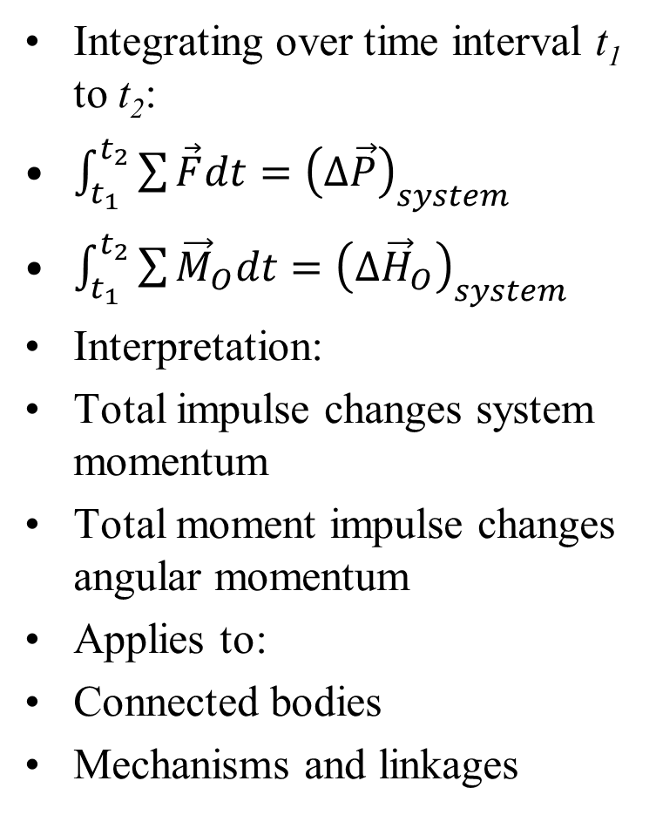
Impulse–Momentum Form (System)
Integrating over time interval t₁ to t₂:
$\int_{t_{1}}^{t_{2}}{\sum{\vec{F}dt}}={\left(∆\vec{P}\right)}_{system}$
$\int_{t_{1}}^{t_{2}}{\sum{{\vec{M}}_{O}dt}}={\left(∆{\vec{H}}_{O}\right)}_{system}$
Interpretation:
Total impulse changes system momentum
Total moment impulse changes angular momentum
Applies to:
Connected bodies
Mechanisms and linkages
Key Insight
Analyze complex systems by replacing them with a single equivalent system response.

Slide 19
Dynamics of 3D Rigid Bodies

Slide 20
Three-Dimensional Motion– Introduction
Many engineering dynamics problems are solved using: Plane motion (2D)
However, modern applications require: Three-dimensional (3D) motion analysis
Key differences in 3D:
Rectilinear vectors gain an additional third component
Angular quantities gain two additional components
Increased complexity in:
Kinematics
Kinetics

Slide 21
Three-Dimensional Motion– Introduction
Advantage:
Full power of vector analysis is utilized
Important note:
Strong understanding of plane motion is essential
Many concepts extend directly from 2D to 3D
Scope:
Introductory treatment of 3D rigid-body motion

Slide 22
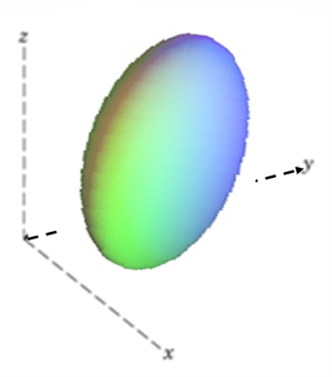

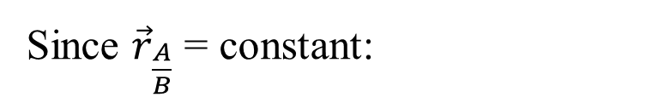

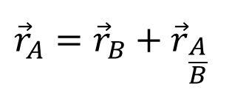





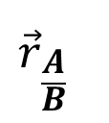

Translation in Three Dimensions
A rigid body undergoes translation if:
All points move along parallel paths
Types of translation:
Rectilinear: straight-line motion
Curvilinear: motion along congruent curves
Key property:
Any line in the body remains parallel to itself Position relation:
A
$$∙$$
$${\vec{v}}_{A}$$
$${\vec{r}}_{\frac{A}{B}}$$
$${\vec{r}}_{A}$$
$$∙$$
B
$${\vec{v}}_{B}$$
$${\vec{r}}_{A}$$
Position relation:
$${\vec{r}}_{A}={\vec{r}}_{B}+{\vec{r}}_{\frac{A}{B}}$$
Since ${\vec{r}}_{\frac{A}{B}}$ = constant:
$${\vec{v}}_{A}={\vec{v}}_{B}$$
$${\vec{a}}_{A}={\vec{a}}_{B}$$

Slide 23
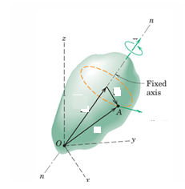




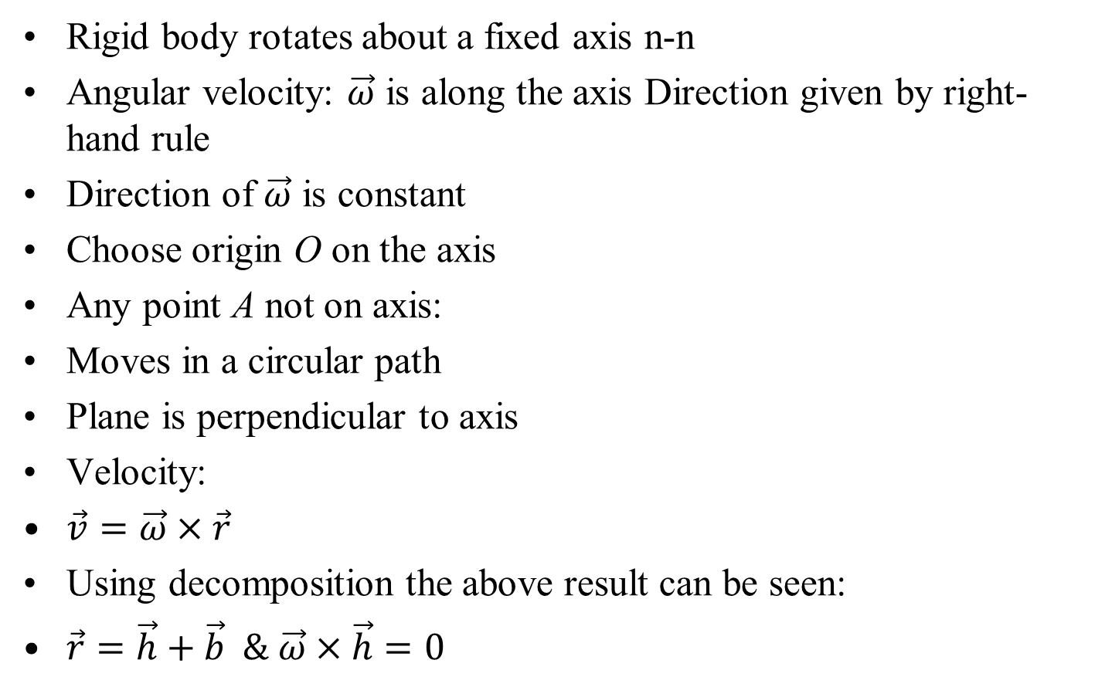

Fixed-Axis Rotation in 3D
Rigid body rotates about a fixed axis n-n
Angular velocity: $\vec{ω}$ is along the axis Direction given by right-hand rule
Direction of $\vec{ω}$ is constant
Choose origin O on the axis
Any point A not on axis:
Moves in a circular path
Plane is perpendicular to axis
Velocity:
$\vec{v}=\vec{ω}×\vec{r}$
Using decomposition the above result can be seen:
$\vec{r}=\vec{h}+\vec{b} \& \vec{ω}×\vec{h}=0$
$$\vec{ω}$$
$$\vec{b}$$
$$\vec{h}$$
$$\vec{v}=\vec{ω}×\vec{r}$$
$$\vec{r}$$

Slide 24
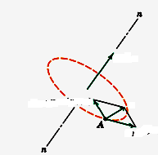

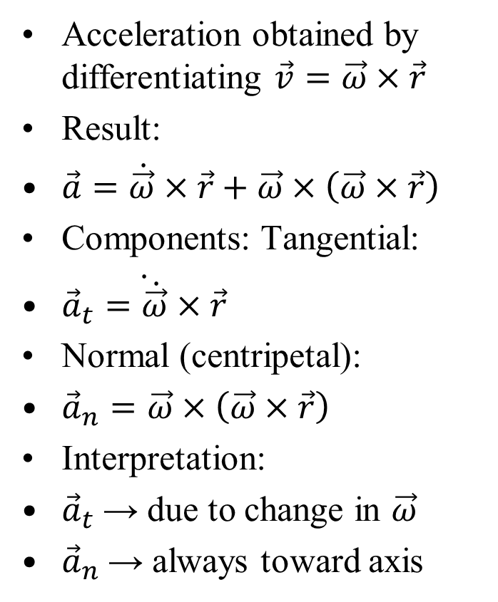



Acceleration in Fixed-Axis Rotation
Acceleration obtained by differentiating $\vec{v}=\vec{ω}×\vec{r}$
Result:
$\vec{a}=\dot{\vec{ω}}×\vec{r}+\vec{ω}×\left(\vec{ω}×\vec{r}\right)$
Components: Tangential:
$\dot{{\vec{a}}_{t}=\dot{\vec{ω}}×\vec{r}}$
Normal (centripetal):
${\vec{a}}_{n}=\vec{ω}×\left(\vec{ω}×\vec{r}\right)$
Interpretation:
${\vec{a}}_{t}$→ due to change in $\vec{ω}$
${\vec{a}}_{n}$→ always toward axis
$$\dot{\vec{ω}}=\vec{α}$$
$$\dot{{\vec{a}}_{n}=\vec{ω}×\left(\vec{ω}×\vec{r}\right)}$$
$$\vec{a}$$
$$\dot{{\vec{a}}_{t}=\dot{\vec{ω}}×\vec{r}}$$

Slide 25
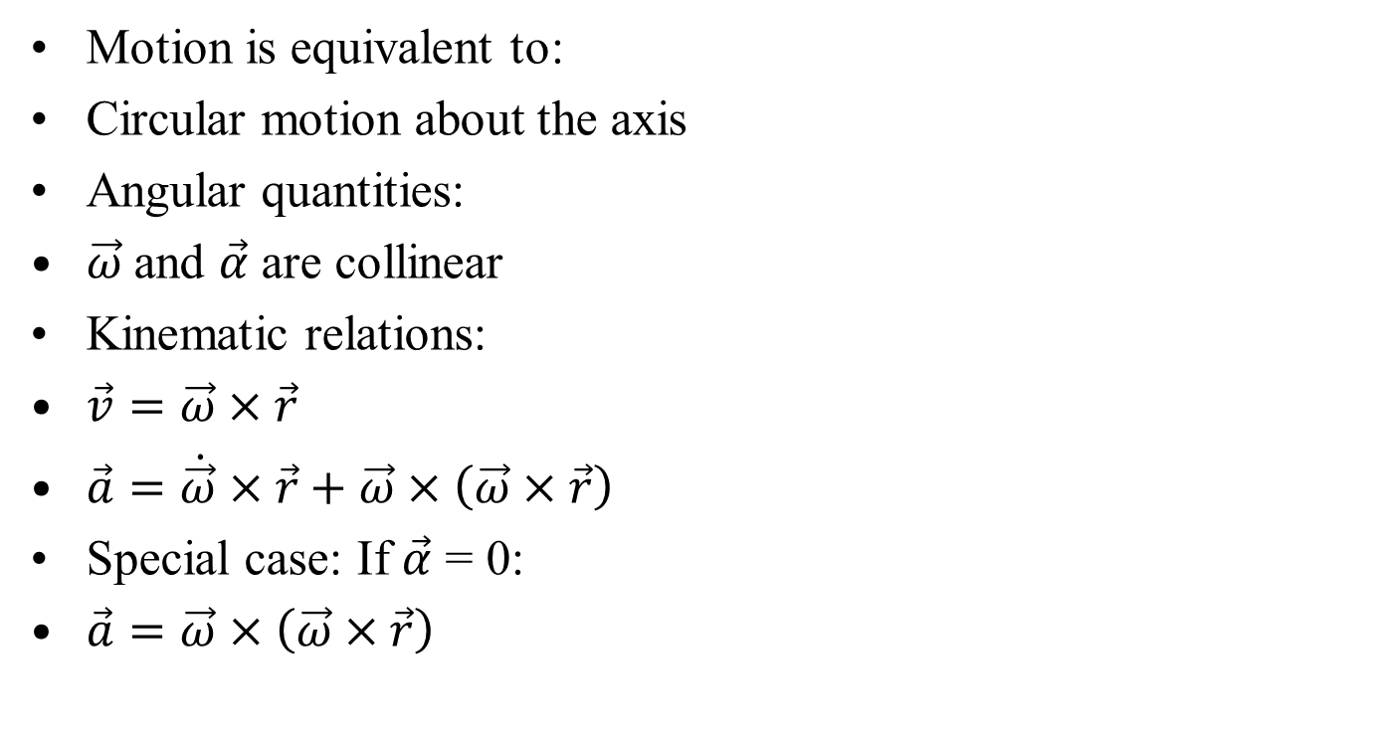
Key Observations: Fixed-Axis Rotation
Motion is equivalent to:
Circular motion about the axis
Angular quantities:
$\vec{ω}$and $\vec{α}$ are collinear
Kinematic relations:
$\vec{v}=\vec{ω}×\vec{r}$
$\vec{a}=\dot{\vec{ω}}×\vec{r}+\vec{ω}×\left(\vec{ω}×\vec{r}\right)$
Special case: If $\vec{α}$ = 0:
$\vec{a}=\vec{ω}×\left(\vec{ω}×\vec{r}\right)$

Slide 26
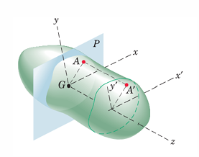
Parallel-Plane Motion
A rigid body undergoes parallel-plane motion when:
All points move in planes parallel to a fixed plane P
This represents a general form of plane motion
Reference plane:
Chosen through mass center G Called the plane of motion
Key idea:
Motion of any point (e.g., A′) is identical to corresponding point (A) in plane P
Therefore
3D motion reduces to equivalent 2D plane motion

Slide 27
Key Observations: Parallel-Plane Motion
Each point in the body:
Moves in its own plane All such planes are parallel
Correspondence:
A↔A′
Same motion projected onto reference plane
Implication:
Full 3D motion described using:
Plane kinematics Practical advantage:
Reduces complexity of 3D motion
Allows use of:
Relative velocity
Instantaneous center
Plane motion equations

Slide 28
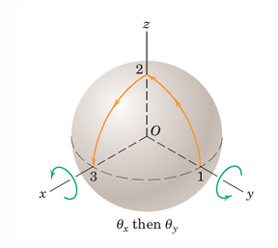
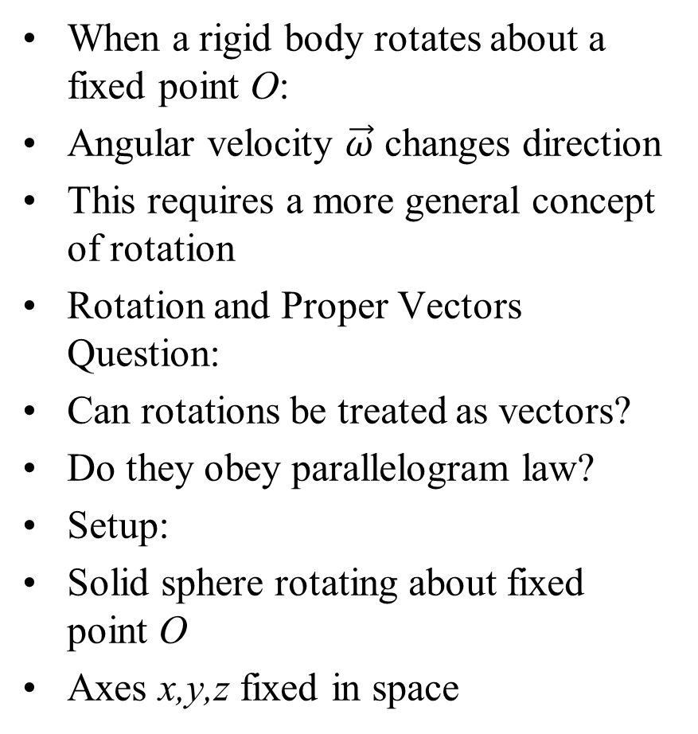
Rotation About a Fixed Point
When a rigid body rotates about a fixed point O:
Angular velocity $\vec{ω}$ changes direction
This requires a more general concept of rotation
Rotation and Proper Vectors Question:
Can rotations be treated as vectors?
Do they obey parallelogram law?
Setup:
Solid sphere rotating about fixed point O
Axes x,y,z fixed in space
Examine:
Two successive 90◦ rotations
Case 1:
Rotate about x-axis, then y-axis
Point moves: 1 →2→3

Slide 29
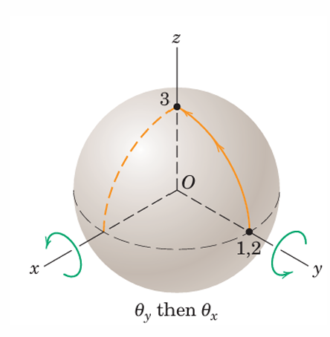
Finite Rotations are Not Commutative
Case 2:
Rotate about y-axis, then x-axis
Point moves differently
Result:
Final positions are different

Slide 30
Key Conclusion on Rotation Vectors
Finite rotations:
Do not obey parallelogram law
Are not commutative
Therefore:
Finite rotations cannot be treated as proper vectors
Important implication:
Order of rotations matters Note:
Only infinitesimal rotations behave like vectors

Slide 31
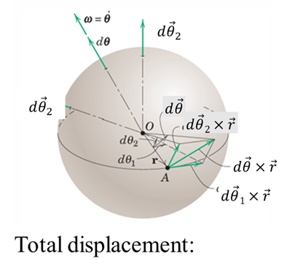
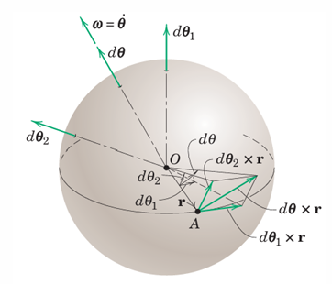


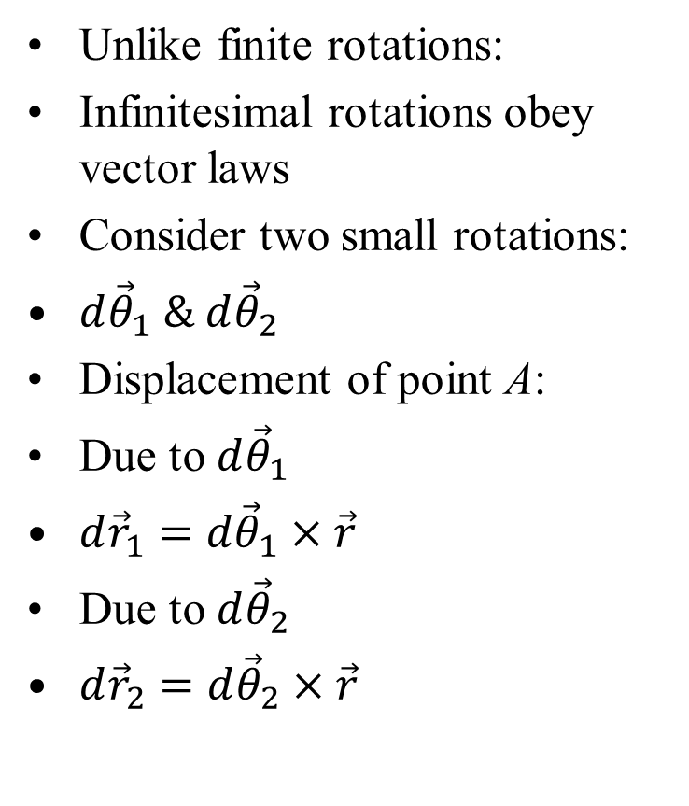

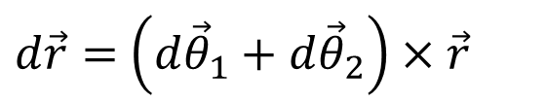




Infinitesimal Rotations as Proper Vectors
Unlike finite rotations:
Infinitesimal rotations obey vector laws
Consider two small rotations:
$d{\vec{θ}}_{1} \& d{\vec{θ}}_{2}$
Displacement of point A:
Due to $d{\vec{θ}}_{1}$
$d{\vec{r}}_{1}=d{\vec{θ}}_{1}×\vec{r}$
Due to $d{\vec{θ}}_{2}$
$d{\vec{r}}_{2}=d{\vec{θ}}_{2}×\vec{r}$
$$d{\vec{θ}}_{2}$$
$$d{\vec{θ}}_{2}$$
$$d\vec{θ}$$
$$d\vec{θ}2×\vec{r}$$
$$d\vec{θ}×\vec{r}$$
$$d\vec{θ}1×\vec{r}$$
Total displacement:
$d\vec{r}=$ $d{\vec{θ}}_{1}×\vec{r}+d{\vec{θ}}_{2}×\vec{r}$
Factor the expression:
$d\vec{r}=$ $\left(d{\vec{θ}}_{1}+d{\vec{θ}}_{2}\right)×\vec{r}$

Slide 32
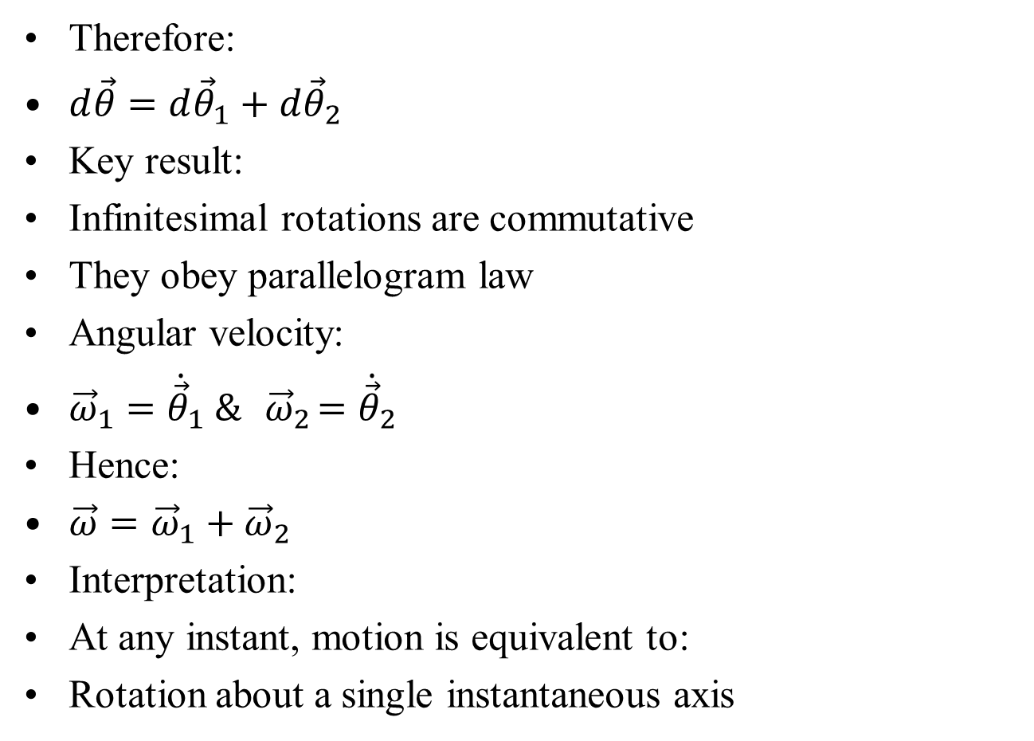
Vector Addition of Infinitesimal Rotations
Therefore:
$d\vec{θ}=d{\vec{θ}}_{1}+d{\vec{θ}}_{2}$
Key result:
Infinitesimal rotations are commutative
They obey parallelogram law
Angular velocity:
${\vec{ω}}_{1}={\dot{\vec{θ}}}_{1} \&{ \vec{ω}}_{2}={\dot{\vec{θ}}}_{2}$
Hence:
$\vec{ω}={\vec{ω}}_{1}+{\vec{ω}}_{2}$
Interpretation:
At any instant, motion is equivalent to:
Rotation about a single instantaneous axis

Slide 33
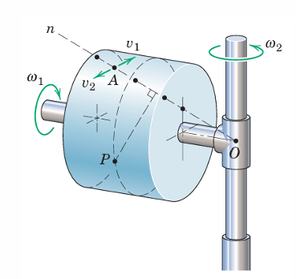
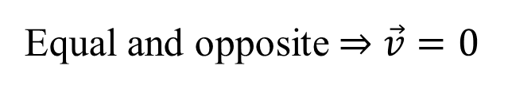
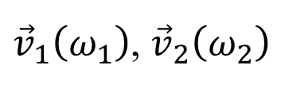
Instantaneous Axis of Rotation
Consider a rigid body with:
Rotation ω₁ about its own shaft
Shaft rotating with ω₂ about a fixed axis
At a given instant:
Some particles appear stationary
Others appear blurred (moving)
Key observation:
A line of points has zero velocity
This line defines:
Instantaneous axis of rotation (O - n)
Example point A:
Velocity components:
${\vec{v}}_{1}\left(ω_{1}\right)$, ${\vec{v}}_{2}\left(ω_{2}\right)$
Equal and opposite ⇒ $\vec{v}=0$

Slide 34
Properties of Instantaneous Axis
Points on axis O-n:
Have zero velocity
All other points:
Move in circular paths
Planes are normal to the axis
Motion interpretation:
Body undergoes pure rotation about the instantaneous axis
Time evolution:
Axis changes position over time
Not fixed in the body
Not fixed in space
Important conclusion: General 3D motion ≡ rotation about a moving instantaneous axis

Slide 35
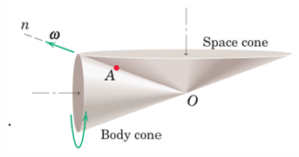

Body and Space Cones
Consider the instantaneous axis of rotation O−A−n
Relative to the body:
The axis generates a right-circular cone
Called the body cone
As motion continues:
The axis also sweeps a cone about the fixed vertical axis
Called the space cone
Thus: One cone attached to the body
One cone fixed in space
$$\vec{ω}$$

Slide 36
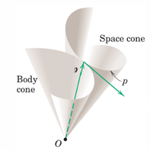
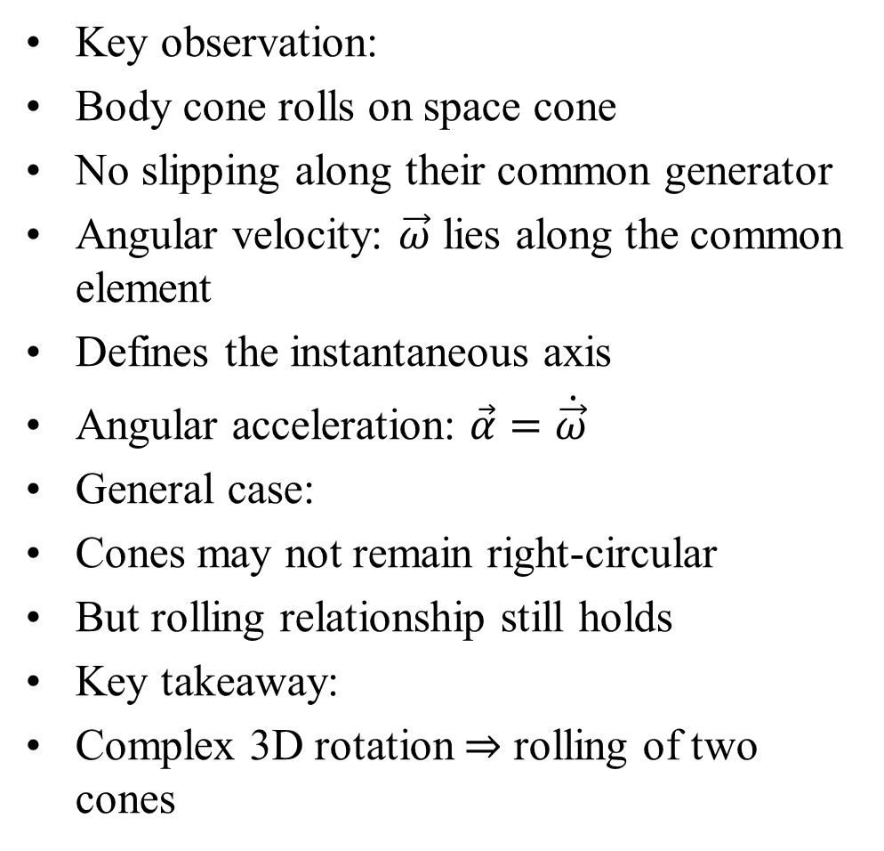


Rolling of Cones and Angular Velocity
Key observation:
Body cone rolls on space cone
No slipping along their common generator
Angular velocity: $\vec{ω}$ lies along the common element
Defines the instantaneous axis
Angular acceleration: $\vec{α}=\dot{\vec{ω}}$
General case:
Cones may not remain right-circular
But rolling relationship still holds
Key takeaway:
Complex 3D rotation ⇒ rolling of two cones
$$\vec{ω}$$
$$\vec{α}=\dot{\vec{ω}}$$

Slide 37
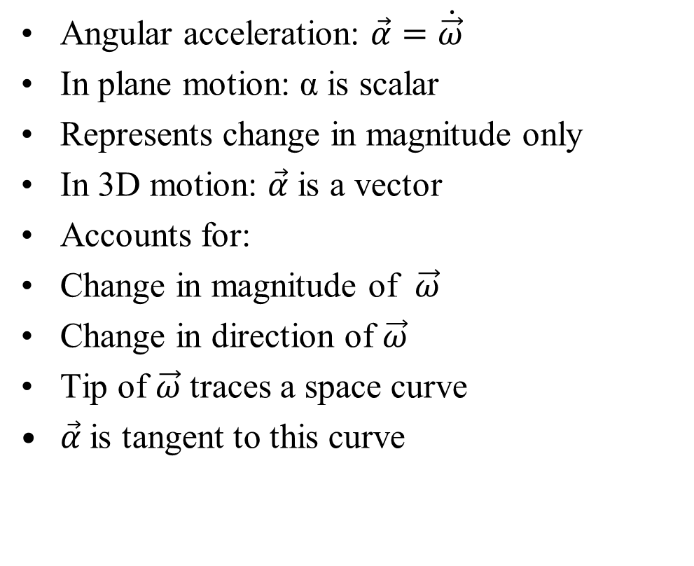
Angular Acceleration in 3D Motion
Angular acceleration: $\vec{α}=\dot{\vec{ω}}$
In plane motion: α is scalar
Represents change in magnitude only
In 3D motion: $\vec{α}$ is a vector
Accounts for:
Change in magnitude of $\vec{ω}$
Change in direction of $\vec{ω}$
Tip of $\vec{ω}$ traces a space curve
$\vec{α}$is tangent to this curve
$$\vec{ω}$$
$$\vec{α}=\dot{\vec{ω}}$$

Slide 38
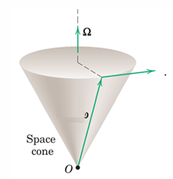






Angular Acceleration for Constant |$\vec{ω}$|
If magnitude of $\vec{ω}$ is constant:
Only direction changes
Then: $\vec{α}\text{⊥}\vec{ω}$
Let $\vec{Ω}$ = angular velocity of $\vec{ω}$ (precession)
Key relation: $\vec{α}=\vec{Ω}×\vec{ω}$
Interpretation:
$\vec{ω}$ rotates about $\vec{Ω}$
Forms a space cone
$$\vec{α}=\dot{\vec{ω}}$$
$$\vec{ω}$$
$$\vec{α}=\vec{Ω}×\vec{ω}$$
$\left|\vec{ω}\right|$=constant

Slide 39











Geometric Analogy of Angular Acceleration
Analogy with particle kinematics:
$\vec{v}=\dot{\vec{r}⟺ }$ $\vec{α}=\vec{Ω}×\vec{ω}$
Correspondence:
$\vec{r} ⟷ \vec{ω}$
$\vec{v} ⟷ \vec{α}$
$\vec{ω} ⟷ \vec{Ω}$
Insight:
Angular velocity behaves like a ”position vector”
Angular acceleration behaves like ”velocity”
Thus: Rotation of ω produces α Same structure as circular motion
$$\vec{ω}$$
$$\vec{r}$$
$$\vec{v}=\dot{\vec{r}}$$
$$=\vec{ω}×\dot{\vec{r}}$$
$$\left|\vec{r}\right|=constant$$
$$\vec{α}=\dot{\vec{ω}}$$
$$\vec{ω}$$
$$\vec{α}=\vec{Ω}×\vec{ω}$$
$\left|\vec{ω}\right|$=constant

Slide 40

Rotation about a Fixed Point: Kinematics
For a rigid body rotating about a fixed point O:
$\vec{v}=\vec{ω}×\vec{r}$
$\vec{a}=\dot{\vec{ω}}×\vec{r}+\vec{ω}×\left(\vec{ω}×\vec{r}\right)$
These are identical to fixed-axis rotation relations
Key Difference
(Fixed Axis vs Fixed Point):
Fixed-axis rotation: $\vec{ω}$ direction is constant
$\vec{α}$ only changes magnitude
Fixed-point rotation:
$\vec{ω}$changes direction
$\vec{α}$ has: Component along $\vec{ω}$and Component normal to $\vec{ω}$

Slide 41

Key Observations for Fixed-Point Rotation
Points on instantaneous axis n–n:
Velocity = 0
Acceleration ≠ 0 (if direction of ω changes)
For fixed-axis rotation:
Points on axis have:
Zero velocity
Zero acceleration
Important Conclusion:
Rotation depends only on angular quantities:$\vec{ω}, \vec{α}$
Independent of motion of the reference point
Same expressions apply even if the point O moves

