Slide 1

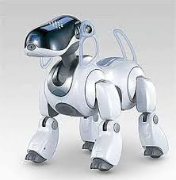
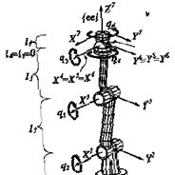

Kinetics of Connected Rigid Bodies
P M V Subbarao
Professor & Head
Mechanical Engineering Department
Basis for Creation of Humanoids & Zoomorphic Robots…..

Slide 2

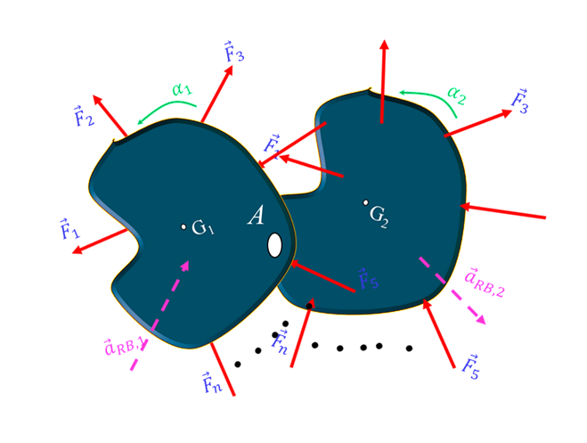

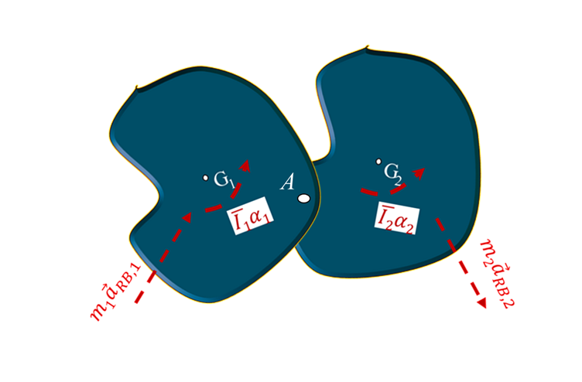




Systems of Interconnected Bodies
For multiple connected rigid bodies:
Motions are kinematically related
Analyze as a single system
Internal forces (e.g., at hinge A): Cancel out
Not included in system analysis
External forces determine motion Force equation.
FBD
$$≡$$
$$∙$$
$$d_{1}$$
$$d_{2}$$
P
Kinematic Diagram of System

Slide 3
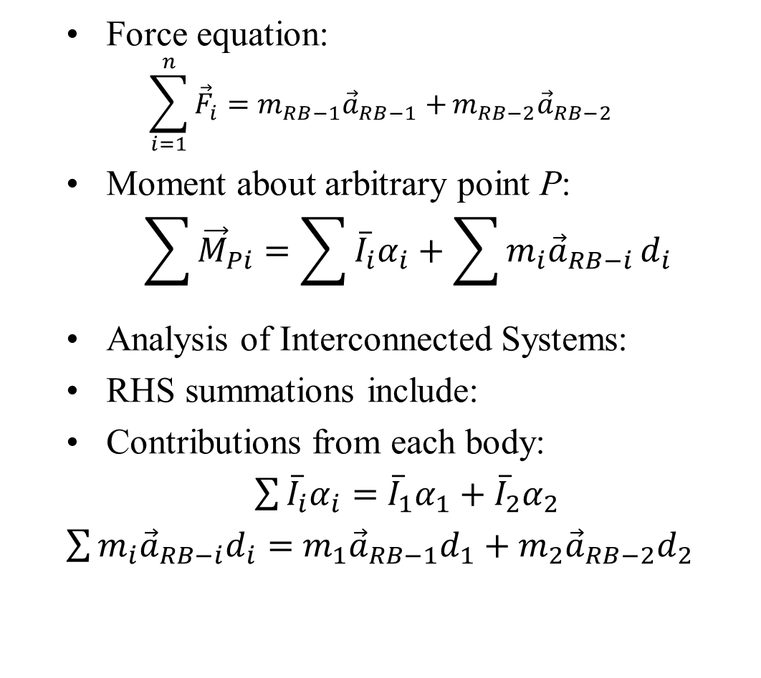



Systems of Interconnected Bodies
Force equation:
  $$\sum_{i=1}^{n}{{\vec{F}}_{i}=m_{RB−1}{\vec{a}}_{RB−1}+}m_{RB−2}{\vec{a}}_{RB−2}$$
Moment about arbitrary point P:
$$\sum{{\vec{M}}_{Pi}}=\sum{{\overline{I}}_{i}α_{i}}+\sum{m_{i}{\vec{a}}_{RB−i}}d_{i}$$
Analysis of Interconnected Systems:
RHS summations include:
Contributions from each body:
$\sum{{\overline{I}}_{i}α_{i}}=$ ${\overline{I}}_{1}α_{1}+{\overline{I}}_{2}α_{2}$
$\sum{m_{i}{\vec{a}}_{RB−i}d_{i}}=$ $m_{1}{\vec{a}}_{RB−1}d_{1}+m_{2}{\vec{a}}_{RB−2}d_{2}$
$$∙$$
$$d_{1}$$
$$d_{2}$$
P
Kinematic Diagram of System

Slide 4
Analysis of Interconnected Systems
Alternative:
Analyze bodies separately
Solve equations simultaneously
Key idea:
Treat system as whole
simplifies force analysis
But may increase unknowns
If unknowns > equations:
Equations of motion are insufficient
Must:
Use additional methods
Possible approaches:
Kinematic relations
Virtual work
Lagrange equations

Slide 5
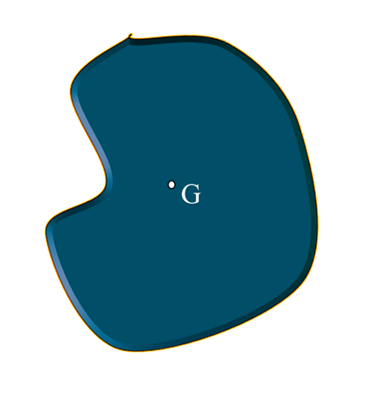


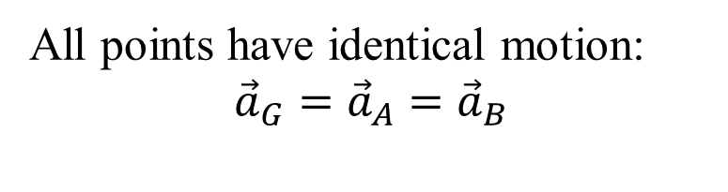


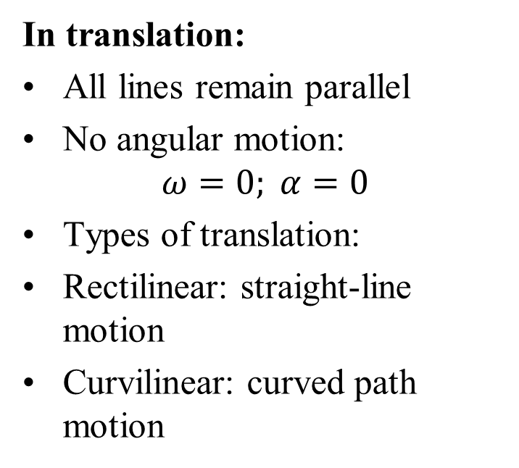

Rigid-Body Translation
In translation:
All lines remain parallel
No angular motion:
$$ω=0; α=0$$
Types of translation:
Rectilinear: straight-line motion
Curvilinear: curved path motion
Path of G
$${\vec{F}}_{1}$$
FBD
$${\vec{F}}_{2}$$
$$≡$$
x
$$m{\vec{a}}_{RB}$$
$${\vec{F}}_{3}$$
y
All points have identical motion:
$${\vec{a}}_{G}={\vec{a}}_{A}={\vec{a}}_{B}$$
d
A
B
Kinematic Diagram

Slide 6

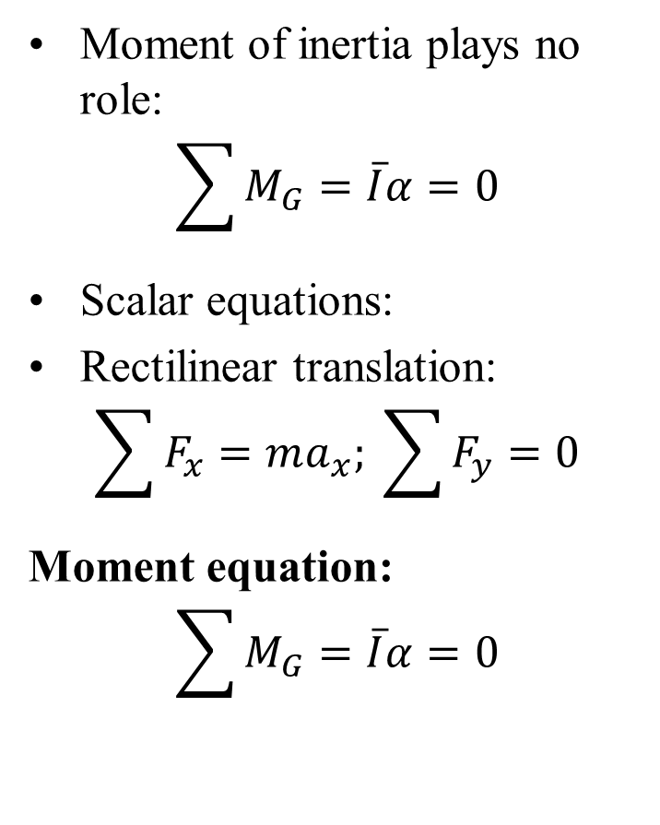
Equations for Rectilinear Translating Bodies
Moment of inertia plays no role:
$$\sum{M_{G}}=\overline{I}α=0$$
Scalar equations:
Rectilinear translation:
$$\sum{F_{x}}=ma_{x}; \sum{F_{y}}=0$$
Moment equation:
$$\sum{M_{G}}=\overline{I}α=0$$
Path of G
$${\vec{F}}_{1}$$
FBD
$${\vec{F}}_{2}$$
$$≡$$
x
$$m{\vec{a}}_{RB}$$
$${\vec{F}}_{3}$$
y
d
P
$$\sum{M_{P}}=mad$$
Kinematic Diagram

Slide 7

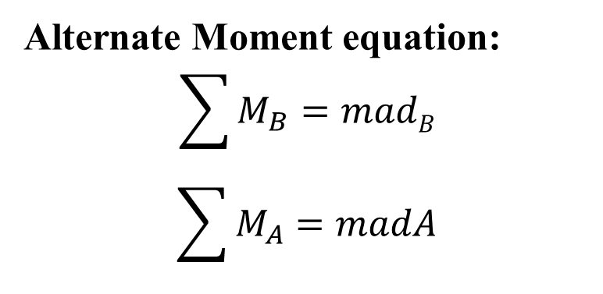



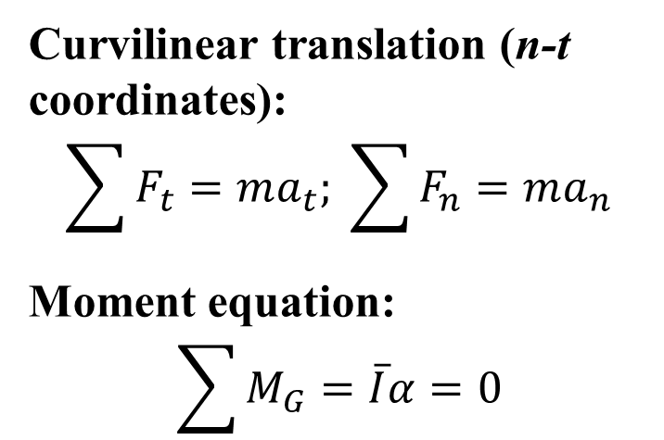
Equations for Curvilinear Translating Bodies
Curvilinear translation (n-t coordinates):
$$\sum{F_{t}}=ma_{t}; \sum{F_{n}}=ma_{n}$$
Moment equation:
$$\sum{M_{G}}=\overline{I}α=0$$
$${\vec{F}}_{1}$$
t
FBD
$${\vec{F}}_{2}$$
Path of G
$$≡$$
n
t
$${\vec{F}}_{3}$$
$$m{\vec{a}}_{RB−t}$$
Alternate Moment equation:
$$\sum{M_{B}}=madB$$
$$\sum{M_{A}}=madA$$
n
d_{A}
d_{B}
A
B
Kinematic Diagram
$$m{\vec{a}}_{RB−n}$$
n

Slide 8
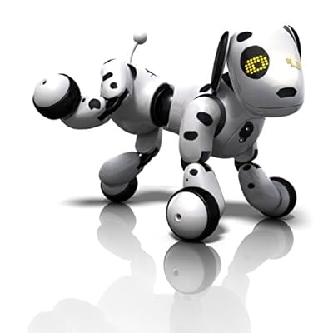





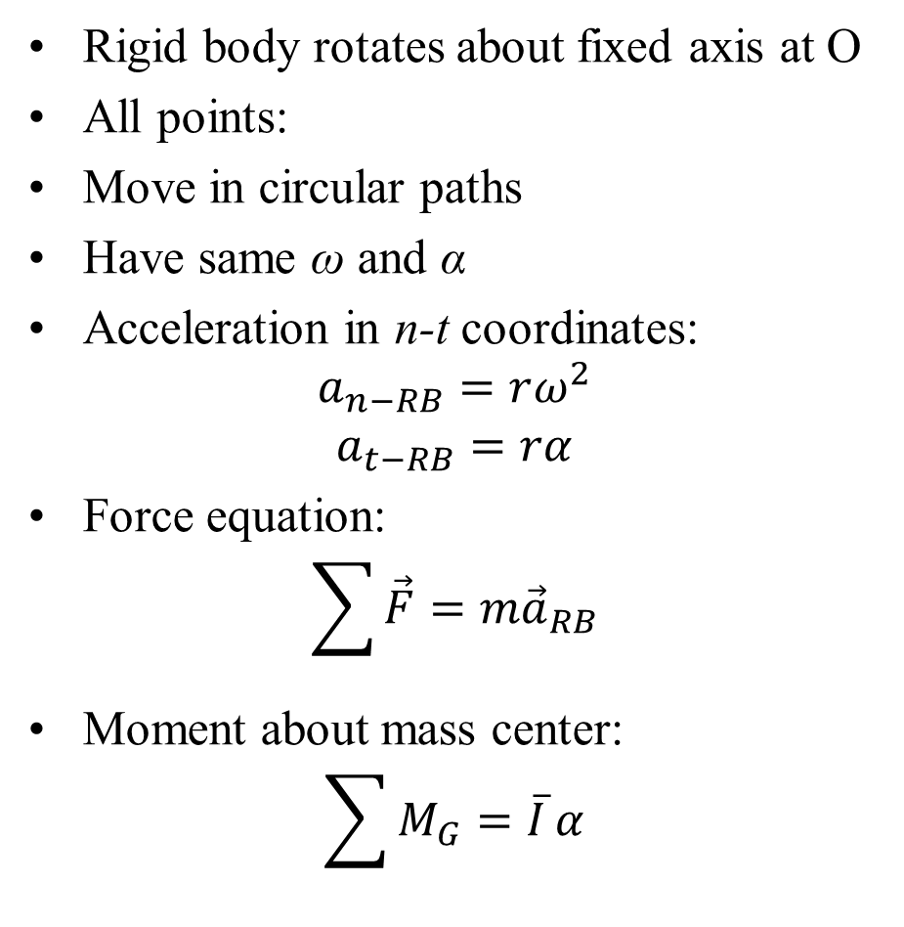

Fixed-Axis Rotation
Rigid body rotates about fixed axis at O
All points:
Move in circular paths
Have same ω and α
Acceleration in n-t coordinates:
$$a_{n−RB}=rω^{2}$$
$$a_{t−RB}=rα$$
Force equation:
$$\sum{\vec{F}=m{\vec{a}}_{RB}}$$
Moment about mass center:
$$\sum{M_{G}=\overline{I}}α$$
$$α$$
$$ω$$
or
$$ω$$
$$a_{t−RB}$$
t
$$a_{n−RB}$$
n
O

Slide 9


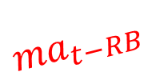





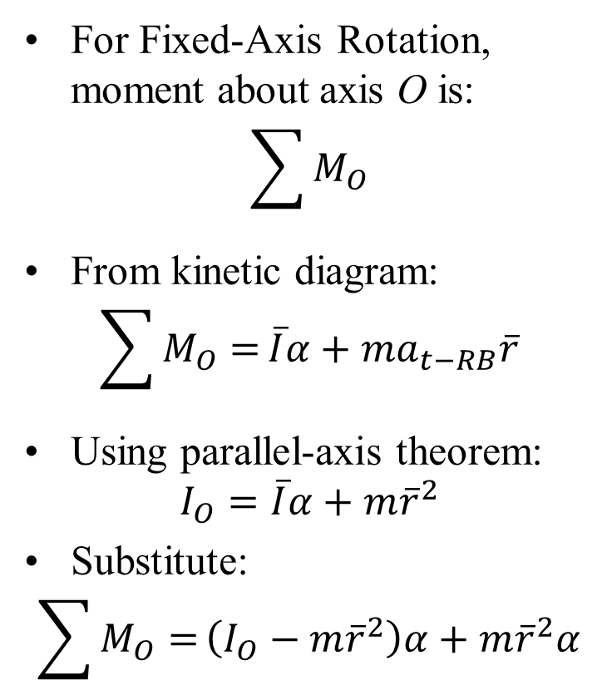

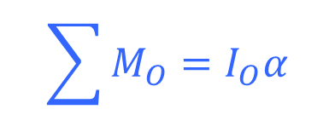
Moment Equation for Fixed-Axis Rotation
For Fixed-Axis Rotation, moment about axis O is:
$$\sum{M_{O}}$$
From kinetic diagram:
$$\sum{M_{O}=}\overline{I}α+ma_{t−RB}\overline{r}$$
Using parallel-axis theorem:
$$I_{O}=\overline{I}α+m{\overline{r}}^{2}$$
Substitute:
$$\sum{M_{O}=}\left(I_{O}−m{\overline{r}}^{2}\right)α+m{\overline{r}}^{2}α$$
$${\vec{F}}_{1}$$
$${\vec{F}}_{2}$$
FBD
$${\vec{r}}_{RB}$$
O
$$≡$$
$${\vec{F}}_{3}$$
$$\overline{I}α$$
$${ma}_{t−RB}$$
$$ma_{n−RB}$$
$$\overline{r}$$
O
$$\sum{M_{O}=I_{O}α}$$
Kinematic Diagram

Slide 10
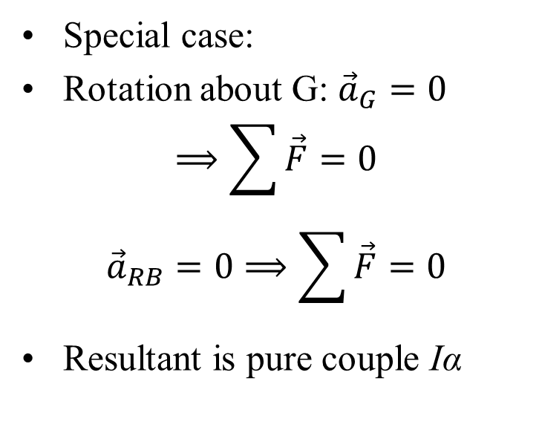
Moment Equation for Fixed-Axis Rotation
$${\vec{F}}_{1}$$
Special case:
Rotation about G: ${\vec{a}}_{G}=0$
$$⟹\sum{\vec{F}}=0$$
$${\vec{a}}_{RB}=0⟹\sum{\vec{F}}=0$$
Resultant is pure couple Iα
$${\vec{F}}_{2}$$
$${\vec{r}}_{RB}$$
O
$$≡$$
$${\vec{F}}_{3}$$
$$\overline{I}α$$
$${ma}_{t−RB}$$
$$ma_{n−RB}$$
O

Slide 11
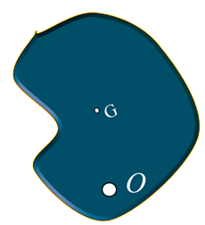



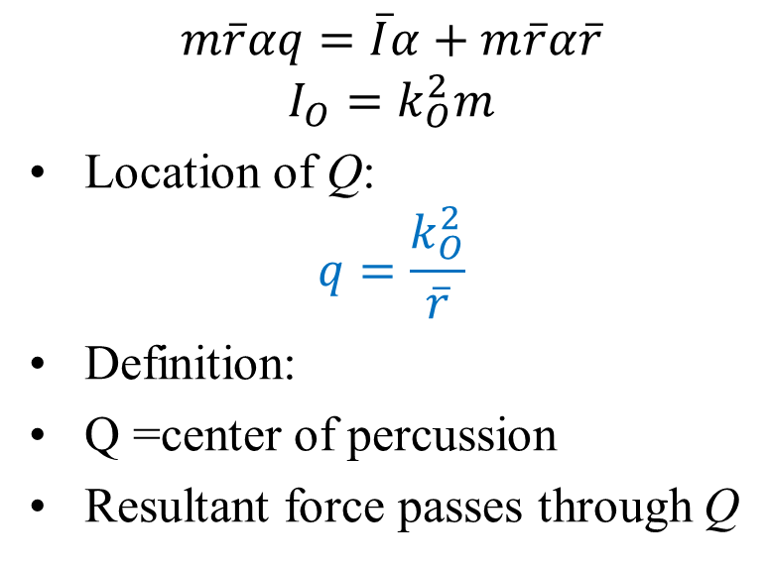

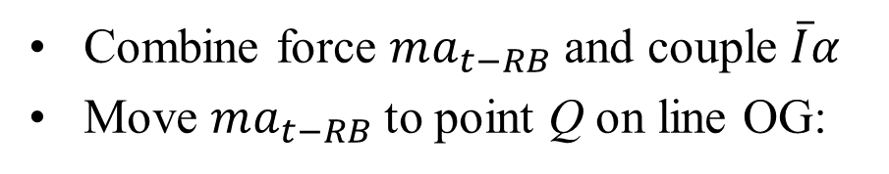

Center of Percussion
Combine force $ma_{t−RB}$ and couple $\overline{I}α$
Move $ma_{t−RB}$to point Q on line OG:
$$α$$
Q
$$m\overline{r}α$$
$$m\overline{r}ω^{2}$$
$$m\overline{r}αq=\overline{I}α+m\overline{r}α\overline{r}$$
$$I_{O}=k_{O}^{2}m$$
Location of Q:
$$q=\frac{k_{O}^{2}}{\overline{r}}$$
Definition:
Q =center of percussion
Resultant force passes through Q
$$q$$
$$\overline{r}$$
Physical meaning:
No reaction moment at Q
Important in impact and rotation problems

Slide 12
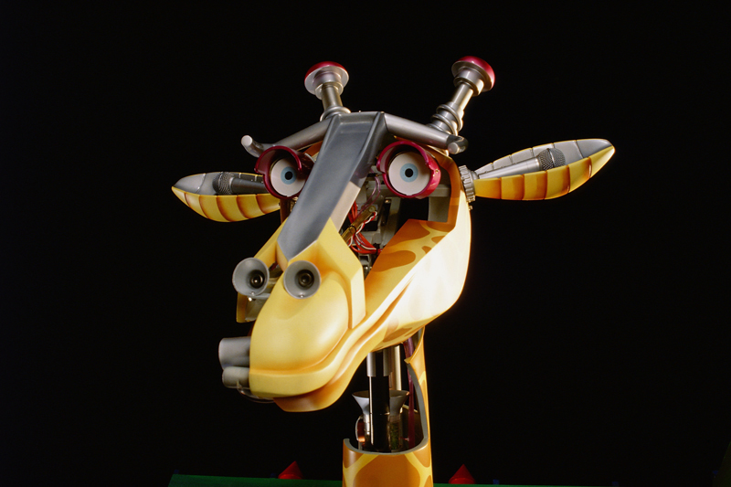
Energy To Be Carried…..

Slide 13
Work–Energy Relations: Overview
Developed previously for:
Particles Systems of connected particles
Key idea:
Motion results from cumulative effect of forces
Acting through distances (work)
Advantages:
Relates velocity change directly to energy needs
Avoids solving acceleration explicitly
Especially useful for: Finite displacements Complex force systems

Slide 14
Work–Energy Relations: Overview
For conservative forces:
Use energy conservation
Analyze initial and final states
Work–energy method:
Eliminates the need to:
Find acceleration
Perform time integration
Extension:
Applicable to rigid-body motion

Slide 15
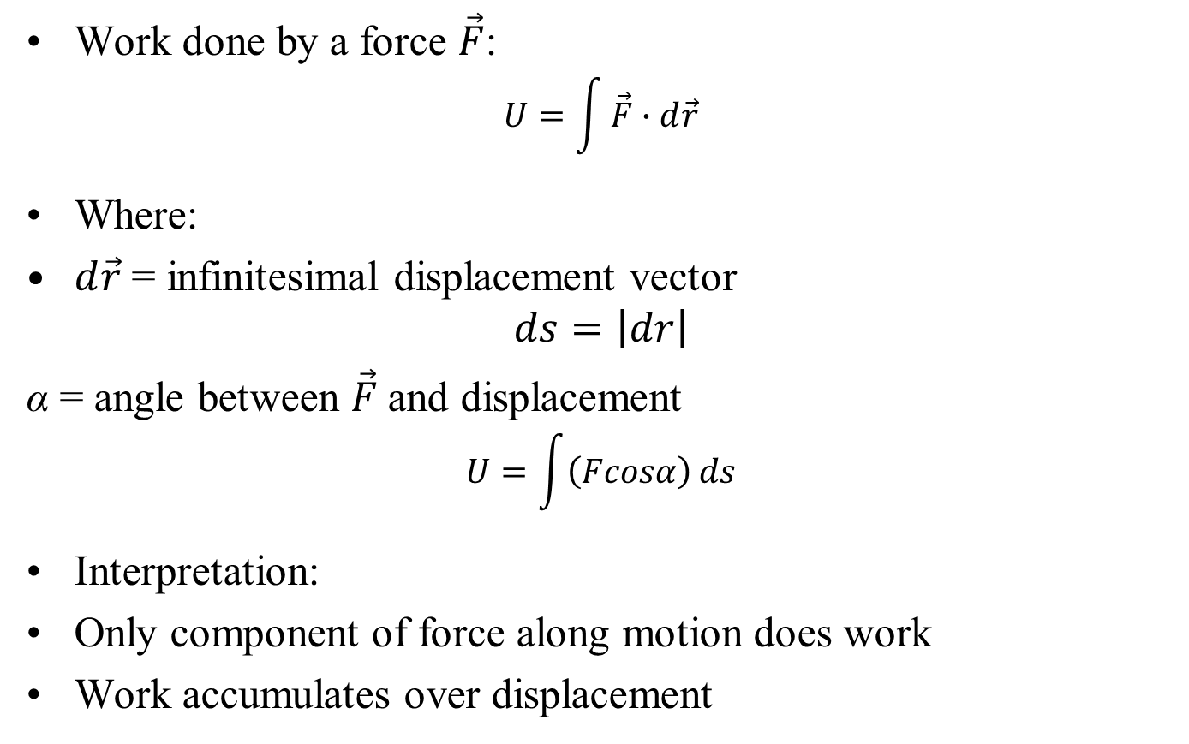
Work of Forces
Work done by a force $\vec{F}$:
$$U=\int{\vec{F}∙d\vec{r}}$$
Where:
$d\vec{r}$ = infinitesimal displacement vector
$$ds=\left|dr\right|$$
α = angle between $\vec{F}$and displacement
$$U=\int{\left(Fcosα\right)}ds$$
Interpretation:
Only component of force along motion does work
Work accumulates over displacement

Slide 16











Work of Couples
$$\vec{F}$$
$$\vec{F}$$
B′
B
$$bdθ$$
B′′
$$dθ$$
$$b$$
$$dθ$$
$$≡$$
A
A′
$$\vec{F}$$
$$\vec{F}$$
$$M$$
Work done by a couple M=Fb which acts on a rigid body during its motion???

Slide 17










Work of Forces
$$\vec{F}$$
$$\vec{F}$$
B′
B
$$bdθ$$
B′′
$$b$$
$$dθ$$
A
A′
Work = Energy transfer by forces
$$\vec{F}$$
$$\vec{F}$$
$$dθ$$
Translation work cancels
$$≡$$
$$M$$

Slide 18
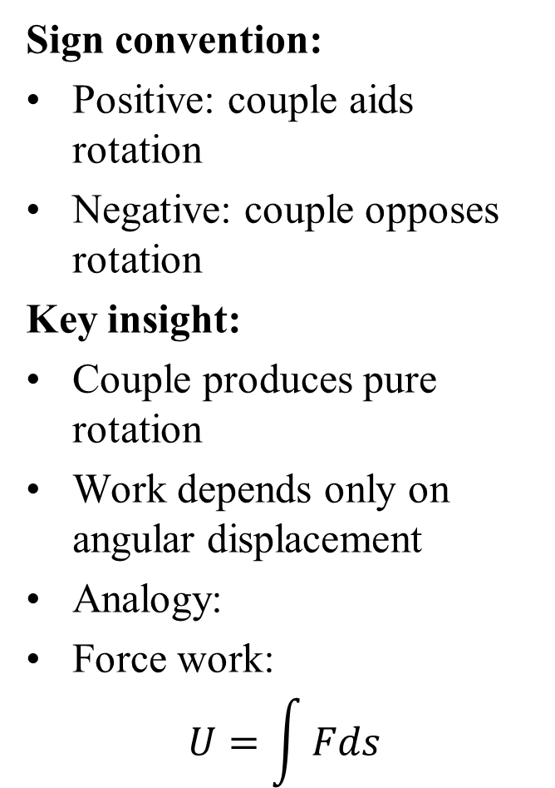
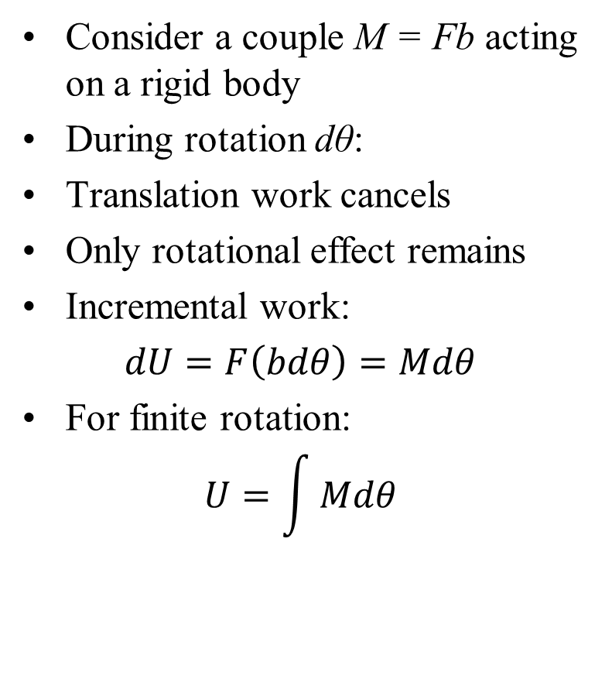
Work of Couples
Consider a couple M = Fb acting on a rigid body
During rotation dθ:
Translation work cancels
Only rotational effect remains
Incremental work:
$dU=F\left(bdθ\right)=Mdθ$
For finite rotation:
$$U=\int{Mdθ}$$
Sign convention:
Positive: couple aids rotation
Negative: couple opposes rotation
Key insight:
Couple produces pure rotation
Work depends only on angular displacement
Analogy:
Force work:
$$U=\int{Fds}$$

Slide 19
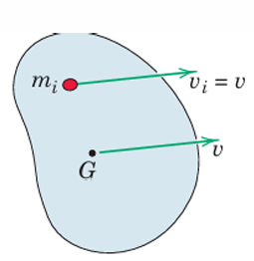
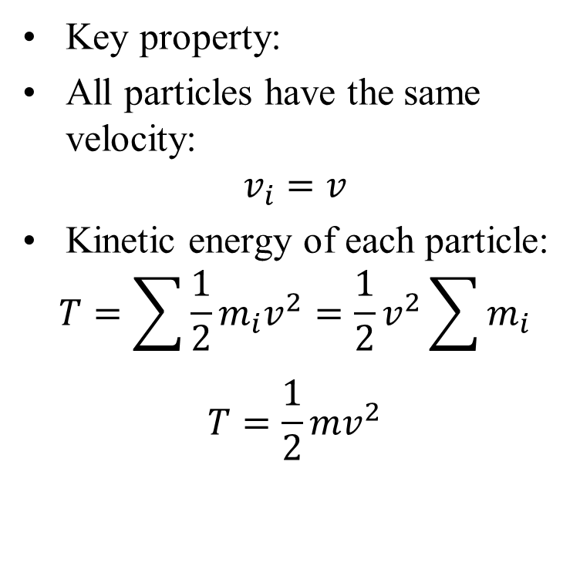
Kinetic Energy: Translation
Consider a rigid body in pure translation
Key property:
All particles have the same velocity:
$$v_{i}=v$$
Kinetic energy of each particle:
$$T=\sum{\frac{1}{2}m_{i}v^{2}}=\frac{1}{2}v^{2}\sum{m_{i}}$$
$$T=\frac{1}{2}mv^{2}$$
Translation
This expression holds for both rectilinear and curvilinear translation.

