Slide 1
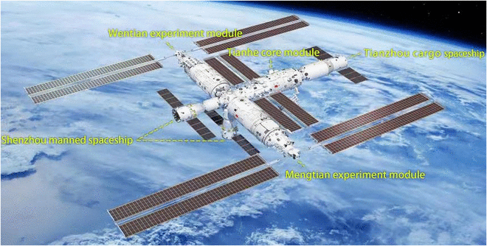


Kinetics of Rigid Bodies
P M V Subbarao
Professor & Head
Mechanical Engineering Department
Bonded Particles: The Mechanics of Real Bodies

Slide 2

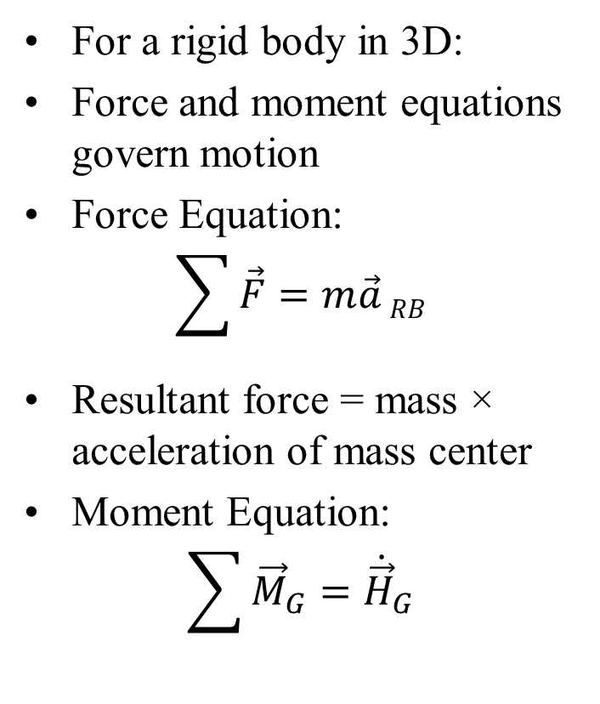
General Equations of Motion
For a rigid body in 3D:
Force and moment equations govern motion
Force Equation:
$$\sum{\vec{F}=m\vec{a}}RB$$
Resultant force = mass × acceleration of mass center
Moment Equation:
$$\sum{{\vec{M}}_{G}={\dot{\vec{H}}}_{G}}$$
Moment about G = rate of change of angular momentum
External forces can be replaced by:
Resultant force at G
Equivalent couple
This simplifies analysis of:
Translation
Rotation
Leads to clearer understanding of rigid-body motion

Slide 3









Free-Body Diagram
$${\vec{F}}_{2}$$
$${\vec{F}}_{3}$$
$${\vec{F}}_{1}$$
$${\vec{F}}_{4}$$
$${\vec{F}}_{n}$$
G
$$∙$$
Free-Body Diagram
Shows all external forces
$$∙$$
$$∙$$
$$∙$$
$$∙$$
$$∙$$
$$∙$$
$${\vec{F}}_{5}$$
$${\vec{F}}_{7}$$
$${\vec{F}}_{6}$$

Slide 4
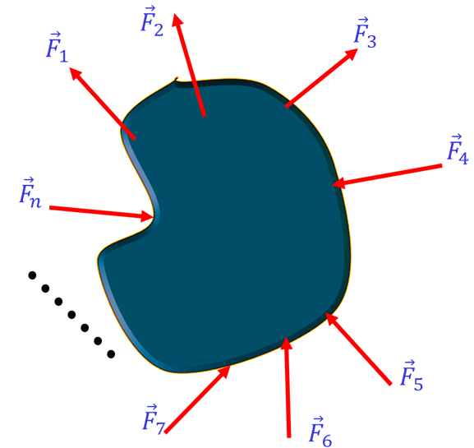
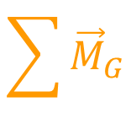
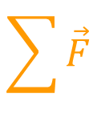

Free-Body & Equivalent System Diagram
$$\sum{{\vec{M}}_{G}}$$
Equivalent Force-Couple System
Resultant force at mass center
Equivalent moment
$$≡$$
G
G
$$\sum{\vec{F}}$$

Slide 5
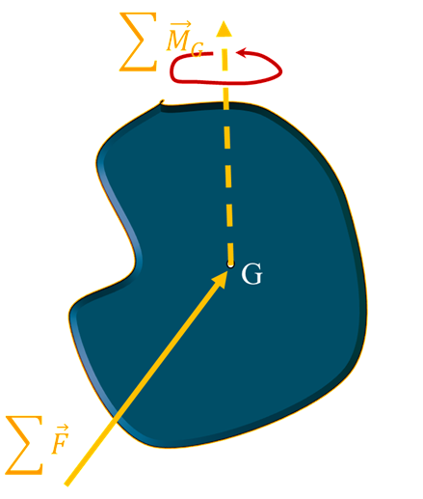
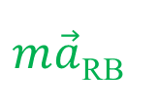




Equivalent System and Kinetic Diagram
$${\dot{\vec{H}}}_{G}$$
$$m\vec{a}RB$$
$$≡$$
G
Kinetic Diagram
Represents dynamic effects:
$${\dot{\vec{H}}}_{G}$$
&
$m\vec{a}$_{RB}

Slide 6
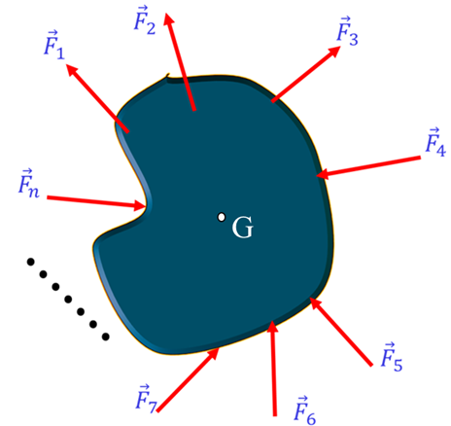

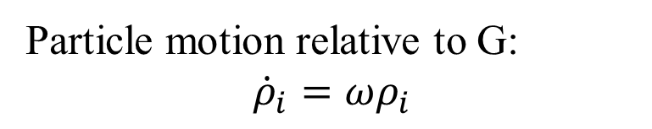



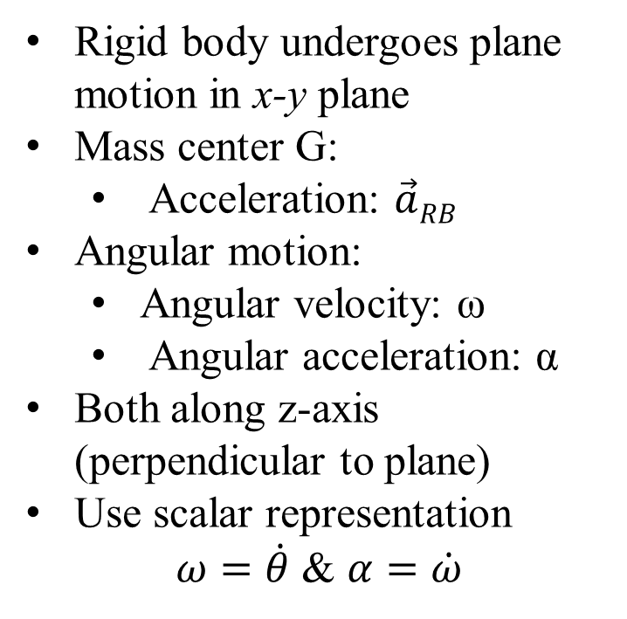

Plane Motion of Rigid Bodies
Rigid body undergoes plane motion in x-y plane
Mass center G:
  Acceleration: $\vec{a}RB$
Angular motion:
  Angular velocity: ω
  Angular acceleration: α
Both along z-axis (perpendicular to plane)
Use scalar representation
$ω=\dot{θ}$ & $α=\dot{ω}$
$$α$$
$$ω$$
$$\vec{a}RB$$
$$m_{i}$$
$$β$$
Particle motion relative to G:
$${\dot{ρ}}_{i}=ωρ_{i}$$

Slide 7


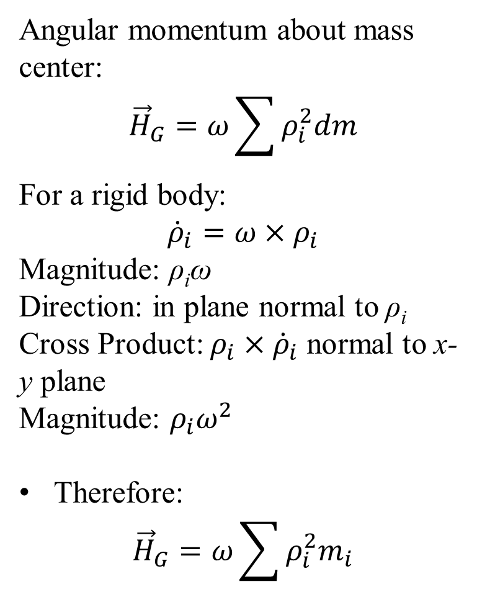
Angular Momentum of a Rigid Body
Angular momentum about mass center:
$${\vec{H}}_{G}=ω\sum{ρ_{i}^{2}dm}$$
For a rigid body:
$${\dot{ρ}}_{i}=ω×ρ_{i}$$
Magnitude: ρ_{i}ω
Direction: in plane normal to ρ_{i}
Cross Product: $ρ_{i}×{\dot{ρ}}_{i}$ normal to x-y plane
Magnitude: $ρ_{i}ω^{2}$
Therefore:
$${\vec{H}}_{G}=ω\sum{ρ_{i}^{2}m_{i}}$$
$$α$$
$$ω$$
$$\vec{a}RB$$
$$m_{i}$$
$$β$$

Slide 8

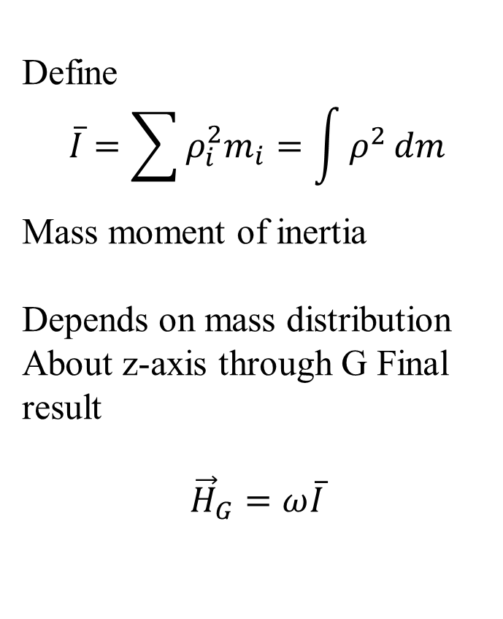
Plane Motion of Rigid Bodies
Define
$$\overline{I}=\sum{ρ_{i}^{2}m_{i}}=\int{ρ^{2}}dm$$
Mass moment of inertia
Depends on mass distribution
About z-axis through G Final result
$${\vec{H}}_{G}=ω\overline{I}$$
$$α$$
$$ω$$
$$\vec{a}$$
$$m_{i}$$
$$β$$

Slide 9
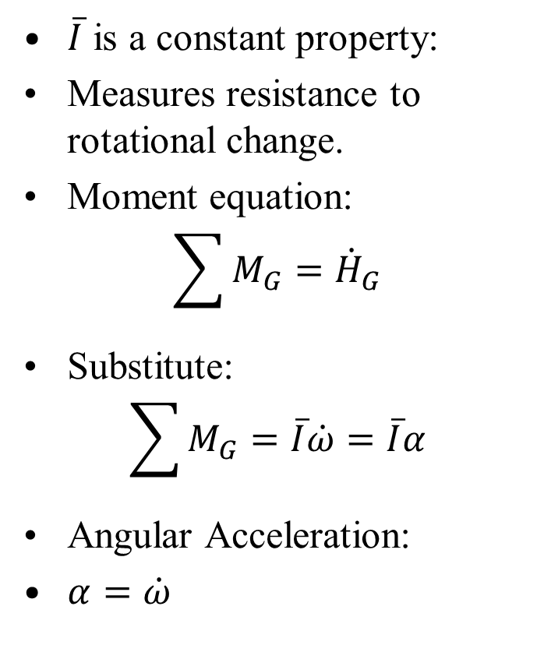
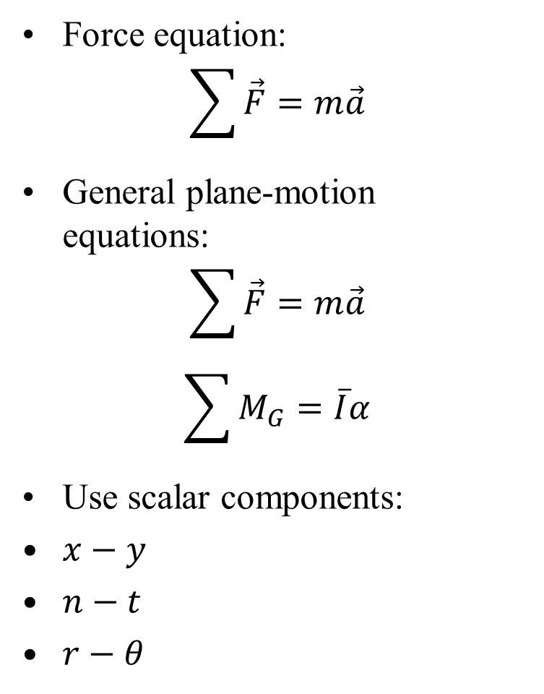
Equations of Motion for Plane Motion
Force equation:
$$\sum{\vec{F}}=m\vec{a}$$
General plane-motion equations:
$$\sum{\vec{F}}=m\vec{a}$$
$$\sum{M_{G}}=\overline{I}α$$
Use scalar components:
$x−y$
$n−t$
$r−θ$
$\overline{I}$ is a constant property:
Measures resistance to rotational change.
Moment equation:
$$\sum{M_{G}}={\dot{H}}_{G}$$
Substitute:
$$\sum{M_{G}}=\overline{I}\dot{ω}=\overline{I}α$$
Angular Acceleration:
$α=\dot{ω}$

Slide 10
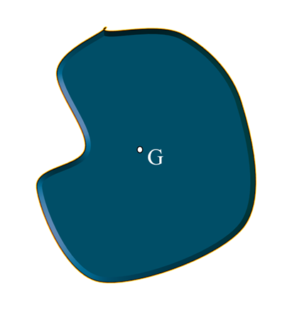




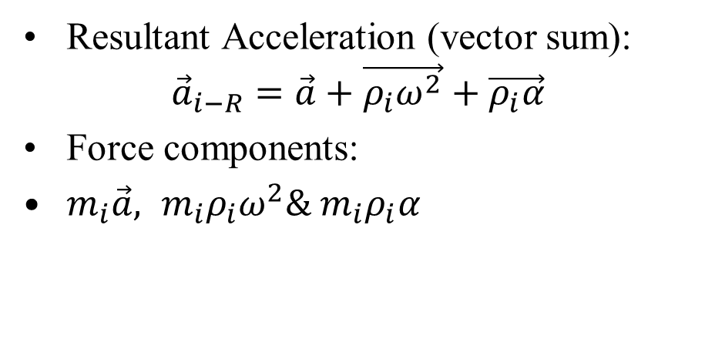






Alternative Derivation of Moment Equation
Consider forces on particle m_{i}:
$$x_{i}$$
Resultant Acceleration (vector sum):
$${\vec{a}}_{i−R}=\vec{a}+\vec{ρ_{i}ω^{2}}+\vec{ρ_{i}α}$$
Force components:
$m_{i}\vec{a}, {m_{i}ρ}_{i}ω^{2}\& m_{i}ρ_{i}α$
$$m_{i}\vec{a}$$
$$ω$$
$$m_{i}ρ_{i}α$$
$$β$$
$$m_{i}$$
or
$$y_{i}$$
$$m_{i}ρ_{i}ω^{2}$$
$$α$$
$$ω$$

Slide 11







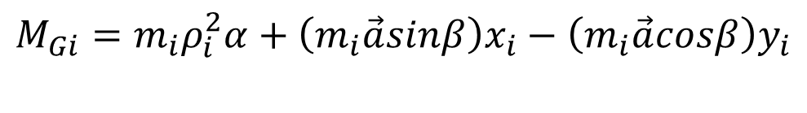



Alternative Derivation of Moment Equation
Moment about G:
$$M_{Gi}=m_{i}ρ_{i}^{2}α+\left(m_{i}\vec{a}sinβ\right)x_{i}−\left(m_{i}\vec{a}cosβ\right)y_{i}$$
$$x_{i}$$
$$m_{i}\vec{a}$$
$$ω$$
$$m_{i}ρ_{i}α$$
$$β$$
$$m_{i}$$
or
$$y_{i}$$
$$m_{i}ρ_{i}ω^{2}$$
$$α$$
$$ω$$

Slide 12
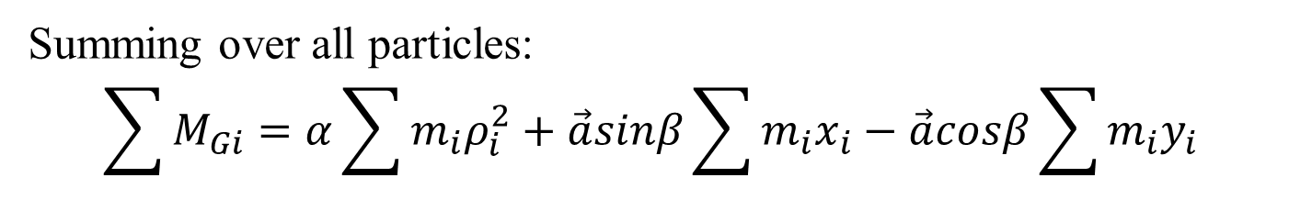
Alternative Derivation of Moment Equation
$$x_{i}$$
$$m_{i}\vec{a}$$
$$ω$$
$$m_{i}ρ_{i}α$$
$$β$$
$$m_{i}$$
or
$$y_{i}$$
$$m_{i}ρ_{i}ω^{2}$$
$$α$$
$$ω$$
Summing over all particles:
$$\sum{M_{Gi}}=α\sum{m_{i}ρ_{i}^{2}}+\vec{a}sinβ\sum{m_{i}x_{i}}−\vec{a}cosβ\sum{m_{i}y_{i}}$$

Slide 13
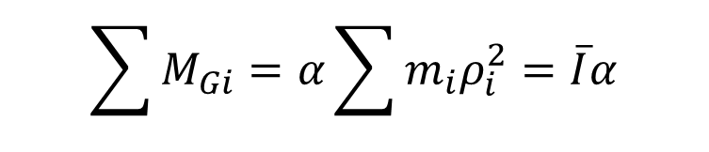
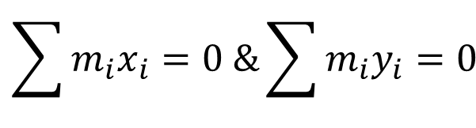
Alternative Derivation of Moment Equation
Since origin at G:
$$x_{i}$$
$$\sum{m_{i}x_{i}=0 \&\sum{m_{i}y_{i}}=0}$$
$$m_{i}\vec{a}$$
$$ω$$
$$m_{i}ρ_{i}α$$
$$β$$
$$m_{i}$$
or
$$y_{i}$$
$$m_{i}ρ_{i}ω^{2}$$
$$\sum{M_{Gi}}=α\sum{m_{i}ρ_{i}^{2}}=\overline{I}α$$
$$α$$
$$ω$$

Slide 14





Interpretation and Kinetic Diagram
$$α$$
$${\vec{a}}_{RB}$$
$$m{\vec{a}}_{RB}$$
$$\overline{I}α$$
$$≡$$
Internal forces:
Cancel in equal and opposite pairs
No contribution to M_{G}
Only external forces contribute

Slide 15
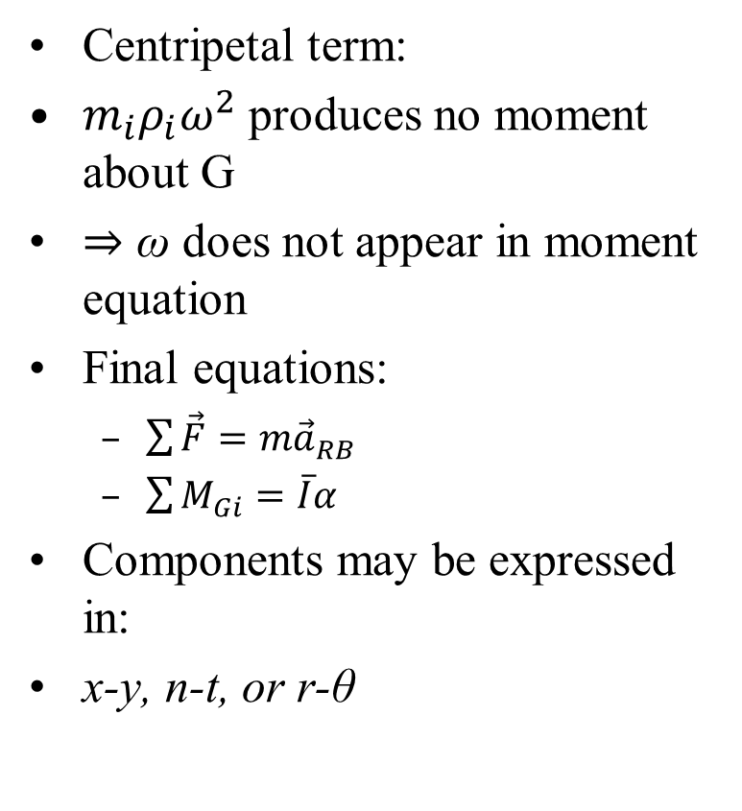
Interpretation and Kinetic Diagram
Centripetal term:
${m_{i}ρ}_{i}ω^{2}$ produces no moment about G
⇒ ω does not appear in moment equation
Final equations:
  $\sum{\vec{F}}=m{\vec{a}}_{RB}$
  $\sum{M_{Gi}}=\overline{I}α$
Components may be expressed in:
x-y, n-t, or r-θ
$$m{\vec{a}}_{RB}$$
$$\overline{I}α$$

Slide 16
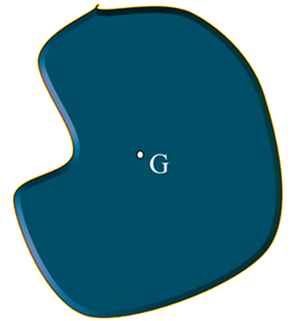


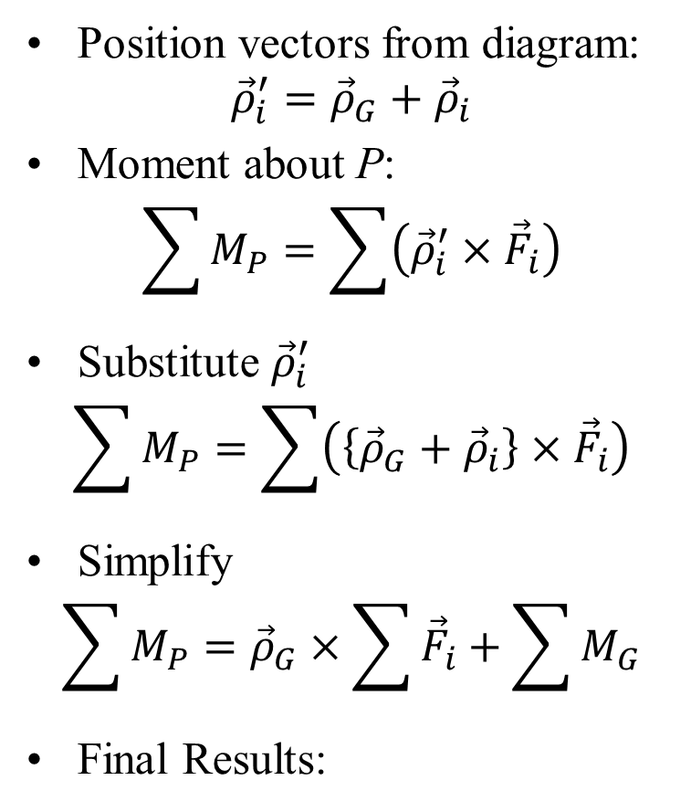







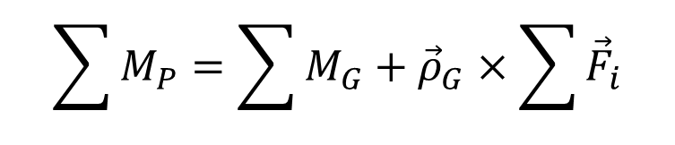
Moment Equation About arbitrary fixed Point P
Position vectors from diagram:
$${\vec{ρ}}_{i}^{′}={\vec{ρ}}_{G}+{\vec{ρ}}_{i}$$
Moment about P:
$$\sum{M_{P}=\sum{\left({\vec{ρ}}_{i}^{′}×{\vec{F}}_{i}\right)}}$$
Substitute ${\vec{ρ}}_{i}^{′}$
$$\sum{M_{P}=\sum{\left(\left\{{\vec{ρ}}_{G}+{\vec{ρ}}_{i}\right\}×{\vec{F}}_{i}\right)}}$$
Simplify
$$\sum{M_{P}={\vec{ρ}}_{G}×\sum{{\vec{F}}_{i}}}+\sum{M_{G}}$$
Final Results:
$$m_{i}$$
$${\vec{ρ}}_{i}$$
$${\vec{ρ′}}_{i}$$
$${\vec{r}}_{i}$$
$${\vec{ρ}}_{G}$$
$${\vec{r}}_{G}$$
$$∙$$
P (arbitrary)
$$∙$$
$${\vec{r}}_{P}$$
O
(fixed)
$$\sum{M_{P}=\sum{M_{G}}+{\vec{ρ}}_{G}×\sum{{\vec{F}}_{i}}}$$

Slide 17
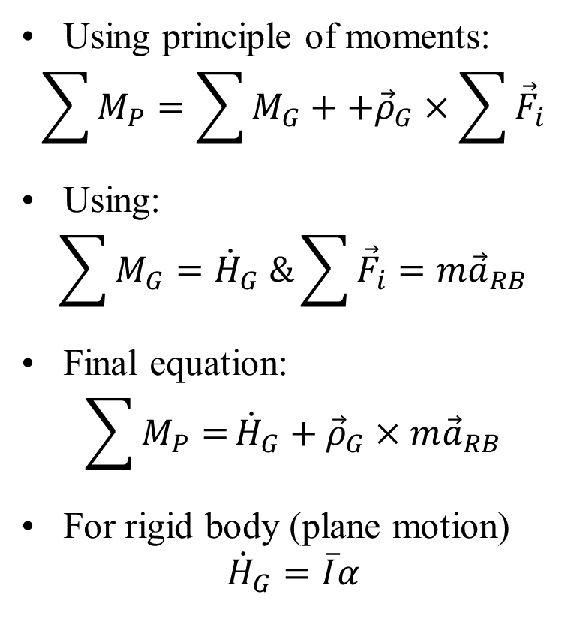
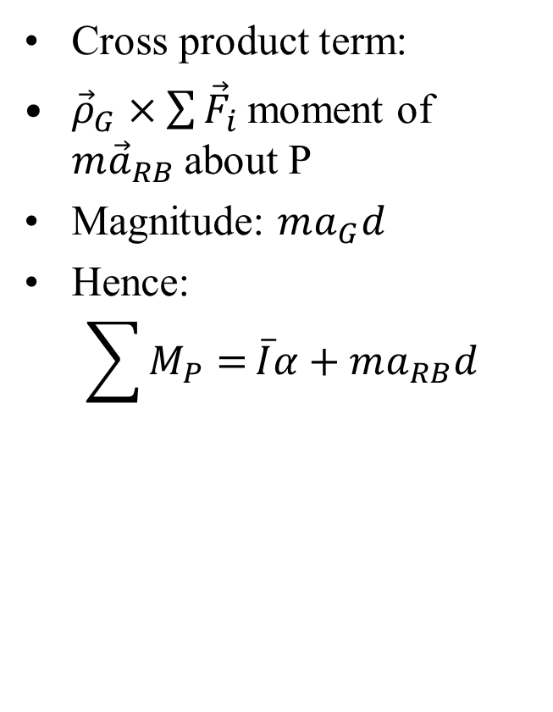
Moment Equation About fixed Point P
Using principle of moments:
$$\sum{M_{P}=\sum{M_{G}}}++{\vec{ρ}}_{G}×\sum{{\vec{F}}_{i}}$$
Using:
$$\sum{M_{G}}={\dot{H}}_{G} \&\sum{{\vec{F}}_{i}}=m{\vec{a}}_{RB}$$
Final equation:
$$\sum{M_{P}=}{\dot{H}}_{G}+{\vec{ρ}}_{G}×m{\vec{a}}_{RB}$$
For rigid body (plane motion)
$${\dot{H}}_{G}=\overline{I}α$$
Cross product term:
${\vec{ρ}}_{G}×\sum{{\vec{F}}_{i}}$moment of $m{\vec{a}}_{RB}$about P
Magnitude: $ma_{G}d$
Hence:
$$\sum{M_{P}=}\overline{I}α+ma_{RB}d$$

Slide 18















Moment Equation About fixed Point P
$${\vec{F}}_{2}$$
$$α$$
$${\vec{F}}_{3}$$
$${\vec{F}}_{1}$$
d
$$∙$$
$$∙$$
$${\vec{a}}_{RB}$$
P
P
$$m{\vec{a}}_{RB}$$
$${\vec{F}}_{4}$$
$$\vec{ρ}$$
$$≡$$
G
$$\overline{I}α$$
$$∙$$
$$∙$$
$$∙$$
$${\vec{F}}_{5}$$
$$∙$$
$$∙$$
$${\vec{F}}_{n}$$

Slide 19
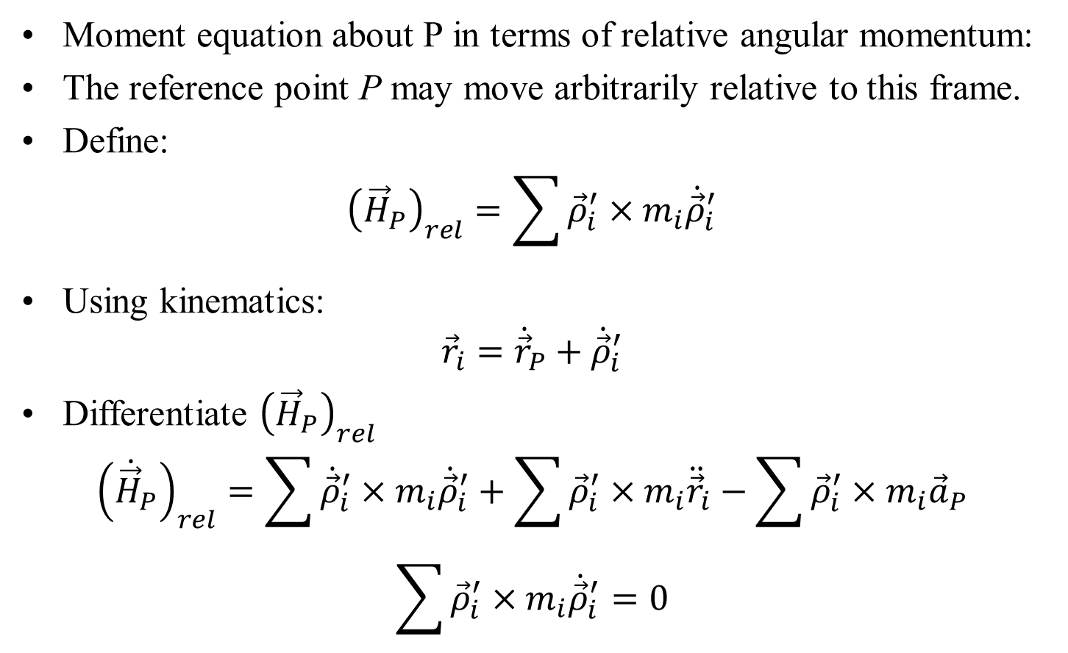
Recapitulation: Angular Momentum About moving point P
Moment equation about P in terms of relative angular momentum:
The reference point P may move arbitrarily relative to this frame.
Define:
$${\left({\vec{H}}_{P}\right)}_{rel}=\sum{{\vec{ρ}}_{i}^{′}×m_{i}{\dot{\vec{ρ}}}_{i}^{′}}$$
Using kinematics:
$${\vec{r}}_{i}={\dot{\vec{r}}}_{P}+{\dot{\vec{ρ}}}_{i}^{′}$$
Differentiate ${\left({\vec{H}}_{P}\right)}_{rel}$
$${\left({\dot{\vec{H}}}_{P}\right)}_{rel}=\sum{{\dot{\vec{ρ}}}_{i}^{′}×m_{i}{\dot{\vec{ρ}}}_{i}^{′}}+\sum{{\vec{ρ}}_{i}^{′}×m_{i}{\ddot{\vec{r}}}_{i}}−\sum{{\vec{ρ}}_{i}^{′}×m_{i}{\vec{a}}_{P}}$$
$$\sum{{\vec{ρ}}_{i}^{′}×m_{i}{\dot{\vec{ρ}}}_{i}^{′}}=0$$

Slide 20
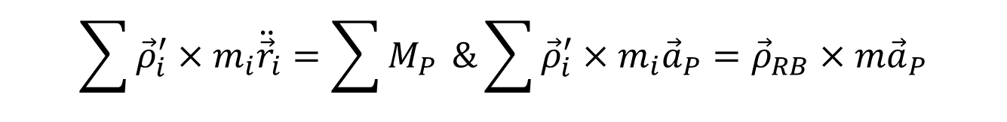
Moment Equation About Moving Point P
$${\vec{F}}_{2}$$
$$α$$
$${\vec{F}}_{3}$$
$${\vec{F}}_{1}$$
d
$$∙$$
$$∙$$
$${\vec{a}}_{RB}$$
P
P
$$m{\vec{a}}_{RB}$$
$${\vec{F}}_{4}$$
$$\vec{ρ}$$
$$≡$$
G
$$\overline{I}α$$
$$∙$$
$$∙$$
$$∙$$
$${\vec{F}}_{5}$$
$$\sum{{\vec{ρ}}_{i}^{′}×m_{i}{\ddot{\vec{r}}}_{i}}=\sum{M_{P}} \&\sum{{\vec{ρ}}_{i}^{′}×m_{i}{\vec{a}}_{P}}={\vec{ρ}}_{RB}×m{\vec{a}}_{P}$$
$$∙$$
$$∙$$
$${\vec{F}}_{n}$$

Slide 21
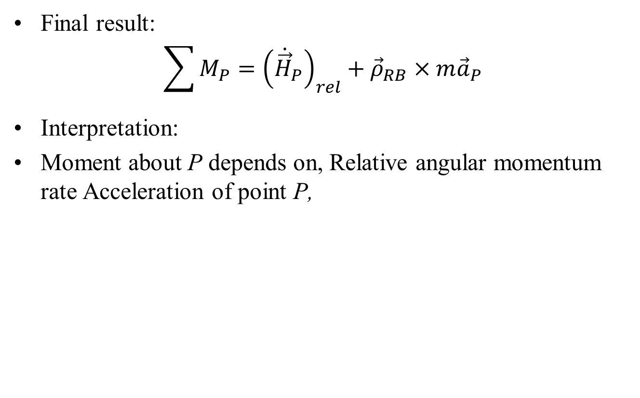
Recapitulation: Angular Momentum About moving point P
Final result:
$$\sum{M_{P}}={\left({\dot{\vec{H}}}_{P}\right)}_{rel}+{\vec{ρ}}_{RB}×m{\vec{a}}_{P}$$
Interpretation:
Moment about P depends on, Relative angular momentum rate Acceleration of point P,

Slide 22
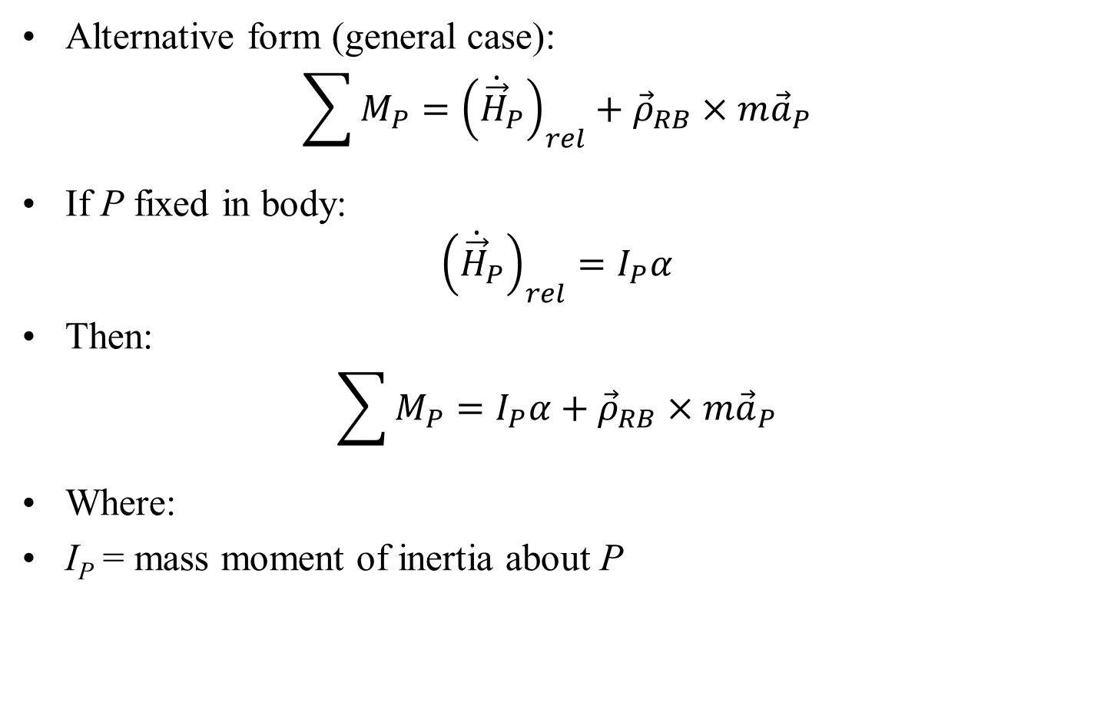
Further Generalization of Moment Equation
Alternative form (general case):
$$\sum{M_{P}}={\left({\dot{\vec{H}}}_{P}\right)}_{rel}+{\vec{ρ}}_{RB}×m{\vec{a}}_{P}$$
If P fixed in body:
$${\left({\dot{\vec{H}}}_{P}\right)}_{rel}=I_{P}α$$
Then:
$$\sum{M_{P}}=I_{P}α+{\vec{ρ}}_{RB}×m{\vec{a}}_{P}$$
Where:
I_{P} = mass moment of inertia about P

Slide 23
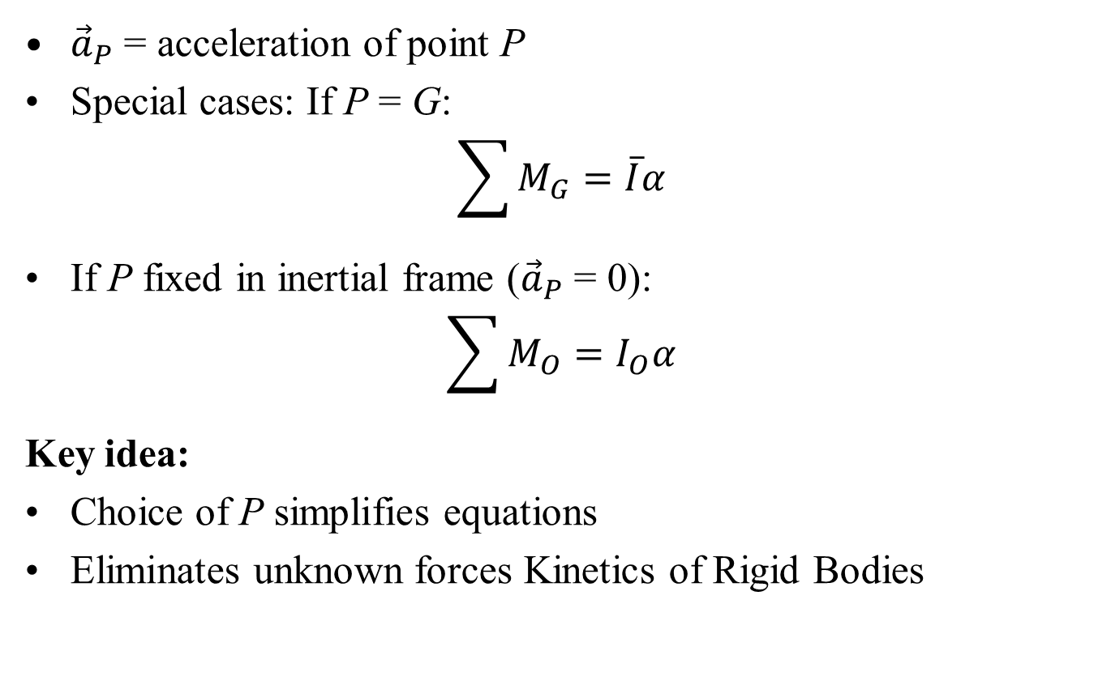
Further Generalization of Moment Equation
${\vec{a}}_{P}$ = acceleration of point P
Special cases: If P = G:
$$\sum{M_{G}}=\overline{I}α$$
If P fixed in inertial frame (${\vec{a}}_{P}$ = 0):
$$\sum{M_{O}}=I_{O}α$$
Key idea:
Choice of P simplifies equations
Eliminates unknown forces Kinetics of Rigid Bodies

Slide 24
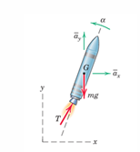
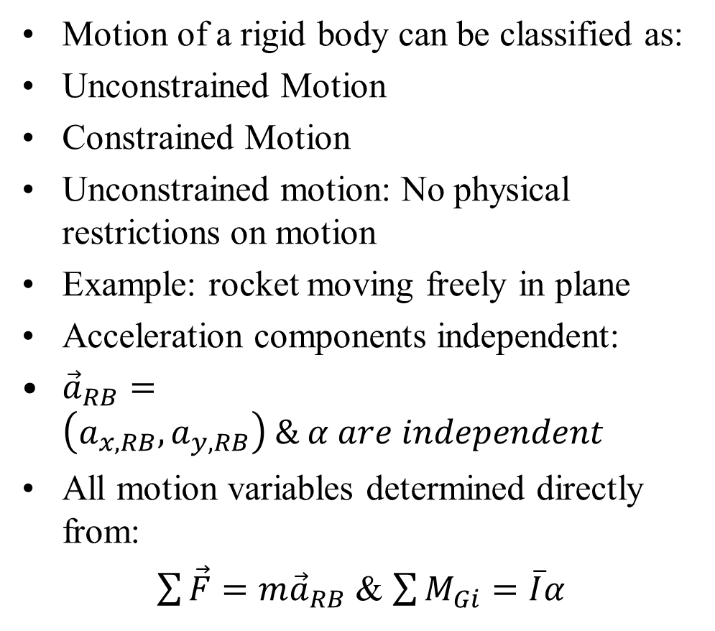
Unconstrained vs Constrained Motion
Motion of a rigid body can be classified as:
Unconstrained Motion
Constrained Motion
Unconstrained motion: No physical restrictions on motion
Example: rocket moving freely in plane
Acceleration components independent:
${\vec{a}}_{RB}=\left(a_{x,RB},a_{y,RB}\right) \& α are independent$
All motion variables determined directly from:
$\sum{\vec{F}}=m{\vec{a}}_{RB}$ & $\sum{M_{Gi}}=\overline{I}α$

Slide 25
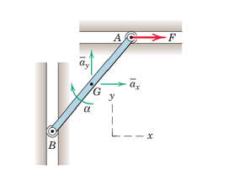
Kinematics of Constrained Motion
Constrained motion:
Motion restricted by guides/links
Example:
bar with sliding ends
Constraints impose:
Relationship between a_{x},a_{y} and α
Cannot determine motion from dynamics alone
Must combine:
Kinematics
Kinetics
General principle: Constraints ⇒ dependent motion variables
Key implication:
Solve kinematics first
Then apply equations of motion Without kinematics:
Problem is underdetermined Therefore:
Strong understanding of kinematics is essential

