Slide 1



Particle Mechanics Approach for Rocket Propulsion
P M V Subbarao
Professor & Head
Mechanical Engineering Department
Particle Mechanics: The Heart of Thrust Generation

Slide 2

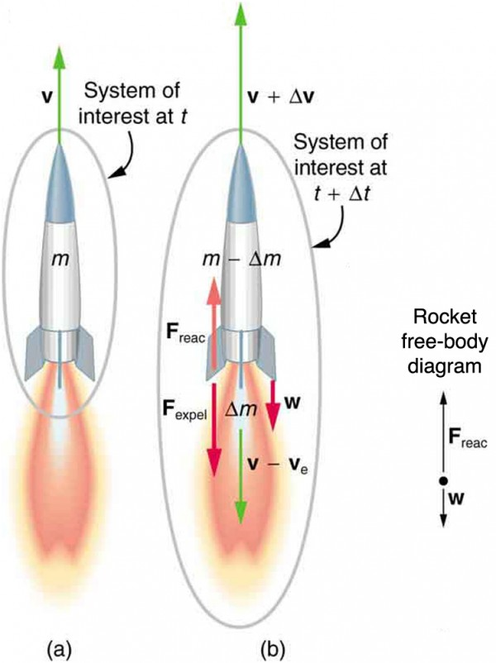
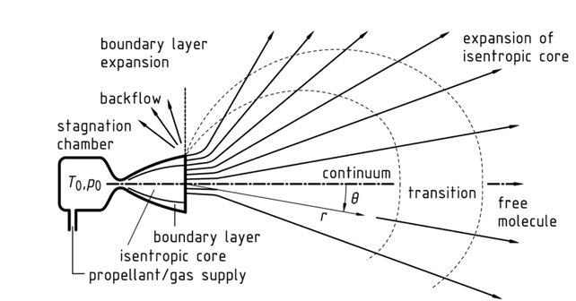
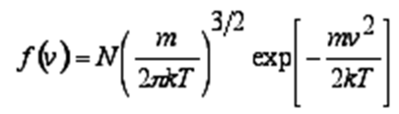














Billions of Particles Pushing A Giant Vehicle in Space
Rocket Motion in Space
Rocket Motion in Troposphere & Stratosphere
O
$$∙$$
$$∙$$
$$∙$$
$$∙$$
$$∙$$
$$∙$$
$$∙$$
$$∙$$
$$∙$$
$$∙$$
$$∙$$
$$∙$$
$$∙$$
$$∙$$
$$∙$$
$$∙$$
$$∙$$
$$∙$$
$$∙$$
$$∙$$
$$∙$$
$$∙$$
$$∙$$
$$∙$$
$$∙$$
$$∙$$
$$∙$$
$$∙$$
$$∙$$
$$∙$$
$$∙$$
$$∙$$
$$∙$$
$$∙$$
$$∙$$
$$∙$$
$$∙$$
$$∙$$
$$∙$$
$$∙$$
$$∙$$
$$∙$$
$$∙$$
$$∙$$
$$∙$$
$$∙$$
$$∙$$
$$∙$$
$$∙$$
$$∙$$
$$∙$$
$$∙$$
$$∙$$
$$∙$$
$$∙$$
$$∙$$
$$∙$$
$$∙$$
$$∙$$
$$∙$$
$$∙$$
$$∙$$
$$∙$$
$$∙$$
$$∙$$
$$∙$$
$$∙$$
$$∙$$
$$∙$$
$$∙$$
$$∙$$
$$∙$$
$$∙$$

Slide 3
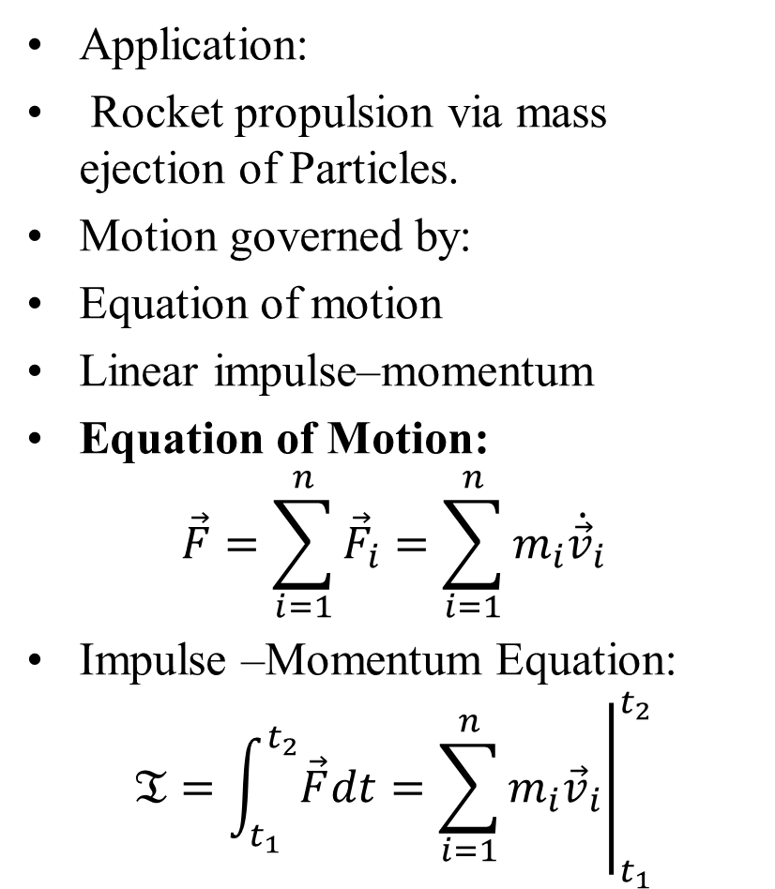

Particle Mechanics Approach: Rocket Propulsion
Application:
Rocket propulsion via mass ejection of Particles.
Motion governed by:
Equation of motion
Linear impulse–momentum
Equation of Motion:
$$\vec{F}=\sum_{i=1}^{n}{{\vec{F}}_{i}}=\sum_{i=1}^{n}{m_{i}{\dot{\vec{v}}}_{i}}$$
Impulse –Momentum Equation:
$$𝔗=\int_{t_{1}}^{t_{2}}{\vec{F}dt}={\left.\sum_{i=1}^{n}{m_{i}{\vec{v}}_{i}}\right|}_{t_{1}}^{t_{2}}$$
O
A belief that the ejection system must consist of the same set of particles throughout the interval from t₁ to t_{2.}
$$∙$$
$$∙$$
$$∙$$
$$∙$$
$$∙$$
$$∙$$
$$∙$$
$$∙$$
$$∙$$
$$∙$$
$$∙$$
$$∙$$
$$∙$$
$$∙$$
$$∙$$
$$∙$$
$$∙$$
$$∙$$
$$∙$$
$$∙$$
$$∙$$
$$∙$$
$$∙$$
$$∙$$
$$∙$$
$$∙$$
$$∙$$
$$∙$$
$$∙$$
$$∙$$
$$∙$$
$$∙$$
$$∙$$
$$∙$$
$$∙$$
$$∙$$
$$∙$$
$$∙$$

Slide 4
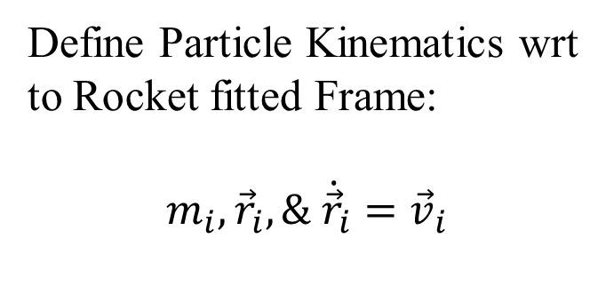


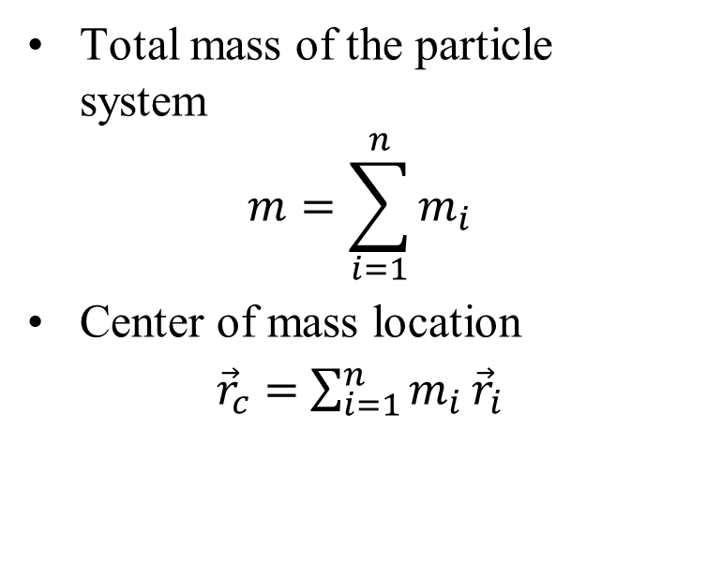

Billions of Particles Pushing A Giant Vehicle in Space
Define Particle Kinematics wrt to Rocket fitted Frame:
$$m_{i}, {\vec{r}}_{i}, \& {\dot{\vec{r}}}_{i}={\vec{v}}_{i}$$
O
Total mass of the particle system
$$m=\sum_{i=1}^{n}{m_{i}}$$
Center of mass location
${\vec{r}}_{c}=$ $\sum_{i=1}^{n}{m_{i}}{\vec{r}}_{i}$
$${\vec{r}}_{i}$$
$$∙$$
$$∙$$
$$∙$$
$$∙$$
$$m_{i}$$
$$∙$$
$$∙$$
$$∙$$
$$∙$$
$$∙$$
$$∙$$
$$∙$$
$$∙$$
$$∙$$
$$∙$$
$$∙$$
$$∙$$
$$∙$$
$$∙$$
$$∙$$
$$∙$$
$$∙$$
$$∙$$
$$∙$$
$$∙$$
$$∙$$
$$∙$$
$$∙$$
$$∙$$
$$∙$$
$$∙$$
$$∙$$
$$∙$$
$$∙$$
$$∙$$
$$∙$$
$$∙$$
$$∙$$
$$∙$$
$$∙$$
$$∙$$
$$∙$$
$$∙$$
$$∙$$
$$∙$$
$$∙$$
$$∙$$
$$∙$$
$$∙$$
$$∙$$
$$∙$$
$$∙$$
$$∙$$
$$∙$$
$$∙$$
$$∙$$
$$∙$$
$$∙$$
$$∙$$
$$∙$$
$$∙$$
$$∙$$
$$∙$$
$$∙$$
$$∙$$
$$∙$$
$$∙$$
$$∙$$
$$∙$$
$$∙$$
$$∙$$
$$∙$$
$$∙$$
$$∙$$

Slide 5
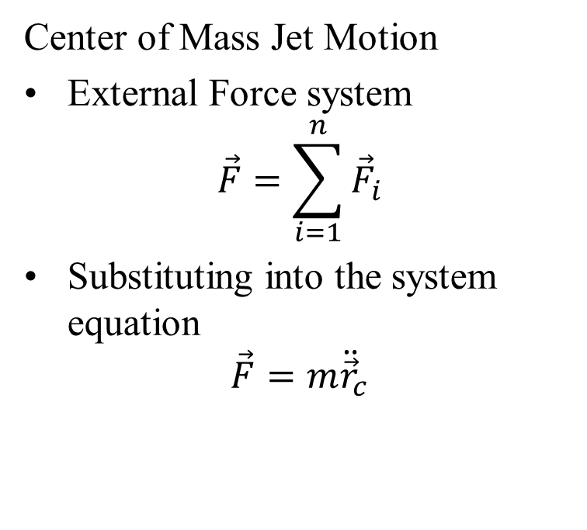
Billions of Particles Pushing A Giant Vehicle in Space
Center of Mass Jet Motion
External Force system
$$\vec{F}=\sum_{i=1}^{n}{{\vec{F}}_{i}}$$
Substituting into the system equation
$$\vec{F}=m{\ddot{\vec{r}}}_{c}$$
O
$$∙$$
$$∙$$
$$∙$$
$$∙$$
$$∙$$
$$∙$$
$$∙$$
$$∙$$
$$∙$$
$$∙$$
$$∙$$
$$∙$$
$$∙$$
$$∙$$
$$∙$$
$$∙$$
$$∙$$
$$∙$$
$$∙$$
$$∙$$
$$∙$$
$$∙$$
$$∙$$
$$∙$$
$$∙$$
$$∙$$
$$∙$$
$$∙$$
$$∙$$
$$∙$$
$$∙$$
$$∙$$
$$∙$$
$$∙$$
$$∙$$
$$∙$$
$$∙$$

Slide 6
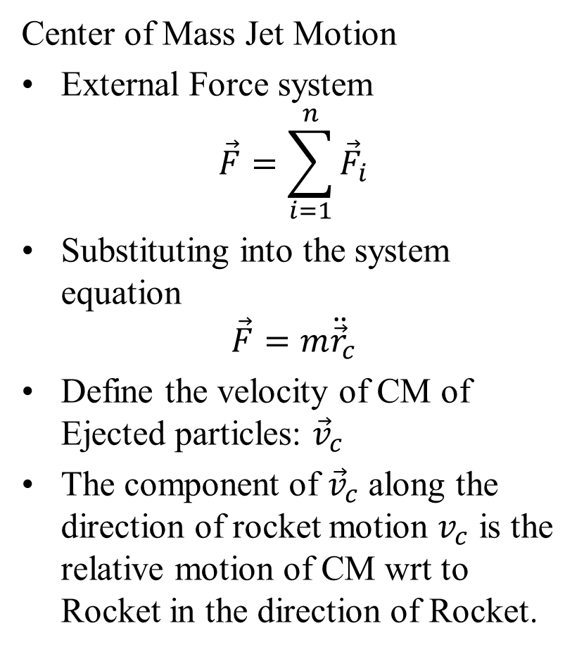
Billions of Particles Pushing A Giant Vehicle in Space
Center of Mass Jet Motion
External Force system
$$\vec{F}=\sum_{i=1}^{n}{{\vec{F}}_{i}}$$
Substituting into the system equation
$$\vec{F}=m{\ddot{\vec{r}}}_{c}$$
Define the velocity of CM of Ejected particles: ${\vec{v}}_{c}$
The component of ${\vec{v}}_{c}$ along the direction of rocket motion $v_{c}$ is the relative motion of CM wrt to Rocket in the direction of Rocket.
O
Scalar Approach Preferred here!
$$∙$$
$$∙$$
$$∙$$
$$∙$$
$$∙$$
$$∙$$
$$∙$$
$$∙$$
$$∙$$
$$∙$$
$$∙$$
$$∙$$
$$∙$$
$$∙$$
$$∙$$
$$∙$$
$$∙$$
$$∙$$
$$∙$$
$$∙$$
$$∙$$
$$∙$$
$$∙$$
$$∙$$
$$∙$$
$$∙$$
$$∙$$
$$∙$$
$$∙$$
$$∙$$
$$∙$$
$$∙$$
$$∙$$
$$∙$$
$$∙$$
$$∙$$
$$∙$$

Slide 7
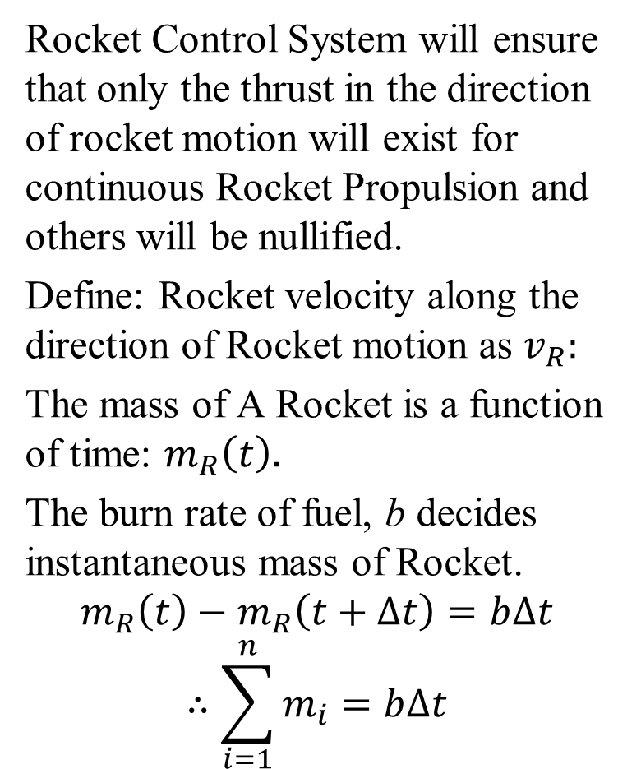
Billions of Particles Pushing A Giant Vehicle in Space: Scalar Model
Rocket Control System will ensure that only the thrust in the direction of rocket motion will exist for continuous Rocket Propulsion and others will be nullified.
Define: Rocket velocity along the direction of Rocket motion as $v_{R}:$
The mass of A Rocket is a function of time: $m_{R}\left(t\right).$
The burn rate of fuel, b decides instantaneous mass of Rocket.
$$m_{R}\left(t\right)−m_{R}\left(t+∆t\right)=b∆t$$
$$∴\sum_{i=1}^{n}{m_{i}}=b∆t$$
O
$$∙$$
$$∙$$
$$∙$$
$$∙$$
$$∙$$
$$∙$$
$$∙$$
$$∙$$
$$∙$$
$$∙$$
$$∙$$
$$∙$$
$$∙$$
$$∙$$
$$∙$$
$$∙$$
$$∙$$
$$∙$$
$$∙$$
$$∙$$
$$∙$$
$$∙$$
$$∙$$
$$∙$$
$$∙$$
$$∙$$
$$∙$$
$$∙$$
$$∙$$
$$∙$$
$$∙$$
$$∙$$
$$∙$$
$$∙$$
$$∙$$
$$∙$$
$$∙$$
$$∙$$

Slide 8
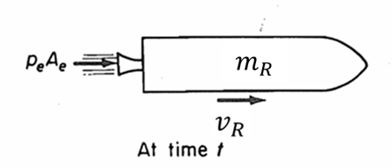
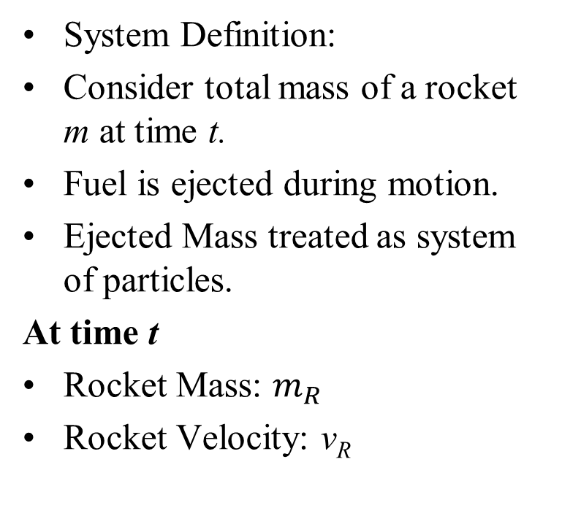
Rocket System at Successive Instants: Scalar Approach
System Definition:
Consider total mass of a rocket m at time t.
Fuel is ejected during motion.
Ejected Mass treated as system of particles.
At time t
Rocket Mass: $m_{R}$
Rocket Velocity: v_{R}
Although the rocket is moving in a vacuum, the pressure p_{e} exists because the exhaust gases are not fully expanded at the exit of the nozzle.

Slide 9
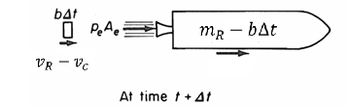
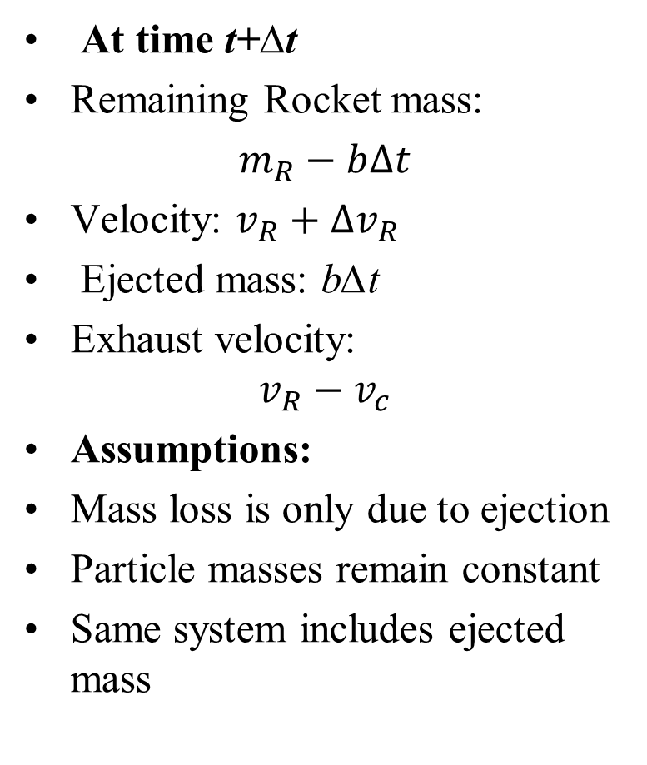

Rocket System at Successive Instants: Scalar Approach
At time t+∆t
Remaining Rocket mass:
$m_{R}−b∆t$
Velocity: $v_{R}+∆v_{R}$
Ejected mass: b∆t
Exhaust velocity:
$$v_{R}−v_{c}$$
Assumptions:
Mass loss is only due to ejection
Particle masses remain constant
Same system includes ejected mass
$$v_{R}+∆v_{R}$$

Slide 10

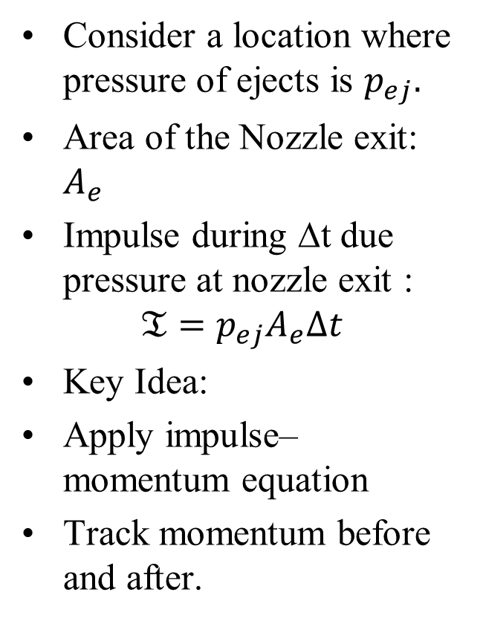

Impulse Generated Due to Particle Pressure
Consider a location where pressure of ejects is $p_{ej}.$
Area of the Nozzle exit: $A_{e}$
Impulse during ∆t due pressure at nozzle exit :
$$𝔗=p_{ej}A_{e}∆t$$
Key Idea:
Apply impulse–momentum equation
Track momentum before and after.
O
$$∙$$
$$p_{0}>p_{ejects}>0$$
$$∙$$
$$∙$$
$$∙$$
$$∙$$
$$∙$$
$$∙$$
$$∙$$
$$∙$$
$$∙$$
$$∙$$
$$∙$$
$$∙$$
$$∙$$
$$∙$$
$$∙$$
$$∙$$
$$∙$$
$$∙$$
$$∙$$
$$∙$$
$$∙$$
$$∙$$
$$∙$$
$$∙$$
$$∙$$
$$∙$$
$$∙$$
$$∙$$
$$∙$$
$$∙$$
$$∙$$
$$∙$$
$$p_{ejects}→0$$
$$∙$$
$$∙$$
$$∙$$
$$∙$$
$$∙$$

Slide 11
Particle Mechanics Approach: Rocket Propulsion
Important Assumption
System consists of same particles over time
Rocket Model (Simplified):
Vacuum (no gravity)
Nozzle exit area: A_{e}
Exit pressure: p_{ej}
Exhaust velocity CM(relative): v_{c}
O
$$∙$$
$$∙$$
$$∙$$
$$∙$$
$$∙$$
$$∙$$
$$∙$$
$$∙$$
$$∙$$
$$∙$$
$$∙$$
$$∙$$
$$∙$$
$$∙$$
$$∙$$
$$∙$$
$$∙$$
$$∙$$
$$∙$$
$$∙$$
$$∙$$
$$∙$$
$$∙$$
$$∙$$
$$∙$$
$$∙$$
$$∙$$
$$∙$$
$$∙$$
$$∙$$
$$∙$$
$$∙$$
$$∙$$
$$∙$$
$$∙$$
$$∙$$
$$∙$$
$$∙$$

Slide 12
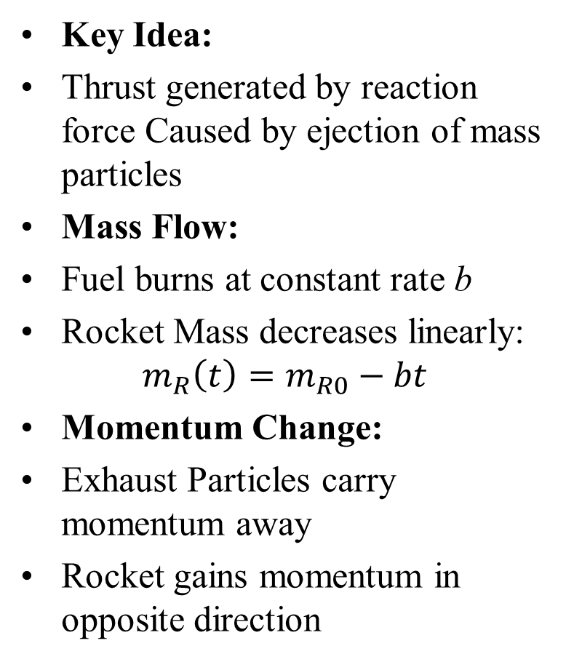
Rocket Propulsion: Physical Interpretation
Key Idea:
Thrust generated by reaction force Caused by ejection of mass particles
Mass Flow:
Fuel burns at constant rate b
Rocket Mass decreases linearly:
$$m_{R}\left(t\right)=m_{R0}−bt$$
Momentum Change:
Exhaust Particles carry momentum away
Rocket gains momentum in opposite direction
Outcome:
Leads to rocket thrust equation
Basis for propulsion analysis in outer space

Slide 13
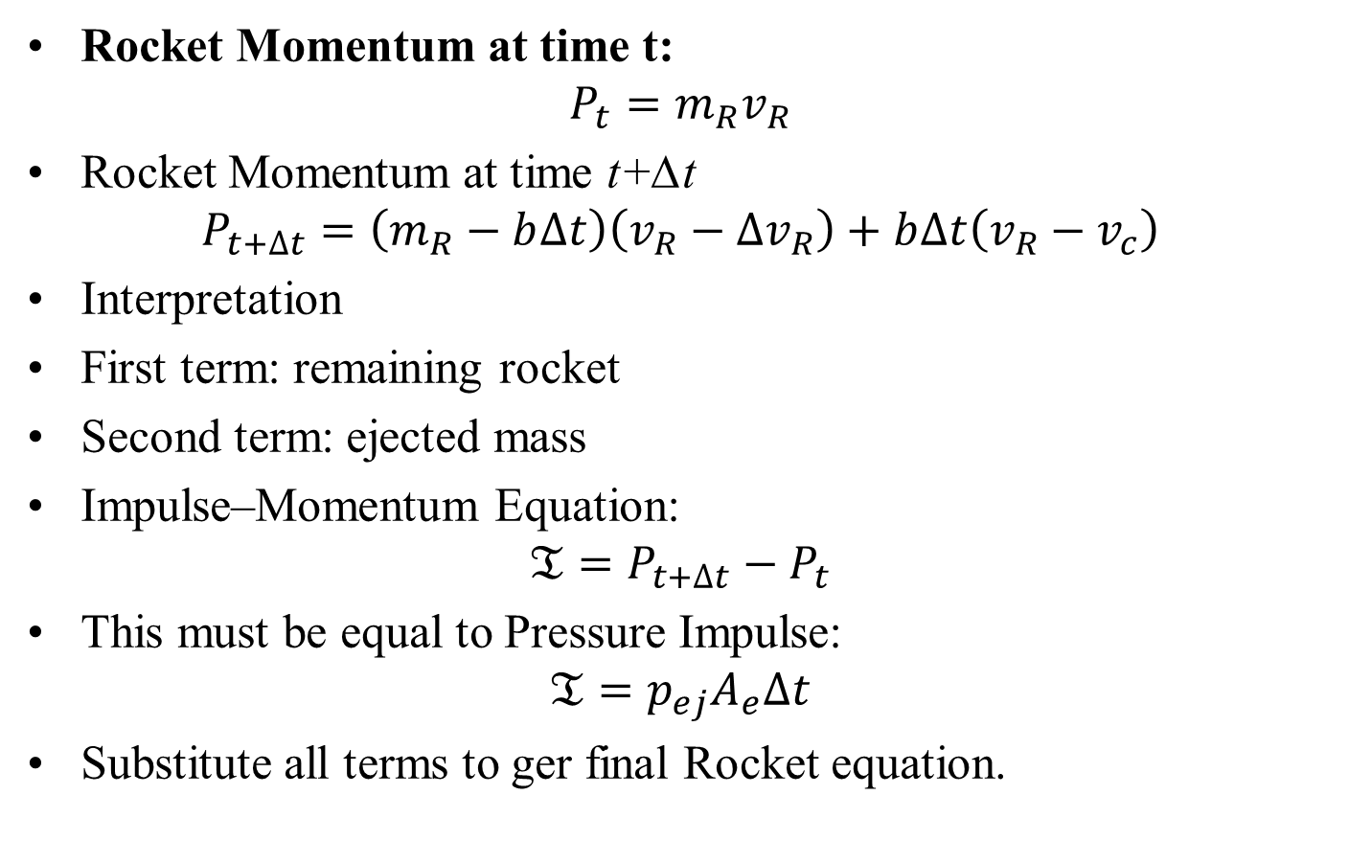
Scalar Momentum Balance for Rocket System
Rocket Momentum at time t:
$$P_{t}=m_{R}v_{R}$$
Rocket Momentum at time t+∆t
$$P_{t+∆t}=\left(m_{R}−b∆t\right)\left(v_{R}−∆v_{R}\right)+b∆t\left(v_{R}−v_{c}\right)$$
Interpretation
First term: remaining rocket
Second term: ejected mass
Impulse–Momentum Equation:
$$𝔗=P_{t+∆t}−P_{t}$$
This must be equal to Pressure Impulse:
$$𝔗=p_{ej}A_{e}∆t$$
Substitute all terms to ger final Rocket equation.

Slide 14
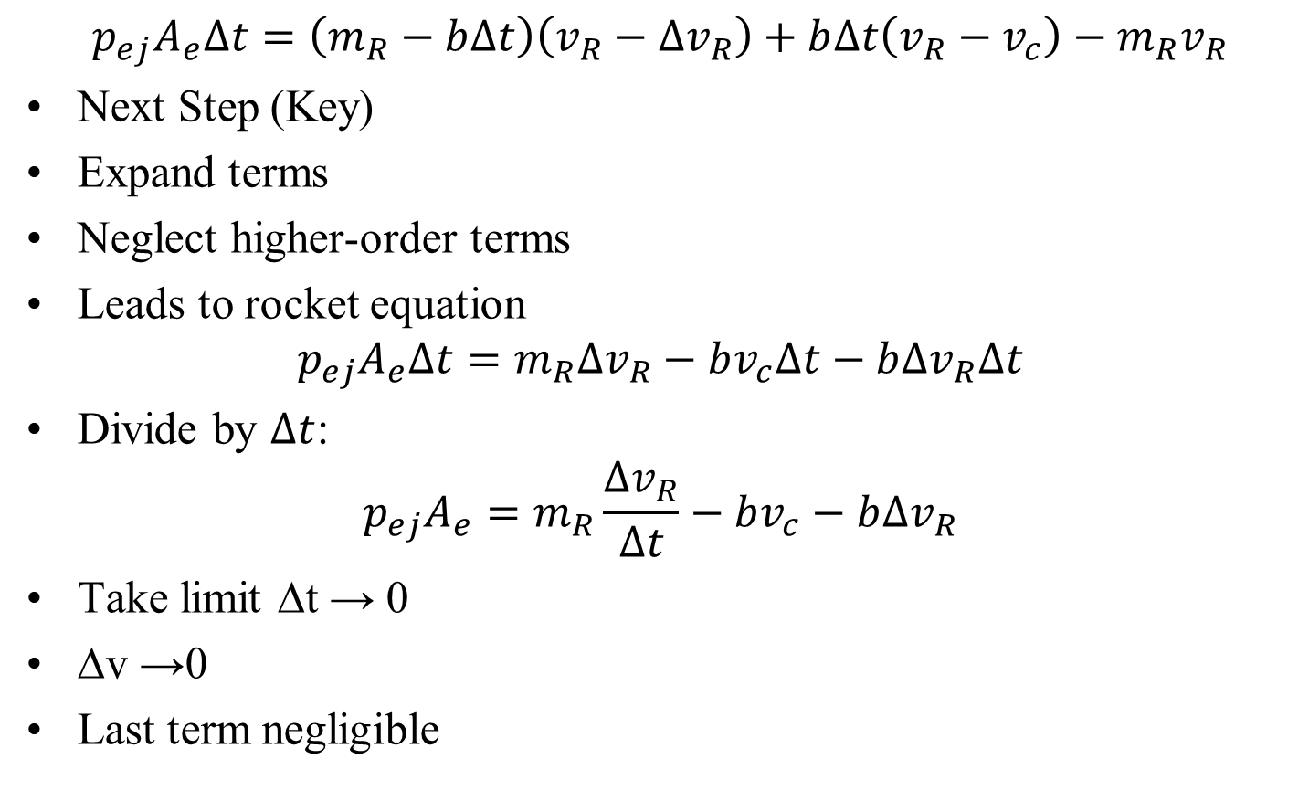
The Rocket Equation
$$p_{ej}A_{e}∆t=\left(m_{R}−b∆t\right)\left(v_{R}−∆v_{R}\right)+b∆t\left(v_{R}−v_{c}\right)−m_{R}v_{R}$$
Next Step (Key)
Expand terms
Neglect higher-order terms
Leads to rocket equation
$$p_{ej}A_{e}∆t=m_{R}∆v_{R}−bv_{c}∆t−b∆v_{R}∆t$$
Divide by $∆t$:
$$p_{ej}A_{e}=m_{R}\frac{∆v_{R}}{∆t}−bv_{c}−b∆v_{R}$$
Take limit ∆t → 0
∆v →0
Last term negligible

Slide 15
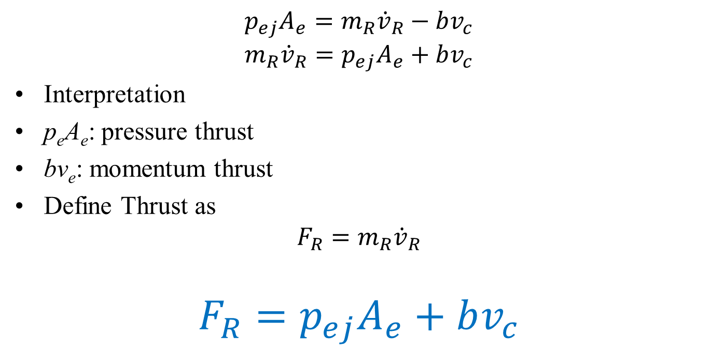
The Rocket Equation
$$p_{ej}A_{e}=m_{R}{\dot{v}}_{R}−bv_{c}$$
$$m_{R}{\dot{v}}_{R}=p_{ej}A_{e}+bv_{c}$$
Interpretation
p_{e}A_{e}: pressure thrust
bv_{e}: momentum thrust
Define Thrust as
$$F_{R}=m_{R}{\dot{v}}_{R}$$
$$F_{R}=p_{ej}A_{e}+bv_{c}$$

Slide 16
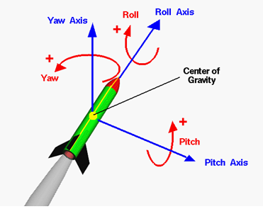
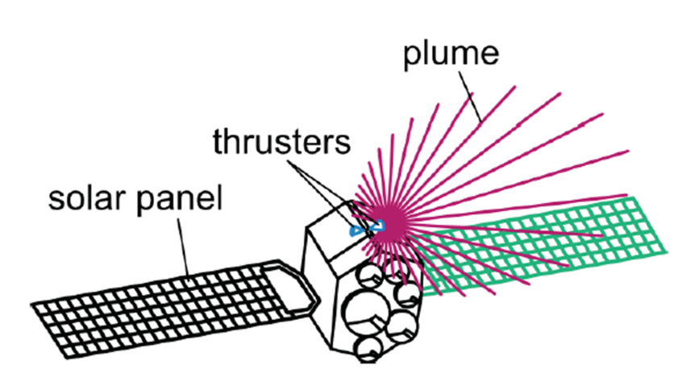




Particle Swarm Generated Rigid Body Dynamics
$$∙$$
$$∙$$
$$∙$$
$$∙$$
$$∙$$
$$∙$$
$$∙$$
$$∙$$
$$∙$$
$$∙$$
$$∙$$
$$∙$$
$$∙$$
$$∙$$

Slide 17
Kinetics of Rigid Bodies
Rigid body approximated as a thin slab
Motion confined to a single plane
Plane of motion:
Contains mass center
Includes all applied forces
Applicable to:
Thin bodies, or
Symmetrical bodies about the plane
Represents many real-world motions
Kinetics of rigid bodies studies:
External forces acting on a body
Resulting motion (translation and rotation)
Builds on kinematics of plane motion
Focus:
Effects of forces on 2D motion
Application to real systems

Slide 18
Background for the Study of Kinetics
For particle motion in a plane:
Two force equations required For rigid-body plane motion:
Additional equation for rotation
2 force + 1 moment equation
Determines complete motion state
Based on kinetic relations from:
Systems of particles
Strong kinematics foundation required:
Velocities
Accelerations
Relative acceleration
Incorrect kinematics ⇒ incorrect kinetic

Slide 19
Analysis Tools and Key Concepts
Start by isolating the system
Use diagrams:
Free-Body Diagram (FBD)
Impulse-Momentum Diagram
Work-Energy Diagram
Define:
External boundary
All external forces
Essential rule:
Do not solve before identifying all forces
Introduces:
Mass moment of inertia
Represents:
Mass distribution about an axis
Crucial for rotational motion analysis

