Slide 1


Kinetics of Particles Collisions
P M V Subbarao
Professor & Head
Mechanical Engineering Department
Modern AI Controlled Swarm to Follow A Target

Slide 2

Collisions of Smooth Spheres
Physical Situation:
Interaction between two bodies during impact
Modeled as smooth spheres
Centers of mass = geometric centers
Key Assumptions:
Contact force acts along line of centers
Force is normal to contact plane
No tangential force (smooth surfaces)
Important Consequences
No rotation is introduced
Geometry at Impact
Line of centers defines direction of force
Motion lies in a single plane
Velocity Decomposition
v_{n}: along line of centers
v_{t}: perpendicular to line of centers
Key Idea:
Only v_{n} changes during impact v_{t} remains unchanged

Slide 3
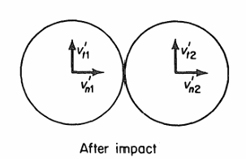
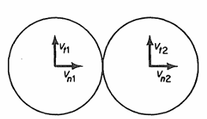



Velocity Components Before and After Impact
Before Impact
Velocity split into: Normal component v_{n}
Tangential component v_{t}
Motion relative to inertial frame
After Impact
Normal component changes
Tangential component unchanged
$$v_{t1}^{′}=v_{t1}\& v_{n1}^{′}≠ v_{n1}$$
Before Impact
$$v_{t2}^{′}=v_{t2}\& v_{n2}^{′}≠ v_{n2}$$
Key Insight:

Slide 4
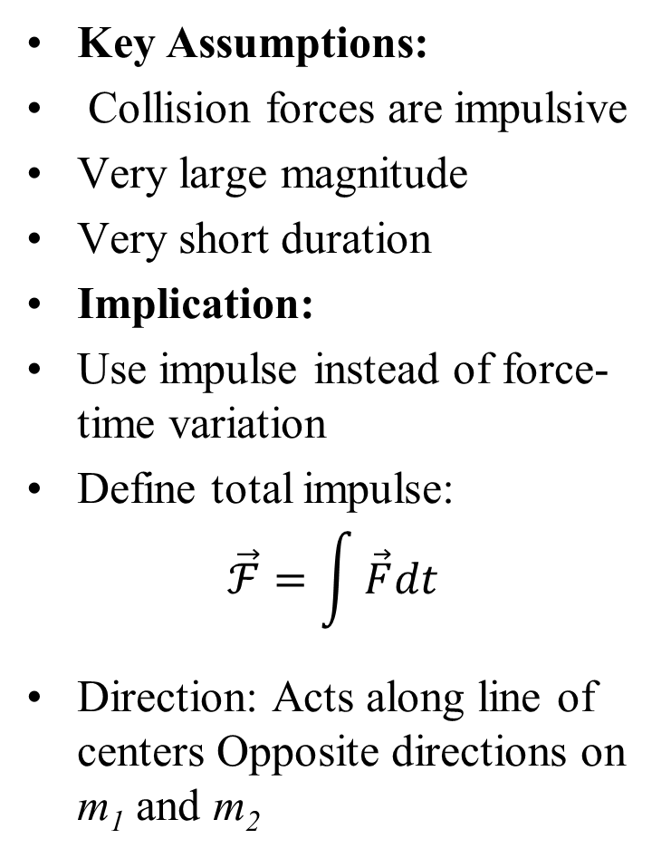
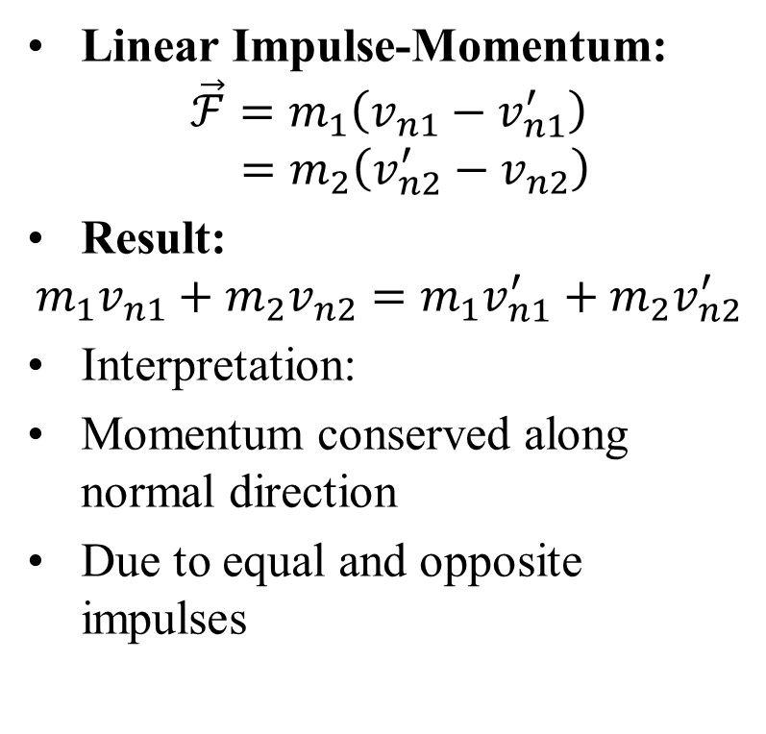
Impulsive Forces in Collision
Key Assumptions:
Collision forces are impulsive
Very large magnitude
Very short duration
Implication:
Use impulse instead of force-time variation
Define total impulse:
$$\vec{ℱ}=\int{\vec{F}dt}$$
Direction: Acts along line of centers Opposite directions on m₁ and m₂
Linear Impulse-Momentum:
$$\vec{ℱ}=m_{1}\left(v_{n1}−v_{n1}^{′}\right)$$
$$=m_{2}\left(v_{n2}^{′}−v_{n2}\right)$$
Result:
$$m_{1}v_{n1}+m_{2}v_{n2}=m_{1}v_{n1}^{′}+m_{2}v_{n2}^{′}$$
Interpretation:
Momentum conserved along normal direction
Due to equal and opposite impulses

Slide 5
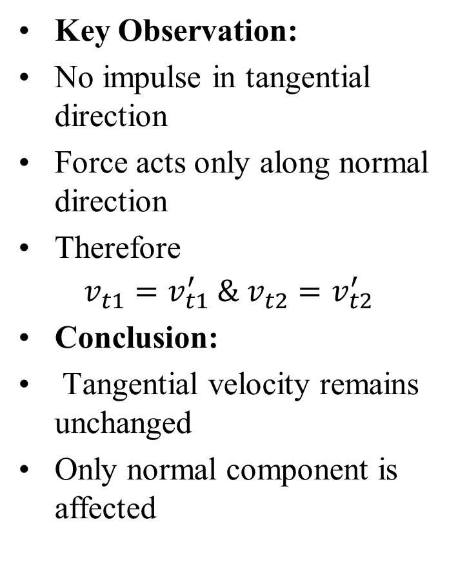
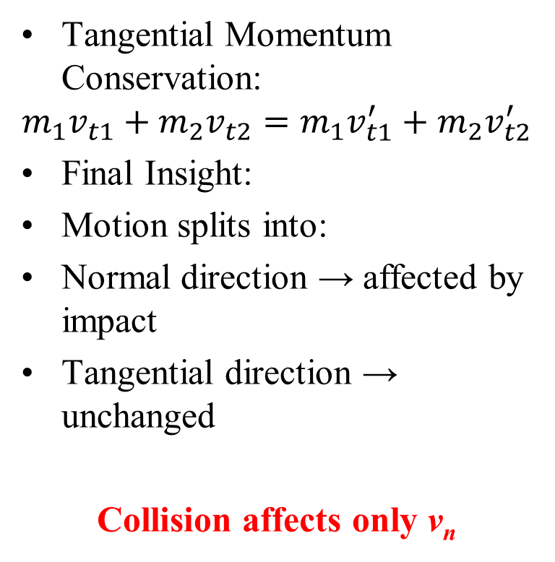
Tangential Components in Collision
Key Observation:
No impulse in tangential direction
Force acts only along normal direction
Therefore
$$v_{t1}^{}=v_{t1}^{′} \& v_{t2}^{}=v_{t2}^{′}$$
Conclusion:
Tangential velocity remains unchanged
Only normal component is affected
Tangential Momentum Conservation:
$$m_{1}v_{t1}+m_{2}v_{t2}=m_{1}v_{t1}^{′}+m_{2}v_{t2}^{′}$$
Final Insight:
Motion splits into:
Normal direction → affected by impact
Tangential direction → unchanged
Collision affects only v_{n}

Slide 6
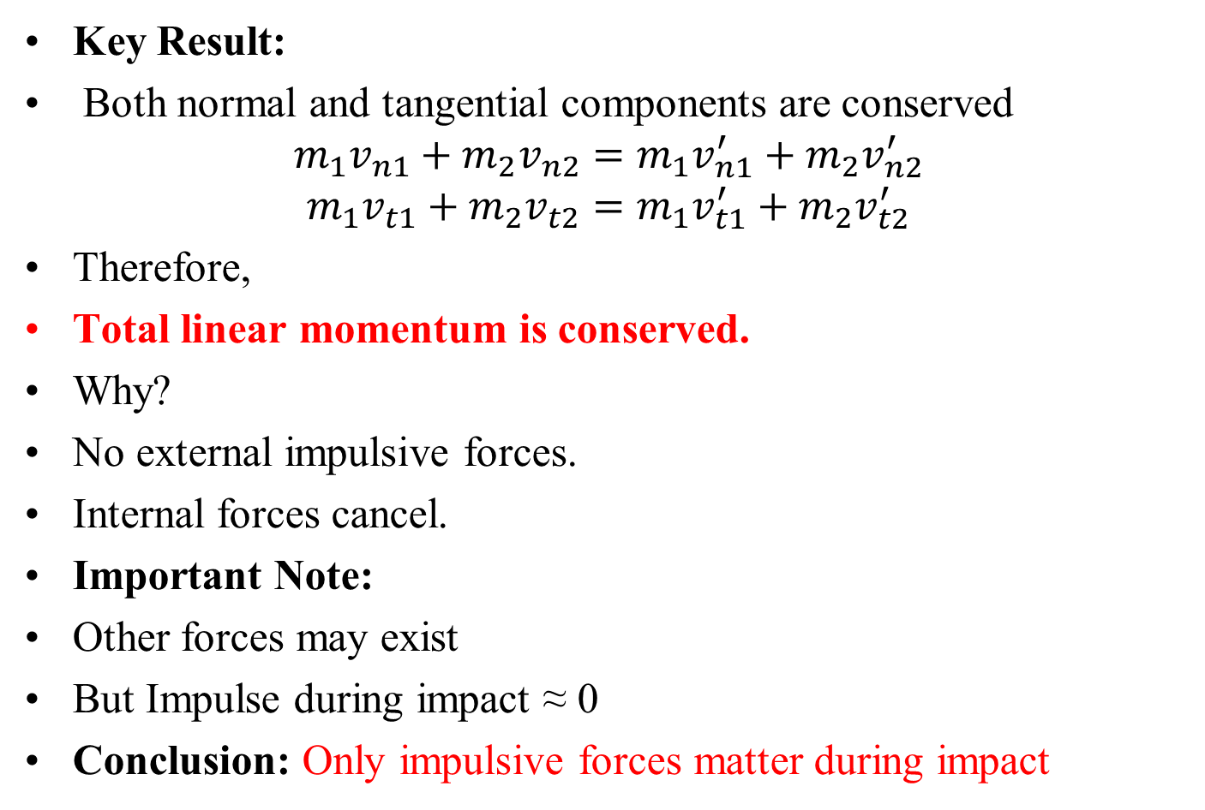
Momentum Conservation in Collision
Key Result:
Both normal and tangential components are conserved
$$m_{1}v_{n1}+m_{2}v_{n2}=m_{1}v_{n1}^{′}+m_{2}v_{n2}^{′}$$
$$m_{1}v_{t1}+m_{2}v_{t2}=m_{1}v_{t1}^{′}+m_{2}v_{t2}^{′}$$
Therefore,
Total linear momentum is conserved.
Why?
No external impulsive forces.
Internal forces cancel.
Important Note:
Other forces may exist
But Impulse during impact ≈ 0
Conclusion: Only impulsive forces matter during impact

Slide 7
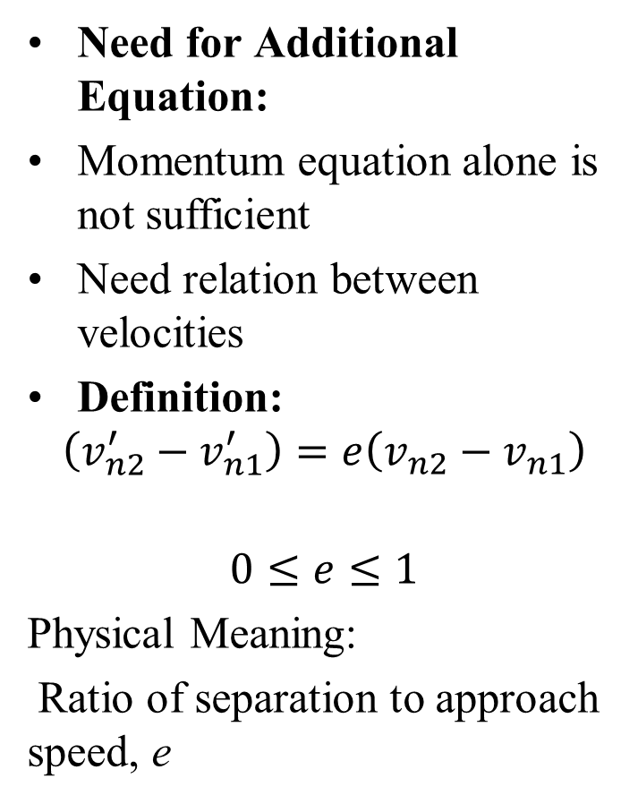
Coefficient of Restitution e
Need for Additional Equation:
Momentum equation alone is not sufficient
Need relation between velocities
Definition:
$$\left(v_{n2}^{′}−v_{n1}^{′}\right)=e\left(v_{n2}−v_{n1}\right)$$
$$0≤e≤1$$
Physical Meaning:
Ratio of separation to approach speed, e
Cases:
e = 1: Perfectly elastic collision
0 < e < 1: Partially elastic collision.
e = 0: Plastic Collision.
Depends on:
Material properties
Shape and size
Impact conditions

Slide 8
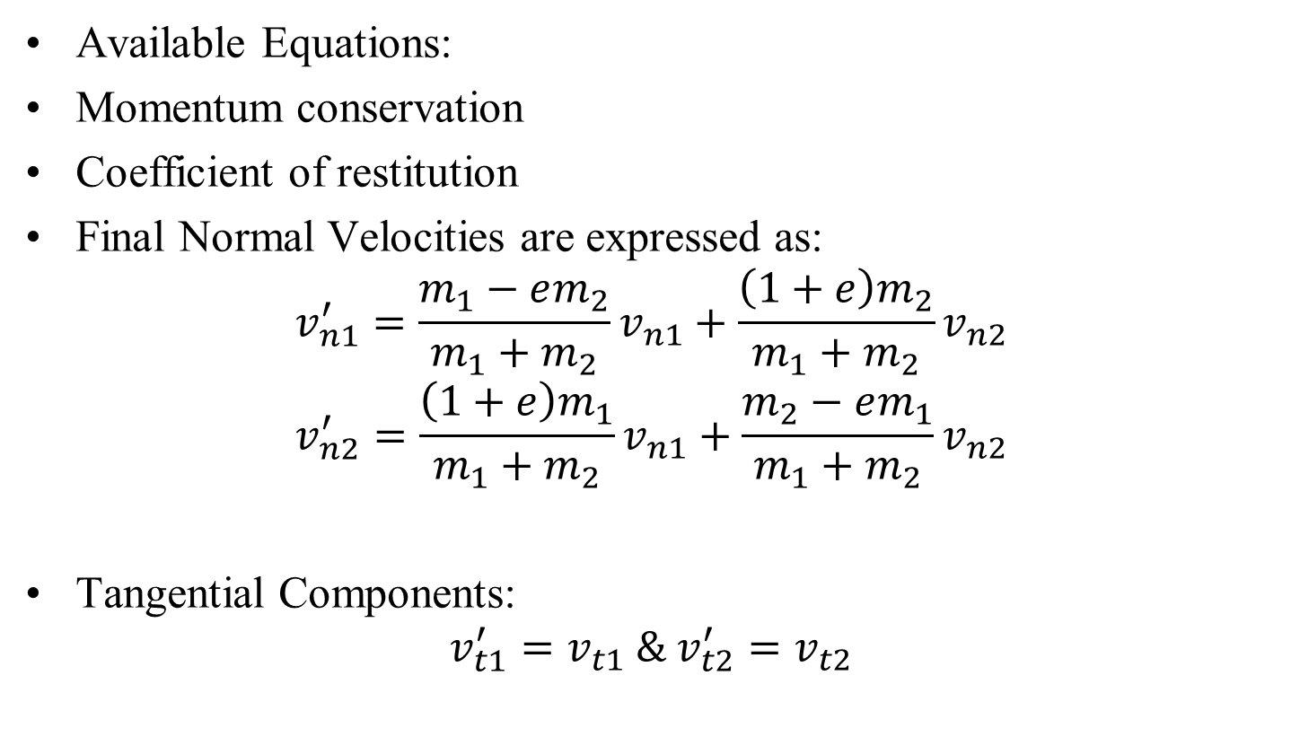
Velocities After Impact
Available Equations:
Momentum conservation
Coefficient of restitution
Final Normal Velocities are expressed as:
$$v_{n1}^{′}=\frac{m_{1}−em_{2}}{m_{1}+m_{2}}v_{n1}+\frac{{\left(1+e\right)m}_{2}}{m_{1}+m_{2}}v_{n2}$$
$$v_{n2}^{′}=\frac{{\left(1+e\right)m}_{1}}{m_{1}+m_{2}}v_{n1}+\frac{m_{2}−em_{1}}{m_{1}+m_{2}}v_{n2}$$
Tangential Components:
$$v_{t1}^{′}=v_{t1} \& v_{t2}^{′}=v_{t2}$$

Slide 9
Velocities After Impact
Key Insight:
Collision affects only normal direction
Tangential motion unchanged
Design Strategy:
Resolve velocities into n and t
Apply equations separately

Slide 10
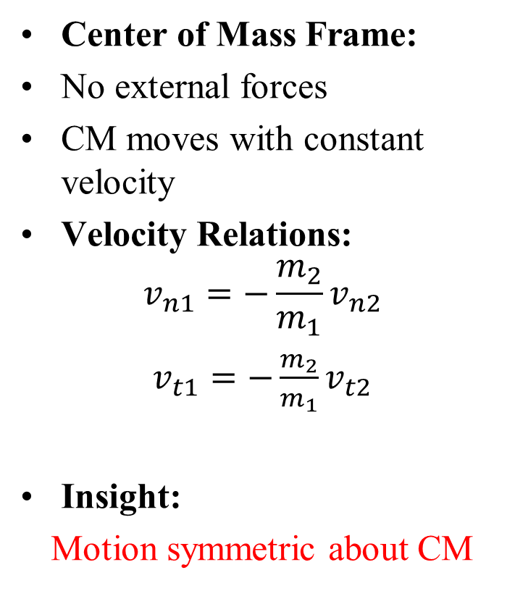
Energy and Center of Mass in Collisions
Energy Behavior:
Momentum always conserved
Kinetic energy:
Conserved only if e = 1
Otherwise, loss occurs
Energy Loss Mechanisms:
Plastic deformation
Internal vibrations
Heat due to friction
Center of Mass Frame:
No external forces
CM moves with constant velocity
Velocity Relations:
$$v_{n1}=−\frac{m_{2}}{m_{1}}v_{n2}$$
$v_{t1}=−\frac{m_{2}}{m_{1}}v_{t2}$
Insight:
Motion symmetric about CM

Slide 11
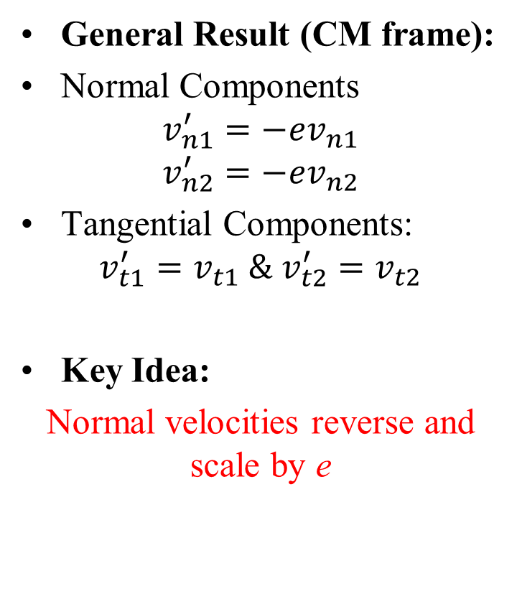
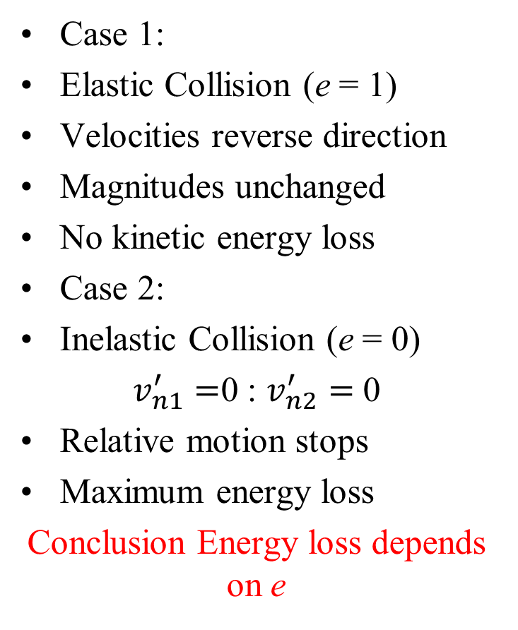
Extreme Cases of Collision
General Result (CM frame):
Normal Components
$$v_{n1}^{′}=−ev_{n1}$$
$$v_{n2}^{′}=−ev_{n2}$$
Tangential Components:
$$v_{t1}^{′}=v_{t1} \& v_{t2}^{′}=v_{t2}$$
Key Idea:
Normal velocities reverse and scale by e
Case 1:
Elastic Collision (e = 1)
Velocities reverse direction
Magnitudes unchanged
No kinetic energy loss
Case 2:
Inelastic Collision (e = 0)
$v_{n1}^{′}=$0 : $v_{n2}^{′}=$ 0
Relative motion stops
Maximum energy loss
Conclusion Energy loss depends on e

Slide 12
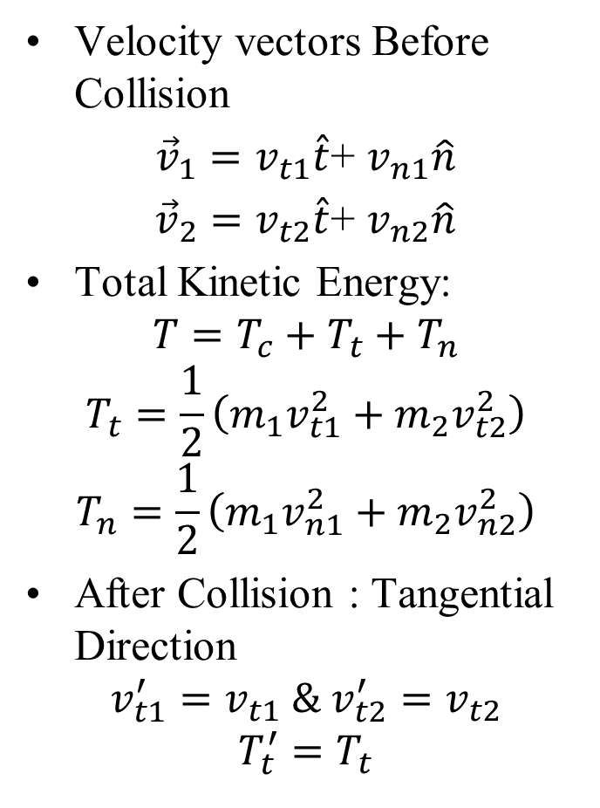
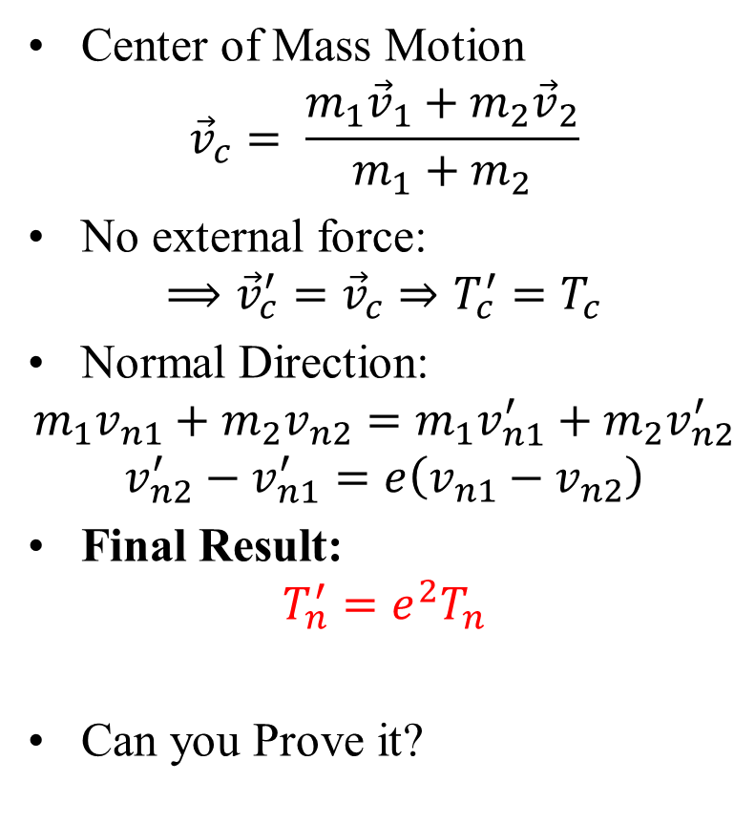
Kinetic Energy Decomposition in Collision
Velocity vectors Before Collision
${\vec{v}}_{1}=v_{t1}\hat{t}$+ $v_{n1}\hat{n}$
${\vec{v}}_{2}=v_{t2}\hat{t}$+ $v_{n2}\hat{n}$
Total Kinetic Energy:
$$T=T_{c}+T_{t}+T_{n}$$
$$T_{t}=\frac{1}{2}\left(m_{1}v_{t1}^{2}+m_{2}v_{t2}^{2}\right)$$
$$T_{n}=\frac{1}{2}\left(m_{1}v_{n1}^{2}+m_{2}v_{n2}^{2}\right)$$
After Collision : Tangential Direction
$$v_{t1}^{′}=v_{t1} \& v_{t2}^{′}=v_{t2}$$
$$T_{t}^{′}=T_{t}$$
Center of Mass Motion
$${\vec{v}}_{c}= \frac{m_{1}{\vec{v}}_{1}+m_{2}{\vec{v}}_{2}}{m_{1}+m_{2}}$$
No external force:
$$⟹{\vec{v}}_{c}^{′}={\vec{v}}_{c}⇒T_{c}^{′}=T_{c}$$
Normal Direction:
$$m_{1}v_{n1}+m_{2}v_{n2}=m_{1}v_{n1}^{′}+m_{2}v_{n2}^{′}$$
$$v_{n2}^{′}−v_{n1}^{′}=e\left(v_{n1}−v_{n2}\right)$$
Final Result:
$$T_{n}^{′}=e^{2}T_{n}$$
Can you Prove it?

Slide 13
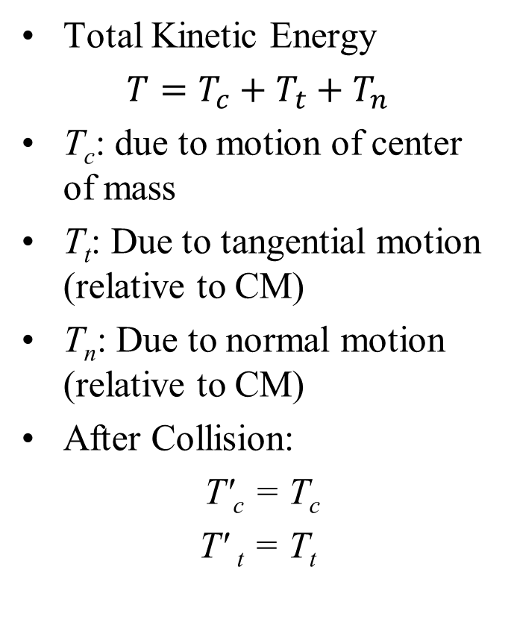
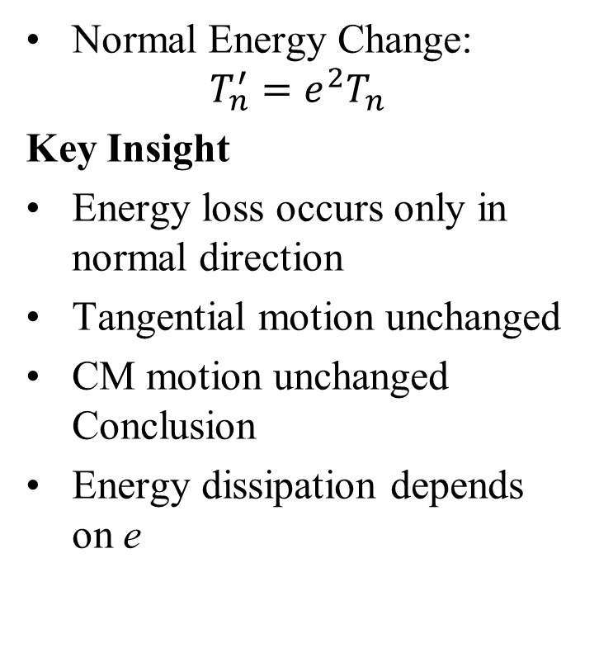
Kinetic Energy Decomposition in Collision
Total Kinetic Energy
$T=T_{c}+T_{t}+T_{n}$
T_{c}: due to motion of center of mass
T_{t}: Due to tangential motion (relative to CM)
T_{n}: Due to normal motion (relative to CM)
After Collision:
T′_{c} = T_{c}
T′ _{t} = T_{t}
Normal Energy Change:
$$T_{n}^{′}=e^{2}T_{n}$$
Key Insight
Energy loss occurs only in normal direction
Tangential motion unchanged
CM motion unchanged Conclusion
Energy dissipation depends on e

Slide 14
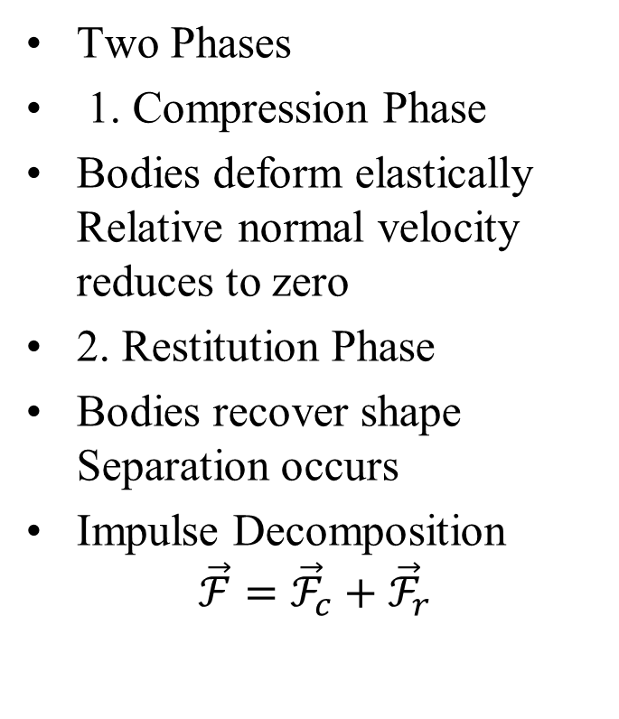
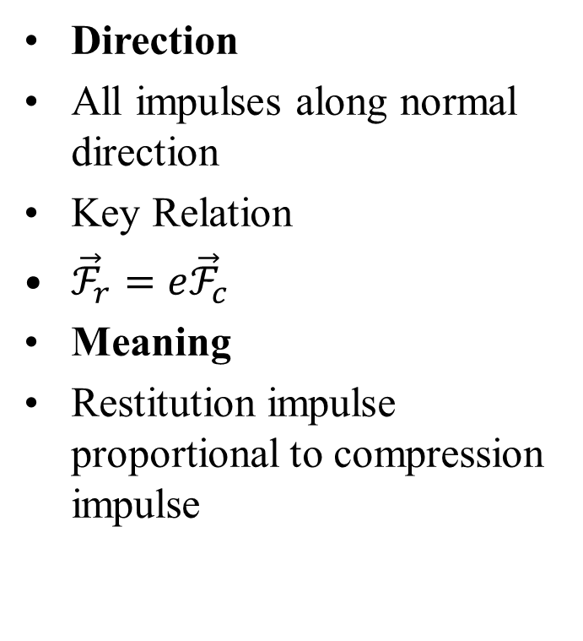
Phases of Collision
Two Phases
1. Compression Phase
Bodies deform elastically Relative normal velocity reduces to zero
2. Restitution Phase
Bodies recover shape Separation occurs
Impulse Decomposition
$$\vec{ℱ}={\vec{ℱ}}_{c}+{\vec{ℱ}}_{r}$$
Direction
All impulses along normal direction
Key Relation
${\vec{ℱ}}_{r}=e{\vec{ℱ}}_{c}$
Meaning
Restitution impulse proportional to compression impulse

Slide 15
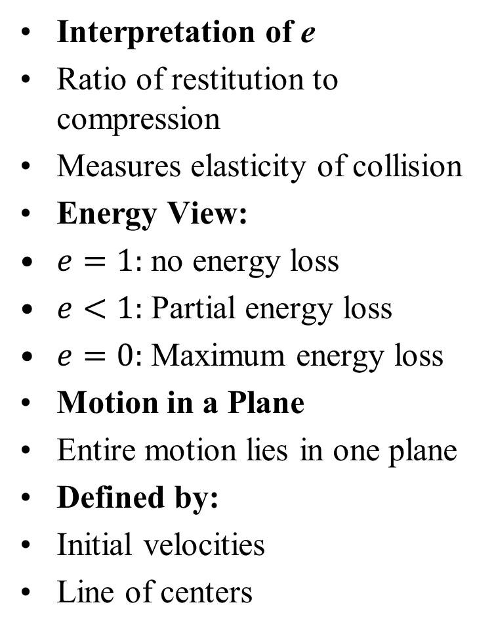
Physical Interpretation and Generalization
Interpretation of e
Ratio of restitution to compression
Measures elasticity of collision
Energy View:
$e=1:$ no energy loss
$e<1:$ Partial energy loss
$e=0:$ Maximum energy loss
Motion in a Plane
Entire motion lies in one plane
Defined by:
Initial velocities
Line of centers
Reference Frame Insight
Choose convenient inertial frame
Examples:
Center of mass frame
Frame moving with one body
Conclusion:
Results are general with proper frame choice

Slide 16
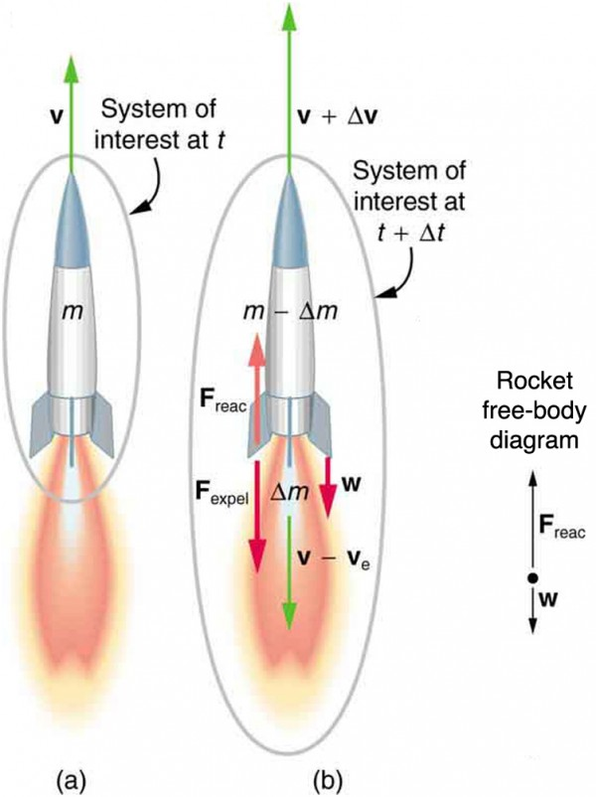
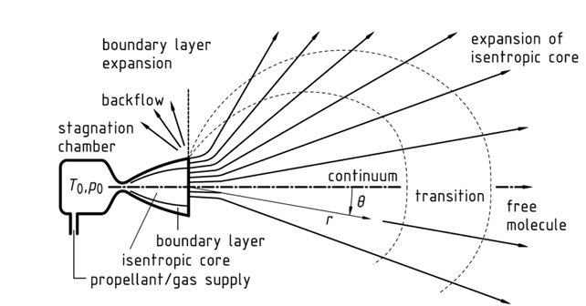



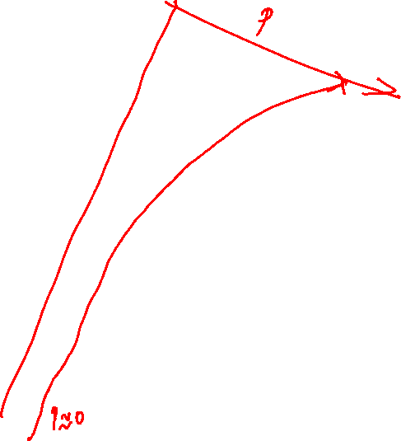











Billions of Particles Pushing A Giant Vehicle in Space
Rocket Motion in Space
Rocket Motion in Troposphere & Stratosphere
O
$$∙$$
$$∙$$
$$∙$$
$$∙$$
$$∙$$
$$∙$$
$$∙$$
$$∙$$
$$∙$$
$$∙$$
$$∙$$
$$∙$$
$$∙$$
$$∙$$
$$∙$$
$$∙$$
$$∙$$
$$∙$$
$$∙$$
$$∙$$
$$∙$$
$$∙$$
$$∙$$
$$∙$$
$$∙$$
$$∙$$
$$∙$$
$$∙$$
$$∙$$
$$∙$$
$$∙$$
$$∙$$
$$∙$$
$$∙$$
$$∙$$
$$∙$$
$$∙$$
$$∙$$
$$∙$$
$$∙$$
$$∙$$
$$∙$$
$$∙$$
$$∙$$
$$∙$$
$$∙$$
$$∙$$
$$∙$$
$$∙$$
$$∙$$
$$∙$$
$$∙$$
$$∙$$
$$∙$$
$$∙$$
$$∙$$
$$∙$$
$$∙$$
$$∙$$
$$∙$$
$$∙$$
$$∙$$
$$∙$$
$$∙$$
$$∙$$
$$∙$$
$$∙$$
$$∙$$
$$∙$$
$$∙$$
$$∙$$
$$∙$$
$$∙$$

