Slide 1

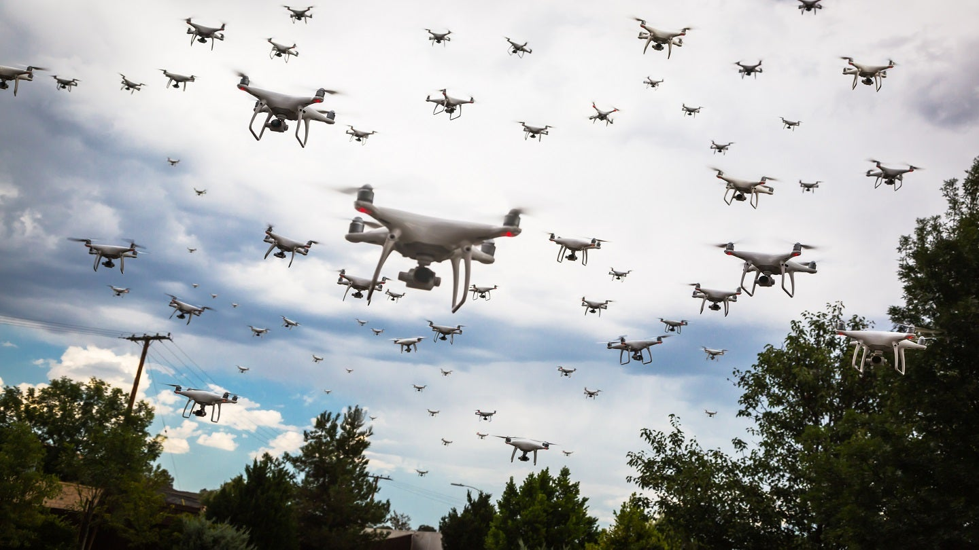

Impulse Momentum Analysis of Particle Swarm About a Moving Target
P M V Subbarao
Professor & Head
Mechanical Engineering Department
Modern AI Controlled Swarm to Follow A Target

Slide 2

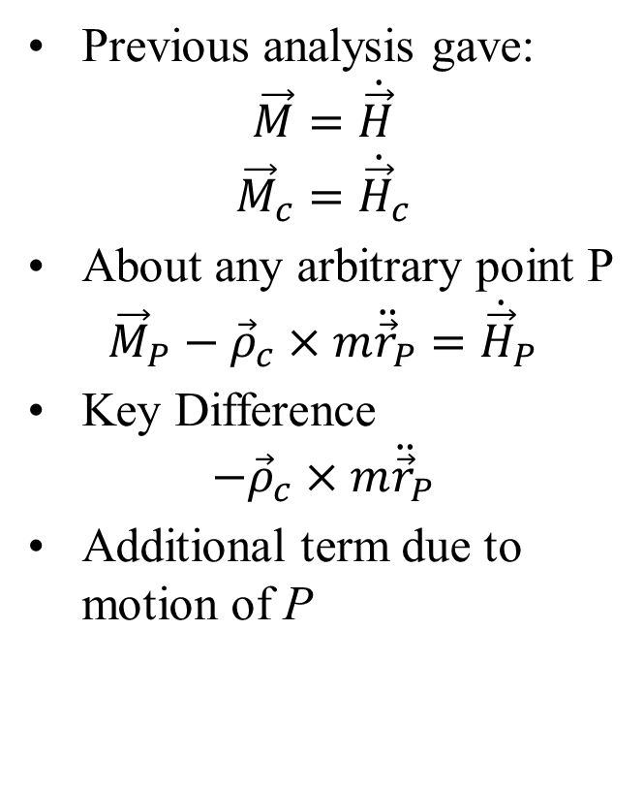
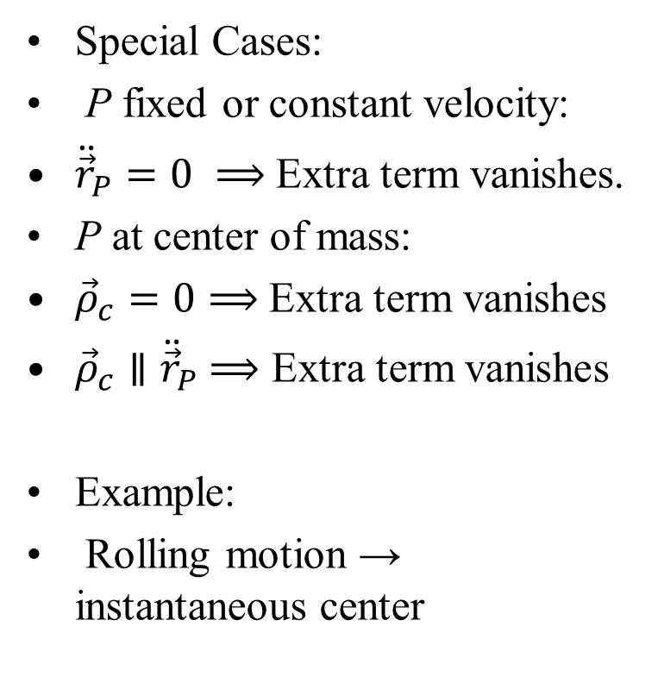
Comparison with Previous Results
Previous analysis gave:
$$\vec{M}=\dot{\vec{H}}$$
$${\vec{M}}_{c}={\dot{\vec{H}}}_{c}$$
About any arbitrary point P
$${\vec{M}}_{P}−{\vec{ρ}}_{c}×m{\ddot{\vec{r}}}_{P}={\dot{\vec{H}}}_{P}$$
Key Difference
$$−{\vec{ρ}}_{c}×m{\ddot{\vec{r}}}_{P}$$
Additional term due to motion of P
Special Cases:
P fixed or constant velocity:
${\ddot{\vec{r}}}_{P}=0 ⟹$ Extra term vanishes.
P at center of mass:
${\vec{ρ}}_{c}=0⟹$ Extra term vanishes
${\vec{ρ}}_{c}∥{\ddot{\vec{r}}}_{P}$ $⟹$ Extra term vanishes
Example:
Rolling motion → instantaneous center

Slide 3
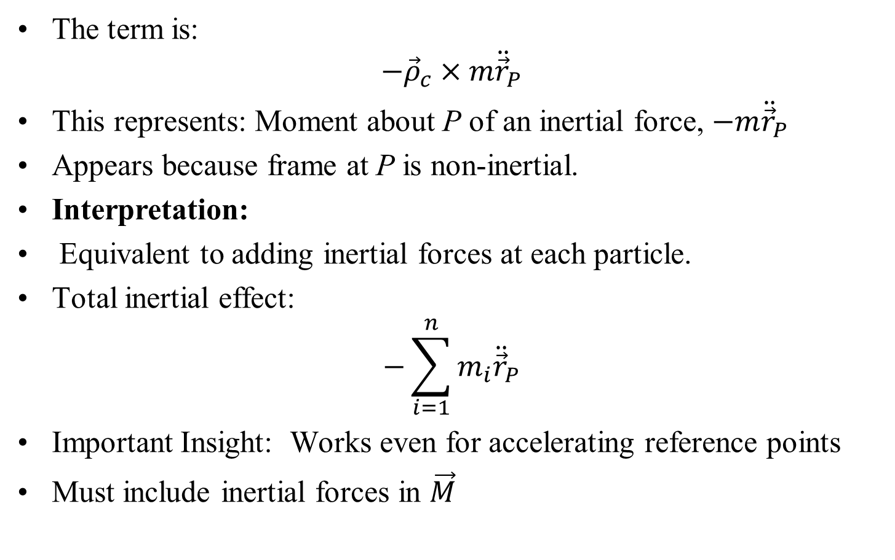
Physical Interpretation of Additional Term
The term is:
$$−{\vec{ρ}}_{c}×m{\ddot{\vec{r}}}_{P}$$
This represents: Moment about P of an inertial force, $−m{\ddot{\vec{r}}}_{P}$
Appears because frame at P is non-inertial.
Interpretation:
Equivalent to adding inertial forces at each particle.
Total inertial effect:
$$−\sum_{i=1}^{n}{m_{i}{\ddot{\vec{r}}}_{P}}$$
Important Insight: Works even for accelerating reference points
Must include inertial forces in $\vec{M}$

Slide 4
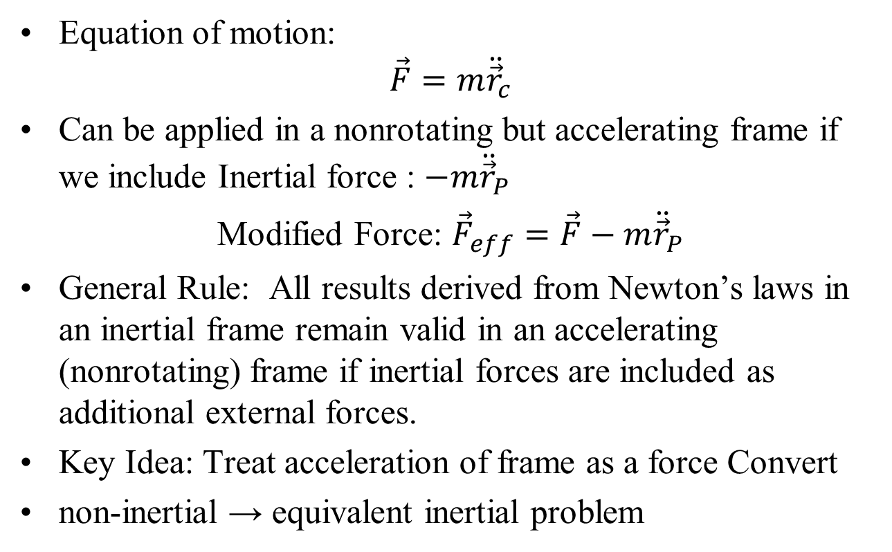
Extension to Accelerating Frames
Equation of motion:
$$\vec{F}=m{\ddot{\vec{r}}}_{c}$$
Can be applied in a nonrotating but accelerating frame if we include Inertial force : $−m{\ddot{\vec{r}}}_{P}$
Modified Force: ${\vec{F}}_{eff}=\vec{F}−m{\ddot{\vec{r}}}_{P}$
General Rule: All results derived from Newton’s laws in an inertial frame remain valid in an accelerating (nonrotating) frame if inertial forces are included as additional external forces.
Key Idea: Treat acceleration of frame as a force Convert
non-inertial → equivalent inertial problem

Slide 5
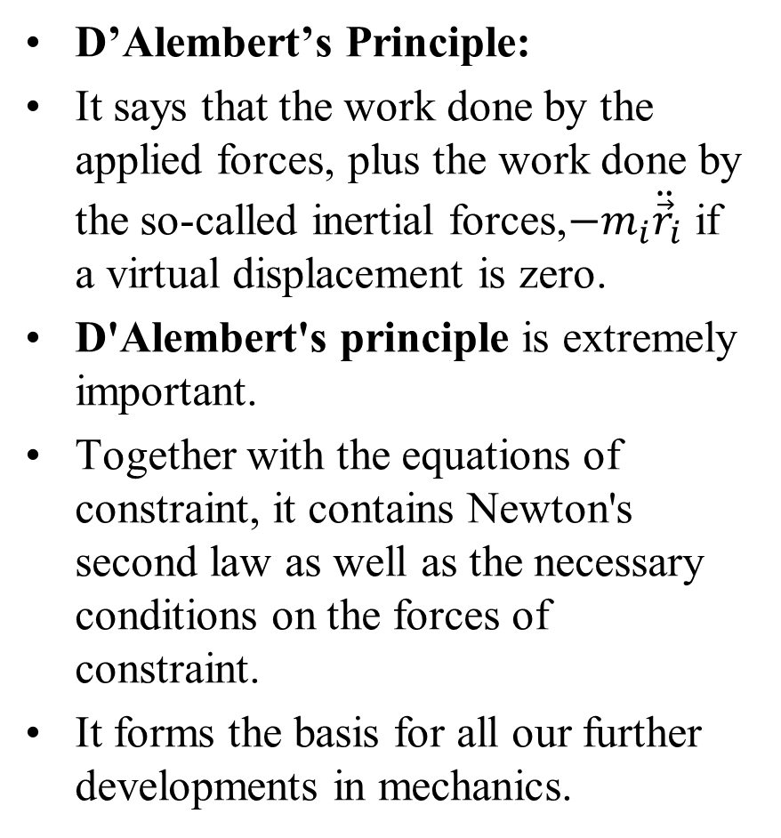
Implications and Applications
D’Alembert’s Principle:
It says that the work done by the applied forces, plus the work done by the so-called inertial forces,$−m_{i}{\ddot{\vec{r}}}_{i}$ if a virtual displacement is zero.
D'Alembert's principle is extremely important.
Together with the equations of constraint, it contains Newton's second law as well as the necessary conditions on the forces of constraint.
It forms the basis for all our further developments in mechanics.
Applies to all analyses:
Work and energy
Kinetic energy
Linear momentum
Angular momentum
Key Advantage:
Same equations usable in accelerating frames.
No need to reformulate mechanics

Slide 6
Implications and Applications
Applies to all analyses:
Work and energy
Kinetic energy
Linear momentum
Angular momentum
Key Advantage:
Same equations usable in accelerating frames.
No need to reformulate mechanics
Connection to D’Alembert’s Principle:
Introduces inertial forces
Converts dynamics → statics
Special Case:
Frame moves with particle
No relative motion System appears in static equilibrium
External forces + Inertial force = 0

Slide 7
Choice of Reference Frame
Inertial Frame:(Recommended)
Observer fixed in inertial space
Use Newton’s laws directly
Include only true external forces
Advantages
Conceptually simple
No inertial (fictitious) forces needed
Standard equations apply directly
Non-Inertial Frame:
Observer is accelerating
Requires inclusion of inertial forces
When Useful?
Simplifies certain problems
Example: using center of mass
Helpful for rotational analysis
Key Insight
Choose the frame that simplifies equations
Physics remains unchanged

Slide 8
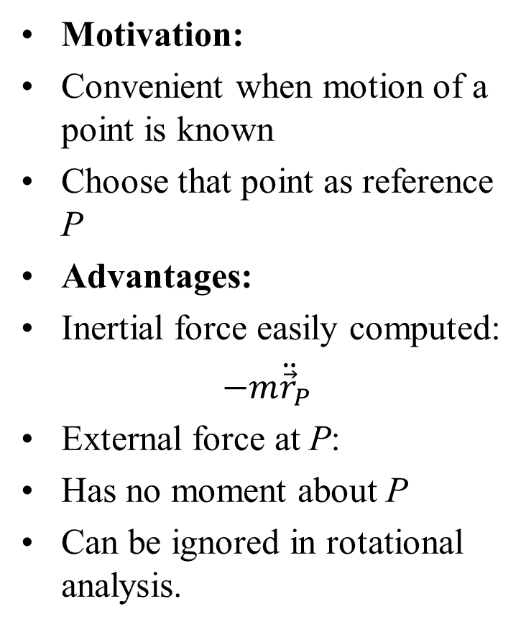
Use of an Arbitrary Reference Point P
Motivation:
Convenient when motion of a point is known
Choose that point as reference P
Advantages:
Inertial force easily computed:
$−m{\ddot{\vec{r}}}_{P}$
External force at P:
Has no moment about P
Can be ignored in rotational analysis.
Applications Systems with moving components
Spacecraft with internal motion Multi-body dynamics
Strategy:
Fix reference point in one body
Describe motion relative to P
View system from a moving observer
Key Benefit:
Simplifies rotational equations
Reduces unknown forces

Slide 9
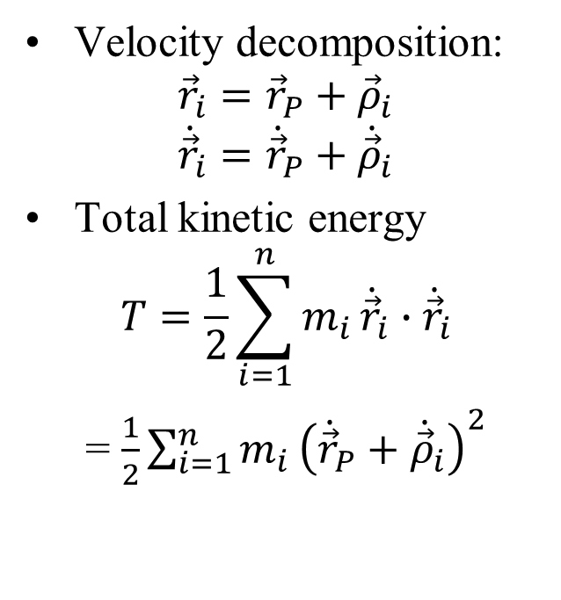
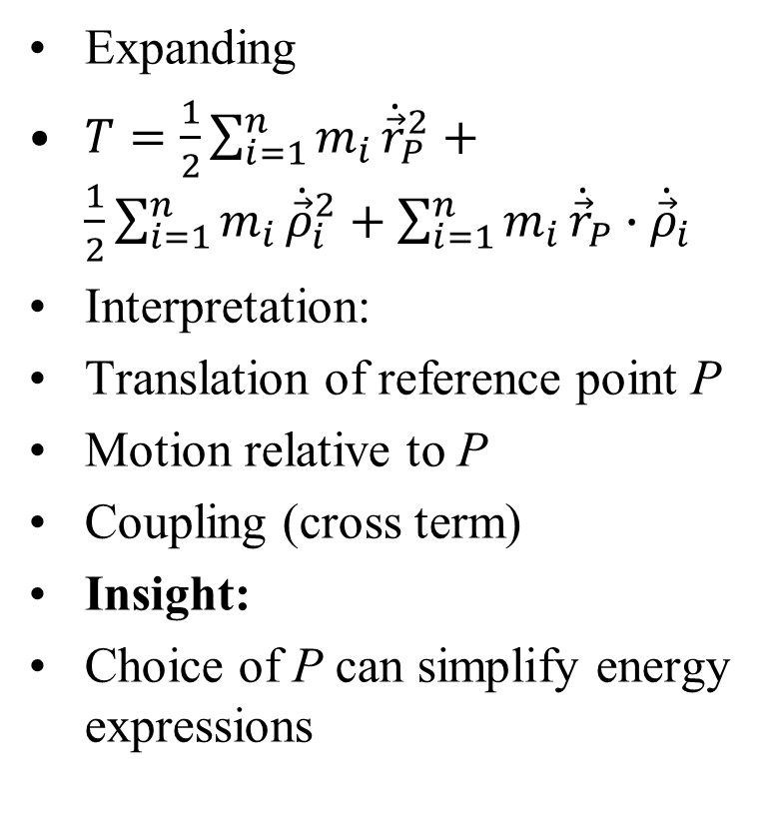
Kinetic Energy Relative to Point P
Expanding
$T=\frac{1}{2}\sum_{i=1}^{n}{m_{i}}{\dot{\vec{r}}}_{P}^{2}+\frac{1}{2}\sum_{i=1}^{n}{m_{i}}{\dot{\vec{ρ}}}_{i}^{2}+\sum_{i=1}^{n}{m_{i}}{\dot{\vec{r}}}_{P}∙{\dot{\vec{ρ}}}_{i}$
Interpretation:
Translation of reference point P
Motion relative to P
Coupling (cross term)
Insight:
Choice of P can simplify energy expressions
Velocity decomposition:
$${\vec{r}}_{i}={\vec{r}}_{P}+{\vec{ρ}}_{i}$$
$${\dot{\vec{r}}}_{i}={\dot{\vec{r}}}_{P}+{\dot{\vec{ρ}}}_{i}$$
Total kinetic energy
$$T=\frac{1}{2}\sum_{i=1}^{n}{m_{i}}{\dot{\vec{r}}}_{i}∙{\dot{\vec{r}}}_{i}$$
= $\frac{1}{2}\sum_{i=1}^{n}{m_{i}}{\left({\dot{\vec{r}}}_{P}+{\dot{\vec{ρ}}}_{i}\right)}^{2}$

Slide 10
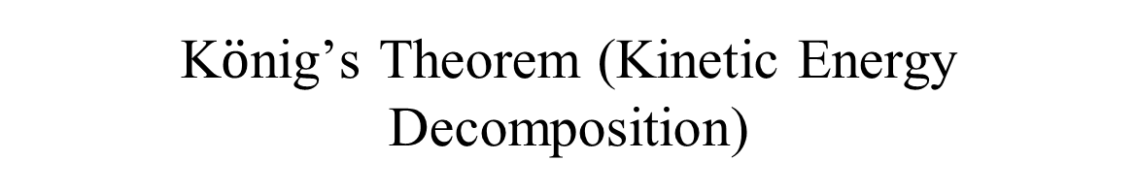
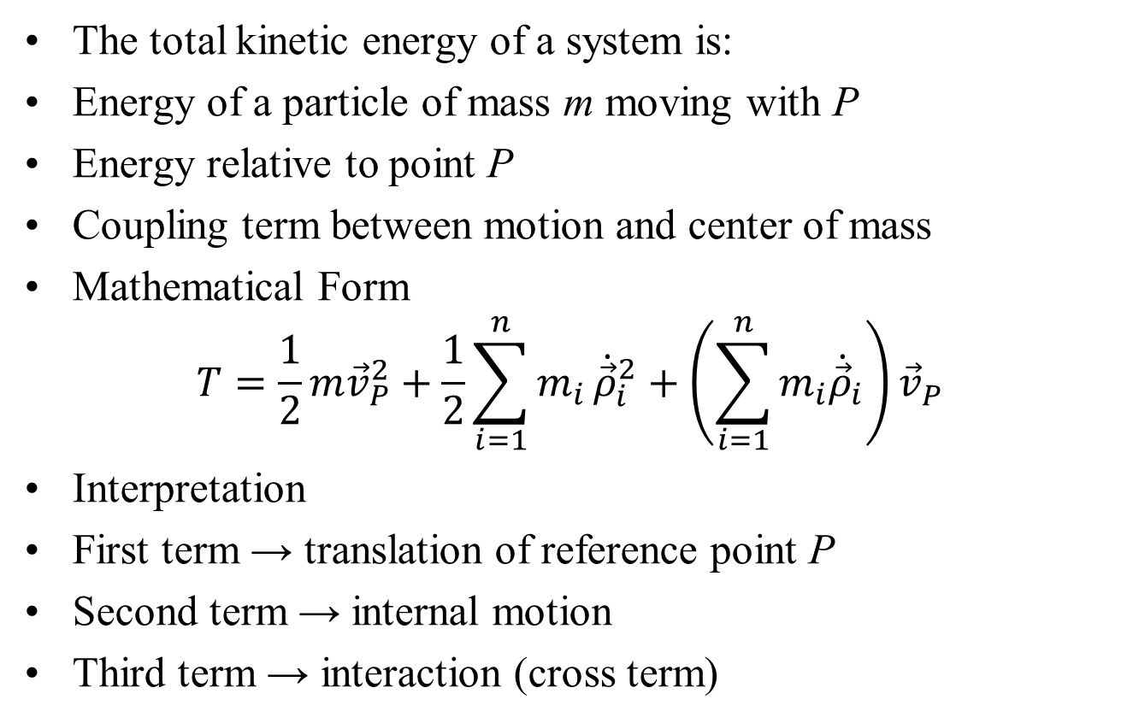
K$\ddot{o}$nig’s Theorem (Kinetic Energy Decomposition)
The total kinetic energy of a system is:
Energy of a particle of mass m moving with P
Energy relative to point P
Coupling term between motion and center of mass
Mathematical Form
$$T=\frac{1}{2}m{\vec{v}}_{P}^{2}+\frac{1}{2}\sum_{i=1}^{n}{m_{i}}{\dot{\vec{ρ}}}_{i}^{2}+\left(\sum_{i=1}^{n}{m_{i}{\dot{\vec{ρ}}}_{i}}\right){\vec{v}}_{P}^{}$$
Interpretation
First term → translation of reference point P
Second term → internal motion
Third term → interaction (cross term)

Slide 11
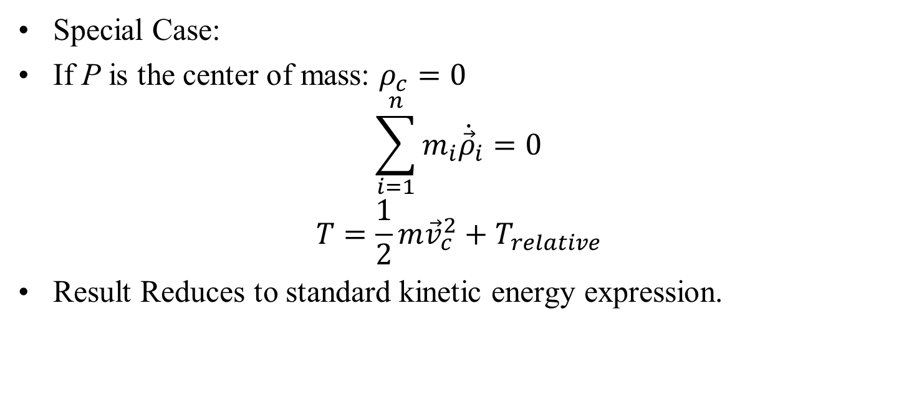
K$\ddot{o}$nig’s Theorem (Kinetic Energy Decomposition)
Special Case:
If P is the center of mass: $ρ_{c}=0$
$$\sum_{i=1}^{n}{m_{i}{\dot{\vec{ρ}}}_{i}}=0$$
$$T=\frac{1}{2}m{\vec{v}}_{c}^{2}+T_{relative}$$
Result Reduces to standard kinetic energy expression.

Slide 12
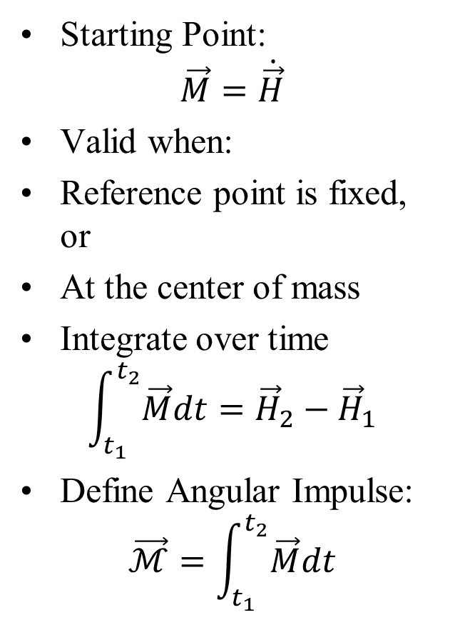
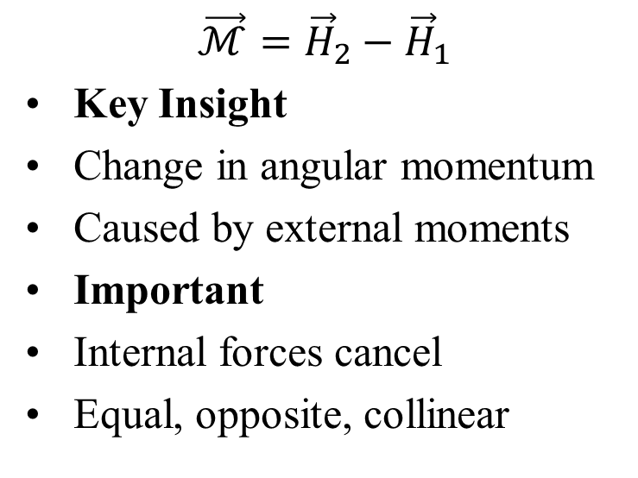
Angular Impulse and Momentum
Starting Point:
$$\vec{M}=\dot{\vec{H}}$$
Valid when:
Reference point is fixed, or
At the center of mass
Integrate over time
$$\int_{t_{1}}^{t_{2}}{\vec{M}dt}={\vec{H}}_{2}−{\vec{H}}_{1}$$
Define Angular Impulse:
$$\vec{ℳ}=\int_{t_{1}}^{t_{2}}{\vec{M}dt}$$
$$\vec{ℳ}={\vec{H}}_{2}−{\vec{H}}_{1}$$
Key Insight
Change in angular momentum
Caused by external moments
Important
Internal forces cancel
Equal, opposite, collinear

Slide 13
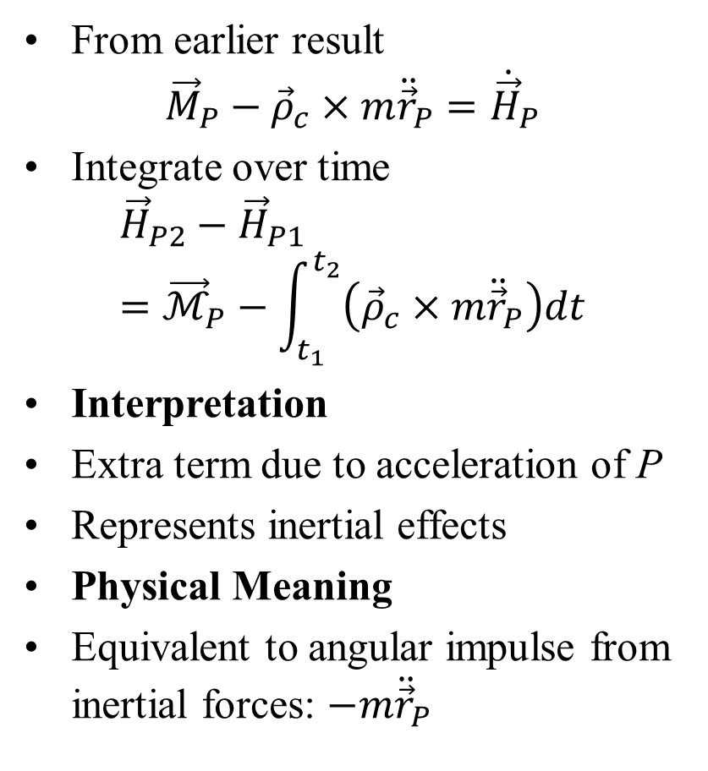
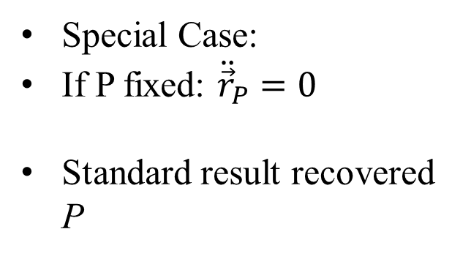
Angular Impulse about an Arbitrary Point P
From earlier result
$${\vec{M}}_{P}−{\vec{ρ}}_{c}×m{\ddot{\vec{r}}}_{P}={\dot{\vec{H}}}_{P}$$
Integrate over time
$${\vec{H}}_{P2}−{\vec{H}}_{P1}={\vec{ℳ}}_{P}−\int_{t_{1}}^{t_{2}}{\left({\vec{ρ}}_{c}×m{\ddot{\vec{r}}}_{P}\right)dt}$$
Interpretation
Extra term due to acceleration of P
Represents inertial effects
Physical Meaning
Equivalent to angular impulse from inertial forces: $−m{\ddot{\vec{r}}}_{P}$
Special Case:
If P fixed: ${\ddot{\vec{r}}}_{P}=0$
Standard result recovered P

Slide 14
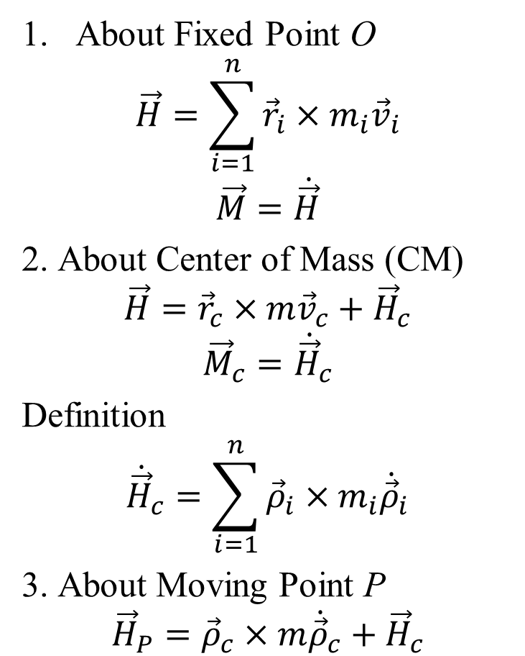
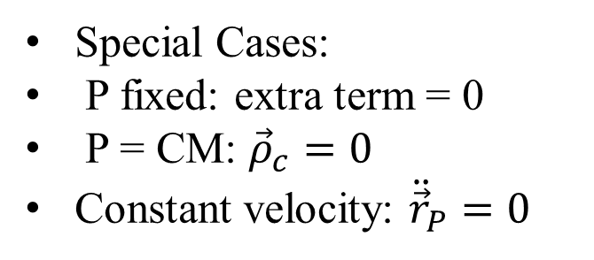

Angular Momentum Summary
About Fixed Point O
$$\vec{H}=\sum_{i=1}^{n}{{\vec{r}}_{i}}×m_{i}{\vec{v}}_{i}$$
$$\vec{M}=\dot{\vec{H}}$$
2. About Center of Mass (CM)
$$\vec{H}={\vec{r}}_{c}×m{\vec{v}}_{c}+{\vec{H}}_{c}$$
$${\vec{M}}_{c}={\dot{\vec{H}}}_{c}$$
Definition
$${\dot{\vec{H}}}_{c}=\sum_{i=1}^{n}{{\vec{ρ}}_{i}×m_{i}{\dot{\vec{ρ}}}_{i}}$$
3. About Moving Point P
$${\vec{H}}_{P}={\vec{ρ}}_{c}×m{\dot{\vec{ρ}}}_{c}+{\vec{H}}_{c}$$
$${\dot{\vec{H}}}_{P}={\vec{M}}_{P}−{\vec{ρ}}_{c}×m{\ddot{\vec{r}}}_{P}$$
Special Cases:
P fixed: extra term = 0
P = CM: ${\vec{ρ}}_{c}=0$
Constant velocity: ${\ddot{\vec{r}}}_{P}=0$
Always choose the reference point that simplifies the problem

Slide 15
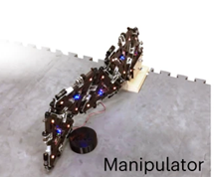
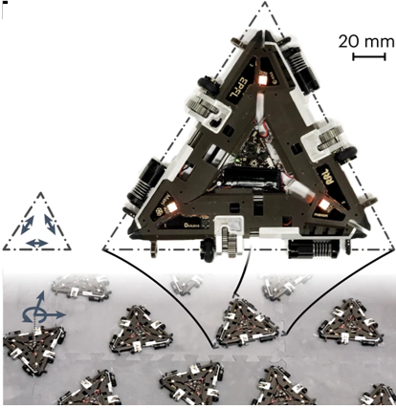
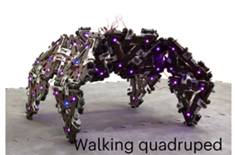
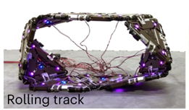
Swarm Robotics
Collision is an unavoidable event in particle swarm

Slide 16




Dynamics or Particle Pair : Before and After Impact
$${\vec{v}}_{2,BI}$$
$${\vec{v}}_{1,BI}$$
$${\vec{v}}_{2,AI}$$
$${\vec{v}}_{1,AI}$$

Slide 17
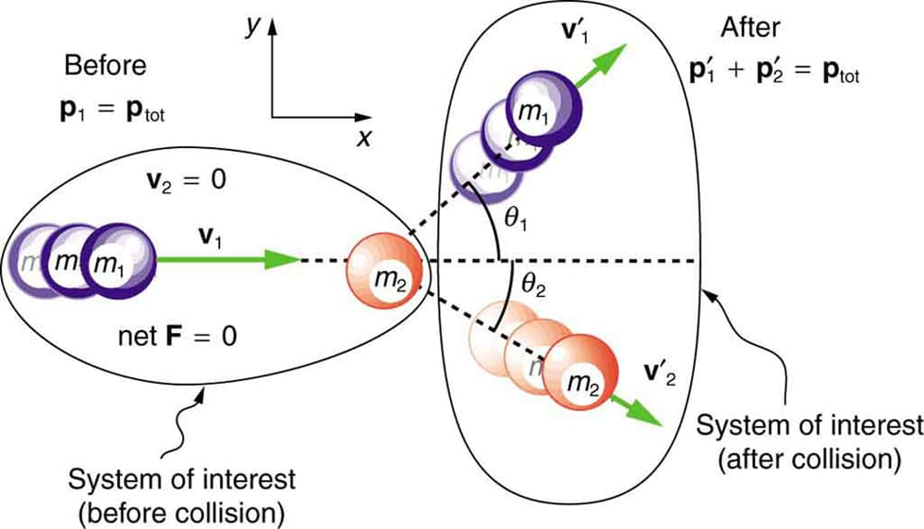
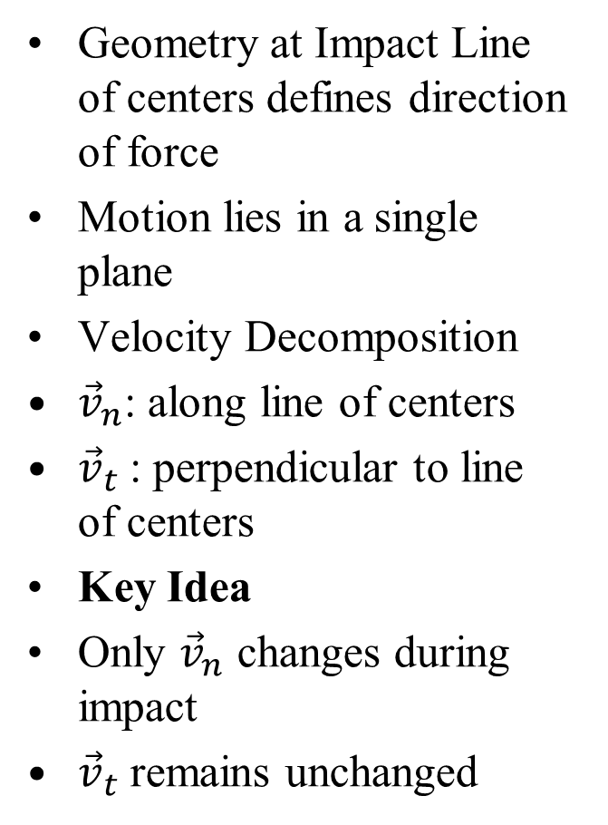
Collision of Smooth Spheres
Physical Situation:
Interaction between two bodies during impact
Modeled as smooth spheres
Centers of mass = geometric centers
Key Assumptions
Contact force acts along line of centers
Force is normal to contact plane
No tangential force (smooth surfaces)
Important Consequences
No rotation is introduced
Geometry at Impact Line of centers defines direction of force
Motion lies in a single plane
Velocity Decomposition
${\vec{v}}_{n}$: along line of centers
${\vec{v}}_{t}$: perpendicular to line of centers
Key Idea
Only ${\vec{v}}_{n}$ changes during impact
${\vec{v}}_{t}$ remains unchanged

Slide 18
Collisions of Smooth Spheres
Physical Situation:
Interaction between two bodies during impact
Modeled as smooth spheres
Centers of mass = geometric centers
Key Assumptions:
Contact force acts along line of centers
Force is normal to contact plane
No tangential force (smooth surfaces)
Important Consequences
No rotation is introduced
Geometry at Impact
Line of centers defines direction of force
Motion lies in a single plane
Velocity Decomposition
v_{n}: along line of centers
v_{t}: perpendicular to line of centers
Key Idea:
Only v_{n} changes during impact v_{t} remains unchanged

