Slide 1



Impulse Momentum Analysis of Particle Swarm About a Target
P M V Subbarao
Professor & Head
Mechanical Engineering Department
Control the Swarm to Target ?!?!?…

Slide 2

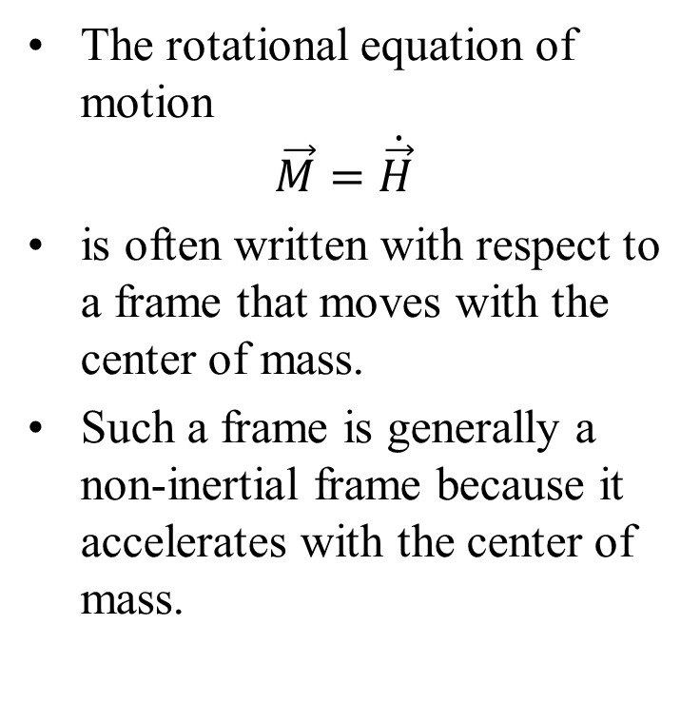
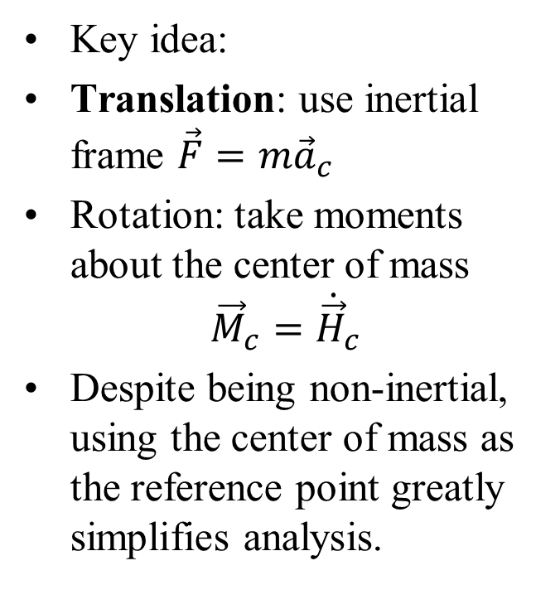
Center of Mass as a Reference Frame
Using a nonrotating reference frame that translates with the center of mass has important consequences.
The rotational equation of motion
$$\vec{M}=\dot{\vec{H}}$$
is often written with respect to a frame that moves with the center of mass.
Such a frame is generally a non-inertial frame because it accelerates with the center of mass.
Key idea:
Translation: use inertial frame $\vec{F}=m{\vec{a}}_{c}$
Rotation: take moments about the center of mass
$${\vec{M}}_{c}={\dot{\vec{H}}}_{c}$$
Despite being non-inertial, using the center of mass as the reference point greatly simplifies analysis.

Slide 3
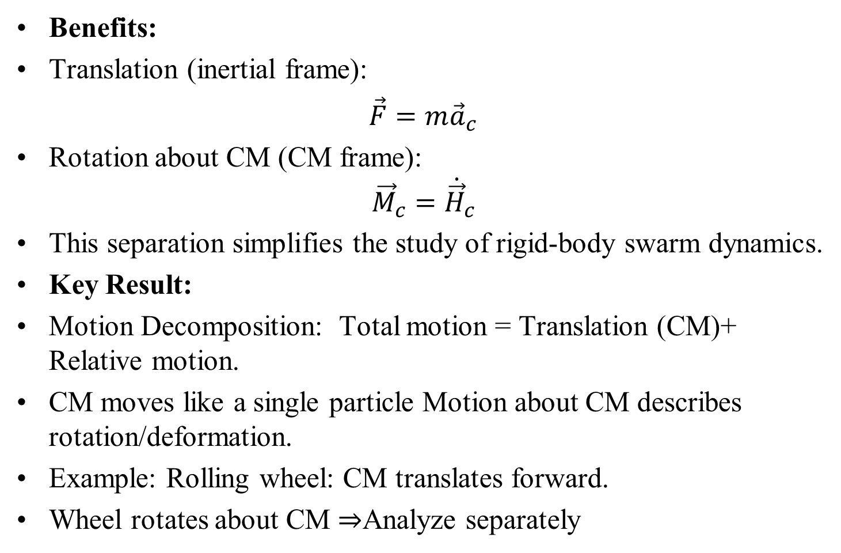
Center of Mass as a Reference Frame
Benefits:
Translation (inertial frame):
$\vec{F}=m{\vec{a}}_{c}$
Rotation about CM (CM frame):
$${\vec{M}}_{c}={\dot{\vec{H}}}_{c}$$
This separation simplifies the study of rigid-body swarm dynamics.
Key Result:
Motion Decomposition: Total motion = Translation (CM)+ Relative motion.
CM moves like a single particle Motion about CM describes rotation/deformation.
Example: Rolling wheel: CM translates forward.
Wheel rotates about CM ⇒Analyze separately

Slide 4

Physical Picture: Center of Mass Decomposition
Any motion can be viewed as:
$Motion=Movement of CM+Motion about CM$
Translation
Rotation/internal motion
Examples
Projectile (spinning ball): CM follows a parabola spin is independent
Explosion: CM continues straight, fragments move relative to CM
Rigid body: translation + rotation about CM
Key takeaway
External forces → CM motion ;
Internal forces → relative motion

Slide 5
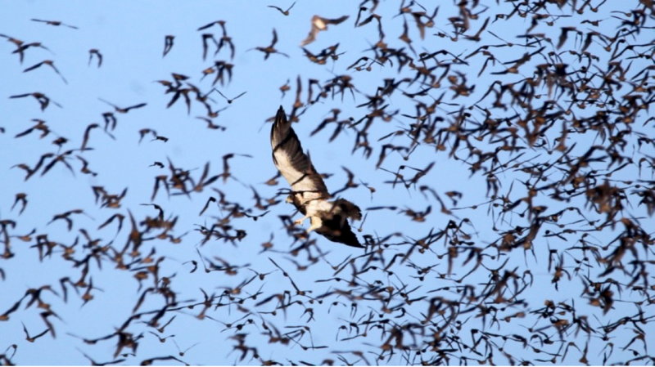

Slide 6
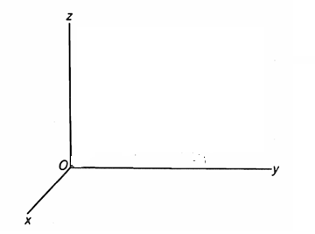















Forces in a System of Particles
$${\vec{F}}_{1}$$
$$m_{2}$$
$${\vec{F}}_{2}$$
$$m_{1}$$
$${\vec{f}}_{12}$$
$${\vec{f}}_{21}$$
C.M.
$${\vec{f}}_{13}$$
$${\vec{r}}_{1}$$
$${\vec{f}}_{23}$$
$$m_{3}$$
$${\vec{r}}_{c}$$
P
$${\vec{f}}_{31}$$
$${\vec{F}}_{3}$$
$${\vec{f}}_{32}$$
$${\vec{r}}_{P}$$

Slide 7
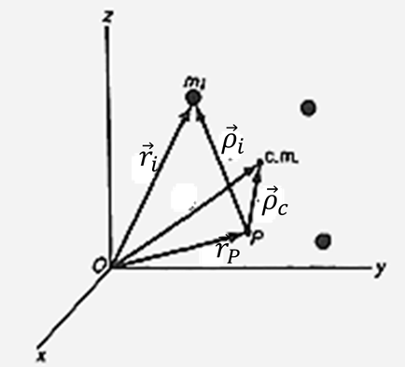
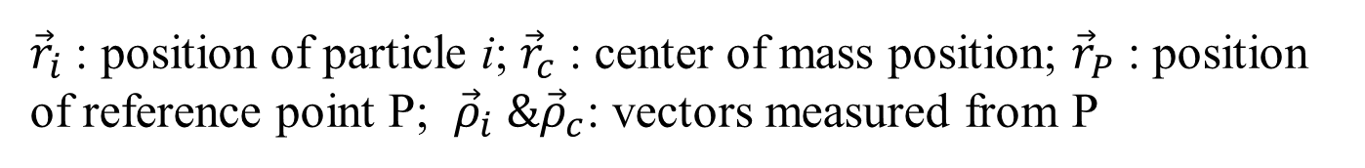
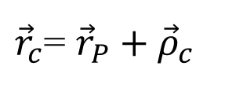
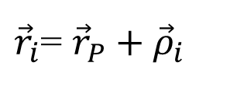
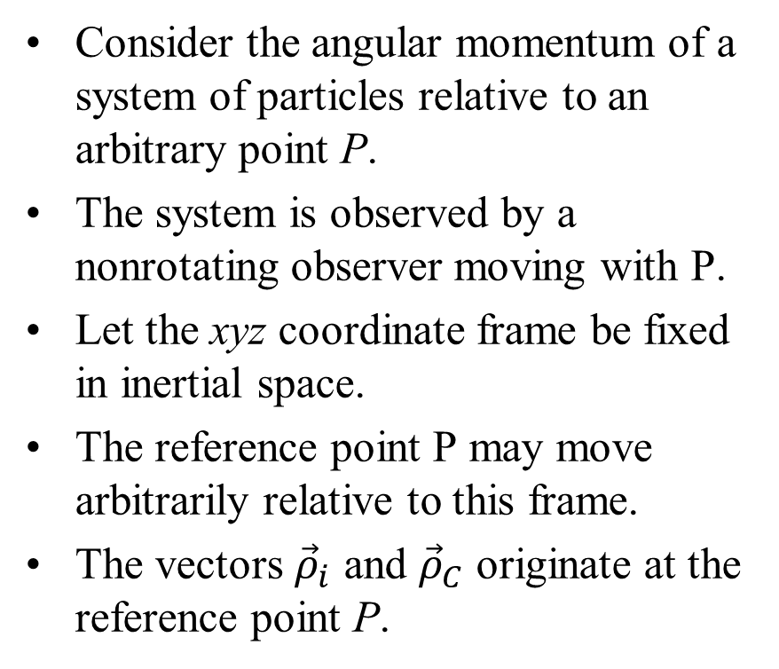
Angular Momentum About an Arbitrary Reference Point
Consider the angular momentum of a system of particles relative to an arbitrary point P.
The system is observed by a nonrotating observer moving with P.
Let the xyz coordinate frame be fixed in inertial space.
The reference point P may move arbitrarily relative to this frame.
The vectors ${\vec{ρ}}_{i}$ and ${\vec{ρ}}_{C}$ originate at the reference point P.
${\vec{r}}_{i}$= ${\vec{r}}_{P}+{\vec{ρ}}_{i}$
${\vec{r}}_{c}$= ${\vec{r}}_{P}+{\vec{ρ}}_{c}$
${\vec{r}}_{i}$ : position of particle i; ${\vec{r}}_{c}$ : center of mass position; ${\vec{r}}_{P}$ : position of reference point P; ${\vec{ρ}}_{i} \&{\vec{ρ}}_{c}$: vectors measured from P

Slide 8
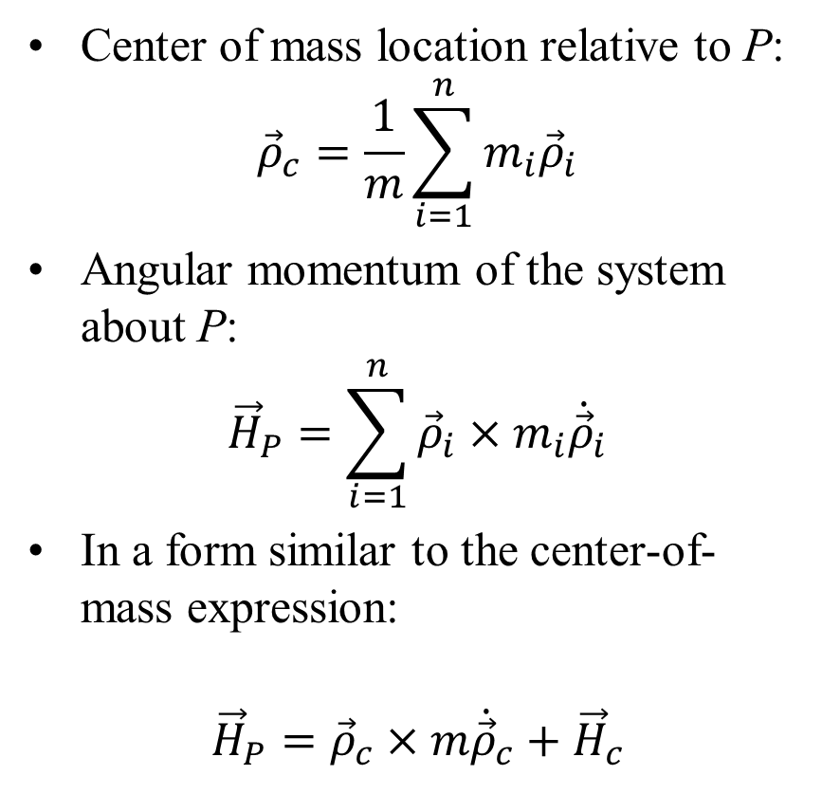
Angular Momentum About an Arbitrary Reference Point
Center of mass location relative to P:
$${\vec{ρ}}_{c}=\frac{1}{m}\sum_{i=1}^{n}{m_{i}{\vec{ρ}}_{i}}$$
Angular momentum of the system about P:
$${\vec{H}}_{P}=\sum_{i=1}^{n}{{\vec{ρ}}_{i}×m_{i}{\dot{\vec{ρ}}}_{i}}$$
In a form similar to the center-of-mass expression:
$${\vec{H}}_{P}={\vec{ρ}}_{c}×m{\dot{\vec{ρ}}}_{c}+{\vec{H}}_{c}$$

Slide 9

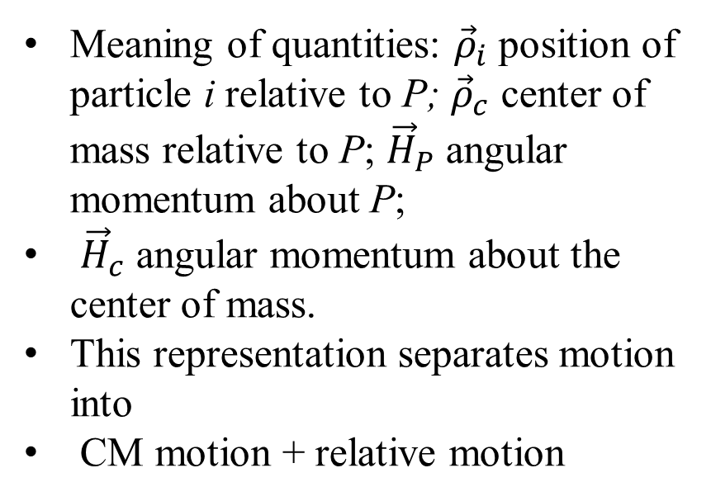

Angular Momentum About an Arbitrary Reference Point
$${\vec{ρ}}_{c}=\frac{1}{m}\sum_{i=1}^{n}{m_{i}{\vec{ρ}}_{i}}$$
$${\vec{H}}_{P}={\vec{ρ}}_{c}×m{\dot{\vec{ρ}}}_{c}+{\vec{H}}_{c}$$
Meaning of quantities: ${\vec{ρ}}_{i}$position of particle i relative to P; ${\vec{ρ}}_{c}$ center of mass relative to P; ${\vec{H}}_{P}$ angular momentum about P;
${\vec{H}}_{c}$ angular momentum about the center of mass.
This representation separates motion into
CM motion + relative motion

Slide 10

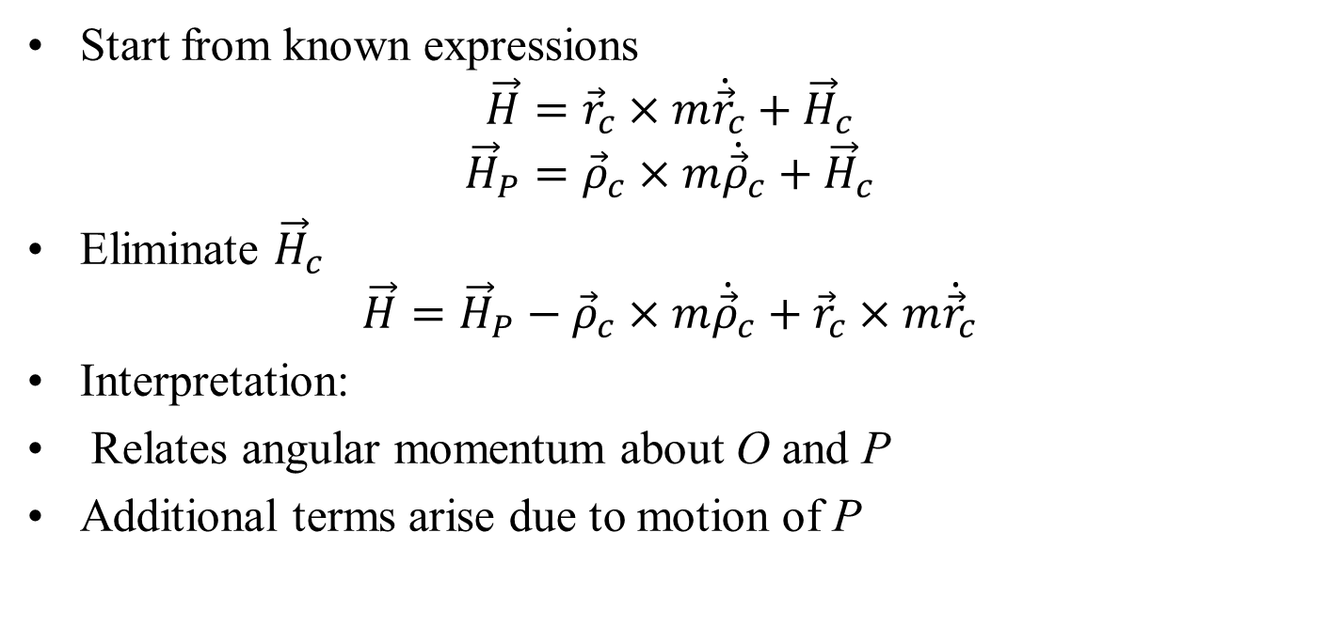
Relation Between $\vec{H}$ and ${\vec{H}}_{P}$
Start from known expressions
$$\vec{H}={\vec{r}}_{c}×m{\dot{\vec{r}}}_{c}+{\vec{H}}_{c}$$
$${\vec{H}}_{P}={\vec{ρ}}_{c}×m{\dot{\vec{ρ}}}_{c}+{\vec{H}}_{c}$$
Eliminate ${\vec{H}}_{c}$
$${\vec{H}=\vec{H}}_{P}−{\vec{ρ}}_{c}×m{\dot{\vec{ρ}}}_{c}+{\vec{r}}_{c}×m{\dot{\vec{r}}}_{c}$$
Interpretation:
Relates angular momentum about O and P
Additional terms arise due to motion of P

Slide 11
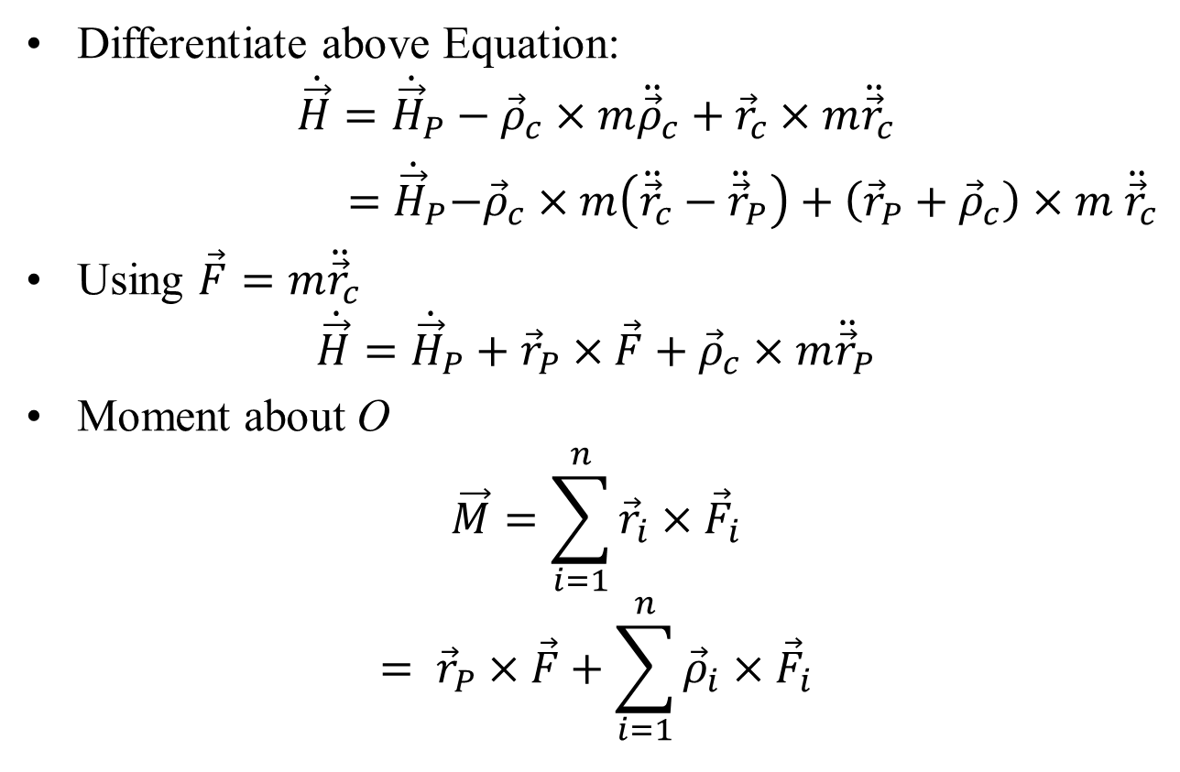

Angular Momentum About a Moving Point
$${\vec{H}=\vec{H}}_{P}−{\vec{ρ}}_{c}×m{\dot{\vec{ρ}}}_{c}+{\vec{r}}_{c}×m{\dot{\vec{r}}}_{c}$$
Differentiate above Equation:
$$\dot{\vec{H}}={\dot{\vec{H}}}_{P}−{\vec{ρ}}_{c}×m{\ddot{\vec{ρ}}}_{c}+{\vec{r}}_{c}×m{\ddot{\vec{r}}}_{c}$$
${ =\dot{\vec{H}}}_{P}−{\vec{ρ}}_{c}×m\left({\ddot{\vec{r}}}_{c}−{\ddot{\vec{r}}}_{P}\right)+\left({\vec{r}}_{P}+{\vec{ρ}}_{c}\right)×m$ ${\ddot{\vec{r}}}_{c}$
Using $\vec{F}=m{\ddot{\vec{r}}}_{c}$
$$\dot{\vec{H}}={\dot{\vec{H}}}_{P}+{\vec{r}}_{P}×\vec{F}+{\vec{ρ}}_{c}×m{\ddot{\vec{r}}}_{P}$$
Moment about O
$$\vec{M}=\sum_{i=1}^{n}{{\vec{r}}_{i}}×{\vec{F}}_{i}$$
$$= {\vec{r}}_{P}×\vec{F}+\sum_{i=1}^{n}{{\vec{ρ}}_{i}}×{\vec{F}}_{i}$$

Slide 12
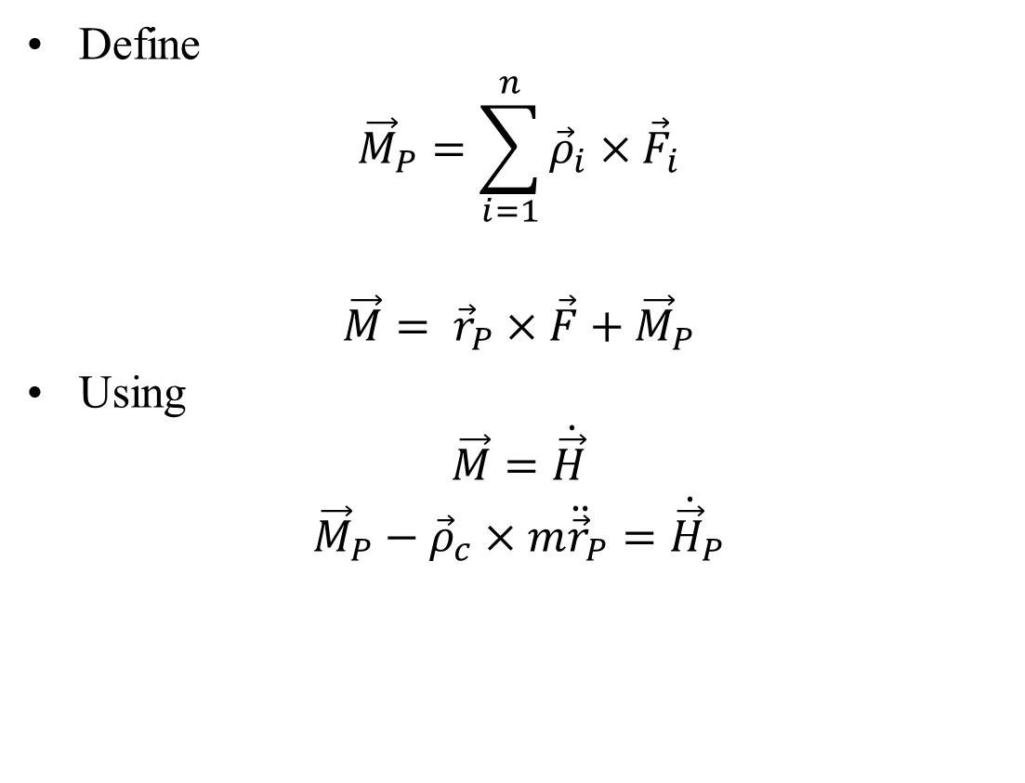
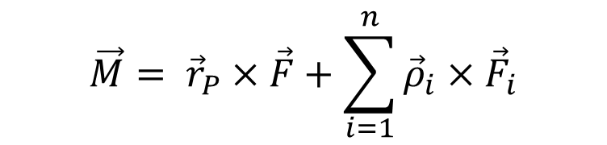
Angular Momentum About a Moving Point
$$\vec{M}= {\vec{r}}_{P}×\vec{F}+\sum_{i=1}^{n}{{\vec{ρ}}_{i}}×{\vec{F}}_{i}$$
Define
$${\vec{M}}_{P}=\sum_{i=1}^{n}{{\vec{ρ}}_{i}×{\vec{F}}_{i}}$$
$$\vec{M}= {\vec{r}}_{P}×\vec{F}+{\vec{M}}_{P}$$
Using
$$\vec{M}=\dot{\vec{H}}$$
$${\vec{M}}_{P}−{\vec{ρ}}_{c}×m{\ddot{\vec{r}}}_{P}={\dot{\vec{H}}}_{P}$$

