Slide 1


Impulse Momentum Analysis of Particle Swarm
P M V Subbarao
Professor & Head
Mechanical Engineering Department
Live Forces on Individual to Collective Behavior …

Slide 2

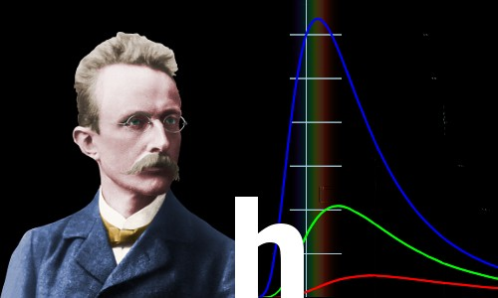
Visualization of Fluid as A Particle Swarm
Hermann Muller, a teacher, fostered Max Planck's ability to visualize physics.
Müller considered Visualization as a "vital weapon" for physicists.
Maxwell’s Distribution (1860) followed by Boltzmann's refinement (1870) were the best examples for Visulization of Physics.
Max Planck changed physics and our understanding of the world forever

Slide 3
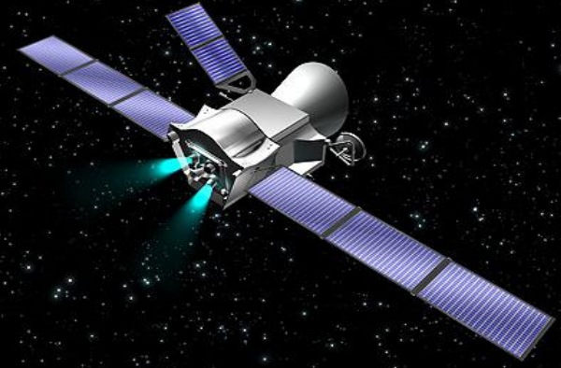
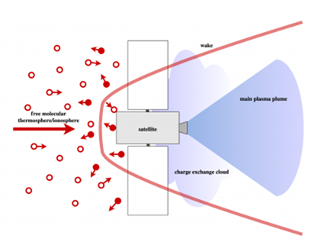
Particle Swarm Micro-thrusters For Alignment of Artificial Satellites

Slide 4

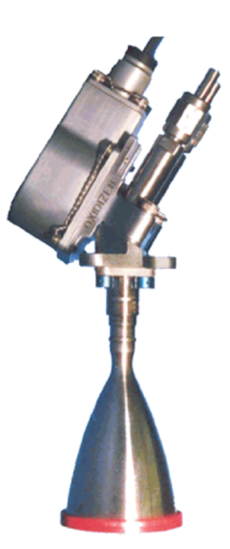
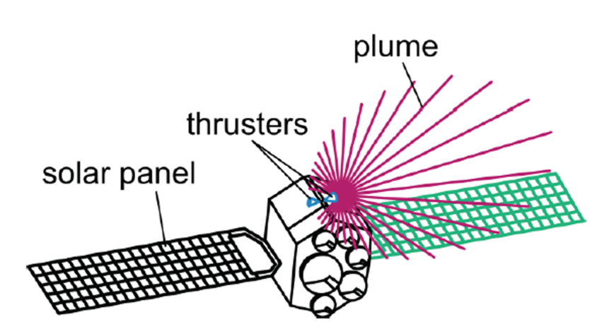
Particle Swarm Micro-thrusters For Alignment of Artificial Satellites
A thruster is a spacecraft propulsion device used for orbital station-keeping, attitude control, or long-duration, low-thrust acceleration.

Slide 5
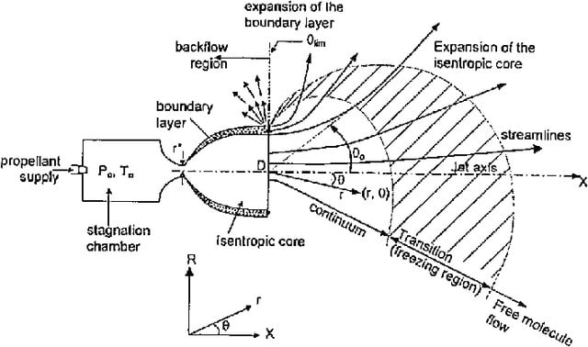
Dynamics of Typical plume flow from Micro thruster in vacuum

Slide 6
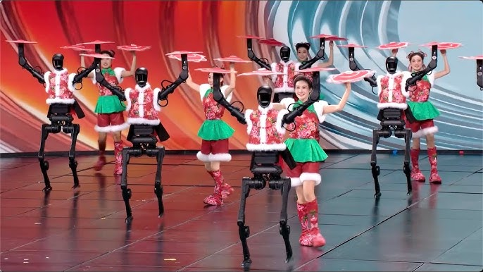
Live Forces on System of Particles
Each battery of a humanoid is roughly 1,000 Wh to over 2,000 Wh,
designed with 48V–58V to Meet High Torque/Force /Impulse Requirement.

Slide 7
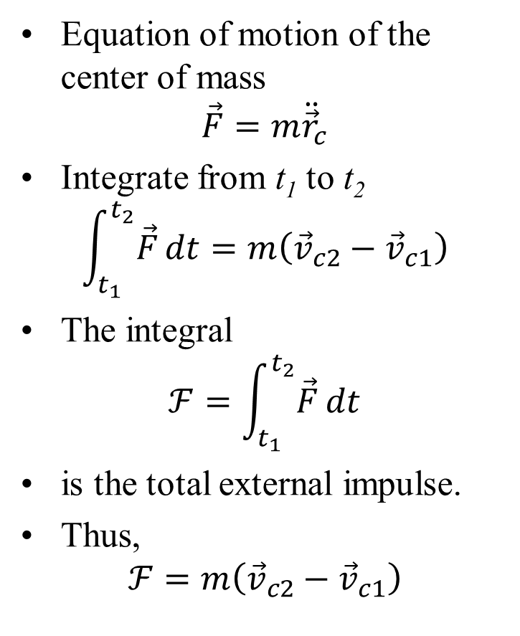
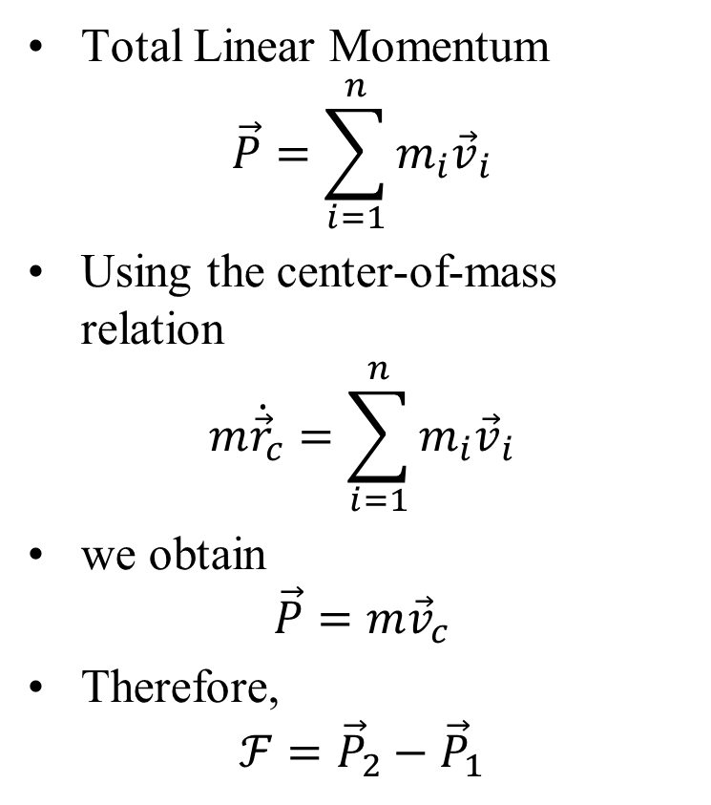
Linear Impulse and Momentum for System of Particles
Equation of motion of the center of mass
$$\vec{F}=m{\ddot{\vec{r}}}_{c}$$
Integrate from t₁ to t₂
$$\int_{t_{1}}^{t_{2}}{\vec{F}}dt=m\left({\vec{v}}_{c2}−{\vec{v}}_{c1}\right)$$
The integral
$$ℱ=\int_{t_{1}}^{t_{2}}{\vec{F}}dt$$
is the total external impulse.
Thus,
$$ℱ=m\left({\vec{v}}_{c2}−{\vec{v}}_{c1}\right)$$
Total Linear Momentum
$$\vec{P}=\sum_{i=1}^{n}{m_{i}{\vec{v}}_{i}}$$
Using the center-of-mass relation
$$m{\dot{\vec{r}}}_{c}=\sum_{i=1}^{n}{m_{i}{\vec{v}}_{i}}$$
we obtain
$$\vec{P}=m{\vec{v}}_{c}$$
Therefore,
$$ℱ={\vec{P}}_{2}−{\vec{P}}_{1}$$

Slide 8
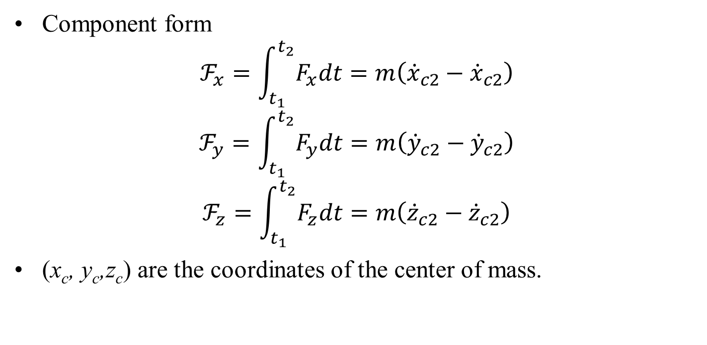
Impulse Components and Momentum Conservation
Component form
$$ℱ_{x}=\int_{t_{1}}^{t_{2}}{F_{x}dt}=m\left({\dot{x}}_{c2}−{\dot{x}}_{c2}\right)$$
$$ℱ_{y}=\int_{t_{1}}^{t_{2}}{F_{y}dt}=m\left({\dot{y}}_{c2}−{\dot{y}}_{c2}\right)$$
$$ℱ_{z}=\int_{t_{1}}^{t_{2}}{F_{z}dt}=m\left({\dot{z}}_{c2}−{\dot{z}}_{c2}\right)$$
(x_{c}, y_{c},z_{c}) are the coordinates of the center of mass.

Slide 9
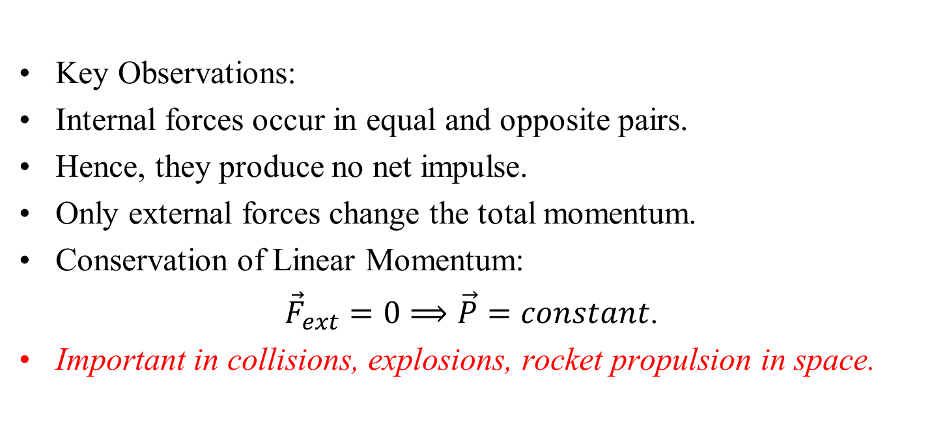
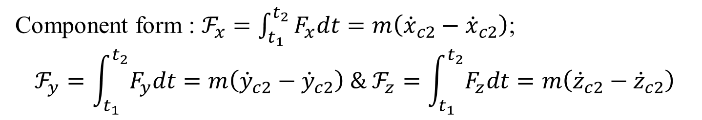
Impulse Components and Momentum Conservation
Component form : $ℱ_{x}=\int_{t_{1}}^{t_{2}}{F_{x}dt}=m\left({\dot{x}}_{c2}−{\dot{x}}_{c2}\right)$;
$$ℱ_{y}=\int_{t_{1}}^{t_{2}}{F_{y}dt}=m\left({\dot{y}}_{c2}−{\dot{y}}_{c2}\right) \& ℱ_{z}=\int_{t_{1}}^{t_{2}}{F_{z}dt}=m\left({\dot{z}}_{c2}−{\dot{z}}_{c2}\right)$$
Key Observations:
Internal forces occur in equal and opposite pairs.
Hence, they produce no net impulse.
Only external forces change the total momentum.
Conservation of Linear Momentum:
${\vec{F}}_{ext}=0⟹\vec{P}=constant$.
Important in collisions, explosions, rocket propulsion in space.

Slide 10
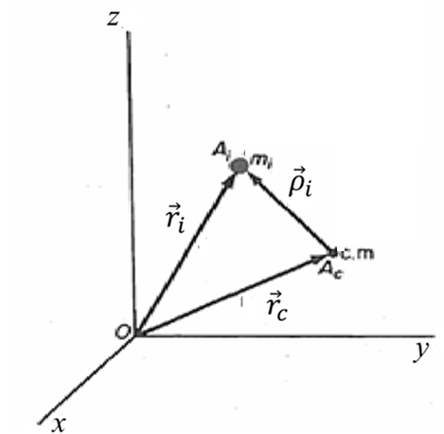
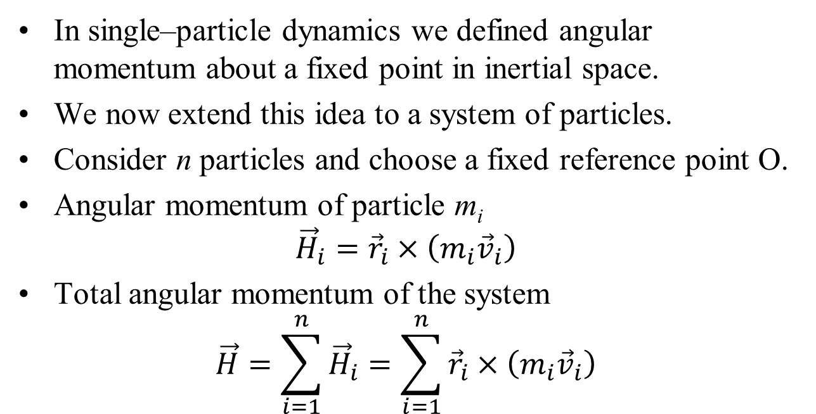
Angular Momentum of a System about a Fixed Reference Point
In single–particle dynamics we defined angular momentum about a fixed point in inertial space.
We now extend this idea to a system of particles.
Consider n particles and choose a fixed reference point O.
Angular momentum of particle m_{i}
$${\vec{H}}_{i}={\vec{r}}_{i}×\left(m_{i}{\vec{v}}_{i}\right)$$
Total angular momentum of the system
$$\vec{H}=\sum_{i=1}^{n}{{\vec{H}}_{i}}=\sum_{i=1}^{n}{{\vec{r}}_{i}×\left(m_{i}{\vec{v}}_{i}\right)}$$

Slide 11
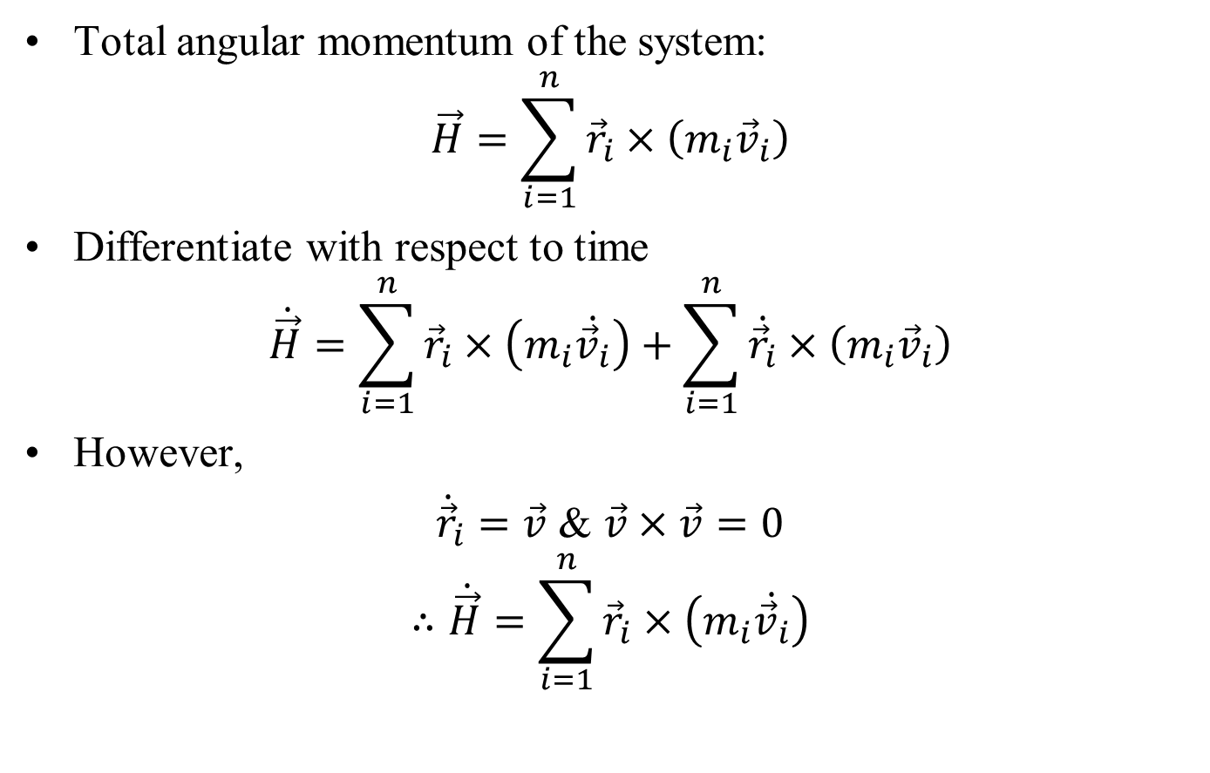
Time Rate of Change of Angular Momentum
Total angular momentum of the system:
$$\vec{H}=\sum_{i=1}^{n}{{\vec{r}}_{i}×\left(m_{i}{\vec{v}}_{i}\right)}$$
Differentiate with respect to time
$$\dot{\vec{H}}=\sum_{i=1}^{n}{{\vec{r}}_{i}×\left(m_{i}\dot{{\vec{v}}_{i}}\right)+\sum_{i=1}^{n}{\dot{{\vec{r}}_{i}}×\left(m_{i}{\vec{v}}_{i}\right)}}$$
However,
${\dot{\vec{r}}}_{i}=\vec{v}$ & $\vec{v}×\vec{v}=0$
$$∴\dot{\vec{H}}=\sum_{i=1}^{n}{{\vec{r}}_{i}×\left(m_{i}\dot{{\vec{v}}_{i}}\right)}$$

Slide 12
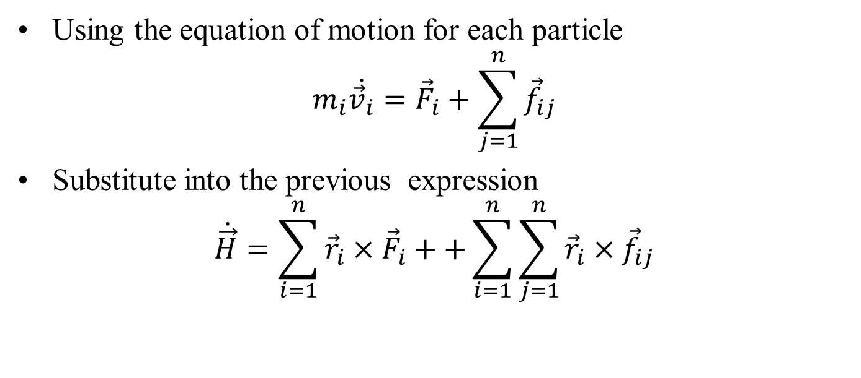
Time Rate of Change of Angular Momentum
Using the equation of motion for each particle
$$m_{i}\dot{{\vec{v}}_{i}}={\vec{F}}_{i}+\sum_{j=1}^{n}{{\vec{f}}_{ij}}$$
Substitute into the previous expression
$$\dot{\vec{H}}=\sum_{i=1}^{n}{{\vec{r}}_{i}×{\vec{F}}_{i}}++\sum_{i=1}^{n}{\sum_{j=1}^{n}{{{\vec{r}}_{i}×\vec{f}}_{ij}}}$$

Slide 13
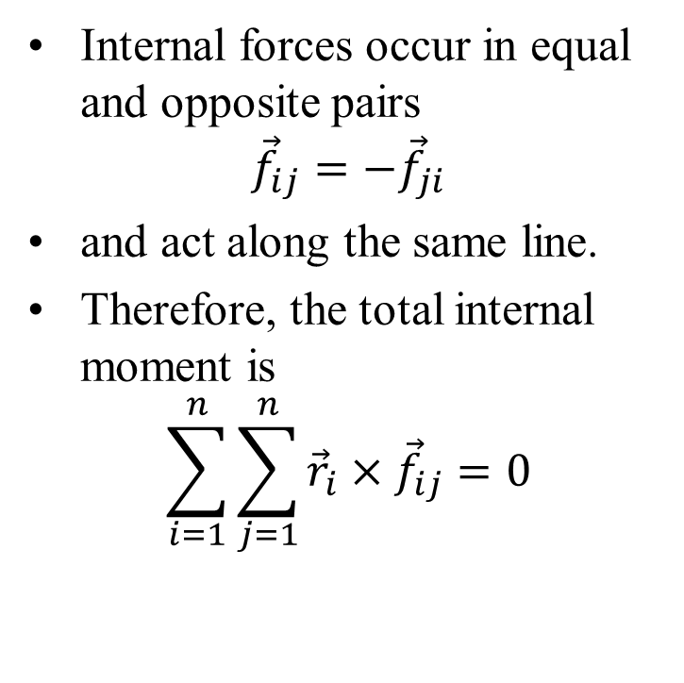
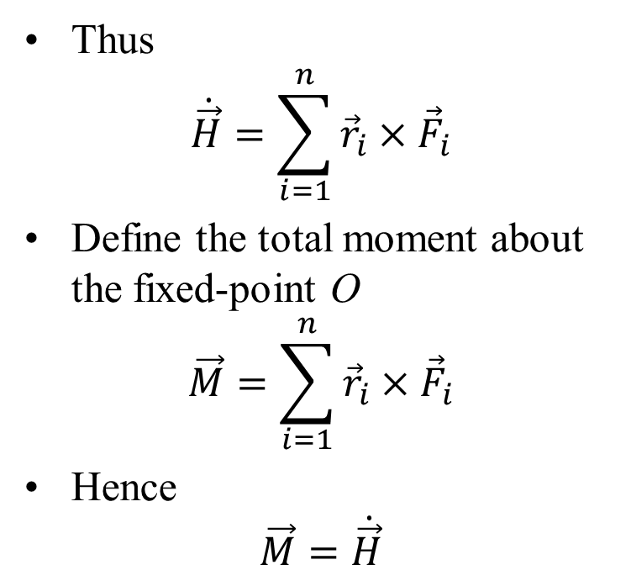
Moment Equation for a System of Particles
Internal forces occur in equal and opposite pairs
$${\vec{f}}_{ij}=−{\vec{f}}_{ji}$$
and act along the same line.
Therefore, the total internal moment is
$$\sum_{i=1}^{n}{\sum_{j=1}^{n}{{\vec{r}}_{i}×{\vec{f}}_{ij}}=0}$$
Thus
$$\dot{\vec{H}}=\sum_{i=1}^{n}{{\vec{r}}_{i}×{\vec{F}}_{i}}$$
Define the total moment about the fixed-point O
$$\vec{M}=\sum_{i=1}^{n}{{\vec{r}}_{i}×{\vec{F}}_{i}}$$
Hence
$$\vec{M}=\dot{\vec{H}}$$
Important Result
For a system of particles, Rate of change of angular momentum about a fixed point O = Total external moment about O of the external forces acting on the system.

Slide 14
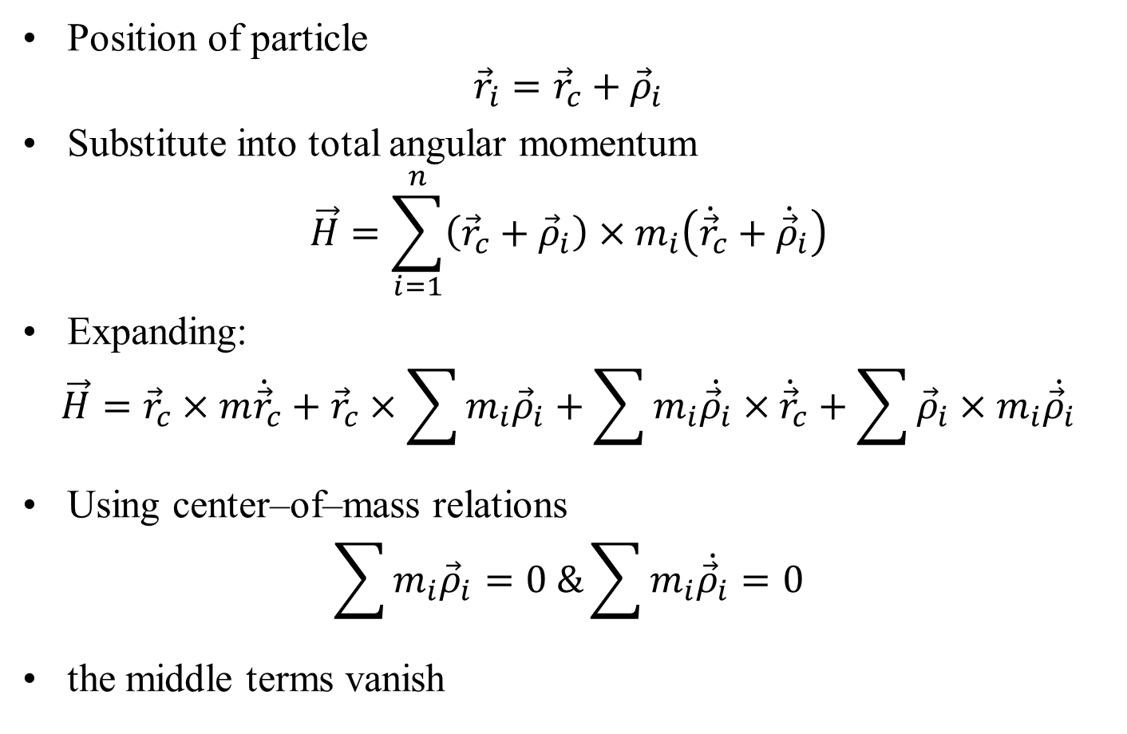
Angular Momentum about the Center of Mass
Position of particle
$${\vec{r}}_{i}={\vec{r}}_{c}+{\vec{ρ}}_{i}$$
Substitute into total angular momentum
$$\vec{H}=\sum_{i=1}^{n}{\left({\vec{r}}_{c}+{\vec{ρ}}_{i}\right)×m_{i}\left({\dot{\vec{r}}}_{c}+{\dot{\vec{ρ}}}_{i}\right)}$$
Expanding:
$$\vec{H}={\vec{r}}_{c}×m{\dot{\vec{r}}}_{c}+{\vec{r}}_{c}×\sum{m_{i}{\vec{ρ}}_{i}}+\sum{m_{i}\dot{{\vec{ρ}}_{i}}}×{\dot{\vec{r}}}_{c}+\sum{{\vec{ρ}}_{i}×m_{i}\dot{{\vec{ρ}}_{i}}}$$
Using center–of–mass relations
$$\sum{m_{i}{\vec{ρ}}_{i}}=0 \&\sum{m_{i}\dot{{\vec{ρ}}_{i}}}=0$$
the middle terms vanish

Slide 15
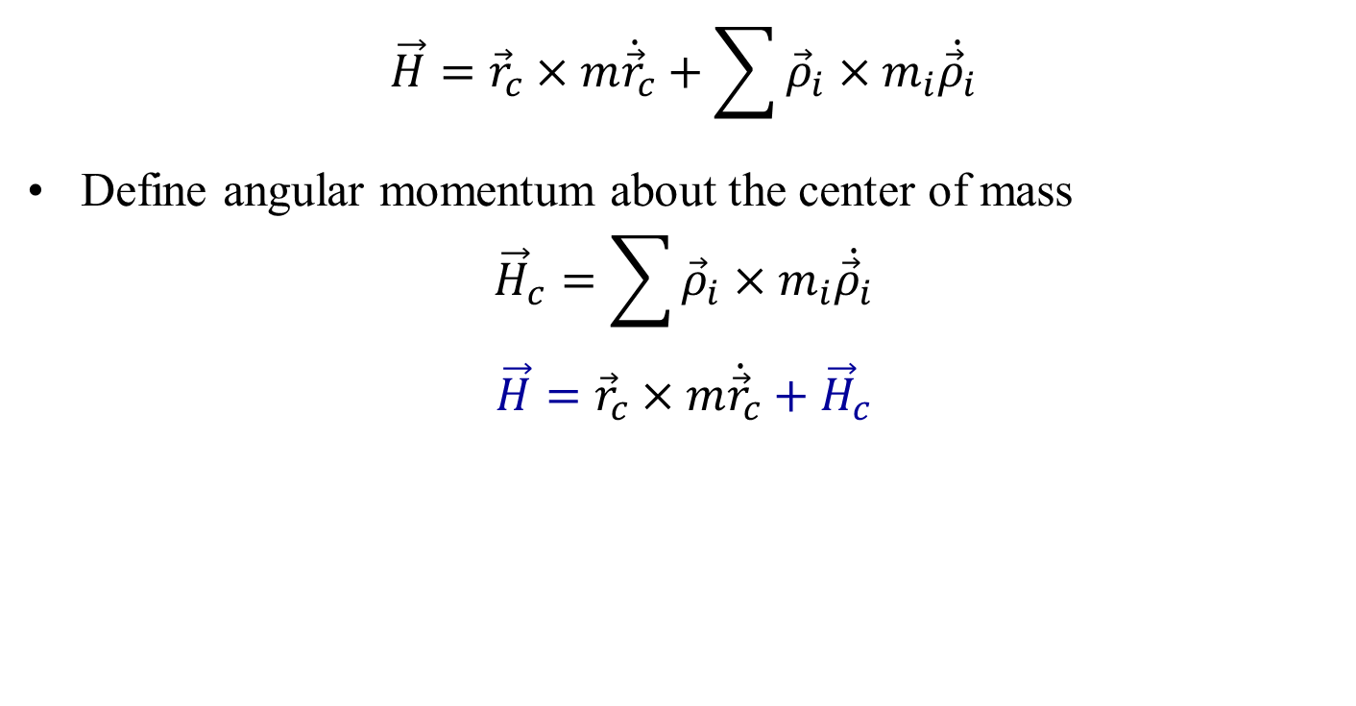
Angular Momentum about the Center of Mass
$$\vec{H}={\vec{r}}_{c}×m{\dot{\vec{r}}}_{c}+\sum{{\vec{ρ}}_{i}×m_{i}\dot{{\vec{ρ}}_{i}}}$$
Define angular momentum about the center of mass
$${\vec{H}}_{c}=\sum{{\vec{ρ}}_{i}×m_{i}\dot{{\vec{ρ}}_{i}}}$$
$$\vec{H}={\vec{r}}_{c}×m{\dot{\vec{r}}}_{c}+{\vec{H}}_{c}$$

Slide 16
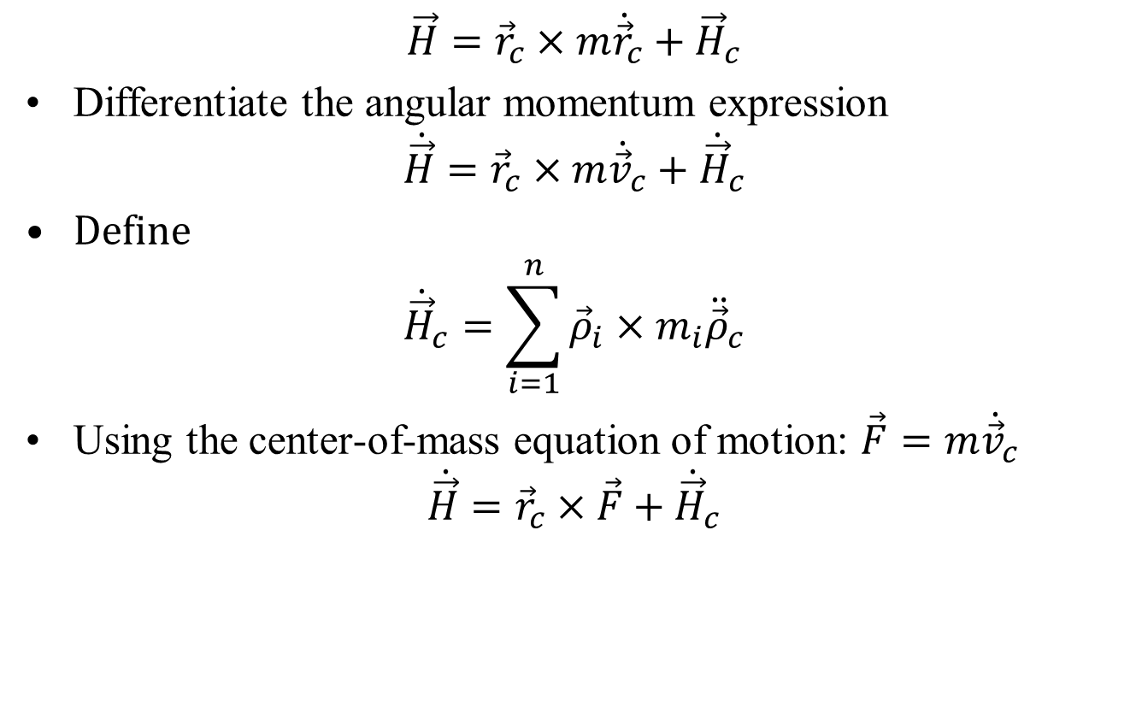
Time Rate of Change of Angular Momentum
$$\vec{H}={\vec{r}}_{c}×m{\dot{\vec{r}}}_{c}+{\vec{H}}_{c}$$
Differentiate the angular momentum expression
$$\dot{\vec{H}}={\vec{r}}_{c}×m{\dot{\vec{v}}}_{c}+{\dot{\vec{H}}}_{c}$$
Define
$${\dot{\vec{H}}}_{c}=\sum_{i=1}^{n}{{\vec{ρ}}_{i}×m_{i}{\ddot{\vec{ρ}}}_{c}}$$
Using the center-of-mass equation of motion: $\vec{F}=m{\dot{\vec{v}}}_{c}$
$$\dot{\vec{H}}={\vec{r}}_{c}×\vec{F}+{\dot{\vec{H}}}_{c}$$

Slide 17
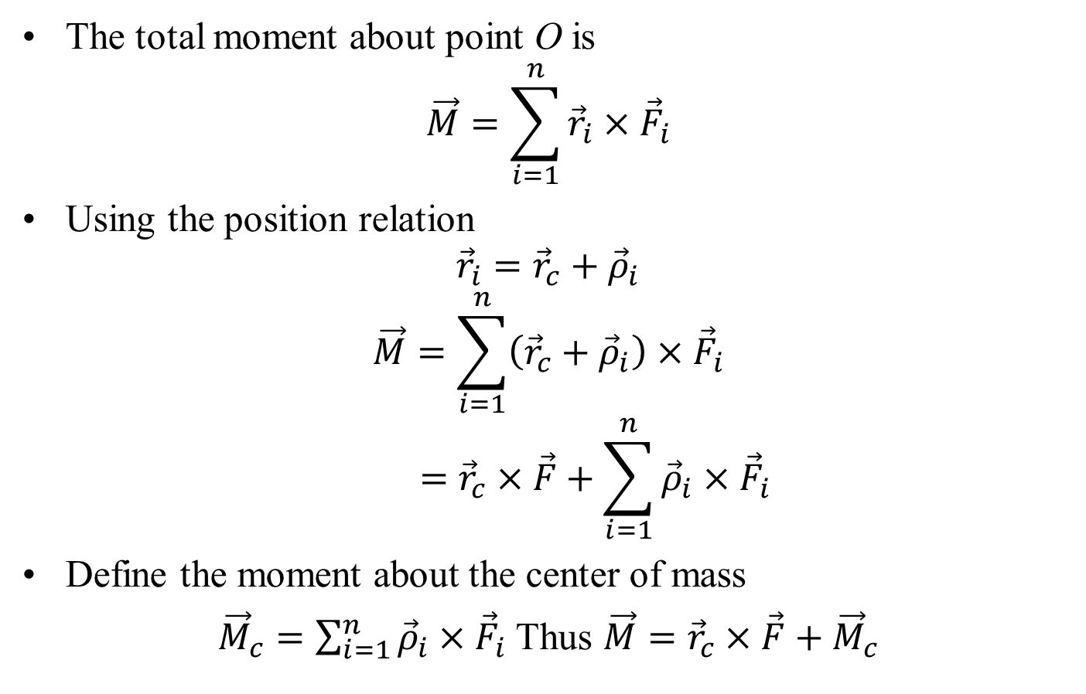
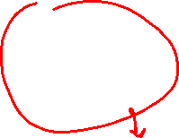
Moment of External Forces
The total moment about point O is
$$\vec{M}=\sum_{i=1}^{n}{{\vec{r}}_{i}×{\vec{F}}_{i}}$$
Using the position relation
$${\vec{r}}_{i}={\vec{r}}_{c}+{\vec{ρ}}_{i}$$
$$\vec{M}=\sum_{i=1}^{n}{\left({\vec{r}}_{c}+{\vec{ρ}}_{i}\right)×{\vec{F}}_{i}}$$
$$={\vec{r}}_{c}×\vec{F}+\sum_{i=1}^{n}{{\vec{ρ}}_{i}×{\vec{F}}_{i}}$$
Define the moment about the center of mass
${\vec{M}}_{c}=\sum_{i=1}^{n}{{\vec{ρ}}_{i}×{\vec{F}}_{i}}$ Thus $\vec{M}={\vec{r}}_{c}×\vec{F}+{\vec{M}}_{c}$

Slide 18
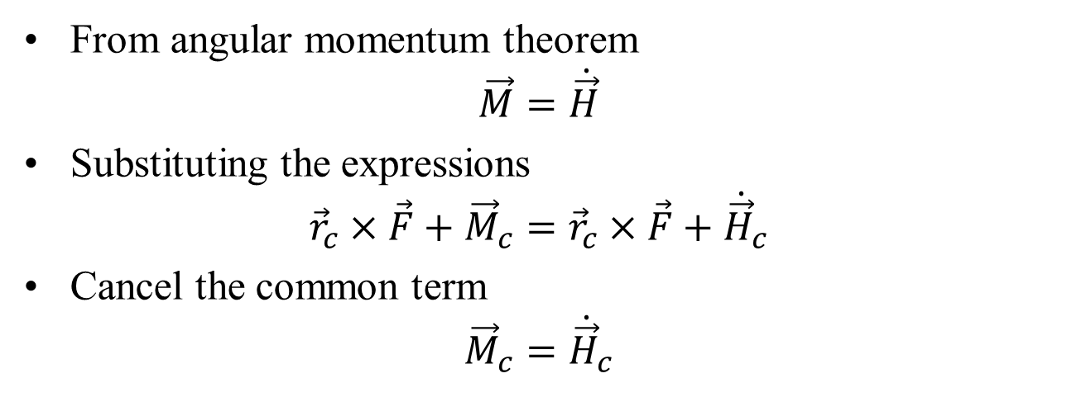
Angular Momentum Equation About the Center of Mass
From angular momentum theorem
$$\vec{M}=\dot{\vec{H}}$$
Substituting the expressions
$${\vec{r}}_{c}×\vec{F}+{\vec{M}}_{c}={\vec{r}}_{c}×\vec{F}+{\dot{\vec{H}}}_{c}$$
Cancel the common term
$${\vec{M}}_{c}={\dot{\vec{H}}}_{c}$$
Result: The rate of change of angular momentum about the center of mass equals the moment of external forces about the center of mass.

Slide 19
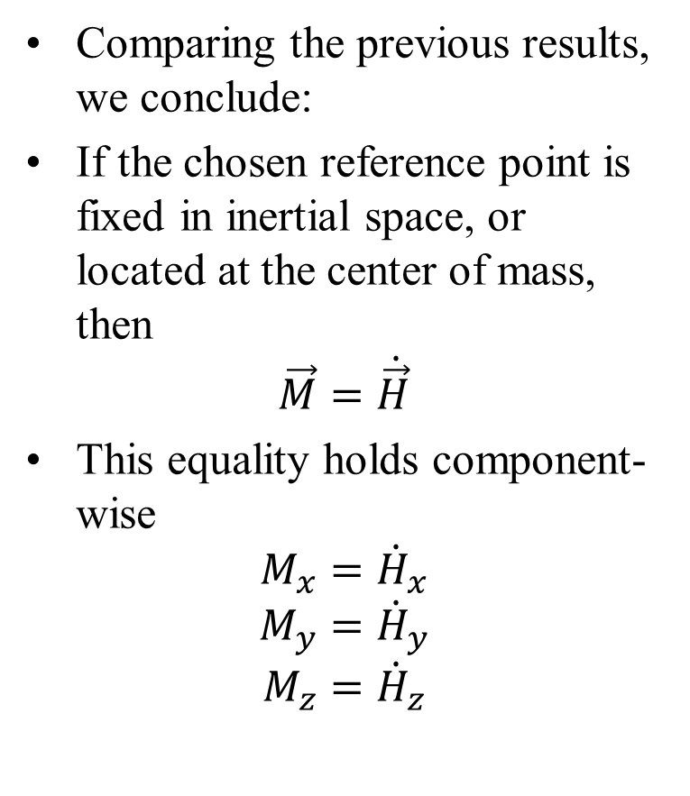
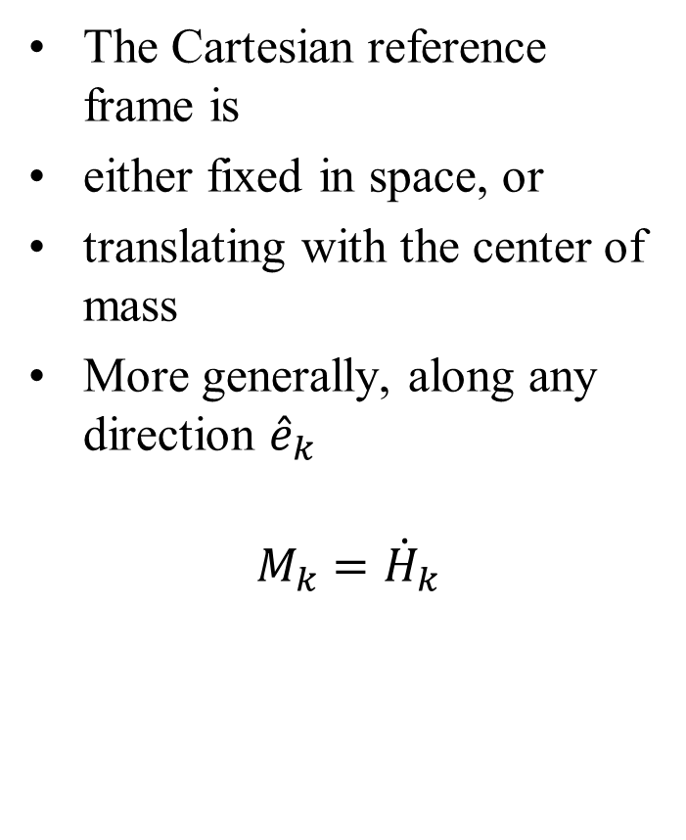
Component Form of Angular Momentum Equation
Comparing the previous results, we conclude:
If the chosen reference point is fixed in inertial space, or located at the center of mass, then
$$\vec{M}=\dot{\vec{H}}$$
This equality holds component-wise
$$M_{x}={\dot{H}}_{x}$$
$$M_{y}={\dot{H}}_{y}$$
$$M_{z}={\dot{H}}_{z}$$
The Cartesian reference frame is
either fixed in space, or
translating with the center of mass
More generally, along any direction ${\hat{e}}_{k}$
$$M_{k}={\dot{H}}_{k}$$

Slide 20
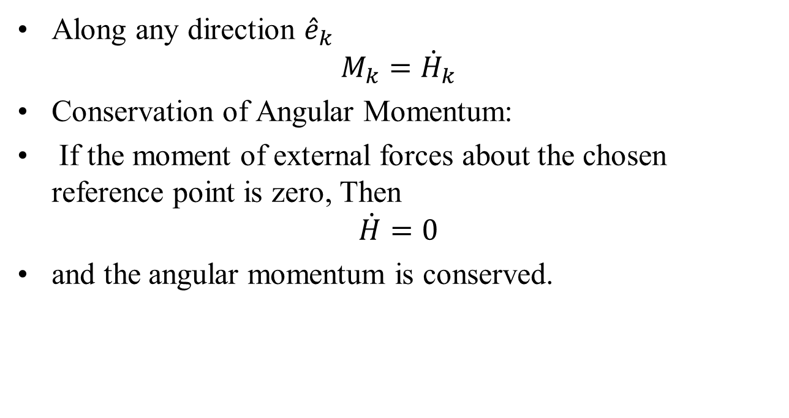
Component Form of Angular Momentum Equation
Along any direction ${\hat{e}}_{k}$
$$M_{k}={\dot{H}}_{k}$$
Conservation of Angular Momentum:
If the moment of external forces about the chosen reference point is zero, Then
$$\dot{H}=0$$
and the angular momentum is conserved.

Slide 21
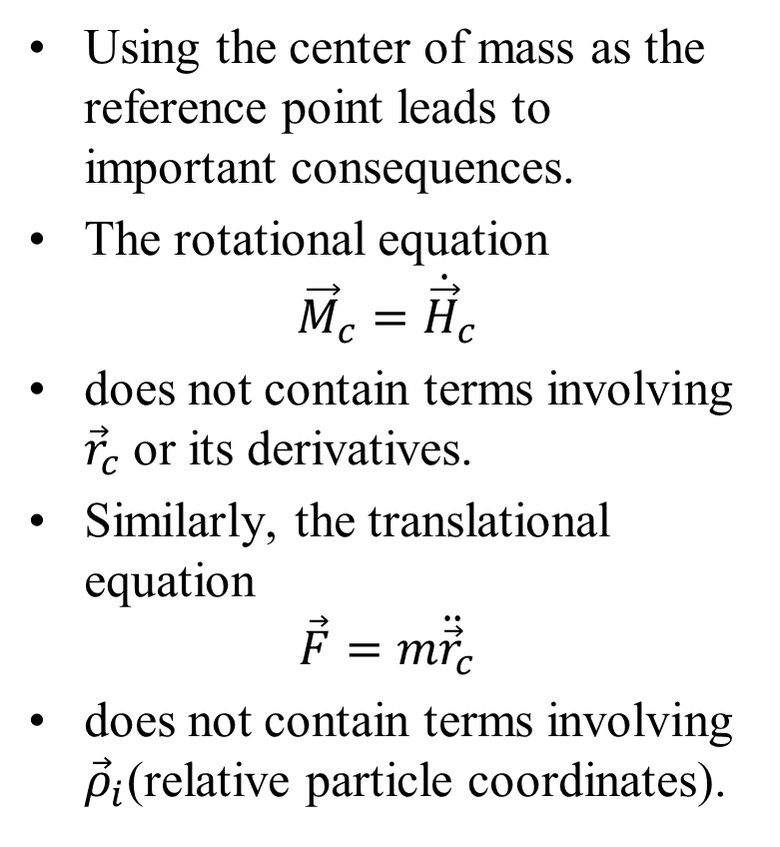
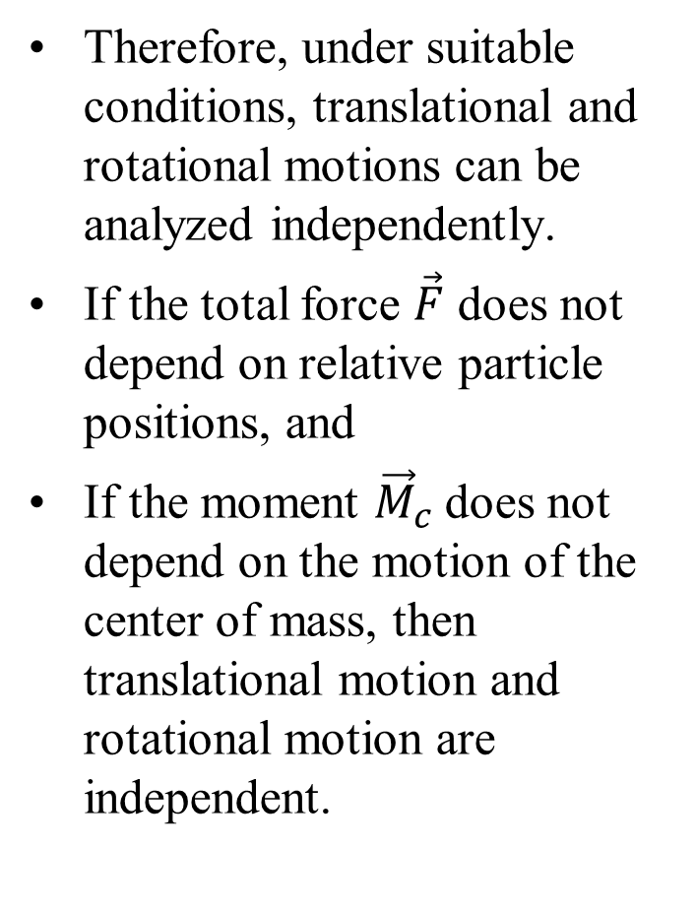
Implications of Using the Center of Mass
Using the center of mass as the reference point leads to important consequences.
The rotational equation
$${\vec{M}}_{c}={\dot{\vec{H}}}_{c}$$
does not contain terms involving ${\vec{r}}_{c}$ or its derivatives.
Similarly, the translational equation
$$\vec{F}=m{\ddot{\vec{r}}}_{c}$$
does not contain terms involving ${\vec{ρ}}_{i}$(relative particle coordinates).
Therefore, under suitable conditions, translational and rotational motions can be analyzed independently.
If the total force $\vec{F}$ does not depend on relative particle positions, and
If the moment ${\vec{M}}_{c}$does not depend on the motion of the center of mass, then translational motion and rotational motion are independent.

Slide 22
Implications of Using the Center of Mass
Furthermore, work–energy relations for motion relative to the center of mass can be evaluated separately from the motion of the center of mass.

Slide 23
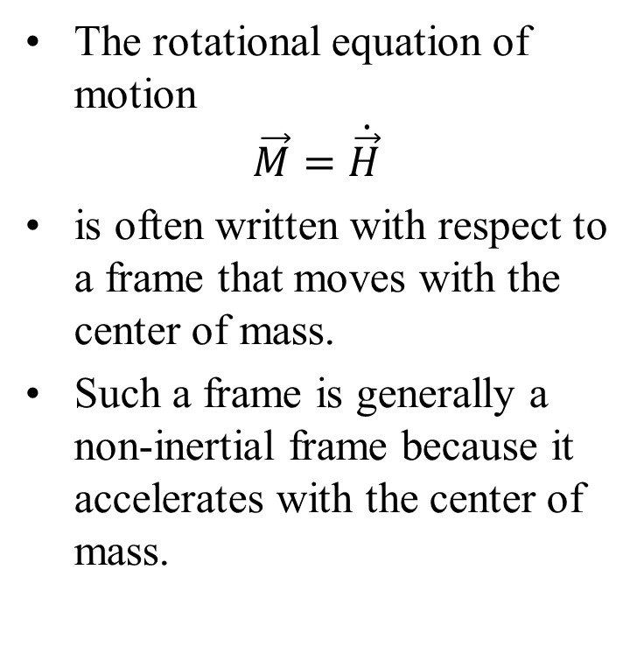
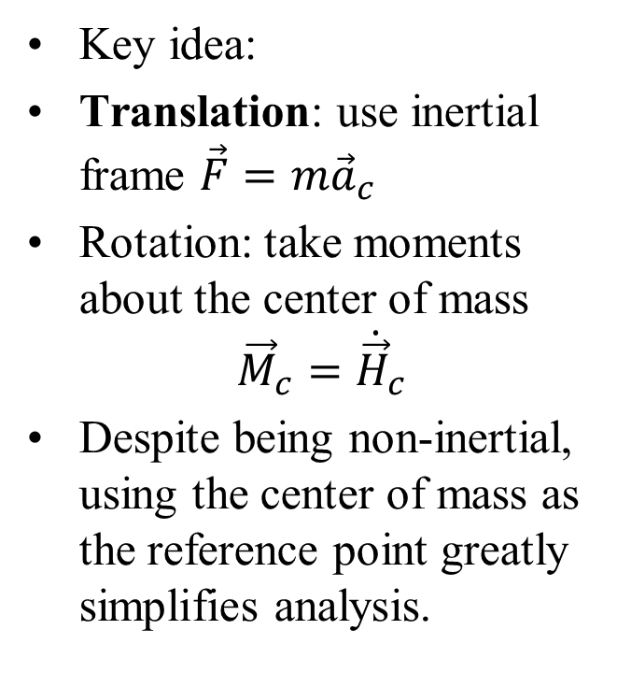
Center of Mass as a Reference Frame
Using a nonrotating reference frame that translates with the center of mass has important consequences.
The rotational equation of motion
$$\vec{M}=\dot{\vec{H}}$$
is often written with respect to a frame that moves with the center of mass.
Such a frame is generally a non-inertial frame because it accelerates with the center of mass.
Key idea:
Translation: use inertial frame $\vec{F}=m{\vec{a}}_{c}$
Rotation: take moments about the center of mass
$${\vec{M}}_{c}={\dot{\vec{H}}}_{c}$$
Despite being non-inertial, using the center of mass as the reference point greatly simplifies analysis.

