Slide 1



Dynamics of A Particle Swarm
Each battery of a humanoid is roughly 1,000 Wh to over 2,000 Wh
P M V Subbarao
Professor & Head
Mechanical Engineering Department
From Particles to Patterns: The Mechanics of Many…

Slide 2

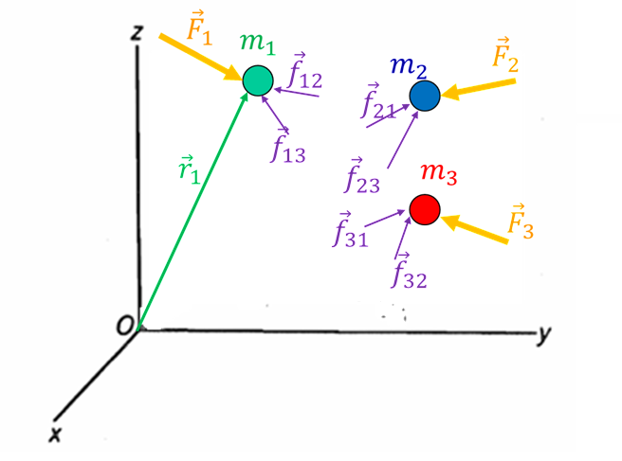
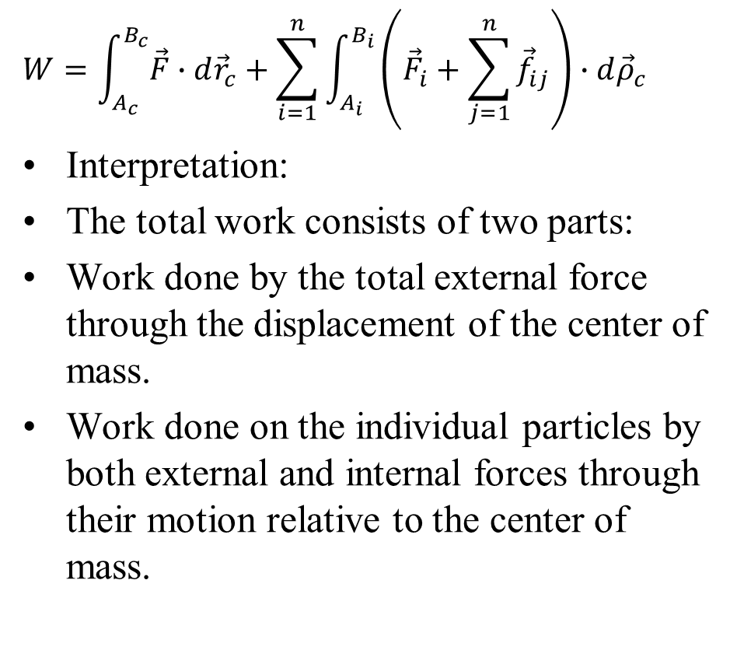
Total Work of a System
$$W=\int_{A_{c}}^{B_{c}}{\vec{F}∙d{\vec{r}}_{c}}+\sum_{i=1}^{n}{\int_{A_{i}}^{B_{i}}{\left({\vec{F}}_{i}+\sum_{j=1}^{n}{{\vec{f}}_{ij}}\right)∙d{\vec{ρ}}_{c}}}$$
Interpretation:
The total work consists of two parts:
Work done by the total external force through the displacement of the center of mass.
Work done on the individual particles by both external and internal forces through their motion relative to the center of mass.

Slide 3
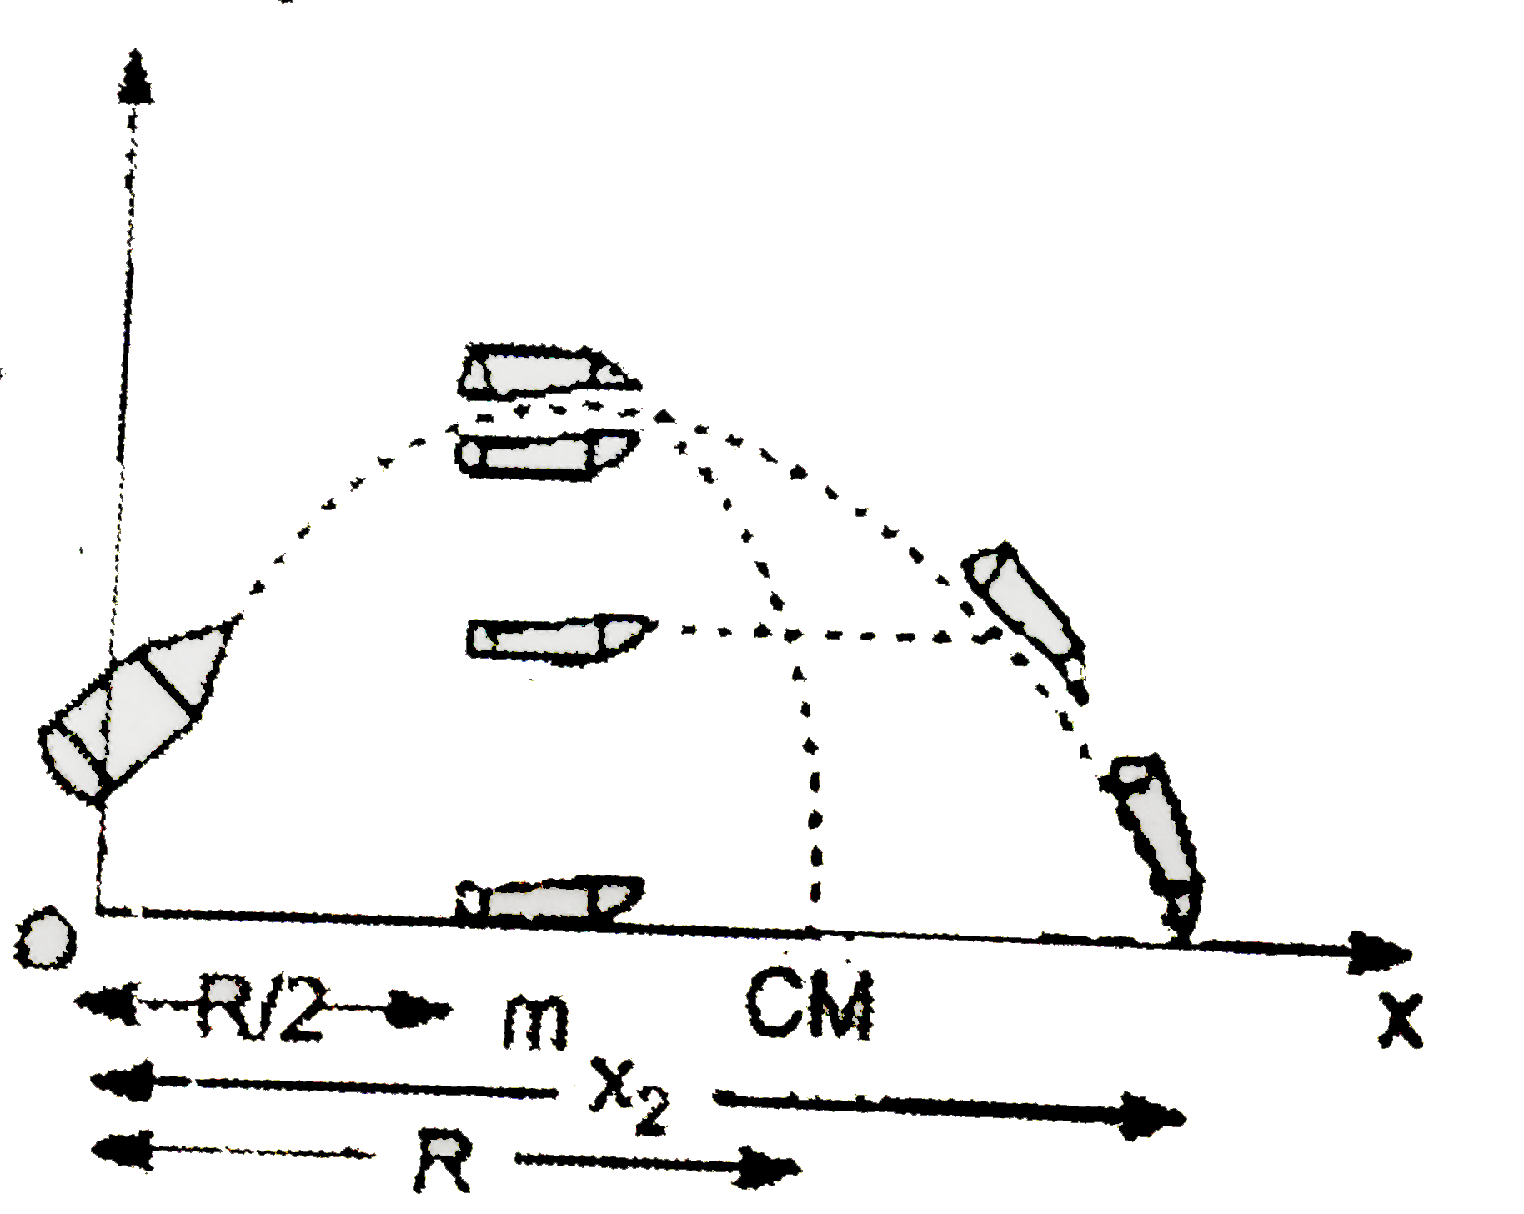
Case Study: Explosion of a Projectile
Intuitive Example:
Consider a bomb moving along a trajectory in the air.
Before the explosion, the bomb behaves like a single particle with mass m located at its center of mass.
At some instant, the bomb explodes into several fragments.
Internal forces between fragments become very large, causing the pieces to move relative to each other.
However, these internal forces occur in equal and opposite pairs and therefore do not affect the motion of the center of mass.

Slide 4
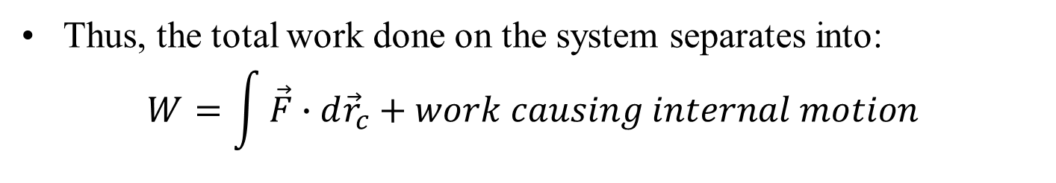
Case Study: Explosion of a Projectile
Key Result:
The center of mass continues to follow the same trajectory that the bomb would have followed if it had not exploded.
The additional motion of the fragments represents internal motion relative to the center of mass.
Thus, the total work done on the system separates into:
$$W=\int{\vec{F}∙d{\vec{r}}_{c}}+work causing internal motion$$
Work done through the displacement of the center of mass
Work done on the individual particles

Slide 5
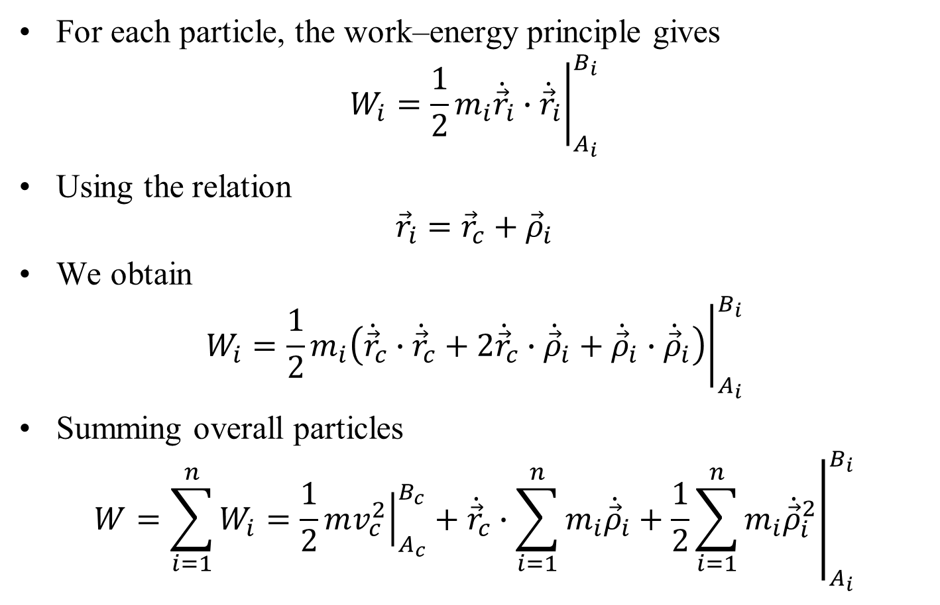
Work–Energy for a System of Particles
For each particle, the work–energy principle gives
$$W_{i}={\left.\frac{1}{2}m_{i}{\dot{\vec{r}}}_{i}∙{\dot{\vec{r}}}_{i}\right|}_{A_{i}}^{B_{i}}$$
Using the relation
$${\vec{r}}_{i}={\vec{r}}_{c}+{\vec{ρ}}_{i}$$
We obtain
$$W_{i}={\left.\frac{1}{2}m_{i}\left({\dot{\vec{r}}}_{c}∙{\dot{\vec{r}}}_{c}+2{\dot{\vec{r}}}_{c}∙{\dot{\vec{ρ}}}_{i}+{\dot{\vec{ρ}}}_{i}∙{\dot{\vec{ρ}}}_{i}\right)\right|}_{A_{i}}^{B_{i}}$$
Summing overall particles
$$W=\sum_{i=1}^{n}{W_{i}}=\frac{1}{2}{\left.mv_{c}^{2}\right|}_{A_{c}}^{B_{c}}+{\left.{\dot{\vec{r}}}_{c}∙\sum_{i=1}^{n}{m_{i}{\dot{\vec{ρ}}}_{i}+\frac{1}{2}\sum_{i=1}^{n}{m_{i}{\dot{\vec{ρ}}}_{i}^{2}}}\right|}_{A_{i}}^{B_{i}}$$

Slide 6
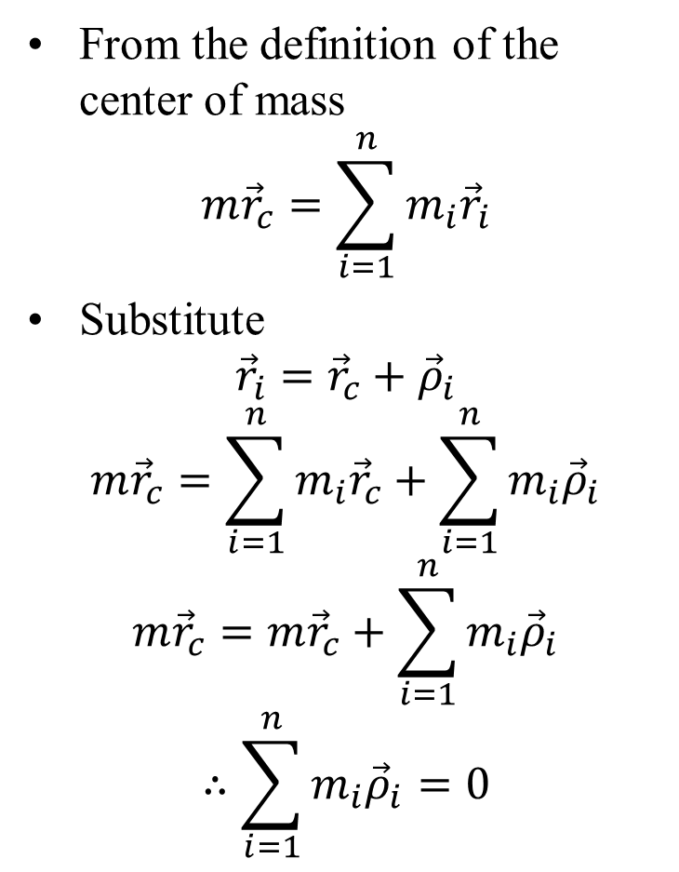
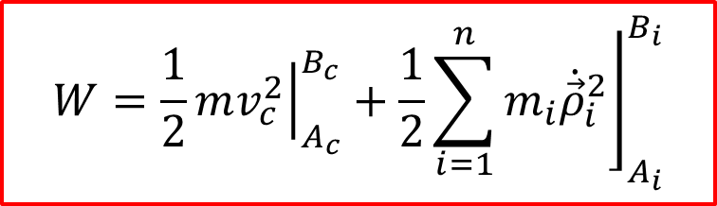
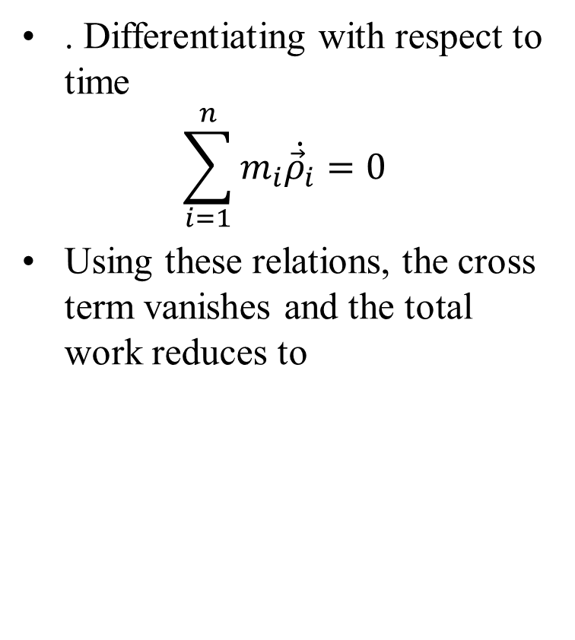
Center of Mass Relations
From the definition of the center of mass
$$m{\vec{r}}_{c}=\sum_{i=1}^{n}{m_{i}{\vec{r}}_{i}}$$
Substitute
$${\vec{r}}_{i}={\vec{r}}_{c}+{\vec{ρ}}_{i}$$
$$m{\vec{r}}_{c}=\sum_{i=1}^{n}{m_{i}{\vec{r}}_{c}}+\sum_{i=1}^{n}{m_{i}{\vec{ρ}}_{i}}$$
$$m{\vec{r}}_{c}=m{\vec{r}}_{c}+\sum_{i=1}^{n}{m_{i}{\vec{ρ}}_{i}}$$
$$∴\sum_{i=1}^{n}{m_{i}{\vec{ρ}}_{i}}=0$$
. Differentiating with respect to time
$$\sum_{i=1}^{n}{m_{i}\dot{{\vec{ρ}}_{i}}}=0$$
Using these relations, the cross term vanishes and the total work reduces to
$$W=\frac{1}{2}{\left.mv_{c}^{2}\right|}_{A_{c}}^{B_{c}}+{\left.\frac{1}{2}\sum_{i=1}^{n}{m_{i}{\dot{\vec{ρ}}}_{i}^{2}}\right\rfloor }_{A_{i}}^{B_{i}}$$

Slide 7
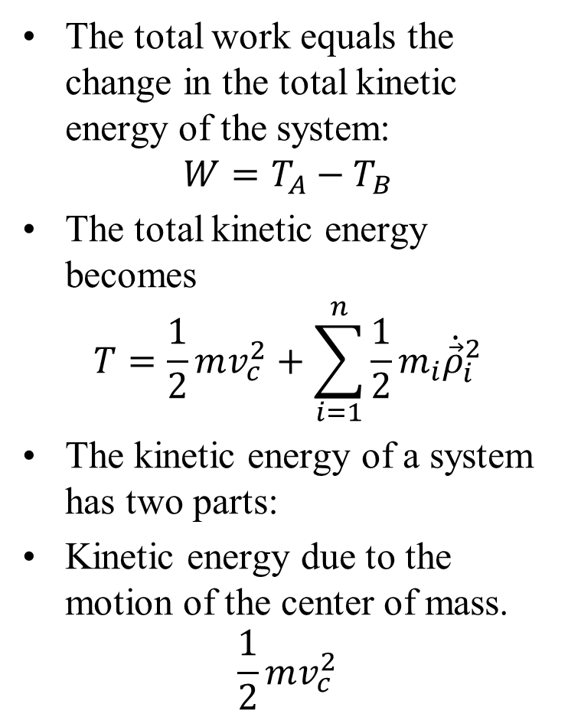
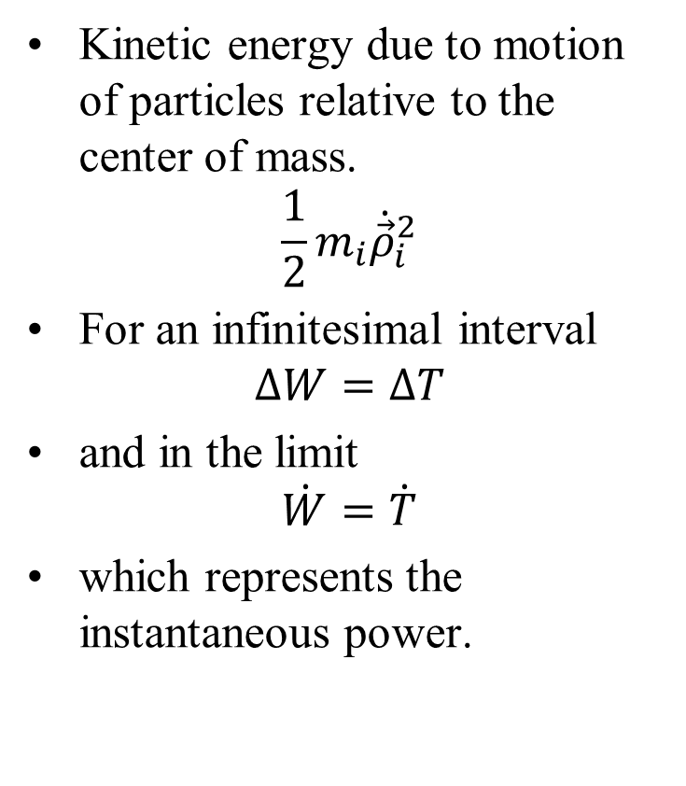
Total Kinetic Energy of a System
The total work equals the change in the total kinetic energy of the system:
$$W=T_{A}−T_{B}$$
The total kinetic energy becomes
$$T=\frac{1}{2}mv_{c}^{2}+\sum_{i=1}^{n}{\frac{1}{2}m_{i}{\dot{\vec{ρ}}}_{i}^{2}}$$
The kinetic energy of a system has two parts:
Kinetic energy due to the motion of the center of mass.
$$\frac{1}{2}mv_{c}^{2}$$
Kinetic energy due to motion of particles relative to the center of mass.
$$\frac{1}{2}m_{i}{\dot{\vec{ρ}}}_{i}^{2}$$
For an infinitesimal interval
$$∆W=∆T$$
and in the limit
$$\dot{W}=\dot{T}$$
which represents the instantaneous power.

Slide 8
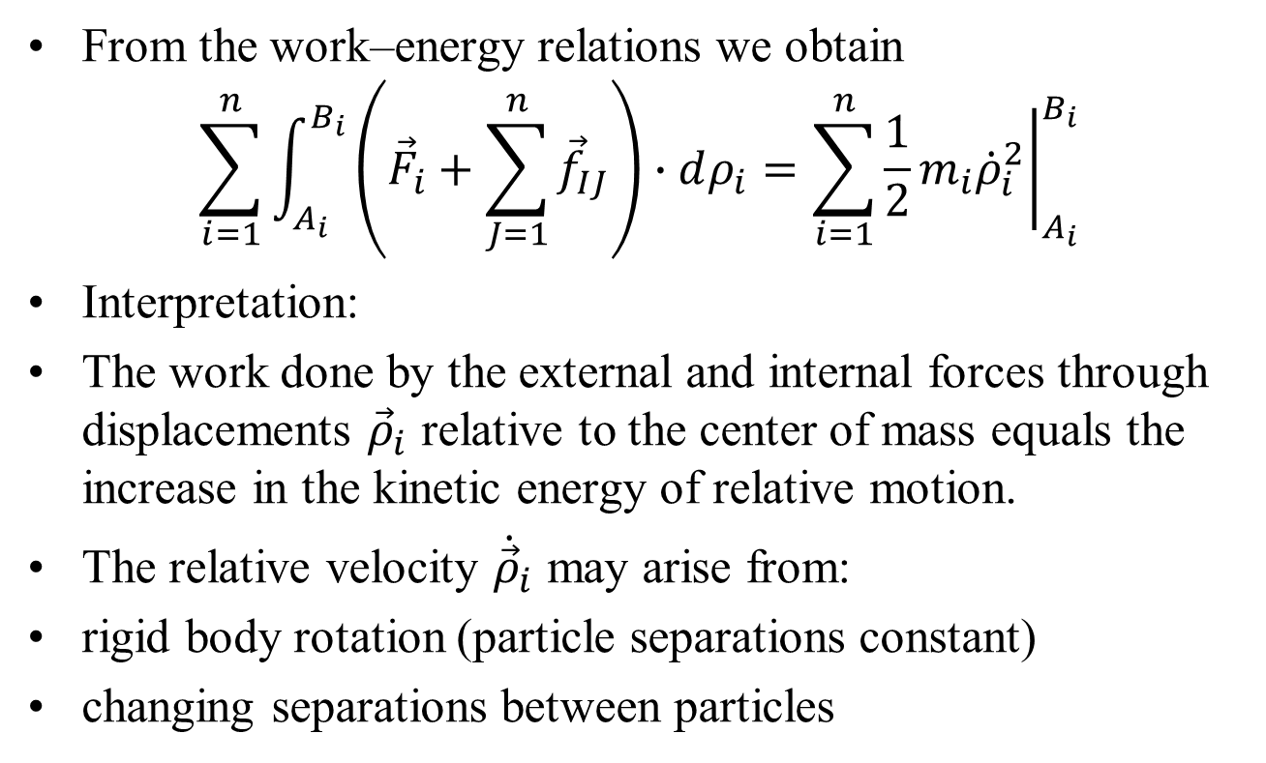
Work–Energy of a System: Final result
From the work–energy relations we obtain
$$\sum_{i=1}^{n}{\int_{A_{i}}^{B_{i}}{\left({\vec{F}}_{i}+\sum_{J=1}^{n}{{\vec{f}}_{IJ}}\right)}∙dρ_{i}}=\sum_{i=1}^{n}{{\left.\frac{1}{2}m_{i}{\dot{ρ}}_{i}^{2}\right|}_{A_{i}}^{B_{i}}}$$
Interpretation:
The work done by the external and internal forces through displacements ${\vec{ρ}}_{i}$ relative to the center of mass equals the increase in the kinetic energy of relative motion.
The relative velocity ${\dot{\vec{ρ}}}_{i}$ may arise from:
rigid body rotation (particle separations constant)
changing separations between particles

Slide 9
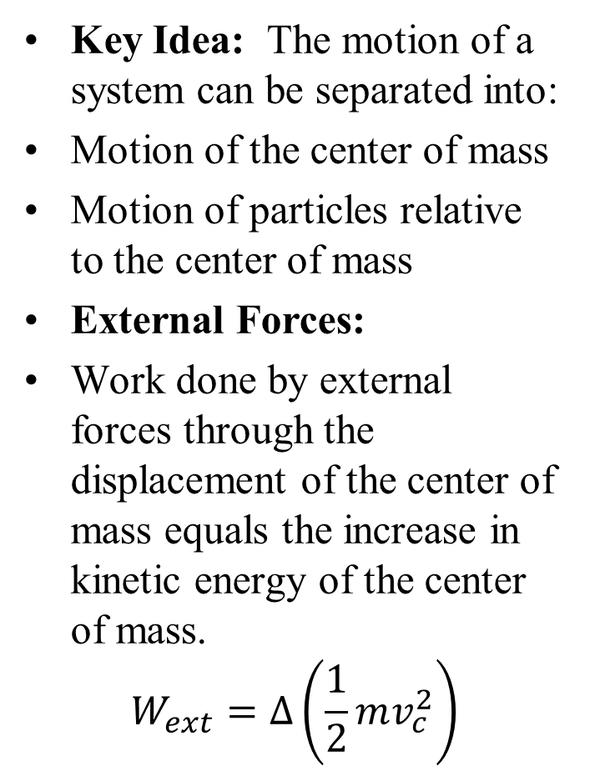
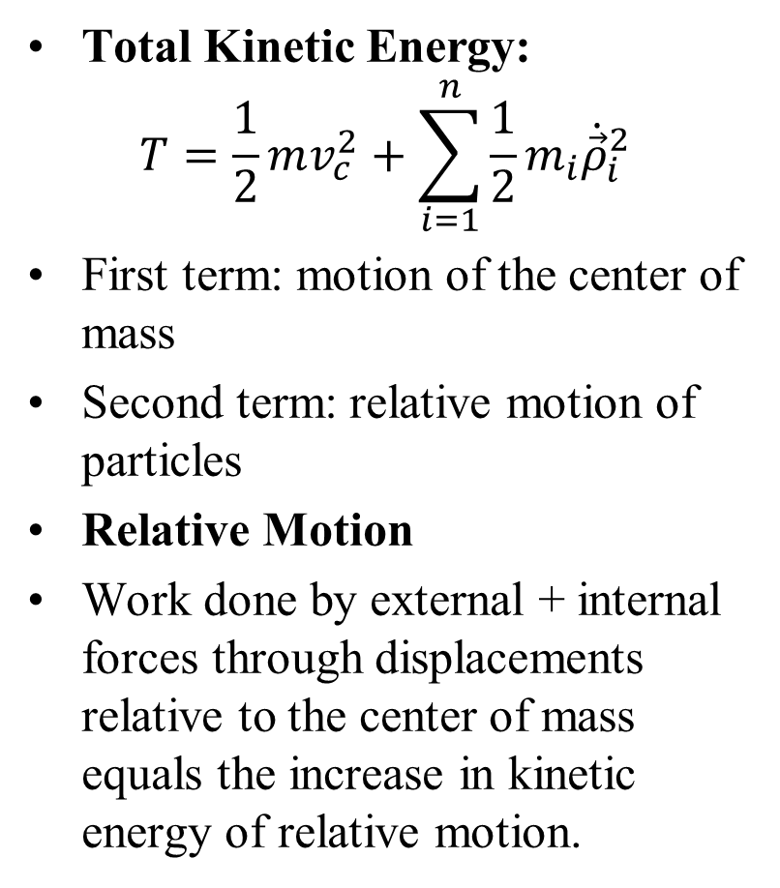
Summary: Work–Energy of a System of Particles
Key Idea: The motion of a system can be separated into:
Motion of the center of mass
Motion of particles relative to the center of mass
External Forces:
Work done by external forces through the displacement of the center of mass equals the increase in kinetic energy of the center of mass.
$$W_{ext}=∆\left(\frac{1}{2}mv_{c}^{2}\right)$$
Total Kinetic Energy:
$$T=\frac{1}{2}mv_{c}^{2}+\sum_{i=1}^{n}{\frac{1}{2}m_{i}{\dot{\vec{ρ}}}_{i}^{2}}$$
First term: motion of the center of mass
Second term: relative motion of particles
Relative Motion
Work done by external + internal forces through displacements relative to the center of mass equals the increase in kinetic energy of relative motion.

Slide 10
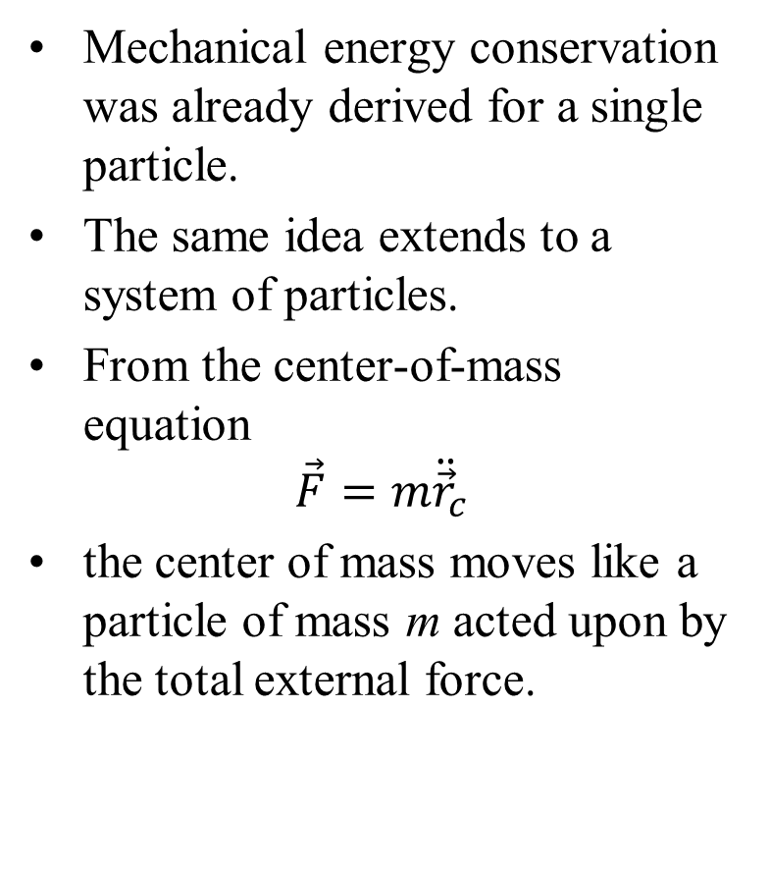
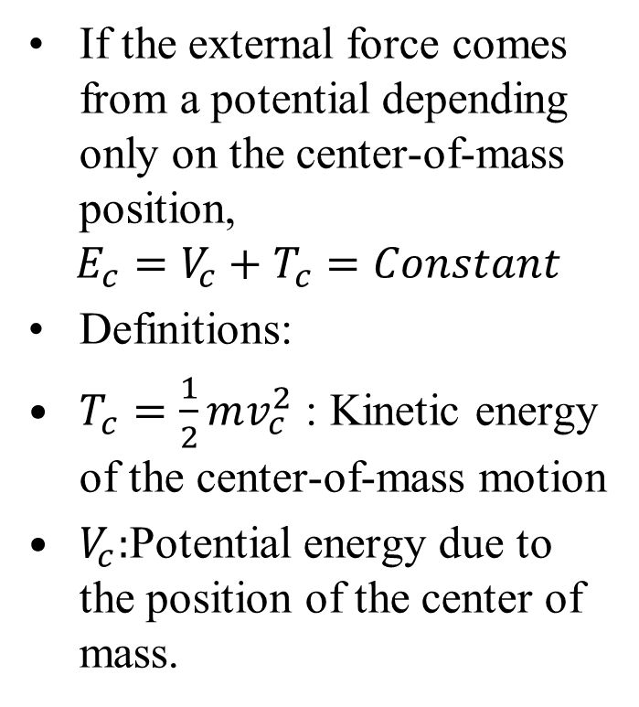
Conservation of Mechanical Energy for System of Particles
Mechanical energy conservation was already derived for a single particle.
The same idea extends to a system of particles.
From the center-of-mass equation
$$\vec{F}=m{\ddot{\vec{r}}}_{c}$$
the center of mass moves like a particle of mass m acted upon by the total external force.
If the external force comes from a potential depending only on the center-of-mass position,
$$E_{c}=V_{c}+T_{c}=Constant$$
Definitions:
$T_{c}=\frac{1}{2}mv_{c}^{2}$ : Kinetic energy of the center-of-mass motion
$V_{c}:$Potential energy due to the position of the center of mass.
Thus, E_{c} may remain constant even when dissipative internal forces exist.

Slide 11
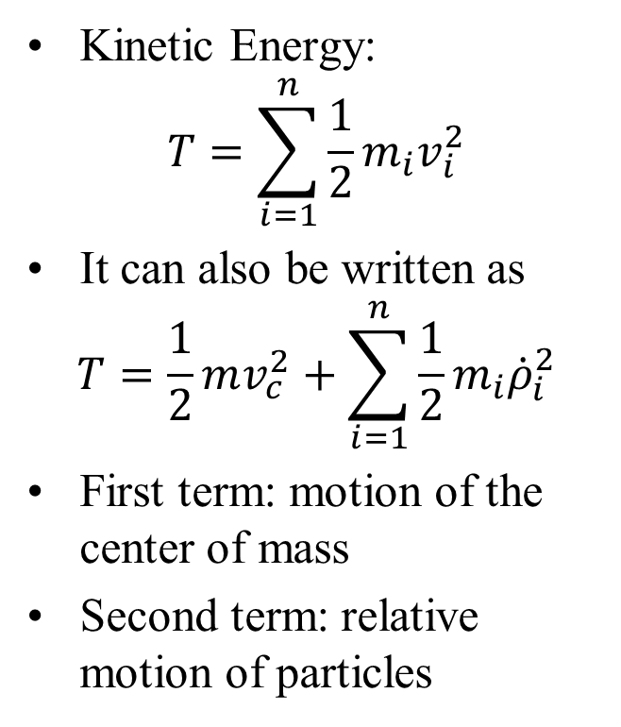
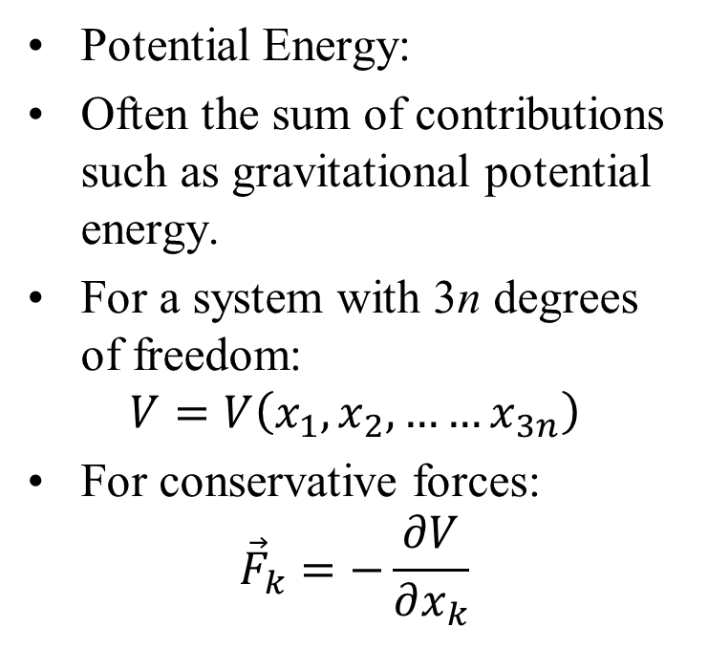
Total Mechanical Energy of a System
If both the external and internal forces are conservative, the total mechanical energy of the system is conserved.
E = T + V = constant
Kinetic Energy:
$$T=\sum_{i=1}^{n}{\frac{1}{2}m_{i}v_{i}^{2}}$$
It can also be written as
$$T=\frac{1}{2}mv_{c}^{2}+\sum_{i=1}^{n}{\frac{1}{2}m_{i}{\dot{ρ}}_{i}^{2}}$$
First term: motion of the center of mass
Second term: relative motion of particles
Potential Energy:
Often the sum of contributions such as gravitational potential energy.
For a system with 3n degrees of freedom:
$$V=V\left(x_{1},x_{2}, ……x_{3n}\right)$$
For conservative forces:
$${\vec{F}}_{k}=−\frac{∂V}{∂x_{k}}$$

Slide 12
Systems with Conservative and Nonconservative Forces
If a system has both conservative and nonconservative forces, strict conservation of mechanical energy does not hold.
However, the motion can still be analyzed using work–energy principles.
Let W_{n} denote the work done on the system by nonconservative internal and external forces as the system moves from configuration A to B.
The change in mechanical energy of the system is then determined by the work of these forces.
Energy Relation:
E_{A} and E_{B} are the total mechanical energies of the system at states A and B.
These energies include all potential energy terms associated with conservative forces.
Nonconservative forces (such as friction or damping) account for the change in mechanical energy

