Slide 1


Vector Analysis for Force System
P M V Subbarao
Professor & Head
Mechanical Engineering Department
Force is Vahati / Vehere ……..

Slide 2

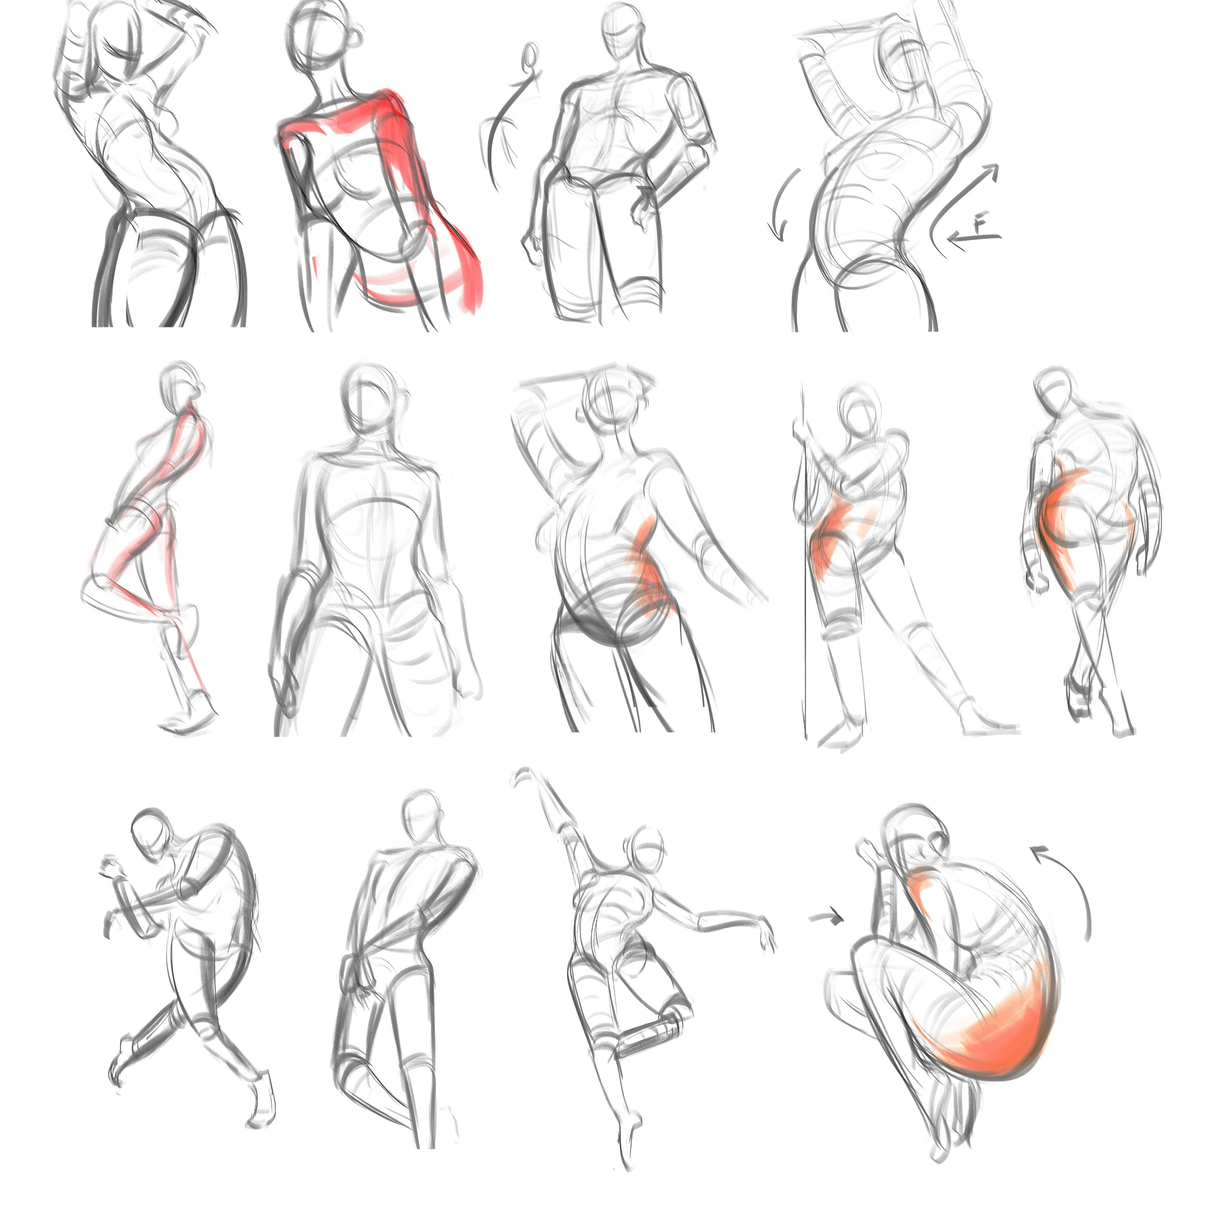

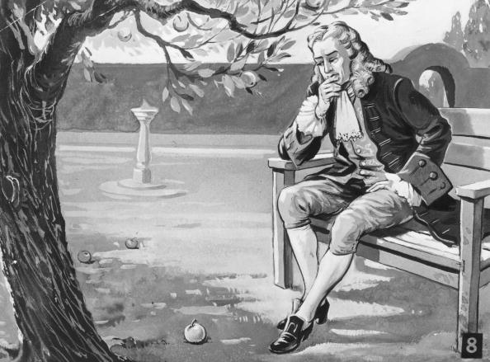
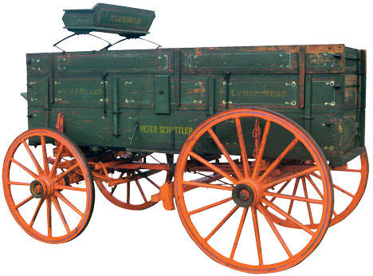
Newton: An Explorer of Force Gesture???
Newton developed the theories of gravitation in 1666, when he was only 23 years old.
Some twenty years later, in 1686, he presented his three laws of motion in the
"Principia Mathematica Philosophiae Naturalis.“

Slide 3
Fundamental concepts to Construct A Force Vector
The basic concepts used in mechanics to construct a Force are space, time, mass.
Concept of space
It is associated with the notion of the position of a point P
The position of P can be defined by three lengths measured from a certain reference point, or origin, in three given directions.
These lengths are known as the coordinates of P
Concept of time
To define an event, it is not sufficient to indicate its position in space. The time of the event should also be given.
Time is the measure of the succession of events and is a basic quantity in dynamics.

Slide 4
Weight A Primary Force Vector
Concept of mass
A mass will have a weight W on planets, Satellites…..
Weight is (Only) the means of measuring mass!
Two bodies of the same mass, for example, will be attracted by the earth in the same manner; they will also offer the same resistance to a change in translational motion.
Mass is used to characterize and compare bodies on the basis of certain fundamental mechanical experiments.
The specific weight of a body: Weight per unit volume.
Density and specific weight are simply related by gravitational acceleration (gravity) on any planet/satellite.
Mass is essential to create inertia and hence acceleration!

Slide 5
Concept of A Force Vector
A force represents the action of one body on another.
It can be exerted by actual contact or at a distance, as in the case of gravitational forces and magnetic forces.
A force is characterized by its point of application , its magnitude , and its direction, a force is represented by a vector.
In Newtonian mechanics, space, time, and mass are absolute concepts, independent of each other.

Slide 6
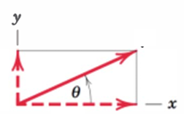
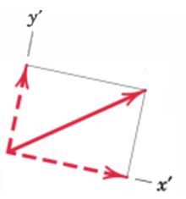








Force in 2D Cartesian Coordinate System
A Force in Rectangular (Cartesian) Two-Dimensional (2D) Space is represented as:
$${\vec{F}}_{2D−space}$$
$${\vec{F}}_{2D−space′}$$
$${\vec{F}}_{y′}$$
$${\vec{F}}_{y}$$
$${\vec{F}}_{x′}$$
$${\vec{F}}_{x}$$
$${\vec{F}}_{2D−space}={\vec{F}}_{x}+{\vec{F}}_{y}$$
$${\vec{F}}_{2D−space′}={\vec{F}}_{x′}+{\vec{F}}_{y′}$$

Slide 7
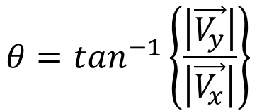
Force in 2D Cartesian Coordinate System
Rectangular (Cartesian) Components in Two-Dimensional (2D)Space
$${\vec{F}}_{2D−space}$$
$${\vec{F}}_{2D−space′}$$
$${\vec{F}}_{y′}$$
$${\vec{F}}_{y}$$
$${\vec{F}}_{x′}$$
$${\vec{F}}_{x}$$
Vectors can be referred to any basis!
When expressed in rectangular (Cartesian) components, the direction of the vector with respect to, say, the x-axis is clearly specified by the angle θ, where
$$θ=\tan^{−1}\left\{\frac{\left|\vec{V_{y}}\right|}{\left|\vec{V_{x}}\right|}\right\}$$

Slide 8

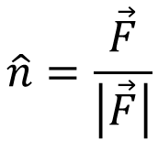
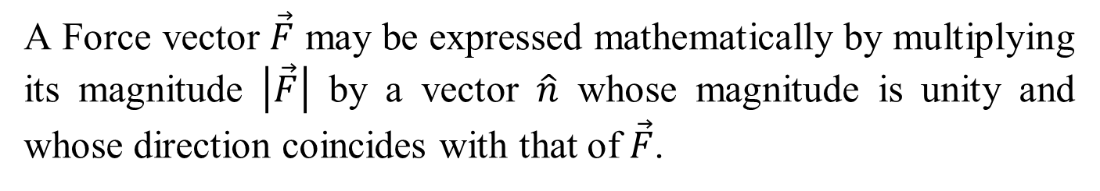
Unit Vector
A Force vector $\vec{F}$ may be expressed mathematically by multiplying its magnitude $\left|\vec{F}\right|$ by a vector $\hat{n}$ whose magnitude is unity and whose direction coincides with that of $\vec{F}$.
$$\hat{n}=\frac{\vec{F}}{\left|\vec{F}\right|}$$
$$\vec{F}=\left|\vec{F}\right|\hat{n}$$
Both the magnitude and direction of the vector are conveniently contained in one mathematical expression given above.

Slide 9


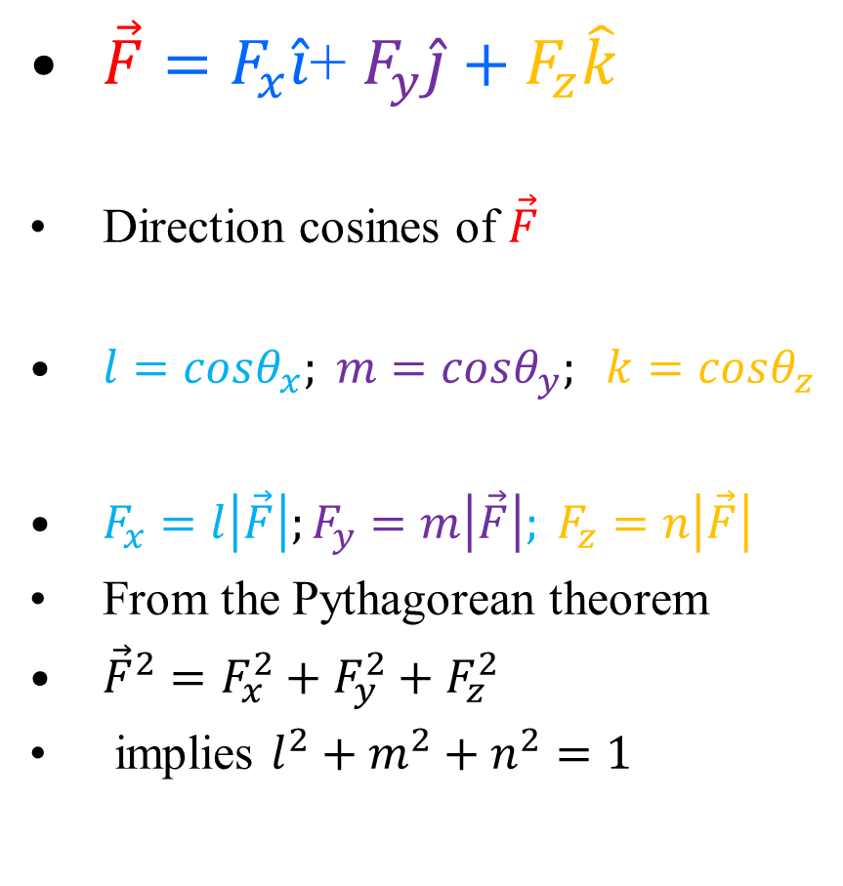

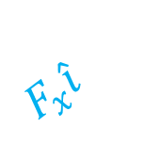






Force in 3D Rectangular (Cartesian) Components Space
$\vec{F}=F_{x}\hat{i}$+ $F_{y}\hat{j}+F_{z}\hat{k}$
Direction cosines of $\vec{F}$
$l=cosθ_{x}; m=cosθ_{y}; k=cosθ_{z}$
$F_{x}=l\left|\vec{F}\right|;F_{y}=m\left|\vec{F}\right|; F_{z}=n\left|\vec{F}\right|$
From the Pythagorean theorem
${\vec{F}}^{2}=F_{x}^{2}+F_{y}^{2}+F_{z}^{2}$
implies $l^{2}+m^{2}+n^{2}=1$
Z
$$\hat{k}$$
$$\vec{F}$$
$$F_{z}\hat{k}$$
$$θ_{z}$$
$$θ_{x}$$
$$θ_{y}$$
$$F_{y}\hat{j}$$
Y
$$F_{x}\hat{i}$$
$$\hat{j}$$
X
$$\hat{i}$$

Slide 10

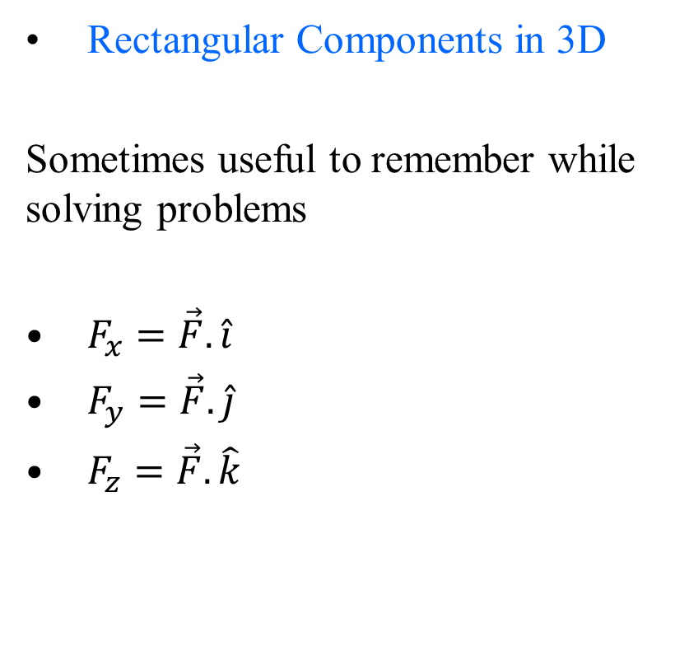

Rectangular (Cartesian) Components in 3D Space
Rectangular Components in 3D
Sometimes useful to remember while solving problems
$F_{x}=\vec{F}.\hat{i}$
$F_{y}=\vec{F}.\hat{j}$
$F_{z}=\vec{F}.\hat{k}$
Z
$$\hat{k}$$
$$\vec{F}$$
$$F_{z}\hat{k}$$
$$θ_{y}$$
$$θ_{x}$$
$$θ_{y}$$
$$F_{y}\hat{j}$$
Y
$$F_{x}\hat{i}$$
$$\hat{j}$$
X
$$\hat{i}$$

Slide 11
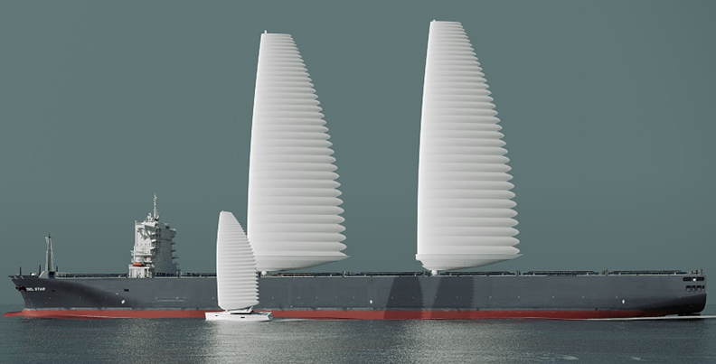
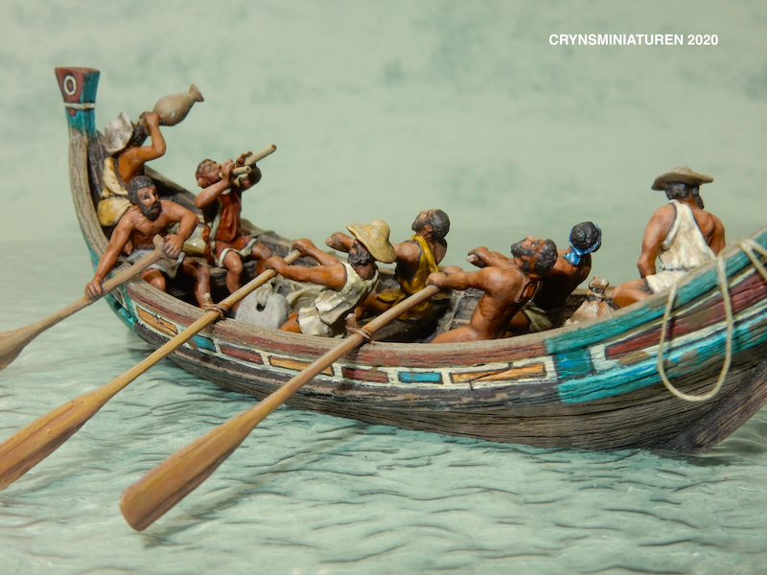
Force for Human Service :
Travel on Water

Slide 12
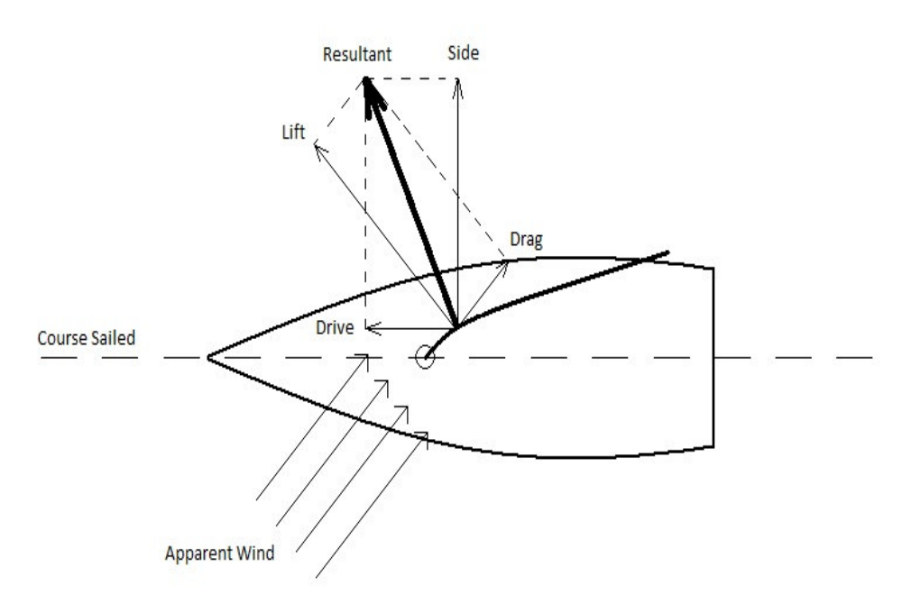
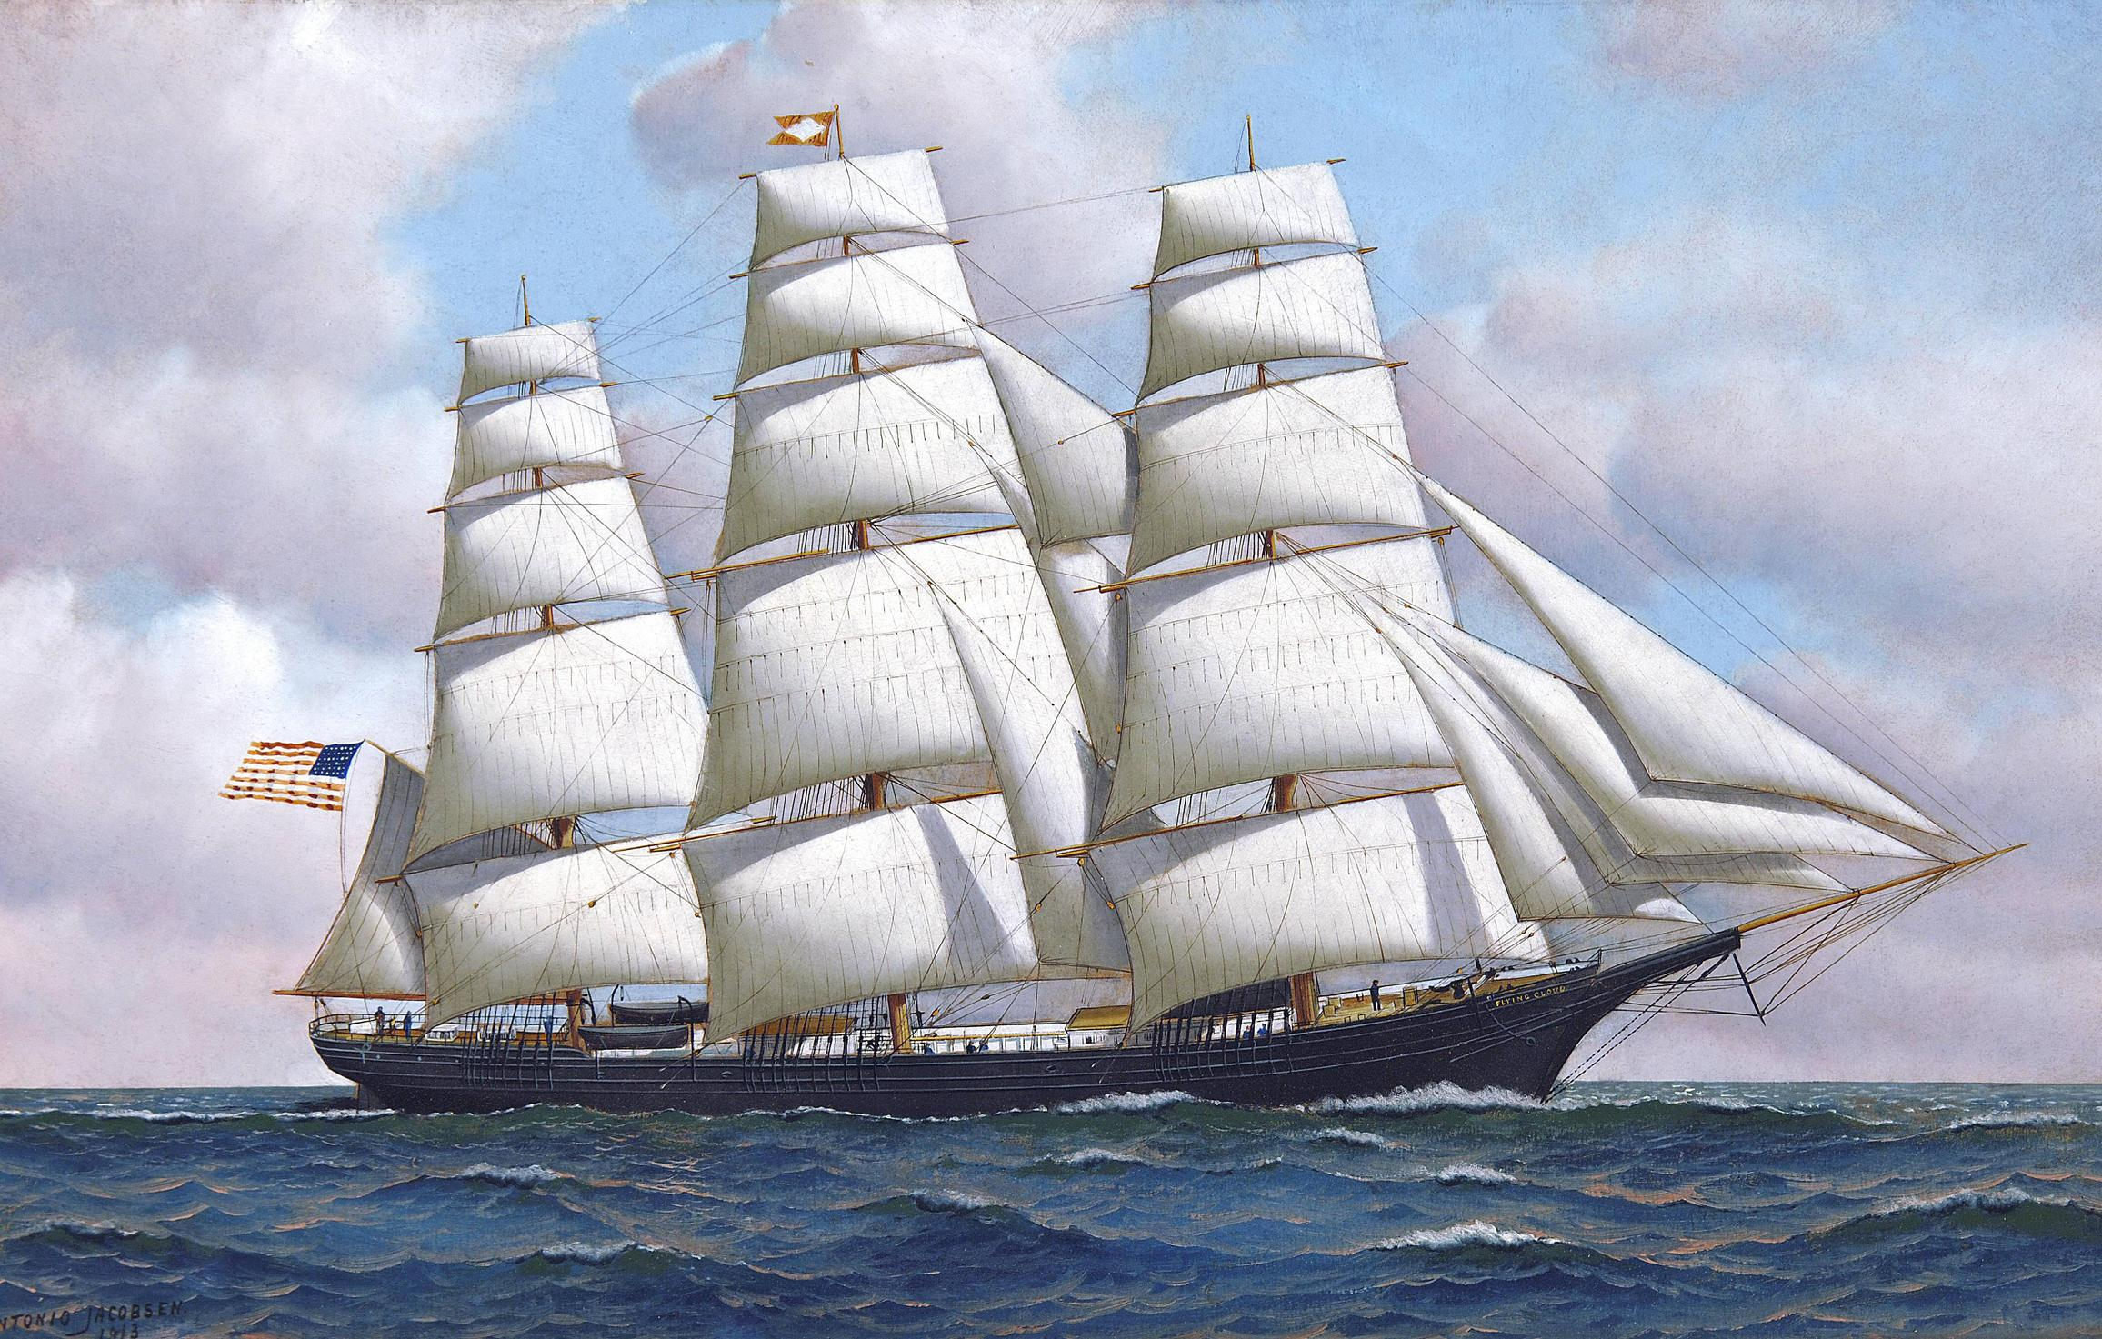


Utilization of Wind Force for Immediate Service
Instantaneous work done by wind on sail:
$$δW=\vec{F}.d\vec{x}$$
Scalar product leads to Immediate Consumption!
For a constant force
$$W=\vec{F}.\vec{x}$$

Slide 13
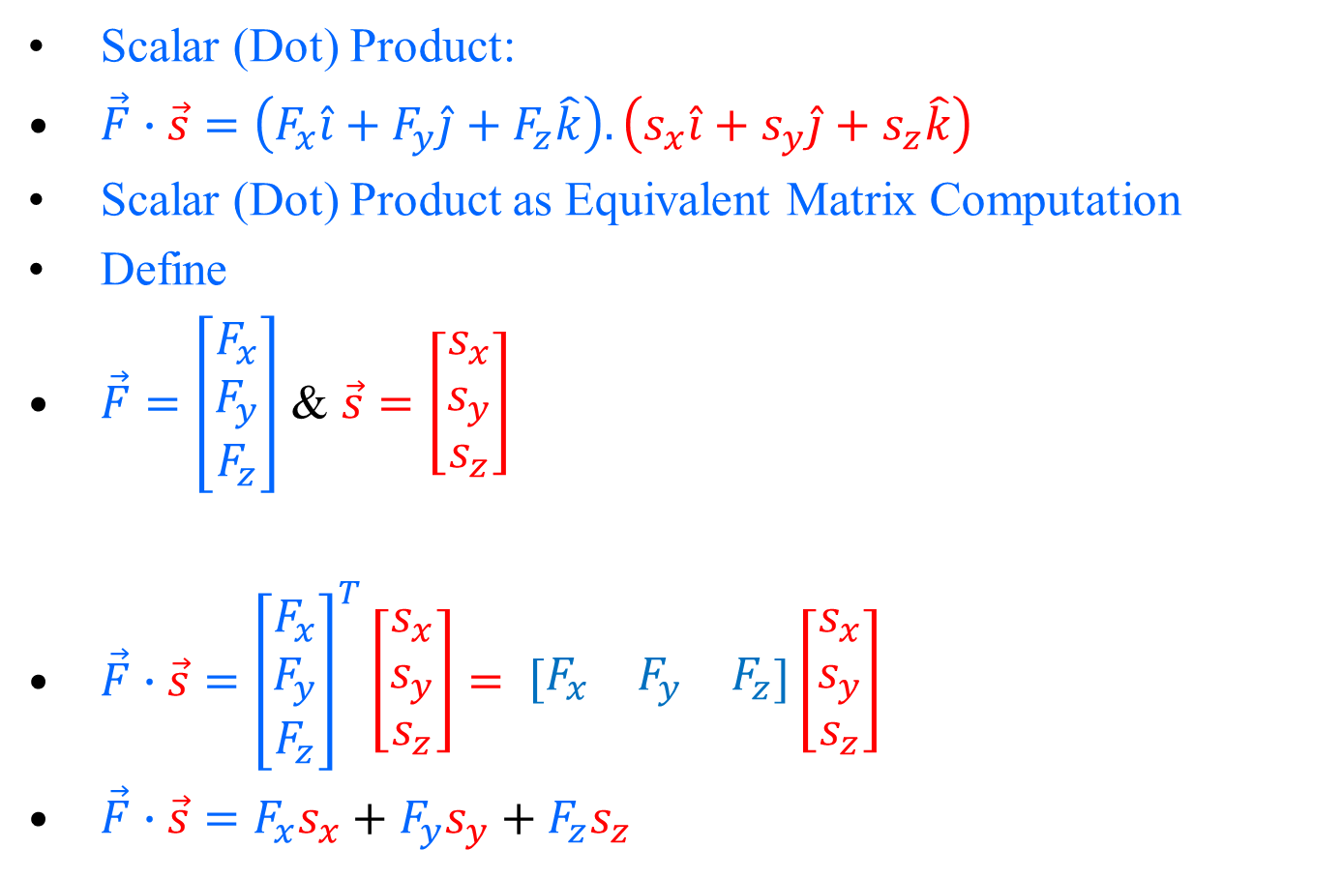
Scalar (Dot) Product of Vectors
Scalar (Dot) Product:
$\vec{F}∙\vec{s}=\left(F_{x}\hat{i}+F_{y}\hat{j}+F_{z}\hat{k}\right).\left(s_{x}\hat{i}+s_{y}\hat{j}+s_{z}\hat{k}\right)$
Scalar (Dot) Product as Equivalent Matrix Computation
Define
$\vec{F}=\left[\begin{matrix}F_{x} \\ F_{y} \\ F_{z}\end{matrix}\right]$ & $\vec{s}=\left[\begin{matrix}s_{x} \\ s_{y} \\ s_{z}\end{matrix}\right]$
$\vec{F}∙\vec{s}={\left[\begin{matrix}F_{x} \\ F_{y} \\ F_{z}\end{matrix}\right]}^{T}\left[\begin{matrix}s_{x} \\ s_{y} \\ s_{z}\end{matrix}\right]= \left[\begin{matrix}F_{x} & F_{y} & F_{z}\end{matrix}\right]\left[\begin{matrix}s_{x} \\ s_{y} \\ s_{z}\end{matrix}\right]$
$\vec{F}∙\vec{s}=F_{x}s_{x}+$ $F_{y}s_{y}+F_{z}s_{z}$

Slide 14
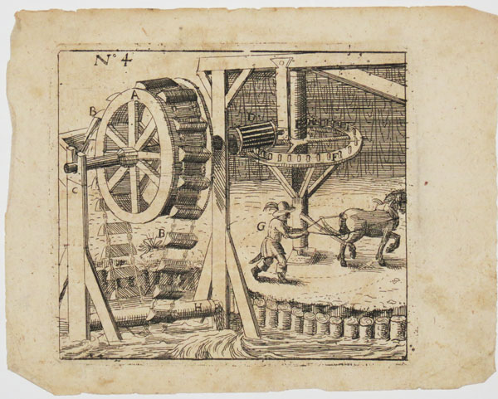
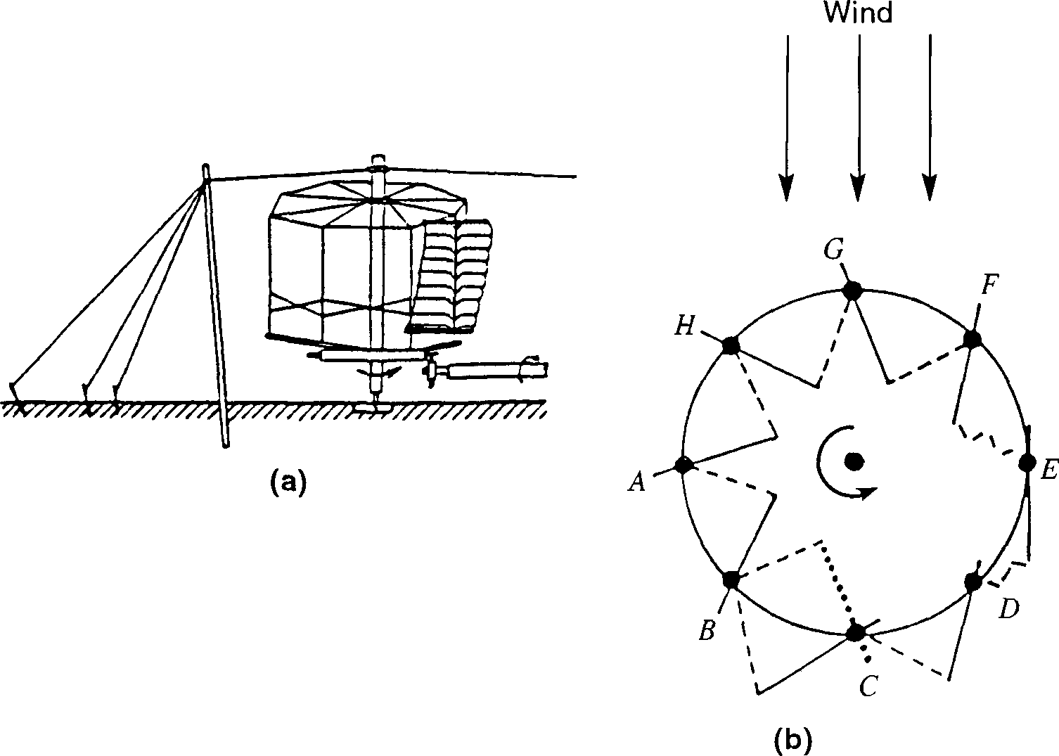


Utilization of Wind Force for Creation of Artificial Horse
Instantaneous Torque generated by wind :
$$\vec{τ}=\vec{F}× \vec{r}$$
Instantaneous shaft work done by wind :
Vector product preceding the Scalar product enhances the benefits!
$$δW=\vec{τ}.d\vec{θ}$$

Slide 15
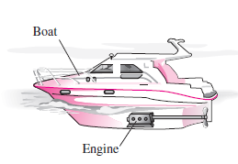
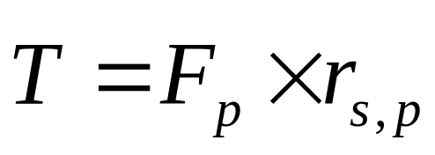
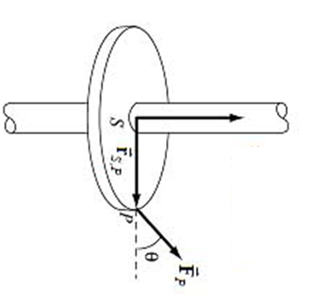
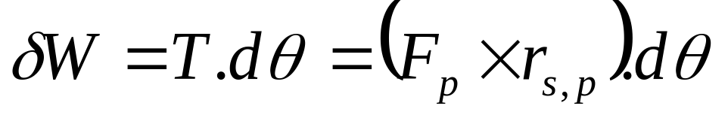
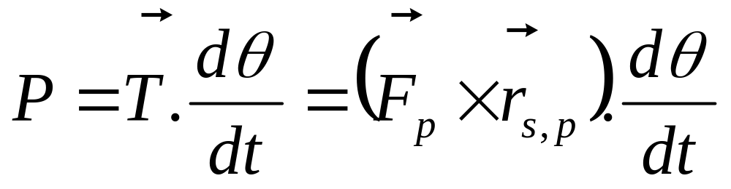
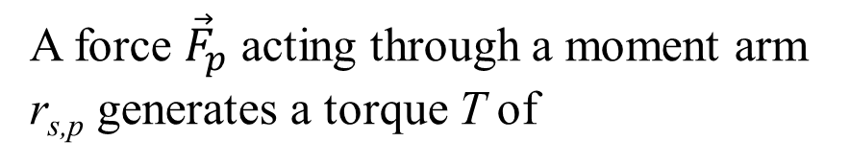
Exotic Service of A Force
Power transmission with a rotating shaft is very common in engineering practice.
A force ${\vec{F}}_{p}$ acting through a moment arm r_{s,p} generates a torque T of

Slide 16
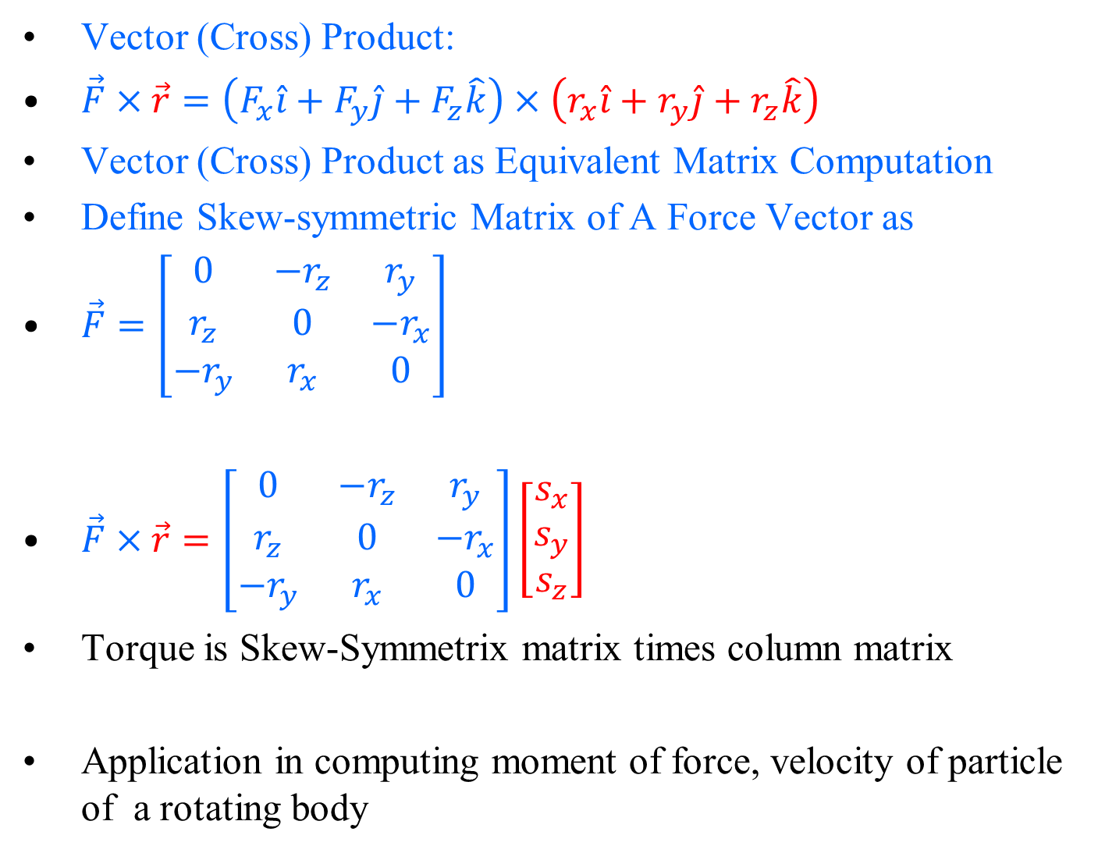
Cross Product of Vectors
Vector (Cross) Product:
$\vec{F}×\vec{r}=\left(F_{x}\hat{i}+F_{y}\hat{j}+F_{z}\hat{k}\right)×\left(r_{x}\hat{i}+r_{y}\hat{j}+r_{z}\hat{k}\right)$
Vector (Cross) Product as Equivalent Matrix Computation
Define Skew-symmetric Matrix of A Force Vector as
$\vec{F}=\left[\begin{matrix}0 & −r_{z} & r_{y} \\ r_{z} & 0 & −r_{x} \\ −r_{y} & r_{x} & 0\end{matrix}\right]$
$\vec{F}×\vec{r}=\left[\begin{matrix}0 & −r_{z} & r_{y} \\ r_{z} & 0 & −r_{x} \\ −r_{y} & r_{x} & 0\end{matrix}\right]\left[\begin{matrix}s_{x} \\ s_{y} \\ s_{z}\end{matrix}\right]$
Torque is Skew-Symmetrix matrix times column matrix
Application in computing moment of force, velocity of particle of a rotating body

