Slide 1


Dynamics of System of Particles
P M V Subbarao
Professor & Head
Mechanical Engineering Department
Group of Particles are more Important …

Slide 2

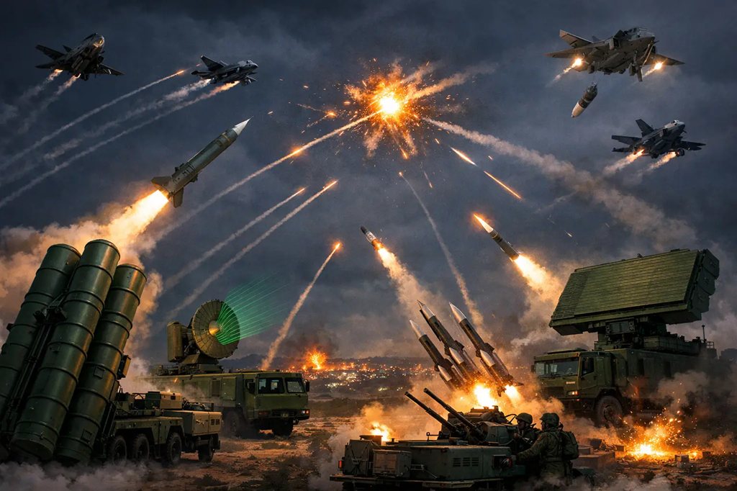
Dynamics of a System of Particles

Slide 3
Dynamics of a System of Particles
Dynamics of particles and systems of particles is a cornerstone of classical mechanics that studies forces and their effect on motion.
While particle dynamics deals with point masses, the system of particles generalizes this to multiple interacting bodies.
Focus on their collective behavior, center of mass, total momentum, and total kinetic energy.
When dealing with a system of interacting particles: Individual particle motions can still be analyzed.
Certain overall properties of the system can be determined without solving the motion of each particle.
Applications: Collision problems & Rocket propulsion

Slide 4
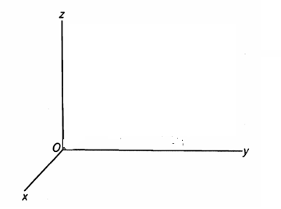






Forces in a System of Particles
$$m_{1}$$
$$m_{2}$$
$${\vec{r}}_{1}$$
$$m_{3}$$
$${\vec{r}}_{2}$$
$${\vec{r}}_{3}$$
Consider a system of n particles.
Forces acting on the i^{th} particle are classified as:

Slide 5


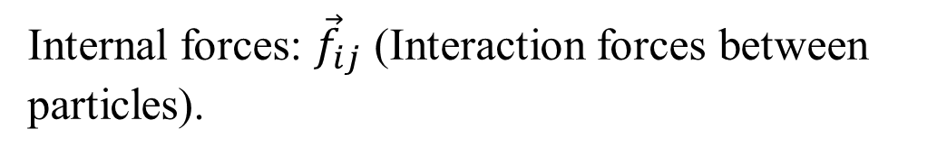






Forces in a System of Particles
$$m_{1}$$
Newton’s third law gives
$${\vec{f}}_{12}$$
$$m_{2}$$
$${\vec{f}}_{21}$$
$${\vec{f}}_{13}$$
$${\vec{f}}_{ij}=−{\vec{f}}_{ji}$$
$${\vec{r}}_{1}$$
$${\vec{f}}_{23}$$
$$m_{3}$$
$${\vec{f}}_{31}$$
$${\vec{f}}_{32}$$
Internal forces: ${\vec{f}}_{ij}$ (Interaction forces between particles).
The first subscript indicates the particle on which the force acts, and the second indicates the acting particle.

Slide 6
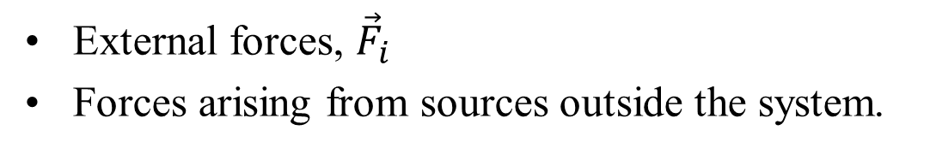



Forces in a System of Particles
$${\vec{F}}_{1}$$
$$m_{1}$$
$${\vec{F}}_{2}$$
$${\vec{f}}_{12}$$
$$m_{2}$$
$${\vec{f}}_{21}$$
$${\vec{f}}_{13}$$
$${\vec{r}}_{1}$$
$${\vec{f}}_{23}$$
$$m_{3}$$
$${\vec{f}}_{31}$$
$${\vec{F}}_{3}$$
$${\vec{f}}_{32}$$
External forces, ${\vec{F}}_{i}$
Forces arising from sources outside the system.

Slide 7
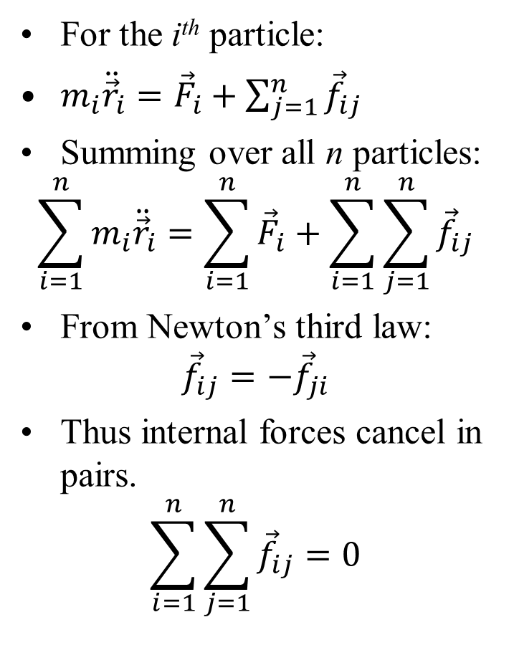
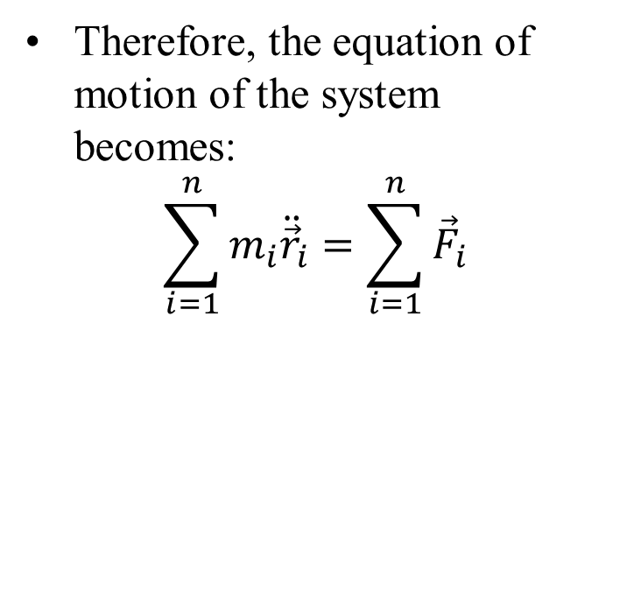
Equations of Motion of a System
For the i^{th} particle:
$m_{i}{\ddot{\vec{r}}}_{i}={\vec{F}}_{i}+\sum_{j=1}^{n}{{\vec{f}}_{ij}}$
Summing over all n particles:
$$\sum_{i=1}^{n}{m_{i}{\ddot{\vec{r}}}_{i}}=\sum_{i=1}^{n}{{\vec{F}}_{i}}+\sum_{i=1}^{n}{\sum_{j=1}^{n}{{\vec{f}}_{ij}}}$$
From Newton’s third law:
$${\vec{f}}_{ij}=−{\vec{f}}_{ji}$$
Thus internal forces cancel in pairs.
$$\sum_{i=1}^{n}{\sum_{j=1}^{n}{{\vec{f}}_{ij}}}=0$$
Therefore, the equation of motion of the system becomes:
$$\sum_{i=1}^{n}{m_{i}{\ddot{\vec{r}}}_{i}}=\sum_{i=1}^{n}{{\vec{F}}_{i}}$$

Slide 8
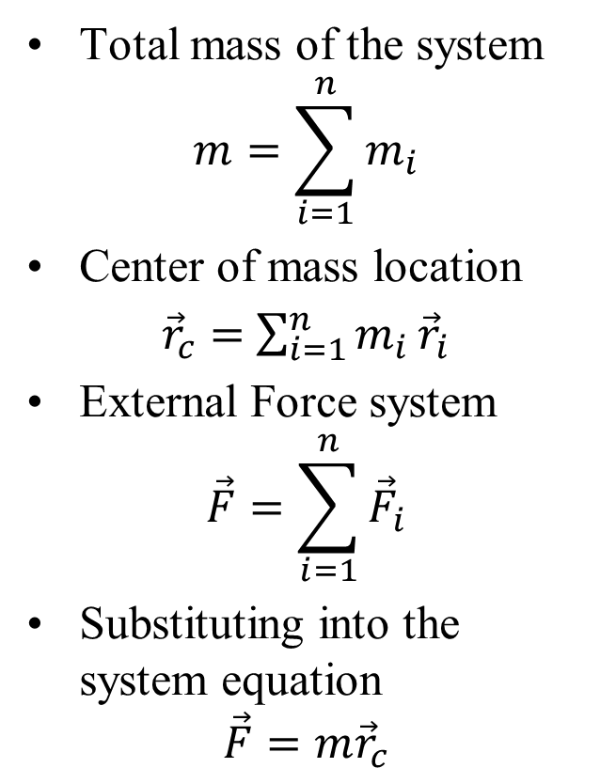
Center of Mass Motion
Total mass of the system
$$m=\sum_{i=1}^{n}{m_{i}}$$
Center of mass location
${\vec{r}}_{c}=$ $\sum_{i=1}^{n}{m_{i}}{\vec{r}}_{i}$
External Force system
$$\vec{F}=\sum_{i=1}^{n}{{\vec{F}}_{i}}$$
Substituting into the system equation
$$\vec{F}=m{\vec{r}}_{c}$$
Interpretation The center of mass of a system moves as if the entire mass of the system were concentrated at that point and acted upon by the total external force.
Example: Explosion of a projectile If a bomb explodes during flight, the center of mass of all the fragments continues along the same trajectory that the bomb would have followed if it had not exploded, provided the external forces remain unchanged.

Slide 9
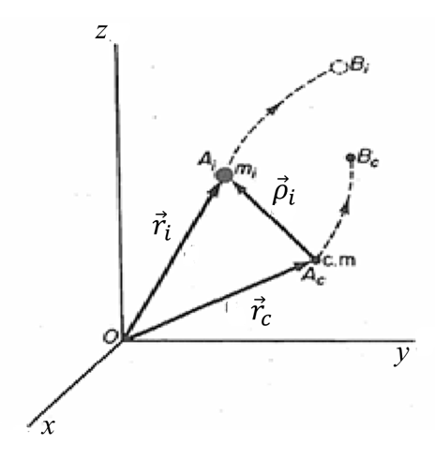
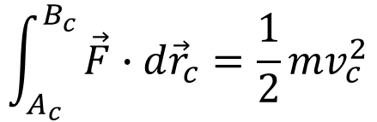
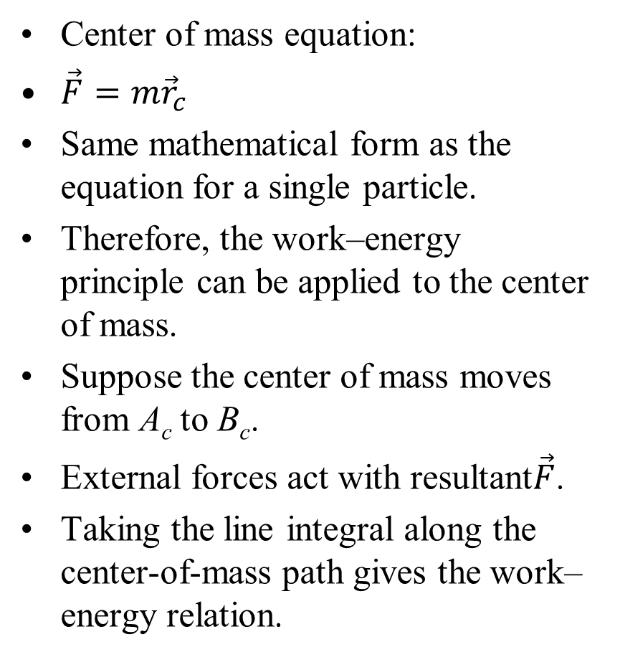
Work–Energy of a System of Particles
Center of mass equation:
$\vec{F}=m{\vec{r}}_{c}$
Same mathematical form as the equation for a single particle.
Therefore, the work–energy principle can be applied to the center of mass.
Suppose the center of mass moves from A_{c} to B_{c}.
External forces act with resultant$\vec{F}$.
Taking the line integral along the center-of-mass path gives the work–energy relation.
Position vectors of the center of mass and a typical particle during displacement.
$$\int_{A_{c}}^{B_{c}}{\vec{F}∙d{\vec{r}}_{c}=\frac{1}{2}mv_{c}^{2}}$$

Slide 10
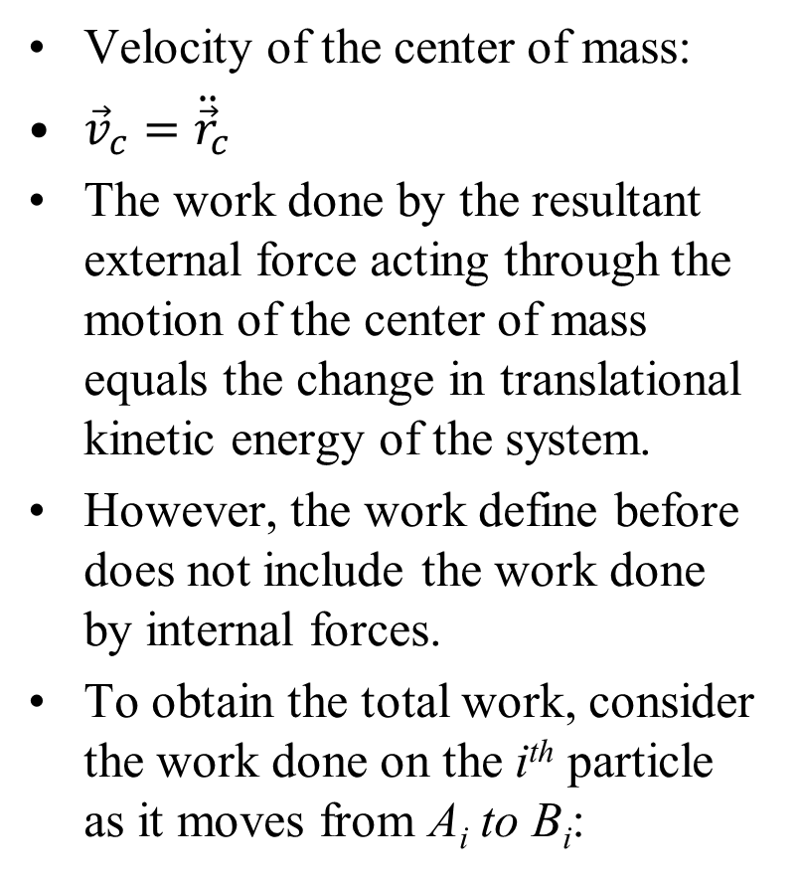
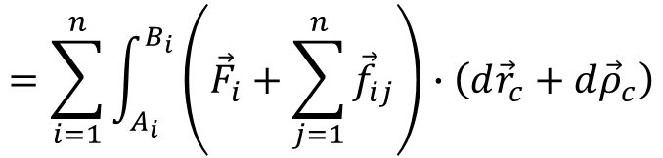
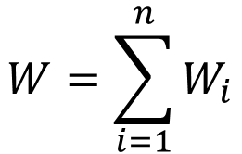
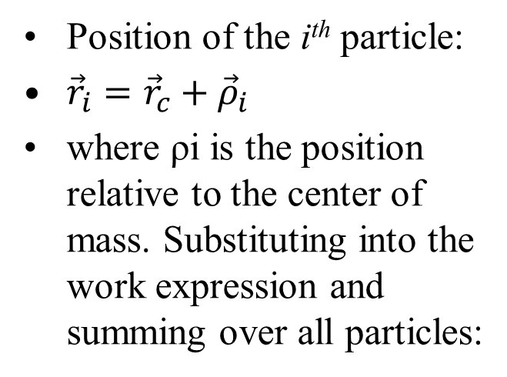
Work Done on a System of Particles
Velocity of the center of mass:
${\vec{v}}_{c}={\ddot{\vec{r}}}_{c}$
The work done by the resultant external force acting through the motion of the center of mass equals the change in translational kinetic energy of the system.
However, the work define before does not include the work done by internal forces.
To obtain the total work, consider the work done on the i^{th} particle as it moves from A_{i} to B_{i}:
Position of the i^{th} particle:
${\vec{r}}_{i}={\vec{r}}_{c}+{\vec{ρ}}_{i}$
where ρi is the position relative to the center of mass. Substituting into the work expression and summing over all particles:
$$W=\sum_{i=1}^{n}{W_{i}}$$
$$=\sum_{i=1}^{n}{\int_{A_{i}}^{B_{i}}{\left({\vec{F}}_{i}+\sum_{j=1}^{n}{{\vec{f}}_{ij}}\right)∙\left(d{\vec{r}}_{c}+d{\vec{ρ}}_{c}\right)}}$$

Slide 11
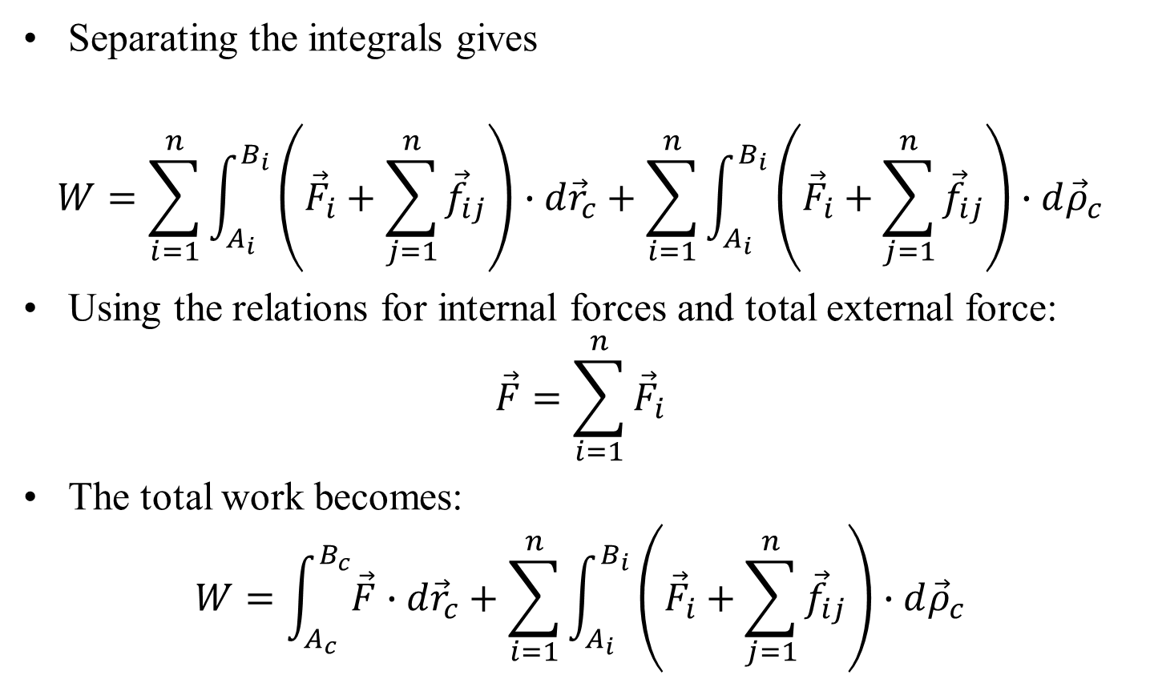

Total Work of a System
Separating the integrals gives
$$W=\sum_{i=1}^{n}{\int_{A_{i}}^{B_{i}}{\left({\vec{F}}_{i}+\sum_{j=1}^{n}{{\vec{f}}_{ij}}\right)∙d{\vec{r}}_{c}}}+\sum_{i=1}^{n}{\int_{A_{i}}^{B_{i}}{\left({\vec{F}}_{i}+\sum_{j=1}^{n}{{\vec{f}}_{ij}}\right)∙d{\vec{ρ}}_{c}}}$$
Using the relations for internal forces and total external force:
$$\vec{F}=\sum_{i=1}^{n}{{\vec{F}}_{i}}$$
The total work becomes:
$$W=\int_{A_{c}}^{B_{c}}{\vec{F}∙d{\vec{r}}_{c}}+\sum_{i=1}^{n}{\int_{A_{i}}^{B_{i}}{\left({\vec{F}}_{i}+\sum_{j=1}^{n}{{\vec{f}}_{ij}}\right)∙d{\vec{ρ}}_{c}}}$$

Slide 12
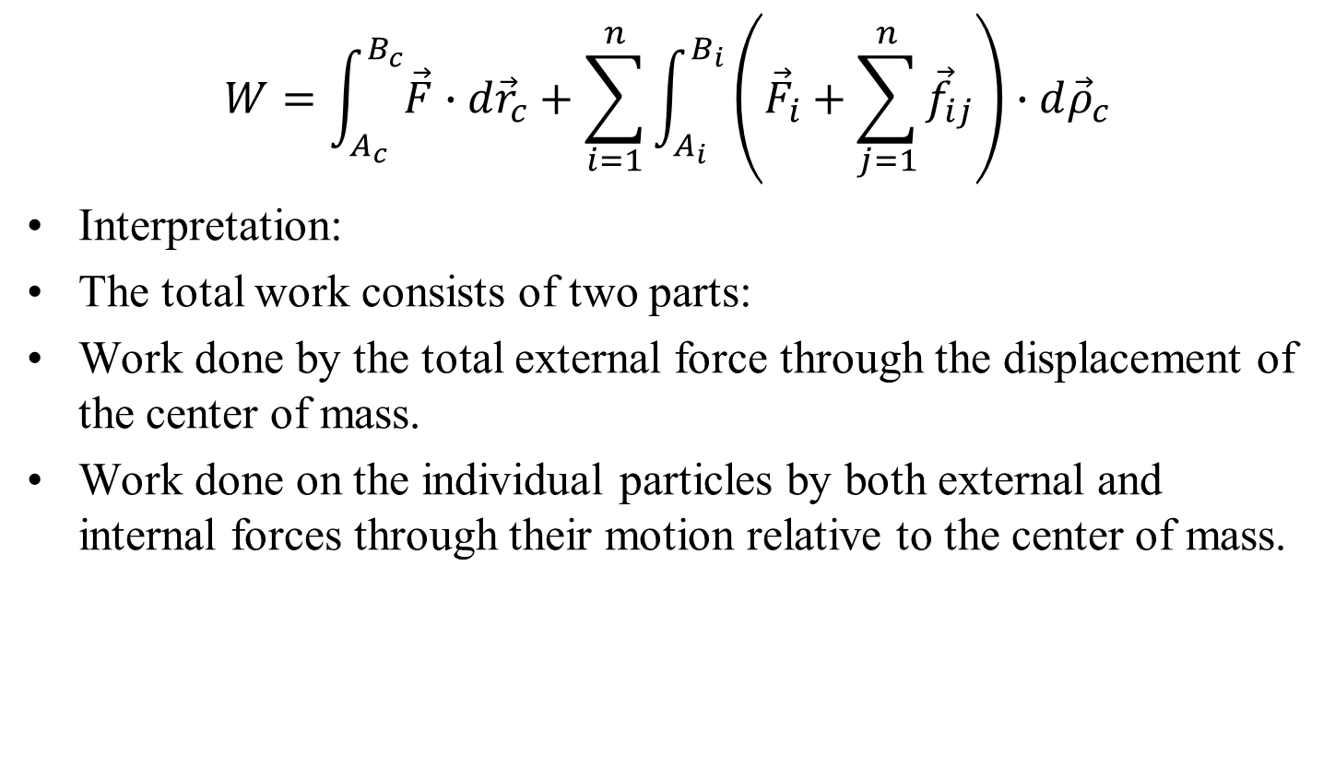
Total Work of a System
$$W=\int_{A_{c}}^{B_{c}}{\vec{F}∙d{\vec{r}}_{c}}+\sum_{i=1}^{n}{\int_{A_{i}}^{B_{i}}{\left({\vec{F}}_{i}+\sum_{j=1}^{n}{{\vec{f}}_{ij}}\right)∙d{\vec{ρ}}_{c}}}$$
Interpretation:
The total work consists of two parts:
Work done by the total external force through the displacement of the center of mass.
Work done on the individual particles by both external and internal forces through their motion relative to the center of mass.

