Slide 1


Impulse-Momentum Principles for Kinetics of A Particle
P M V Subbarao
Professor & Head
Mechanical Engineering Department
An Impulse View of Cause-Effect Duos …

Slide 2



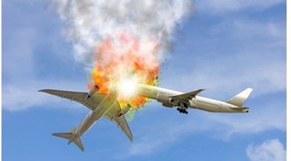
Kinetics is Always Initiated by an Impulse
In Kinetics, every change in motion, including starting motion from a state of rest, begins with an impulse.
This led to proposition of “The Impulse-Momentum Theorem”

Slide 3
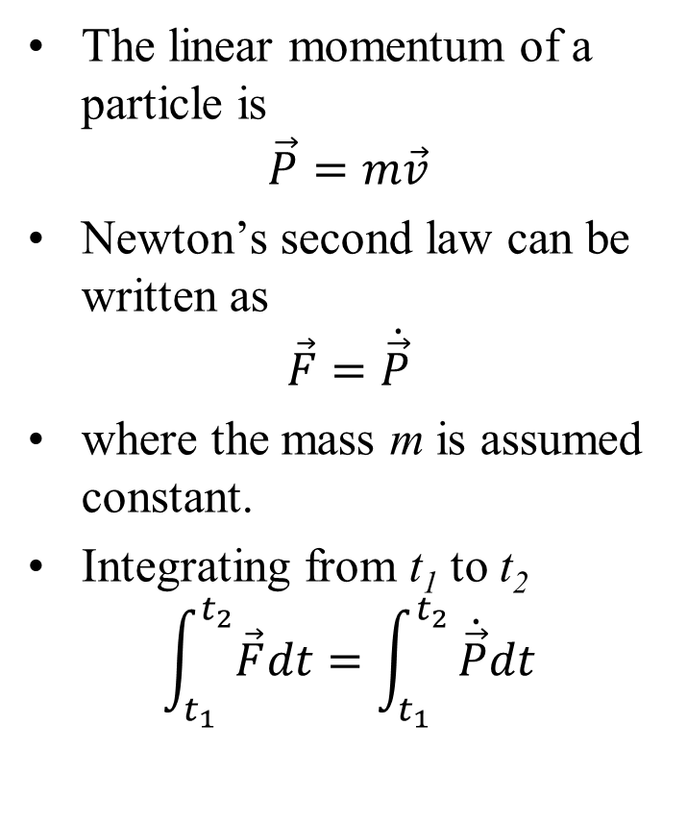
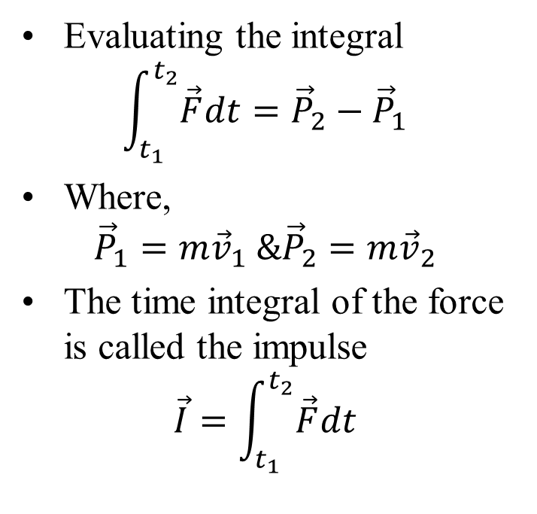
Linear Impulse and Momentum
The linear momentum of a particle is
$$\vec{P}=m\vec{v}$$
Newton’s second law can be written as
$$\vec{F}=\dot{\vec{P}}$$
where the mass m is assumed constant.
Integrating from t₁ to t₂
$$\int_{t_{1}}^{t_{2}}{\vec{F}dt}=\int_{t_{1}}^{t_{2}}{\dot{\vec{P}}dt}$$
Evaluating the integral
$$\int_{t_{1}}^{t_{2}}{\vec{F}dt}={\vec{P}}_{2}−{\vec{P}}_{1}$$
Where,
$${\vec{P}}_{1}=m{\vec{v}}_{1} \&{\vec{P}}_{2}=m{\vec{v}}_{2}$$
The time integral of the force is called the impulse
$$\vec{I}=\int_{t_{1}}^{t_{2}}{\vec{F}dt}$$

Slide 4
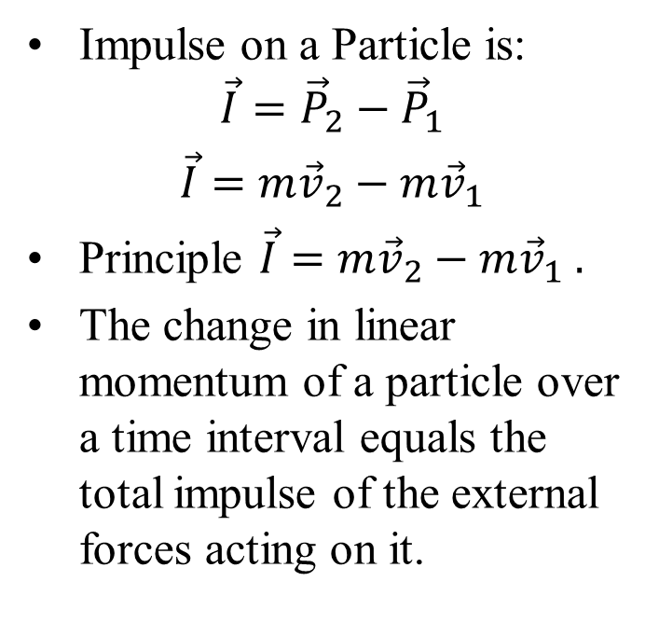
Impulse–Momentum Principle
If the duration of a force becomes extremely small but its magnitude becomes very large such that the impulse remains finite, the force is called an impulsive force
Effect of an impulsive force:
Velocity changes instantaneously
Position remains continuous
Impulse on a Particle is:
$$\vec{I}={\vec{P}}_{2}−{\vec{P}}_{1}$$
$\vec{I}=$ $m{\vec{v}}_{2}−m{\vec{v}}_{1}$
Principle $\vec{I}=$ $m{\vec{v}}_{2}−m{\vec{v}}_{1} .$
The change in linear momentum of a particle over a time interval equals the total impulse of the external forces acting on it.

Slide 5
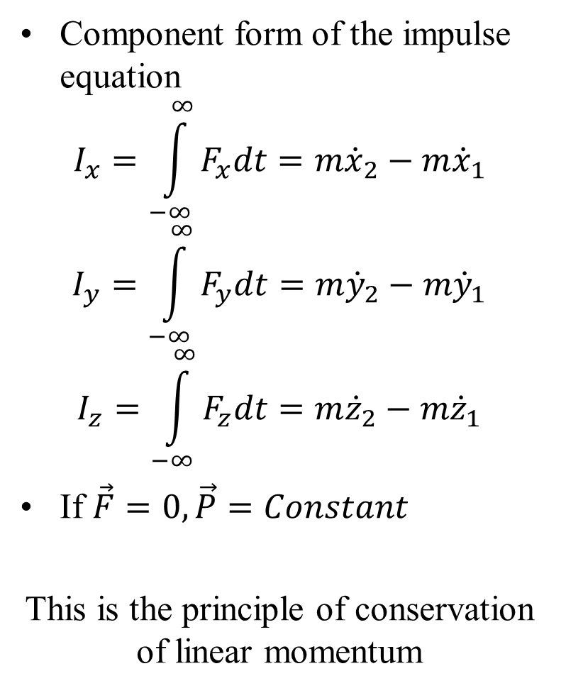
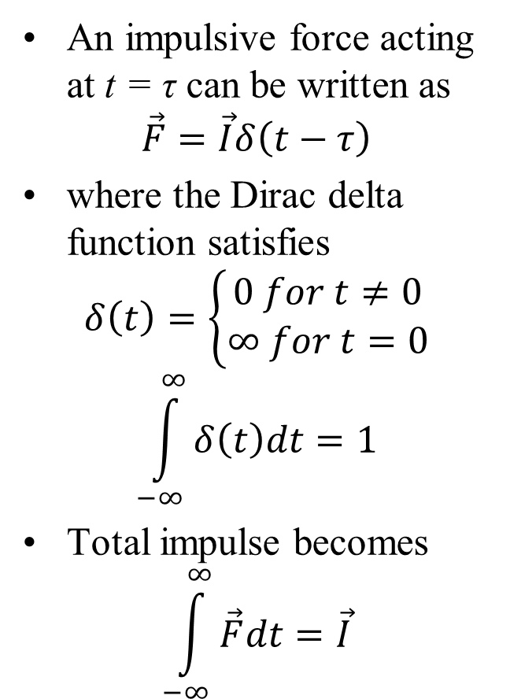
Impulsive Forces and Momentum Conservation
An impulsive force acting at t = τ can be written as
$$\vec{F}=\vec{I}δ\left(t−τ\right)$$
where the Dirac delta function satisfies
$$δ\left(t\right)=\left\{\begin{aligned}0 for t≠0 \\ ∞ for t=0\end{aligned}\right.$$
$$\int_{−∞}^{∞}{δ\left(t\right)dt}=1$$
Total impulse becomes
$$\int_{−∞}^{∞}{\vec{F}dt}=\vec{I}$$
Component form of the impulse equation
$$I_{x}=\int_{−∞}^{∞}{F_{x}dt}=m{\dot{x}}_{2}−m{\dot{x}}_{1}$$
$$I_{y}=\int_{−∞}^{∞}{F_{y}dt}=m{\dot{y}}_{2}−m{\dot{y}}_{1}$$
$$I_{z}=\int_{−∞}^{∞}{F_{z}dt}=m{\dot{z}}_{2}−m{\dot{z}}_{1}$$
If $\vec{F}=0, \vec{P}=Constant$
This is the principle of conservation of linear momentum

Slide 6
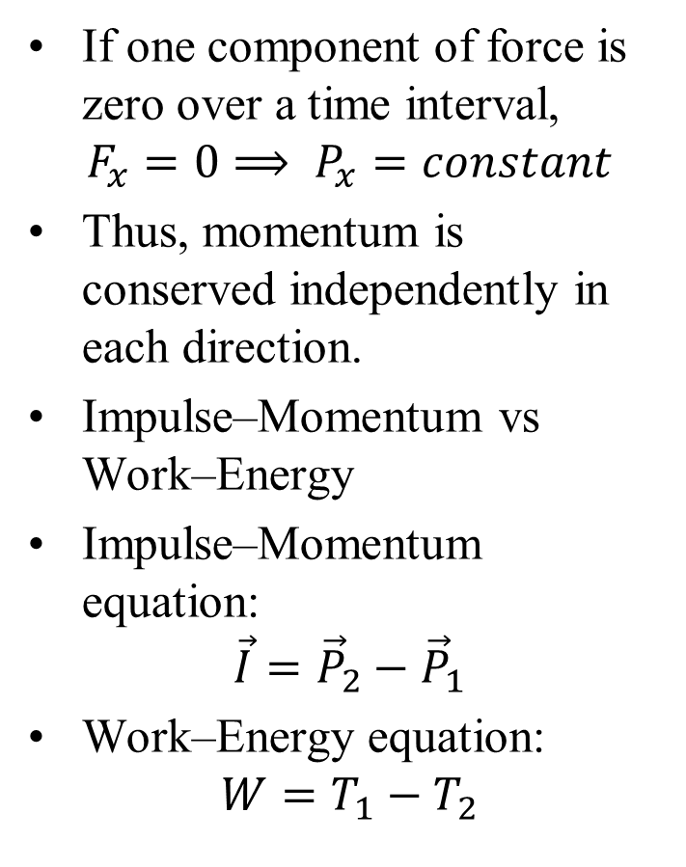
Impulsive Forces and Momentum Conservation
If one component of force is zero over a time interval,
$$F_{x}=0⟹ P_{x}=constant$$
Thus, momentum is conserved independently in each direction.
Impulse–Momentum vs Work–Energy
Impulse–Momentum equation:
$$\vec{I}={\vec{P}}_{2}−{\vec{P}}_{1}$$
Work–Energy equation:
$$W=T_{1}−T_{2}$$
Key differences
Impulse–momentum is a vector equation
Work–energy is a scalar equation
Impulse methods are useful when force depends on time
Work–energy methods are useful when force depends on position.
The total impulse and momentum change are independent of the inertial reference frame.

Slide 7
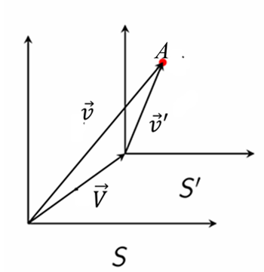
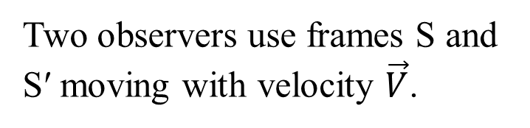
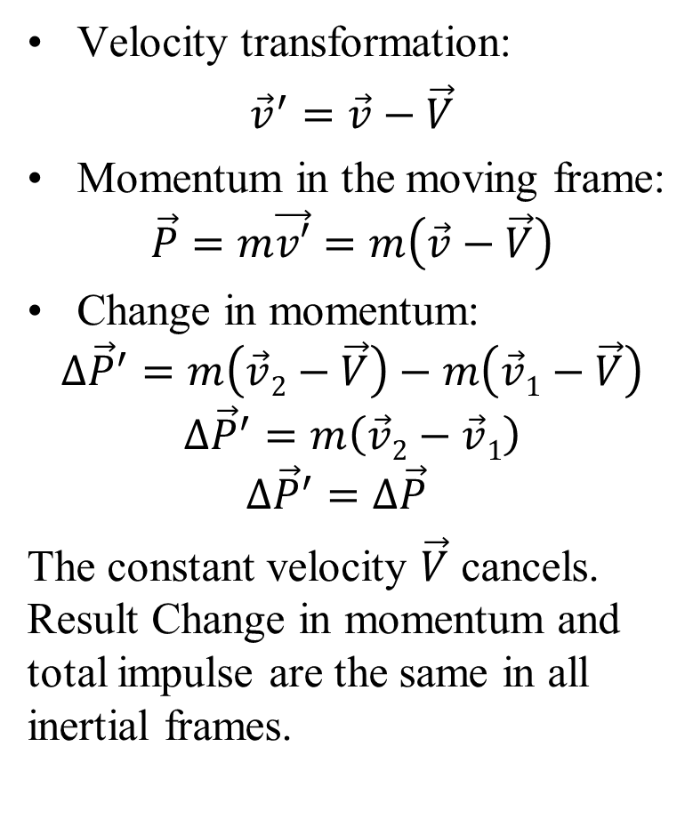
Impulse, Momentum, and Frame Independence
Velocity transformation:
${\vec{v}}^{′}=\vec{v}−\vec{V}$
Momentum in the moving frame:
$$\vec{P}=m\vec{v′}=m\left(\vec{v}−\vec{V}\right)$$
Change in momentum:
$$∆{\vec{P}}^{′}=m\left(\vec{v}2−\vec{V}\right)−m\left(\vec{v}1−\vec{V}\right)$$
$$∆{\vec{P}}^{′}=m\left(\vec{v}2−\vec{v}1\right)$$
$$∆{\vec{P}}^{′}=∆{\vec{P}}^{}$$
The constant velocity $\vec{V}$ cancels. Result Change in momentum and total impulse are the same in all inertial frames.
Two observers use frames S and S′ moving with velocity $\vec{V}$.
Independence from the Inertial Frame

Slide 8
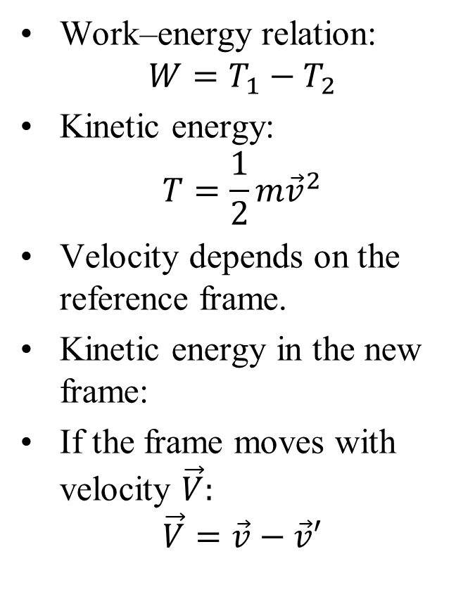
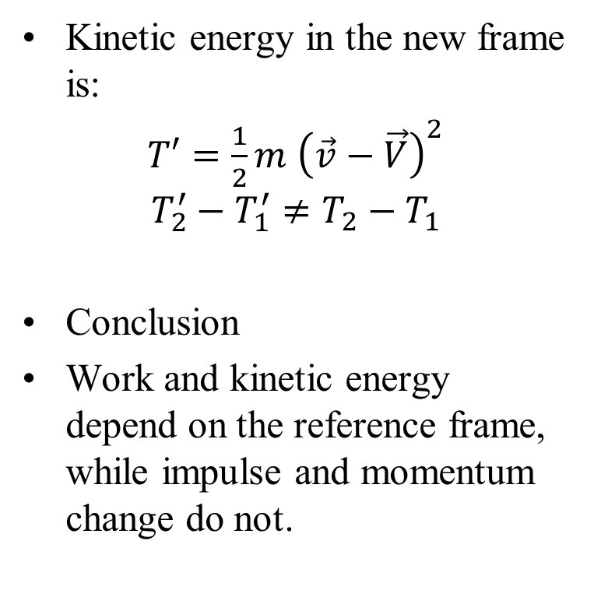
Contrast with Work and Kinetic Energy
Work–energy relation:
$$W=T_{1}−T_{2}$$
Kinetic energy:
$$T=\frac{1}{2}m{\vec{v}}^{2}$$
Velocity depends on the reference frame.
Kinetic energy in the new frame:
If the frame moves with velocity $\vec{V}:$
$$\vec{V}=\vec{v}−\vec{v}′$$
Kinetic energy in the new frame is:
$T′=\frac{1}{2}m$ ${\left(\vec{v}−\vec{V}\right)}^{2}$
$$T_{2}^{′}−T_{1}^{′}≠T_{2}−T_{1}$$
Conclusion
Work and kinetic energy depend on the reference frame, while impulse and momentum change do not.

Slide 9
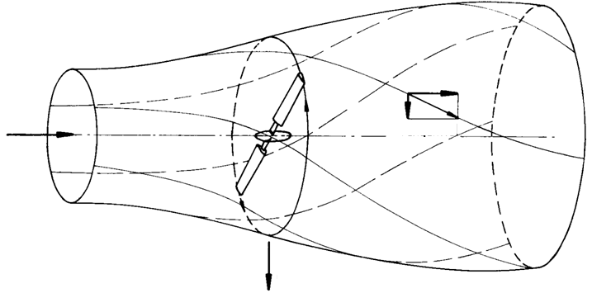
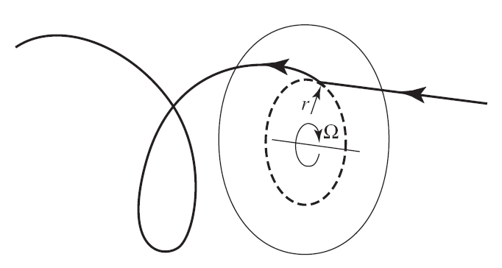




The Spin Energy of A Fluid Parcel
The Trajectory of an Air Particle Passing Through the Rotor Disc

Slide 10
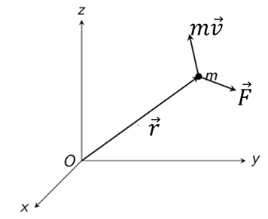
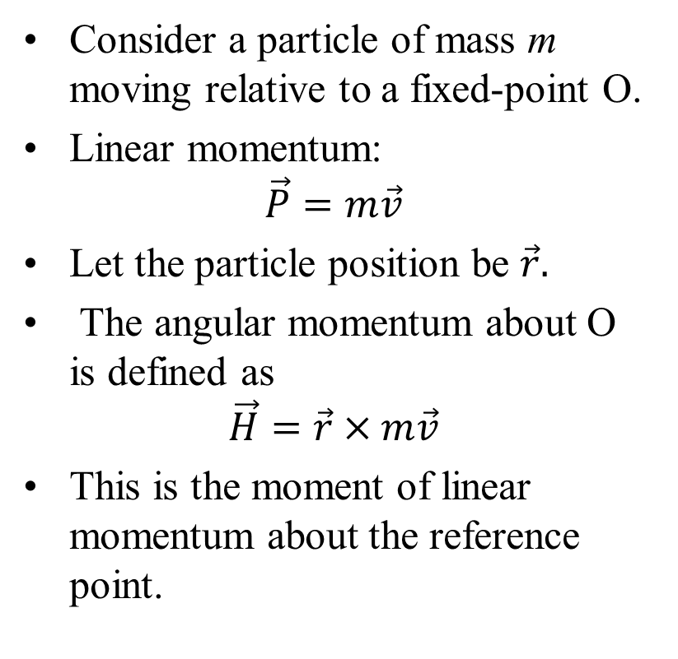
Angular Momentum of a Particle
Consider a particle of mass m moving relative to a fixed-point O.
Linear momentum:
$$\vec{P}=m\vec{v}$$
Let the particle position be $\vec{r}.$
The angular momentum about O is defined as
$$\vec{H}=\vec{r}×m\vec{v}$$
This is the moment of linear momentum about the reference point.

Slide 11
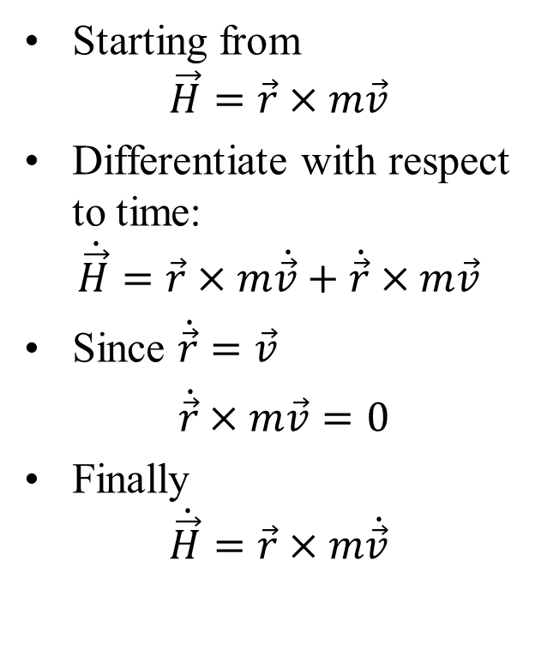

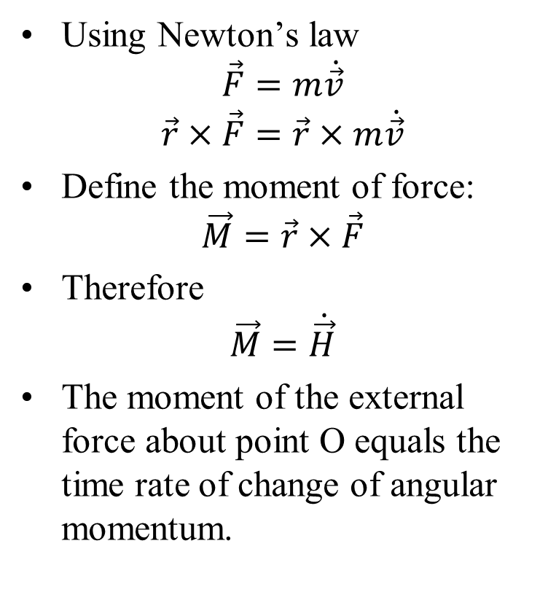
Moment of Force and Angular Momentum
Starting from
$$\vec{H}=\vec{r}×m\vec{v}$$
Differentiate with respect to time:
$$\dot{\vec{H}}=\vec{r}×m\dot{\vec{v}}+\dot{\vec{r}}×m\vec{v}$$
Since $\dot{\vec{r}}=\vec{v}$
$\dot{\vec{r}}×m\vec{v}=0$
Finally
$$\dot{\vec{H}}=\vec{r}×m\dot{\vec{v}}$$
Using Newton’s law
$$\vec{F}=m\dot{\vec{v}}$$
$$\vec{r}×\vec{F}=\vec{r}×m\dot{\vec{v}}$$
Define the moment of force:
$$\vec{M}=\vec{r}×\vec{F}$$
Therefore
$$\vec{M}=\dot{\vec{H}}$$
The moment of the external force about point O equals the time rate of change of angular momentum.

Slide 12
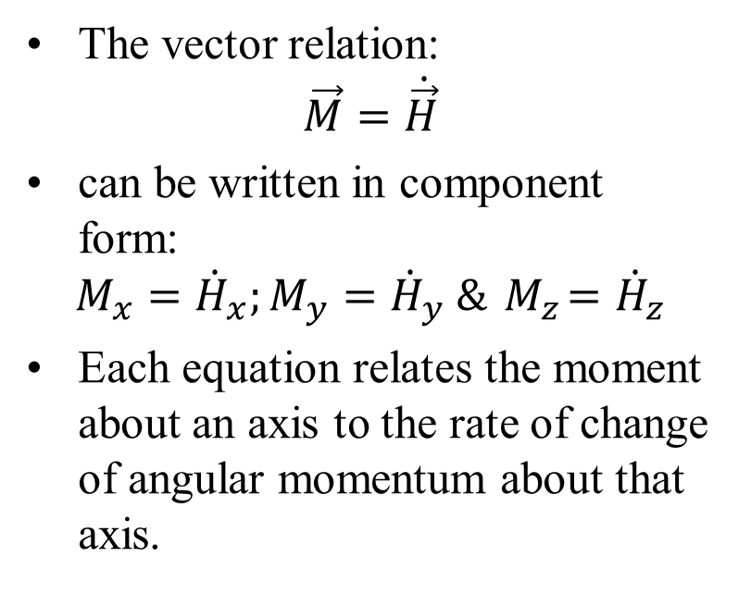
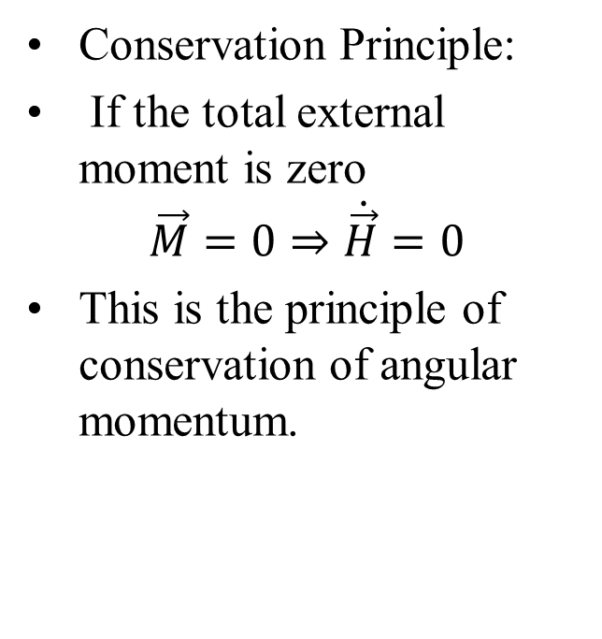
Conservation of Angular Momentum Components
The vector relation:
$$\vec{M}=\dot{\vec{H}}$$
can be written in component form:
$$M_{x}={\dot{H}}_{x};M_{y}={\dot{H}}_{y} \&{ M}_{z}={\dot{H}}_{z}$$
Each equation relates the moment about an axis to the rate of change of angular momentum about that axis.
Conservation Principle:
If the total external moment is zero
$$\vec{M}=0⇒\dot{\vec{H}}=0$$
This is the principle of conservation of angular momentum.
Even if the total angular momentum is not conserved, a component of angular momentum is conserved if the moment about that axis is zero.

Slide 13
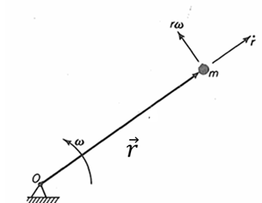
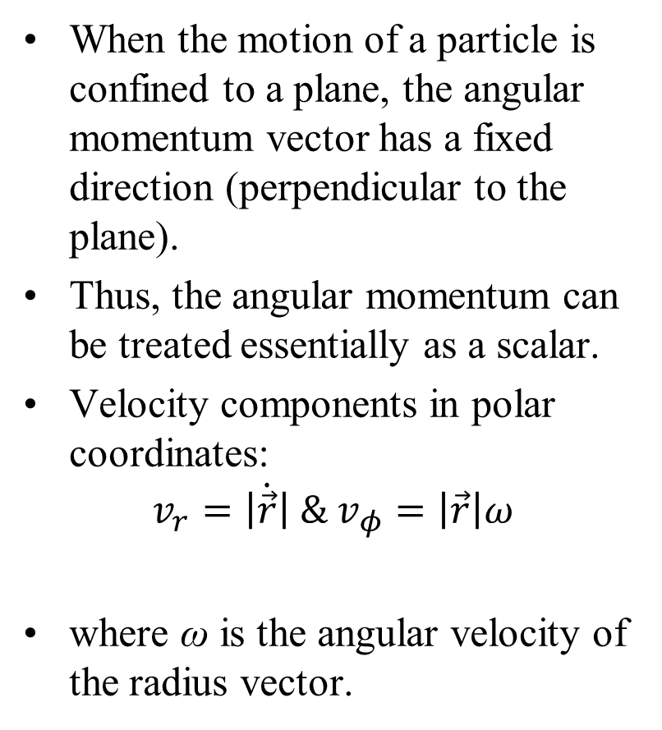
Angular Momentum in Planar Motion
When the motion of a particle is confined to a plane, the angular momentum vector has a fixed direction (perpendicular to the plane).
Thus, the angular momentum can be treated essentially as a scalar.
Velocity components in polar coordinates:
$$v_{r}=\dot{\left|\vec{r}\right|} \& v_{φ}=\left|\vec{r}\right|ω$$
where ω is the angular velocity of the radius vector.
Angular momentum is independent of the radial component because that component passes through the reference point O.

Slide 14
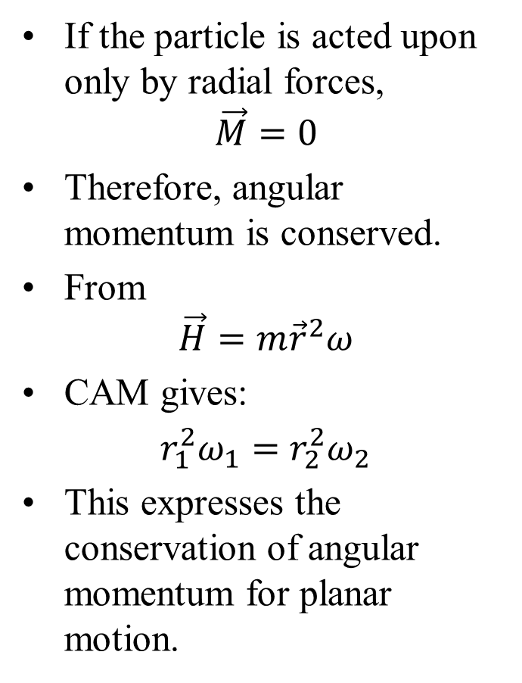
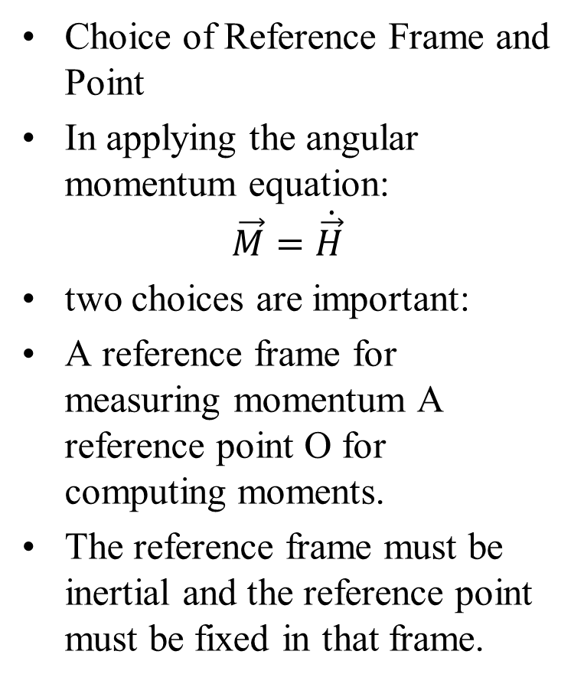
Conservation of Angular Momentum
If the particle is acted upon only by radial forces,
$$\vec{M}=0$$
Therefore, angular momentum is conserved.
From
$$\vec{H}=m{\vec{r}}^{2}ω$$
CAM gives:
$r_{1}^{2}ω_{1}=$ $r_{2}^{2}ω_{2}$
This expresses the conservation of angular momentum for planar motion.
Choice of Reference Frame and Point
In applying the angular momentum equation:
$$\vec{M}=\dot{\vec{H}}$$
two choices are important:
A reference frame for measuring momentum A reference point O for computing moments.
The reference frame must be inertial and the reference point must be fixed in that frame.
Choosing a suitable reference point often simplifies the analysis and may lead to conservation of one or more components of angular momentum!

Slide 15
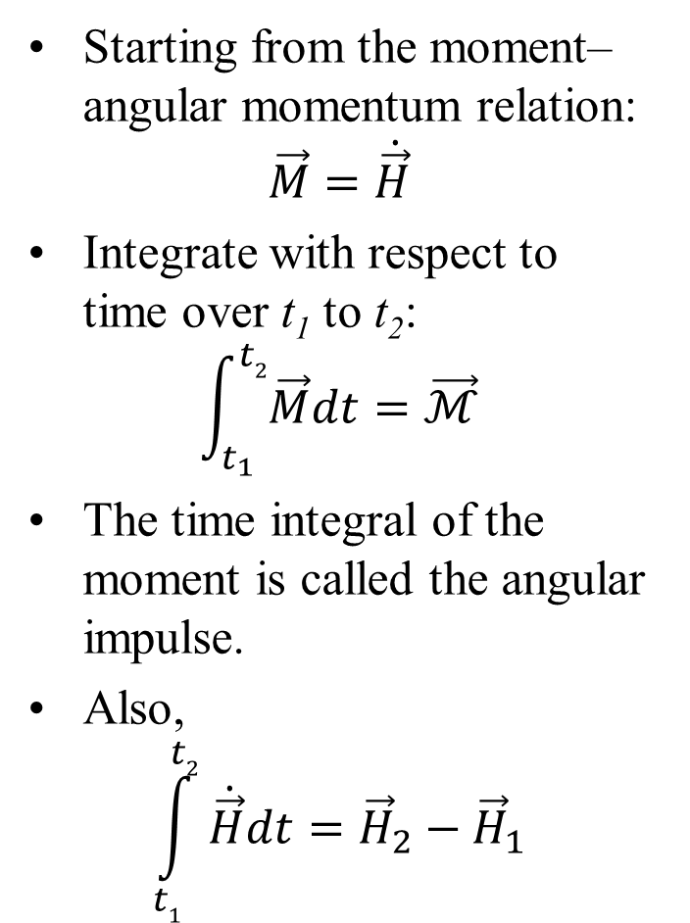
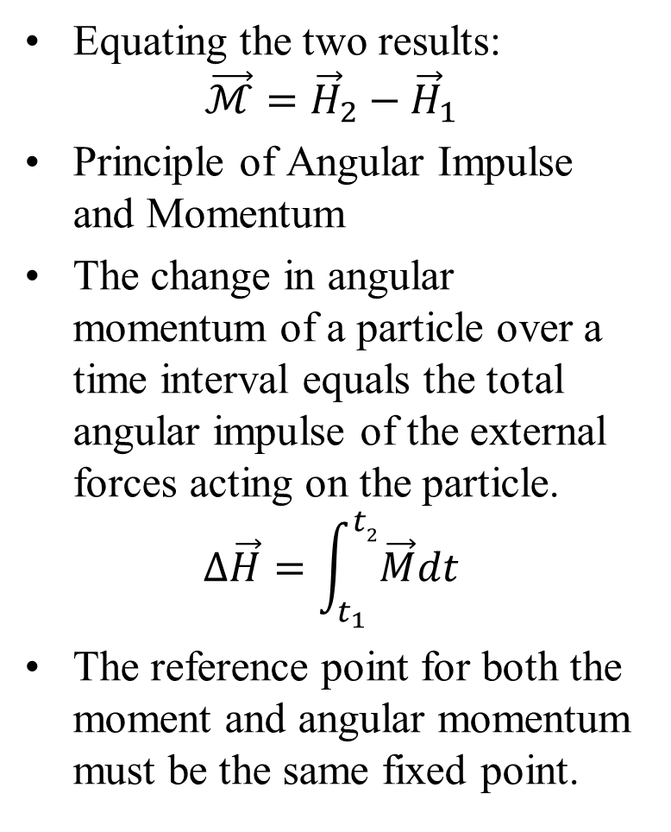
Angular Impulse and Angular Momentum
Starting from the moment–angular momentum relation:
$$\vec{M}=\dot{\vec{H}}$$
Integrate with respect to time over t₁ to t₂:
$$\int_{t_{1}}^{t2}{\vec{M}dt}=\vec{ℳ}$$
The time integral of the moment is called the angular impulse.
Also,
$$\int_{t1}^{t2}{\dot{\vec{H}}dt}={\vec{H}}_{2}−{\vec{H}}_{1}$$
Equating the two results:
$$\vec{ℳ}={\vec{H}}_{2}−{\vec{H}}_{1}$$
Principle of Angular Impulse and Momentum
The change in angular momentum of a particle over a time interval equals the total angular impulse of the external forces acting on the particle.
$$∆\vec{H}=\int_{t_{1}}^{t2}{\vec{M}dt}$$
The reference point for both the moment and angular momentum must be the same fixed point.

