Slide 1


Role of Conservation Fields in Creation of Kinetics of A Particle
P M V Subbarao
Professor & Head
Mechanical Engineering Department
A sequence of Cause-Effect Duos …

Slide 2

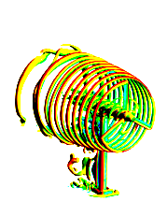
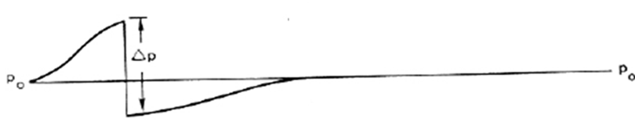
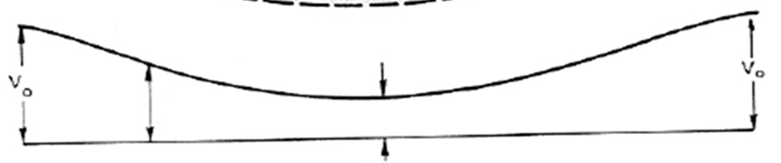
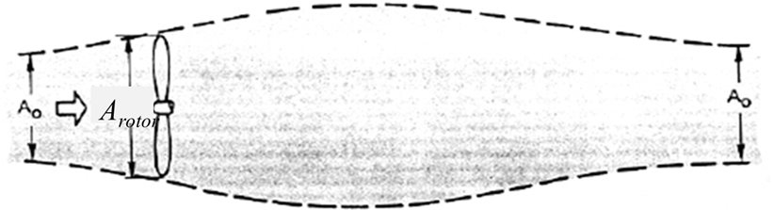

Kinetics of A Single Fluid Parcel

Slide 3
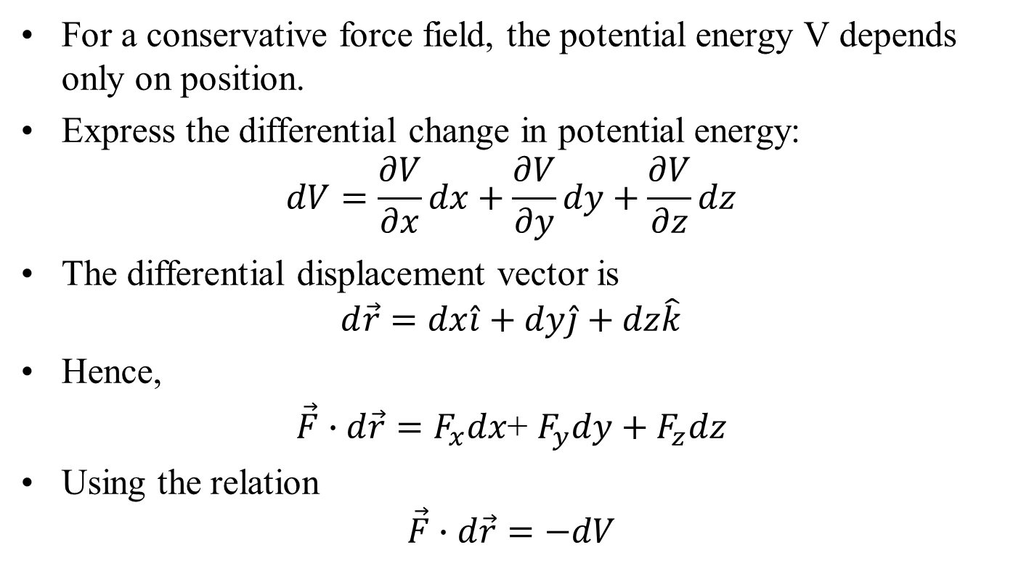
Potential Energy and Conservative Forces
For a conservative force field, the potential energy V depends only on position.
Express the differential change in potential energy:
$$dV=\frac{∂V}{∂x}dx+\frac{∂V}{∂y}dy+\frac{∂V}{∂z}dz$$
The differential displacement vector is
$$d\vec{r}=dx\hat{i}+dy\hat{j}+dz\hat{k}$$
Hence,
$\vec{F}∙d\vec{r}=F_{x}dx$+ $F_{y}dy+F_{z}dz$
Using the relation
$$\vec{F}∙d\vec{r}=−dV$$

Slide 4
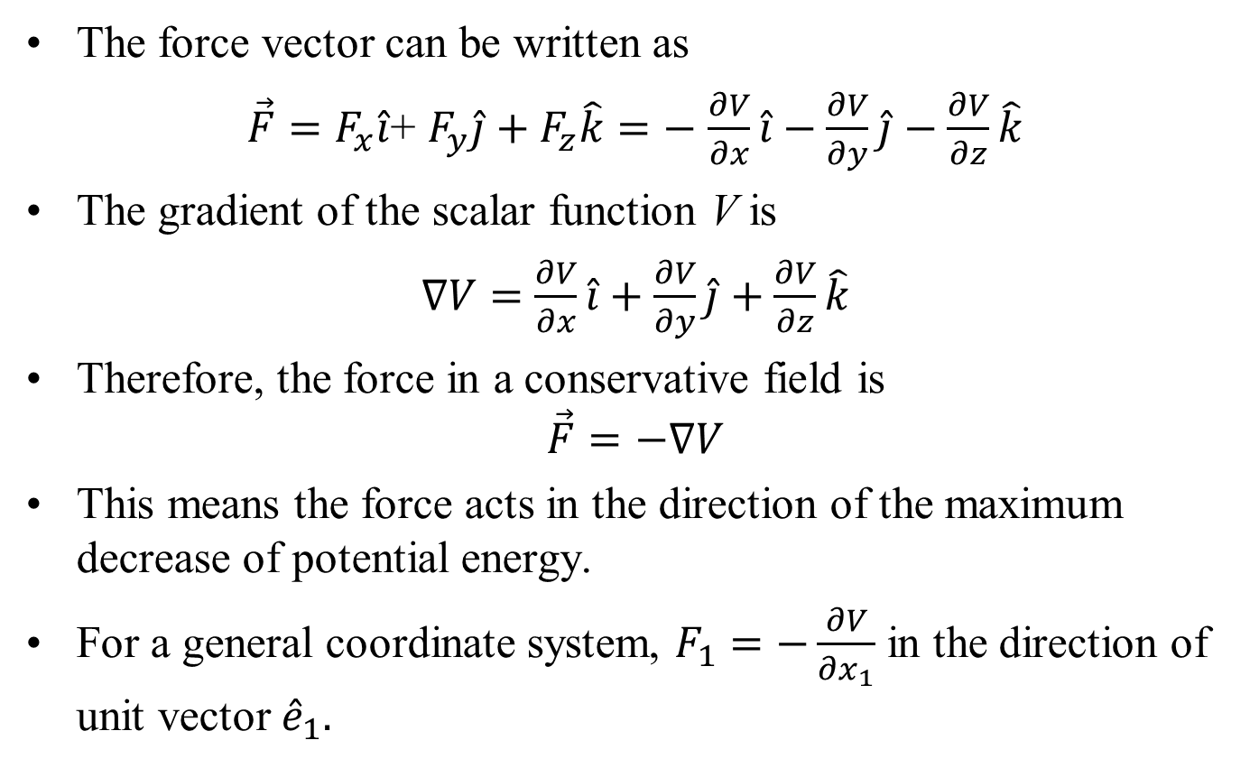
Force as the Gradient of Potential Energy
The force vector can be written as
$\vec{F}=F_{x}\hat{i}$+ $F_{y}\hat{j}+F_{z}\hat{k}=−$ $\frac{∂V}{∂x}\hat{i}−\frac{∂V}{∂y}\hat{j}−\frac{∂V}{∂z}\hat{k}$
The gradient of the scalar function V is
$∇V=$ $\frac{∂V}{∂x}\hat{i}+\frac{∂V}{∂y}\hat{j}+\frac{∂V}{∂z}\hat{k}$
Therefore, the force in a conservative field is
$$\vec{F}=−∇V$$
This means the force acts in the direction of the maximum decrease of potential energy.
For a general coordinate system, $F_{1}=−\frac{∂V}{∂x_{1}}$ in the direction of unit vector ${\hat{e}}_{1}.$

Slide 5
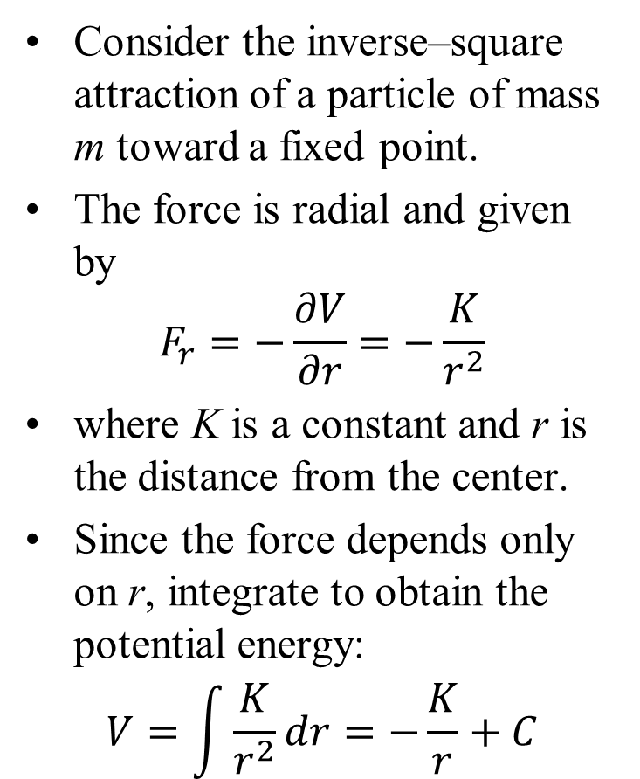
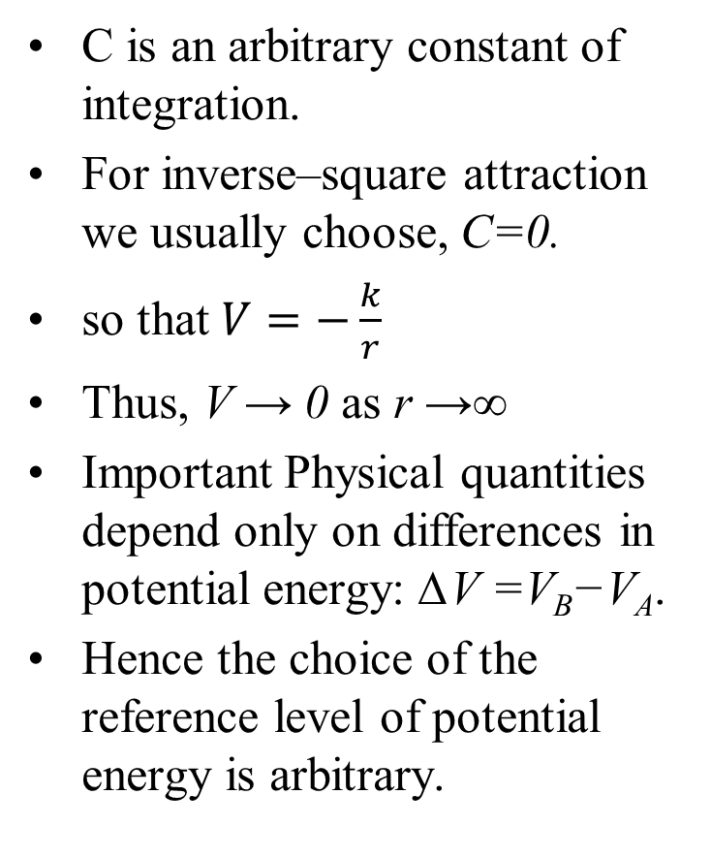
Inverse–Square Potential Energy
Consider the inverse–square attraction of a particle of mass m toward a fixed point.
The force is radial and given by
$$F_{r}=−\frac{∂V}{∂r}=−\frac{K}{r^{2}}$$
where K is a constant and r is the distance from the center.
Since the force depends only on r, integrate to obtain the potential energy:
$$V=\int{\frac{K}{r^{2}}dr}=−\frac{K}{r}+C$$
C is an arbitrary constant of integration.
For inverse–square attraction we usually choose, C=0.
so that $V=−\frac{k}{r}$
Thus, V → 0 as r →∞
Important Physical quantities depend only on differences in potential energy: ∆V =V_{B}−V_{A}.
Hence the choice of the reference level of potential energy is arbitrary.

Slide 6
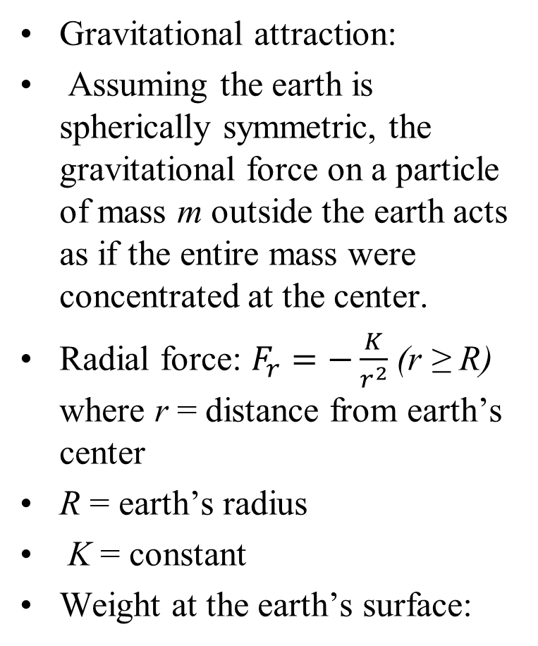
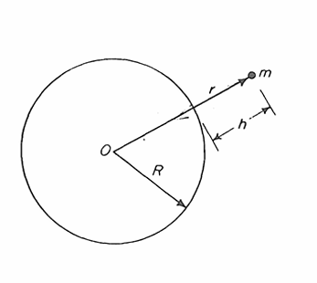
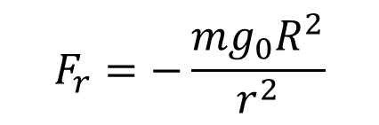
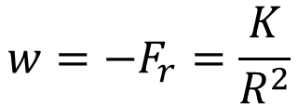
Gravitational Potential Energy
Gravitational attraction:
Assuming the earth is spherically symmetric, the gravitational force on a particle of mass m outside the earth acts as if the entire mass were concentrated at the center.
Radial force: $F_{r}=−\frac{K}{r^{2}}$ (r ≥ R) where r = distance from earth’s center
R = earth’s radius
K = constant
Weight at the earth’s surface:
$$w=−F_{r}=\frac{K}{R^{2}}$$
But also w = mg₀
Thus, K = mg₀R²
Substituting into the force law
$$F_{r}=−\frac{mg_{0}R^{2}}{r^{2}}$$

Slide 7
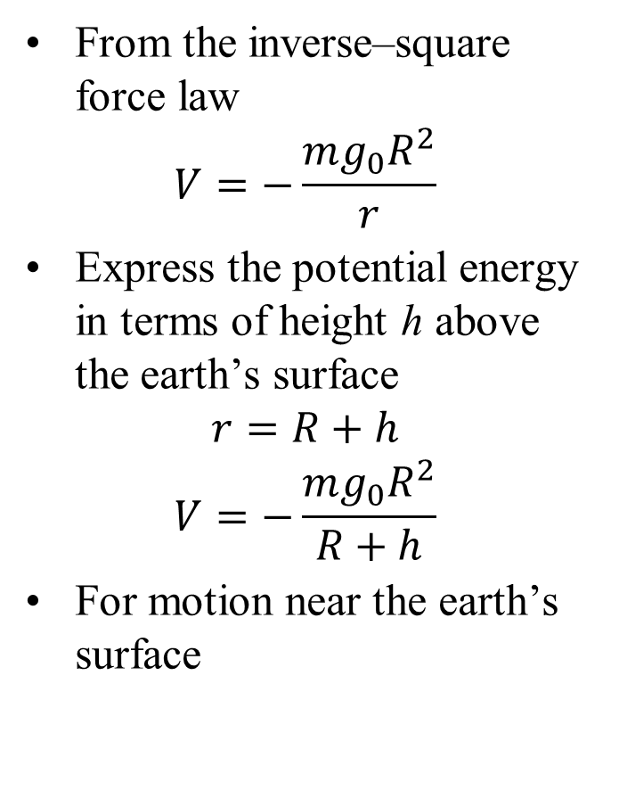
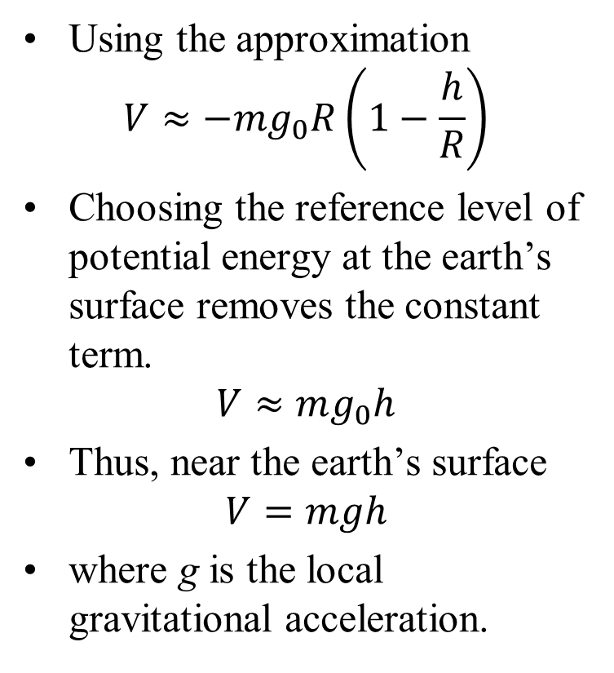
Gravitational Potential Energy
From the inverse–square force law
$$V=−\frac{mg_{0}R^{2}}{r}$$
Express the potential energy in terms of height h above the earth’s surface
$$r=R+h$$
$$V=−\frac{mg_{0}R^{2}}{R+h}$$
For motion near the earth’s surface
Using the approximation
$$V≈−mg_{0}R\left(1−\frac{h}{R}\right)$$
Choosing the reference level of potential energy at the earth’s surface removes the constant term.
$$V≈mg_{0}h$$
Thus, near the earth’s surface
$$V=mgh$$
where g is the local gravitational acceleration.

Slide 8
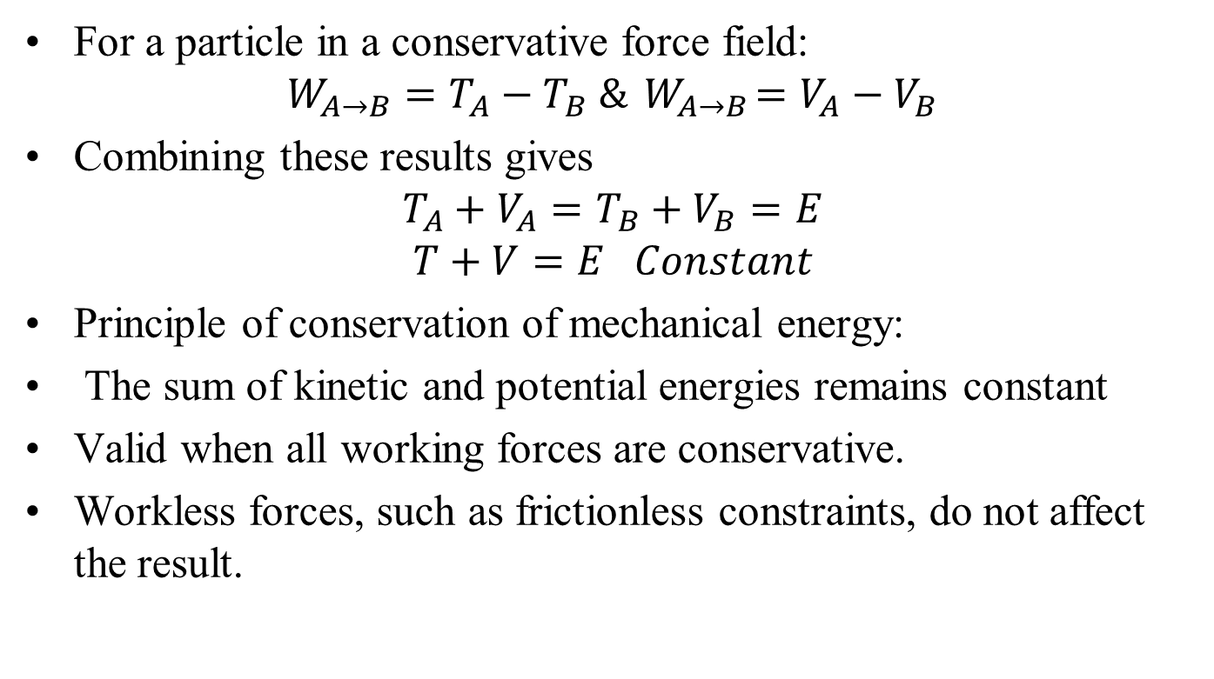
Conservation of Mechanical Energy
For a particle in a conservative force field:
$$W_{A→B}=T_{A}−T_{B} \&{ W}_{A→B}=V_{A}−V_{B}$$
Combining these results gives
$$T_{A}+V_{A}=T_{B}+V_{B}=E$$
$$T+V=E Constant$$
Principle of conservation of mechanical energy:
The sum of kinetic and potential energies remains constant
Valid when all working forces are conservative.
Workless forces, such as frictionless constraints, do not affect the result.

Slide 9
Energy to Living Force

Slide 10
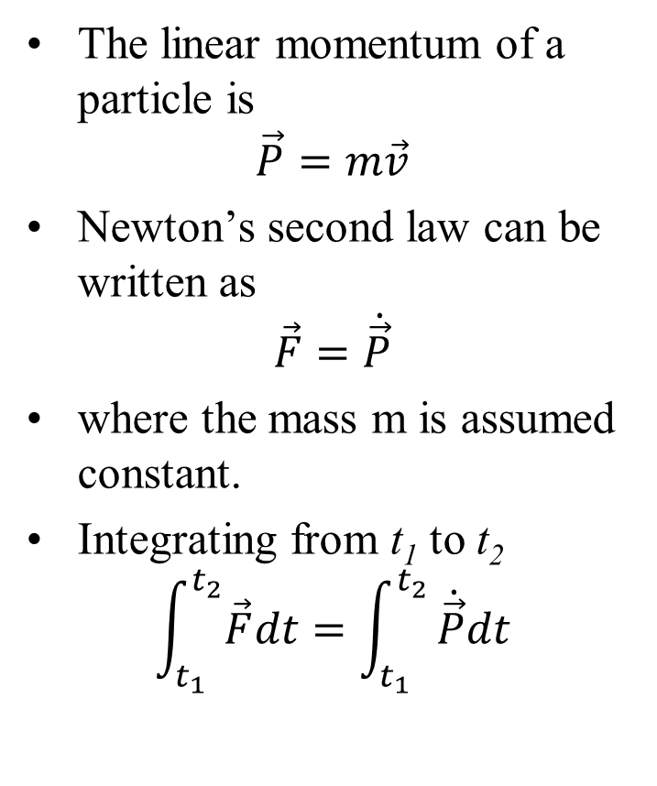
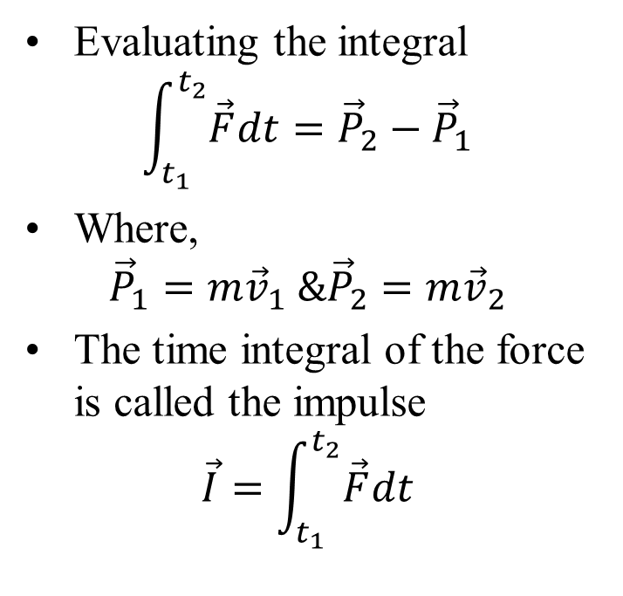
Linear Impulse and Momentum
The linear momentum of a particle is
$$\vec{P}=m\vec{v}$$
Newton’s second law can be written as
$$\vec{F}=\dot{\vec{P}}$$
where the mass m is assumed constant.
Integrating from t₁ to t₂
$$\int_{t_{1}}^{t_{2}}{\vec{F}dt}=\int_{t_{1}}^{t_{2}}{\dot{\vec{P}}dt}$$
Evaluating the integral
$$\int_{t_{1}}^{t_{2}}{\vec{F}dt}={\vec{P}}_{2}−{\vec{P}}_{1}$$
Where,
$${\vec{P}}_{1}=m{\vec{v}}_{1} \&{\vec{P}}_{2}=m{\vec{v}}_{2}$$
The time integral of the force is called the impulse
$$\vec{I}=\int_{t_{1}}^{t_{2}}{\vec{F}dt}$$

Slide 11
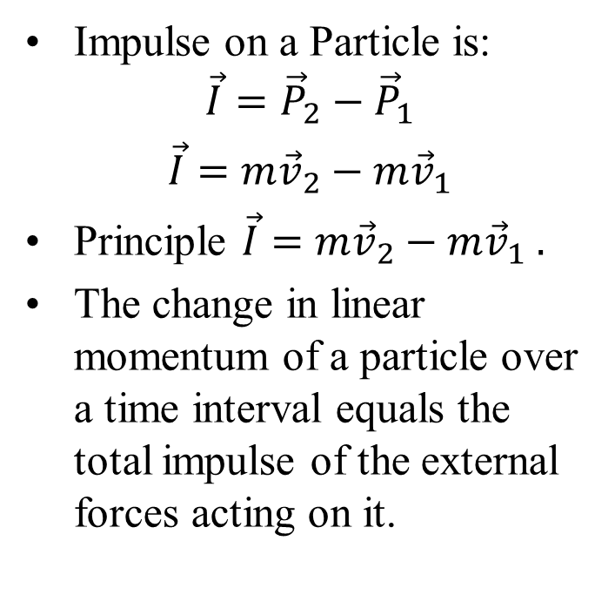
Impulse–Momentum Principle
If the duration of a force becomes extremely small but its magnitude becomes very large such that the impulse remains finite, the force is called an impulsive force
Effect of an impulsive force:
Velocity changes instantaneously
Position remains continuous
Impulse on a Particle is:
$$\vec{I}={\vec{P}}_{2}−{\vec{P}}_{1}$$
$\vec{I}=$ $m{\vec{v}}_{2}−m{\vec{v}}_{1}$
Principle $\vec{I}=$ $m{\vec{v}}_{2}−m{\vec{v}}_{1} .$
The change in linear momentum of a particle over a time interval equals the total impulse of the external forces acting on it.

