Slide 1


Kinetics of Particle thru Principles of Conservation
P M V Subbarao
Professor & Head
Mechanical Engineering Department
Universal Causes and Ultimate Effects…

Slide 2

Philosophy of Energy & Work
The concept of energy is generally credited to Aristotle’s enérgeia (ἐνέργειά).
This word was having no direct translation into English except for “being at work”.
Aristotle’s concept of work grew from Empedocles’s thoughts on the basic elements of all matter: earth, water, air, fire and quintessence.
Fire was characterized as the driver behind his thoughts and understanding leading to the concept of enérgeia.
Aristotle’s concepts remained in vogue for nearly two thousand years before The Age of Enlightenment in European science began to take prominence in creating a new paradigm to understand energy.

Slide 3
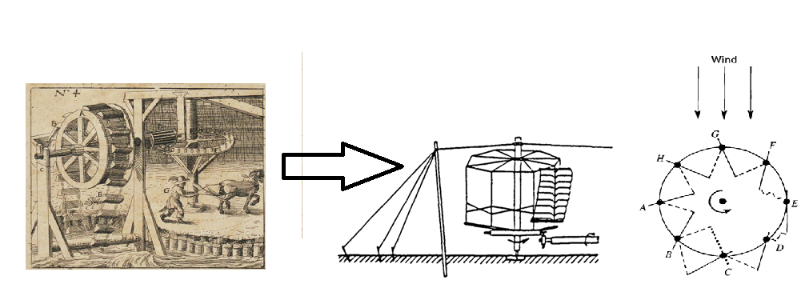
Philosophy of Energy & Work
The first of these developments was in 1669 by Christian Huygens, who recognized that in a specific collision between two hardwood spheres (close to an elastic collision).
He observed that the product of mass times the square of the speed was conserved along with what became known as momentum.
This discovery is credited as the origin of the modern concepts of mechanical energy, specifically kinetic energy.
Huygens’s name for his discovery was not energy but vis viva (living force).
A couple of decades later, Gottfried Wilhelm von Leibniz in 1686 became the first to quantify the concept of vis-viva as the product of mass times the square of the speed.

Slide 4
Modern Philosophy of Energy & Work
The name “energy” was popularized by William Thomson, Lord Kelvin (1824 - 1907) and William J. M. Rankine (1820-1872) as the concept of force was integrated to act across other related phenomena.
18th Century Power: John Smeaton in 1759 defined "power" as the ability to lift a weight over a specific height in a given time, close to the modern definition.
19th Century Formalization:
French mathematicians Gaspard-Gustave Coriolis and Jean-Victor Poncelet independently defined "work" in the late 1820s to calculate the efficiency of machines and steam engines.
They established it as force applied over a distance.

Slide 5
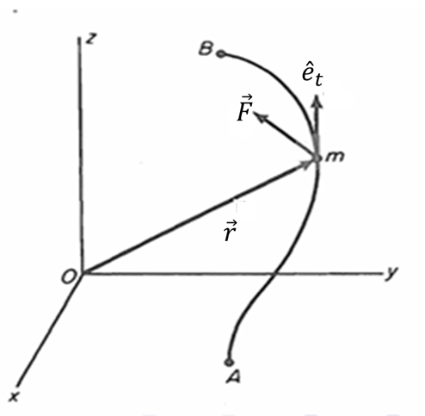
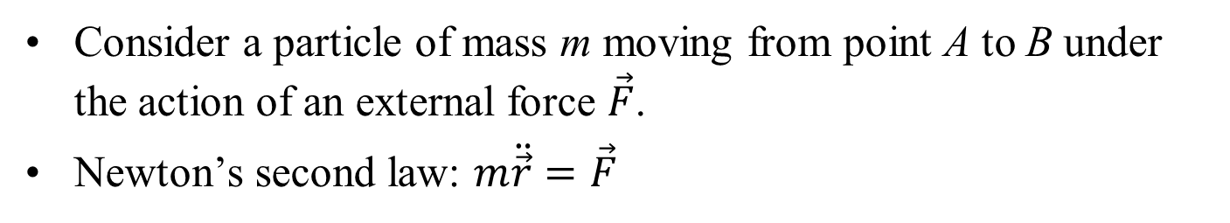
Work and Kinetic Energy
Work–Energy Principle:
The increase in kinetic energy of a particle between two points is equal to the work done by external forces acting on the particle.
Consider a particle of mass m moving from point A to B under the action of an external force $\vec{F}$.
Newton’s second law: $m\ddot{\vec{r}}=\vec{F}$

Slide 6
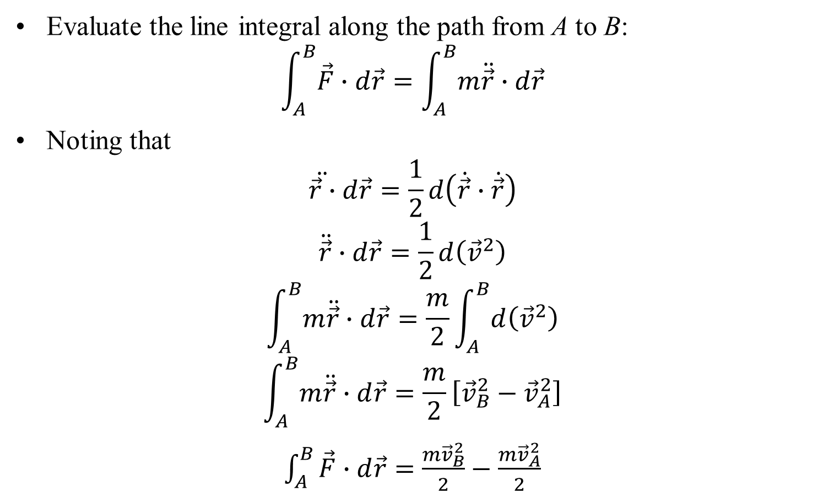
Derivation of the Work–Energy Relation
Evaluate the line integral along the path from A to B:
$$\int_{A}^{B}{\vec{F}∙d\vec{r}}=\int_{A}^{B}{m\ddot{\vec{r}}∙d\vec{r}}$$
Noting that
$$\ddot{\vec{r}∙}d\vec{r}=\frac{1}{2}d\left(\dot{\vec{r}}∙\dot{\vec{r}}\right)$$
$$\ddot{\vec{r}}∙d\vec{r}=\frac{1}{2}d\left({\vec{v}}^{2}\right)$$
$$\int_{A}^{B}{m\ddot{\vec{r}}∙d\vec{r}}=\frac{m}{2}\int_{A}^{B}{d\left({\vec{v}}^{2}\right)}$$
$$\int_{A}^{B}{m\ddot{\vec{r}}∙d\vec{r}}=\frac{m}{2}\left[{\vec{v}}_{B}^{2}−{\vec{v}}_{A}^{2}\right]$$
$\int_{A}^{B}{\vec{F}∙d\vec{r}}=$ $\frac{m{\vec{v}}_{B}^{2}}{2}−\frac{m{\vec{v}}_{A}^{2}}{2}$

Slide 7
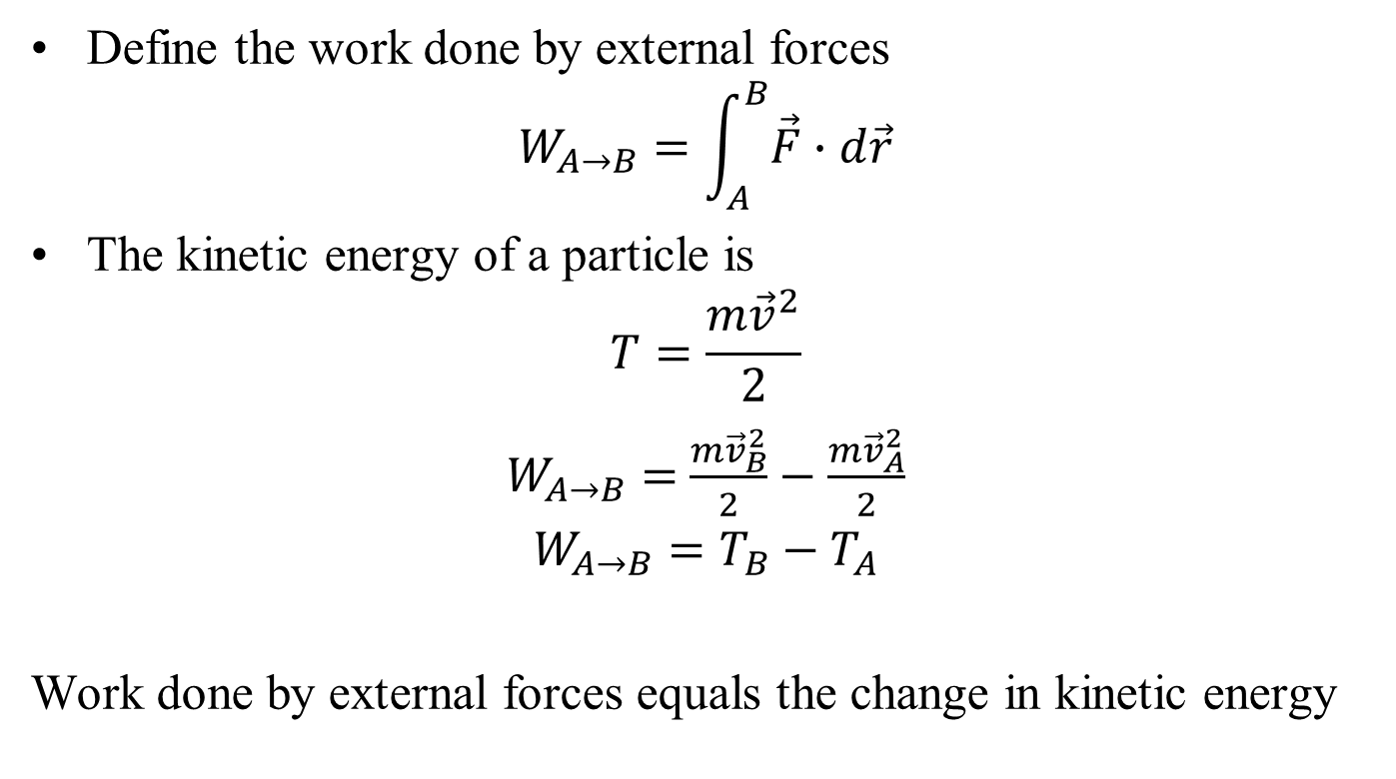
Work–Energy Theorem
Define the work done by external forces
$$W_{A→B}=\int_{A}^{B}{\vec{F}∙d\vec{r}}$$
The kinetic energy of a particle is
$$T=\frac{m{\vec{v}}^{2}}{2}$$
$W_{A→B}=$ $\frac{m{\vec{v}}_{B}^{2}}{2}−\frac{m{\vec{v}}_{A}^{2}}{2}$
$$W_{A→B}=T_{B}−T_{A}$$
Work done by external forces equals the change in kinetic energy

Slide 8

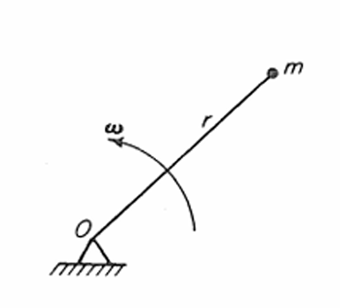
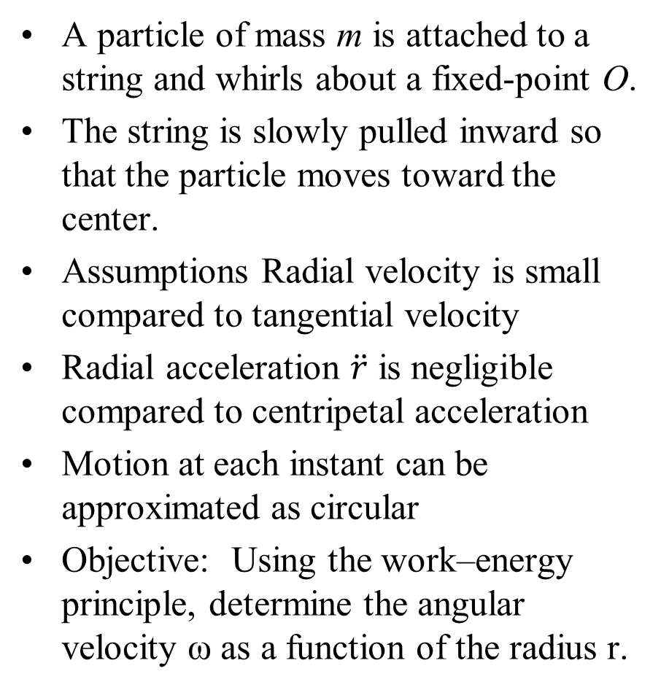
Work–Energy Theorem : Whirling Particle
A particle of mass m is attached to a string and whirls about a fixed-point O.
The string is slowly pulled inward so that the particle moves toward the center.
Assumptions Radial velocity is small compared to tangential velocity
Radial acceleration $\ddot{r}$ is negligible compared to centripetal acceleration
Motion at each instant can be approximated as circular
Objective: Using the work–energy principle, determine the angular velocity ω as a function of the radius r.

Slide 9
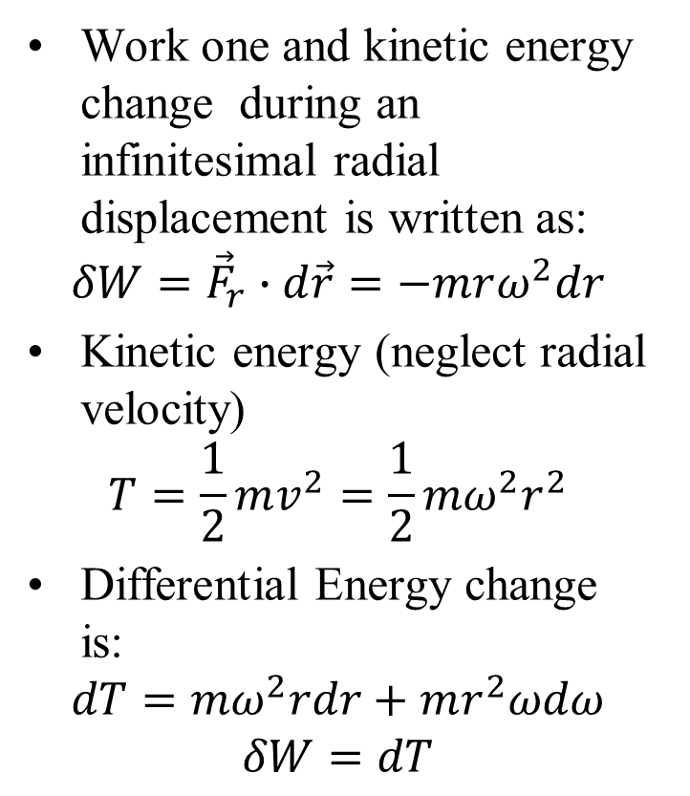
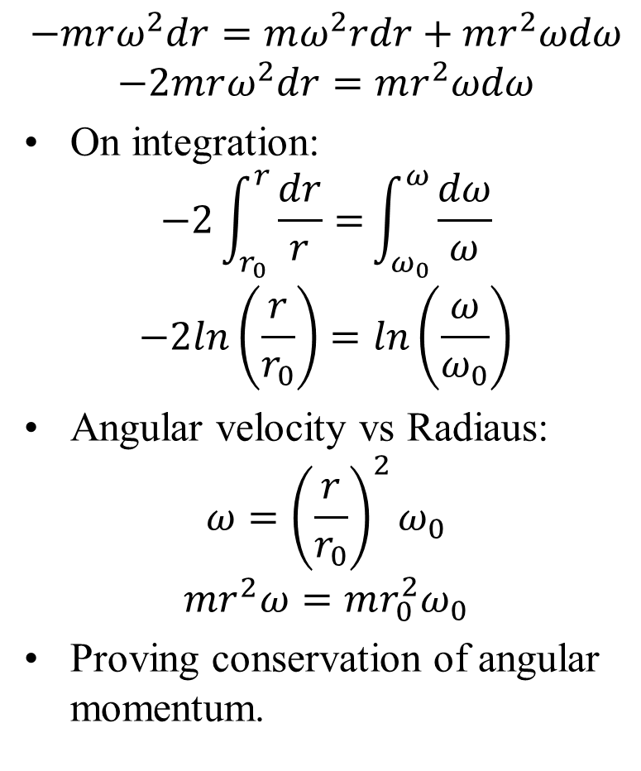
Work–Energy Solution : Whirling Particle
Work one and kinetic energy change during an infinitesimal radial displacement is written as:
$$δW={\vec{F}}_{r}∙d\vec{r}=−mrω^{2}dr$$
Kinetic energy (neglect radial velocity)
$$T=\frac{1}{2}mv^{2}=\frac{1}{2}mω^{2}r^{2}$$
Differential Energy change is:
$$dT=mω^{2}rdr+mr^{2}ωdω$$
$$δW=dT$$
$$−mrω^{2}dr=mω^{2}rdr+mr^{2}ωdω$$
$$−2mrω^{2}dr=mr^{2}ωdω$$
On integration:
$$−2\int_{r_{0}}^{r}{\frac{dr}{r}=}\int_{ω_{0}}^{ω}{\frac{dω}{ω}}$$
$$−2ln\left(\frac{r}{r_{0}}\right)=ln\left(\frac{ω}{ω_{0}}\right)$$
Angular velocity vs Radiaus:
$$ω={\left(\frac{r}{r_{0}}\right)}^{2}ω_{0}$$
$$mr^{2}ω=mr_{0}^{2}ω_{0}$$
Proving conservation of angular momentum.

Slide 10
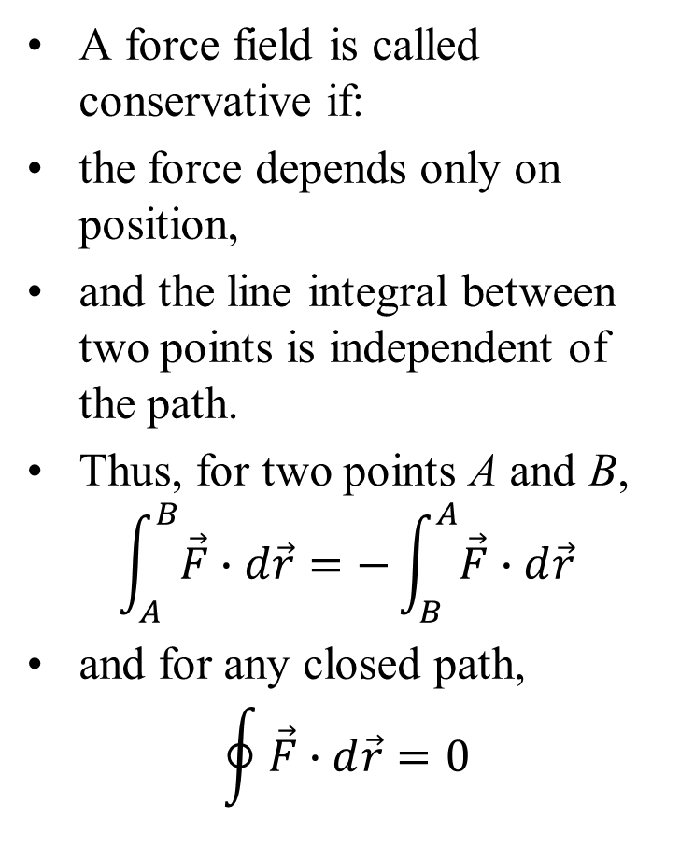
Conservative Systems
A force field is called conservative if:
the force depends only on position,
and the line integral between two points is independent of the path.
Thus, for two points A and B,
$$\int_{A}^{B}{\vec{F}∙d\vec{r}}=−\int_{B}^{A}{\vec{F}∙d\vec{r}}$$
and for any closed path,
$$\oint{\vec{F}∙d\vec{r}}=0$$
This means the work done depends only on the end points, not on the path taken.
A force satisfying these conditions forms a conservative force field.
Such systems are non-dissipative and mechanically reversible.

Slide 11
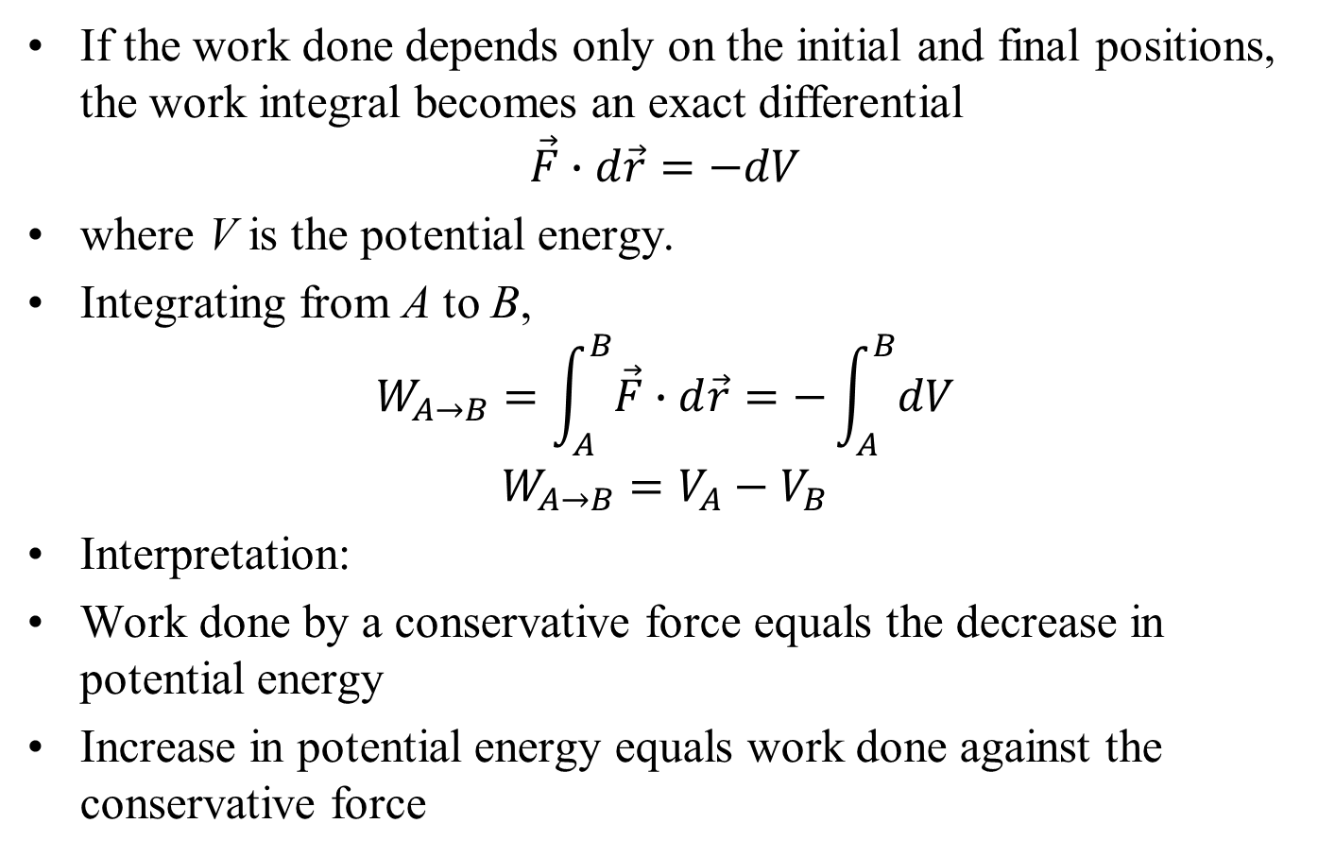
Potential Energy and Work
If the work done depends only on the initial and final positions, the work integral becomes an exact differential
$$\vec{F}∙d\vec{r}=−dV$$
where V is the potential energy.
Integrating from A to B,
$$W_{A→B}=\int_{A}^{B}{\vec{F}∙d\vec{r}}=−\int_{A}^{B}{dV}$$
$$W_{A→B}=V_{A}−V_{B}$$
Interpretation:
Work done by a conservative force equals the decrease in potential energy
Increase in potential energy equals work done against the conservative force

