Slide 1


Equation of Motion for A Particle and Force Functions
P M V Subbarao
Professor & Head
Mechanical Engineering Department
Quality of Forces to Generate A Motion…

Slide 2

Source of Motion :
Forces Functions of Space

Slide 3
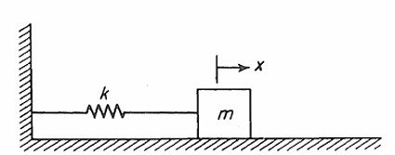
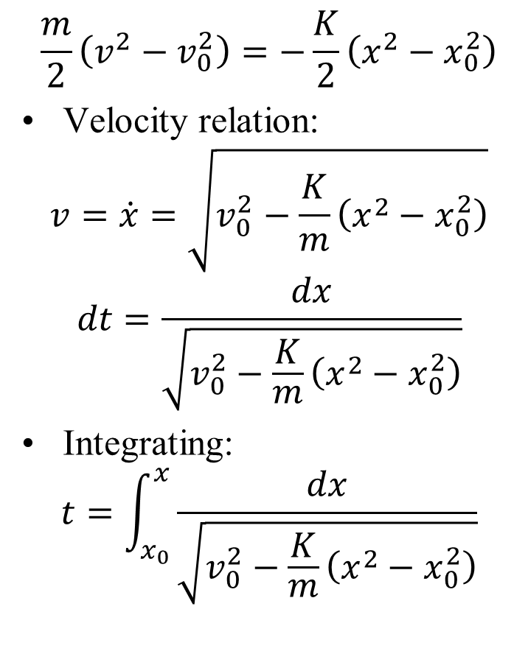
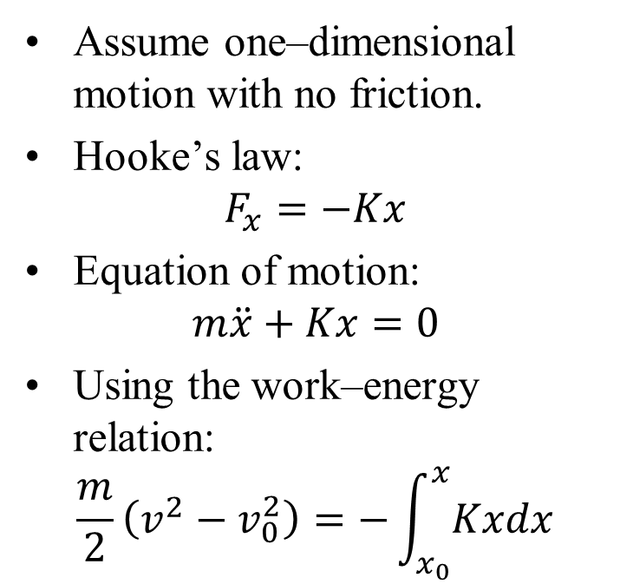
Kinetics of Particle Mass–Spring System
$$\frac{m}{2}\left(v^{2}−v_{0}^{2}\right)=−\frac{K}{2}\left(x^{2}−x_{0}^{2}\right)$$
Velocity relation:
$$v=\dot{x}=\sqrt{v_{0}^{2}−\frac{K}{m}\left(x^{2}−x_{0}^{2}\right)}$$
$$dt=\frac{dx}{\sqrt{v_{0}^{2}−\frac{K}{m}\left(x^{2}−x_{0}^{2}\right)}}$$
Integrating:
$$t=\int_{x_{0}}^{x}{\frac{dx}{\sqrt{v_{0}^{2}−\frac{K}{m}\left(x^{2}−x_{0}^{2}\right)}}}$$
Assume one–dimensional motion with no friction.
Hooke’s law:
$$F_{x}=−Kx$$
Equation of motion:
$$m\ddot{x}+Kx=0$$
Using the work–energy relation:
$$\frac{m}{2}\left(v^{2}−v_{0}^{2}\right)=−\int_{x_{0}}^{x}{Kxdx}$$

Slide 4
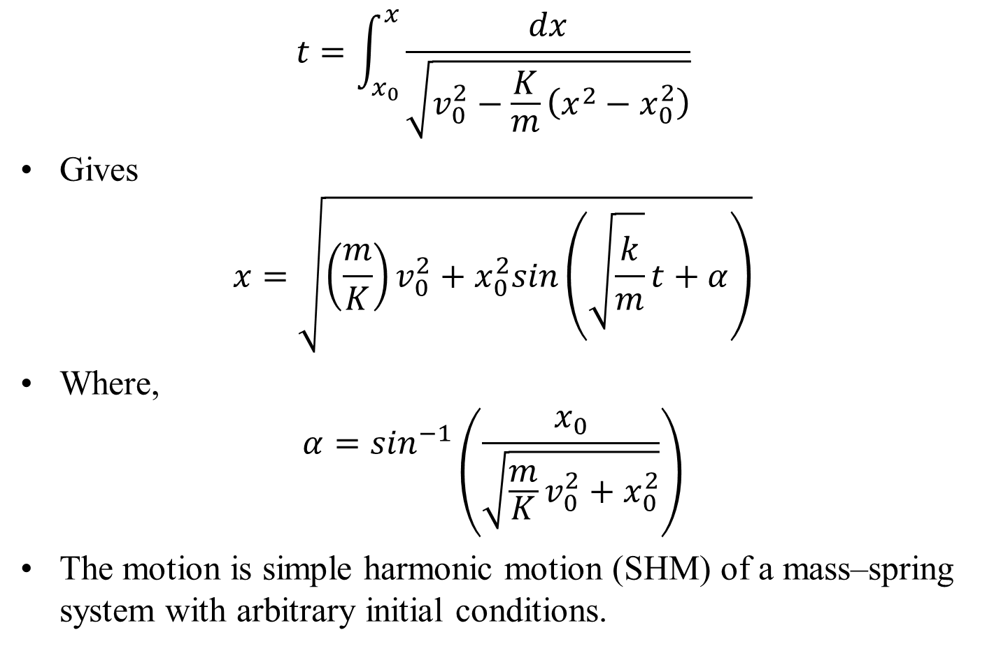
Harmonic Motion
$$t=\int_{x_{0}}^{x}{\frac{dx}{\sqrt{v_{0}^{2}−\frac{K}{m}\left(x^{2}−x_{0}^{2}\right)}}}$$
Gives
$$x=\sqrt{\left(\frac{m}{K}\right)v_{0}^{2}+x_{0}^{2}sin\left(\sqrt{\frac{k}{m}}t+α\right)}$$
Where,
$$α=\sin^{−1}\left(\frac{x_{0}}{\sqrt{\frac{m}{K}v_{0}^{2}+x_{0}^{2}}}\right)$$
The motion is simple harmonic motion (SHM) of a mass–spring system with arbitrary initial conditions.

Slide 5
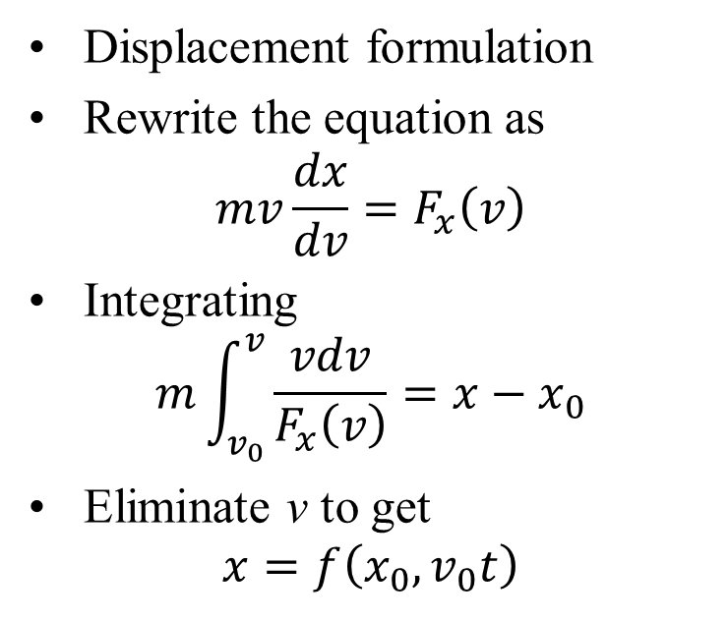
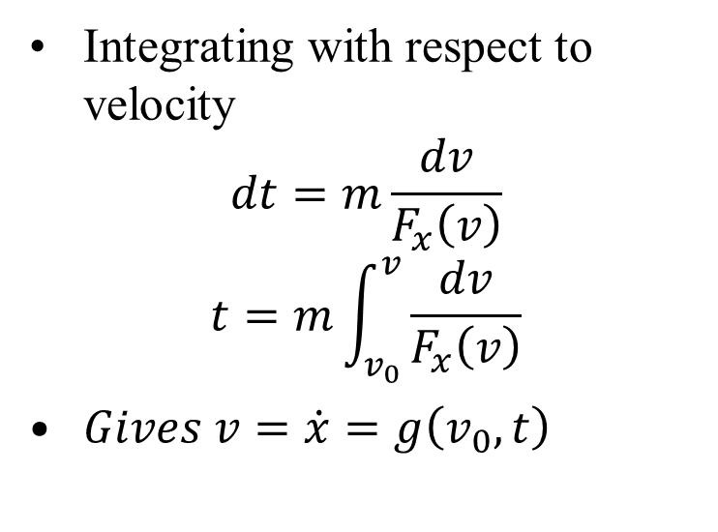
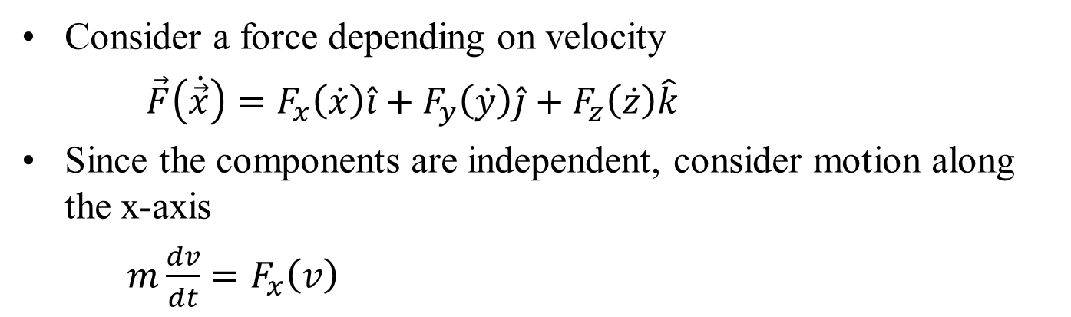
Force as a Function of Velocity
Consider a force depending on velocity
$\vec{F}\left(\dot{\vec{x}}\right)=F_{x}\left(\dot{x}\right)\hat{i}+F_{y}\left(\dot{y}\right)\hat{j}+F_{z}\left(\dot{z}\right)\hat{k}$
Since the components are independent, consider motion along the x-axis
$m\frac{dv}{dt}=F_{x}\left(v\right)$
Displacement formulation
Rewrite the equation as
$$mv\frac{dx}{dv}=F_{x}\left(v\right)$$
Integrating
$$m\int_{v_{0}}^{v}{\frac{vdv}{F_{x}\left(v\right)}}=x−x_{0}$$
Eliminate v to get
$$x=f\left(x_{0},v_{0}t\right)$$
Integrating with respect to velocity
$$dt=m\frac{dv}{F_{x}\left(v\right)}$$
$$t=m\int_{v_{0}}^{v}{\frac{dv}{F_{x}\left(v\right)}}$$
$Gives v=\dot{x}=g\left(v_{0},t\right)$

Slide 6
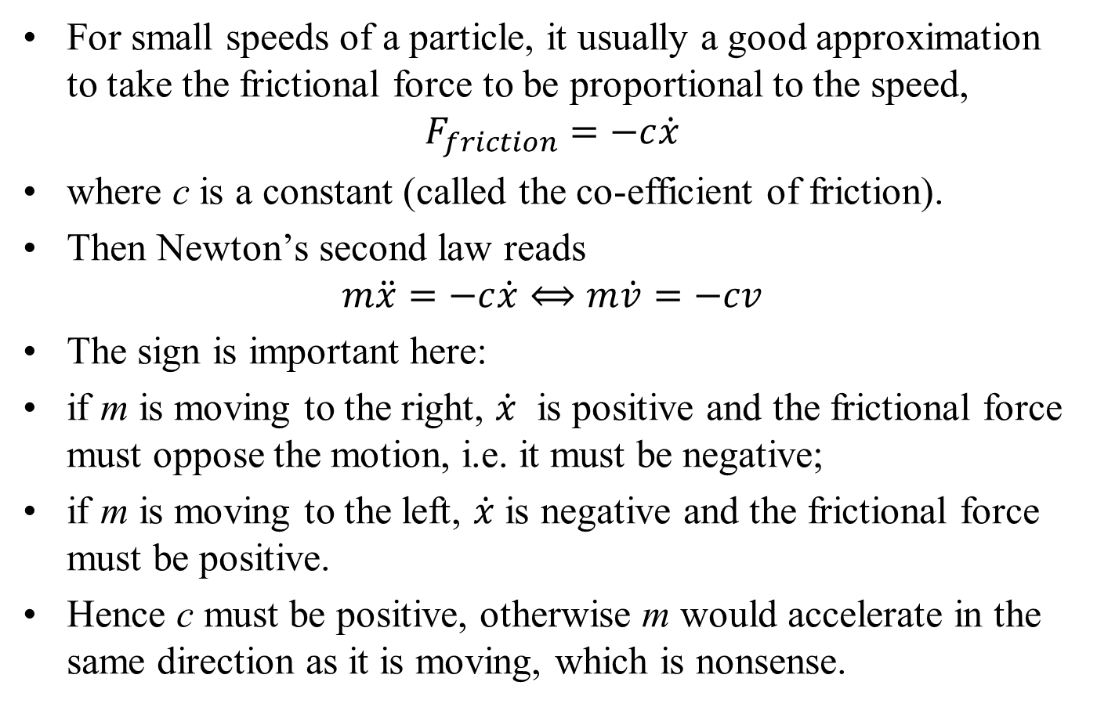
Kinetics of Particle Motion with Friction
For small speeds of a particle, it usually a good approximation to take the frictional force to be proportional to the speed,
$$F_{friction}=−c\dot{x}$$
where c is a constant (called the co-efficient of friction).
Then Newton’s second law reads
$$m\ddot{x}=−c\dot{x}⟺m\dot{v}=−cv$$
The sign is important here:
if m is moving to the right, $\dot{x}$ is positive and the frictional force must oppose the motion, i.e. it must be negative;
if m is moving to the left, $\dot{x}$ is negative and the frictional force must be positive.
Hence c must be positive, otherwise m would accelerate in the same direction as it is moving, which is nonsense.

Slide 7
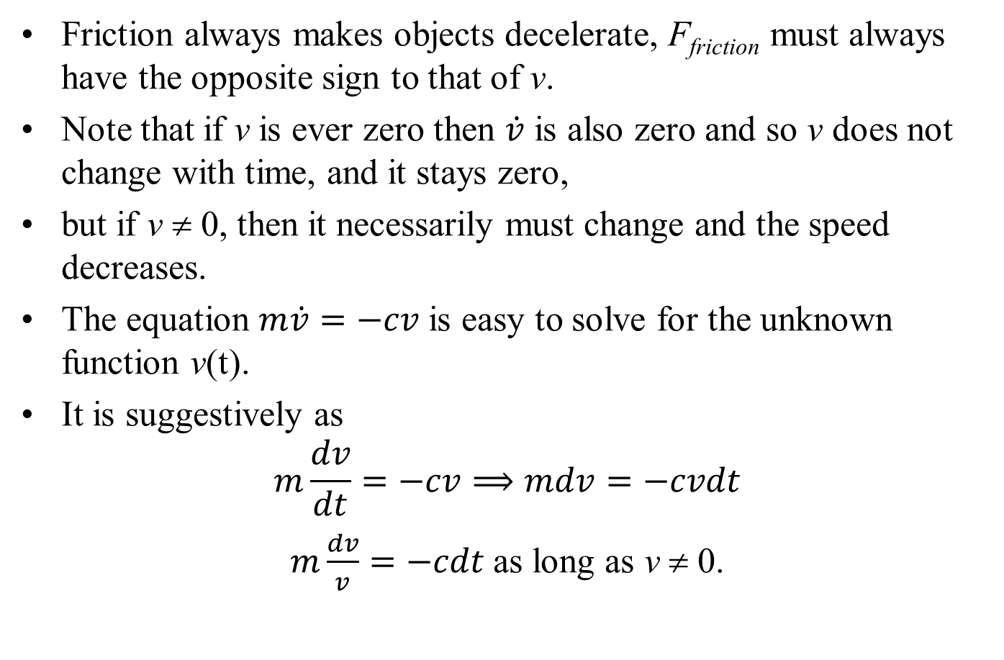
Kinetics of Particle Motion with Friction
Friction always makes objects decelerate, F_{friction} must always have the opposite sign to that of v.
Note that if v is ever zero then $\dot{v}$ is also zero and so v does not change with time, and it stays zero,
but if v ≠ 0, then it necessarily must change and the speed decreases.
The equation $m\dot{v}=−cv$is easy to solve for the unknown function v(t).
It is suggestively as
$$m\frac{dv}{dt}=−cv⟹mdv=−cvdt$$
$m\frac{dv}{v}=−cdt$as long as v ≠ 0.

Slide 8
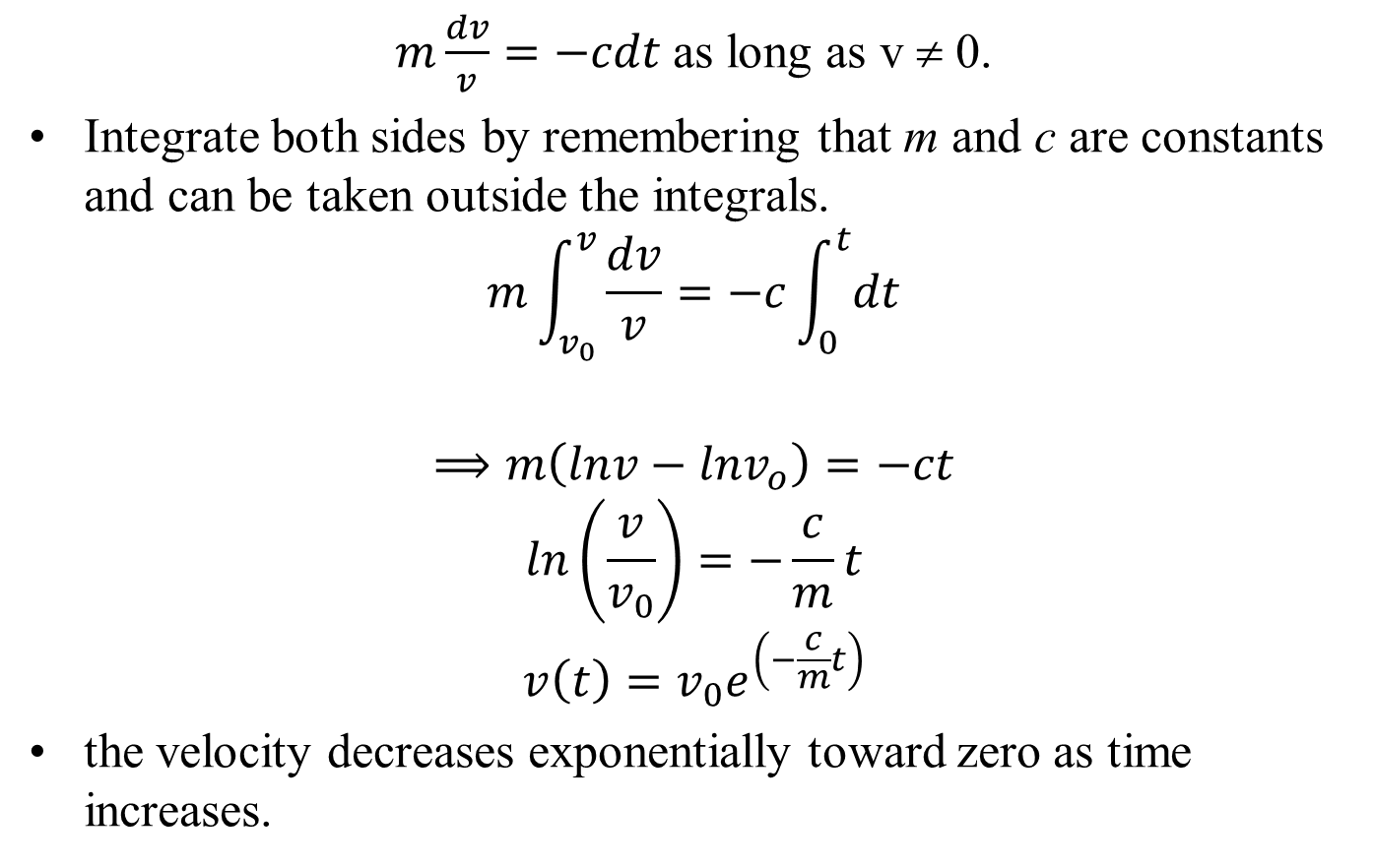
Kinetics of Particle Motion with Friction
$m\frac{dv}{v}=−cdt$as long as v ≠ 0.
Integrate both sides by remembering that m and c are constants and can be taken outside the integrals.
$$m\int_{v_{0}}^{v}{\frac{dv}{v}=−c\int_{0}^{t}{dt}}$$
$$⟹m\left(lnv−lnv_{o}\right)=−ct$$
$$ln\left(\frac{v}{v_{0}}\right)=−\frac{c}{m}t$$
$$v\left(t\right)=v_{0}e^{\left(−\frac{c}{m}t\right)}$$
the velocity decreases exponentially toward zero as time increases.

Slide 9
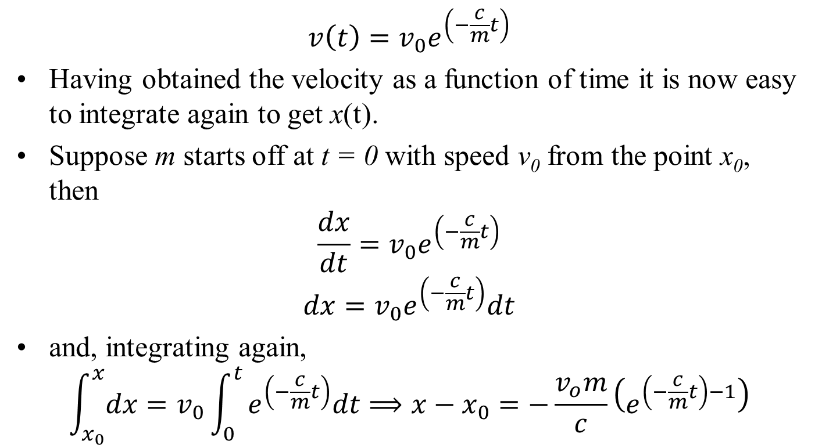
Kinetics of Particle Motion with Friction
$$v\left(t\right)=v_{0}e^{\left(−\frac{c}{m}t\right)}$$
Having obtained the velocity as a function of time it is now easy to integrate again to get x(t).
Suppose m starts off at t = 0 with speed v₀ from the point x₀, then
$$\frac{dx}{dt}=v_{0}e^{\left(−\frac{c}{m}t\right)}$$
$$dx=v_{0}e^{\left(−\frac{c}{m}t\right)}dt$$
and, integrating again,
$$\int_{x_{0}}^{x}{dx}=v_{0}\int_{0}^{t}{e^{\left(−\frac{c}{m}t\right)}dt⟹x−x_{0}=−\frac{v_{o}m}{c}\left(e^{\left(−\frac{c}{m}t\right)−1}\right)}$$

Slide 10
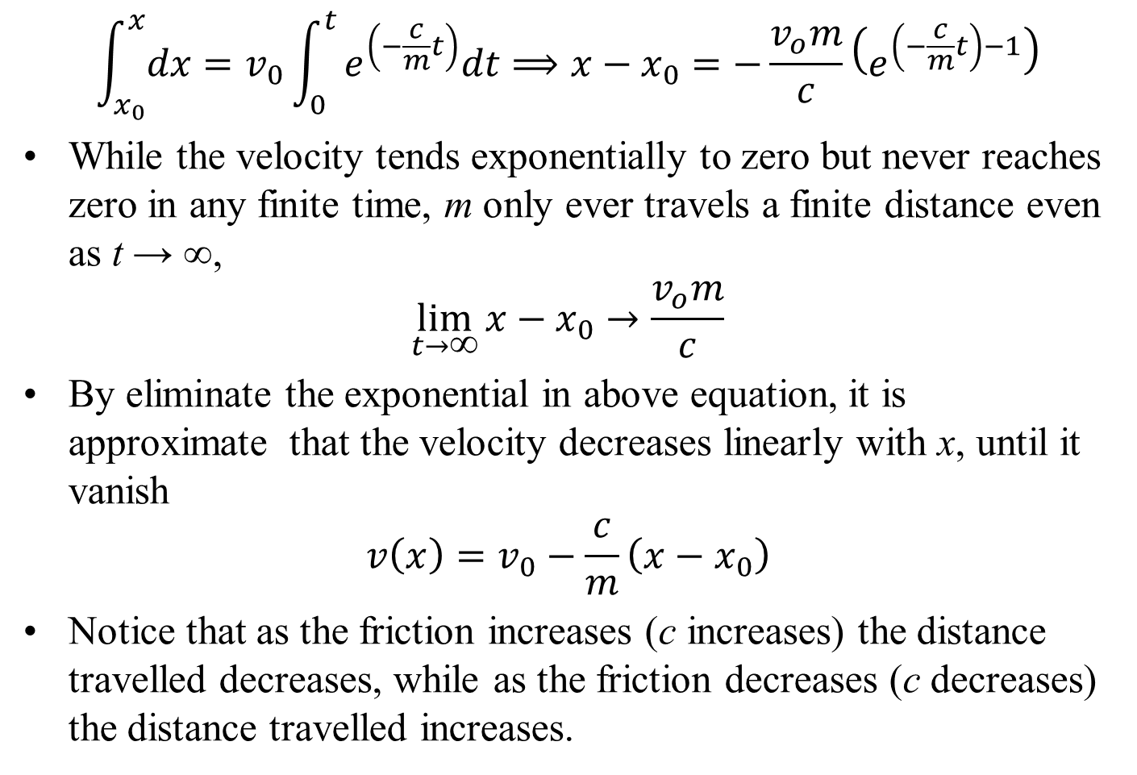
Kinetics of Particle Motion with Friction
$$\int_{x_{0}}^{x}{dx}=v_{0}\int_{0}^{t}{e^{\left(−\frac{c}{m}t\right)}dt⟹x−x_{0}=−\frac{v_{o}m}{c}\left(e^{\left(−\frac{c}{m}t\right)−1}\right)}$$
While the velocity tends exponentially to zero but never reaches zero in any finite time, m only ever travels a finite distance even as t → ∞,
$$\lim_{t→\text{∞}}{x−x_{0}}→\frac{v_{o}m}{c}$$
By eliminate the exponential in above equation, it is approximate that the velocity decreases linearly with x, until it vanish
$$v\left(x\right)=v_{0}−\frac{c}{m}\left(x−x_{0}\right)$$
Notice that as the friction increases (c increases) the distance travelled decreases, while as the friction decreases (c decreases) the distance travelled increases.

Slide 11
Force Supporting the Particle Motions against Friction…

Slide 12
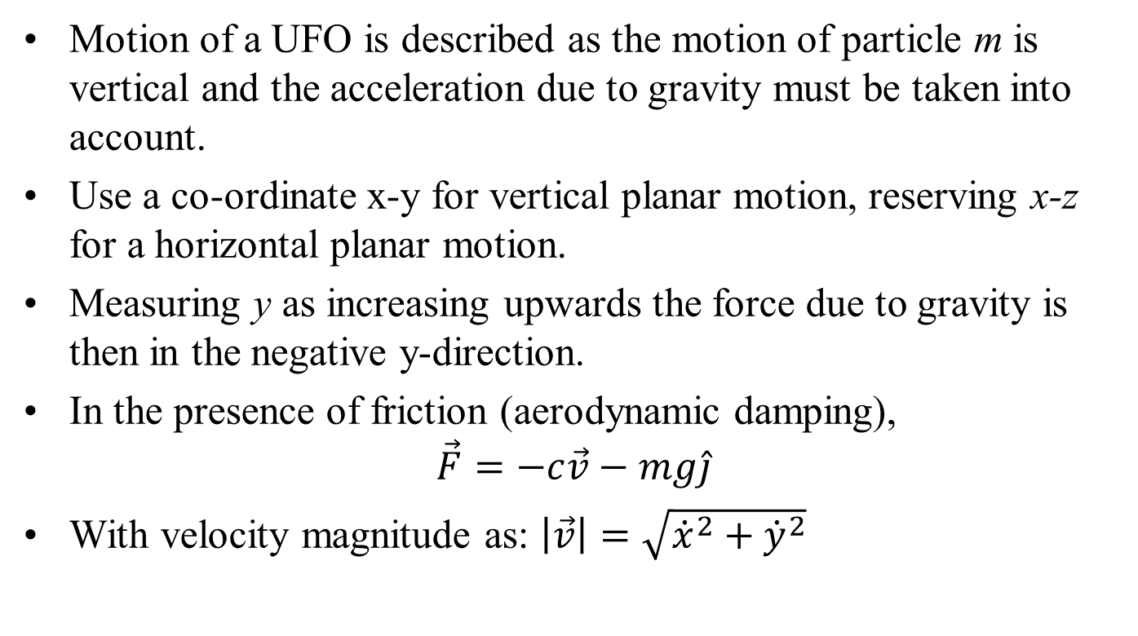
Kinematics of UFOs
Motion of a UFO is described as the motion of particle m is vertical and the acceleration due to gravity must be taken into account.
Use a co-ordinate x-y for vertical planar motion, reserving x-z for a horizontal planar motion.
Measuring y as increasing upwards the force due to gravity is then in the negative y-direction.
In the presence of friction (aerodynamic damping),
$$\vec{F}=−c\vec{v}−mg\hat{j}$$
With velocity magnitude as: $\left|\vec{v}\right|=\sqrt{{\dot{x}}^{2}+{\dot{y}}^{2}}$

Slide 13
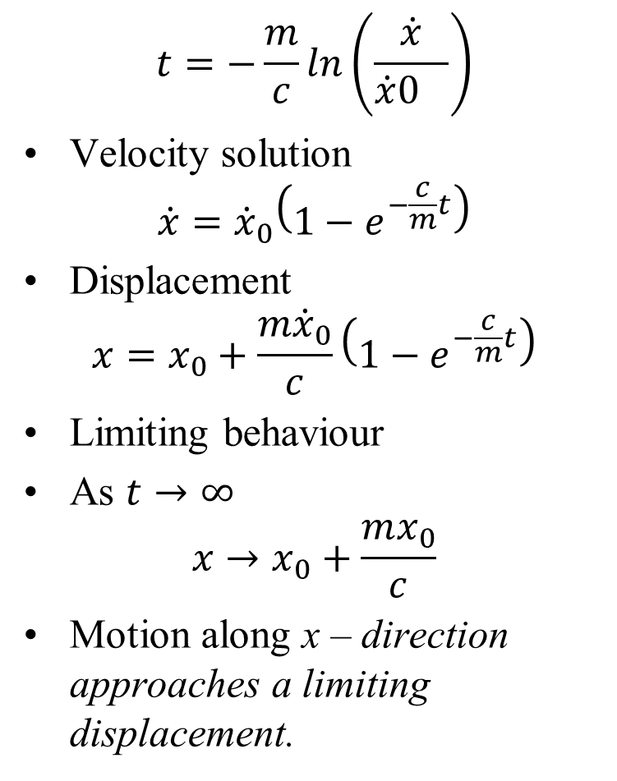
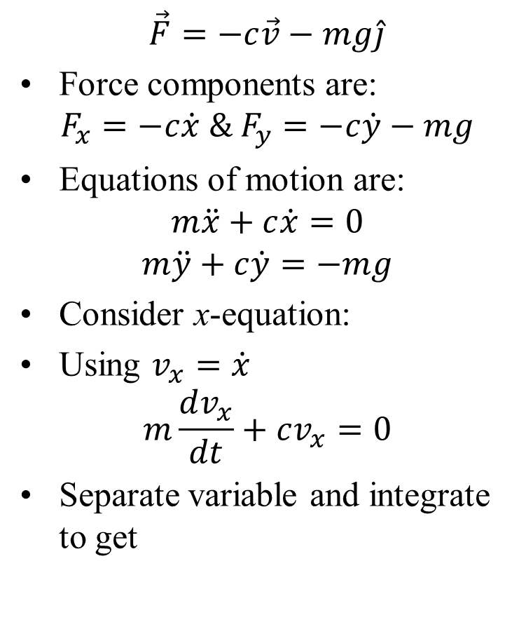
Kinematics of UFOs
$$\vec{F}=−c\vec{v}−mg\hat{j}$$
Force components are:
$$F_{x}=−c\dot{x} \& F_{y}=−c\dot{y}−mg$$
Equations of motion are:
$$m\ddot{x}+c\dot{x}=0$$
$$m\ddot{y}+c\dot{y}=−mg$$
Consider x-equation:
Using $v_{x}=\dot{x}$
$$m\frac{dv_{x}}{dt}+cv_{x}=0$$
Separate variable and integrate to get
$$t=−\frac{m}{c}ln\left(\frac{\dot{x}}{{\dot{x}0}_{}}\right)$$
Velocity solution
$$\dot{x}={\dot{x}}_{0}\left(1−e^{−\frac{c}{m}t}\right)$$
Displacement
$$x=x_{0}+\frac{m{\dot{x}}_{0}}{c}\left(1−e^{−\frac{c}{m}t}\right)$$
Limiting behaviour
As $t→∞$
$$x→x_{0}+\frac{mx_{0}}{c}$$
Motion along x – direction approaches a limiting displacement.

Slide 14
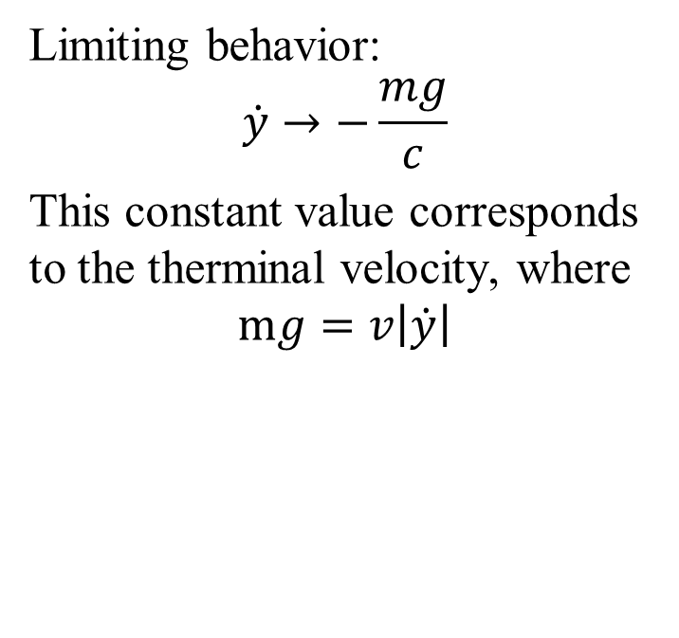
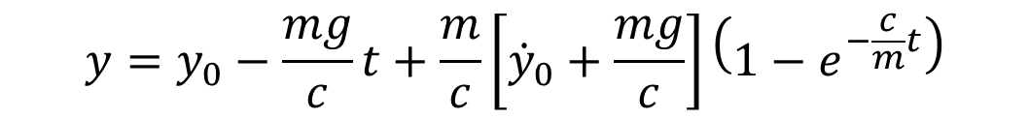
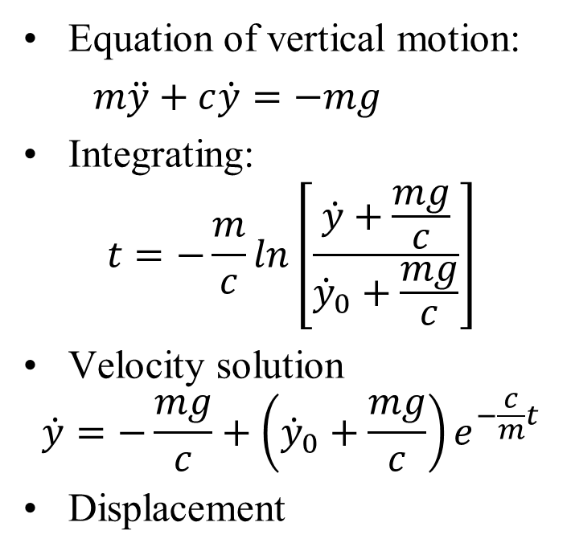
Solution to Vertical Motion of UFO
Equation of vertical motion:
$m\ddot{y}+c\dot{y}=−mg$
Integrating:
$$t=−\frac{m}{c}ln\left[\frac{\dot{y}+\frac{mg}{c}}{{\dot{y}}_{0}+\frac{mg}{c}}\right]$$
Velocity solution
$$\dot{y}=−\frac{mg}{c}+\left({\dot{y}}_{0}+\frac{mg}{c}\right)e^{−\frac{c}{m}t}$$
Displacement
Limiting behavior:
$$\dot{y}→−\frac{mg}{c}$$
This constant value corresponds to the therminal velocity, where
$$mg=v\left|\dot{y}\right|$$
Gravity balances aerodynamic damping
$$y=y_{0}−\frac{mg}{c}t+\frac{m}{c}\left[{\dot{y}}_{0}+\frac{mg}{c}\right]\left(1−e^{−\frac{c}{m}t}\right)$$

Slide 15
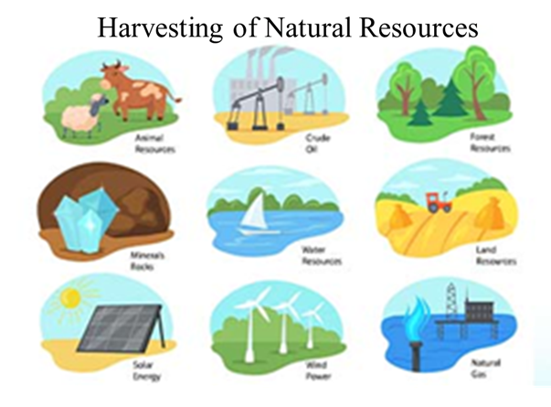
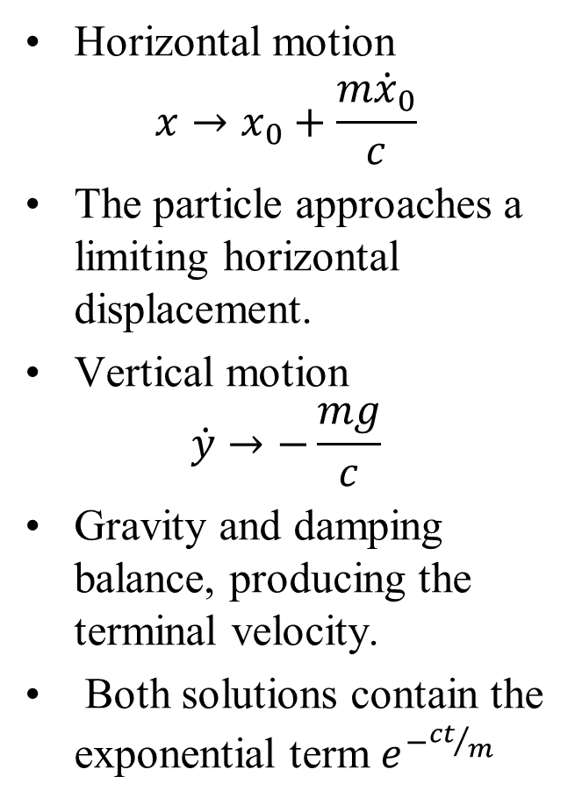
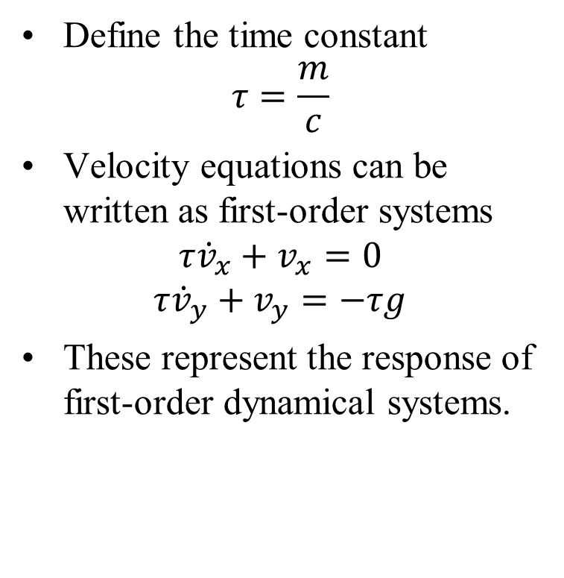
First Order Dynamical Systems
Horizontal motion
$$x→x_{0}+\frac{m{\dot{x}}_{0}}{c}$$
The particle approaches a limiting horizontal displacement.
Vertical motion
$$\dot{y}→−\frac{mg}{c}$$
Gravity and damping balance, producing the terminal velocity.
Both solutions contain the exponential term $e^{−{ct}/m}$
Define the time constant
$$τ=\frac{m}{c}$$
Velocity equations can be written as first-order systems
$$τ{\dot{v}}_{x}+v_{x}=0$$
$$τ{\dot{v}}_{y}+v_{y}=−τg$$
These represent the response of first-order dynamical systems.

Slide 16
Mechanistic Perspective of Universe
Work & Energy

Slide 17
Philosophy of Energy & Work
The concept of energy is generally credited to Aristotle’s enérgeia (ἐνέργειά).
This word was having no direct translation into English except for “being at work”.
Aristotle’s concept of work grew from Empedocles’s thoughts on the basic elements of all matter: earth, water, air, fire and quintessence.
Fire was characterized as the driver behind his thoughts and understanding leading to the concept of enérgeia.
Aristotle’s concepts remained in vogue for nearly two thousand years before The Age of Enlightenment in European science began to take prominence in creating a new paradigm to understand energy.

Slide 18
Philosophy of Energy & Work
The first of these developments was in 1669 by Christian Huygens, who recognized that in a specific collision between two hardwood spheres (close to an elastic collision).
He observed that the product of mass times the square of the speed was conserved along with what became known as momentum.
This discovery is credited as the origin of the modern concepts of mechanical energy, specifically kinetic energy.
Huygens’s name for his discovery was not energy but vis viva (living force).
A couple of decades later, Gottfried Wilhelm von Leibniz in 1686 became the first to quantify the concept of vis-viva as the product of mass times the square of the speed.

Slide 19
Modern Philosophy of Energy & Work
The name “energy” was popularized by William Thomson, Lord Kelvin (1824 - 1907) and William J. M. Rankine (1820-1872) as the concept of force was integrated to act across other related phenomena.
18th Century Power: John Smeaton in 1759 defined "power" as the ability to lift a weight over a specific height in a given time, close to the modern definition.
19th Century Formalization:
French mathematicians Gaspard-Gustave Coriolis and Jean-Victor Poncelet independently defined "work" in the late 1820s to calculate the efficiency of machines and steam engines.
They established it as force applied over a distance.

Slide 20
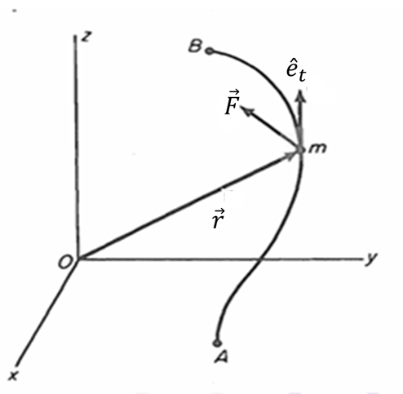
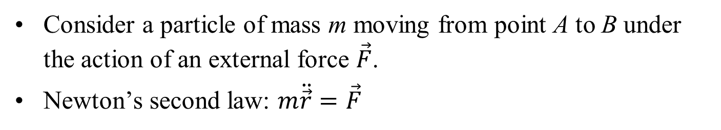
Work and Kinetic Energy
Work–Energy Principle:
The increase in kinetic energy of a particle between two points is equal to the work done by external forces acting on the particle.
Consider a particle of mass m moving from point A to B under the action of an external force $\vec{F}$.
Newton’s second law: $m\ddot{\vec{r}}=\vec{F}$

Slide 21
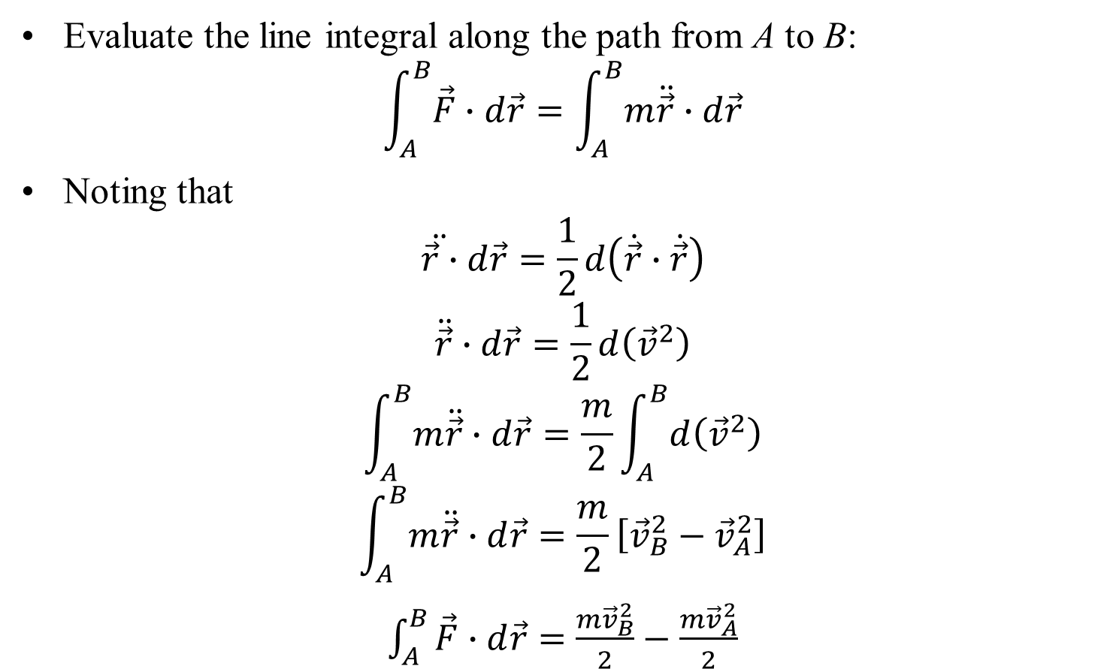
Derivation of the Work–Energy Relation
Evaluate the line integral along the path from A to B:
$$\int_{A}^{B}{\vec{F}∙d\vec{r}}=\int_{A}^{B}{m\ddot{\vec{r}}∙d\vec{r}}$$
Noting that
$$\ddot{\vec{r}∙}d\vec{r}=\frac{1}{2}d\left(\dot{\vec{r}}∙\dot{\vec{r}}\right)$$
$$\ddot{\vec{r}}∙d\vec{r}=\frac{1}{2}d\left({\vec{v}}^{2}\right)$$
$$\int_{A}^{B}{m\ddot{\vec{r}}∙d\vec{r}}=\frac{m}{2}\int_{A}^{B}{d\left({\vec{v}}^{2}\right)}$$
$$\int_{A}^{B}{m\ddot{\vec{r}}∙d\vec{r}}=\frac{m}{2}\left[{\vec{v}}_{B}^{2}−{\vec{v}}_{A}^{2}\right]$$
$\int_{A}^{B}{\vec{F}∙d\vec{r}}=$ $\frac{m{\vec{v}}_{B}^{2}}{2}−\frac{m{\vec{v}}_{A}^{2}}{2}$

Slide 22
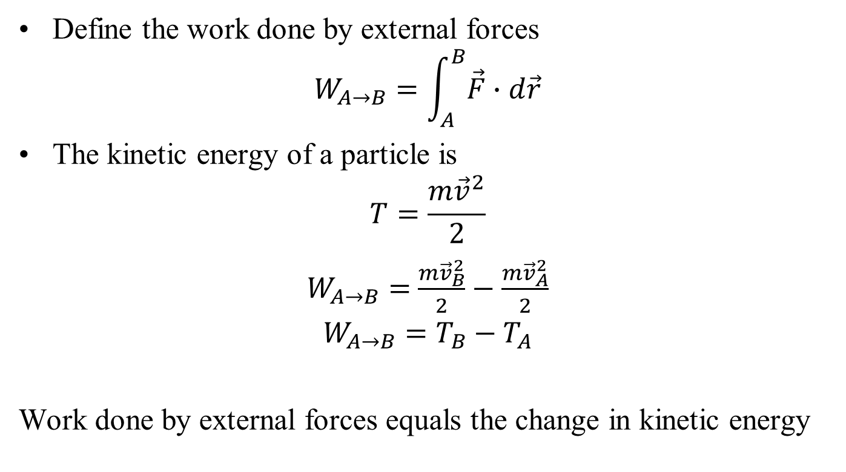
Work–Energy Theorem
Define the work done by external forces
$$W_{A→B}=\int_{A}^{B}{\vec{F}∙d\vec{r}}$$
The kinetic energy of a particle is
$$T=\frac{m{\vec{v}}^{2}}{2}$$
$W_{A→B}=$ $\frac{m{\vec{v}}_{B}^{2}}{2}−\frac{m{\vec{v}}_{A}^{2}}{2}$
$$W_{A→B}=T_{B}−T_{A}$$
Work done by external forces equals the change in kinetic energy

Slide 23
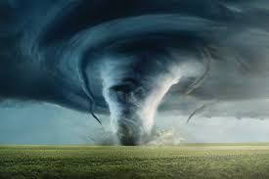
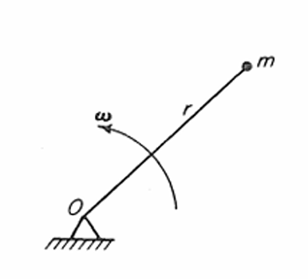
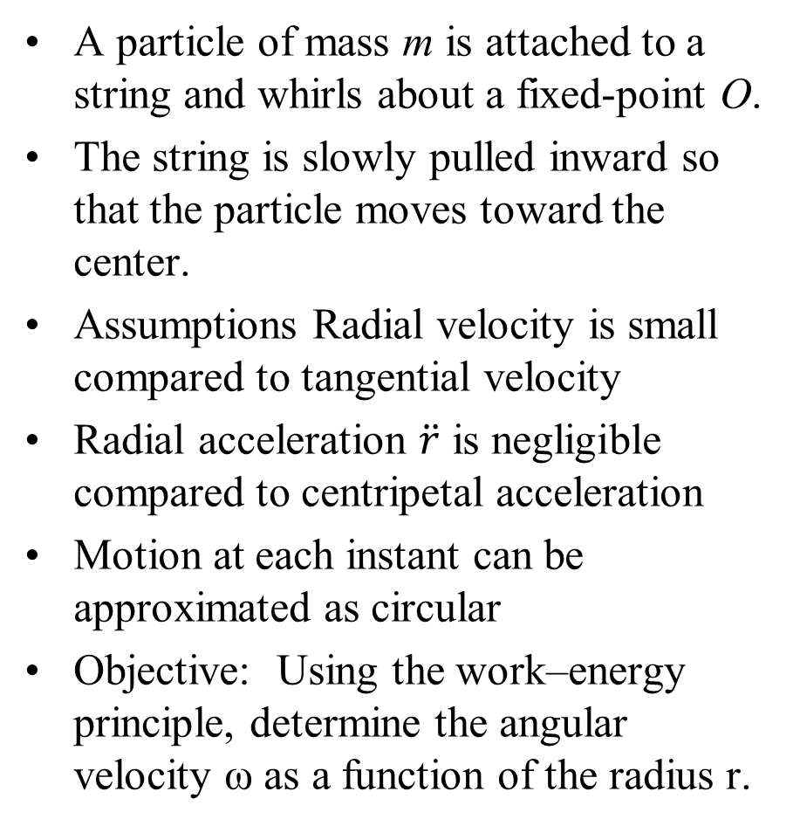
Work–Energy Theorem : Whirling Particle
A particle of mass m is attached to a string and whirls about a fixed-point O.
The string is slowly pulled inward so that the particle moves toward the center.
Assumptions Radial velocity is small compared to tangential velocity
Radial acceleration $\ddot{r}$ is negligible compared to centripetal acceleration
Motion at each instant can be approximated as circular
Objective: Using the work–energy principle, determine the angular velocity ω as a function of the radius r.

Slide 24
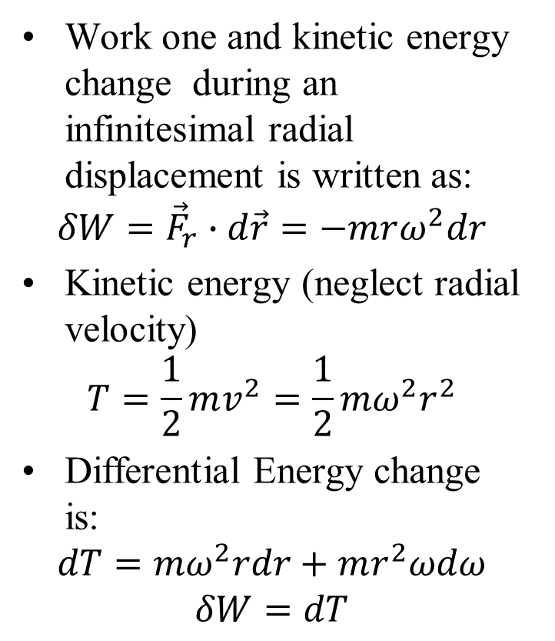
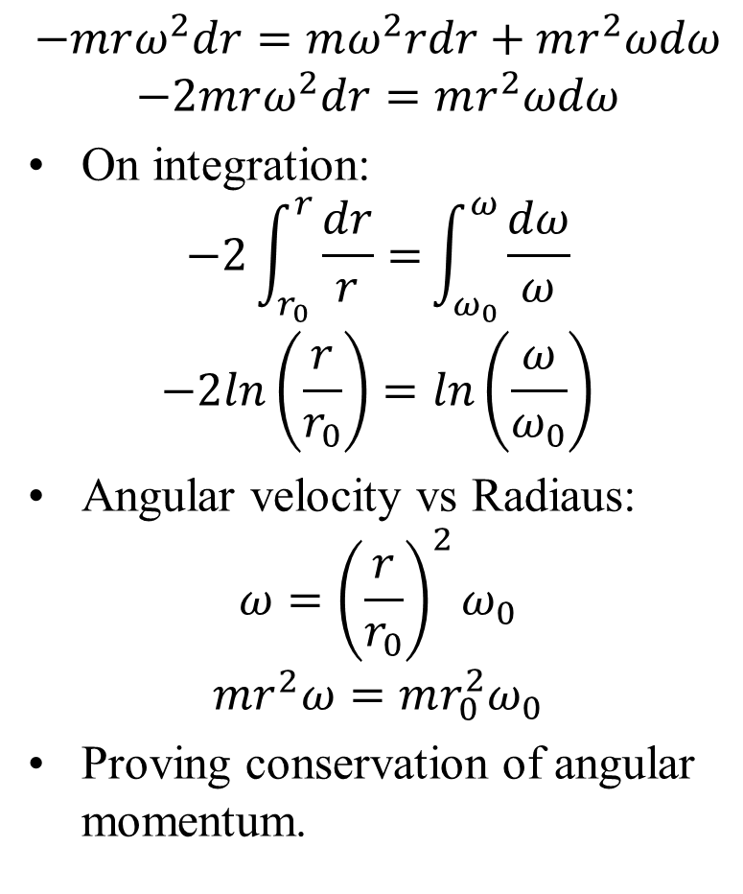
Work–Energy Solution : Whirling Particle
Work one and kinetic energy change during an infinitesimal radial displacement is written as:
$$δW={\vec{F}}_{r}∙d\vec{r}=−mrω^{2}dr$$
Kinetic energy (neglect radial velocity)
$$T=\frac{1}{2}mv^{2}=\frac{1}{2}mω^{2}r^{2}$$
Differential Energy change is:
$$dT=mω^{2}rdr+mr^{2}ωdω$$
$$δW=dT$$
$$−mrω^{2}dr=mω^{2}rdr+mr^{2}ωdω$$
$$−2mrω^{2}dr=mr^{2}ωdω$$
On integration:
$$−2\int_{r_{0}}^{r}{\frac{dr}{r}=}\int_{ω_{0}}^{ω}{\frac{dω}{ω}}$$
$$−2ln\left(\frac{r}{r_{0}}\right)=ln\left(\frac{ω}{ω_{0}}\right)$$
Angular velocity vs Radiaus:
$$ω={\left(\frac{r}{r_{0}}\right)}^{2}ω_{0}$$
$$mr^{2}ω=mr_{0}^{2}ω_{0}$$
Proving conservation of angular momentum.

Slide 25
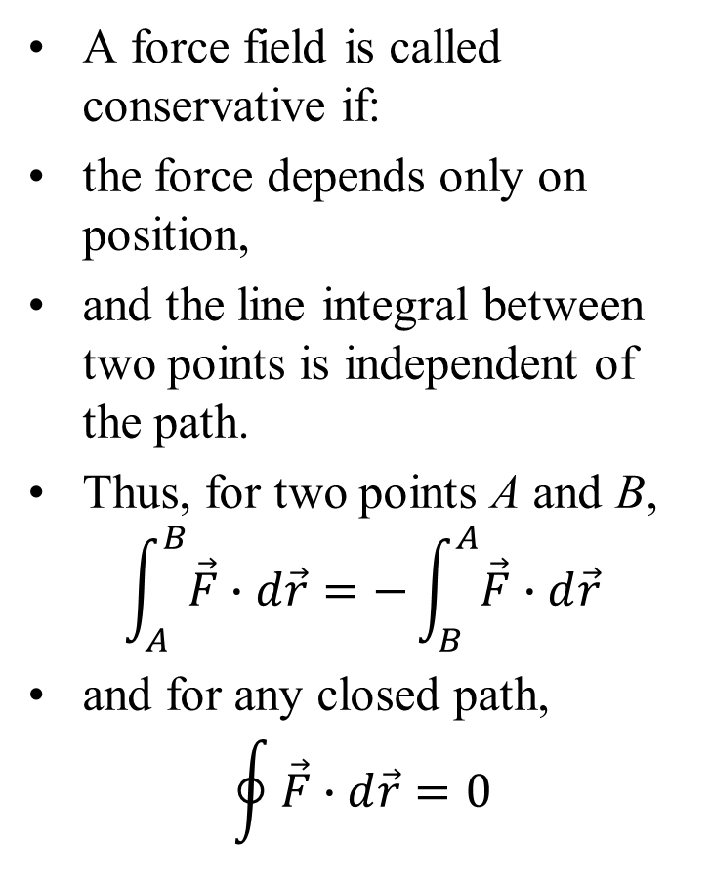
Conservative Systems
A force field is called conservative if:
the force depends only on position,
and the line integral between two points is independent of the path.
Thus, for two points A and B,
$$\int_{A}^{B}{\vec{F}∙d\vec{r}}=−\int_{B}^{A}{\vec{F}∙d\vec{r}}$$
and for any closed path,
$$\oint{\vec{F}∙d\vec{r}}=0$$
This means the work done depends only on the end points, not on the path taken.
A force satisfying these conditions forms a conservative force field.
Such systems are non-dissipative and mechanically reversible.

Slide 26
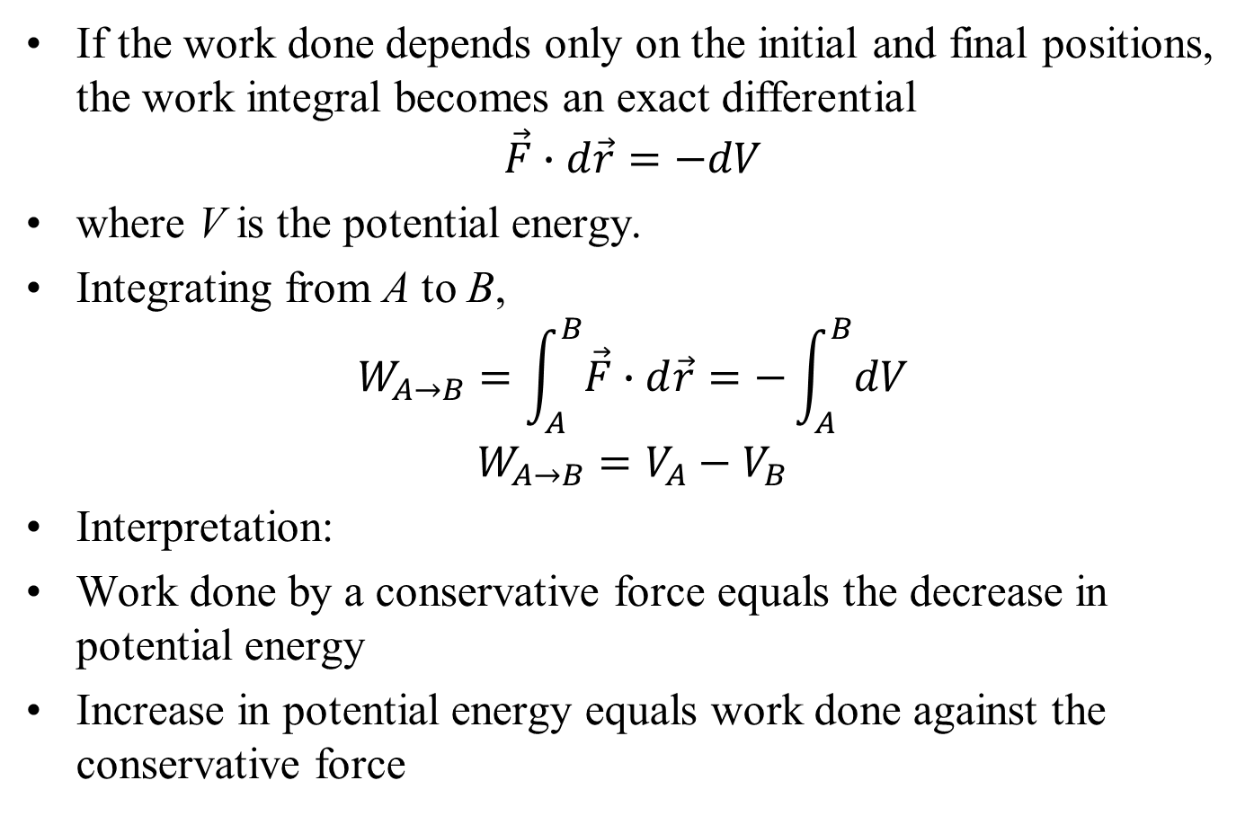
Potential Energy and Work
If the work done depends only on the initial and final positions, the work integral becomes an exact differential
$$\vec{F}∙d\vec{r}=−dV$$
where V is the potential energy.
Integrating from A to B,
$$W_{A→B}=\int_{A}^{B}{\vec{F}∙d\vec{r}}=−\int_{A}^{B}{dV}$$
$$W_{A→B}=V_{A}−V_{B}$$
Interpretation:
Work done by a conservative force equals the decrease in potential energy
Increase in potential energy equals work done against the conservative force

Slide 27
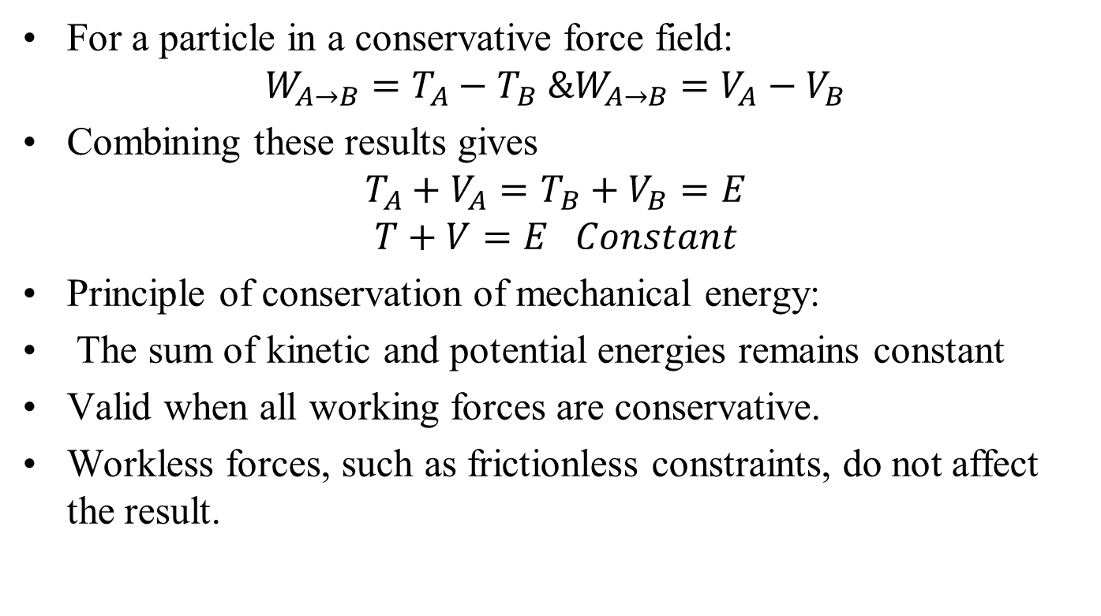
Conservation of Mechanical Energy
For a particle in a conservative force field:
$$W_{A→B}=T_{A}−T_{B} \&W_{A→B}=V_{A}−V_{B}$$
Combining these results gives
$$T_{A}+V_{A}=T_{B}+V_{B}=E$$
$$T+V=E Constant$$
Principle of conservation of mechanical energy:
The sum of kinetic and potential energies remains constant
Valid when all working forces are conservative.
Workless forces, such as frictionless constraints, do not affect the result.

Slide 28
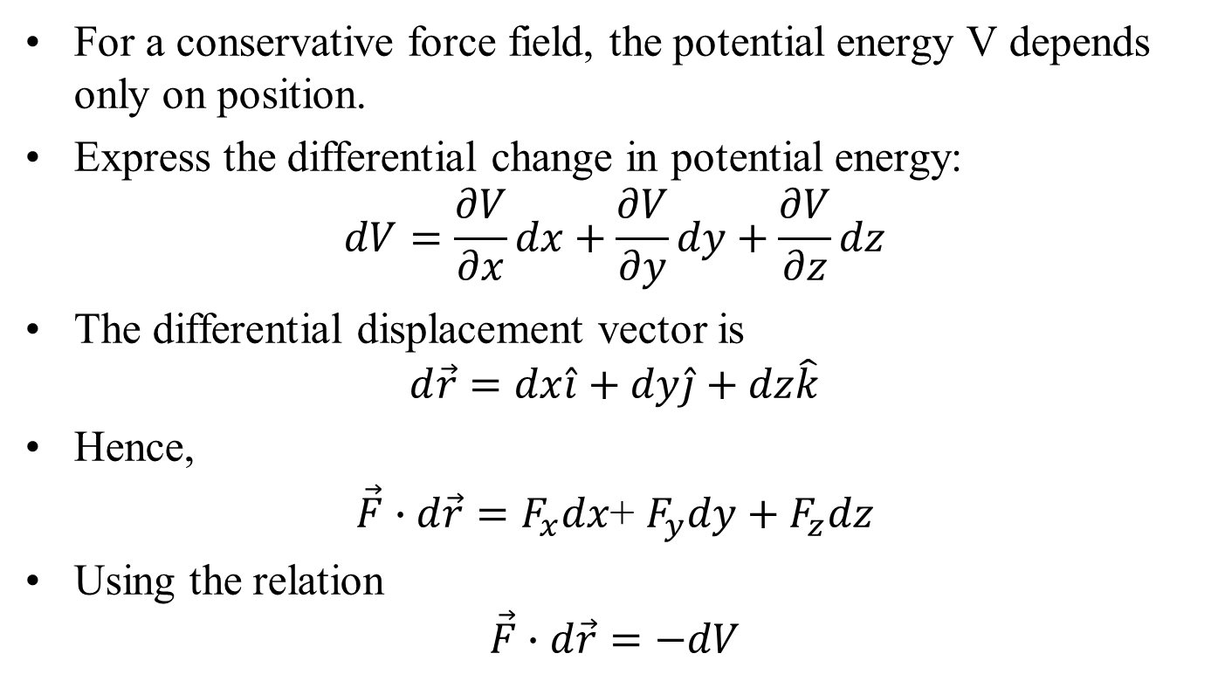
Potential Energy and Conservative Forces
For a conservative force field, the potential energy V depends only on position.
Express the differential change in potential energy:
$$dV=\frac{∂V}{∂x}dx+\frac{∂V}{∂y}dy+\frac{∂V}{∂z}dz$$
The differential displacement vector is
$$d\vec{r}=dx\hat{i}+dy\hat{j}+dz\hat{k}$$
Hence,
$\vec{F}∙d\vec{r}=F_{x}dx$+ $F_{y}dy+F_{z}dz$
Using the relation
$$\vec{F}∙d\vec{r}=−dV$$

Slide 29
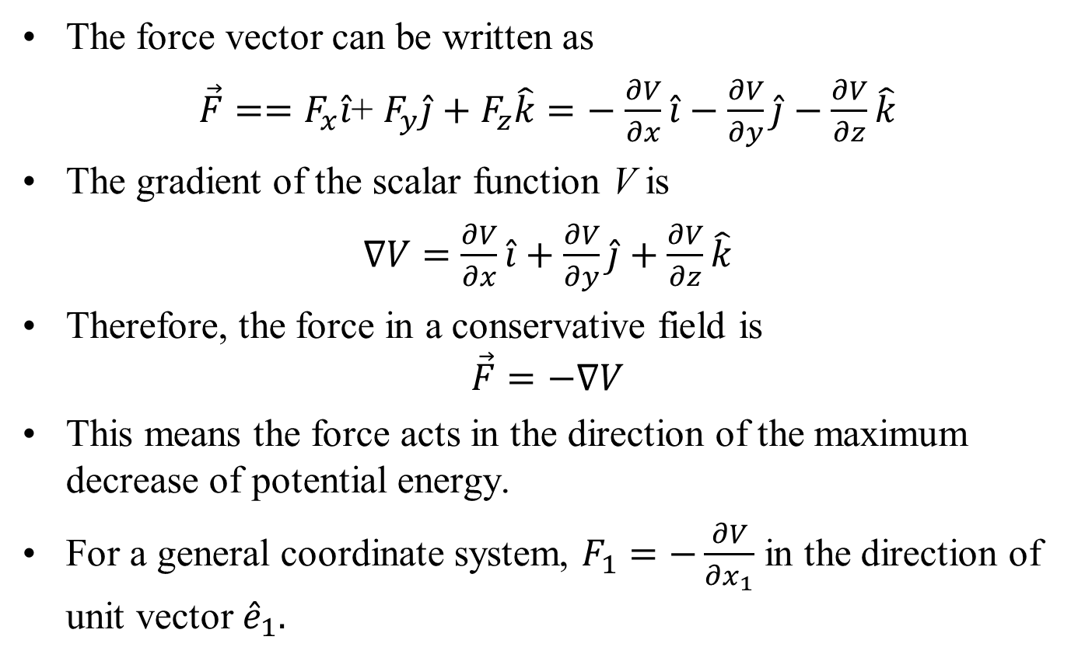
Force as the Gradient of Potential Energy
The force vector can be written as
$\vec{F}==F_{x}\hat{i}$+ $F_{y}\hat{j}+F_{z}\hat{k}=−$ $\frac{∂V}{∂x}\hat{i}−\frac{∂V}{∂y}\hat{j}−\frac{∂V}{∂z}\hat{k}$
The gradient of the scalar function V is
$∇V=$ $\frac{∂V}{∂x}\hat{i}+\frac{∂V}{∂y}\hat{j}+\frac{∂V}{∂z}\hat{k}$
Therefore, the force in a conservative field is
$$\vec{F}=−∇V$$
This means the force acts in the direction of the maximum decrease of potential energy.
For a general coordinate system, $F_{1}=−\frac{∂V}{∂x_{1}}$ in the direction of unit vector ${\hat{e}}_{1}.$

Slide 30
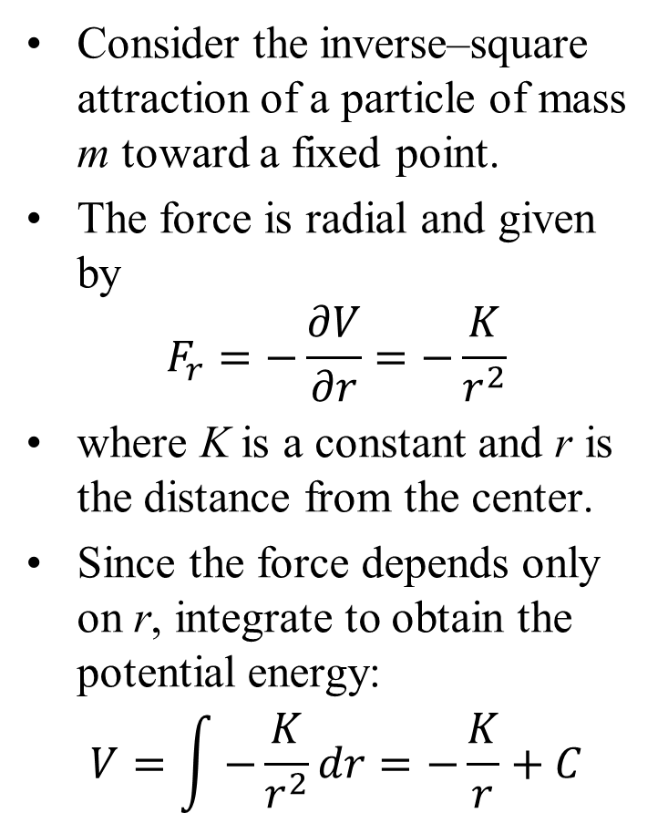
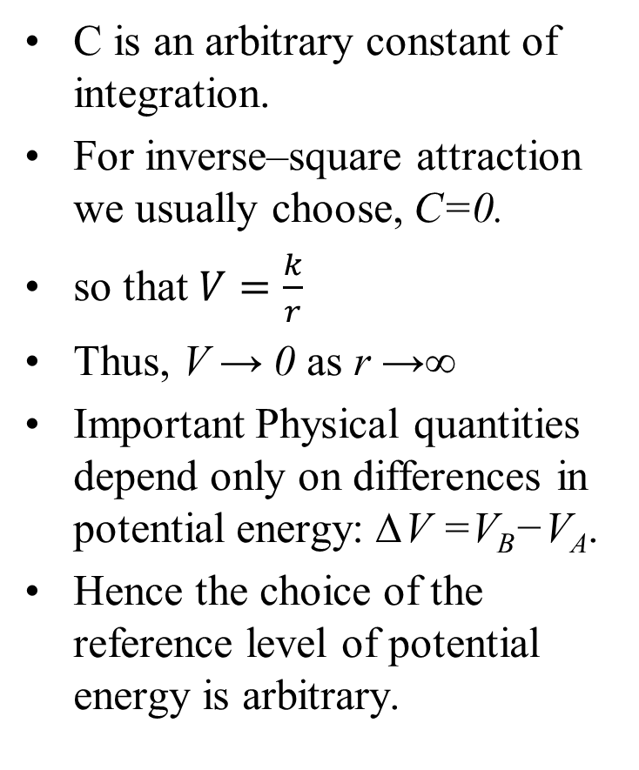
Inverse–Square Potential Energy
Consider the inverse–square attraction of a particle of mass m toward a fixed point.
The force is radial and given by
$$F_{r}=−\frac{∂V}{∂r}=−\frac{K}{r^{2}}$$
where K is a constant and r is the distance from the center.
Since the force depends only on r, integrate to obtain the potential energy:
$$V=\int{−\frac{K}{r^{2}}dr}=−\frac{K}{r}+C$$
C is an arbitrary constant of integration.
For inverse–square attraction we usually choose, C=0.
so that $V=\frac{k}{r}$
Thus, V → 0 as r →∞
Important Physical quantities depend only on differences in potential energy: ∆V =V_{B}−V_{A}.
Hence the choice of the reference level of potential energy is arbitrary.

Slide 31
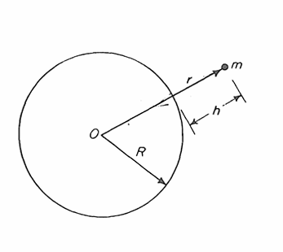
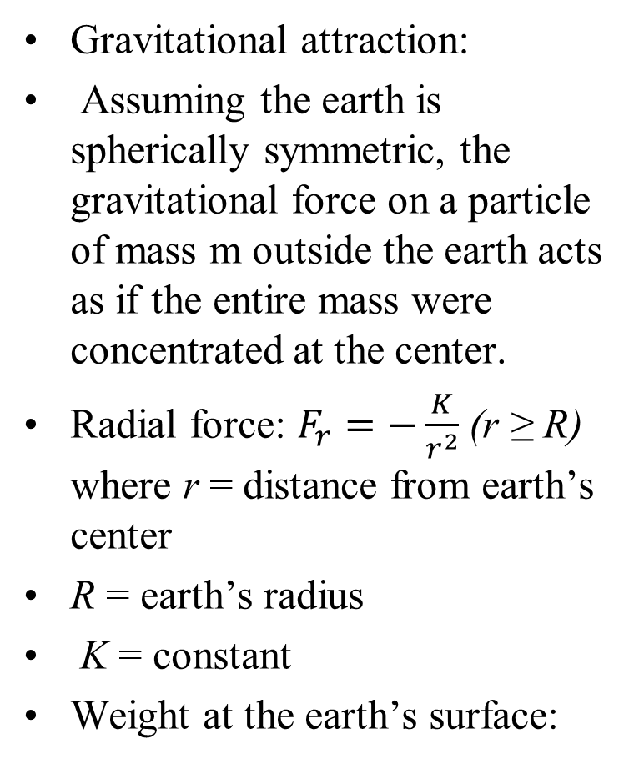
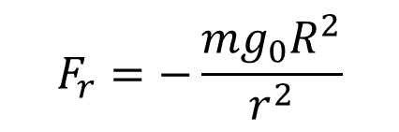
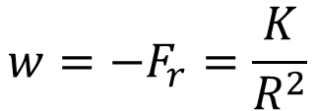
Gravitational Potential Energy
Gravitational attraction:
Assuming the earth is spherically symmetric, the gravitational force on a particle of mass m outside the earth acts as if the entire mass were concentrated at the center.
Radial force: $F_{r}=−\frac{K}{r^{2}}$ (r ≥ R) where r = distance from earth’s center
R = earth’s radius
K = constant
Weight at the earth’s surface:
$$w=−F_{r}=\frac{K}{R^{2}}$$
But also w = mg₀
Thus, K = mg₀R²
Substituting into the force law
$$F_{r}=−\frac{mg_{0}R^{2}}{r^{2}}$$

Slide 32
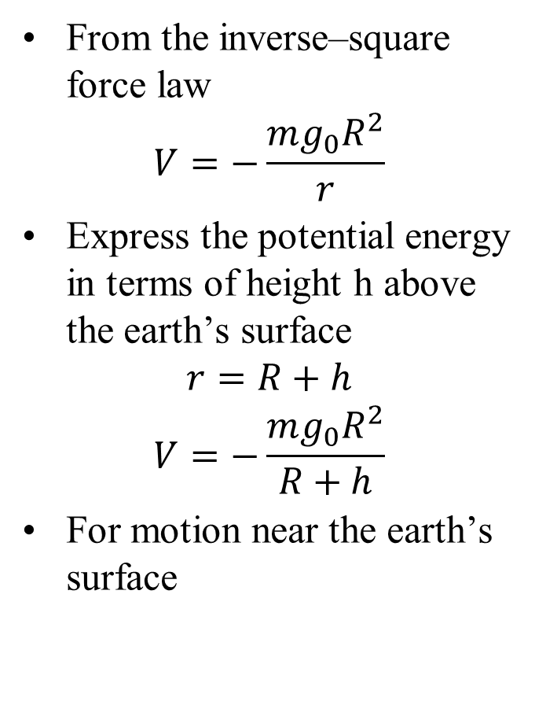
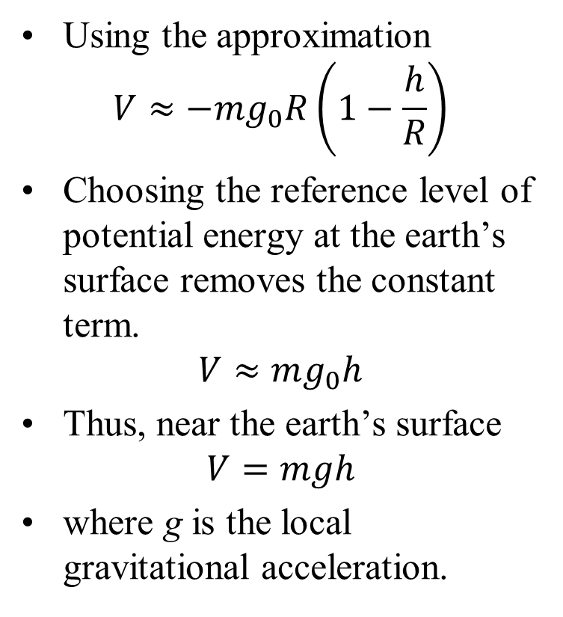
Gravitational Potential Energy
From the inverse–square force law
$$V=−\frac{mg_{0}R^{2}}{r}$$
Express the potential energy in terms of height h above the earth’s surface
$$r=R+h$$
$$V=−\frac{mg_{0}R^{2}}{R+h}$$
For motion near the earth’s surface
Using the approximation
$$V≈−mg_{0}R\left(1−\frac{h}{R}\right)$$
Choosing the reference level of potential energy at the earth’s surface removes the constant term.
$$V≈mg_{0}h$$
Thus, near the earth’s surface
$$V=mgh$$
where g is the local gravitational acceleration.

