Slide 1


Equation of Motion for A Particle & Force Functions
P M V Subbarao
Professor & Head
Mechanical Engineering Department
Qualities of Forces to Generate A Motion…

Slide 2

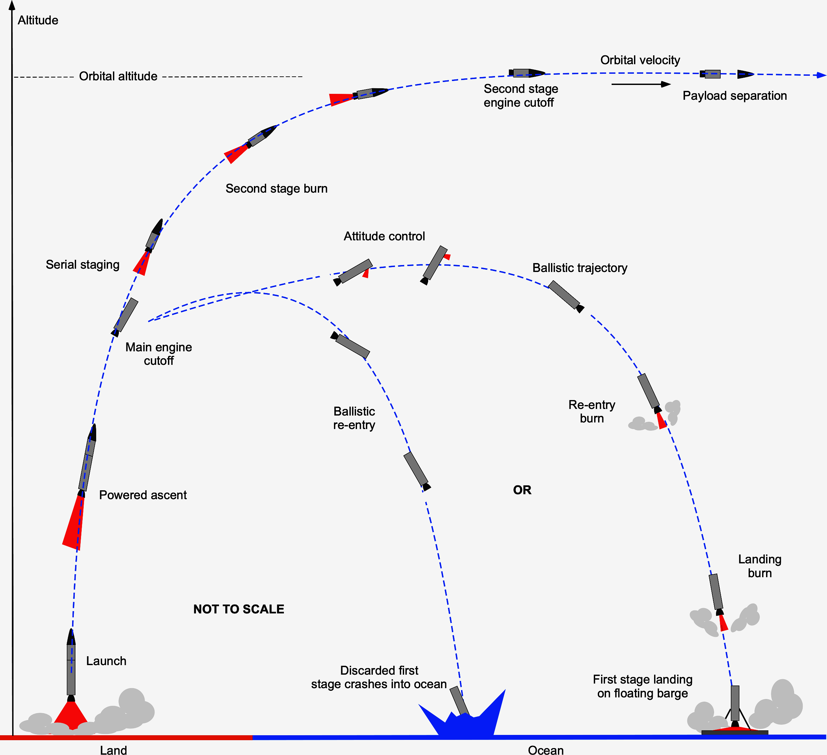
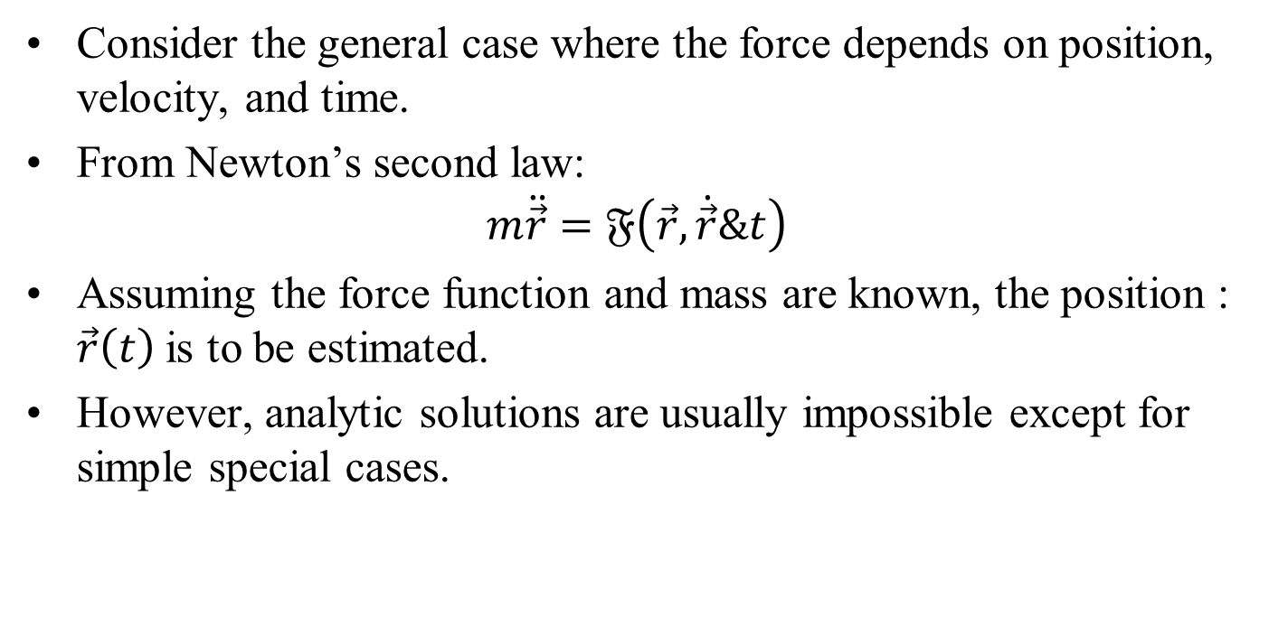
Equation of Motion of a Particle
Consider the general case where the force depends on position, velocity, and time.
From Newton’s second law:
$$m\ddot{\vec{r}}=𝔉\left(\vec{r},\dot{\vec{r}}\&t\right)$$
Assuming the force function and mass are known, the position : $\vec{r}\left(t\right)$is to be estimated.
However, analytic solutions are usually impossible except for simple special cases.

Slide 3
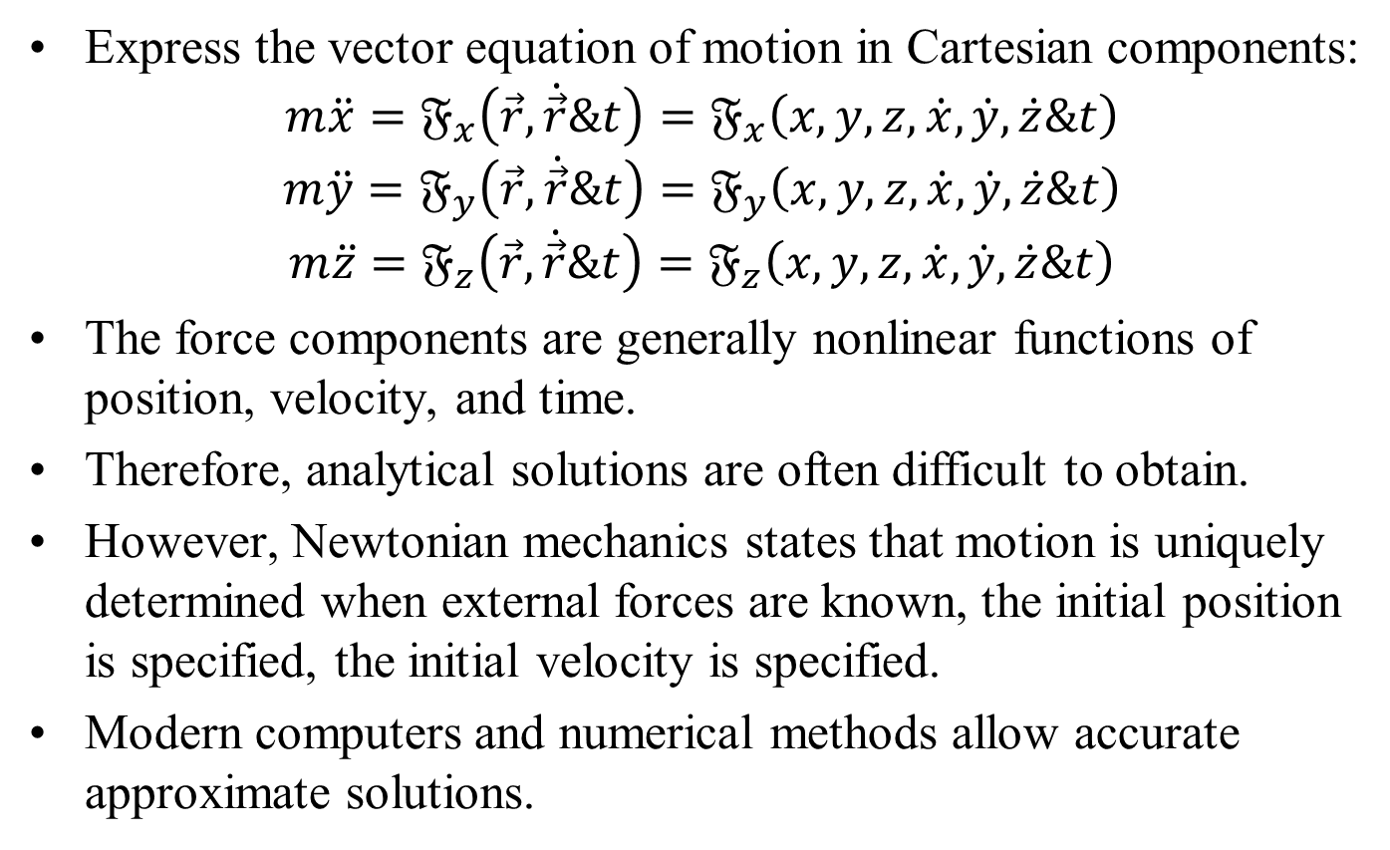
Equation of Motion of a Particle: Cartesian Form
Express the vector equation of motion in Cartesian components:
$$m\ddot{x}=𝔉_{x}\left(\vec{r},\dot{\vec{r}}\&t\right)=𝔉_{x}\left(x,y,z,\dot{x},\dot{y},\dot{z}\&t\right)$$
$$m\ddot{y}=𝔉_{y}\left(\vec{r},\dot{\vec{r}}\&t\right)=𝔉_{y}\left(x,y,z,\dot{x},\dot{y},\dot{z}\&t\right)$$
$$m\ddot{z}=𝔉_{z}\left(\vec{r},\dot{\vec{r}}\&t\right)=𝔉_{z}\left(x,y,z,\dot{x},\dot{y},\dot{z}\&t\right)$$
The force components are generally nonlinear functions of position, velocity, and time.
Therefore, analytical solutions are often difficult to obtain.
However, Newtonian mechanics states that motion is uniquely determined when external forces are known, the initial position is specified, the initial velocity is specified.
Modern computers and numerical methods allow accurate approximate solutions.

Slide 4
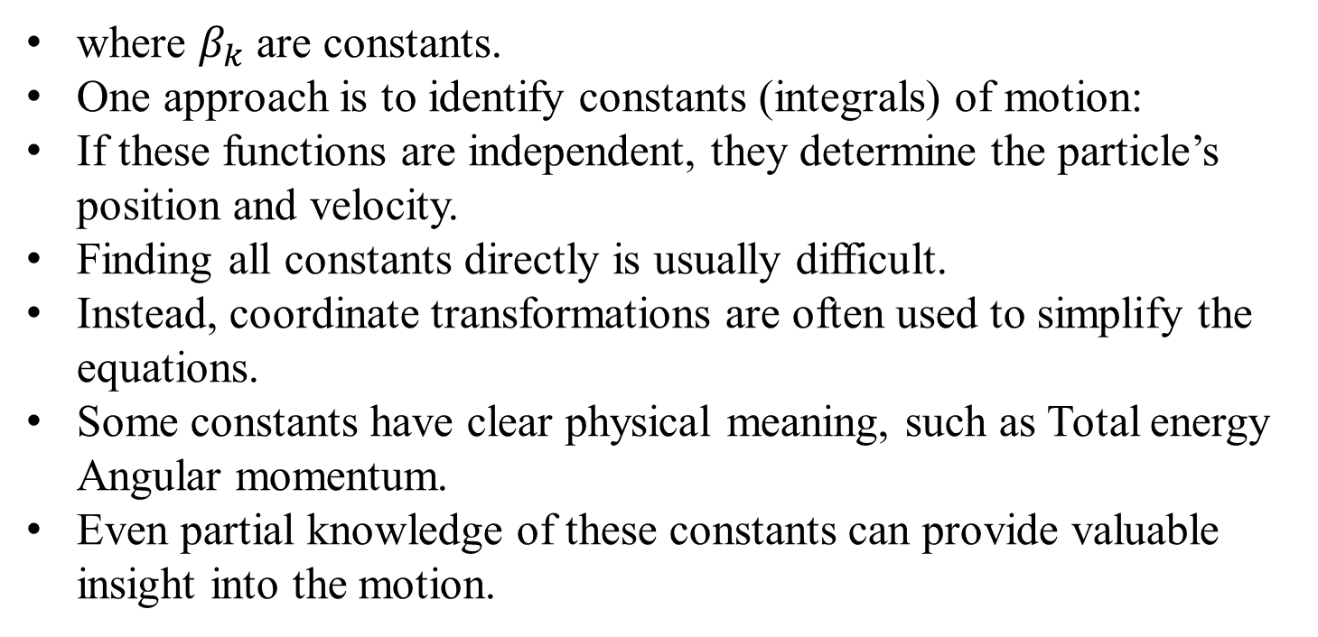
Constants of Motion
A general analytical solution contains six arbitrary constants, determined by six initial conditions.
$$𝔉_{k}\left(x,y,z,\dot{x},\dot{y},\dot{z}\&t\right)=β_{k} k=1,2,3,…6$$
where $β_{k}$ are constants.
One approach is to identify constants (integrals) of motion:
If these functions are independent, they determine the particle’s position and velocity.
Finding all constants directly is usually difficult.
Instead, coordinate transformations are often used to simplify the equations.
Some constants have clear physical meaning, such as Total energy Angular momentum.
Even partial knowledge of these constants can provide valuable insight into the motion.

Slide 5
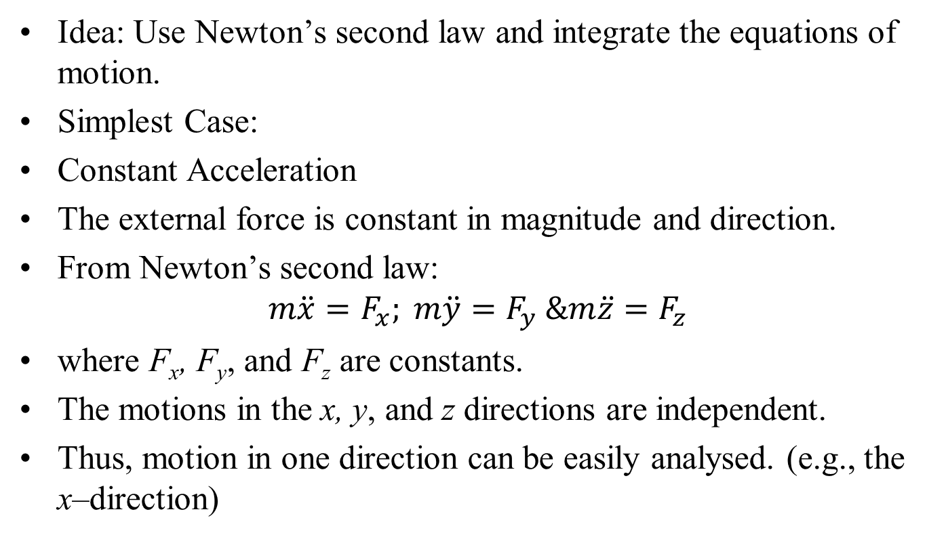
Direct Integration of the Equations of Motion
Idea: Use Newton’s second law and integrate the equations of motion.
Simplest Case:
Constant Acceleration
The external force is constant in magnitude and direction.
From Newton’s second law:
$$m\ddot{x}=F_{x}; m\ddot{y}=F_{y} \&m\ddot{z}=F_{z}$$
where F_{x}, F_{y}, and F_{z} are constants.
The motions in the x, y, and z directions are independent.
Thus, motion in one direction can be easily analysed. (e.g., the x–direction)

Slide 6
Kinematic of A Particle with One-Dimensional Motion

Slide 7
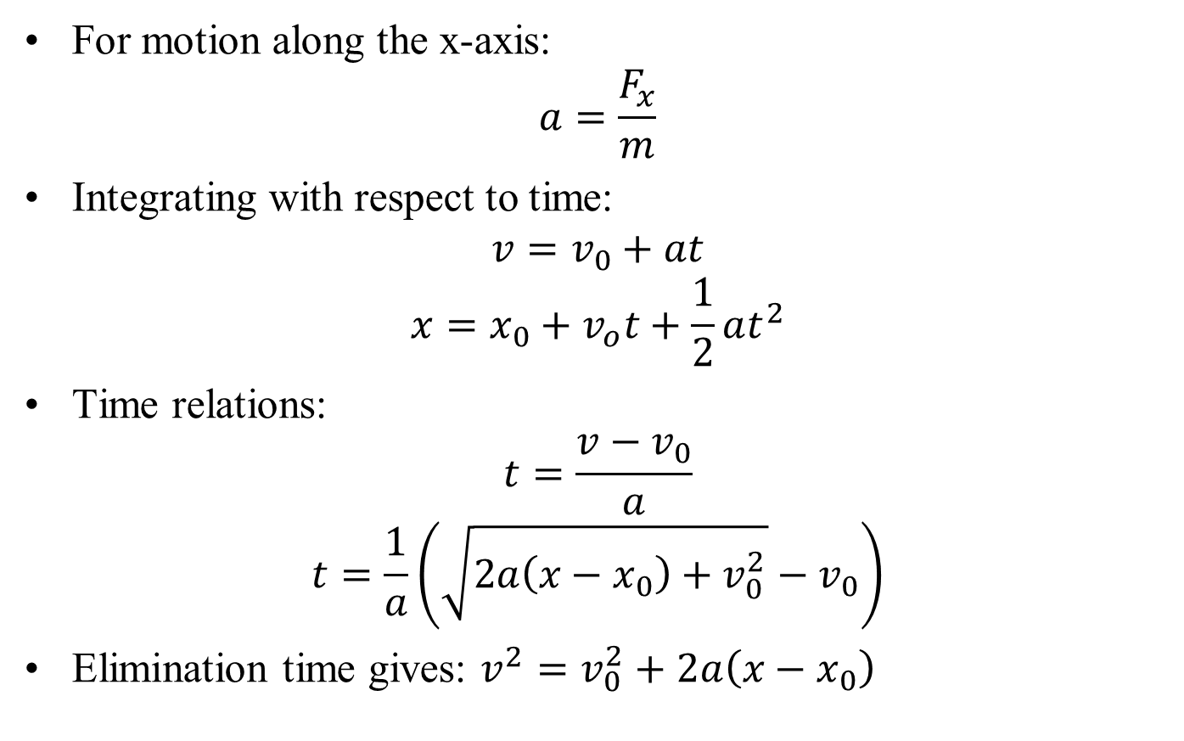
One-Dimensional Motion with Constant Acceleration
For motion along the x-axis:
$$a=\frac{F_{x}}{m}$$
Integrating with respect to time:
$$v=v_{0}+at$$
$$x=x_{0}+v_{o}t+\frac{1}{2}at^{2}$$
Time relations:
$$t=\frac{v−v_{0}}{a}$$
$$t=\frac{1}{a}\left(\sqrt{2a\left(x−x_{0}\right)+v_{0}^{2}}−v_{0}\right)$$
Elimination time gives: $v^{2}=v_{0}^{2}+2a\left(x−x_{0}\right)$

Slide 8
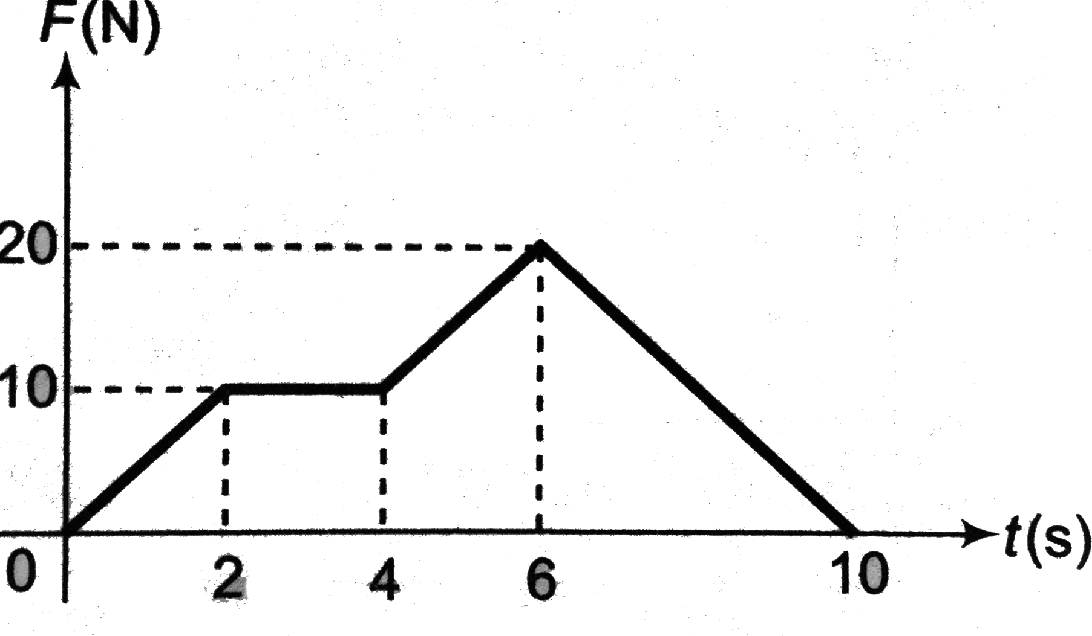
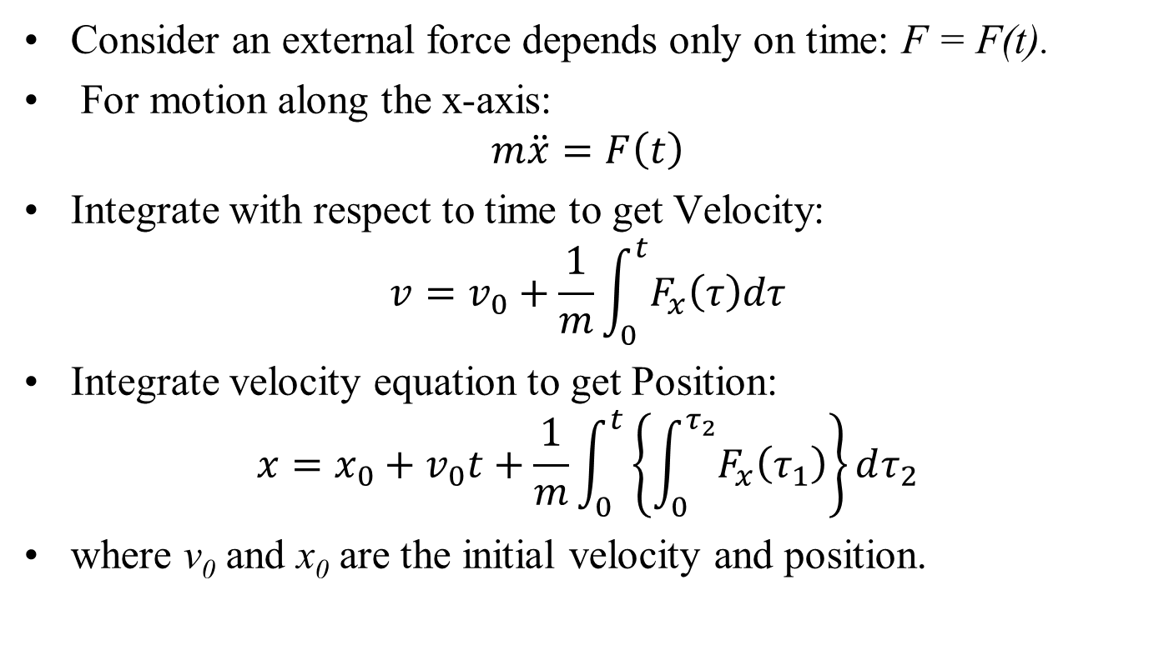
Particle Kinetics: Force as a Function of Time
Consider an external force depends only on time: F = F(t).
For motion along the x-axis:
$$m\ddot{x}=F\left(t\right)$$
Integrate with respect to time to get Velocity:
$$v=v_{0}+\frac{1}{m}\int_{0}^{t}{F_{x}\left(τ\right)dτ}$$
Integrate velocity equation to get Position:
$$x=x_{0}+v_{0}t+\frac{1}{m}\int_{0}^{t}{\left\{\int_{0}^{τ_{2}}{F_{x}\left(τ_{1}\right)}\right\}dτ_{2}}$$
where v₀ and x₀ are the initial velocity and position.

Slide 9
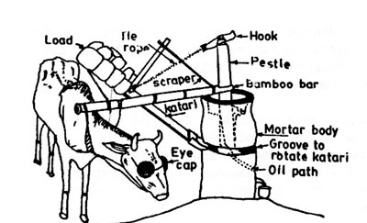
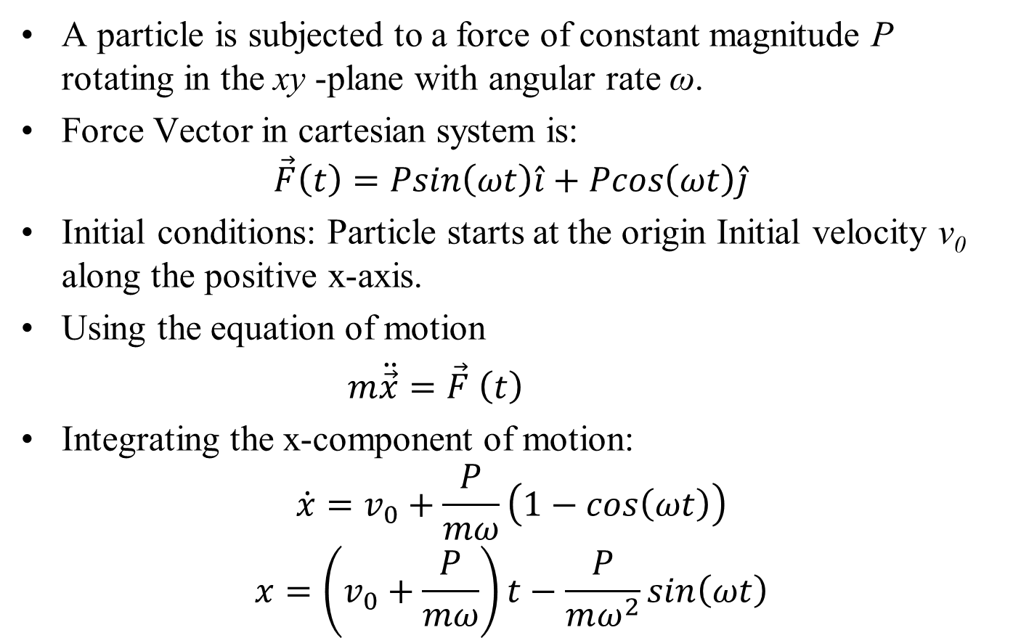
Particle Kinetics: Rotating Force
A particle is subjected to a force of constant magnitude P rotating in the xy -plane with angular rate ω.
Force Vector in cartesian system is:
$$\vec{F}\left(t\right)=Psin\left(ωt\right)\hat{i}+Pcos\left(ωt\right)\hat{j}$$
Initial conditions: Particle starts at the origin Initial velocity v₀ along the positive x-axis.
Using the equation of motion
$m\ddot{\vec{x}}=\vec{F}$ $\left(t\right)$
Integrating the x-component of motion:
$$\dot{x}=v_{0}+\frac{P}{mω}\left(1−cos\left(ωt\right)\right)$$
$$x=\left(v_{0}+\frac{P}{mω}\right)t−\frac{P}{mω^{2}}sin\left(ωt\right)$$

Slide 10
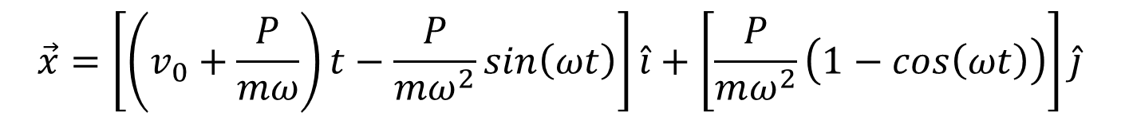

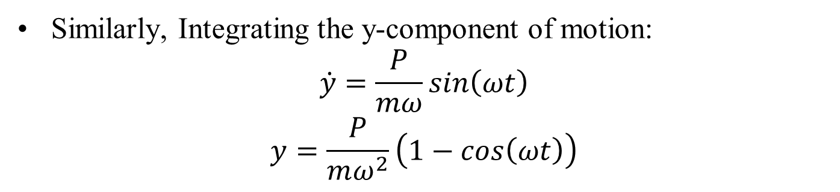
Particle Kinetics: Rotating Force
Similarly, Integrating the y-component of motion:
$$\dot{y}=\frac{P}{mω}sin\left(ωt\right)$$
$$y=\frac{P}{mω^{2}}\left(1−cos\left(ωt\right)\right)$$
$$∴ \vec{v}=\left[v_{0}+\frac{P}{mω}\left(1−cos\left(ωt\right)\right)\right]\hat{i}+\left[\frac{P}{mω}sin\left(ωt\right)\right]\hat{j}$$
$$\vec{x}=\left[\left(v_{0}+\frac{P}{mω}\right)t−\frac{P}{mω^{2}}sin\left(ωt\right)\right]\hat{i}+\left[\frac{P}{mω^{2}}\left(1−cos\left(ωt\right)\right)\right]\hat{j}$$

Slide 11
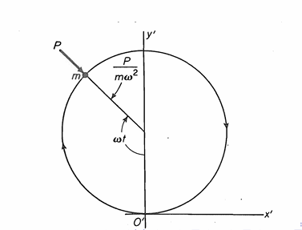
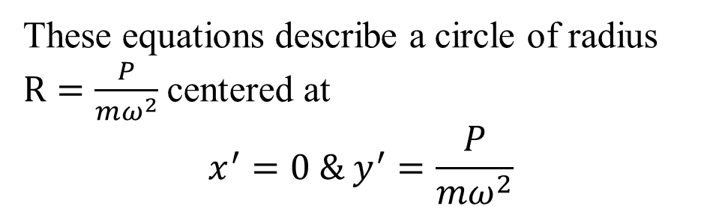
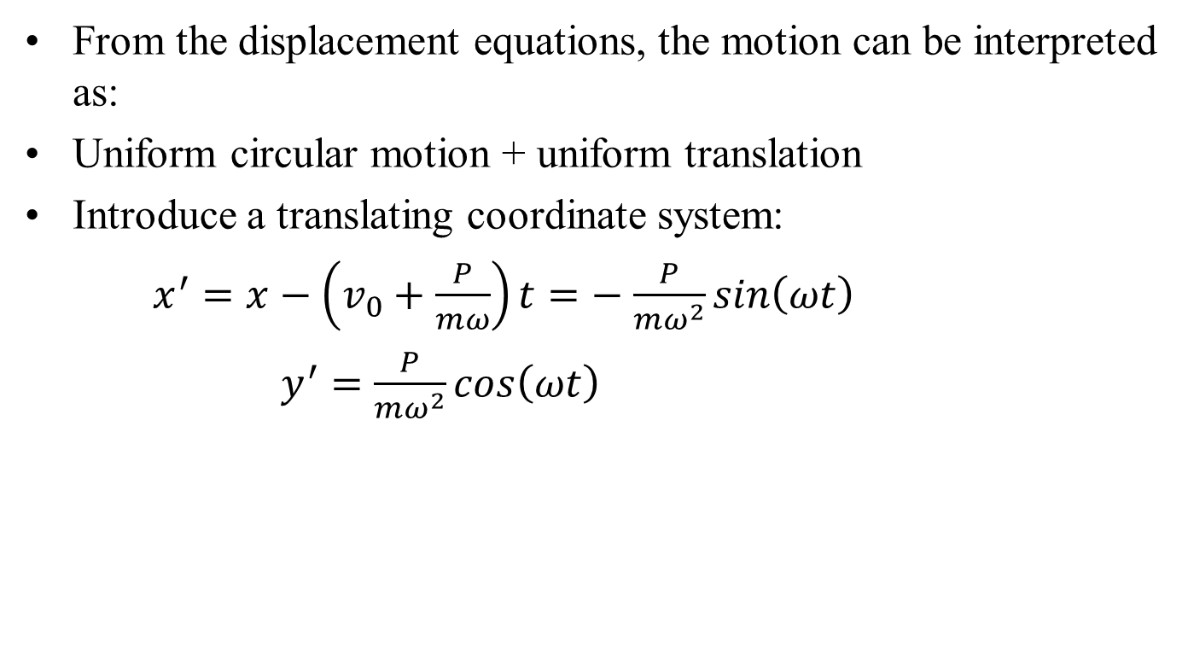
Nature of the Motion
From the displacement equations, the motion can be interpreted as:
Uniform circular motion + uniform translation
Introduce a translating coordinate system:
$x^{′}=x−\left(v_{0}+\frac{P}{mω}\right)t=−$ $\frac{P}{mω^{2}}sin\left(ωt\right)$
$y^{′}=$ $\frac{P}{mω^{2}}cos\left(ωt\right)$
These equations describe a circle of radius $R=\frac{P}{mω^{2}}$centered at
$$x^{′}=0 \& y^{′}=\frac{P}{mω^{2}}$$

Slide 12

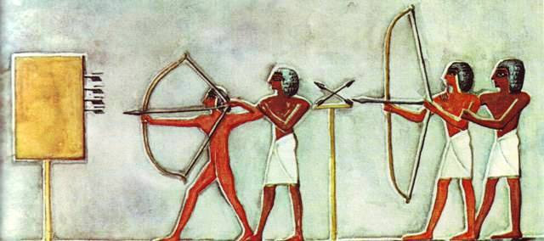
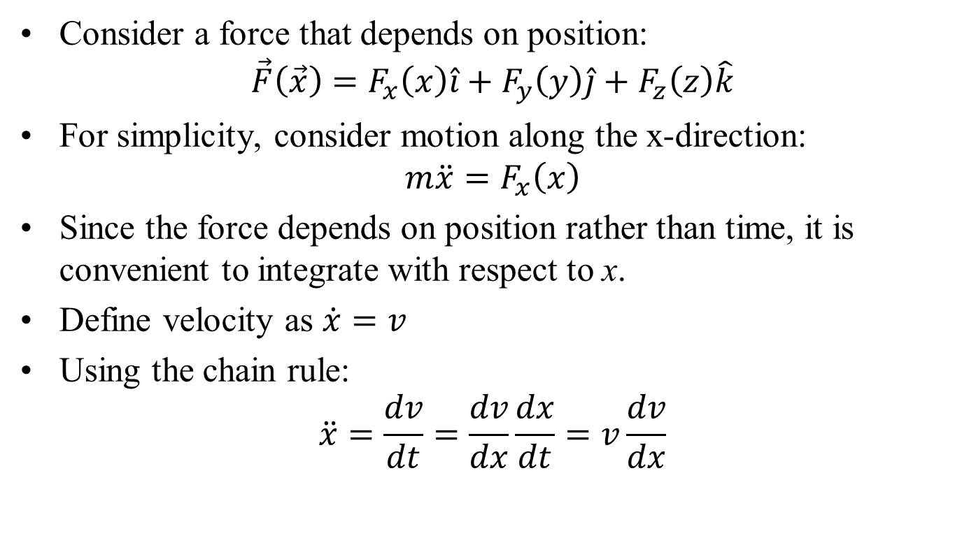
Particle Kinetics: Force as function of Position
Consider a force that depends on position:
$$\vec{F}\left(\vec{x}\right)=F_{x}\left(x\right)\hat{i}+F_{y}\left(y\right)\hat{j}+F_{z}\left(z\right)\hat{k}$$
For simplicity, consider motion along the x-direction:
$$m\ddot{x}=F_{x}\left(x\right)$$
Since the force depends on position rather than time, it is convenient to integrate with respect to x.
Define velocity as $\dot{x}=v$
Using the chain rule:
$$\ddot{x}=\frac{dv}{dt}=\frac{dv}{dx}\frac{dx}{dt}=v\frac{dv}{dx}$$

Slide 13
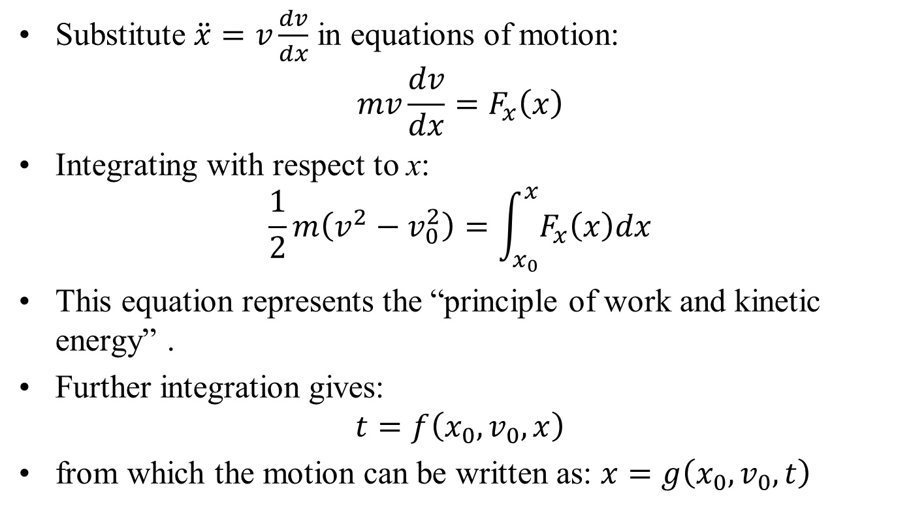
Integration of the Equation of Motion
Substitute $\ddot{x}=v\frac{dv}{dx}$ in equations of motion:
$$mv\frac{dv}{dx}=F_{x}\left(x\right)$$
Integrating with respect to x:
$$\frac{1}{2}m\left(v^{2}−v_{0}^{2}\right)=\int_{x_{0}}^{x}{F_{x}\left(x\right)dx}$$
This equation represents the “principle of work and kinetic energy” .
Further integration gives:
$$t=f\left(x_{0},v_{0},x\right)$$
from which the motion can be written as: $x=g\left(x_{0},v_{0},t\right)$

