Slide 1


Kinematics of Connected Rigid Bodies
P M V Subbarao
Professor & Head
Mechanical Engineering Department
Creation of Machines with Mechanical Advantage…

Slide 2

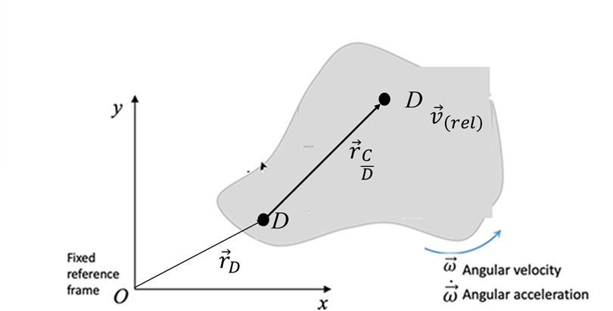
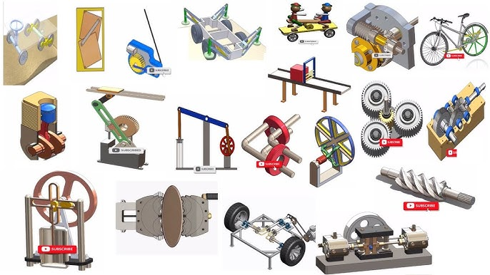
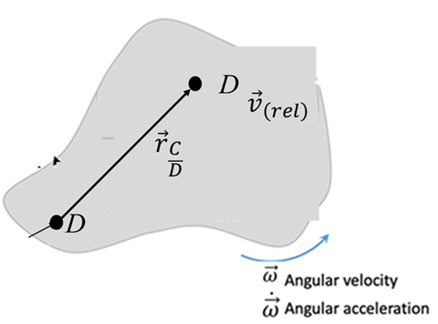

Engineering with Connection of Rigid Bodies

Slide 3
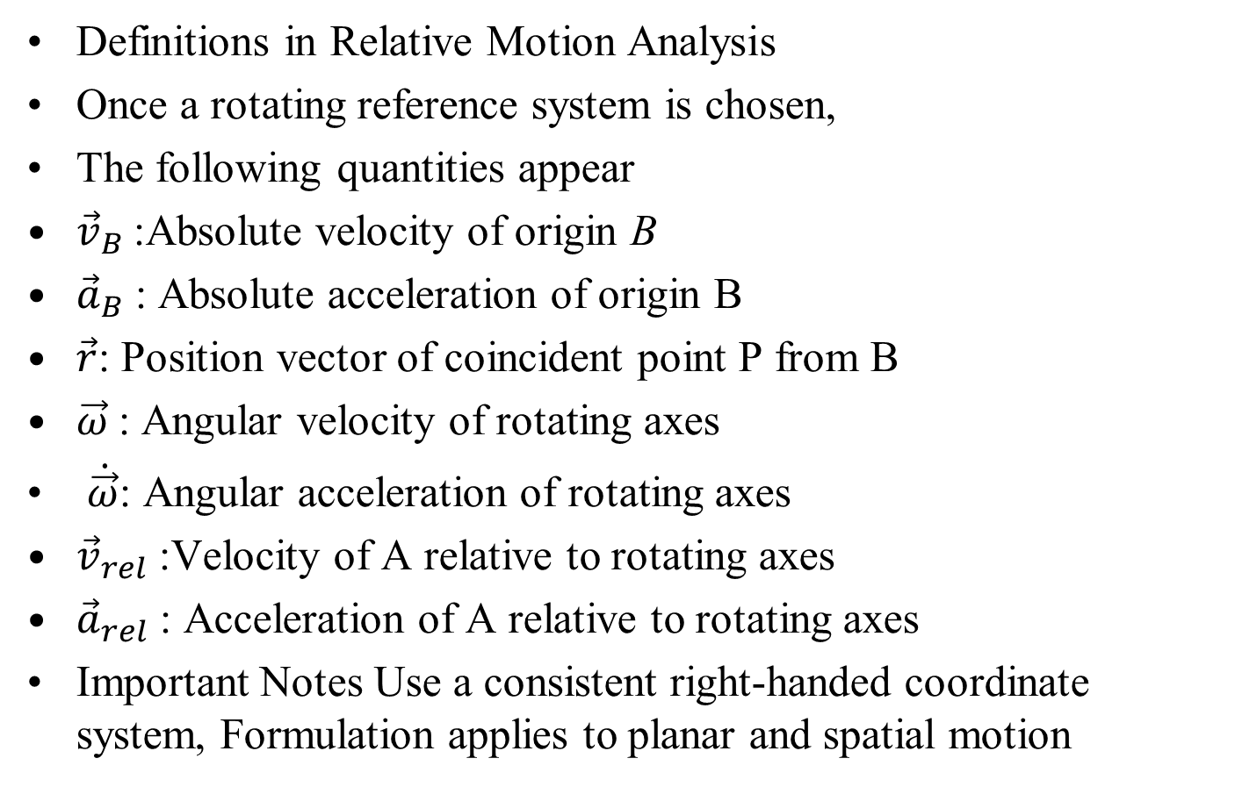
Key Concepts : Rotating Reference Systems
Definitions in Relative Motion Analysis
Once a rotating reference system is chosen,
The following quantities appear
${\vec{v}}_{B}$:Absolute velocity of origin B
${\vec{a}}_{B}$: Absolute acceleration of origin B
$\vec{r}$: Position vector of coincident point P from B
$\vec{ω}$: Angular velocity of rotating axes
$\dot{\vec{ω}}$: Angular acceleration of rotating axes
${\vec{v}}_{rel}$ :Velocity of A relative to rotating axes
${\vec{a}}_{rel}$ : Acceleration of A relative to rotating axes
Important Notes Use a consistent right-handed coordinate system, Formulation applies to planar and spatial motion

Slide 4
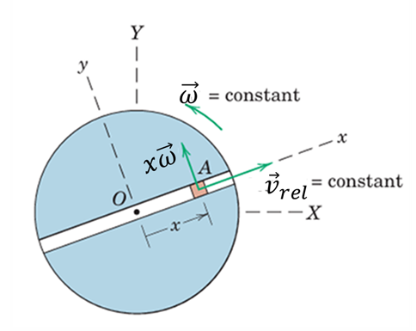
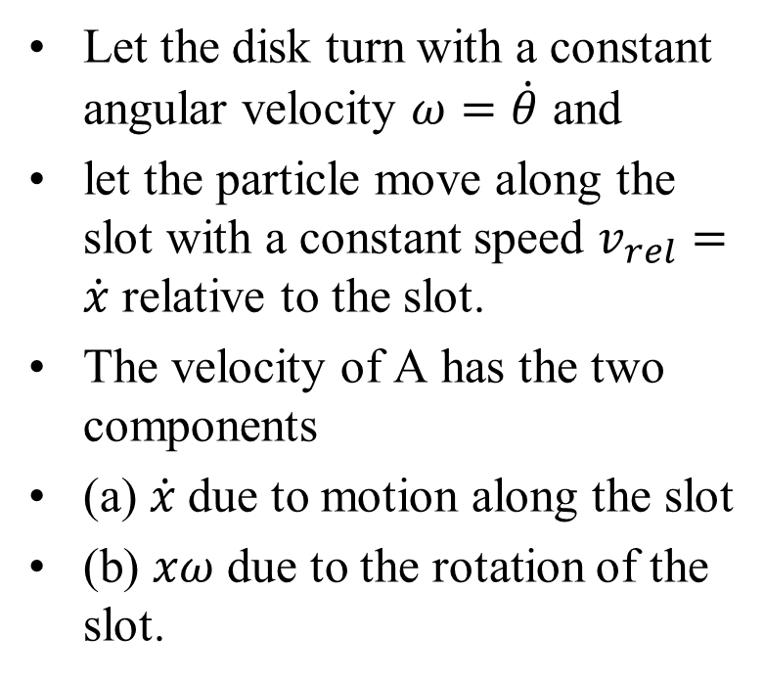
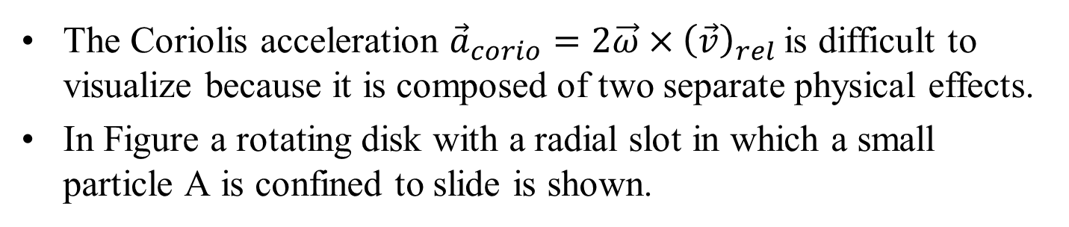
Coriolis Acceleration: Definition
The Coriolis acceleration ${\vec{a}}_{corio}=2\vec{ω}×{\left(\vec{v}\right)}_{rel}$is difficult to visualize because it is composed of two separate physical effects.
In Figure a rotating disk with a radial slot in which a small particle A is confined to slide is shown.
Let the disk turn with a constant angular velocity $ω=\dot{θ}$ and
let the particle move along the slot with a constant speed $v_{rel}=\dot{x}$ relative to the slot.
The velocity of A has the two components
(a) $\dot{x}$due to motion along the slot
(b) $xω$ due to the rotation of the slot.

Slide 5
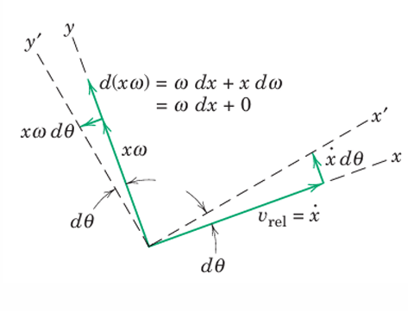
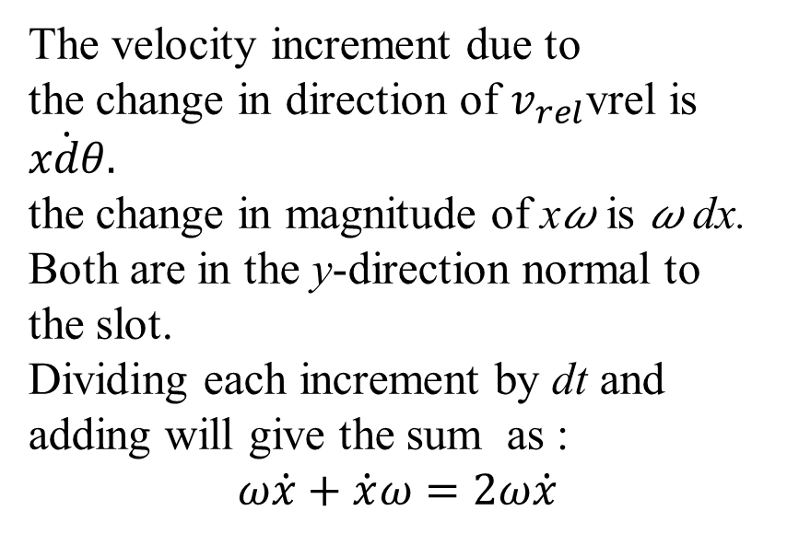
Coriolis Acceleration: Derivation
The changes in these two velocity components due to the rotation of the disk are shown in the figure.
For the interval dt, during which the x-y axes rotate with the disk through the angle d𝜃 to x′-y′.
The velocity increment due to
the change in direction of $v_{rel}$vrel is $\dot{xdθ}.$
the change in magnitude of x𝜔 is 𝜔 dx.
Both are in the y-direction normal to the slot.
Dividing each increment by dt and adding will give the sum as :
$$ω\dot{x}+\dot{x}ω=2ω\dot{x}$$

Slide 6
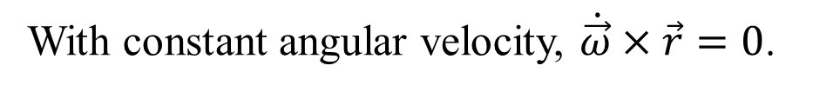
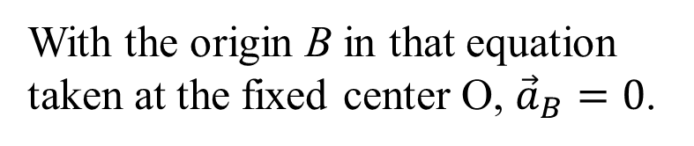
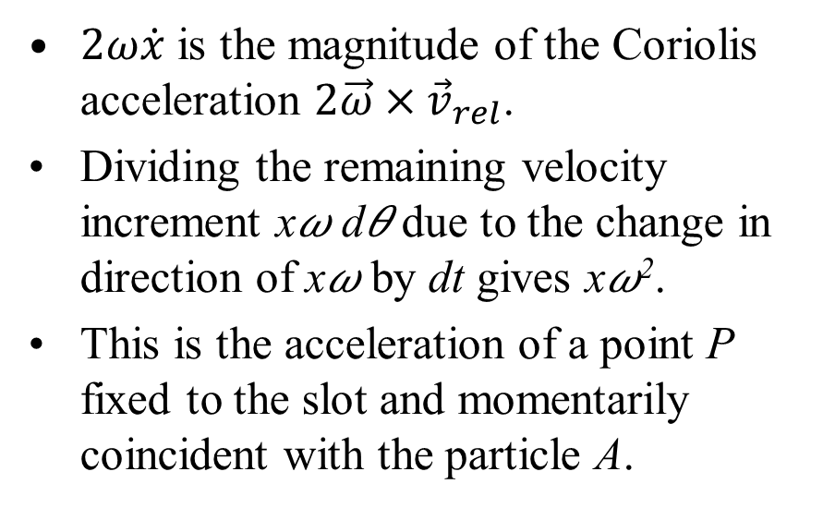
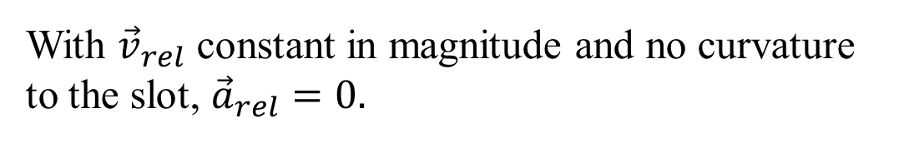
Coriolis Acceleration : Derivation
$2ω\dot{x}$ is the magnitude of the Coriolis acceleration $2\vec{ω}×{\vec{v}}_{rel}$.
Dividing the remaining velocity increment x𝜔 d𝜃 due to the change in direction of x𝜔 by dt gives x𝜔².
This is the acceleration of a point P fixed to the slot and momentarily coincident with the particle A.
With the origin B in that equation taken at the fixed center O, ${\vec{a}}_{B}=0$.
With constant angular velocity, $\dot{\vec{ω}}×\vec{r}=0$.
With ${\vec{v}}_{rel}$ constant in magnitude and no curvature to the slot, ${\vec{a}}_{rel}=0.$

Slide 7
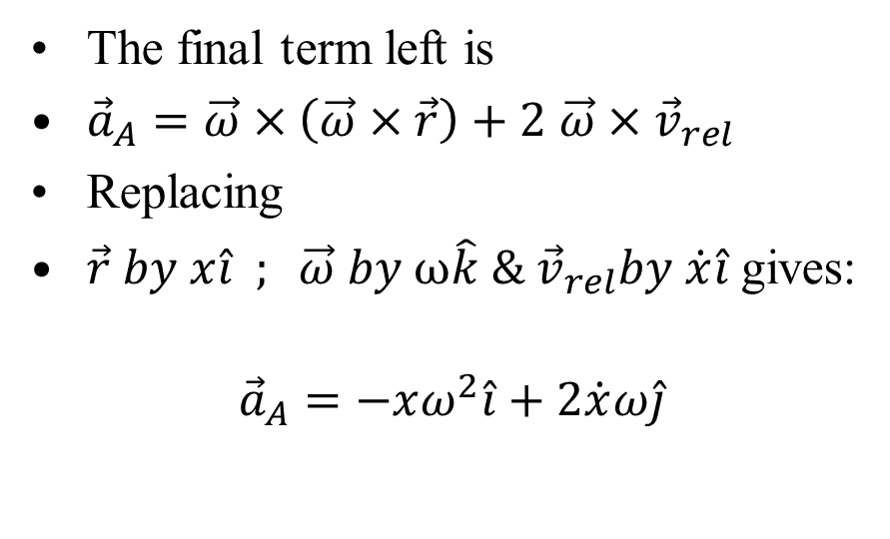
Coriolis Acceleration : Derivation
The final term left is
${\vec{a}}_{A}=\vec{ω}×\left(\vec{ω}×\vec{r}\right)+2$ $\vec{ω}×{\vec{v}}_{rel}$
Replacing
$\vec{r} by x\hat{i} ; \vec{ω} by ω\hat{k} \& {\vec{v}}_{rel}by \dot{x}\hat{i}$ gives:
$${\vec{a}}_{A}=−xω^{2}\hat{i}+2\dot{x}ω\hat{j}$$
Confirms that Coriolis acceleration arises from simultaneous rotation and relative motion.

Slide 8
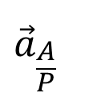
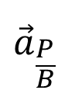

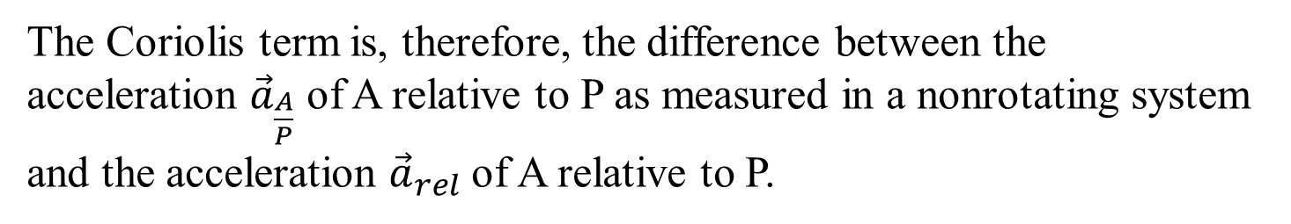

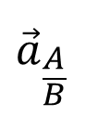
Rotating vs Nonrotating Systems
The following comparison will help to establish the equivalence of, and clarify the differences between, the relative-acceleration equations written for rotating and nonrotating reference axes
$${\vec{a}}_{A}={\vec{a}}_{B}+\dot{\vec{ω}}×\vec{r}+\vec{ω}×\left(\vec{ω}×\vec{r}\right)+2\vec{ω}×{\vec{v}}_{rel}+{\vec{a}}_{rel}$$
$${\vec{a}}_{B}$$
$${\vec{a}}_{\frac{P}{B}}$$
$${\vec{a}}_{\frac{A}{P}}$$
$${\vec{a}}_{P}$$
$${\vec{a}}_{\frac{A}{B}}$$
The Coriolis term is, therefore, the difference between the acceleration ${\vec{a}}_{\frac{A}{P}}$ of A relative to P as measured in a nonrotating system and the acceleration ${\vec{a}}_{rel}$of A relative to P.

Slide 9
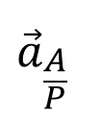
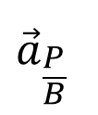

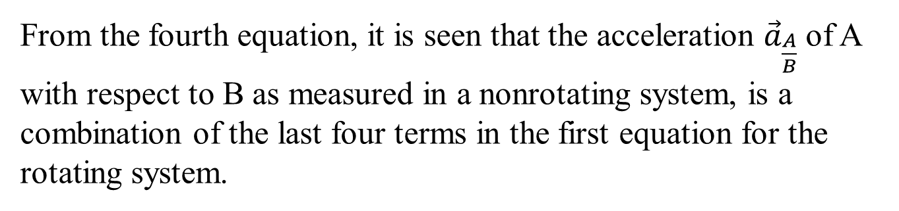

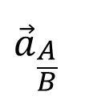
Rotating vs Nonrotating Systems
$${\vec{a}}_{A}={\vec{a}}_{B}+\dot{\vec{ω}}×\vec{r}+\vec{ω}×\left(\vec{ω}×\vec{r}\right)+2\vec{ω}×{\vec{v}}_{rel}+{\vec{a}}_{rel}$$
$${\vec{a}}_{B}$$
$${\vec{a}}_{\frac{P}{B}}$$
$${\vec{a}}_{\frac{A}{P}}$$
$${\vec{a}}_{P}$$
$${\vec{a}}_{\frac{A}{B}}$$
From the fourth equation, it is seen that the acceleration ${\vec{a}}_{\frac{A}{B}}$of A with respect to B as measured in a nonrotating system, is a combination of the last four terms in the first equation for the rotating system.

Slide 10
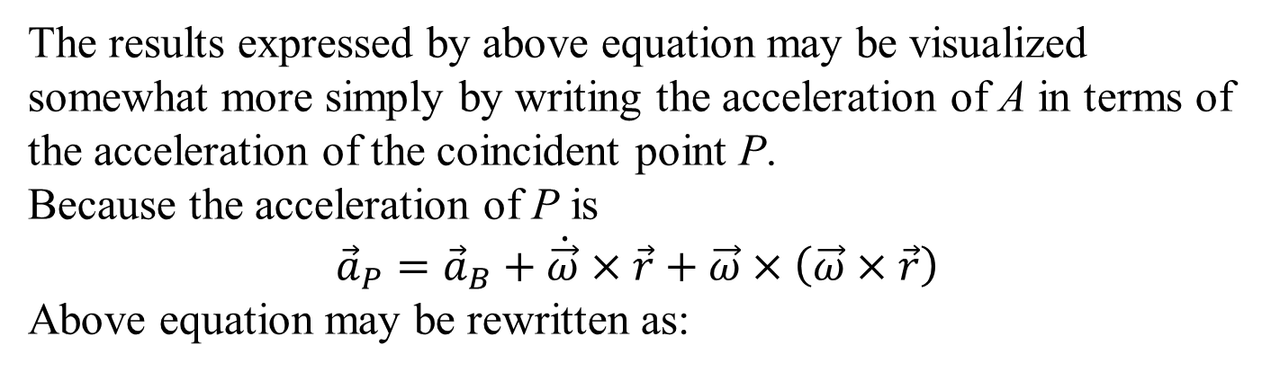

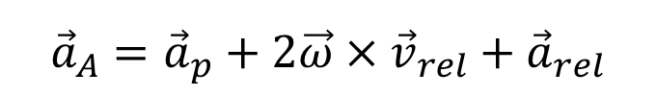
Rotating vs Nonrotating Systems
$${\vec{a}}_{A}={\vec{a}}_{B}+\dot{\vec{ω}}×\vec{r}+\vec{ω}×\left(\vec{ω}×\vec{r}\right)+2\vec{ω}×{\vec{v}}_{rel}+{\vec{a}}_{rel}$$
$${\vec{a}}_{B}$$
$${\vec{a}}_{\frac{P}{B}}$$
$${\vec{a}}_{P}$$
The results expressed by above equation may be visualized somewhat more simply by writing the acceleration of A in terms of the acceleration of the coincident point P.
Because the acceleration of P is
$${\vec{a}}_{P}={\vec{a}}_{B}+\dot{\vec{ω}}×\vec{r}+\vec{ω}×\left(\vec{ω}×\vec{r}\right)$$
Above equation may be rewritten as:
$${\vec{a}}_{A}={\vec{a}}_{p}+2\vec{ω}×{\vec{v}}_{rel}+{\vec{a}}_{rel}$$

Slide 11
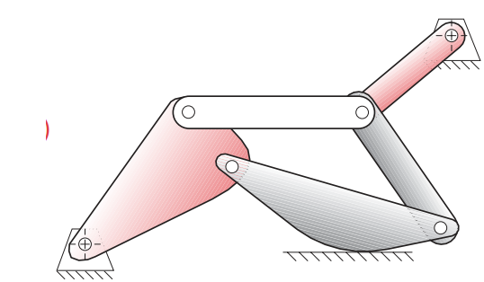
Interconnected Rigid Bodies
A connection between two rigid bodies constrains certain relative motions and allows only specific ones
Hinge allows only relative rotation
Sliding connection
Rolling connection
…Many more
Connections are building
blocks of machines/mechanism

Slide 12
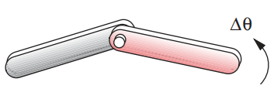
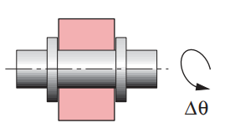
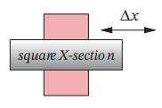

Connection Between Rigid Bodies
A hinge allows only relative rotation
A sliding connection allows only relative translation

Slide 13
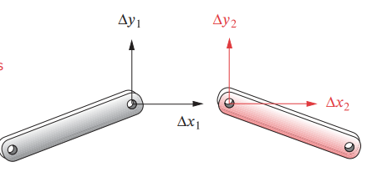
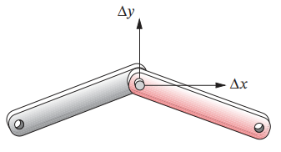
Hinge Connection Between Rigid Bodies
Two unconnected rigid bodies
Connected through hinge
Imagine two material points (real or virtual) belonging to both rigid bodies coinciding with geometric point of hinge
Both those material points have same position, velocity, and acceleration

Slide 14
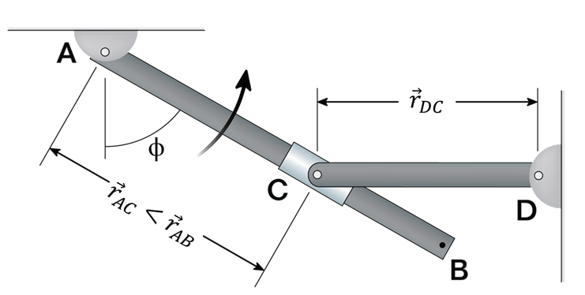
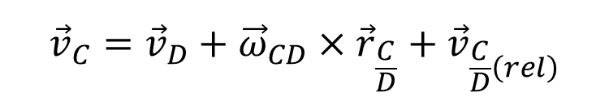
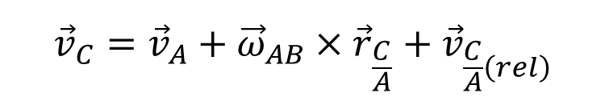


Kinematics of Connected Rigid Bodies
y’
$${\vec{ω}}_{AB}$$
$${\vec{α}}_{AB}$$
x’
A collar which is pinned to rod CD slides along rod AB.
$${\vec{v}}_{C}={\vec{v}}_{A}+{\vec{ω}}_{AB}×{\vec{r}}_{\frac{C}{A}}+{\vec{v}}_{\frac{C}{A}\left(rel\right)}$$
$${\vec{v}}_{C}={\vec{v}}_{D}+{\vec{ω}}_{CD}×{\vec{r}}_{\frac{C}{D}}+{\vec{v}}_{\frac{C}{D}\left(rel\right)}$$

Slide 15
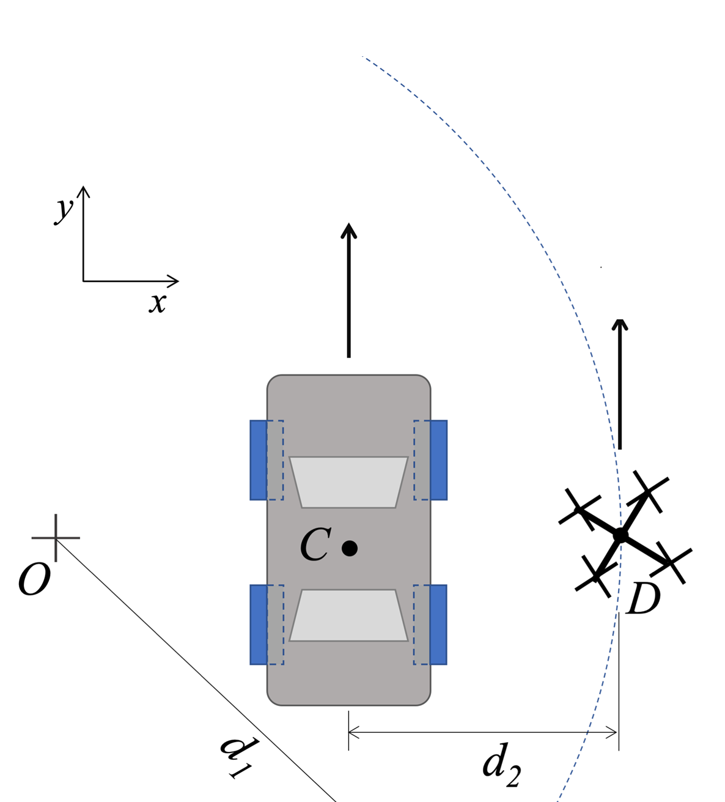



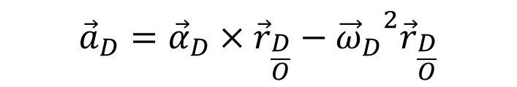

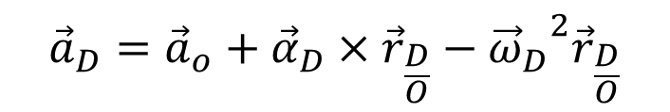



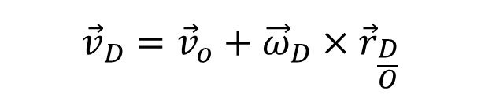
Kinematics of Connected Rigid Bodies
A camera drone, D, flies over a car race in a curved trajectory (center O) with a constant ground-speed of v_{D}
$${\vec{v}}_{C}$$
$${\vec{v}}_{D}={\vec{v}}_{o}+{\vec{ω}}_{D}×{\vec{r}}_{\frac{D}{O}}$$
$${\vec{a}}_{C}$$
$$\left|{\vec{v}}_{D}\right|\hat{j}=\left|{\vec{ω}}_{D}\right|\hat{k}×d_{1}\hat{i}$$
y’
$${\vec{v}}_{D}$$
$${\vec{a}}_{D}$$
$${\vec{a}}_{D}={\vec{a}}_{o}+{\vec{α}}_{D}×{\vec{r}}_{\frac{D}{O}}−{{\vec{ω}}_{D}}^{2}{\vec{r}}_{\frac{D}{O}}$$
x’
$${\vec{a}}_{D}={\vec{α}}_{D}×{\vec{r}}_{\frac{D}{O}}−{{\vec{ω}}_{D}}^{2}{\vec{r}}_{\frac{D}{O}}$$
$$\left|{\vec{a}}_{D}\right|\hat{i}=\left|{\vec{α}}_{D}\right|\hat{k}×d_{1}\hat{i}−{{\vec{ω}}_{D}}^{2}d_{1}\hat{i}$$

Slide 16


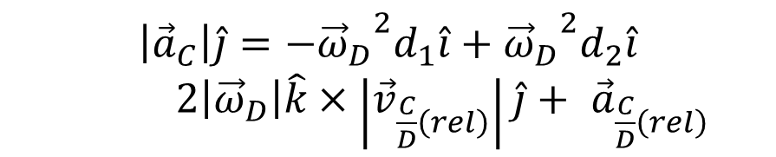

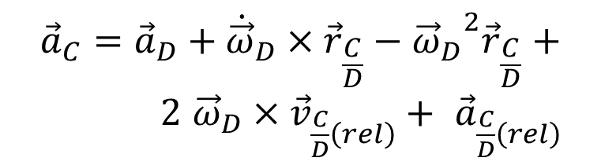

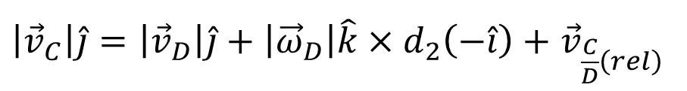
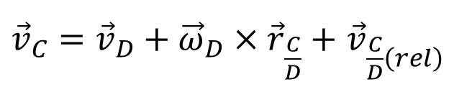
Kinematics of Connected Rigid Bodies
A camera drone, D, flies over a car race in a curved trajectory (center O) with a constant ground-speed of v_{D}
${\vec{v}}_{C}={\vec{v}}_{D}+{\vec{ω}}_{D}×{\vec{r}}_{\frac{C}{D}}+$ ${\vec{v}}_{\frac{C}{D}\left(rel\right)}$
$${\vec{v}}_{C}$$
$${\vec{a}}_{C}$$
$${\vec{v}}_{D}$$
$${\vec{a}}_{D}$$
$\left|{\vec{v}}_{C}\right|\hat{j}=\left|{\vec{v}}_{D}\right|\hat{j}+\left|{\vec{ω}}_{D}\right|\hat{k}×d_{2}\left(−\hat{i}\right)$ $+$ ${\vec{v}}_{\frac{C}{D}\left(rel\right)}$
y’
$${\vec{a}}_{C}={\vec{a}}_{D}+{\dot{\vec{ω}}}_{D}×{\vec{r}}_{\frac{C}{D}}−{{\vec{ω}}_{D}}^{2}{\vec{r}}_{\frac{C}{D}}+$$
$2$ ${\vec{ω}}_{D}×{\vec{v}}_{\frac{C}{D}\left(rel\right)}+ {\vec{a}}_{\frac{C}{D}\left(rel\right)}$
x’
$$\left|{\vec{a}}_{C}\right|\hat{j}=−{{\vec{ω}}_{D}}^{2}d_{1}\hat{i}+{{\vec{ω}}_{D}}^{2}d_{2}\hat{i}$$
$2\left|{\vec{ω}}_{D}\right|\hat{k}×\left|{\vec{v}}_{\frac{C}{D}\left(rel\right)}\right|\hat{j}+ {\vec{a}}_{\frac{C}{D}\left(rel\right)}$

Slide 17
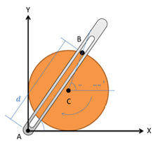

Kinematics of Connected Rigid Bodies
The crank-rocker mechanism as shown below consists of a crank of known radius.
The crank rotates about its fixed center at C at a constant angular speed.
Rocker AB fixed at it's base at A and connects to point B along the edge of the crank.
The pin at point B can slide along a frictionless slot in AB.
$${\vec{ω}}_{C}$$
This system will control the angular velocity of rocker AB!

Slide 18
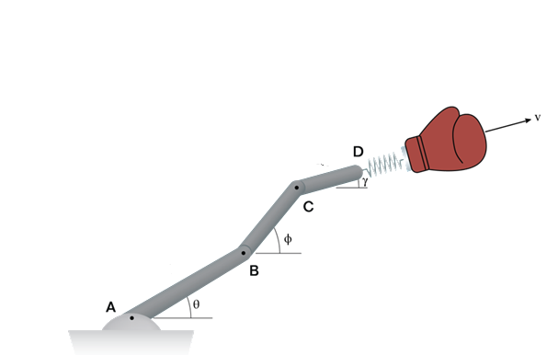



Kinematics of Connected Rigid Bodies
$${\vec{r}}_{CD}$$
$${\vec{r}}_{BC}$$
$${\vec{r}}_{AB}$$
A very funny engineer has attached her prank punching machine to a robotic arm.
Arm BC is rotating at ω_{BC} &α_{BC}
while arm CD is rotating at ω_{CD} and α_{CD}.
Arm AB can be is stationary throughout.
The boxing glove is to move at a maximum constant velocity, relative to the link CD.

Slide 19
What Next?
Engineering is complete only when force agents are designed and created.
Kinematics determines the acceleration of a particle / points on a rigid body.
Using Newton’s second law and knowing the mass, the external force can be determined.
This course focuses on the inverse problem: determining motion from known forces.

Slide 20
Kinetics of A Particle and A System of Particles
Design of Machines with Mechanical Advantage…

Slide 21
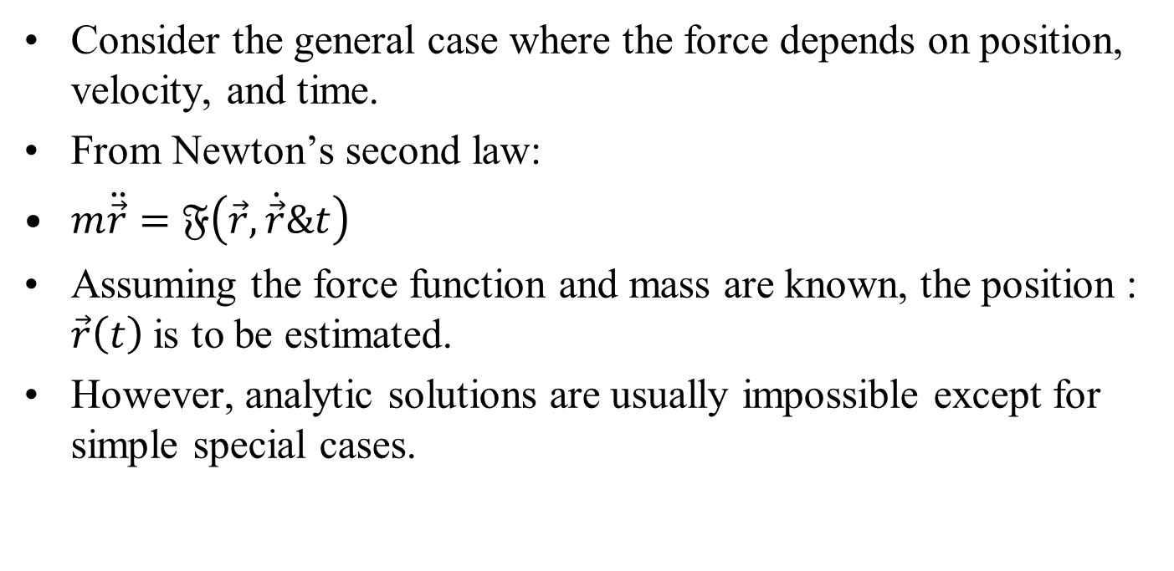
Equation of Motion of a Particle
Consider the general case where the force depends on position, velocity, and time.
From Newton’s second law:
$m\ddot{\vec{r}}=𝔉\left(\vec{r},\dot{\vec{r}}\&t\right)$
Assuming the force function and mass are known, the position : $\vec{r}\left(t\right)$is to be estimated.
However, analytic solutions are usually impossible except for simple special cases.

Slide 22
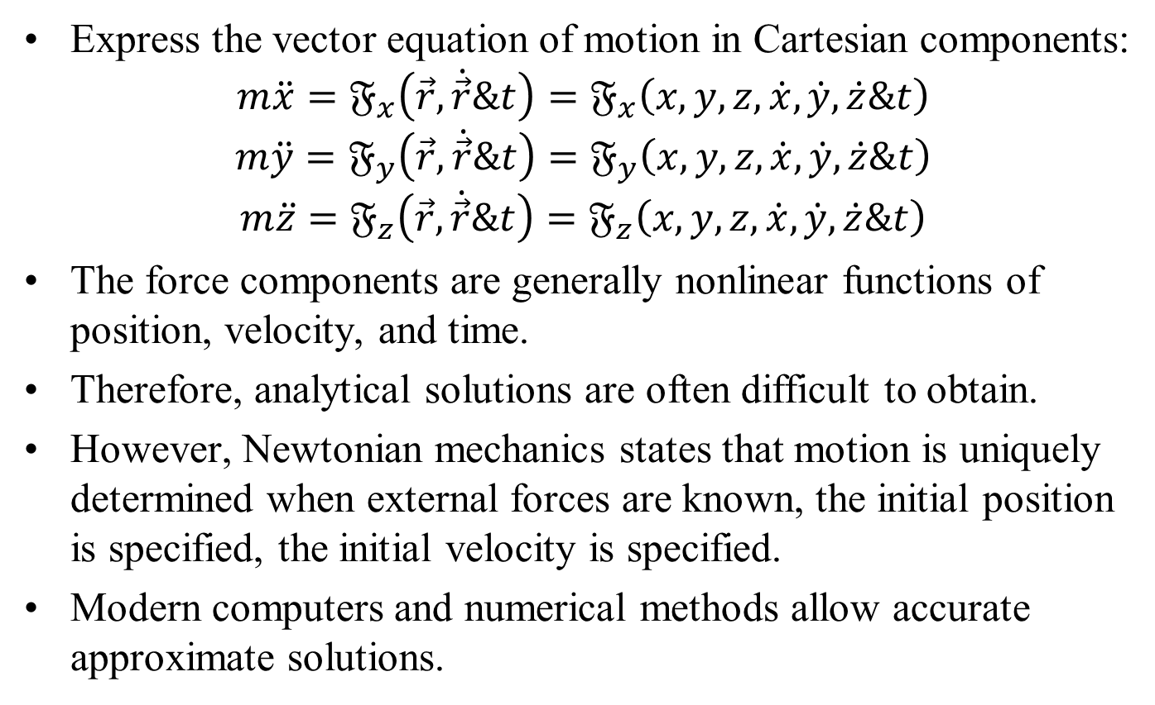
Cartesian Form of the Equation
Express the vector equation of motion in Cartesian components:
$$m\ddot{x}=𝔉_{x}\left(\vec{r},\dot{\vec{r}}\&t\right)=𝔉_{x}\left(x,y,z,\dot{x},\dot{y},\dot{z}\&t\right)$$
$$m\ddot{y}=𝔉_{y}\left(\vec{r},\dot{\vec{r}}\&t\right)=𝔉_{y}\left(x,y,z,\dot{x},\dot{y},\dot{z}\&t\right)$$
$$m\ddot{z}=𝔉_{z}\left(\vec{r},\dot{\vec{r}}\&t\right)=𝔉_{z}\left(x,y,z,\dot{x},\dot{y},\dot{z}\&t\right)$$
The force components are generally nonlinear functions of position, velocity, and time.
Therefore, analytical solutions are often difficult to obtain.
However, Newtonian mechanics states that motion is uniquely determined when external forces are known, the initial position is specified, the initial velocity is specified.
Modern computers and numerical methods allow accurate approximate solutions.

Slide 23
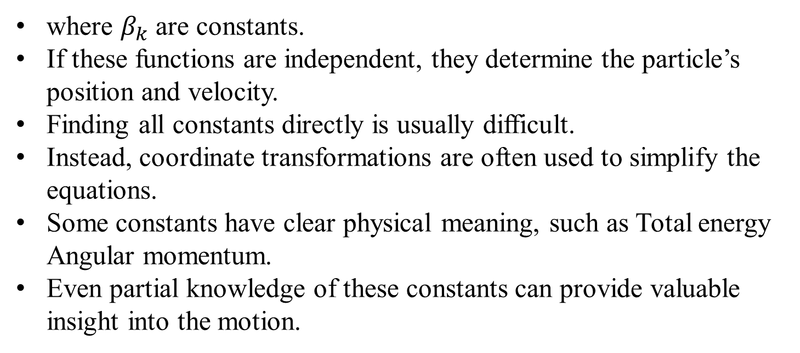
Constants of Motion
A general analytical solution contains six arbitrary constants, determined by six initial conditions.
One approach is to identify constants (integrals) of motion:
$$𝔉_{k}\left(x,y,z,\dot{x},\dot{y},\dot{z}\&t\right)=β_{k} k=1,2,3,…6$$
where $β_{k}$ are constants.
If these functions are independent, they determine the particle’s position and velocity.
Finding all constants directly is usually difficult.
Instead, coordinate transformations are often used to simplify the equations.
Some constants have clear physical meaning, such as Total energy Angular momentum.
Even partial knowledge of these constants can provide valuable insight into the motion.

Slide 24
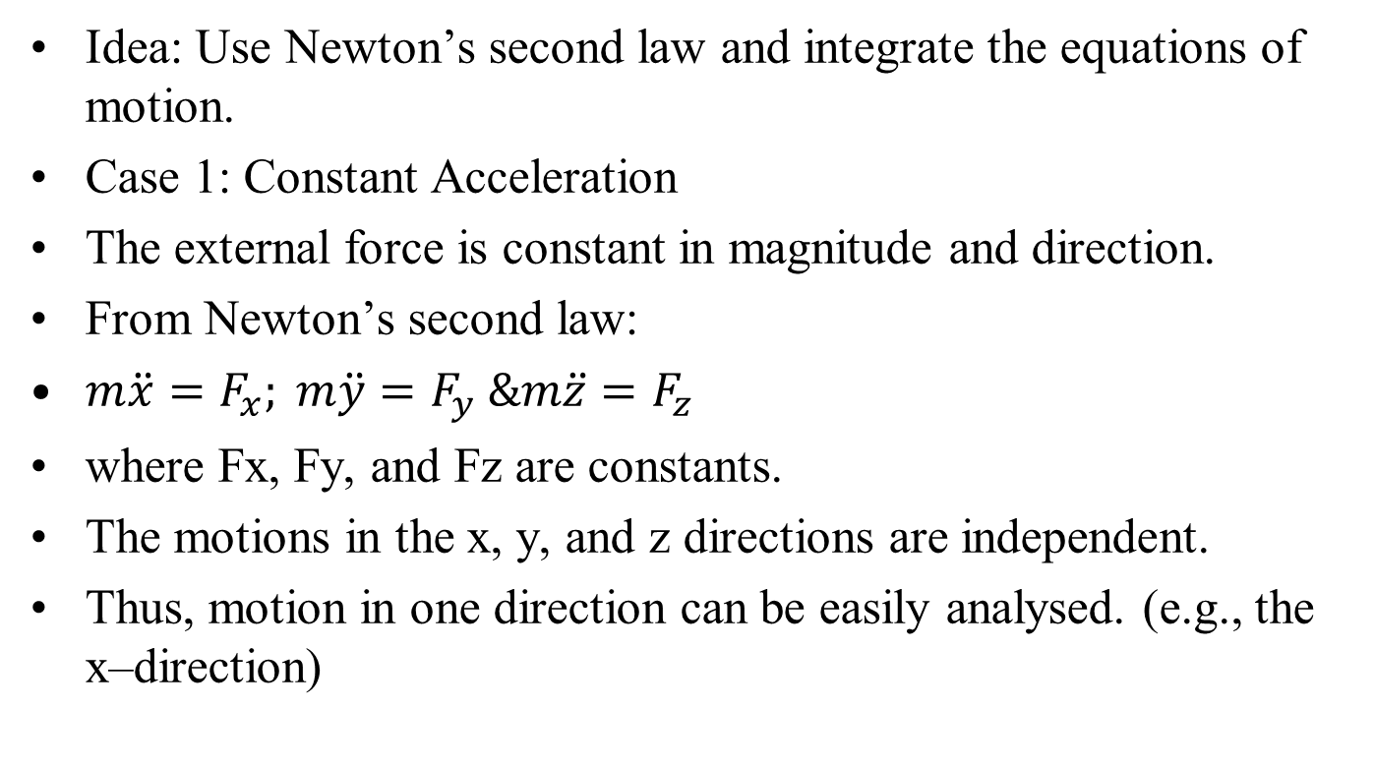
Direct Integration of the Equations of Motion
Idea: Use Newton’s second law and integrate the equations of motion.
Case 1: Constant Acceleration
The external force is constant in magnitude and direction.
From Newton’s second law:
$m\ddot{x}=F_{x}; m\ddot{y}=F_{y} \&m\ddot{z}=F_{z}$
where Fx, Fy, and Fz are constants.
The motions in the x, y, and z directions are independent.
Thus, motion in one direction can be easily analysed. (e.g., the x–direction)

