Slide 1


Compound Kinematics of Rigid Bodies
P M V Subbarao
Professor & Head
Mechanical Engineering Department
Motion with Translation, Rotation, and Everything Together too

Slide 2

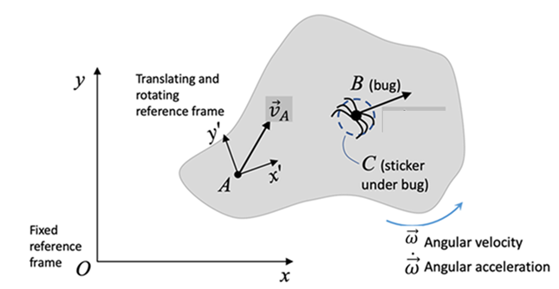
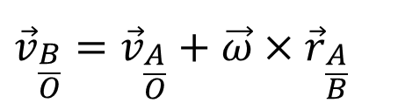
Relative-Velocity Equation: Bug Not Moving
The final expression for the velocity of a stationary bug with respect to the fixed frame is:
Rotating frames velocity:
$${\vec{v}}_{\frac{B}{O}}={\vec{v}}_{\frac{A}{O}}+\vec{ω}×{\vec{r}}_{\frac{A}{B}}$$

Slide 3
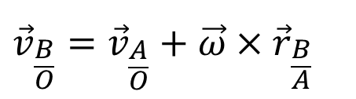
Interpretation of the Relative-Velocity Equation: Bug Not Moving
Rotating frames velocity:
$${\vec{v}}_{\frac{B}{O}}={\vec{v}}_{\frac{A}{O}}+\vec{ω}×{\vec{r}}_{\frac{B}{A}}$$
This is best understood by separating the motion into its translational and rotational components.
The velocity of point B is expressed as the vector sum of:
the translational velocity of the reference point A,
the rotational contribution of A relative to B.

Slide 4
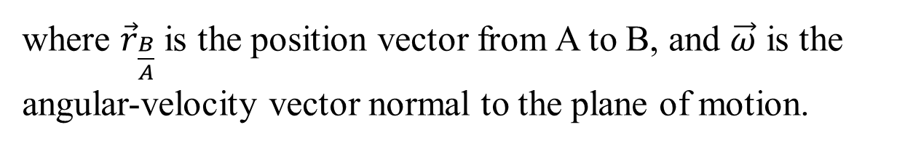
Interpretation of the Relative-Velocity Equation: Bug Not Moving
Rotating frames velocity:
$${\vec{v}}_{\frac{B}{O}}={\vec{v}}_{\frac{A}{O}}+\vec{ω}×{\vec{r}}_{\frac{B}{A}}$$
where ${\vec{r}}_{\frac{B}{A}}$ is the position vector from A to B, and $\vec{ω}$ is the angular-velocity vector normal to the plane of motion.

Slide 5
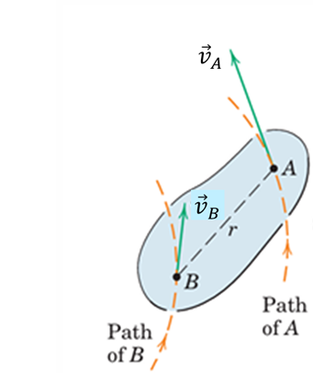
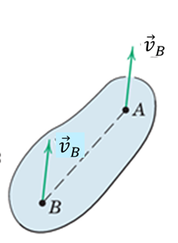
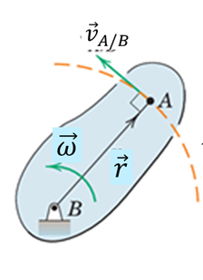
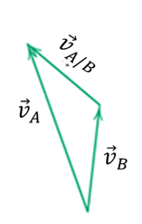
Geometric Decomposition of Relative Velocity of A relative to B
=
+
Velocity of point A decomposed into translation and rotation.

Slide 6
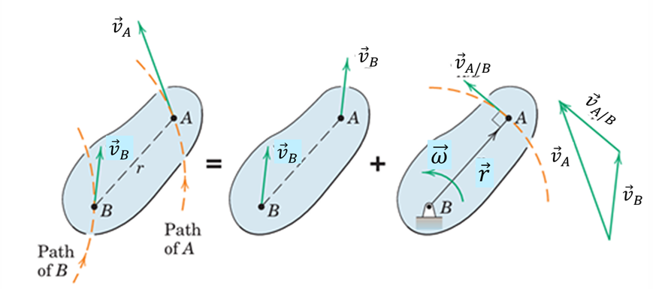
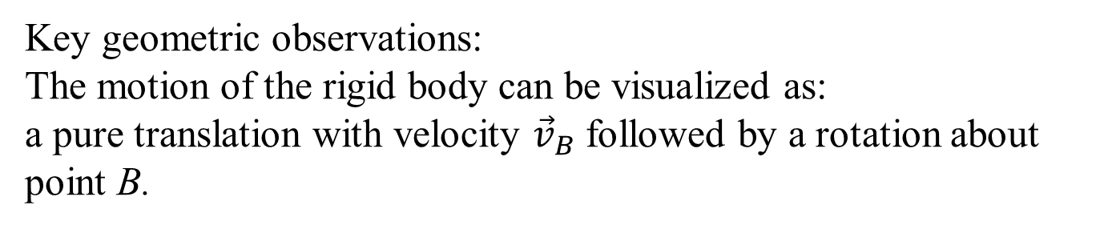
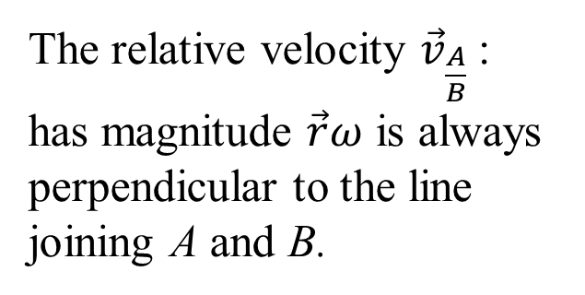
Geometric Decomposition of Relative Velocity
The relative velocity ${\vec{v}}_{\frac{A}{B}}$:
has magnitude $\vec{r}ω$ is always perpendicular to the line joining A and B.
Velocity of point A decomposed into translation and rotation.
This perpendicularity is a key feature used in solving rigid-body plane-motion problems.
Key geometric observations:
The motion of the rigid body can be visualized as:
a pure translation with velocity ${\vec{v}}_{B}$ followed by a rotation about point B.

Slide 7
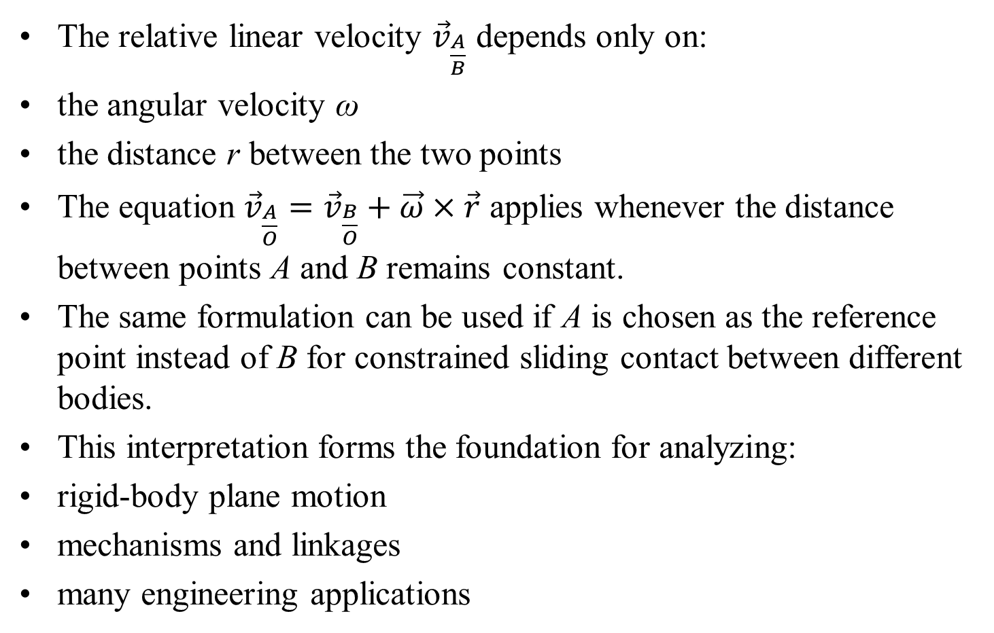
Important Consequences and Applications
The relative linear velocity ${\vec{v}}_{\frac{A}{B}}$ depends only on:
the angular velocity ω
the distance r between the two points
The equation ${\vec{v}}_{\frac{A}{O}}={\vec{v}}_{\frac{B}{O}}+\vec{ω}×\vec{r}$ applies whenever the distance between points A and B remains constant.
The same formulation can be used if A is chosen as the reference point instead of B for constrained sliding contact between different bodies.
This interpretation forms the foundation for analyzing:
rigid-body plane motion
mechanisms and linkages
many engineering applications

Slide 8
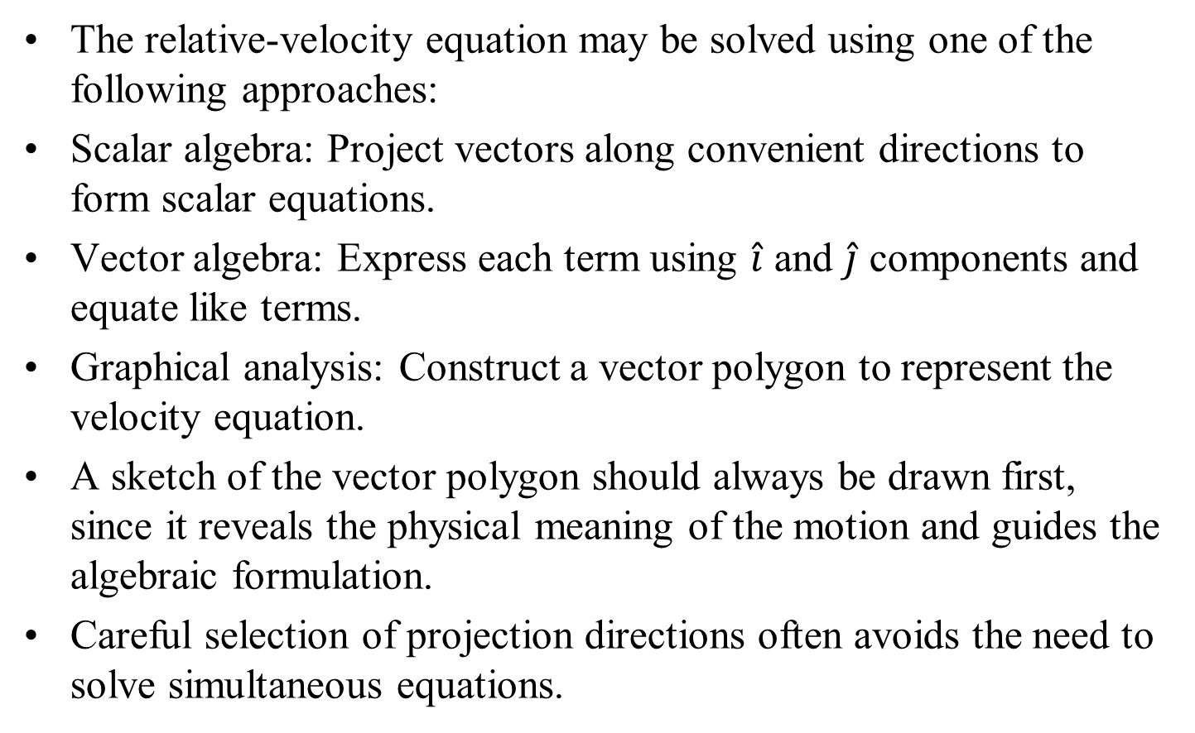
Solution Methods for the Relative-Velocity Equation
The relative-velocity equation may be solved using one of the following approaches:
Scalar algebra: Project vectors along convenient directions to form scalar equations.
Vector algebra: Express each term using $\hat{i}$ and $\hat{j}$ components and equate like terms.
Graphical analysis: Construct a vector polygon to represent the velocity equation.
A sketch of the vector polygon should always be drawn first, since it reveals the physical meaning of the motion and guides the algebraic formulation.
Careful selection of projection directions often avoids the need to solve simultaneous equations.

Slide 9
Graphical Solution Procedure
Graphical Solution Procedure:
1 Construct the known velocity vectors to scale and in correct directions.
2 Complete the vector polygon using the unknown vectors.
3 Measure unknown magnitudes and directions directly from the diagram.
This method is particularly effective when the geometry leads to awkward analytical expressions.

Slide 10
Key Observations
Important Observations
A single vector equation in a plane is equivalent to two scalar equations.
Therefore, at most two scalar unknowns can be determined.
Unknowns may include a vector magnitude, direction, or both.
A systematic identification of knowns and unknowns should always precede the solution.

Slide 11
Instantaneous Center of Zero Velocity
Plane Motion of a Rigid Body
The velocity of any point on a rigid body in plane motion can be expressed as the sum of:
velocity of a reference point, and
relative velocity due to rotation about that point.
A unique reference point can be chosen which has zero velocity at a given instant.
At that instant, the body undergoes pure rotation about an axis normal to the plane of motion passing through this point.

Slide 12
Instantaneous Center of Zero Velocity
This axis is called the instantaneous axis of zero velocity.
The intersection of this axis with the plane of motion is known as the Instantaneous Center of Zero Velocity (IC).
The IC provides a powerful graphical method for visualizing and analyzing velocities in plane motion.

Slide 13
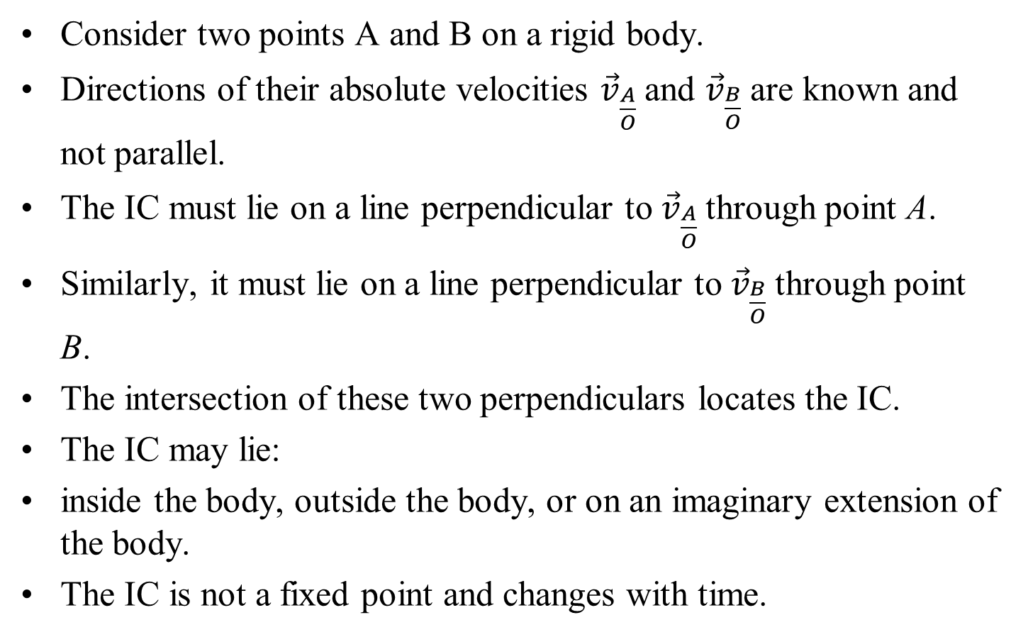
Locating the Instantaneous Center
Consider two points A and B on a rigid body.
Directions of their absolute velocities ${\vec{v}}_{\frac{A}{O}}$and ${\vec{v}}_{\frac{B}{O}}$ are known and not parallel.
The IC must lie on a line perpendicular to ${\vec{v}}_{\frac{A}{O}}$through point A.
Similarly, it must lie on a line perpendicular to ${\vec{v}}_{\frac{B}{O}}$through point B.
The intersection of these two perpendiculars locates the IC.
The IC may lie:
inside the body, outside the body, or on an imaginary extension of the body.
The IC is not a fixed point and changes with time.

Slide 14
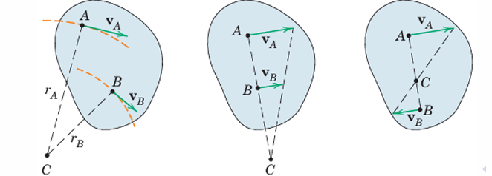
Locating the Instantaneous Center

Slide 15
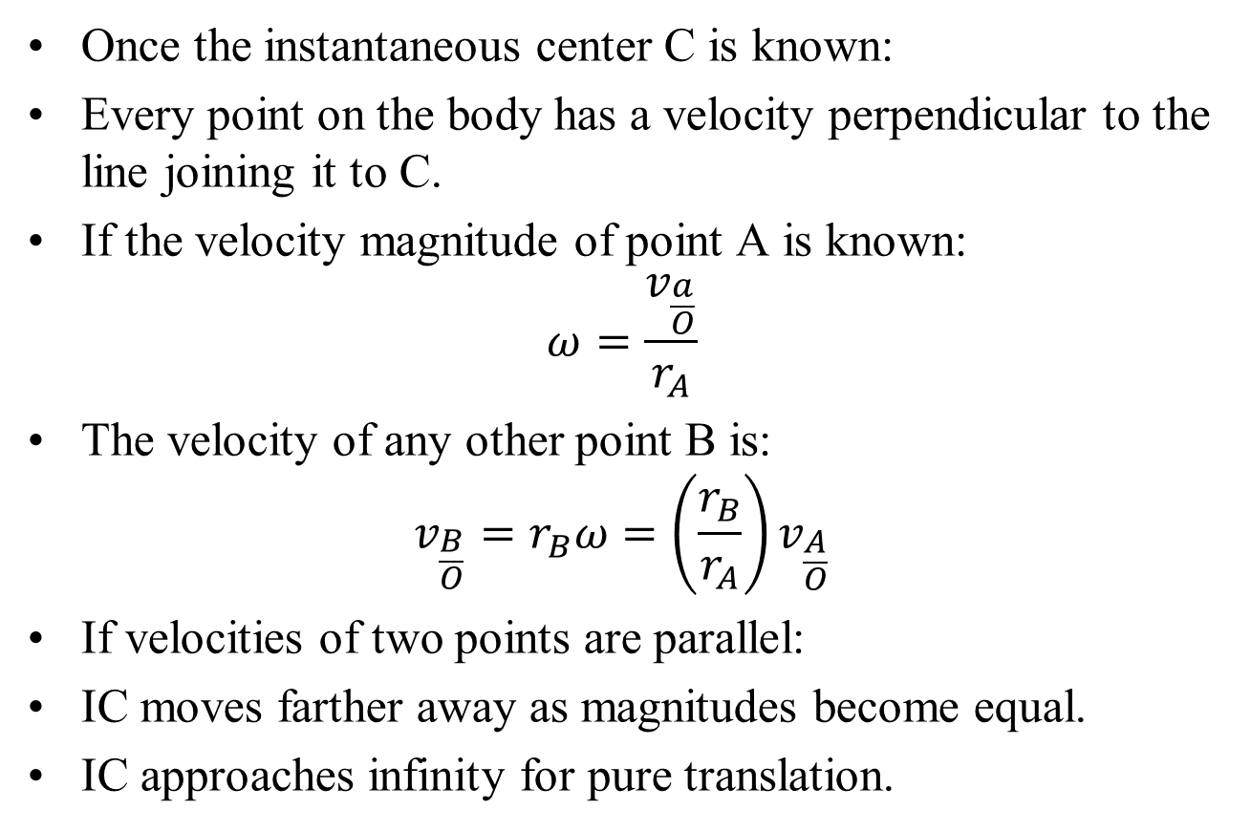
Velocity Relations Using IC
Once the instantaneous center C is known:
Every point on the body has a velocity perpendicular to the line joining it to C.
If the velocity magnitude of point A is known:
$$ω=\frac{v_{\frac{a}{O}}}{r_{A}}$$
The velocity of any other point B is:
$$v_{\frac{B}{O}}=r_{B}ω=\left(\frac{r_{B}}{r_{A}}\right)v_{\frac{A}{O}}$$
If velocities of two points are parallel:
IC moves farther away as magnitudes become equal.
IC approaches infinity for pure translation.

Slide 16
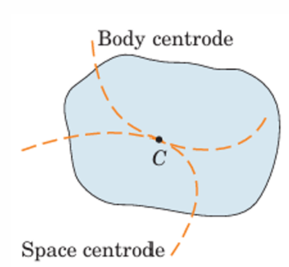
Instantaneous Center: Concept
Instantaneous Center (IC):
As a rigid body moves, the instantaneous center C changes position.
The locus of ICs in space forms the space centrode/
The locus of ICs on the body forms the body centrode.
At any instant, both centrodes are tangent at C Body centrode rolls on the space centrode during motion

Slide 17
Motion and Acceleration of the IC
Key Observations:
IC has zero velocity at the instant considered IC generally has non-zero acceleration.
Hence, IC cannot be used to determine acceleration’
Instantaneous center of zero acceleration exists.
Its determination is a specialized topic in kinematics

Slide 18
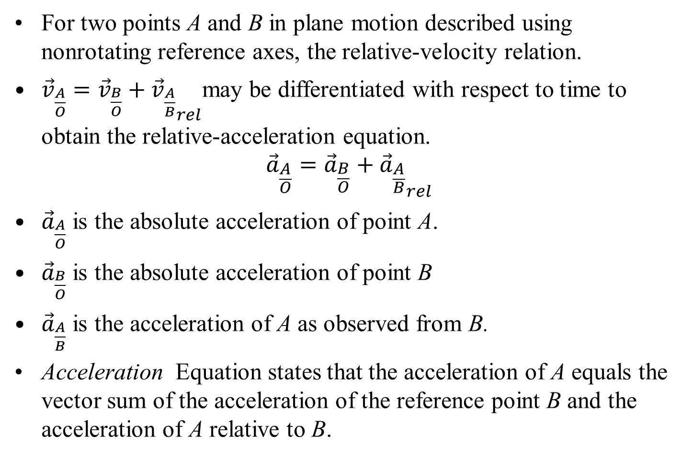
Relative Acceleration
For two points A and B in plane motion described using nonrotating reference axes, the relative-velocity relation.
${\vec{v}}_{\frac{A}{O}}={\vec{v}}_{\frac{B}{O}}+{{\vec{v}}_{\frac{A}{B}}}_{rel}$may be differentiated with respect to time to obtain the relative-acceleration equation.
$${\vec{a}}_{\frac{A}{O}}={\vec{a}}_{\frac{B}{O}}+{{\vec{a}}_{\frac{A}{B}}}_{rel}$$
${\vec{a}}_{\frac{A}{O}}$ is the absolute acceleration of point A.
${\vec{a}}_{\frac{B}{O}}$ is the absolute acceleration of point B
${\vec{a}}_{\frac{A}{B}}$ is the acceleration of A as observed from B.
Acceleration Equation states that the acceleration of A equals the vector sum of the acceleration of the reference point B and the acceleration of A relative to B.

Slide 19
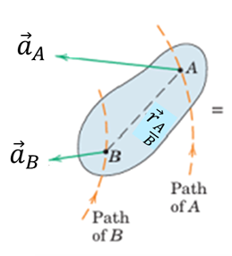
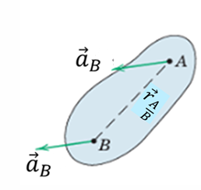
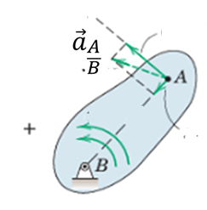




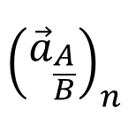
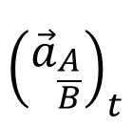
Relative Acceleration Due to Rotation: Physical Interpretation
$$\hat{t}$$
$${\left({\vec{a}}_{\frac{A}{B}}\right)}_{t}$$
$$\vec{α}$$
$$\hat{n}$$
$$\vec{ω}$$
$${\left({\vec{a}}_{\frac{A}{B}}\right)}_{n}$$
Interpretation: Motion of point A is described relative to point B on the same rigid body.
Since the distance AB is constant, the relative motion is circular.
The acceleration of A consists of: Translation of point B Normal and tangential components due to rotation about B

Slide 20
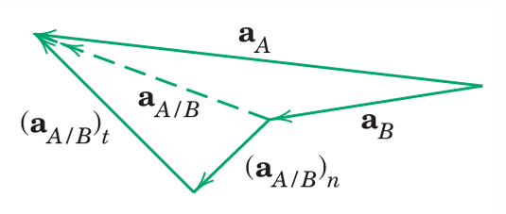
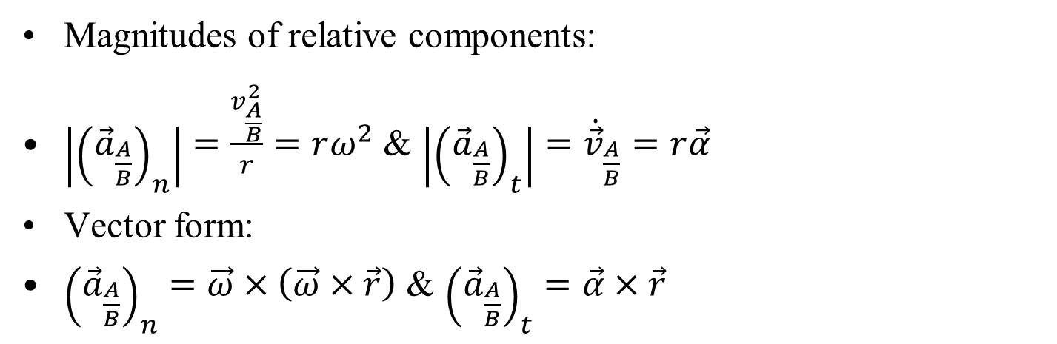
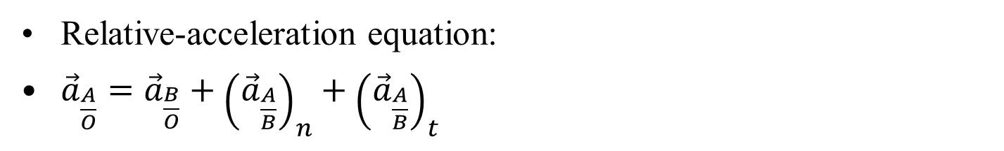
Relative Acceleration Due to Rotation: Intrinsic Formulation
Relative-acceleration equation:
${\vec{a}}_{\frac{A}{O}}={\vec{a}}_{\frac{B}{O}}+{\left({\vec{a}}_{\frac{A}{B}}\right)}_{n}+{\left({\vec{a}}_{\frac{A}{B}}\right)}_{t}$
Magnitudes of relative components:
$\left|{\left({\vec{a}}_{\frac{A}{B}}\right)}_{n}\right|=\frac{v_{\frac{A}{B}}^{2}}{r}=rω^{2}$ & $\left|{\left({\vec{a}}_{\frac{A}{B}}\right)}_{t}\right|={\dot{\vec{v}}}_{\frac{A}{B}}=r\vec{α}$
Vector form:
${\left({\vec{a}}_{\frac{A}{B}}\right)}_{n}=\vec{ω}×\left(\vec{ω}×\vec{r}\right)$ & ${\left({\vec{a}}_{\frac{A}{B}}\right)}_{t}=\vec{α}×\vec{r}$

Slide 21
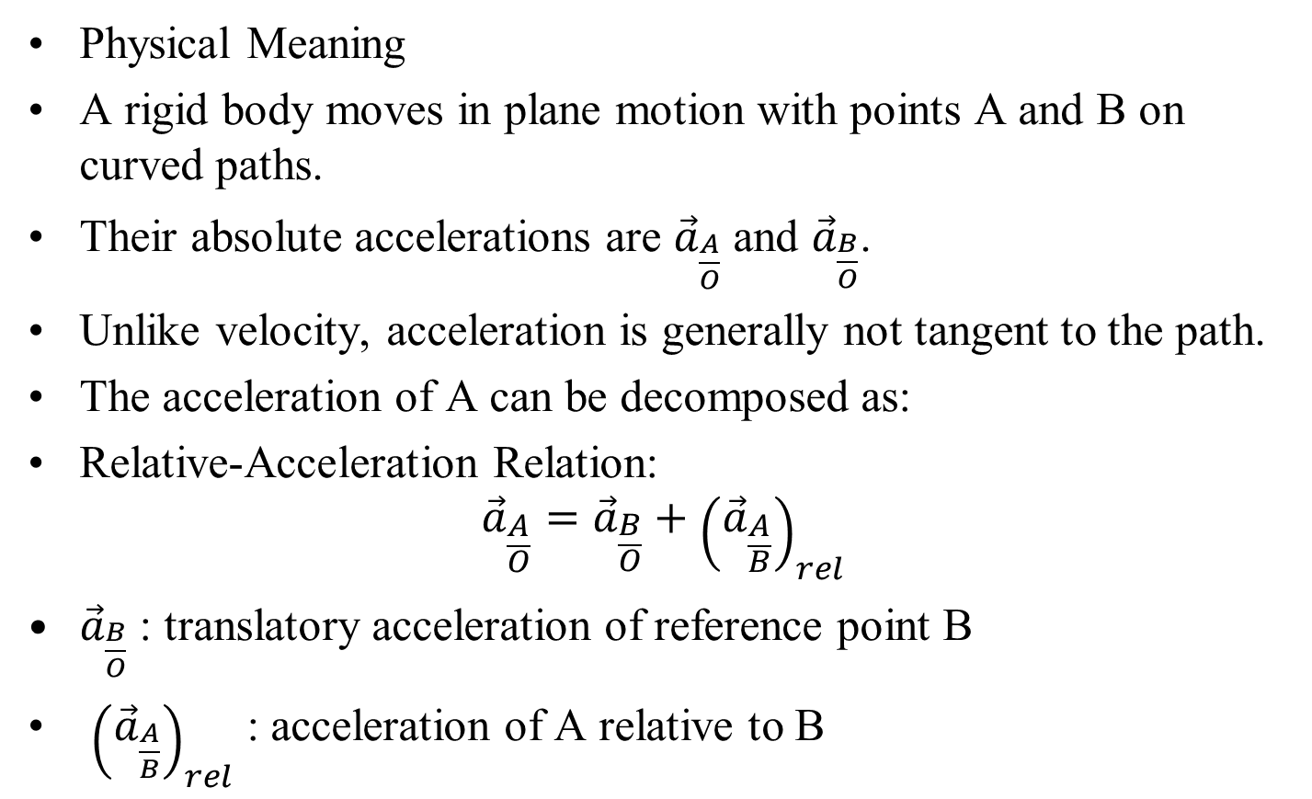
Interpretation of the Relative-Acceleration Equation
Physical Meaning
A rigid body moves in plane motion with points A and B on curved paths.
Their absolute accelerations are ${\vec{a}}_{\frac{A}{O}}$ and ${\vec{a}}_{\frac{B}{O}}$.
Unlike velocity, acceleration is generally not tangent to the path.
The acceleration of A can be decomposed as:
Relative-Acceleration Relation:
$${\vec{a}}_{\frac{A}{O}}={\vec{a}}_{\frac{B}{O}}+{\left({\vec{a}}_{\frac{A}{B}}\right)}_{rel}$$
${\vec{a}}_{\frac{B}{O}}$ : translatory acceleration of reference point B
${\left({\vec{a}}_{\frac{A}{B}}\right)}_{rel}$ : acceleration of A relative to B

Slide 22
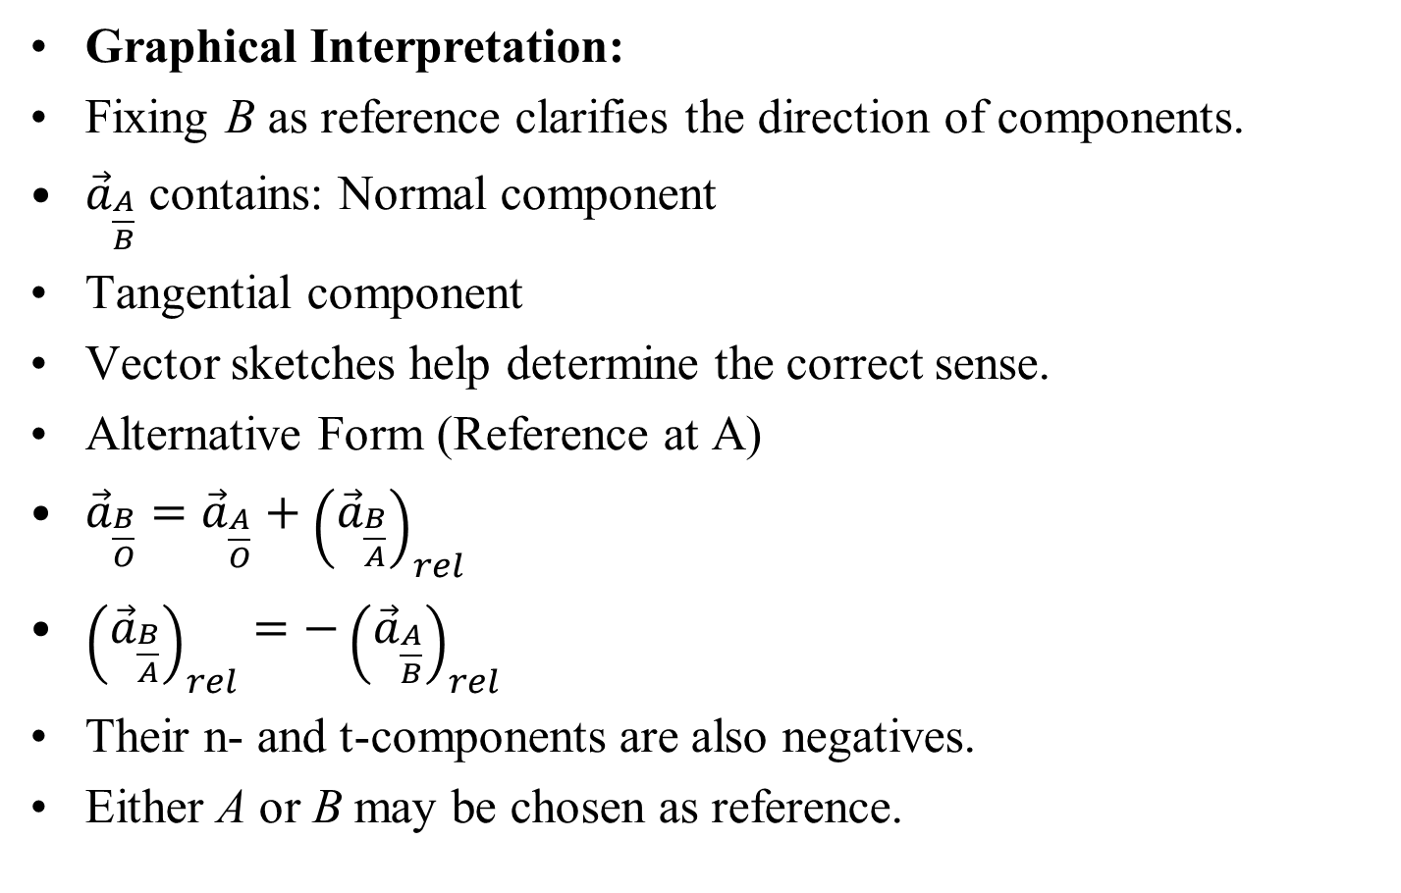
Geometric Interpretation and Alternative Form
Graphical Interpretation:
Fixing B as reference clarifies the direction of components.
${\vec{a}}_{\frac{A}{B}}$ contains: Normal component
Tangential component
Vector sketches help determine the correct sense.
Alternative Form (Reference at A)
${\vec{a}}_{\frac{B}{O}}={\vec{a}}_{\frac{A}{O}}+{\left({\vec{a}}_{\frac{B}{A}}\right)}_{rel}$
${\left({\vec{a}}_{\frac{B}{A}}\right)}_{rel}=−{\left({\vec{a}}_{\frac{A}{B}}\right)}_{rel}$
Their n- and t-components are also negatives.
Either A or B may be chosen as reference.

Slide 23
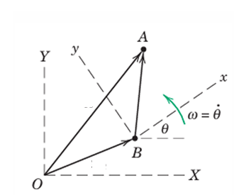
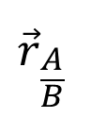


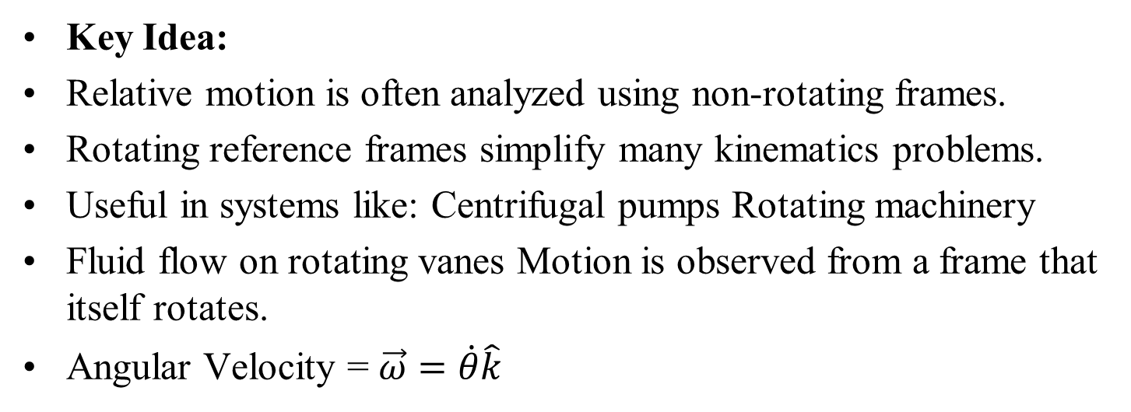
Motion in Rotating Frames : Introduction
Key Idea:
Relative motion is often analyzed using non-rotating frames.
Rotating reference frames simplify many kinematics problems.
Useful in systems like: Centrifugal pumps Rotating machinery
Fluid flow on rotating vanes Motion is observed from a frame that itself rotates.
Angular Velocity = $\vec{ω}=\dot{θ}\hat{k}$
Motion of particles A and B in fixed and rotating frames.
Direction: Normal to plane
Sense: Right-hand rule
$${\vec{r}}_{\frac{A}{B}}$$
$${\vec{r}}_{A}$$
$${\vec{r}}_{B}$$

Slide 24
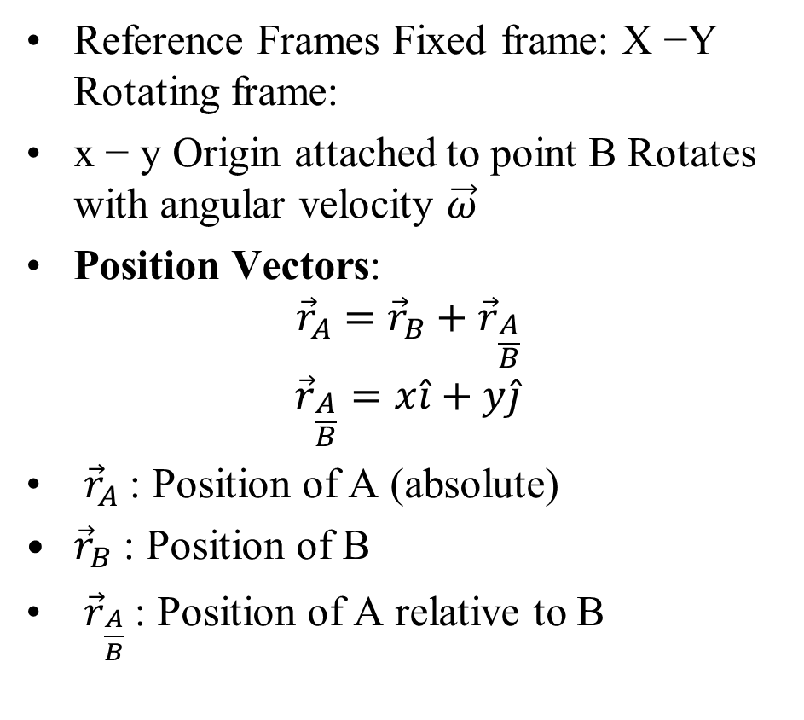
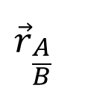


Position Vector in Rotating Frame
Reference Frames Fixed frame: X −Y Rotating frame:
x − y Origin attached to point B Rotates with angular velocity $\vec{ω}$
Position Vectors:
$${\vec{r}}_{A}={\vec{r}}_{B}+{\vec{r}}_{\frac{A}{B}}$$
$${\vec{r}}_{\frac{A}{B}}=x\hat{i}+y\hat{j}$$
${\vec{r}}_{A}$: Position of A (absolute)
${\vec{r}}_{B}$ : Position of B
${\vec{r}}_{\frac{A}{B}}$: Position of A relative to B
$${\vec{r}}_{\frac{A}{B}}$$
$${\vec{r}}_{A}$$
$${\vec{r}}_{B}$$

Slide 25
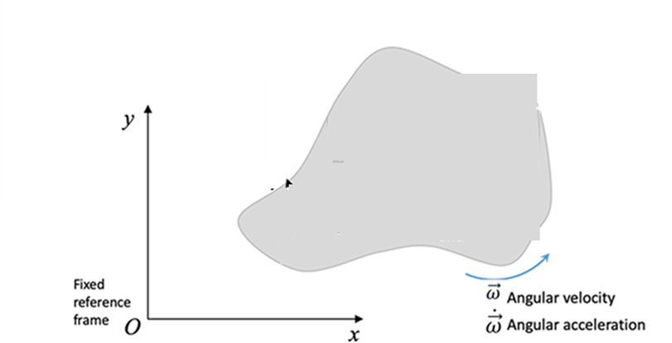

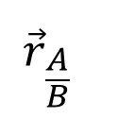

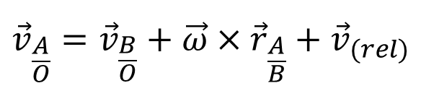
Velocity due to CoD of Unit Vectors
A
$${\vec{v}}_{\left(rel\right)}$$
$${\vec{r}}_{\frac{A}{B}}$$
B
$${\vec{r}}_{B}$$
The final expression for the velocity of A with respect to the fixed frame is:
Rotating frame velocity:
$${\vec{v}}_{\frac{A}{O}}={\vec{v}}_{\frac{B}{O}}+\vec{ω}×{\vec{r}}_{\frac{A}{B}}+{\vec{v}}_{(rel)}$$

Slide 26
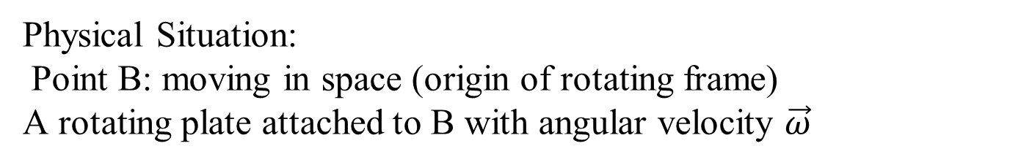
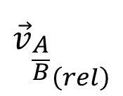
Motion in a Rotating Frame: The Setup
y’
A
$${{\vec{v}}_{\frac{A}{B}}}_{\left(rel\right)}$$
$${\vec{r}}_{\frac{A}{B}}$$
Path of A
B
x’
$${\vec{r}}_{B}$$
Physical Situation:
Point B: moving in space (origin of rotating frame)
A rotating plate attached to B with angular velocity $\vec{ω}$
Particle A sliding in a curved path on the plate

Slide 27
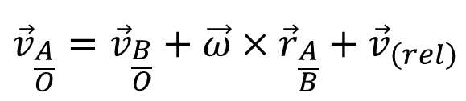
Motion in a Rotating Frame: The Setup
y’
A
$${\vec{v}}_{\left(rel\right)}$$
$${\vec{r}}_{\frac{A}{B}}$$
Path of A
B
x’
$${\vec{r}}_{B}$$
$${\vec{v}}_{\frac{A}{O}}={\vec{v}}_{\frac{B}{O}}+\vec{ω}×{\vec{r}}_{\frac{A}{B}}+{\vec{v}}_{\left(rel\right)}$$
Key Equation:
This equation decomposes the velocity of A into three parts.
Objective: Find the true velocity of A in a fixed (inertial) frame.

Slide 28

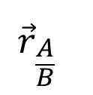

Motion in a Rotating Frame: The Setup
y’
A
$${\vec{v}}_{\left(rel\right)}$$
$${\vec{r}}_{\frac{A}{B}}$$
Path of A
B
x’
$${\vec{r}}_{B}$$
System Characteristics:
Translation (motion of B)
Rotation (spinning plate)
Relative motion (sliding of A)

Slide 29
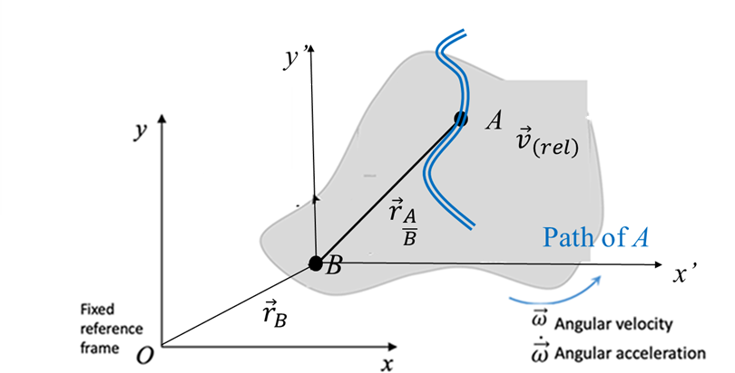
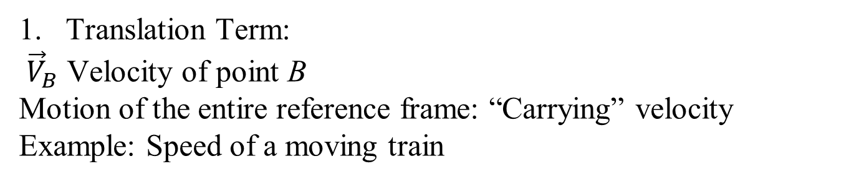
Interpretation of the Velocity Terms
Translation Term:
${\vec{V}}_{B}$ Velocity of point B
Motion of the entire reference frame: “Carrying” velocity
Example: Speed of a moving train

Slide 30

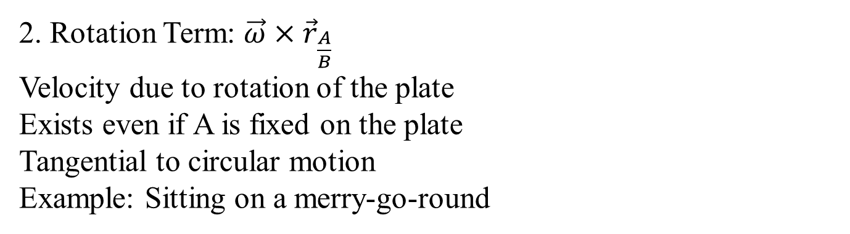
Interpretation of the Velocity Terms
2. Rotation Term: $\vec{ω}×{\vec{r}}_{\frac{A}{B}}$
Velocity due to rotation of the plate
Exists even if A is fixed on the plate
Tangential to circular motion
Example: Sitting on a merry-go-round

Slide 31
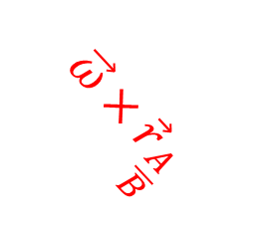
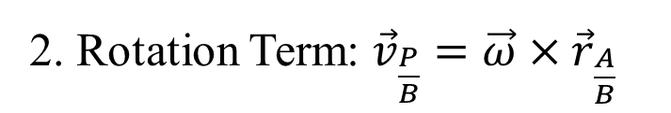
Interpretation of the Velocity Terms
$$\vec{ω}×{\vec{r}}_{\frac{A}{B}}$$
P
2. Rotation Term: ${\vec{v}}_{\frac{P}{B}}=\vec{ω}×{\vec{r}}_{\frac{A}{B}}$

Slide 32
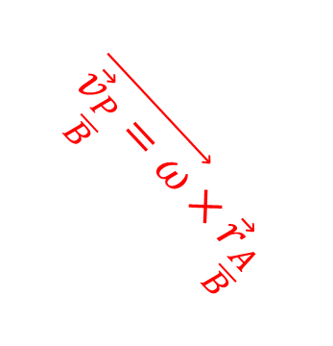
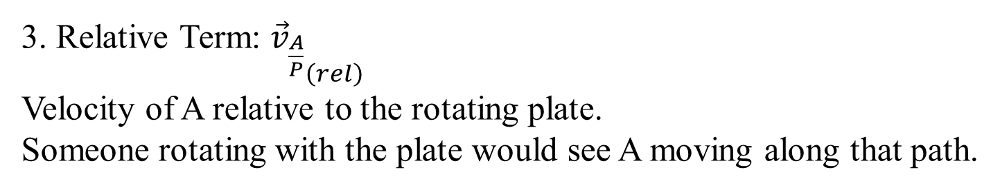
Interpretation of the Velocity Terms
$$\vec{{\vec{v}}_{\frac{P}{B}}=ω}×{\vec{r}}_{\frac{A}{B}}$$
P
3. Relative Term: ${{\vec{v}}_{\frac{A}{P}}}_{\left(rel\right)}$
Velocity of A relative to the rotating plate.
Someone rotating with the plate would see A moving along that path.

Slide 33
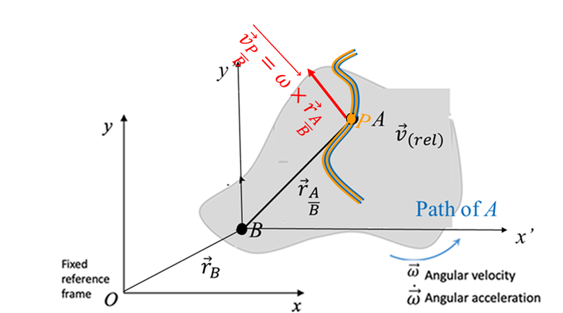
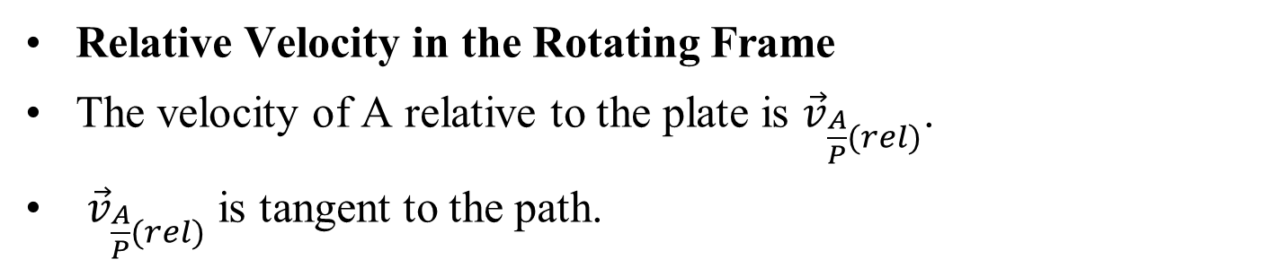
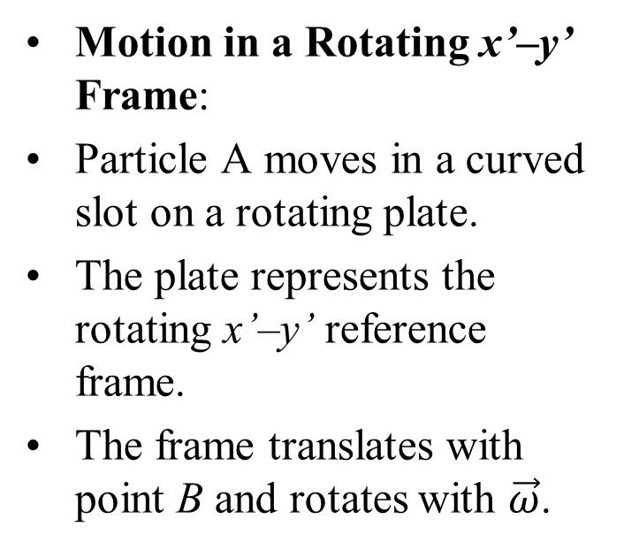
Velocity Decomposition
Motion in a Rotating x’–y’ Frame:
Particle A moves in a curved slot on a rotating plate.
The plate represents the rotating x’–y’ reference frame.
The frame translates with point B and rotates with $\vec{ω}$.
Relative Velocity in the Rotating Frame
The velocity of A relative to the plate is ${\vec{v}}_{\frac{A}{P}(rel)}$.
${\vec{v}}_{\frac{A}{P}(rel)}$is tangent to the path.

Slide 34



Velocity Decomposition
${\vec{v}}_{\frac{A}{P}}$
The magnitude of ${\vec{v}}_{ (rel)}$ is $\dot{s}$, s measured along the path.
This is equivalent to ${\vec{v}}_{\frac{A}{P}}$, where P is fixed to the plate.
Role of Point P is attached to the plate and coincident with A at a given instant.
P moves only due to translation and rotation.

Slide 35



Velocity Decomposition
${\vec{v}}_{\frac{A}{P}}$
Velocity of P relative to B: $\vec{{\vec{v}}_{\frac{P}{B}}}=\vec{ω}×{\vec{r}}_{\frac{A}{B}}$
Velocity Decomposition:
$${\vec{v}}_{\frac{A}{O}}={\vec{v}}_{\frac{B}{O}}+\vec{ω}×{\vec{r}}_{\frac{A}{B}}+{\vec{v}}_{\left(rel\right)}$$

Slide 36



Physical Interpretation and Intuitive Example
$${\vec{v}}_{\frac{A}{O}}={\vec{v}}_{\frac{B}{O}}+\vec{ω}×{\vec{r}}_{\frac{A}{B}}+{\vec{v}}_{\left(rel\right)}$$
Real-Life Analogy A person walking on a spinning platform mounted on a moving truck.
Total velocity: Truck +Spin +Walking
Interpretation of the particle moving on a curved parth attached to a frame that is rotating:
A is carried by B: ${\vec{v}}_{B/O}$
A rotates with the plate: $\vec{ω}×{\vec{r}}_{\frac{A}{B}}$
A slides in the slot: ${\vec{v}}_{\left(rel\right)}$
${\vec{v}}_{A/O}$ = carried motion +spin motion +internal motion

Slide 37


Impact of Change of Direction of Unit Vectors
The small vectors $d{\hat{i}}^{′}$and $d{\hat{j}}^{′}$ describe the change in direction of the unit vectors.
The magnitude of that change is directly related to $\vec{\text{ω}}$, the angular velocity vector of the rigid body and hence the rotating frame.

Slide 38


Impact of Change of Direction of Unit Vectors
$$\frac{d\hat{i^{′}}}{dt}=ω\hat{k}×\hat{i^{′}}=ω\hat{j^{′}}$$
$$\frac{d\hat{j^{′}}}{dt}=ω\hat{k}×\hat{j^{′}}=−ω\hat{i^{′}}$$

Slide 39

Velocity due to CoD of Unit Vectors
The final expression for the velocity of the bug with respect to the fixed frame is:
Rotating frames velocity:
$${\vec{v}}_{\frac{A}{O}}={\vec{v}}_{\frac{B}{O}}+\vec{ω}×\vec{r}+{\vec{v}}_{\left(rel\right)}$$

Slide 40

Derivation of Relative Acceleration: Differentiation
Differentiate Relative Velocity:
$${\vec{v}}_{\frac{A}{O}}={\vec{v}}_{\frac{B}{O}}+\vec{ω}×\vec{r}+{\vec{v}}_{\left(rel\right)}$$
Taking time derivative
$${\vec{a}}_{\frac{A}{O}}={\vec{a}}_{\frac{B}{O}}+\dot{\vec{ω}}×\vec{r}+\vec{ω}×\dot{\vec{r}}+{\dot{\vec{v}}}_{\left(rel\right)}$$
Position Vector in Rotating Frame:
$let \vec{r}=x′\hat{i}+y′\hat{j}$
where $\hat{i} \& \hat{j}$rotate with the plate.
Time Derivative of $\vec{r}$
$\dot{\vec{r}}=\frac{d}{dt}\left(x′\hat{i}+y′\hat{j}\right)={\dot{x}}^{′}\hat{i}+{\dot{y}}^{′}\hat{j}+x^{′}\dot{\hat{i}}+y^{′}\dot{\hat{j}}$
Using definitions of time derivatives of unit vetors:
$$\dot{\vec{r}=}\vec{ω}×\vec{r}+{\vec{v}}_{\left(rel\right)}$$
$$∴\vec{ω}×\dot{\vec{r}}=\vec{ω}×\left(\vec{ω}×\dot{\vec{r}}\right)+\vec{ω}×{\vec{v}}_{\left(rel\right)}$$

Slide 41

Derivation of Relative Acceleration: Differentiation
$${\vec{a}}_{\frac{A}{O}}={\vec{a}}_{\frac{B}{O}}+\dot{\vec{ω}}×\vec{r}+\vec{ω}×\dot{\vec{r}}+{\dot{\vec{v}}}_{\left(rel\right)}$$
$$∴\vec{ω}×\dot{\vec{r}}=\vec{ω}×\left(\vec{ω}×\dot{\vec{r}}\right)+\vec{ω}×{\vec{v}}_{\left(rel\right)}$$
Time Derivative of relative velocity : ${\vec{v}}_{rel}=$ ${\dot{x}}^{′}\hat{i}+{\dot{y}}^{′}\hat{j}$
${\dot{\vec{v}}}_{rel}=\frac{d}{dt}\left({\dot{x}}^{′}\hat{i}+{\dot{y}}^{′}\hat{j}\right)$
${\dot{\vec{v}}}_{rel}=\left({\ddot{x}}^{′}\hat{i}+{\ddot{y}}^{′}\hat{j}\right)+\left({\dot{x}}^{′}\dot{\hat{i}}+{\dot{y}}^{′}\dot{\hat{j}}\right)$
${\dot{\vec{v}}}_{rel}=\vec{ω}×{\vec{v}}_{rel}+{\vec{a}}_{rel}$
Substituting all terms and collect terms to get:
$${\vec{a}}_{\frac{A}{O}}={\vec{a}}_{\frac{B}{O}}+\dot{\vec{ω}}×\vec{r}+\vec{ω}×\left(\vec{ω}×\vec{r}\right)+2\vec{ω}×{\left(\vec{v}\right)}_{rel}+{\left(\vec{a}\right)}_{rel}$$

Slide 42








Components of Acceleration
$$\hat{t}$$
$$\dot{\vec{ω}}×\vec{r}$$
$$\hat{n}$$
$${{\vec{a}}_{rel}}_{t}$$
$$2\vec{ω}×{\left(\vec{v}\right)}_{rel}$$
$${{\vec{a}}_{rel}}_{n}$$
$$\vec{ω}×\left(\vec{ω}×\vec{r}\right)$$
$${\vec{a}}_{\frac{A}{O}}={\vec{a}}_{\frac{B}{O}}+\dot{\vec{ω}}×\vec{r}+\vec{ω}×\left(\vec{ω}×\vec{r}\right)+2\vec{ω}×{\left(\vec{v}\right)}_{rel}+{\left(\vec{a}\right)}_{rel}$$

Slide 43


Derivation of Relative Acceleration: Differentiation
$${\vec{a}}_{\frac{A}{O}}={\vec{a}}_{\frac{B}{O}}+\dot{\vec{ω}}×\vec{r}+\vec{ω}×\left(\vec{ω}×\vec{r}\right)+2\vec{ω}×{\left(\vec{v}\right)}_{rel}+{\left(\vec{a}\right)}_{rel}$$
Physical Interpretation:
${\vec{a}}_{\frac{B}{O}}$: Translational acceleration
$\dot{\vec{ω}}×\vec{r}$: Euler acceleration
$\vec{ω}×\left(\vec{ω}×\vec{r}\right)$: Centrifugal acceleration
$2\vec{ω}×{\left(\vec{v}\right)}_{rel}$: Coriolis acceleration
${\left(\vec{a}\right)}_{rel}$: Relative acceleration

Slide 44


Coriolis Acceleration: Definition
${\vec{a}}_{corio}=2\vec{ω}×{\left(\vec{v}\right)}_{rel}$
Appears in rotating reference frames.
Difference between rotating and inertial acceleration
Direction normal to ${\left(\vec{v}\right)}_{rel}$
Given by right-hand rule
Named after Gaspard Coriolis (1792–1843)

Slide 45

Coriolis Acceleration: Physical Interpretation
${\vec{a}}_{corio}=2\vec{ω}×{\left(\vec{v}\right)}_{rel}$
Consider a rotating disk with:
Constnat Angular velocity:
Particle slides radially Relative speed: $v_{rel}=\dot{x}$
Velocity components:
$\dot{x}$(sliding)
$xω$ (rotation)
Both components change direction, producing Coriolis acceleration.

