Slide 1

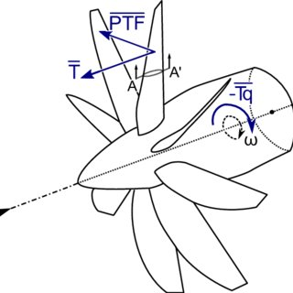
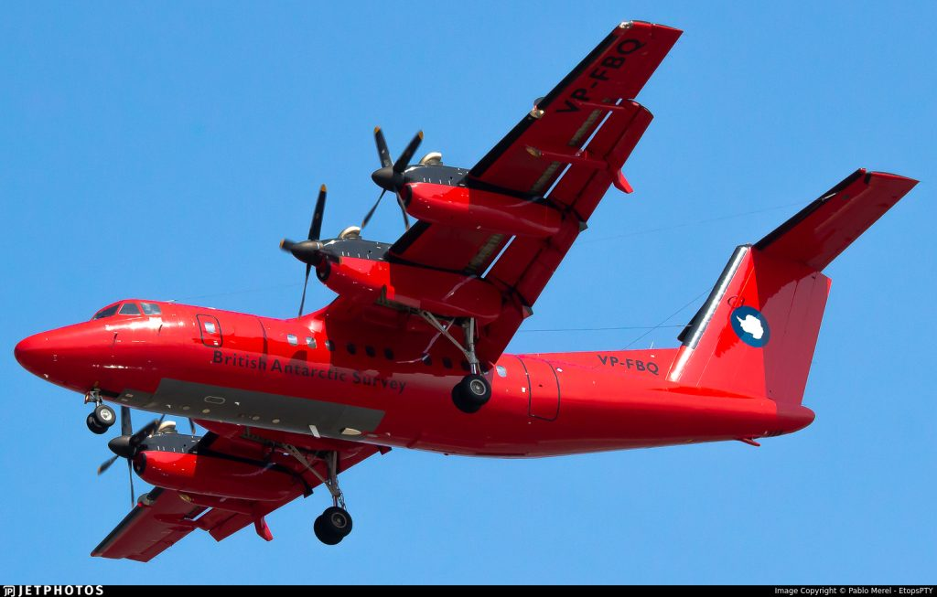

Rotational and Compound Kinematics of Rigid Bodies
P M V Subbarao
Professor & Head
Mechanical Engineering Department
Motion with Translation, Rotation, and Everything Together too

Slide 2

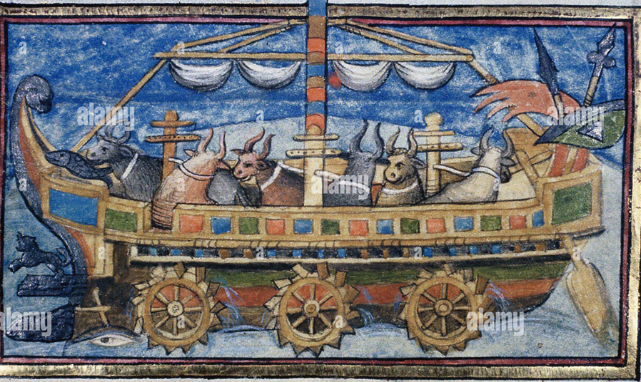
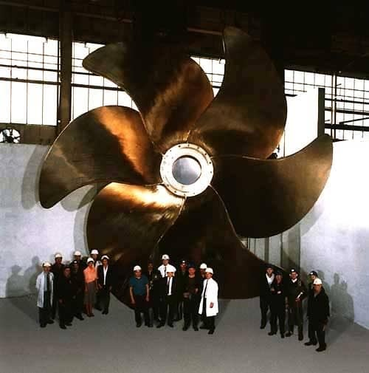
The Symbol of Human Civilization & Trade
4th century anonymous Roman military warship model
The propeller of Emma Maersk, built by Mecklenburger Metallguss GmbH, is the largest ever seen in the maritime industry

Slide 3
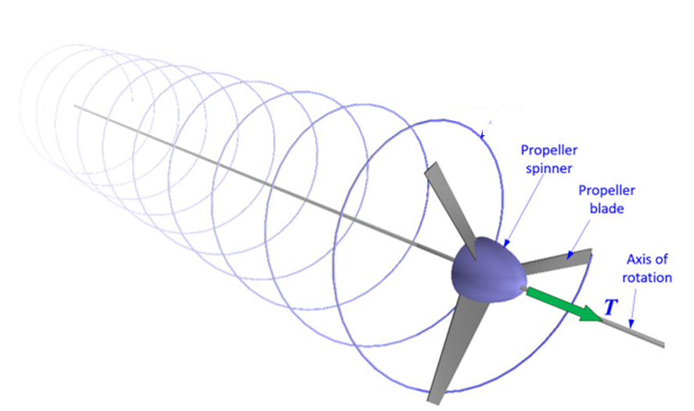
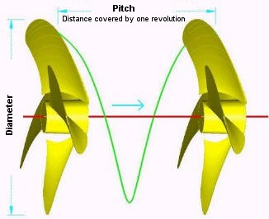
Rigid Body Rotation & Translation

Slide 4
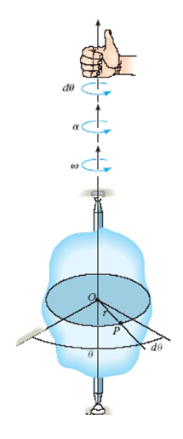
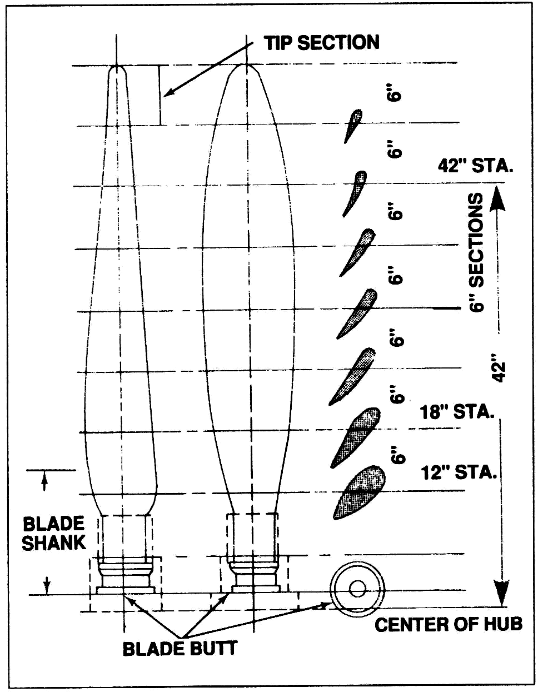
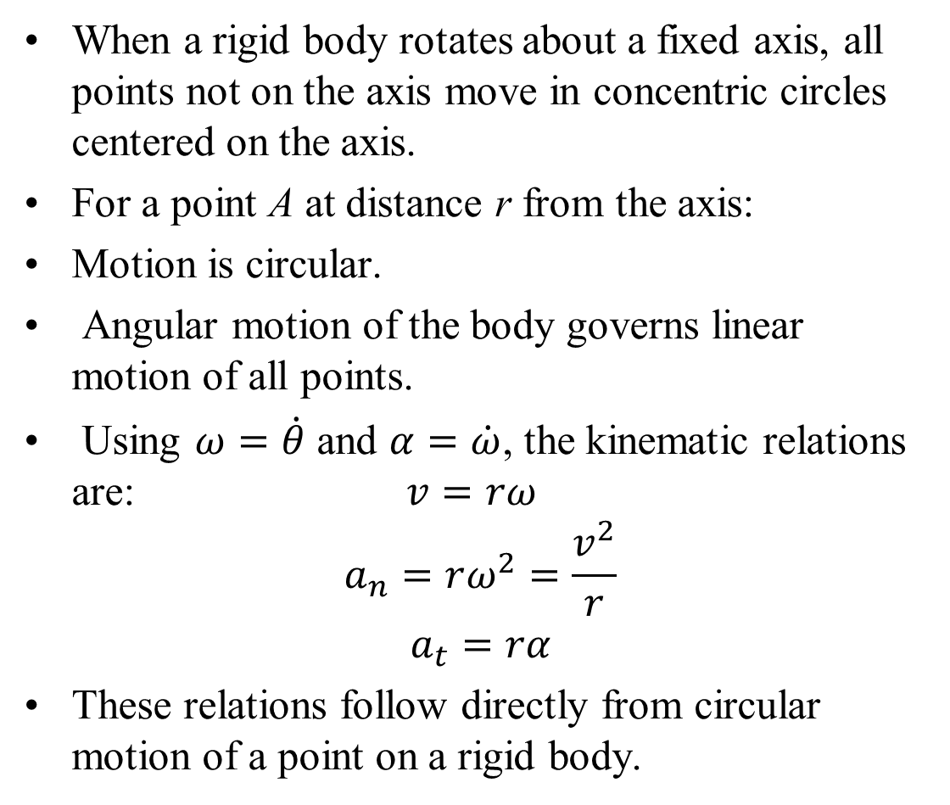
Rigid Body Rotation About a Fixed Axis : Scalar Model
When a rigid body rotates about a fixed axis, all points not on the axis move in concentric circles centered on the axis.
For a point A at distance r from the axis:
Motion is circular.
Angular motion of the body governs linear motion of all points.
Using $ω=\dot{θ}$ and $α=\dot{ω}$, the kinematic relations are: $v=rω$
$$a_{n}=rω^{2}=\frac{v^{2}}{r}$$
$$a_{t}=rα$$
These relations follow directly from circular motion of a point on a rigid body.

Slide 5
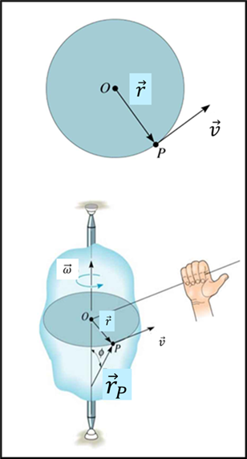
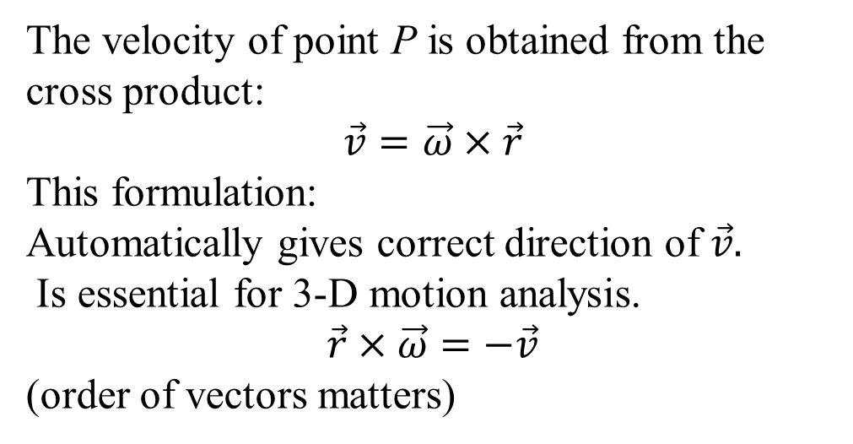
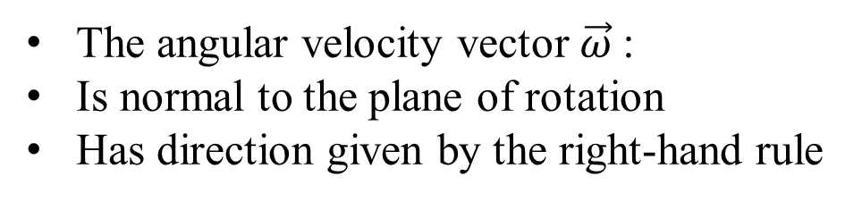
Rotation About a Fixed Axis: Vector Formulation
The angular velocity vector $\vec{ω}$:
Is normal to the plane of rotation
Has direction given by the right-hand rule
The velocity of point P is obtained from the cross product:
$$\vec{v}=\vec{ω}×\vec{r}$$
This formulation:
Automatically gives correct direction of $\vec{v}.$
Is essential for 3-D motion analysis.
$$\vec{r}×\vec{ω}=−\vec{v}$$
(order of vectors matters)

Slide 6
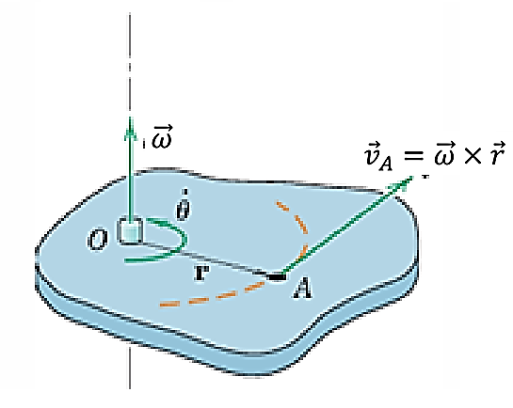
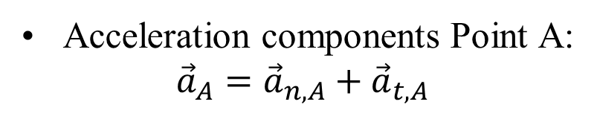
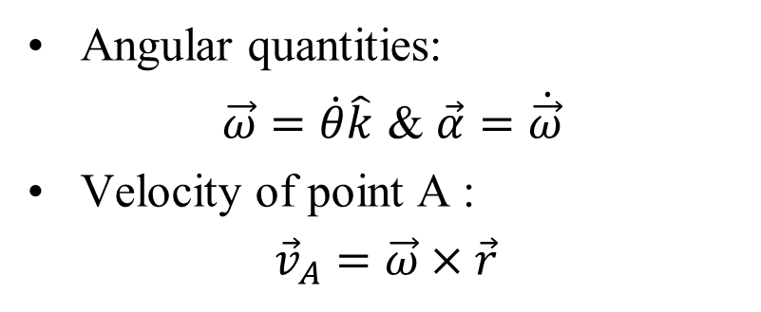
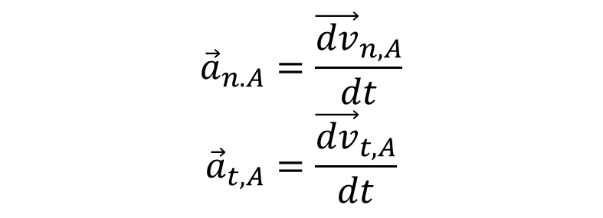

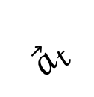
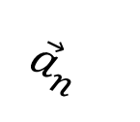
Rotation About a Fixed Axis: Vector Geometry
Angular quantities:
$\vec{ω}=\dot{θ}\hat{k}$ & $\vec{α}=\dot{\vec{ω}}$
Velocity of point A :
${\vec{v}}_{A}=\vec{ω}×\vec{r}$
$${\vec{a}}_{t}$$
Acceleration components Point A:
$${\vec{a}}_{A}={\vec{a}}_{n,A}+{\vec{a}}_{t,A}$$
$${\vec{a}}_{n}$$
$$\vec{r}$$
$${\vec{a}}_{n.A}=\frac{{\vec{dv}}_{n,A}}{dt}$$
$${\vec{a}}_{t,A}=\frac{{\vec{dv}}_{t,A}}{dt}$$
Rotation about fixed axis through O.

Slide 7
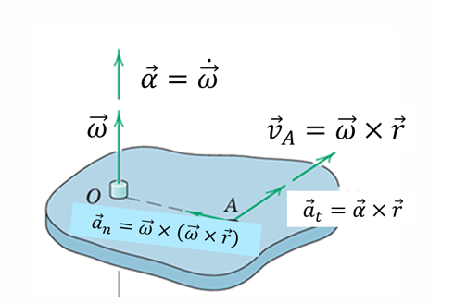
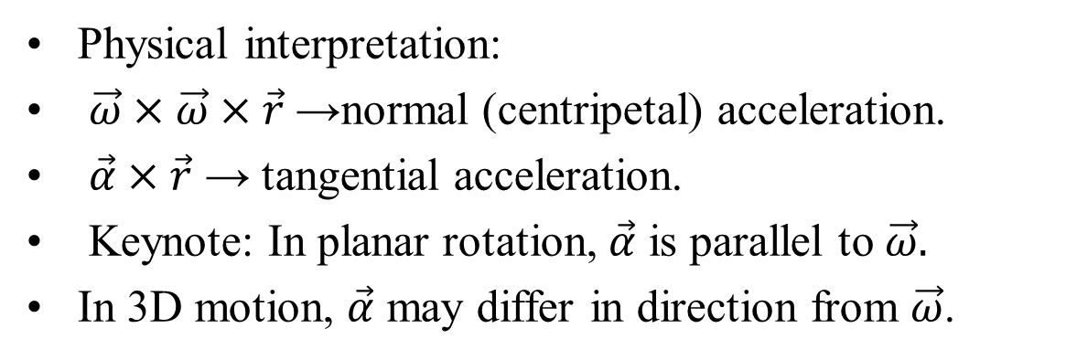
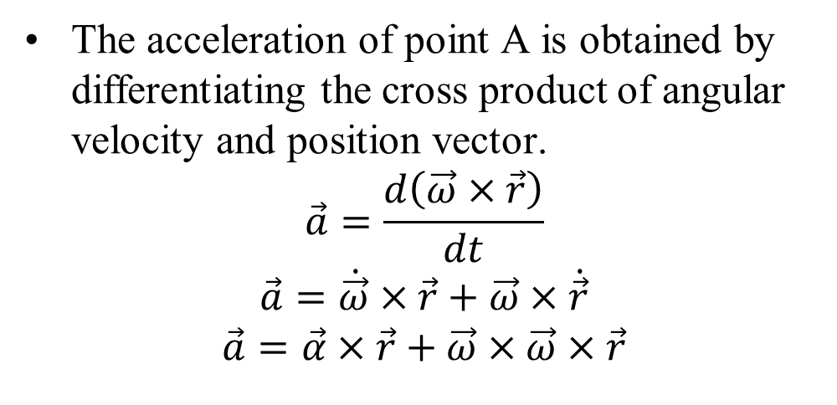
Acceleration from Vector Differentiation
The acceleration of point A is obtained by differentiating the cross product of angular velocity and position vector.
$$\vec{a}=\frac{d\left(\vec{ω}×\vec{r}\right)}{dt}$$
$$\vec{a}=\dot{\vec{ω}}×\vec{r}+\vec{ω}×\dot{\vec{r}}$$
$$\vec{a}=\vec{α}×\vec{r}+\vec{ω}×\vec{ω}×\vec{r}$$
Physical interpretation:
$\vec{ω}×\vec{ω}×\vec{r}$→normal (centripetal) acceleration.
$\vec{α}×\vec{r}$ → tangential acceleration.
Keynote: In planar rotation, $\vec{α}$ is parallel to $\vec{ω}.$
In 3D motion, $\vec{α}$ may differ in direction from $\vec{ω}$.

Slide 8
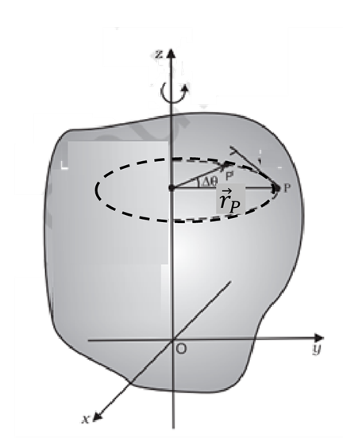
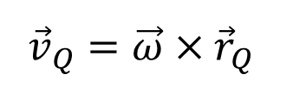
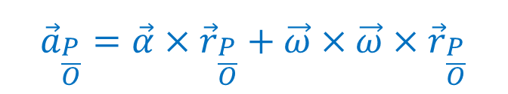
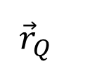
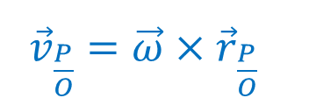

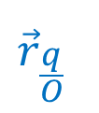

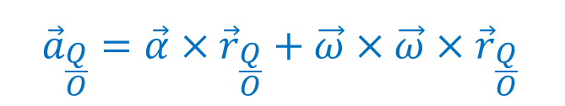
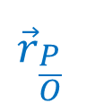
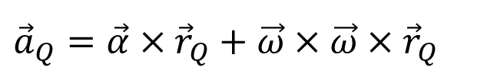
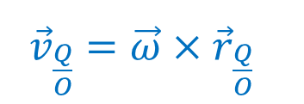
Complete Absolute Motion of A Rigid Body
${\vec{v}}_{P}=\vec{ω}×{\vec{r}}_{P}$
$${\vec{a}}_{P}=\vec{α}×{\vec{r}}_{P}+\vec{ω}×\vec{ω}×{\vec{r}}_{P}$$
${\vec{v}}_{Q}=\vec{ω}×{\vec{r}}_{Q}$
$${\vec{r}}_{\frac{P}{O}}$$
$${\vec{a}}_{Q}=\vec{α}×{\vec{r}}_{Q}+\vec{ω}×\vec{ω}×{\vec{r}}_{Q}$$
$${\vec{r}}_{Q}$$
${\vec{v}}_{\frac{P}{O}}=\vec{ω}×{\vec{r}}_{\frac{P}{O}}$
Q
$${\vec{r}}_{\frac{q}{O}}$$
$${\vec{a}}_{\frac{P}{O}}=\vec{α}×{\vec{r}}_{\frac{P}{O}}+\vec{ω}×\vec{ω}×{\vec{r}}_{\frac{P}{O}}$$
${\vec{v}}_{\frac{Q}{O}}=\vec{ω}×{\vec{r}}_{\frac{Q}{O}}$
$${\vec{a}}_{\frac{Q}{O}}=\vec{α}×{\vec{r}}_{\frac{Q}{O}}+\vec{ω}×\vec{ω}×{\vec{r}}_{\frac{Q}{O}}$$

Slide 9
Absolute Motion
An absolute-motion approach to describe the plane kinematics of rigid bodies using geometric relations and their time derivatives.
Absolute-motion analysis uses the geometry of the body configuration to define position relations.
Velocities and accelerations are obtained by successive time differentiation of these relations.
Key distinction from particle kinematics: Earlier problems involved only linear variables.
Rigid-body motion involves both linear and angular variables.
Their time derivatives therefore produce linear and angular velocities and accelerations.

Slide 10
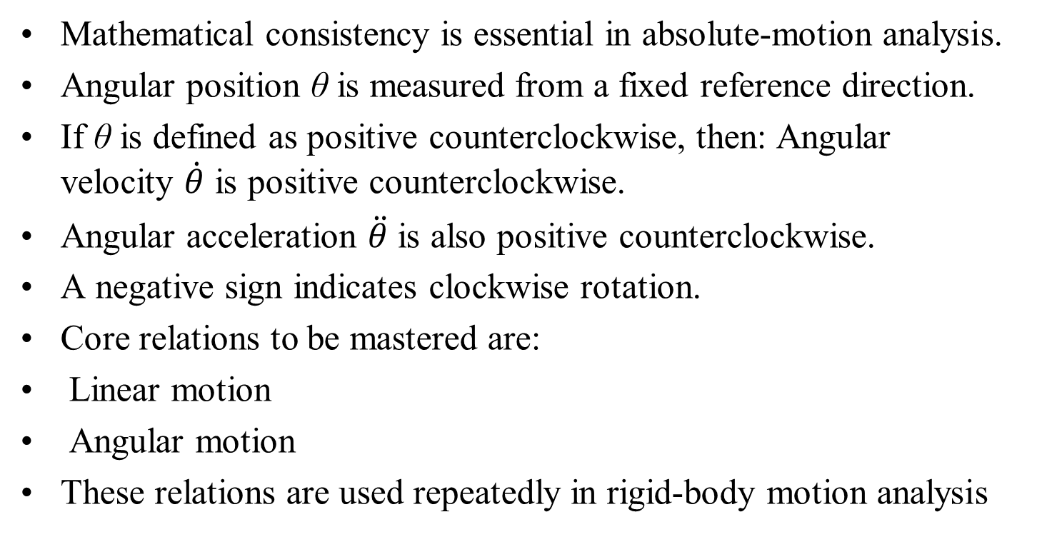
Absolute Motion: Sign Convention
Mathematical consistency is essential in absolute-motion analysis.
Angular position θ is measured from a fixed reference direction.
If θ is defined as positive counterclockwise, then: Angular velocity $\dot{θ}$ is positive counterclockwise.
Angular acceleration $\ddot{θ}$ is also positive counterclockwise.
A negative sign indicates clockwise rotation.
Core relations to be mastered are:
Linear motion
Angular motion
These relations are used repeatedly in rigid-body motion analysis

Slide 11

Relative Velocity in Rigid-Body Motion
Relative :
The practical approach to rigid-body kinematics is based on the principles of relative motion.

Slide 12
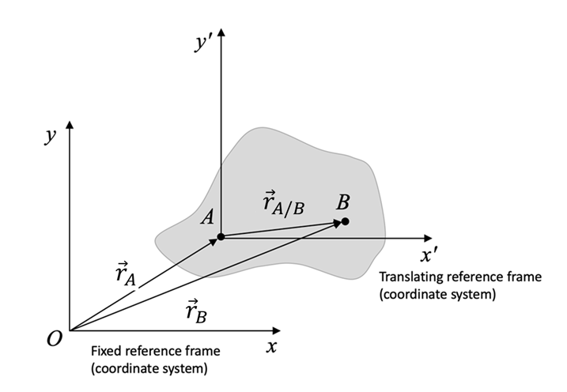
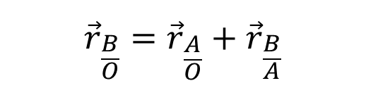
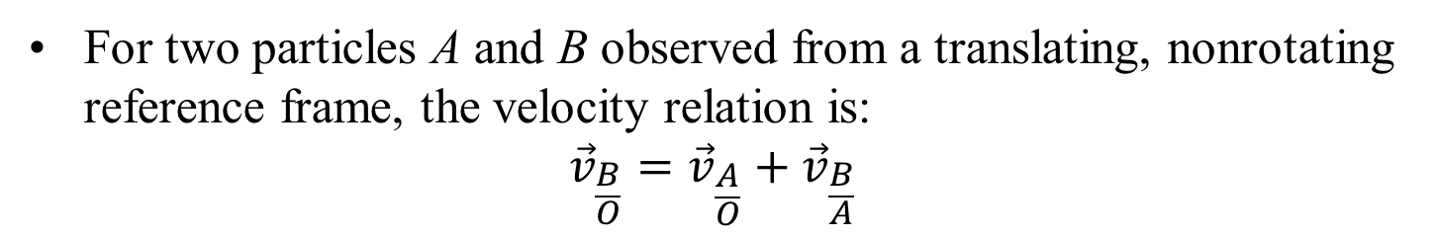
Relative Velocity in Rigid-Body Motion
Translating Axes
Relative Velocity (Translating Axes):
The practical approach to rigid-body kinematics is based on the principles of relative motion.
The Position:
$${\vec{r}}_{\frac{B}{O}}={\vec{r}}_{\frac{A}{O}}+{\vec{r}}_{\frac{B}{A}}$$
For two particles A and B observed from a translating, nonrotating reference frame, the velocity relation is:
$${\vec{v}}_{\frac{B}{O}}={\vec{v}}_{\frac{A}{O}}+{\vec{v}}_{\frac{B}{A}}$$

Slide 13
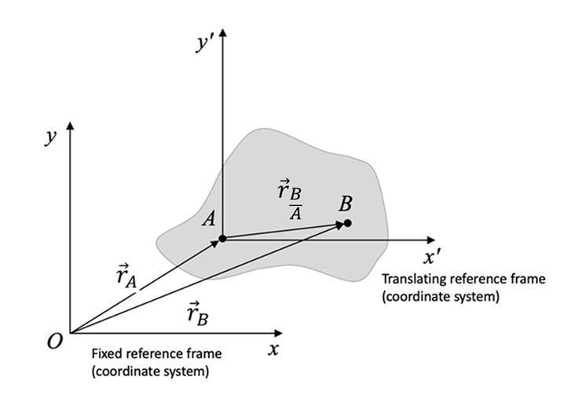
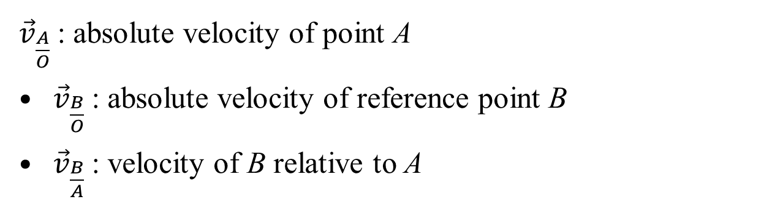
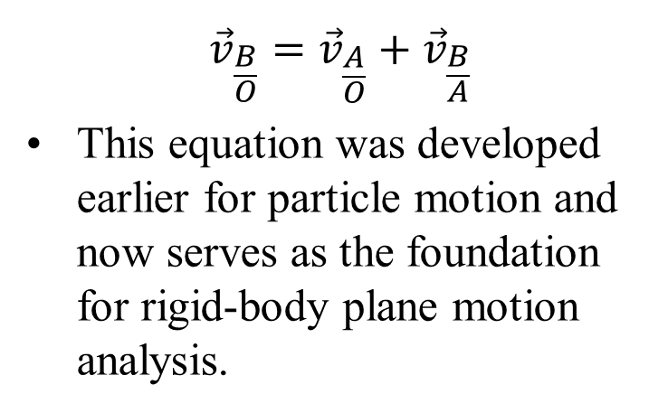
Relative Velocity in Rigid-Body Motion
$${\vec{v}}_{\frac{B}{O}}={\vec{v}}_{\frac{A}{O}}+{\vec{v}}_{\frac{B}{A}}$$
This equation was developed earlier for particle motion and now serves as the foundation for rigid-body plane motion analysis.
${\vec{v}}_{\frac{A}{O}}$: absolute velocity of point A
${\vec{v}}_{\frac{B}{O}}$: absolute velocity of reference point B
${\vec{v}}_{\frac{B}{A}}$: velocity of B relative to A

Slide 14

Relative Acceleration in Rigid-Body Translation
The Acceleration Relation:
$${\vec{a}}_{\frac{B}{O}}={\vec{a}}_{\frac{A}{O}}+{\vec{a}}_{\frac{B}{A}}$$

Slide 15
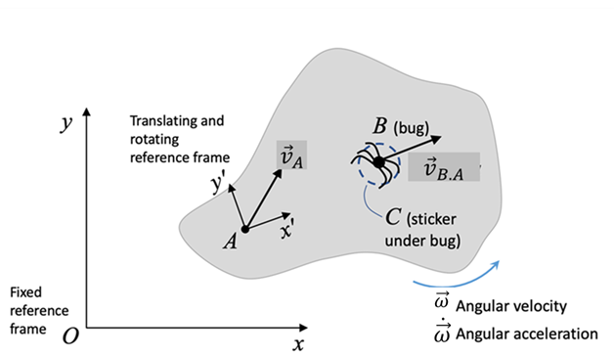
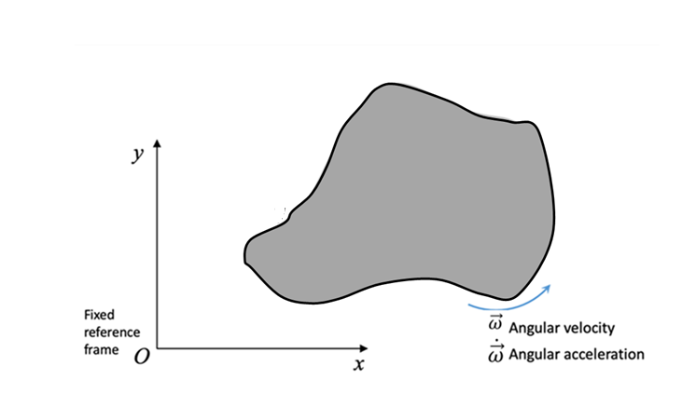

Relative Velocity Due to Rotation
Consider a reference frame that is attached to a point on the rigid body and both rotating and translating with the rigid body.
Introduce few extra terms to account for the rotation of the frame.

Slide 16
Relative Velocity Due to Rotation
Consider a rigid body with frame x'y'z’ at point A.
x'y'z' translates and rotates with the body.

Slide 17
Relative Velocity Due to Rotation
A bug, B, is crawling along the body.

Slide 18
Relative Velocity Due to Rotation
For an observer sitting at A, the bug appears to be crawling away in a straight line.
But for an observer sitting at O, the bug does not look like it is moving in a straight line, because the body it is crawling on is also moving (translating and rotating).

Slide 19
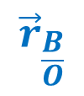
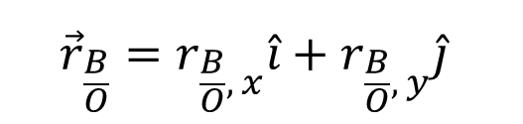
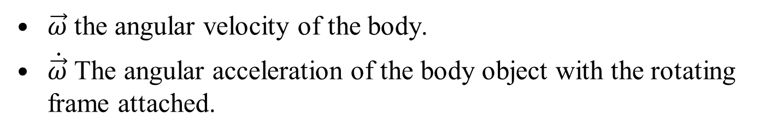
Relative Velocity Due to Rotation
Description of the motion of the bug as seen by an observer at O.
The position vector of the bug is defined as:
$${\vec{r}}_{\frac{B}{O}}=r_{\frac{B}{O}, x}\hat{i}+r_{\frac{B}{O}, y}\hat{j}$$
$${\vec{r}}_{\frac{B}{O}}$$
$\vec{ω}$ the angular velocity of the body.
$\dot{\vec{ω}}$ The angular acceleration of the body object with the rotating frame attached.

Slide 20
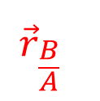
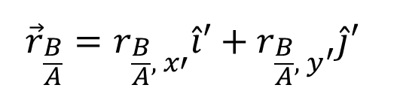
Relative Velocity Due to Rotation
The direction of unit vectors attached to a rotating body, changes due to rotation of rigid body.
Same must be accounted while deriving velocity and acceleration expressions.
$${\vec{r}}_{\frac{B}{A}}=r_{\frac{B}{A}, x′}\hat{i}′+r_{\frac{B}{A}, y^{′}}\hat{j}′$$
$${\vec{r}}_{\frac{B}{A}}$$

Slide 21
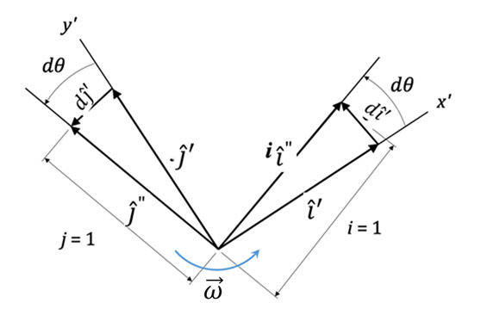
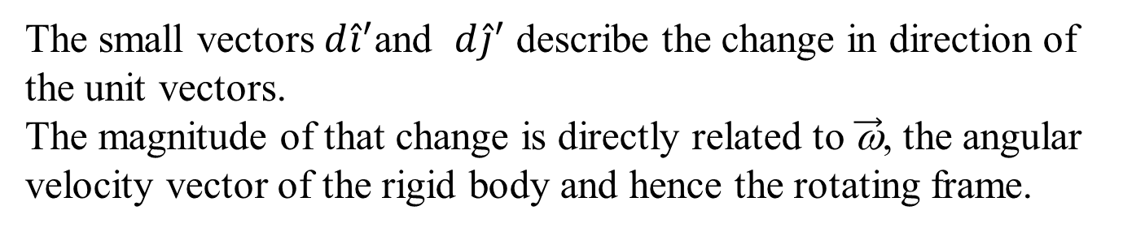
Impact of Change of Direction of Unit Vectors
The small vectors $d{\hat{i}}^{′}$and $d{\hat{j}}^{′}$ describe the change in direction of the unit vectors.
The magnitude of that change is directly related to $\vec{\text{ω}}$, the angular velocity vector of the rigid body and hence the rotating frame.

Slide 22
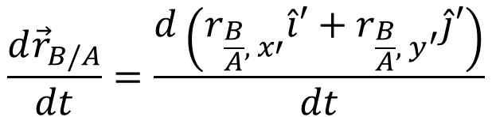
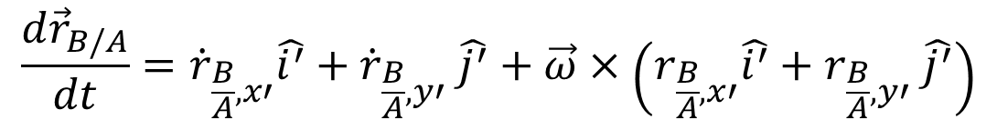
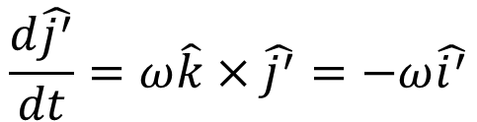

Impact of Change of Direction of Unit Vectors
$$\frac{d\hat{i^{′}}}{dt}=ω\hat{k}×\hat{i^{′}}=ω\hat{j^{′}}$$
$$\frac{d\hat{j^{′}}}{dt}=ω\hat{k}×\hat{j^{′}}=−ω\hat{i^{′}}$$
When the relative position of the bug, B, is differentiated with respect to the rotating frame, A, we have:
$$\frac{d{\vec{r}}_{B/A}}{dt}=\frac{d\left(r_{\frac{B}{A}, x′}\hat{i}′+r_{\frac{B}{A}, y^{′}}\hat{j}′\right)}{dt}$$
$$\frac{d{\vec{r}}_{B/A}}{dt}={\dot{r}}_{\frac{B}{A}, x′}\hat{i^{′}}+{\dot{r}}_{\frac{B}{A}, y′} \hat{j^{′}}+\vec{ω}×\left(r_{\frac{B}{A}, x′}\hat{i^{′}}+r_{\frac{B}{A}, y′} \hat{j^{′}}\right)$$

Slide 23



Impact of Change of Direction of Unit Vectors
$$\frac{d{\vec{r}}_{B/A}}{dt}={\dot{r}}_{\frac{B}{A}, x′}\hat{i^{′}}+{\dot{r}}_{\frac{B}{A}, y′} \hat{j^{′}}+\vec{ω}×\left(r_{\frac{B}{A}, x′}\hat{i^{′}}+r_{\frac{B}{A}, y′} \hat{j^{′}}\right)$$
New term:
$${\dot{r}}_{\frac{B}{A}, x′}\hat{i^{′}}+{\dot{r}}_{\frac{B}{A}, y′} \hat{j^{′}}={{\vec{v}}_{\frac{B}{A}}}_{\left(rel\right)}$$
Same as before:
$$\vec{ω}×\left({\vec{r}}_{\frac{B}{A}, x′}\hat{i^{′}}+{\dot{r}}_{\frac{B}{A}, y′} \hat{j^{′}}\right)=\vec{ω}×{\vec{r}}_{\frac{B}{A}}$$

Slide 24

Acceleration due to CoD of Unit Vectors
$${\dot{r}}_{\frac{B}{A}, x′}\hat{i^{′}}+{\dot{r}}_{\frac{B}{A}, y′} \hat{j^{′}}={{\vec{v}}_{\frac{B}{A}}}_{\left(rel\right)}$$
This new term describes the motion of the bug due to the rotation of the rigid body (and the x'y'z' frame), while the familiar term above describes the motion of the bug as seen by an observer fixed to x'y'z’.
Our final expression for the velocity of the bug with respect to the fixed frame is:

Slide 25


Velocity due to CoD of Unit Vectors
The same formulation can be used if if A is chosen as the bug and B as the reference point.
The final expression for the velocity of the bug with respect to the fixed frame is:
Rotating frames velocity:
$${\vec{v}}_{\frac{B}{O}}={\vec{v}}_{\frac{A}{O}}+\vec{ω}×{\vec{r}}_{\frac{A}{B}}+{{\vec{v}}_{\frac{B}{A}}}_{\left(rel\right)}$$
Note that ${{\vec{v}}_{\frac{B}{A}}}_{\left(rel\right)}=0$ if the bug is not moving.

