Slide 1


History & Tradition of Engineering Mechanics
P M V Subbarao
Professor & Head
Mechanical Engineering Department
Nature Driven Practice of Extrasomatic Mechanics By Humans ….
An Interplay between Practice & Theory

Slide 2

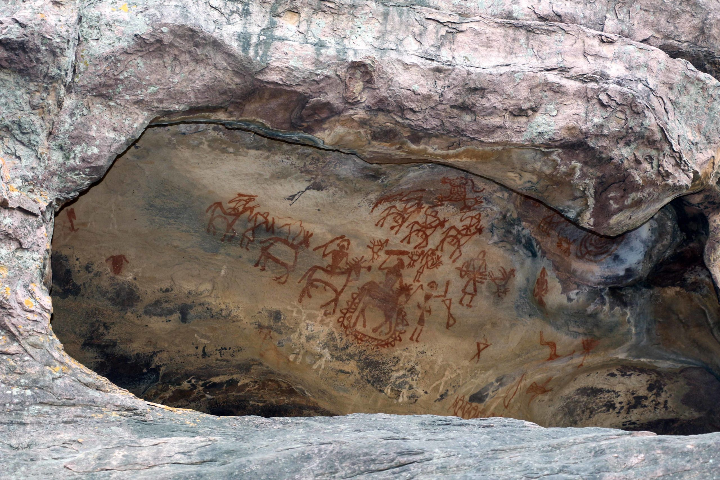
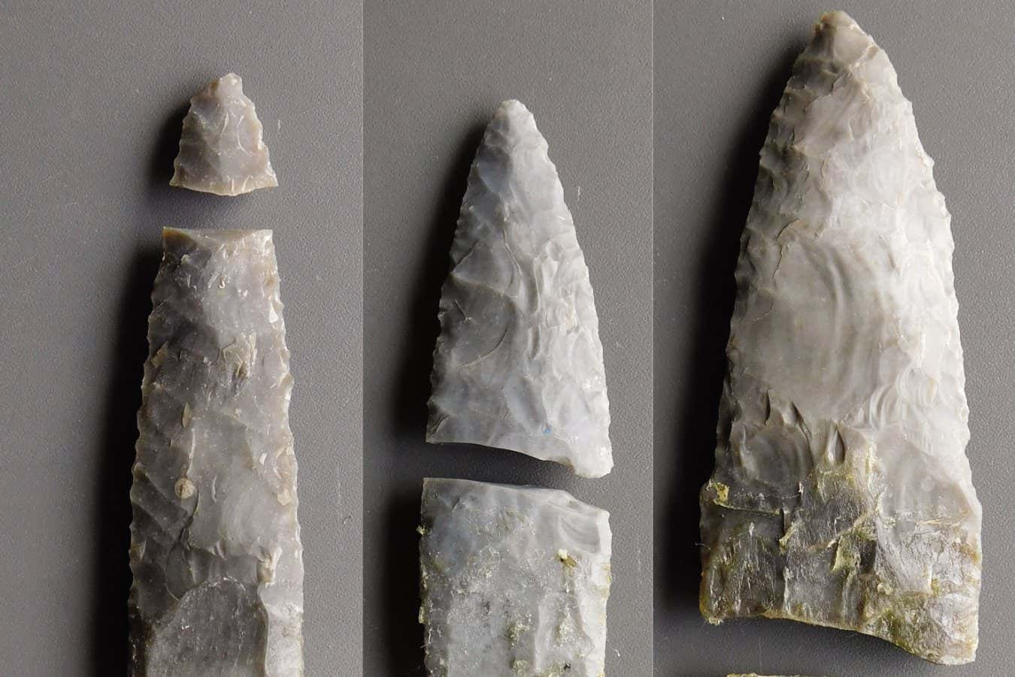
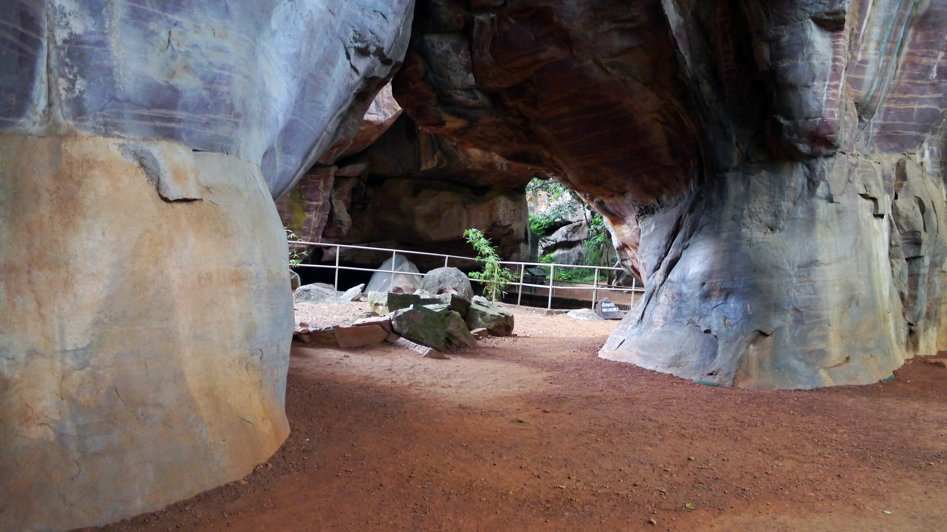
Practice of Mechanics :
Somatic Needs to Extrasomatic Needs:
Bhimbetka cave paintings: ~ 7000 BC Prehistoric paintings found on the Bhimbetka rock shelters in the Raisen district of present-day Madhya Pradesh.

Slide 3
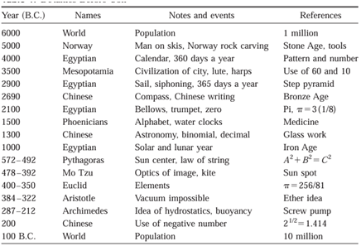
Development of Mechanics Before Common Era B.C.

Slide 4
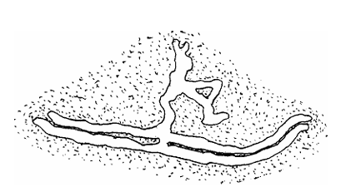
Mechanics as a Sequel of Human Ingenuity
Stone and Bronze Ages ~5,000 ± 2,000B.C.:
The population of the world was just over one million.
Human's ingenuity mainly dealt with
basic tools,
construction,
forces,
overcoming friction,
sailing, movement of water, mining, and
the sounds of music from drums, lutes, harps, lyres, trumpets, and bells.
These Primitive engineers were less sophisticated in their knowledge of Engineering Mechanics.
They had not studied electricity, magnetism, or chemistry.

Slide 5
Mechanics as a Sequel of Human Ingenuity
600 to 500 B.C.
The mathematics of algebra, geometry, arithmetic, and measurements were used in the design and construction of pyramids, ships, tools, houses, chariot wheels, and the charting of the sky.
In the modern perspective the night sky with fascinating constellations was the only television channel for our early ancestors.
Arithmetic numbers based on 10 and 60 were used in astronomy, computing the time of year, and the calendar.
Ref: Some Historical and Future Aspects of Engineering Mechanics Downloaded from ascelibrary.org by Indian Institute Of Technology Delhi on 12/23/25. Copyright ASCE. For personal use only; all rights reserved. Ching-Jen Chen1 and Yousef Haik: J. Eng. Mech., 2002, 128(12): 1242-1253

Slide 6
Aristotelian Origins of Mechanics
384 – 322 BC
Science of Natural Motions:
Aristotelian mechanics, dominant for nearly 2,000 years.
Two realms of Motion

Slide 7
Core Principles of Aristotelian Mechanics
Two Realms:
A perfect, unchanging celestial realm (ether, circular motion).
An imperfect, changing terrestrial realm (earth, air, fire, water, straight-line motion).
Natural Place & Motion: Everything has a natural place; objects move to return there (e.g., stones down, fire up).
Violent Motion: Any motion away from the natural place, requiring a continuous external force (e.g., Projectiles).
Force & Resistance: Velocity was proportional to motive force (weight) and inversely proportional to resistance (medium), meaning heavier objects fell faster.

Slide 8
Core Principles of Aristotelian Mechanics
No Vacuum: A void couldn't exist because objects would move infinitely fast, leading to immediate filling, thus contradicting its nature.
Teleological Explanation: Motion was explained by purpose
The object's inherent tendency to reach its natural state.
No importance to force.

Slide 9
Aristotelian Origins of Mechanics
384 – 322 BC
The AM emphasizing teleology (purpose), defined motion as natural (to place) or violent (forced), and rejected the vacuum, influencing science until Galileo challenged it.

Slide 10
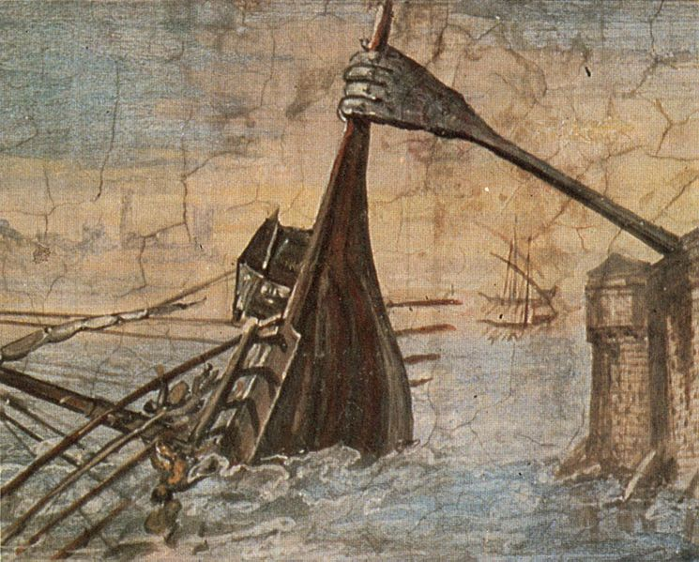
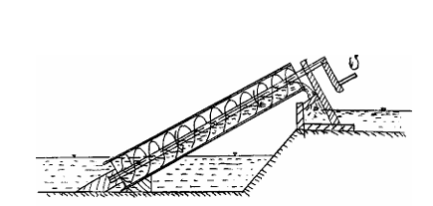
Mechanics as a Sequel: Ingenuity of Archimedes
Archimedes Iron Claw
Archimedes water screw pump invented in 200 B.C

Slide 11
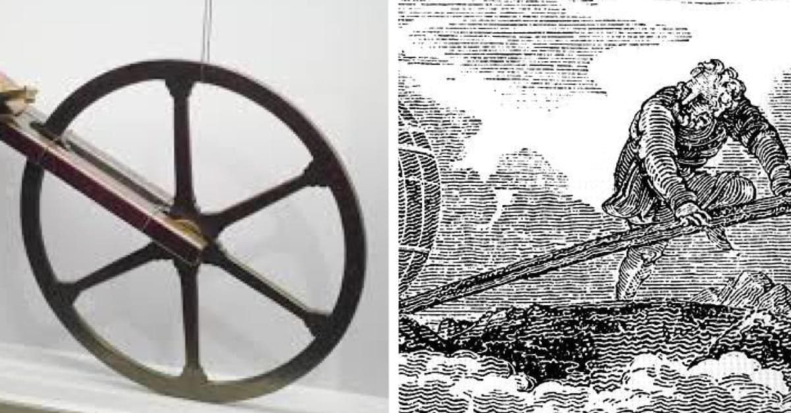
Mechanics as a Sequel: Ingenuity of Archimedes
The odometer

Slide 12
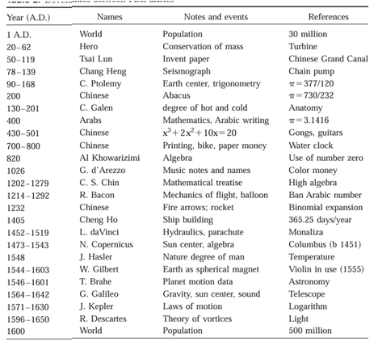
Influence of Mechanics
1st to 16th Centuries

Slide 13
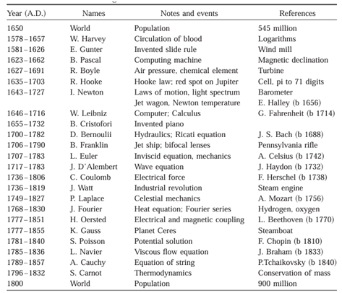
Expeditious Development in 17th & 18th Centuries

Slide 14
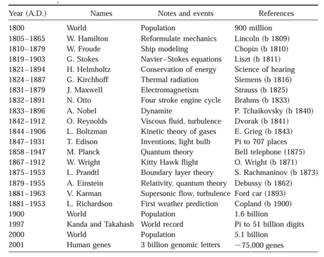
Glory of Mechanics in 19th & 20th Centuries
Practice of Extrasomatic Mechanics Created Extrasomatic Energy Generation and Consumption.

Slide 15
The Tradition of Mechanics
The tradition of mechanics is a millennia - old lineage:
Tradition started with ancient Greek logic (Aristotle) and mathematics (Archimedes) to understand motion,
Evolved through Islamic scholars (Avicenna, al-Khazini) who introduced experimentation, culminating in Newton's foundational laws.
Expanded with Galileo, Huygens, Lagrange, and Einstein, forming classical mechanics (forces, energy, gravity)
and later branching into modern fields like continuum mechanics, quantum mechanics, and engineering applications, blending theory, math, and practical devices

Slide 16
Recapitulation of Ancient Roots
Indian Practitioners: Ancient Civilizations, community level facilities….
Greek Philosophers: Aristotle introduced logical frameworks for motion (natural vs. forced), while Pythagoreans used math for analysis.
Archimedes: Contributed to statics, hydrostatics, and levers, establishing mathematics in mechanics.
Islamic Scholars: Al-Biruni and al-Khazini integrated statics/dynamics and hydrodynamics; Ibn Sina and al-Baghdaadi developed theories on motion and projectiles.

Slide 17
The Classical Revolution
Galileo Galilei: Challenged old ideas, established inertia, and laid groundwork for modern physics.
Isaac Newton: Formulated the universal laws of motion and gravitation, providing the bedrock for "classical mechanics".
18th-19th Centuries: Mathematicians developed analytical mechanics (Lagrange, Hamilton) focusing on energy, and continuum mechanics for materials.

Slide 18
Modern Developments (20th Century & Beyond)
Relativity: Einstein showed Newton's laws weren't universal, valid only at lower speeds.
Quantum Mechanics: Developed to explain the atomic and subatomic world, contrasting classical mechanics.
Engineering: Mechanics became central to engineering, with methods for strength of materials, plasticity, and fluid dynamics (Hero of Alexandria's simple machines foreshadowed this).

Slide 19
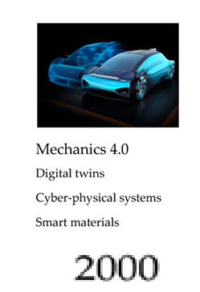
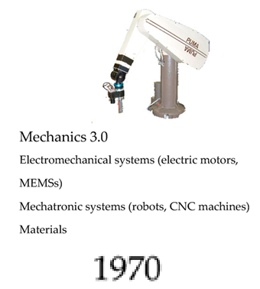
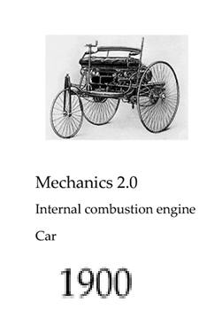
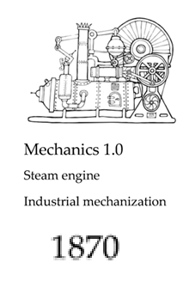
Evolutions of Mechanics in the Industrial Revolutions

Slide 20
Mechanics 4.0
The concept of Mechanics 4.0 was proposed as the interrelation between Mechanical Engineering and artificial intelligence.
The purpose is to model and solve various problems related to multiphysics systems.
These systems represent the basis of many applications in Industry 4.0.
The concept of Mechanics 4.0 is expressed in terms of the four driving forces
as a function of new consumer demands,
new requirements in production systems and their relationships
with disruptive technologies &
basic sciences.

Slide 21
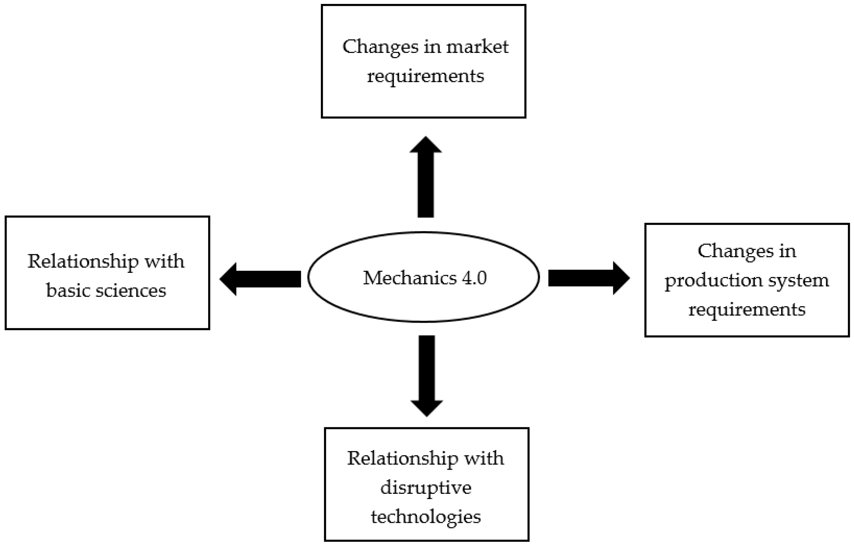
Framework of Mechanics 4.0

Slide 22
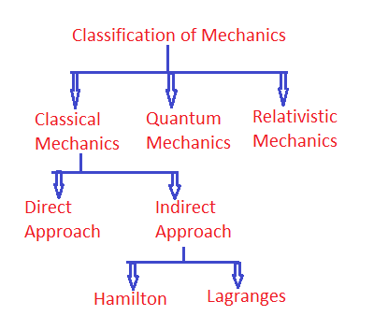
Modern Mechanics

Slide 23
Key Traditions within Mechanics
Vector Formulation: Emphasizes force (Newton, Euler).
Analytic Formulation: Emphasizes work and energy (Leibniz, Lagrange).
Theory & Practice: A continuous interplay, from Hero's devices to modern engineering applications.

