Slide 1



Introduction to Kinematic of Rigid Bodies
P M V Subbarao
Professor & Head
Mechanical Engineering Department
Motion with Translation, Rotation, and Everything in Between

Slide 2

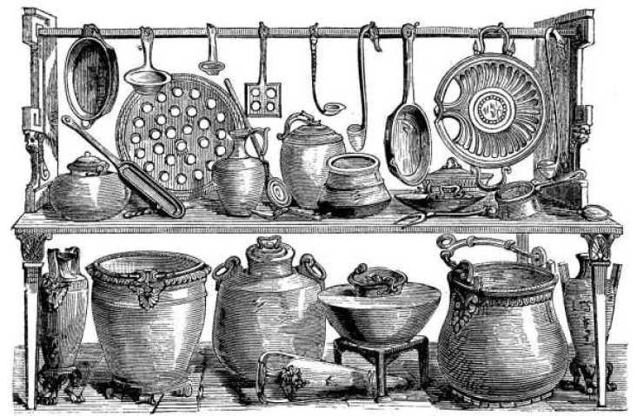
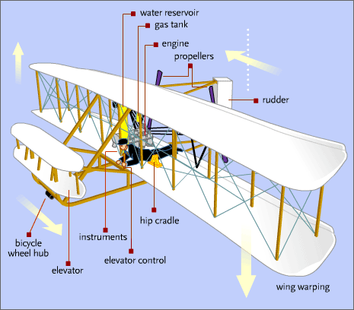

Definition of A Rigid-Body
A rigid body is defined as a system of particles for which the distances between all particles remain constant.
Any point on the body is located by a position vector from reference axes attached to the body.
Relative positions of points on the body do not change with time.
Justification of the assumption: Deformations are usually very small compared to the overall motion of the body.
Example: Aircraft wing deformation due to flutter does not significantly affect the aircraft’s flight path.
The assumption fails when internal deformation (e.g. wing flutter stresses) is of interest.

Slide 3
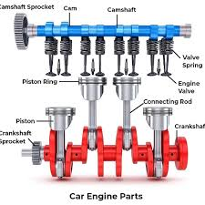
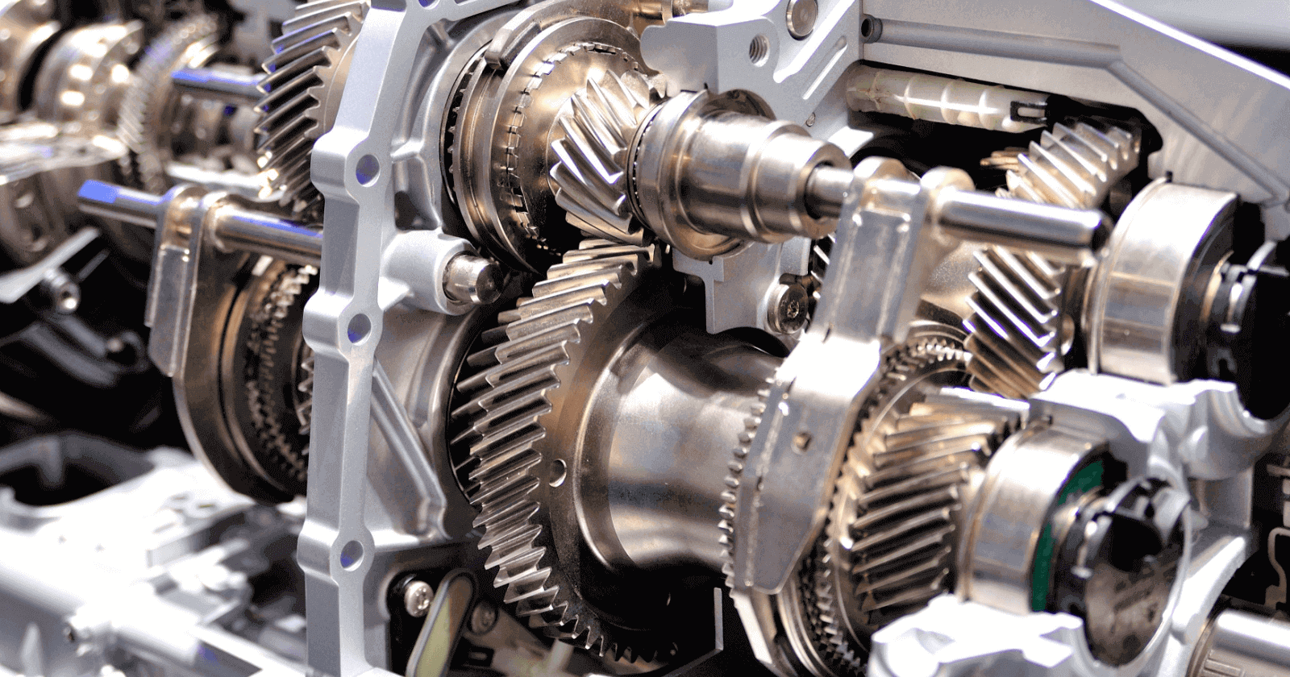
Introduction to Rigid-Body Kinematics
Particle kinematics is focused on displacement, velocity, and acceleration of points moving along straight or curved paths.
Rigid-body kinematics extends these ideas by accounting for the rotation of the body in addition to translation.
Why rigid-body motion must be studied?:
Rigid bodies are used to generate, transmit, and control motion in engineering systems such as cams, gears, and linkages.
Motion analysis is required to determine the geometry and design of mechanical components.
Forces arise due to motion and must be accounted for in design (e.g. rockets under thrust and gravity).
Plane rigid-body motion, is studied before entering into motion in three dimensions.

Slide 4
Plane Motion of a Rigid Body
Important: Most of rigid-body kinematics and dynamics is built on this assumption
A rigid body executes plane motion when all parts of the body move in parallel planes.
The plane of motion is usually chosen to contain the mass center.
The body is idealized as a thin slab whose motion is confined to this plane.
This idealization accurately represents a large class of engineering motions.
The plane motion of a rigid body can be classified into three categories.

Slide 5
Types of Plane Motion
1. Translation Every line in the body remains parallel to its original position.
There is no rotation of any line in the body.
Rectilinear translation: all points move in straight, parallel lines.
Curvilinear translation: all points move on congruent curves.
Motion is fully described by the motion of any single point.
2. Rotation about a Fixed Axis All particles move in circular paths about the axis.
All lines perpendicular to the axis rotate through the same angle in the same time.
3. General Plane Motion A combination of translation and rotation.
Described using relative-motion principles.

Slide 6
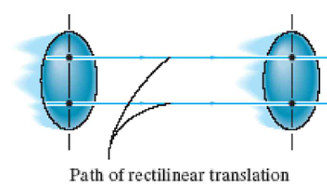

Types of Rigid-Body Plane Motion
Rectilinear translation All points move along parallel straight lines.

Slide 7
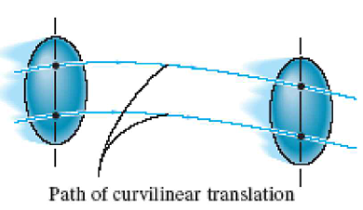
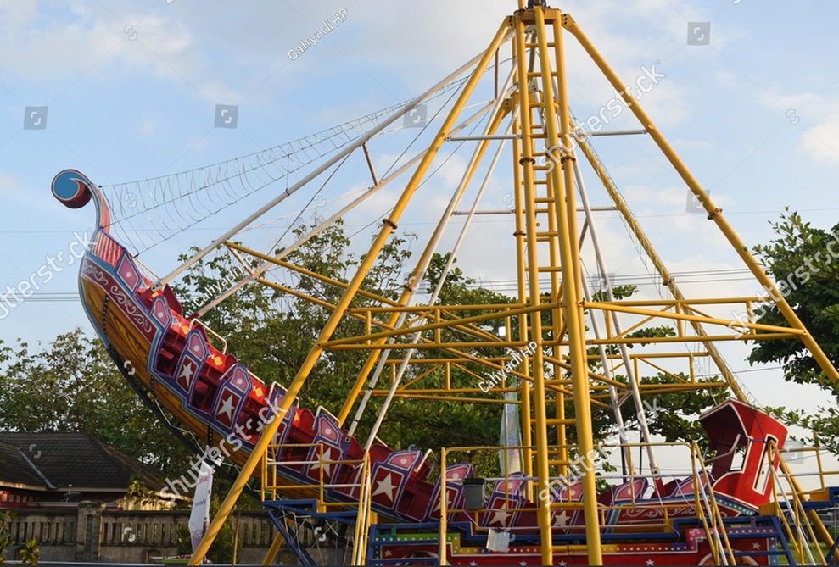
Types of Rigid-Body Plane Motion
Curvilinear translation All points move along congruent curved paths.

Slide 8
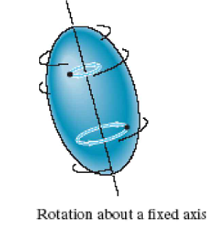
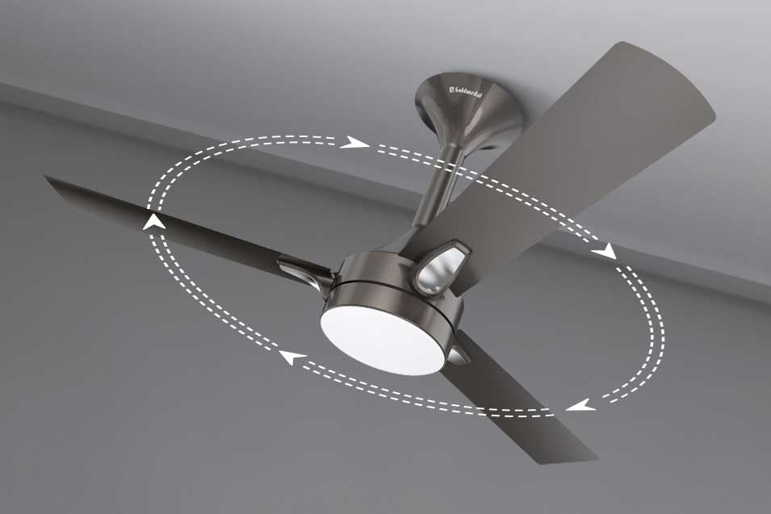
Types of Rigid-Body Plane Motion
Fixed-axis rotation: All points move in circular paths about a fixed axis.

Slide 9
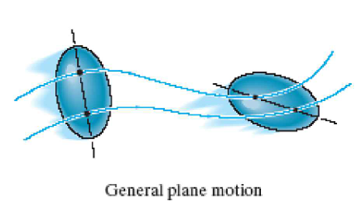
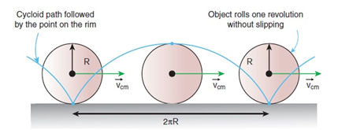
Types of Rigid-Body Plane Motion
General plane motion with Combination of translation and rotation.

Slide 10
Remarks on Plane Motion of Rigid Bodies
In all cases shown, the actual three-dimensional paths of particles are projected onto a single plane of motion.
Analysis of rigid-body plane motion can be carried out by:
Direct calculation of absolute displacements, velocities, and accelerations from geometry, or
Application of relative-motion principles.
Both approaches are important and need to be studied.

Slide 11
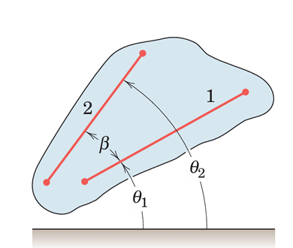
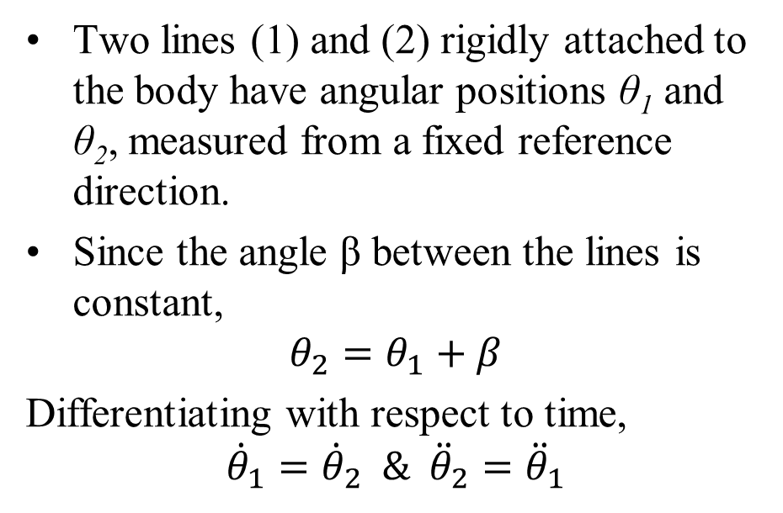
Rotation of a Rigid Body
The rotation of a rigid body is described by its angular motion.
Consider a rigid body undergoing plane motion.
Two lines (1) and (2) rigidly attached to the body have angular positions θ₁ and θ₂, measured from a fixed reference direction.
Since the angle β between the lines is constant,
$$θ_{2}=θ_{1}+β$$
Differentiating with respect to time,
$${\dot{θ}}_{1}={\dot{θ}}_{2} \& {\ddot{θ}}_{2}={\ddot{θ}}_{1}$$

Slide 12
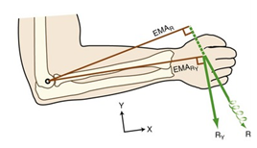
Consequences of Rigid-Body Rotation
All lines in a rigid body undergoing plane rotation have:
the same angular displacement
the same angular velocity
the same angular acceleration
Angular motion depends only on:
angular position relative to a fixed reference
time derivatives of that angular position
No fixed axis is required:
rotation can occur without a physical axis normal to the plane of motion.
Key Result: All points of a rigid body in plane motion share identical angular motion.

Slide 13
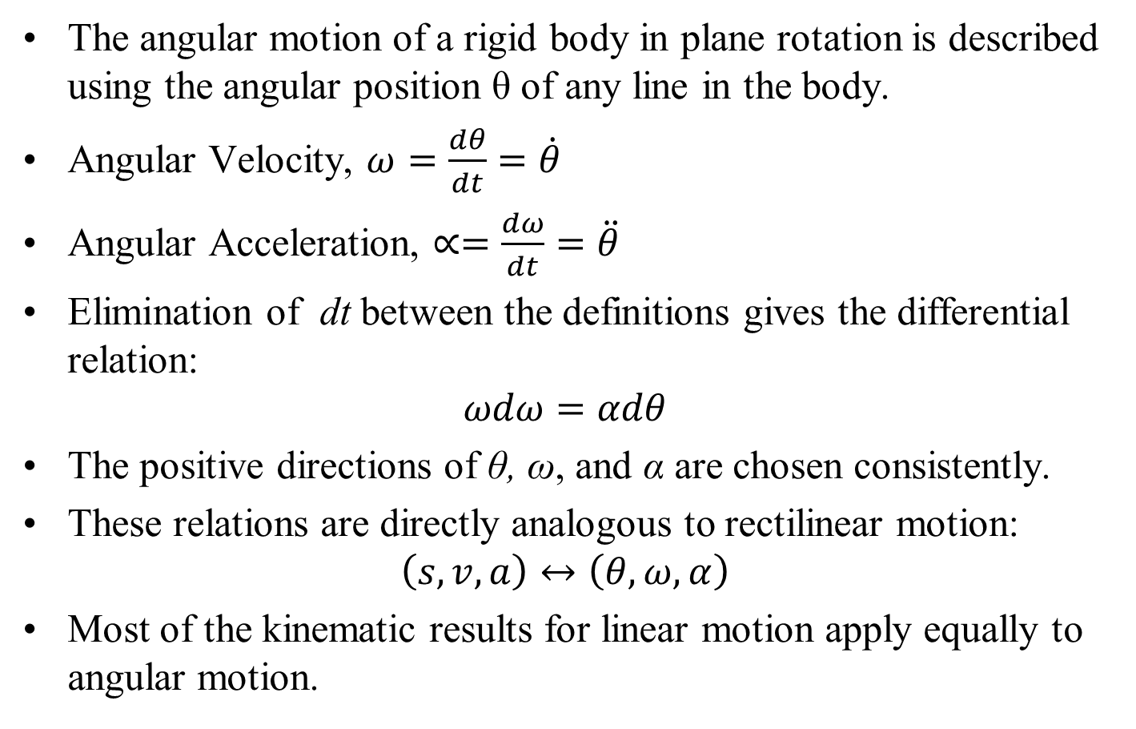
Angular-Motion Relations
The angular motion of a rigid body in plane rotation is described using the angular position θ of any line in the body.
Angular Velocity, $ω=\frac{dθ}{dt}=\dot{θ}$
Angular Acceleration, $∝=\frac{dω}{dt}=\ddot{θ}$
Elimination of dt between the definitions gives the differential relation:
$$ωdω=αdθ$$
The positive directions of θ, ω, and α are chosen consistently.
These relations are directly analogous to rectilinear motion:
$$\left(s,v,a\right)↔\left(θ,ω,α\right)$$
Most of the kinematic results for linear motion apply equally to angular motion.

Slide 14
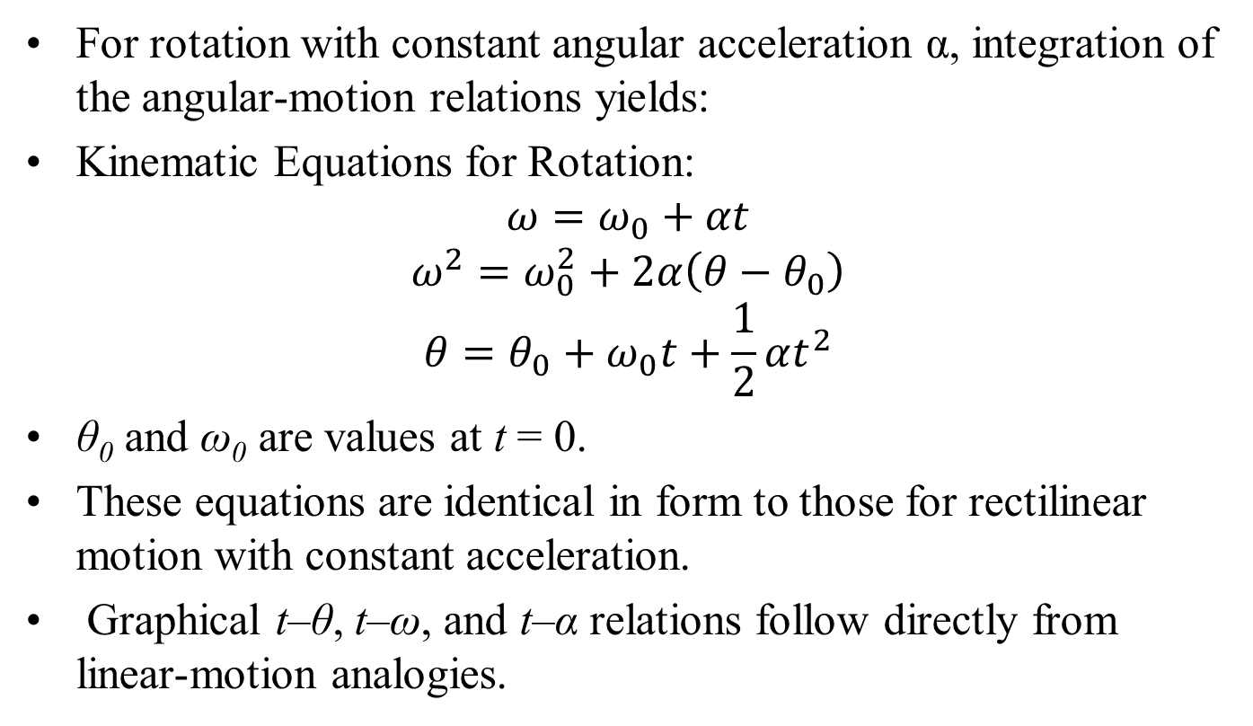
Rotation with Constant Angular Acceleration
For rotation with constant angular acceleration α, integration of the angular-motion relations yields:
Kinematic Equations for Rotation:
$$ω=ω_{0}+αt$$
$$ω^{2}=ω_{0}^{2}+2α\left(θ−θ_{0}\right)$$
$$θ=θ_{0}+ω_{0}t+\frac{1}{2}αt^{2}$$
θ₀ and ω₀ are values at t = 0.
These equations are identical in form to those for rectilinear motion with constant acceleration.
Graphical t–θ, t–ω, and t–α relations follow directly from linear-motion analogies.

Slide 15
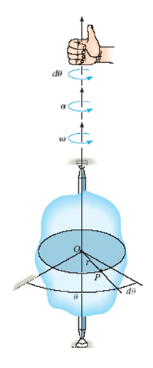
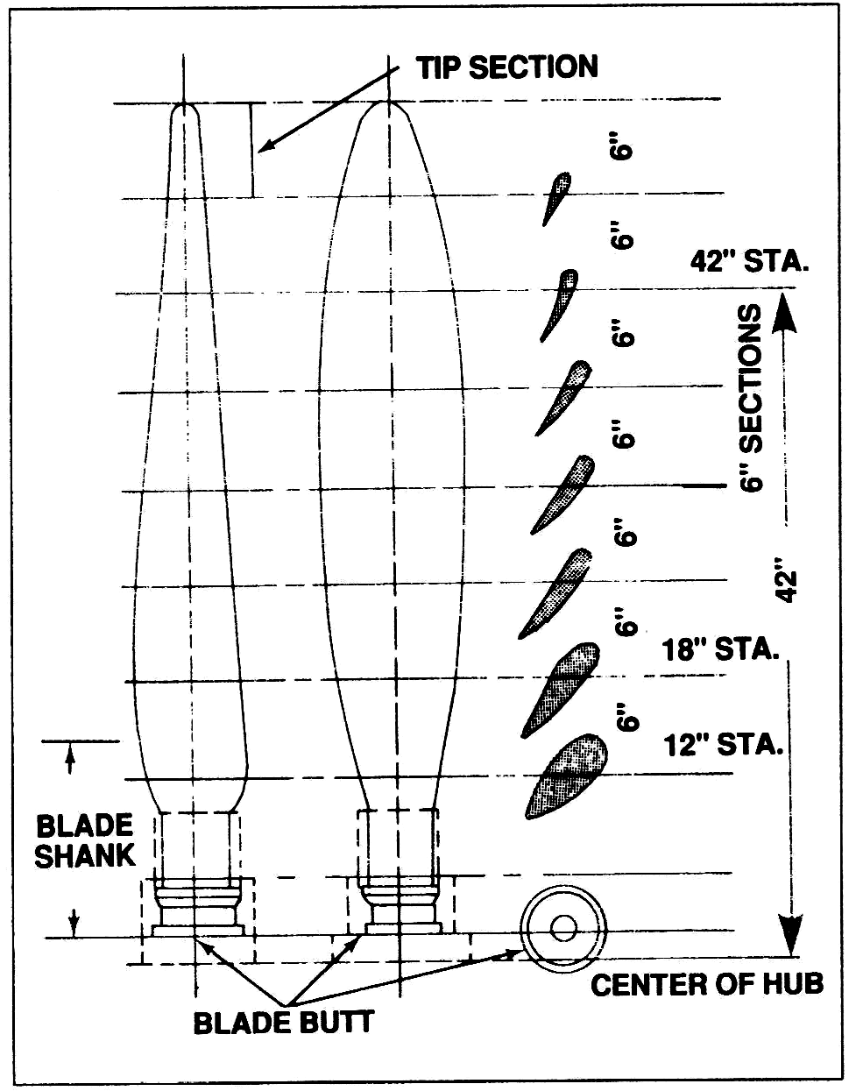
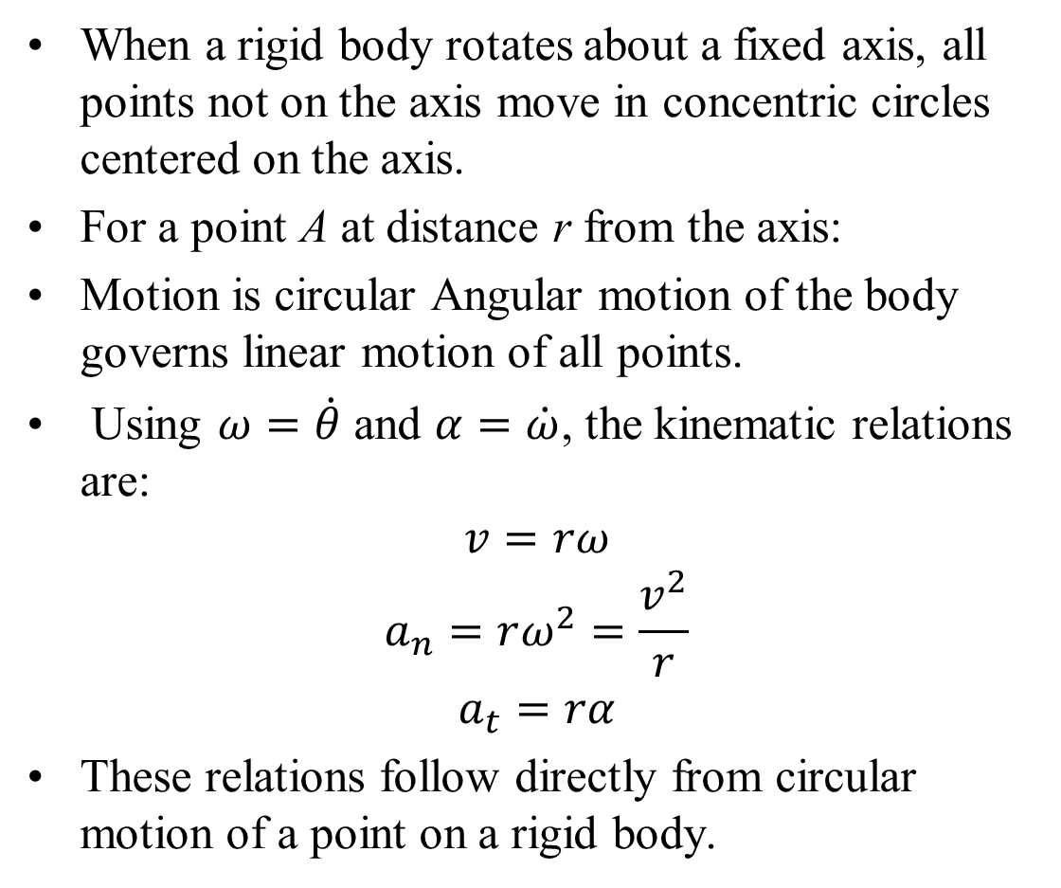
Rotation About a Fixed Axis
When a rigid body rotates about a fixed axis, all points not on the axis move in concentric circles centered on the axis.
For a point A at distance r from the axis:
Motion is circular Angular motion of the body governs linear motion of all points.
Using $ω=\dot{θ}$ and $α=\dot{ω}$, the kinematic relations are:
$$v=rω$$
$$a_{n}=rω^{2}=\frac{v^{2}}{r}$$
$$a_{t}=rα$$
These relations follow directly from circular motion of a point on a rigid body.

