Slide 1


Kinematic of Real-World Movables as Particles
P M V Subbarao
Professor & Head
Mechanical Engineering Department
https://mechanics.ju.se/ParticleKinematics.html
Engineering Every Move: From Drones to Rockets.

Slide 2

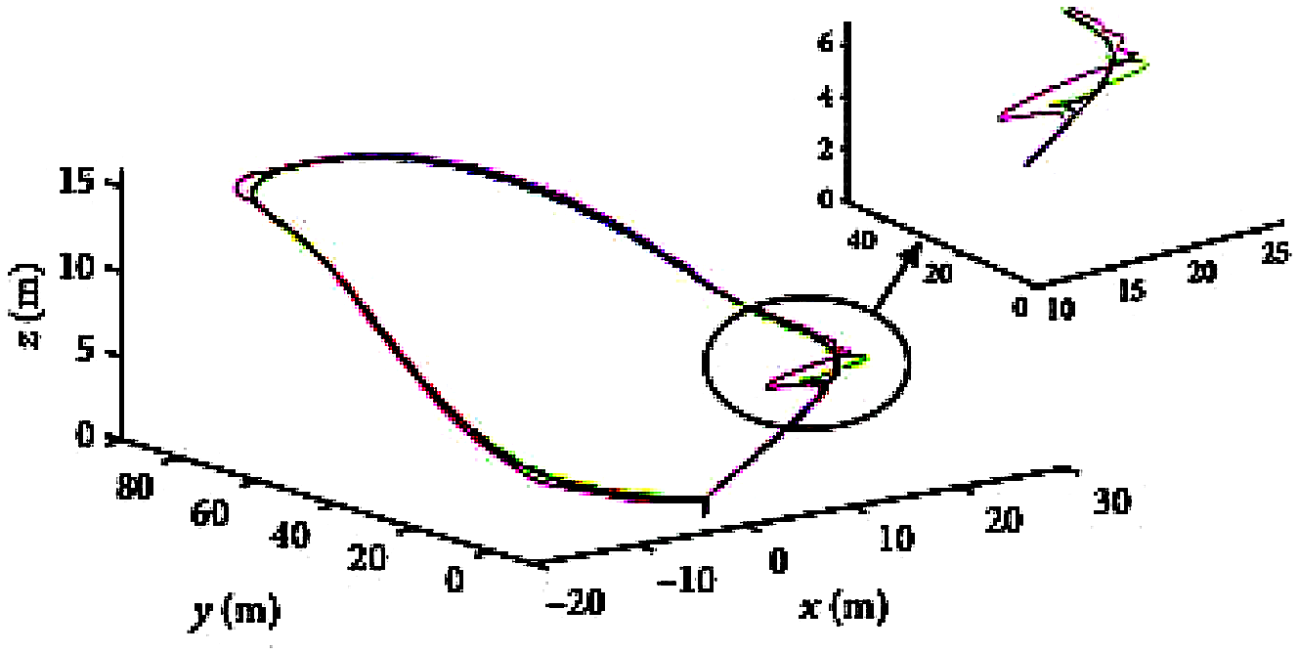
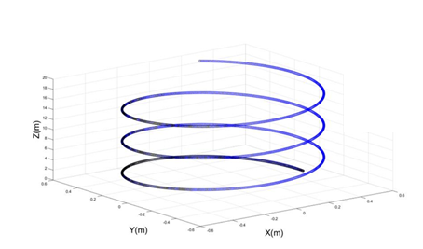
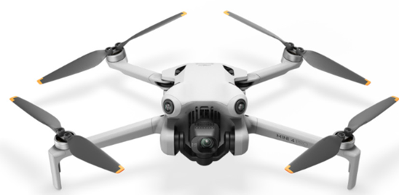
Role of Acceleration in Path Planning for Drones

Slide 3
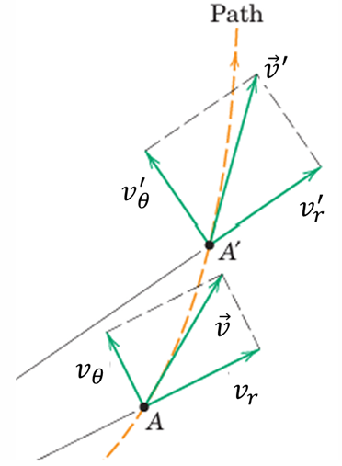




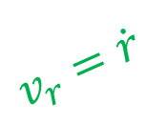

Description of Particle Acceleration in r-θ Coordinates
$$\vec{dv_{θ}}$$
$$v_{θ}=r\dot{θ}$$
$$v_{r}^{′}$$
$$v_{θ}^{′}$$
$$\vec{dv_{r}}$$
$$v_{r}=\dot{r}$$

Slide 4
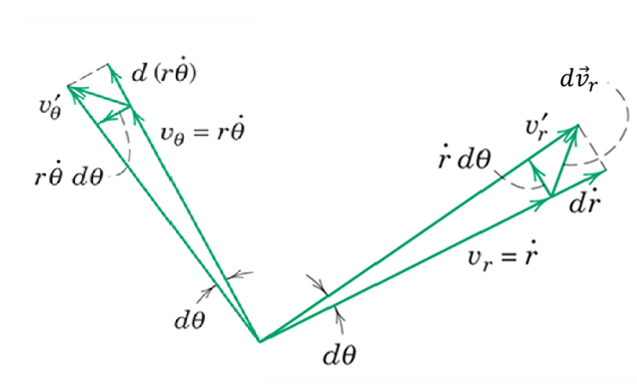
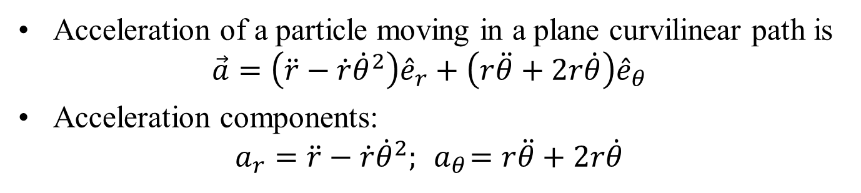
Description of Particle Acceleration in r-θ Coordinates
Acceleration of a particle moving in a plane curvilinear path is
$$\vec{a}=\left(\ddot{r}−\dot{r}{\dot{θ}}^{2}\right){\hat{e}}_{r}+\left(r\ddot{θ}+2r\dot{θ}\right){\hat{e}}_{θ}$$
Acceleration components:
$$a_{r}=\ddot{r}−\dot{r}{\dot{θ}}^{2}; { a}_{θ}=r\ddot{θ}+2r\dot{θ}$$

Slide 5
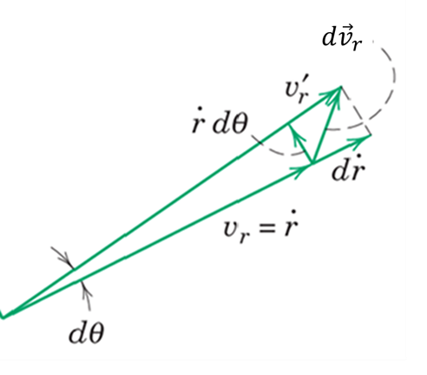
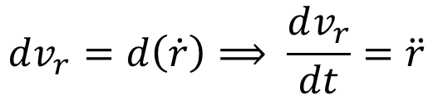
Geometric Interpretation: Acceleration Components
Change in Magnitude of v_{r} :
An increase in the length of v_{r} generates a change in magnitude along r:
$$dv_{r}=d\left(\dot{r}\right)⟹ \frac{dv_{r}}{dt}=\ddot{r}$$
Acting along the positive r-direction.

Slide 6
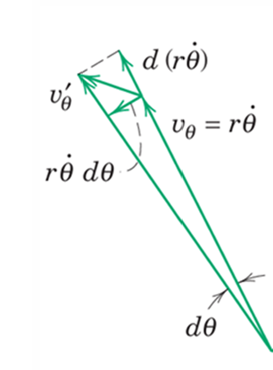
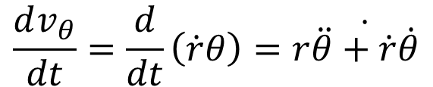
Geometric Interpretation: Acceleration Components
Magnitude change of v_{θ} :
$$\frac{dv_{θ}}{dt}=\frac{d}{dt}\left(\dot{r}θ\right)=r\dot{\ddot{θ}+\dot{r}\dot{θ}}$$
contributing in the positive θ-direction.

Slide 7
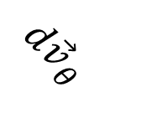
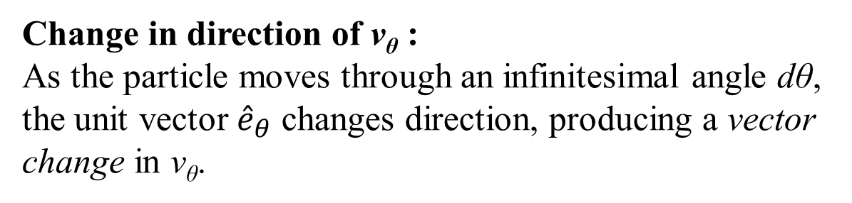
Geometric Interpretation: Direction Change of v_{θ}
$$d{\vec{v}}_{θ}$$
Change in direction of v_{θ} :
As the particle moves through an infinitesimal angle dθ, the unit vector ${\hat{e}}_{θ}$ changes direction, producing a vector change in v_{θ}.

Slide 8


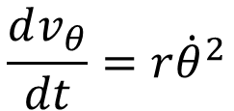
Geometric Interpretation: Direction Change of v_{θ}
The magnitude of the resulting vector change is
$$dv_{θ}=v_{θ}dθ=r\dot{θ}dθ$$
Dividing by dt, the corresponding acceleration contribution is
$$\frac{dv_{θ}}{dt}=r{\dot{θ}}^{2}$$
which acts in the negative r–direction.
$a_{r}^{\left(v_{θ}\right)}=−$ $r{\dot{θ}}^{2}$

Slide 9
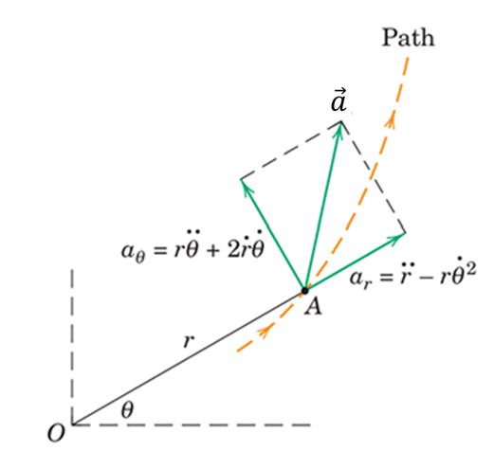
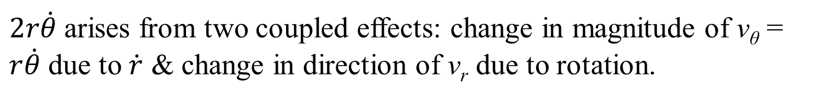
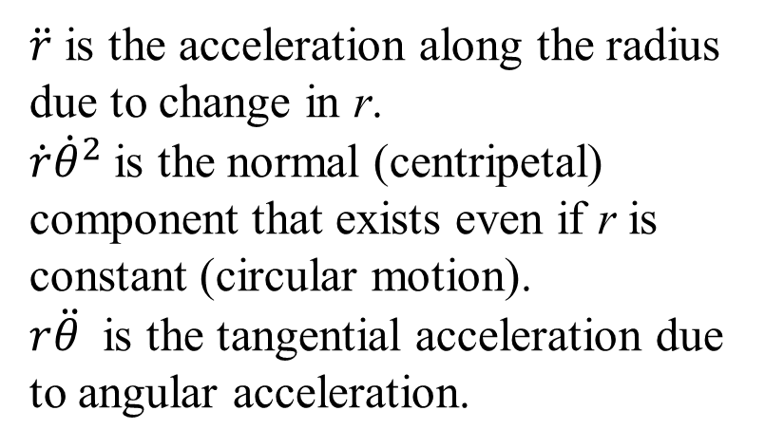

Resultant Acceleration in Polar Coordinates
Collecting terms from the geometric interpretation of velocity changes gives
$$\vec{a}=\left(\ddot{r}−\dot{r}{\dot{θ}}^{2}\right){\hat{e}}_{r}+\left(r\ddot{θ}+2r\dot{θ}\right){\hat{e}}_{θ}$$
$\ddot{r}$ is the acceleration along the radius due to change in r.
$\dot{r}{\dot{θ}}^{2}$is the normal (centripetal) component that exists even if r is constant (circular motion).
$r\ddot{θ}$ is the tangential acceleration due to angular acceleration.
$2r\dot{θ}$arises from two coupled effects: change in magnitude of v_{θ} = $r\dot{θ}$ due to $\dot{r}$ & change in direction of v_{r} due to rotation.

Slide 10
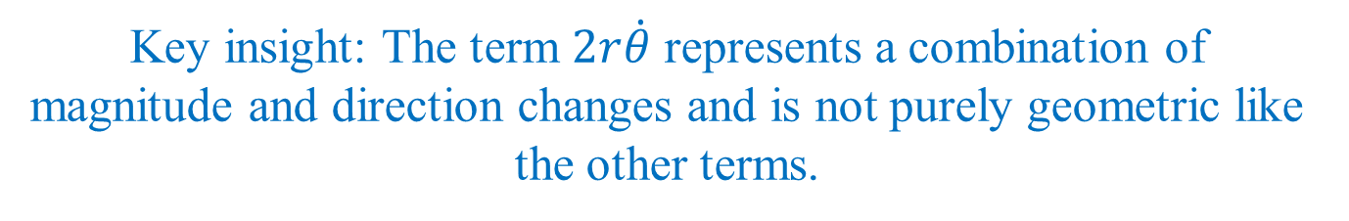
Resultant Acceleration in Polar Coordinates
Key insight: The term $2r\dot{θ}$ represents a combination of magnitude and direction changes and is not purely geometric like the other terms.

Slide 11

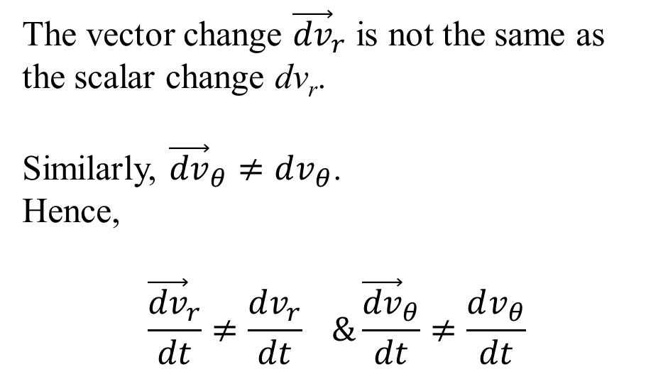
Important Observations on Accélération Components
The vector change ${\vec{dv}}_{r}$ is not the same as the scalar change dv_{r}.
Similarly, ${\vec{dv}}_{θ}≠dv_{θ}$.
Hence,
$$\frac{{\vec{dv}}_{r}}{dt}≠\frac{dv_{r}}{dt} \&\frac{{\vec{dv}}_{θ}}{dt}≠\frac{dv_{θ}}{dt}$$
As a result:
$$a_{r}≠{\dot{v}}_{r} \& a_{θ}≠{\dot{v}}_{θ}$$
If the motion has a component normal to the path, its direction must be toward the center of curvature, consistent with n–t coordinates.

Slide 12
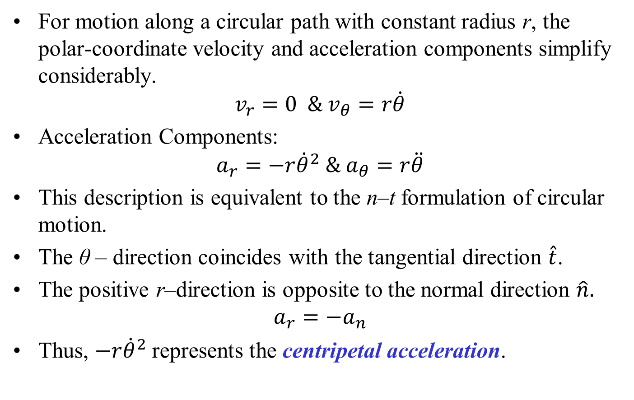
Circular Motion : Velocity & Acceleration
For motion along a circular path with constant radius r, the polar-coordinate velocity and acceleration components simplify considerably.
$$v_{r}=0 \& v_{θ}=r\dot{θ}$$
Acceleration Components:
$$a_{r}=−r{\dot{θ}}^{2} \& a_{θ}=r\ddot{θ}$$
This description is equivalent to the n–t formulation of circular motion.
The θ – direction coincides with the tangential direction $\hat{t}$.
The positive r–direction is opposite to the normal direction $\hat{n}.$
$$a_{r}=−a_{n}$$
Thus, $−r{\dot{θ}}^{2}$represents the centripetal acceleration.

Slide 13
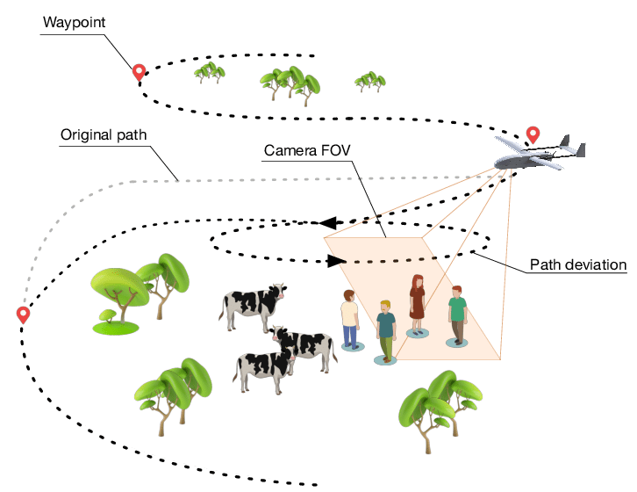
Space Curvilinear Motion
A Drone starts with a pre-defined path.
The Drone deviates from its pre-defined path to circle around the detected objects to maximize the information gained about them.
Then it continues the mission to explore additional areas.

Slide 14
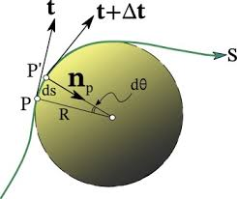

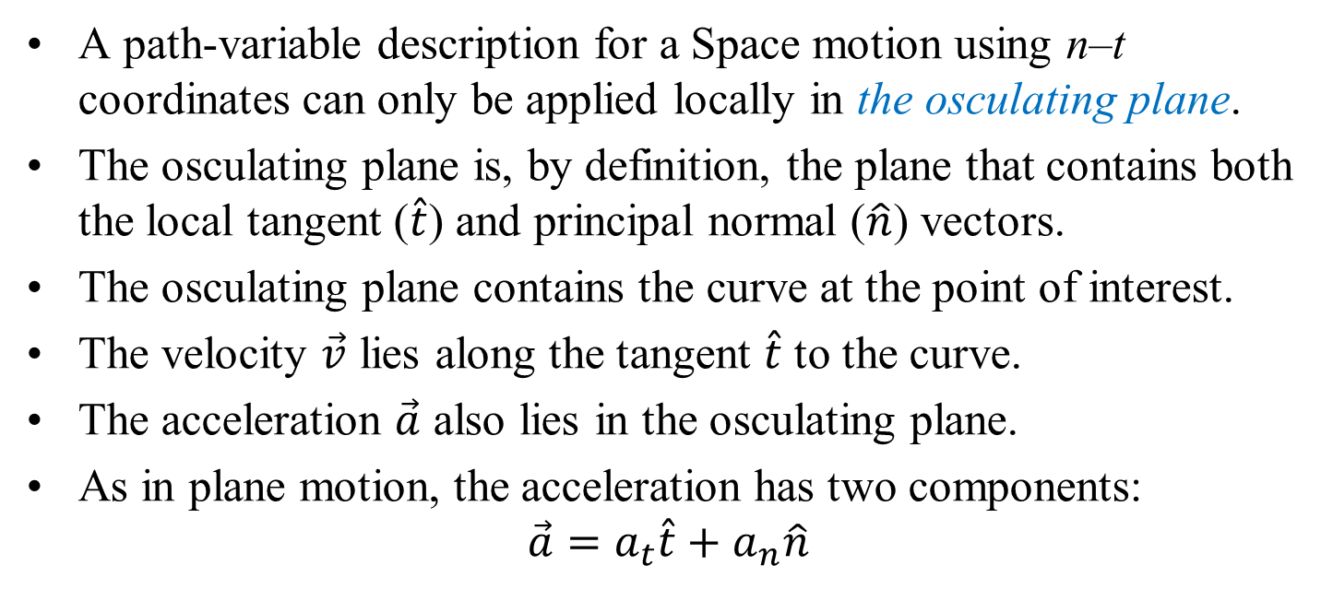

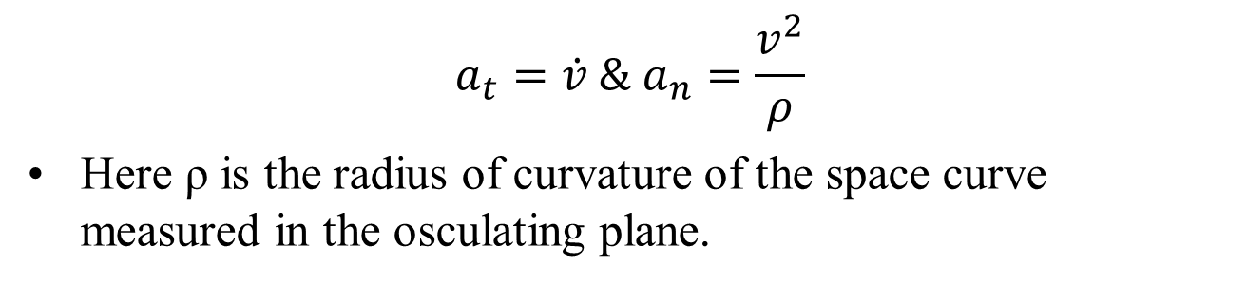
Space Curvilinear Motion: Osculating Plane
A path-variable description for a Space motion using n–t coordinates can only be applied locally in the osculating plane.
The osculating plane is, by definition, the plane that contains both the local tangent ($\hat{t}$) and principal normal ($\hat{n}$) vectors.
The osculating plane contains the curve at the point of interest.
The velocity $\vec{v}$ lies along the tangent $\hat{t}$ to the curve.
The acceleration $\vec{a}$ also lies in the osculating plane.
As in plane motion, the acceleration has two components:
$$\vec{a}=a_{t}\hat{t}+a_{n}\hat{n}$$
$$\hat{t}$$
$$\hat{n}$$
$$a_{t}=\dot{v} \& a_{n}=\frac{v^{2}}{ρ}$$
Here ρ is the radius of curvature of the space curve measured in the osculating plane.

Slide 15
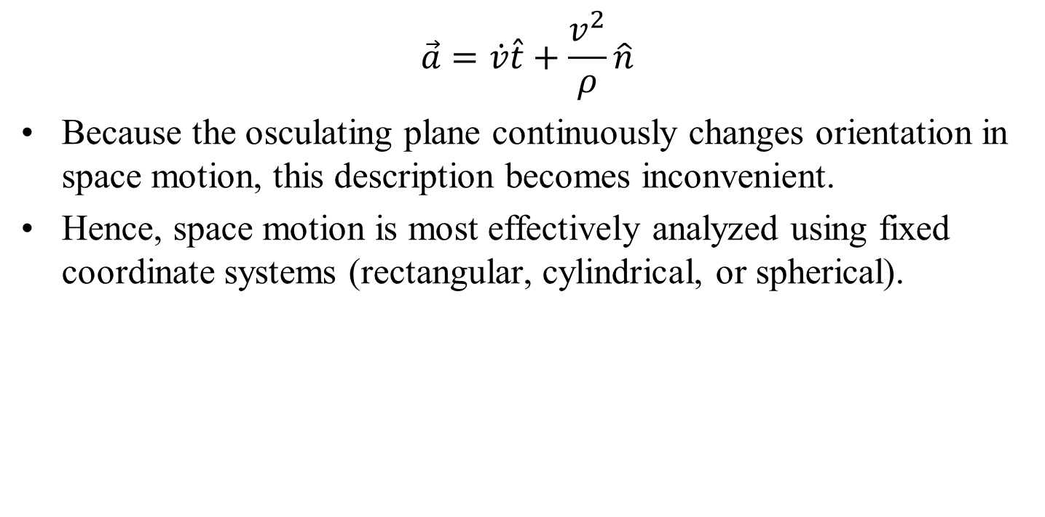
Space Curvilinear Motion: Osculating Plane
$$\vec{a}=\dot{v}\hat{t}+\frac{v^{2}}{ρ}\hat{n}$$
Because the osculating plane continuously changes orientation in space motion, this description becomes inconvenient.
Hence, space motion is most effectively analyzed using fixed coordinate systems (rectangular, cylindrical, or spherical).

Slide 16
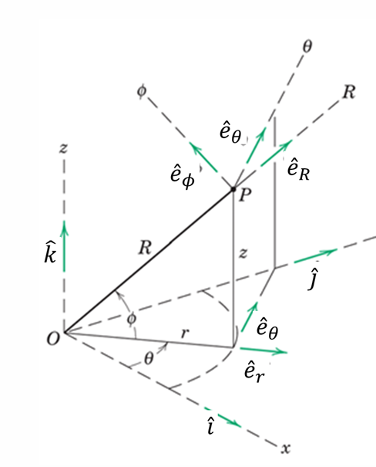
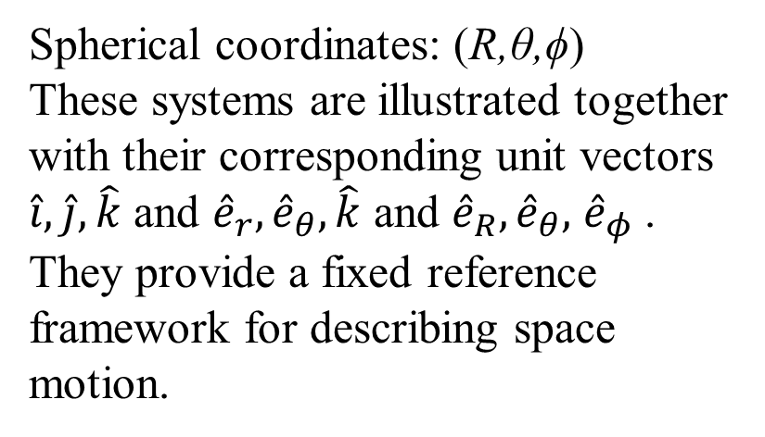
Particle Motion in Real World
The general case of three-dimensional motion of a particle along a space curve can be described using fixed coordinate systems:
Rectangular coordinates: (x,y,z)
Cylindrical coordinates: (r,θ,z)
Spherical coordinates: (R,θ,ϕ)
These systems are illustrated together with their corresponding unit vectors $\hat{i},\hat{j}, \hat{k}$ and ${\hat{e}}_{r},{\hat{e}}_{θ},\hat{k}$ and ${\hat{e}}_{R},{\hat{e}}_{θ},$ ${\hat{e}}_{φ}$ .
They provide a fixed reference framework for describing space motion.
Unit vectors.

Slide 17
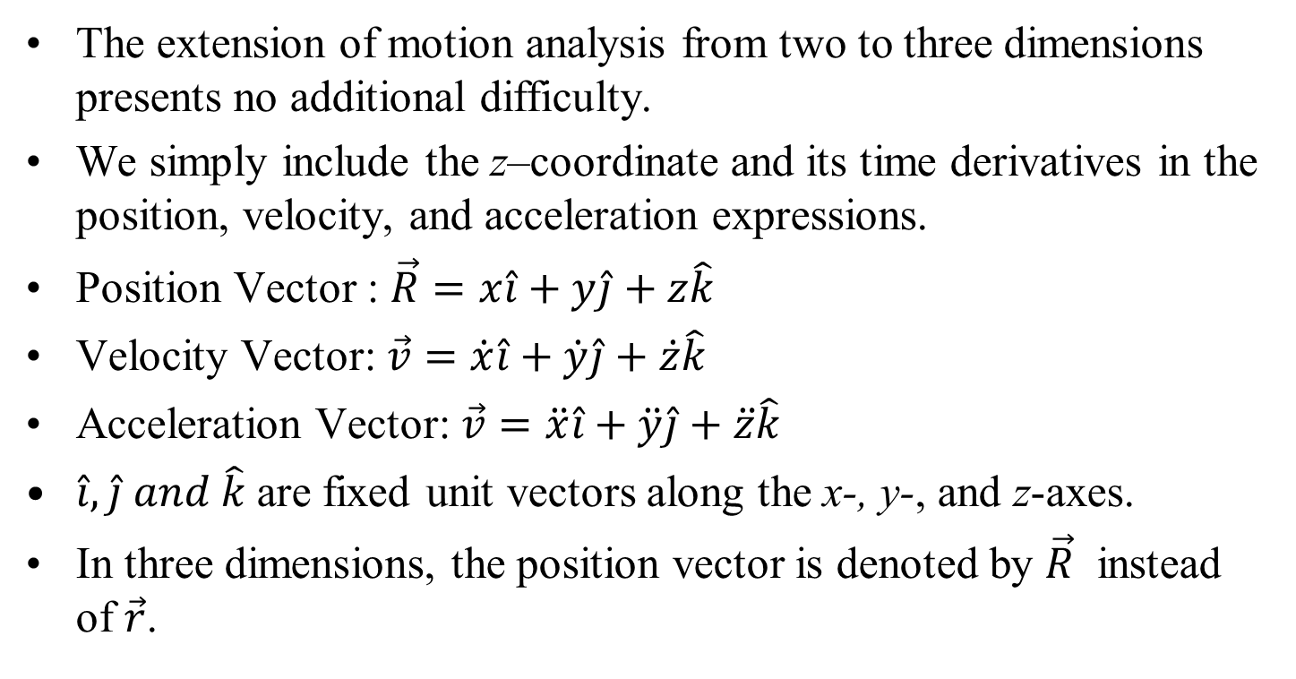
Rectangular Coordinates (x–y–z)
The extension of motion analysis from two to three dimensions presents no additional difficulty.
We simply include the z–coordinate and its time derivatives in the position, velocity, and acceleration expressions.
Position Vector : $\vec{R}=x\hat{i}+y\hat{j}+z\hat{k}$
Velocity Vector: $\vec{v}=\dot{x}\hat{i}+\dot{y}\hat{j}+\dot{z}\hat{k}$
Acceleration Vector: $\vec{v}=\ddot{x}\hat{i}+\ddot{y}\hat{j}+\ddot{z}\hat{k}$
$\hat{i},\hat{j} and \hat{k}$are fixed unit vectors along the x-, y-, and z-axes.
In three dimensions, the position vector is denoted by $\vec{R}$ instead of $\vec{r}$.

Slide 18
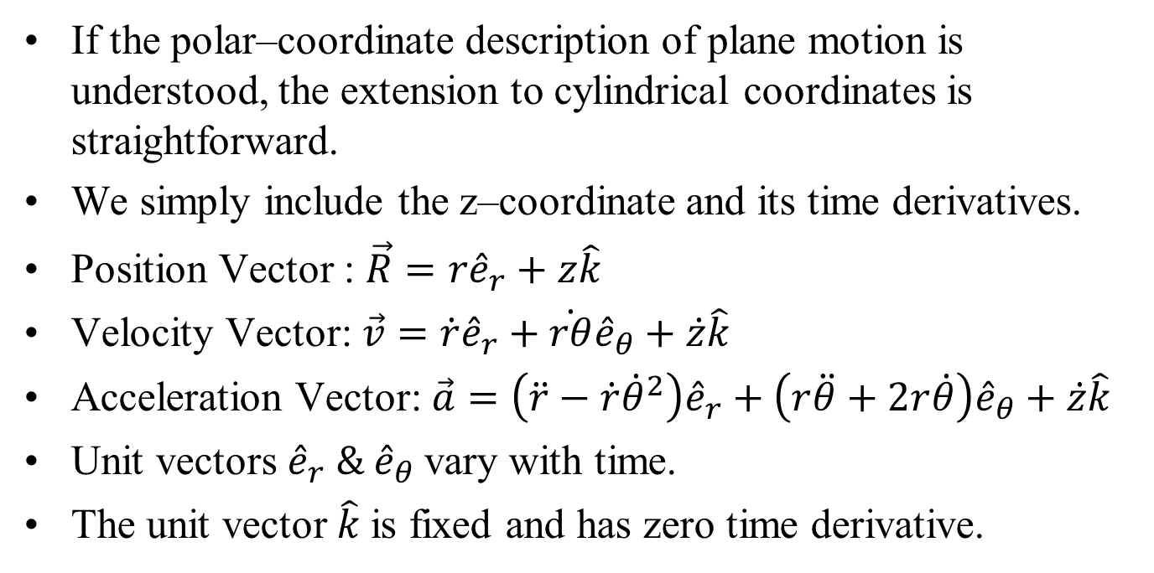
Cylindrical Coordinates (r–θ–z): Position and Velocity
If the polar–coordinate description of plane motion is understood, the extension to cylindrical coordinates is straightforward.
We simply include the z–coordinate and its time derivatives.
Position Vector : $\vec{R}=r{\hat{e}}_{r}+z\hat{k}$
Velocity Vector: $\vec{v}=\dot{r}{\hat{e}}_{r}+\dot{rθ}{\hat{e}}_{θ}+\dot{z}\hat{k}$
Acceleration Vector: $\vec{a}=\left(\ddot{r}−\dot{r}{\dot{θ}}^{2}\right){\hat{e}}_{r}+\left(r\ddot{θ}+2r\dot{θ}\right){\hat{e}}_{θ}+\dot{z}\hat{k}$
Unit vectors ${\hat{e}}_{r} \& {\hat{e}}_{θ}$vary with time.
The unit vector $\hat{k}$is fixed and has zero time derivative.

Slide 19
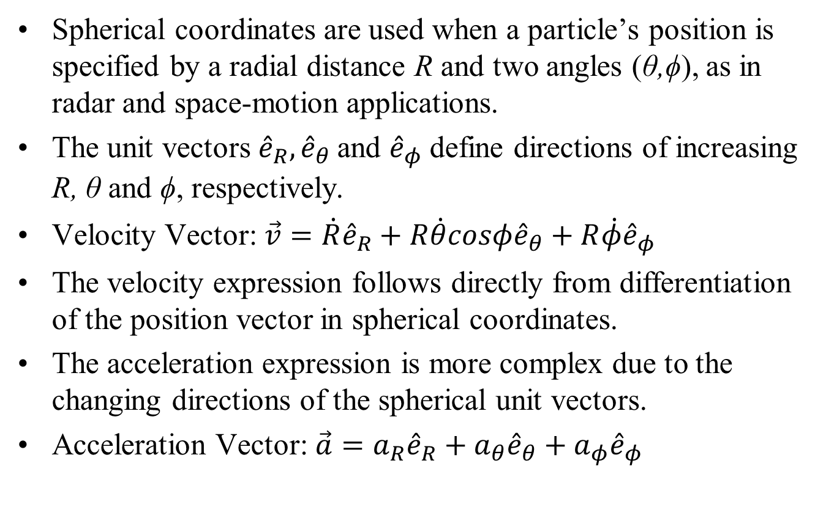
Spherical Coordinates (R–θ–ϕ)
Spherical coordinates are used when a particle’s position is specified by a radial distance R and two angles (θ,ϕ), as in radar and space-motion applications.
The unit vectors ${\hat{e}}_{R},{\hat{e}}_{θ}$and ${\hat{e}}_{φ}$ define directions of increasing R, θ and ϕ, respectively.
Velocity Vector: $\vec{v}=\dot{R}{\hat{e}}_{R}+R\dot{θ}cosφ{\hat{e}}_{θ}+R\dot{φ}{\hat{e}}_{φ}$
The velocity expression follows directly from differentiation of the position vector in spherical coordinates.
The acceleration expression is more complex due to the changing directions of the spherical unit vectors.
Acceleration Vector: $\vec{a}=a_{R}{\hat{e}}_{R}+a_{θ}{\hat{e}}_{θ}+a_{φ}{\hat{e}}_{φ}$

Slide 20
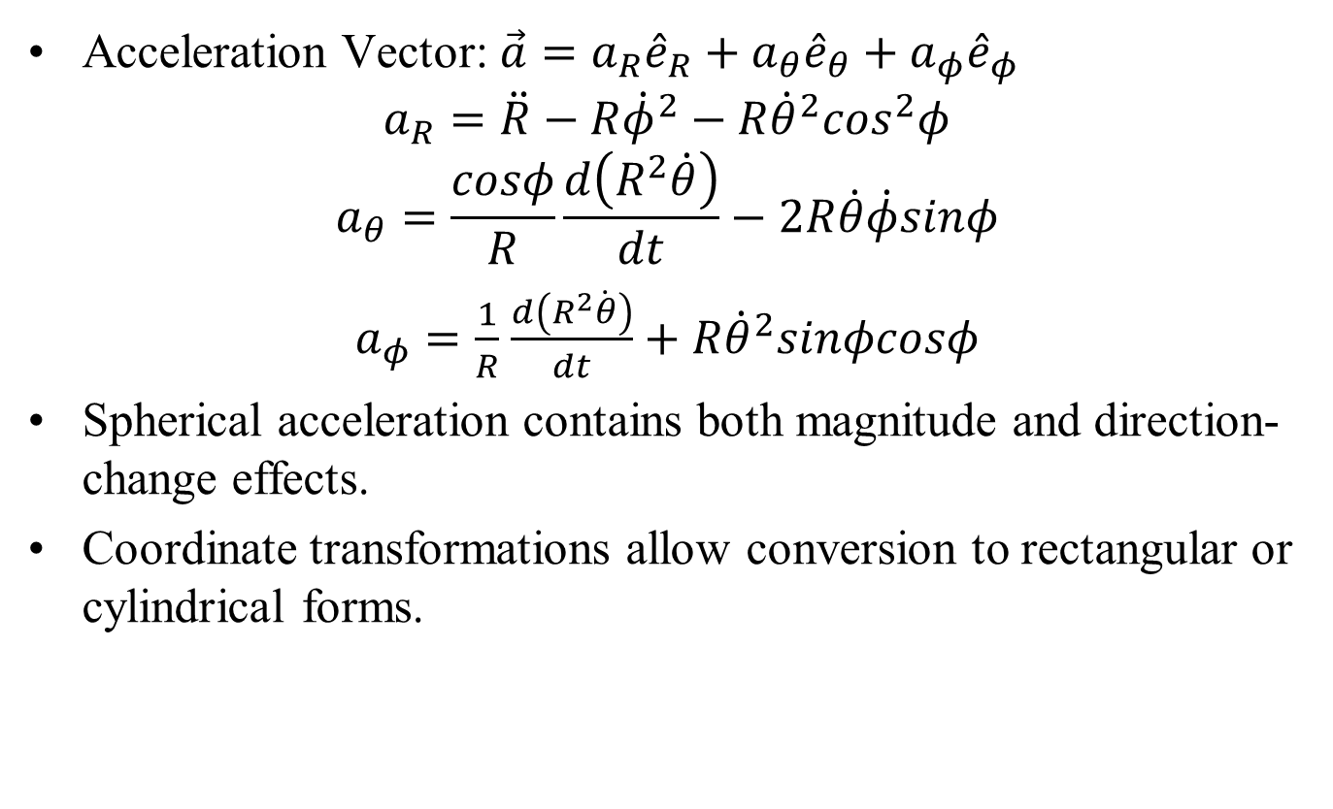
Acceleration in Spherical Coordinates
Acceleration Vector: $\vec{a}=a_{R}{\hat{e}}_{R}+a_{θ}{\hat{e}}_{θ}+a_{φ}{\hat{e}}_{φ}$
$$a_{R}=\ddot{R}−R{\dot{φ}}^{2}−R{\dot{θ}}^{2}\cos^{2}φ$$
$$a_{θ}=\frac{cosφ}{R}\frac{d\left(R^{2}\dot{θ}\right)}{dt}−2R\dot{θ}\dot{φ}sinφ$$
$a_{φ}=\frac{1}{R}$ $\frac{d\left(R^{2}\dot{θ}\right)}{dt}+R{\dot{θ}}^{2}sinφcosφ$
Spherical acceleration contains both magnitude and direction-change effects.
Coordinate transformations allow conversion to rectangular or cylindrical forms.

Slide 21
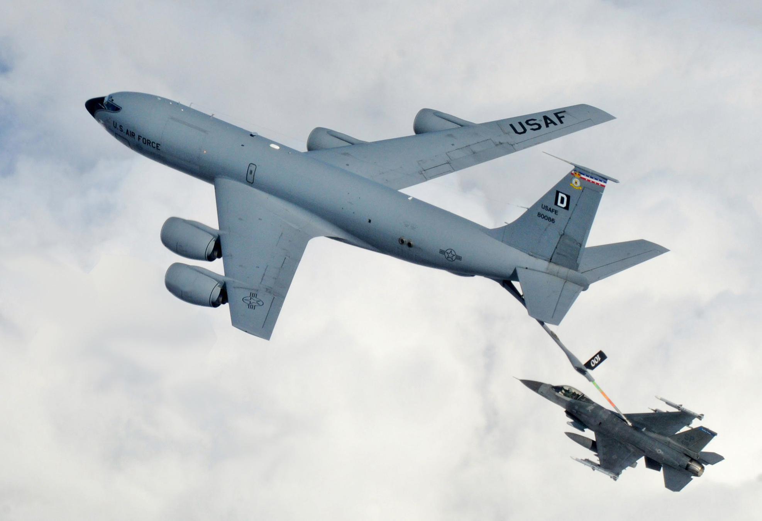
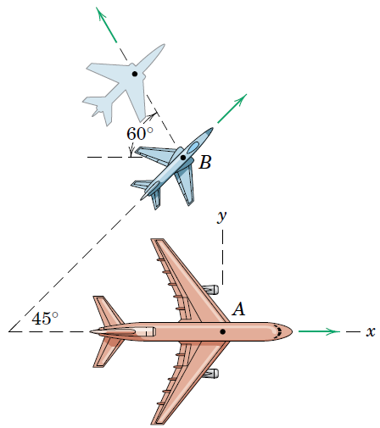

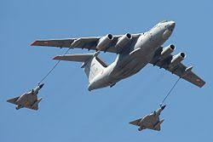
Coordinated Motion Among Several Particles

Slide 22
Relative Motion
Absolute vs. Relative Motion:
Motion described using coordinates fixed in space is called absolute motion.
In many engineering problems, using a fixed reference frame is not convenient or even possible.
Measurements made relative to a moving reference system can simplify the analysis.
Relative-Motion Analysis: Measurements relative to a moving coordinate system are combined with the motion of that system itself.
This combination allows determination of the absolute motion.

Slide 23
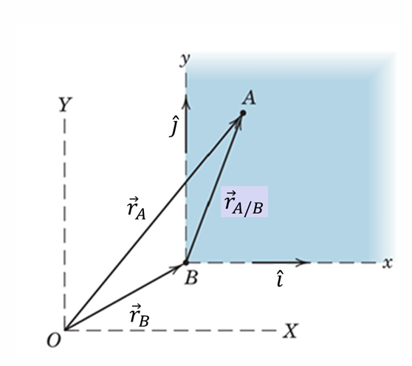
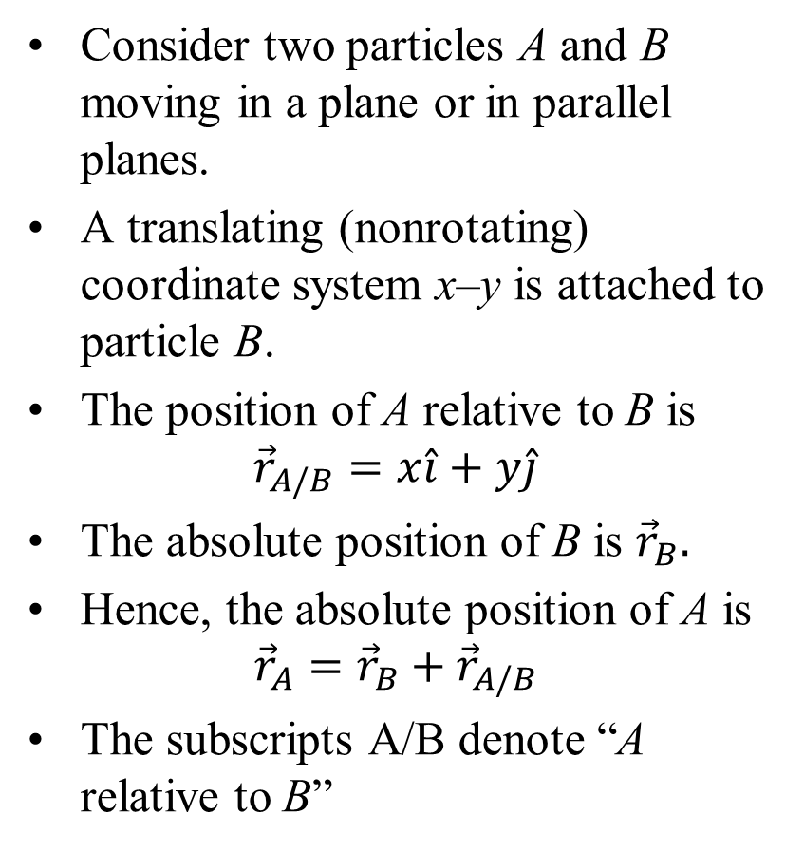
Vector Representation of Relative Motion
Consider two particles A and B moving in a plane or in parallel planes.
A translating (nonrotating) coordinate system x–y is attached to particle B.
The position of A relative to B is
$${\vec{r}}_{A/B}=x\hat{i}+y\hat{j}$$
The absolute position of B is ${\vec{r}}_{B}.$
Hence, the absolute position of A is
$${{\vec{r}}_{A}={\vec{r}}_{B}+\vec{r}}_{A/B}$$
The subscripts A/B denote “A relative to B”

Slide 24
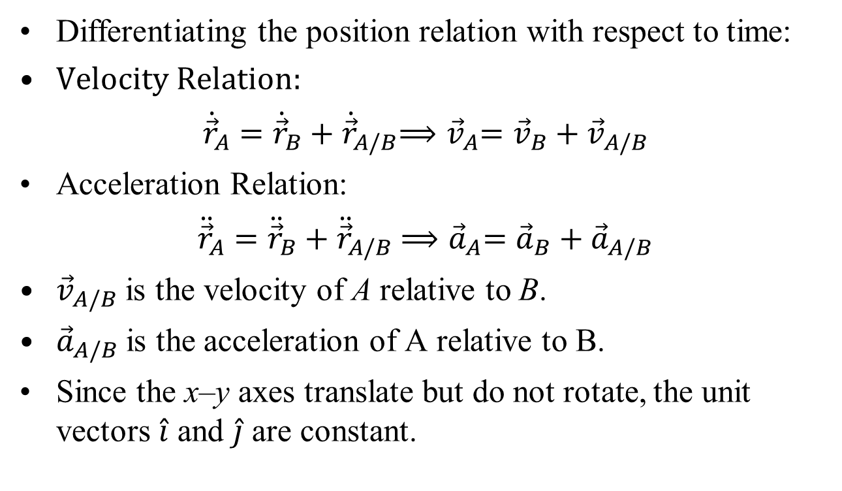
Relative Velocity and Acceleration
Differentiating the position relation with respect to time:
Velocity Relation:
${\dot{\vec{r}}}_{A}={\dot{\vec{r}}}_{B}+{\dot{\vec{r}}}_{A/B}$ ${⟹\vec{v}}_{A}={\vec{v}}_{B}+{\vec{v}}_{A/B}$
Acceleration Relation:
${\ddot{\vec{r}}}_{A}={\ddot{\vec{r}}}_{B}+{\ddot{\vec{r}}}_{A/B}$ ${⟹\vec{a}}_{A}={\vec{a}}_{B}+{\vec{a}}_{A/B}$
${\vec{v}}_{A/B}$ is the velocity of A relative to B.
${\vec{a}}_{A/B}$is the acceleration of A relative to B.
Since the x–y axes translate but do not rotate, the unit vectors $\hat{i}$ and $\hat{j}$ are constant.

Slide 25
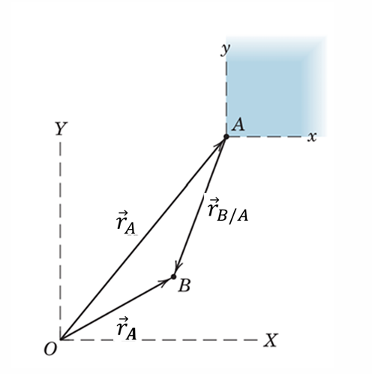
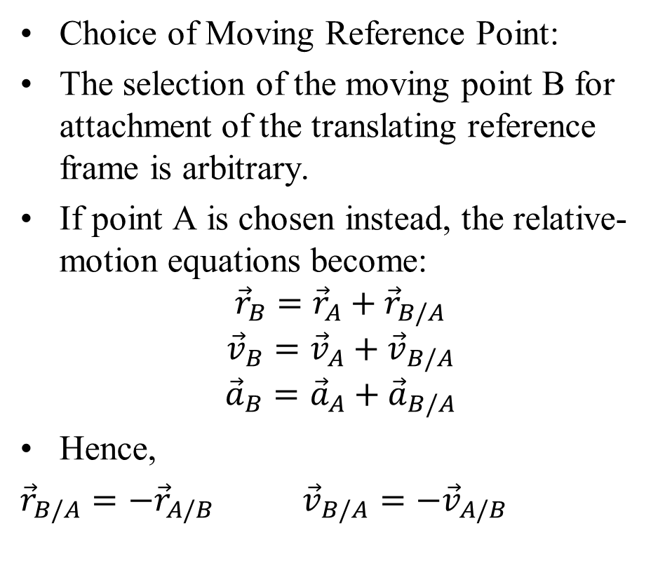
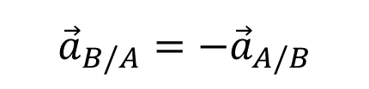
Additional Considerations in Relative Motion
Choice of Moving Reference Point:
The selection of the moving point B for attachment of the translating reference frame is arbitrary.
If point A is chosen instead, the relative-motion equations become:
$${{\vec{r}}_{B}={\vec{r}}_{A}+\vec{r}}_{B/A}$$
$${\vec{v}}_{B}={\vec{v}}_{A}+{\vec{v}}_{B/A}$$
$${\vec{a}}_{B}={\vec{a}}_{A}+{\vec{a}}_{B/A}$$
Hence,
${\vec{r}}_{B/A}=−{\vec{r}}_{A/B}$ ${\vec{v}}_{B/A}=−{\vec{v}}_{A/B}$
Key Result: If the translating frame has constant velocity, the acceleration measured in the moving frame is identical to that measured in a fixed frame. Such a translating frame is therefore an inertial system
$${\vec{a}}_{B/A}=−{\vec{a}}_{A/B}$$

