Slide 1


Curvilinear Kinematic of Particles
P M V Subbarao
Professor & Head
Mechanical Engineering Department
One of the most common types of motion observed in the physical world.

Slide 2

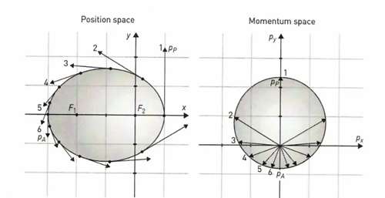
The Art of Motion Visualization
Finally, Newton attacked with success by proposing the law of gravitation that makes the planets revolve in elliptical orbits around the Sun.
In 1847, Hamilton invented the hodograph and used it to solve this famous problem.

Slide 3
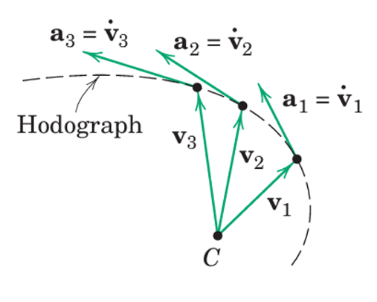



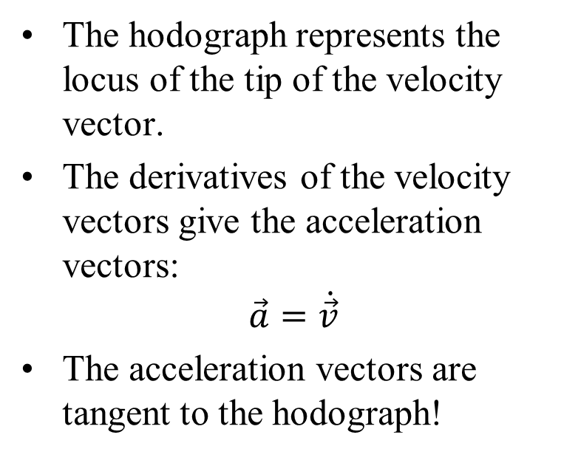



Visualization of the Motion: Hodograph
If the velocity vectors are plotted from a common reference point C, a curve known as the hodograph is formed.
The hodograph represents the locus of the tip of the velocity vector.
The derivatives of the velocity vectors give the acceleration vectors:
$$\vec{a}=\dot{\vec{v}}$$
The acceleration vectors are tangent to the hodograph!
$${\vec{a}}_{3}={\dot{\vec{v}}}_{3}$$
$${\vec{a}}_{2}={\dot{\vec{v}}}_{2}$$
$${\vec{a}}_{1}={\dot{\vec{v}}}_{1}$$
$${\vec{v}}_{3}$$
$${\vec{v}}_{2}$$
$${\vec{v}}_{1}$$

Slide 4
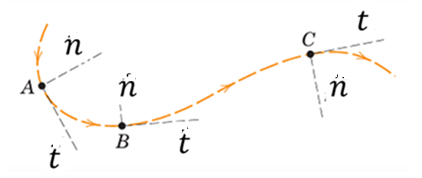
Revisit to Normal and Tangential Coordinates
A common description of curvilinear motion uses measurements made along the tangent t and normal n to the path of the particle.
The n and t – coordinates are considered to move along the path together with the particle (points A–B–C).
The positive direction for n at any position is always taken toward the center of curvature of the path.
If the curvature changes direction, the positive n–direction shifts from one side of the curve to the other.

Slide 5
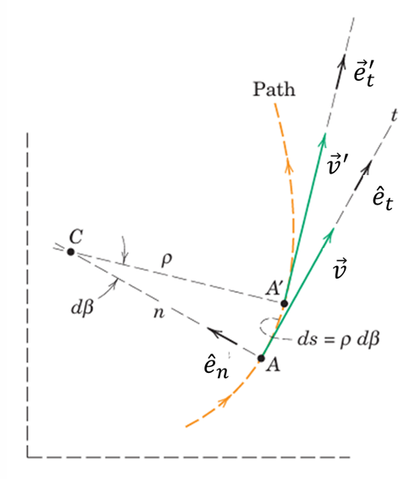
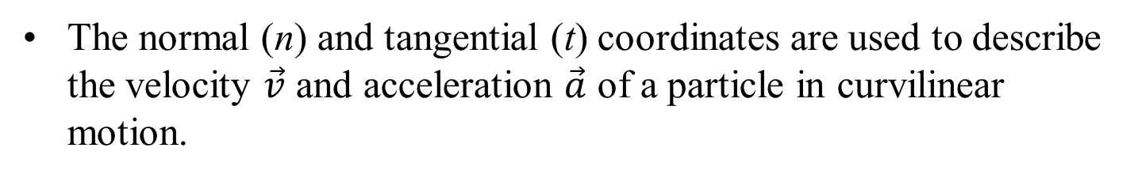
Velocity and Acceleration: Coordinate Setup
The normal (n) and tangential (t) coordinates are used to describe the velocity $\vec{v}$ and acceleration $\vec{a}$ of a particle in curvilinear motion.

Slide 6
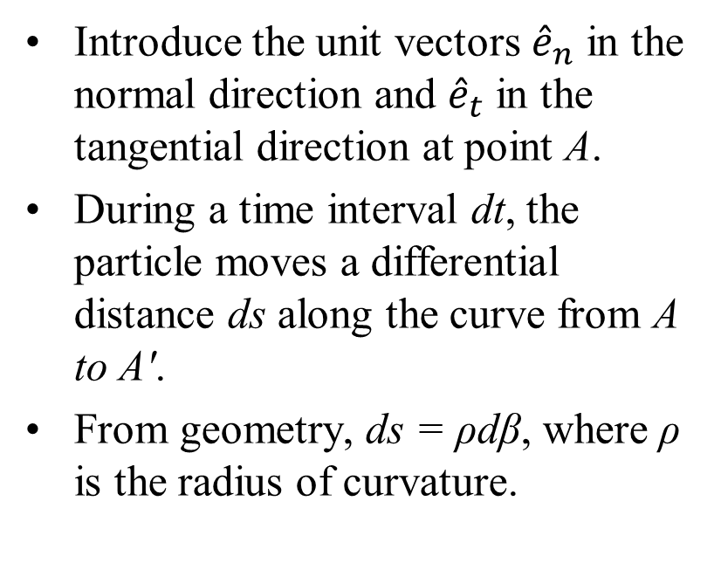
Velocity and Acceleration: Coordinate Setup
Introduce the unit vectors ${\hat{e}}_{n}$ in the normal direction and ${\hat{e}}_{t}$ in the tangential direction at point A.
During a time interval dt, the particle moves a differential distance ds along the curve from A to A′.
From geometry, ds = ρdβ, where ρ is the radius of curvature.

Slide 7
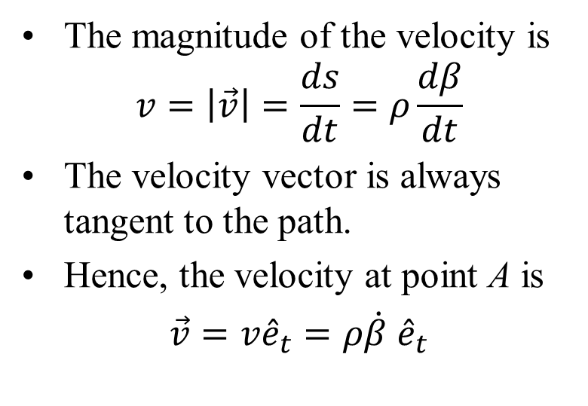
Velocity in Normal–Tangential Coordinates
The magnitude of the velocity is
$$v=\left|\vec{v}\right|=\frac{ds}{dt}=ρ\frac{dβ}{dt}$$
The velocity vector is always tangent to the path.
Hence, the velocity at point A is
$\vec{v}=v{\hat{e}}_{t}=ρ\dot{β}$ ${\hat{e}}_{t}$

Slide 8
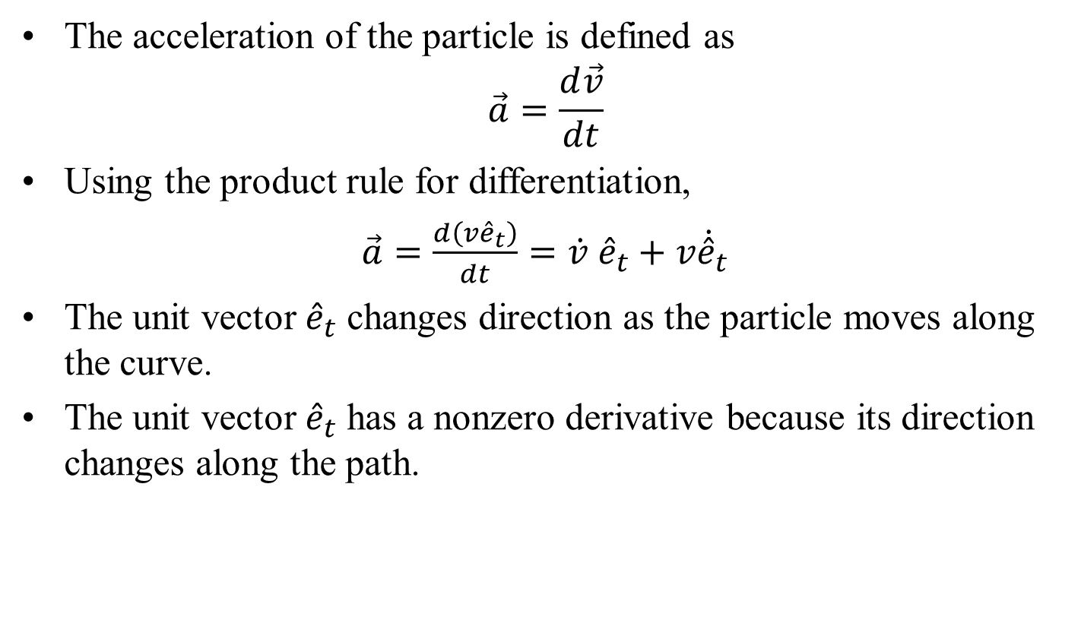
Acceleration in Normal–Tangential Coordinates
The acceleration of the particle is defined as
$$\vec{a}=\frac{d\vec{v}}{dt}$$
Using the product rule for differentiation,
$\vec{a}=\frac{d\left(v{\hat{e}}_{t}\right)}{dt}=\dot{v}$ ${\hat{e}}_{t}+v{\dot{\hat{e}}}_{t}$
The unit vector ${\hat{e}}_{t}$ changes direction as the particle moves along the curve.
The unit vector ${\hat{e}}_{t}$ has a nonzero derivative because its direction changes along the path.

Slide 9
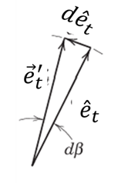
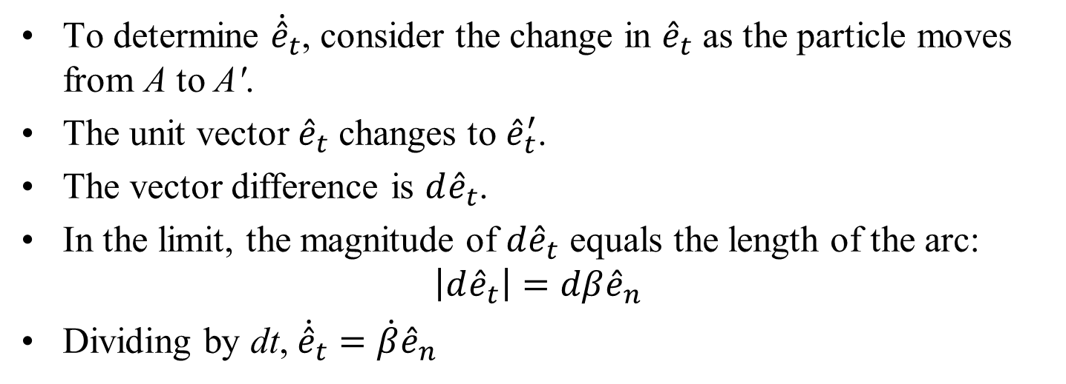
Acceleration due to Change of the Tangent Unit Vector
To determine ${\dot{\hat{e}}}_{t}$, consider the change in ${\hat{e}}_{t}$ as the particle moves from A to A′.
The unit vector ${\hat{e}}_{t}$ changes to ${\hat{e}}_{t}^{′}$.
The vector difference is ${d\hat{e}}_{t}$.
In the limit, the magnitude of ${d\hat{e}}_{t}$ equals the length of the arc:
$$\left|{d\hat{e}}_{t}\right|=dβ{\hat{e}}_{n}$$
Dividing by dt, ${\dot{\hat{e}}}_{t}=\dot{β}{\hat{e}}_{n}$

Slide 10
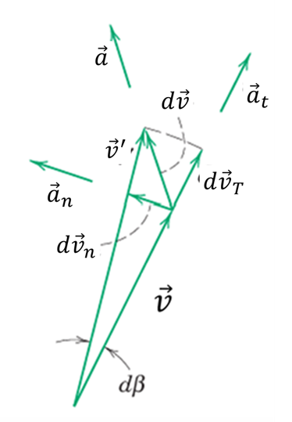
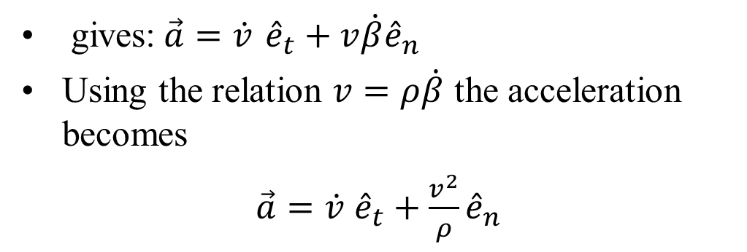
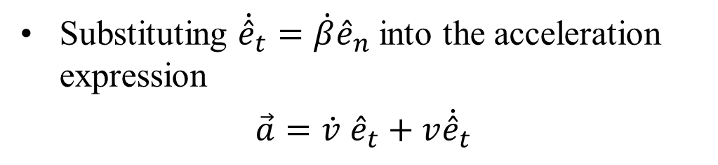
Acceleration in Normal–Tangential Coordinates
Substituting ${\dot{\hat{e}}}_{t}=\dot{β}{\hat{e}}_{n}$ into the acceleration expression
$\vec{a}=\dot{v}$ ${\hat{e}}_{t}+{v\dot{\hat{e}}}_{t}$
gives:$\vec{a}=\dot{v}$ ${\hat{e}}_{t}+v\dot{β}{\hat{e}}_{n}$
Using the relation $v=ρ\dot{β}$ the acceleration becomes
$\vec{a}=\dot{v}$ ${\hat{e}}_{t}+\frac{v^{2}}{ρ}{\hat{e}}_{n}$

Slide 11
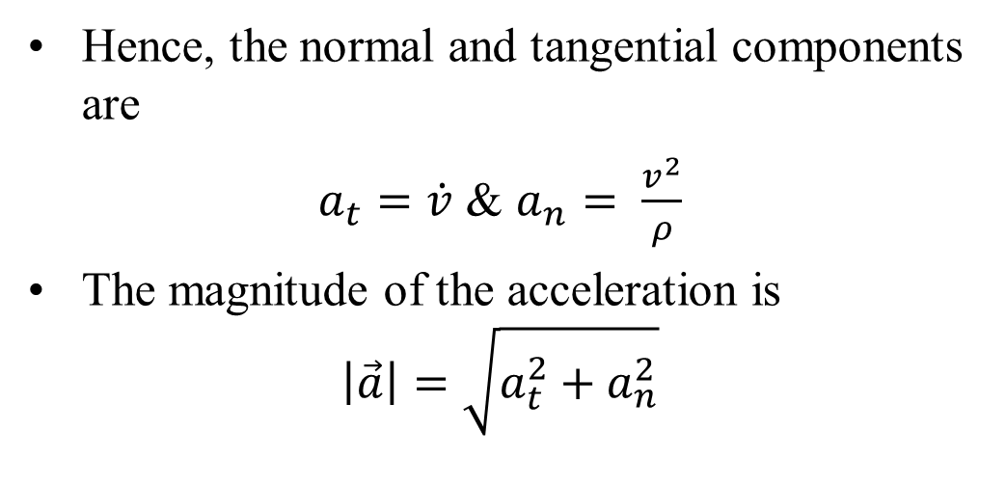

Acceleration in Normal–Tangential Coordinates
$\vec{a}=\dot{v}$ ${\hat{e}}_{t}+\frac{v^{2}}{ρ}{\hat{e}}_{n}$
Hence, the normal and tangential components are
$a_{t}=\dot{v}$ & $a_{n}= \frac{v^{2}}{ρ}$
The magnitude of the acceleration is
$$\left|\vec{a}\right|=\sqrt{a_{t}^{2}+a_{n}^{2}}$$

Slide 12
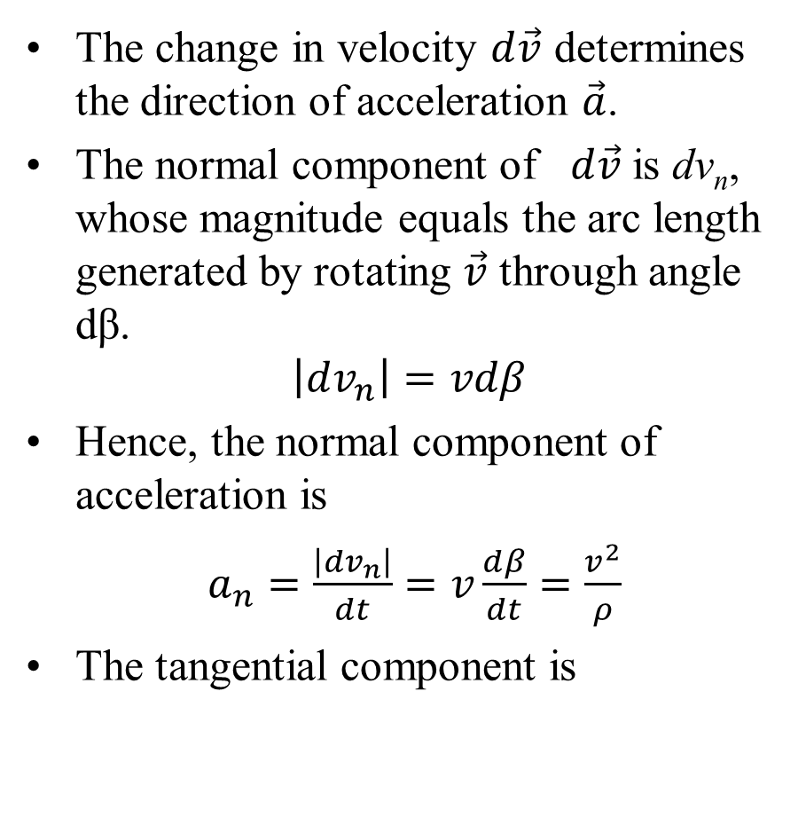
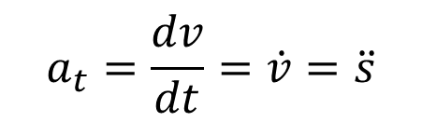
Geometric Interpretation of Acceleration
The change in velocity $d\vec{v}$ determines the direction of acceleration $\vec{a}$.
The normal component of $d\vec{v}$is dv_{n}, whose magnitude equals the arc length generated by rotating $\vec{v}$ through angle dβ.
$$\left|dv_{n}\right|=vdβ$$
Hence, the normal component of acceleration is
$a_{n}=\frac{\left|dv_{n}\right|}{dt}=v\frac{dβ}{dt}=\frac{v^{2}}{ρ}$
The tangential component is
$$a_{t}=\frac{dv}{dt}=\dot{v}=\ddot{s}$$

Slide 13
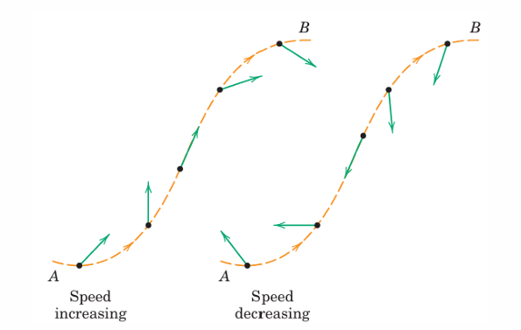
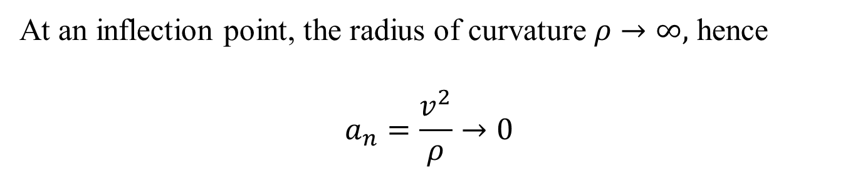
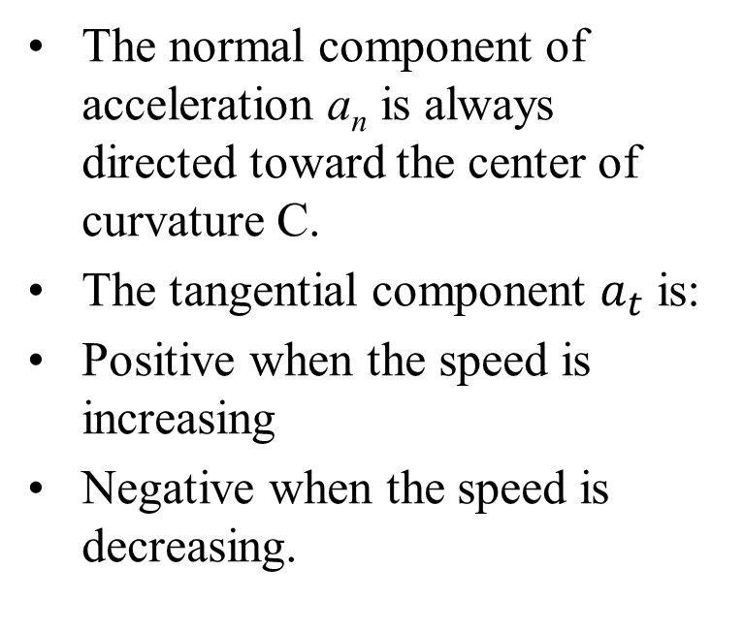
Acceleration Vectors Along a Curved Path
The normal component of acceleration a_{n} is always directed toward the center of curvature C.
The tangential component $a_{t}$ is:
Positive when the speed is increasing
Negative when the speed is decreasing.
At an inflection point, the radius of curvature $ρ→∞,$ hence
$$a_{n}=\frac{v^{2}}{ρ}→0$$

Slide 14
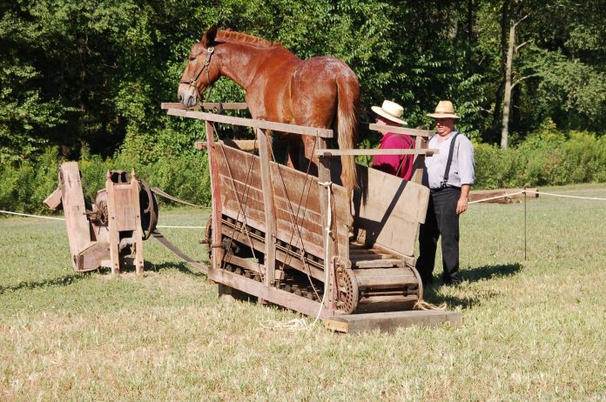
Circular Motion
These relations are fundamental and repeatedly used in dynamics

Slide 15
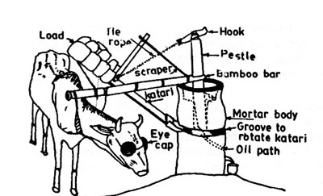
Circular Motion

Slide 16
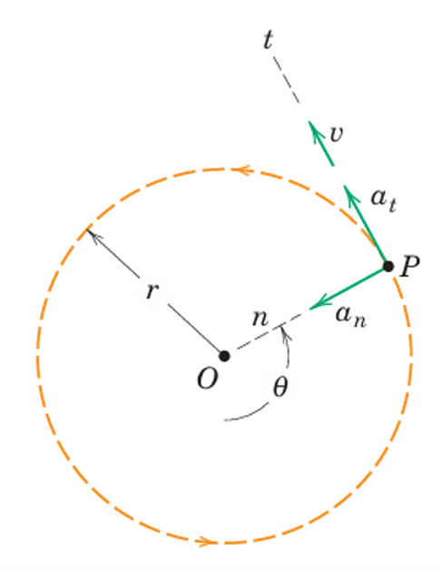
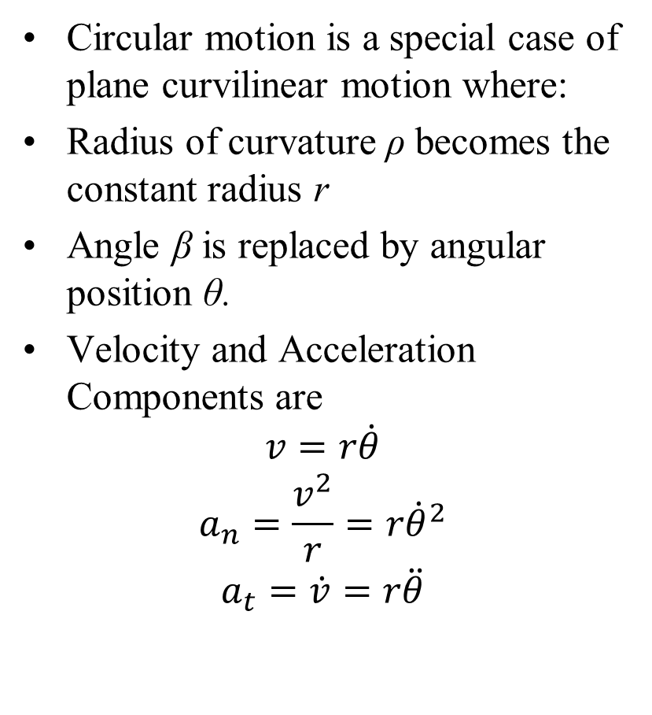
Circular Motion
Circular motion is a special case of plane curvilinear motion where:
Radius of curvature ρ becomes the constant radius r
Angle β is replaced by angular position θ.
Velocity and Acceleration Components are
$$v=r\dot{θ}$$
$$a_{n}=\frac{v^{2}}{r}=r{\dot{θ}}^{2}$$
$$a_{t}=\dot{v}=r\ddot{θ}$$
These relations are fundamental and repeatedly used in dynamics

Slide 17
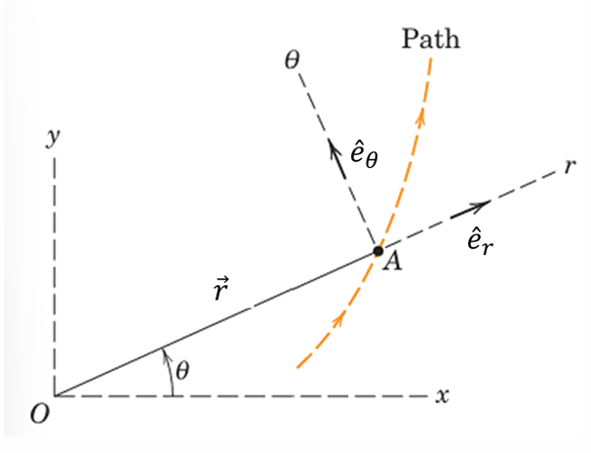
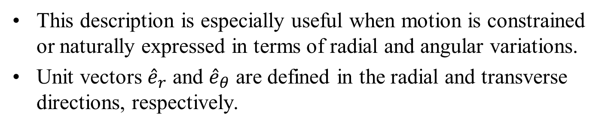
Extrinsic Coordinate System:
Polar Coordinates (r–θ)
Polar coordinates provide a third description of plane curvilinear motion.
The particle position is specified by: the radial distance r from a fixed-point O, the angular position θ measured from a fixed reference line (x-axis).
This description is especially useful when motion is constrained or naturally expressed in terms of radial and angular variations.
Unit vectors ${\hat{e}}_{r}$ and ${\hat{e}}_{θ}$ are defined in the radial and transverse directions, respectively.

Slide 18
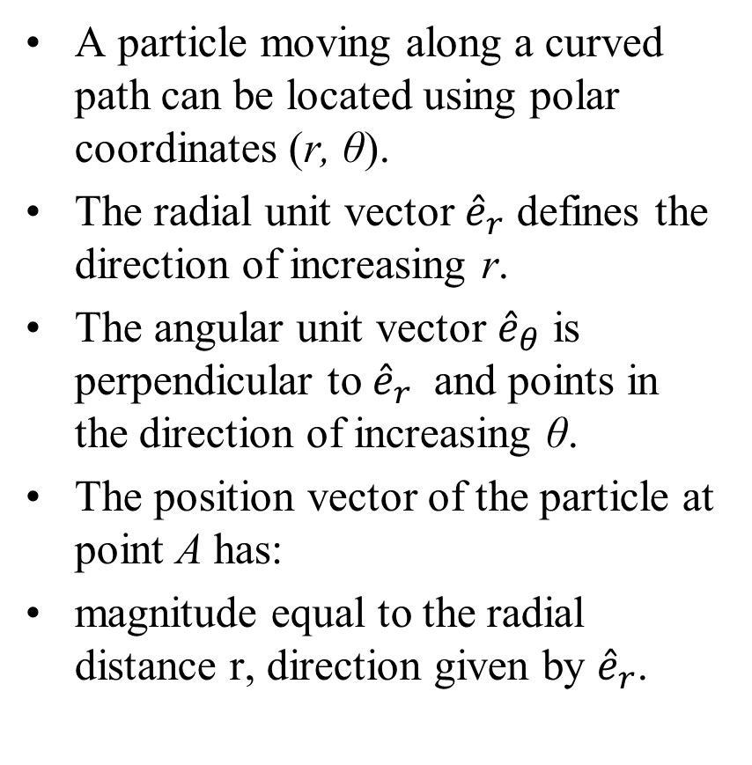
Position Vector in Polar Coordinates
A particle moving along a curved path can be located using polar coordinates (r, θ).
The radial unit vector ${\hat{e}}_{r}$ defines the direction of increasing r.
The angular unit vector ${\hat{e}}_{θ}$ is perpendicular to ${\hat{e}}_{r}$ and points in the direction of increasing θ.
The position vector of the particle at point A has:
magnitude equal to the radial distance r, direction given by ${\hat{e}}_{r}$.

Slide 19
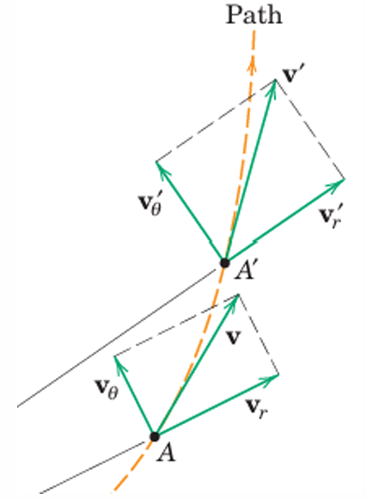


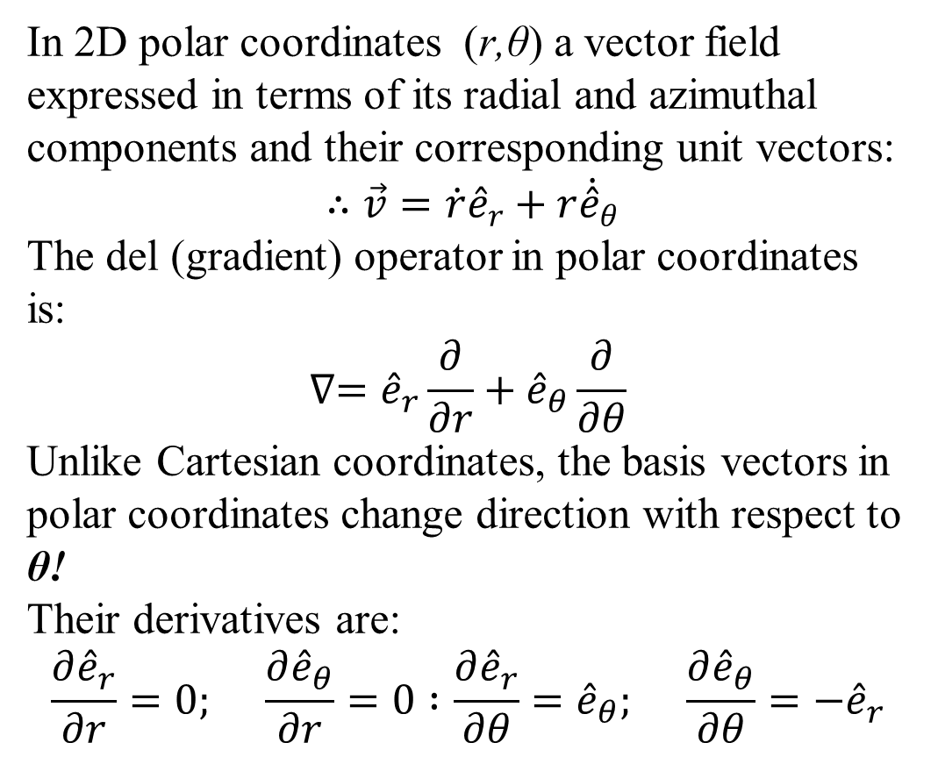




Geometric Interpretation: Gradient of Velocity
In 2D polar coordinates (r,θ) a vector field expressed in terms of its radial and azimuthal components and their corresponding unit vectors:
$∴\vec{v}=\dot{r}{\hat{e}}_{r}+r{\dot{\hat{e}}}_{θ}$
The del (gradient) operator in polar coordinates is:
$$∇={\hat{e}}_{r}\frac{∂}{∂r}+{\hat{e}}_{θ}\frac{∂}{∂θ}$$
Unlike Cartesian coordinates, the basis vectors in polar coordinates change direction with respect to θ!
Their derivatives are:
$$\frac{∂{\hat{e}}_{r}}{∂r}=0; \frac{∂{\hat{e}}_{θ}}{∂r}=0 :\frac{∂{\hat{e}}_{r}}{∂θ}={\hat{e}}_{θ}; \frac{∂{\hat{e}}_{θ}}{∂θ}={−\hat{e}}_{r}$$
$${\vec{v}}^{′}$$
$$v_{θ}^{′}$$
$$v_{r}^{′}$$
$$\vec{v}$$
$$v_{θ}$$
$$v_{r}$$

Slide 20
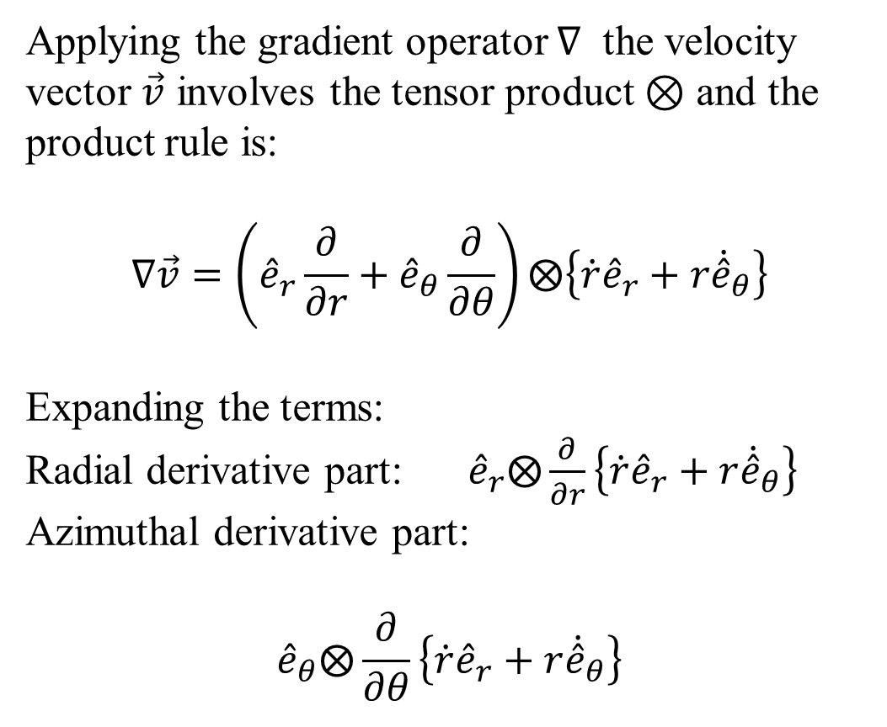
Geometric Interpretation: Gradient of Velocity
Applying the gradient operator ∇ the velocity vector $\vec{v}$ involves the tensor product ⊗ and the product rule is:
$$∇\vec{v}=\left({\hat{e}}_{r}\frac{∂}{∂r}+{\hat{e}}_{θ}\frac{∂}{∂θ}\right)⨂\left\{\dot{r}{\hat{e}}_{r}+r{\dot{\hat{e}}}_{θ}\right\}$$
Expanding the terms:
Radial derivative part:${\hat{e}}_{r}⨂\frac{∂}{∂r}\left\{\dot{r}{\hat{e}}_{r}+r{\dot{\hat{e}}}_{θ}\right\}$
Azimuthal derivative part:
$${\hat{e}}_{θ}⨂\frac{∂}{∂θ}\left\{\dot{r}{\hat{e}}_{r}+r{\dot{\hat{e}}}_{θ}\right\}$$
$${\vec{v}}^{′}$$
$$v_{θ}^{′}$$
$$v_{r}^{′}$$
$$\vec{v}$$
$$v_{θ}$$
$$v_{r}$$

Slide 21
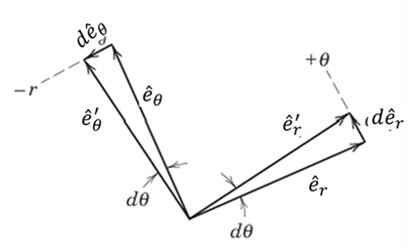
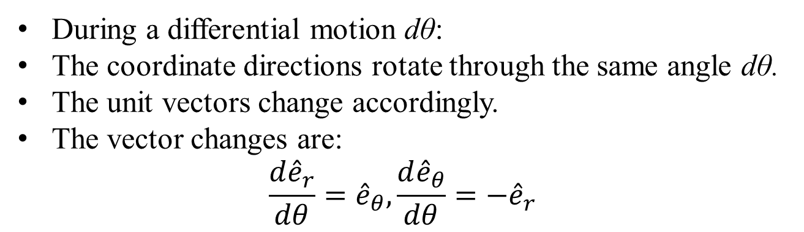
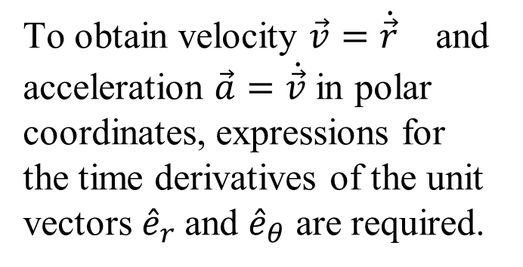
Time Derivatives of the Unit Vectors
To obtain velocity $\vec{v}=\dot{\vec{r}}$ and acceleration $\vec{a}=\dot{\vec{v}}$in polar coordinates, expressions for the time derivatives of the unit vectors ${\hat{e}}_{r}$and ${\hat{e}}_{θ}$ are required.
During a differential motion dθ:
During a differential motion dθ:
The coordinate directions rotate through the same angle dθ.
The unit vectors change accordingly.
The vector changes are:
$$\frac{d{\hat{e}}_{r}}{dθ}={\hat{e}}_{θ}, \frac{d{\hat{e}}_{θ}}{dθ}=−{\hat{e}}_{r}$$

Slide 22
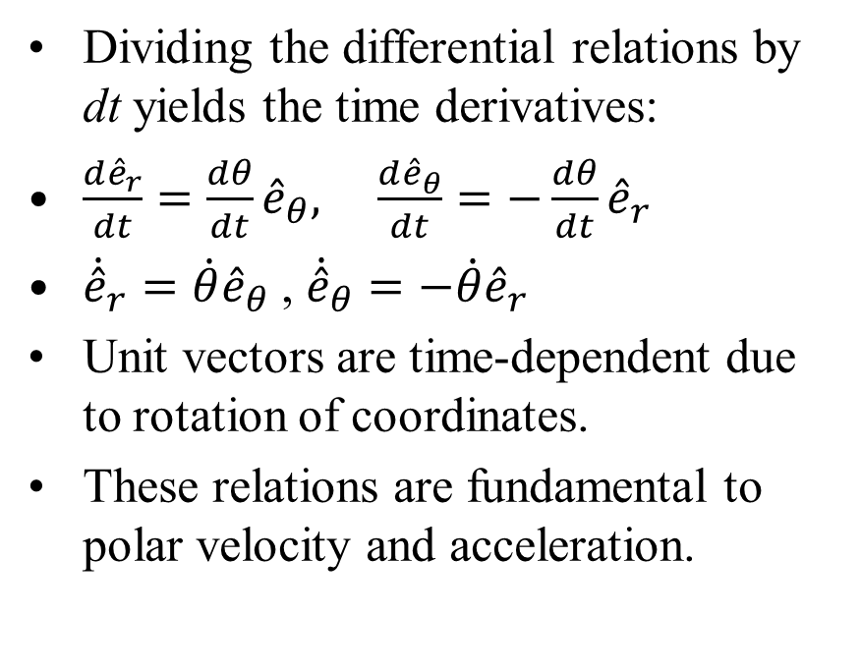
Time Derivatives of Polar Unit Vectors
Dividing the differential relations by dt yields the time derivatives:
$\frac{d{\hat{e}}_{r}}{dt}=\frac{dθ}{dt}{\hat{e}}_{θ}, \frac{d{\hat{e}}_{θ}}{dt}=−\frac{dθ}{dt}{\hat{e}}_{r}$
${\dot{\hat{e}}}_{r}=\dot{θ}{\hat{e}}_{θ}$ , ${\dot{\hat{e}}}_{θ}=−\dot{θ}{\hat{e}}_{r}$
Unit vectors are time-dependent due to rotation of coordinates.
These relations are fundamental to polar velocity and acceleration.

Slide 23
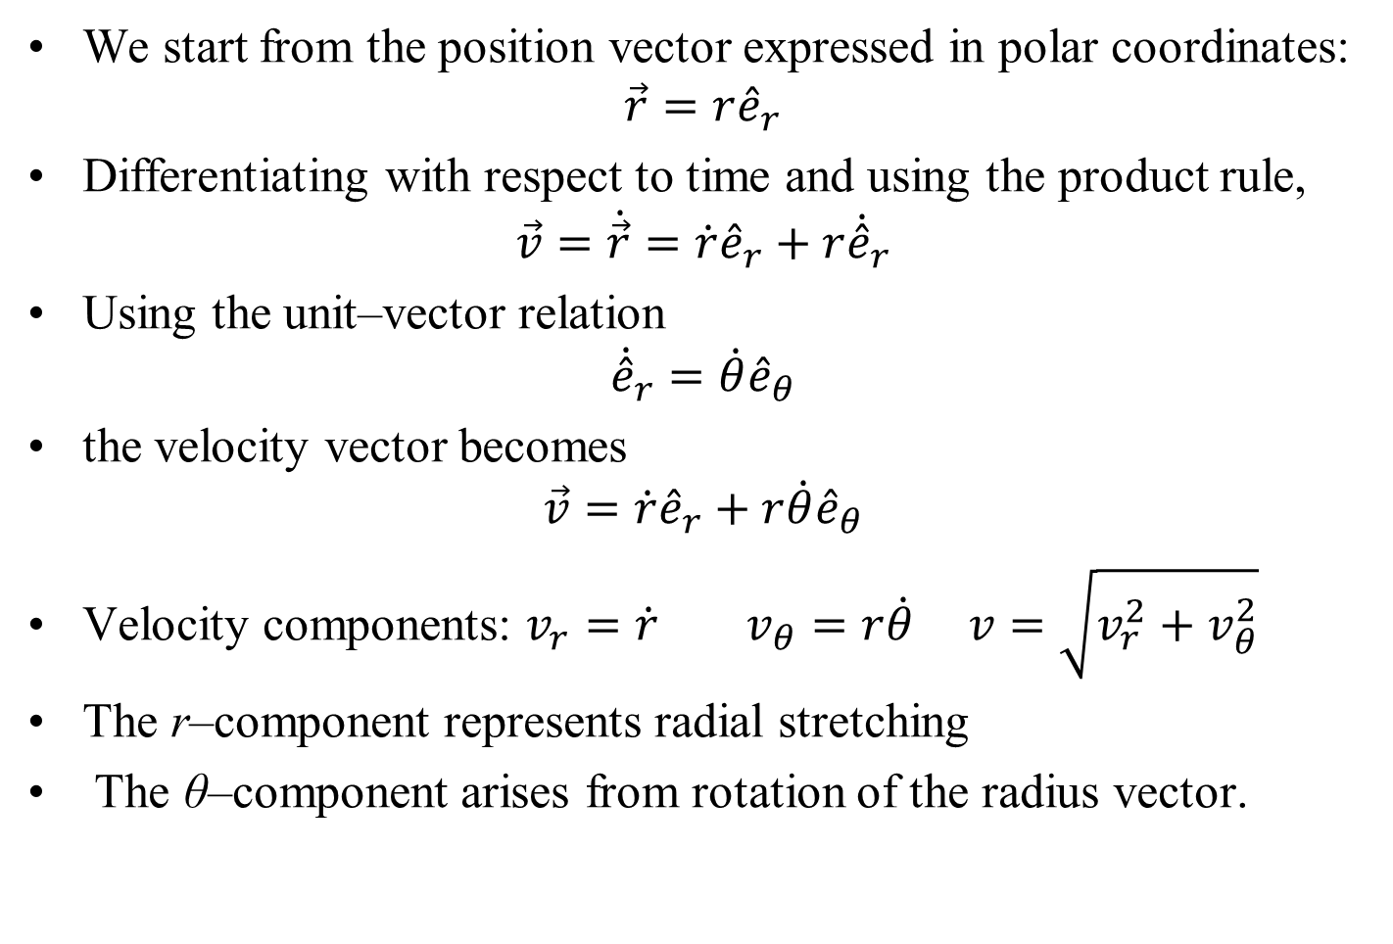
Polar Coordinates: Velocity
We start from the position vector expressed in polar coordinates:
$$\vec{r}=r{\hat{e}}_{r}$$
Differentiating with respect to time and using the product rule,
$$\vec{v}=\dot{\vec{r}}=\dot{r}{\hat{e}}_{r}+r{\dot{\hat{e}}}_{r}$$
Using the unit–vector relation
$${\dot{\hat{e}}}_{r}=\dot{θ}{\hat{e}}_{θ}$$
the velocity vector becomes
$$\vec{v}=\dot{r}{\hat{e}}_{r}+r\dot{θ}{\hat{e}}_{θ}$$
Velocity components: $v_{r}=\dot{r} v_{θ}=r\dot{θ} v=\sqrt{v_{r}^{2}+v_{θ}^{2}}$
The r–component represents radial stretching
The θ–component arises from rotation of the radius vector.

Slide 24
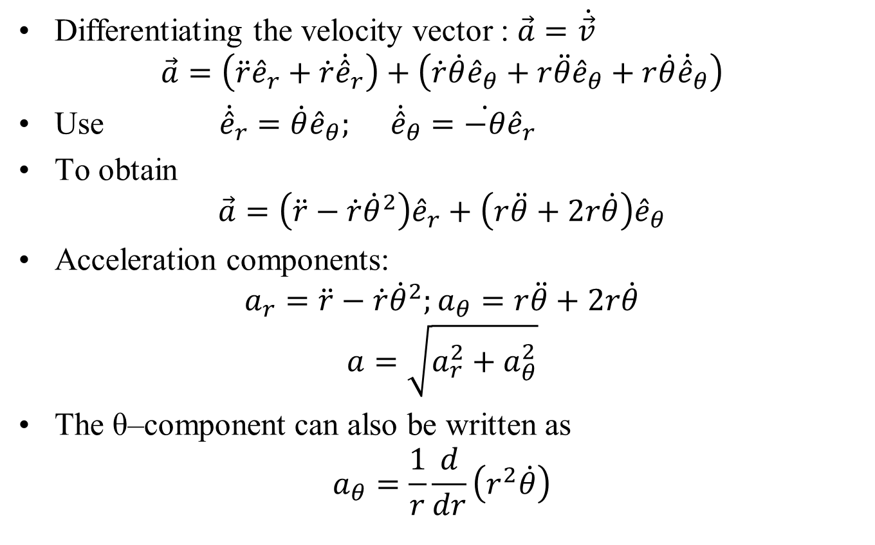
Polar Coordinates: Acceleration
Differentiating the velocity vector : $\vec{a}=\dot{\vec{v}}$
$$\vec{a}=\left(\ddot{r}{\hat{e}}_{r}+\dot{r}{\dot{\hat{e}}}_{r}\right)+\left(\dot{r}\dot{θ}{\hat{e}}_{θ}+r\ddot{θ}{\hat{e}}_{θ}+r\dot{θ}{\dot{\hat{e}}}_{θ}\right)$$
Use ${\dot{\hat{e}}}_{r}=\dot{θ}{\hat{e}}_{θ}; {\dot{\hat{e}}}_{θ}=\dot{−θ}{\hat{e}}_{r}$
To obtain
$$\vec{a}=\left(\ddot{r}−\dot{r}{\dot{θ}}^{2}\right){\hat{e}}_{r}+\left(r\ddot{θ}+2r\dot{θ}\right){\hat{e}}_{θ}$$
Acceleration components:
$$a_{r}=\ddot{r}−\dot{r}{\dot{θ}}^{2};a_{θ}=r\ddot{θ}+2r\dot{θ}$$
$$a=\sqrt{a_{r}^{2}+a_{θ}^{2}}$$
The θ–component can also be written as
$$a_{θ}=\frac{1}{r}\frac{d}{dr}\left(r^{2}\dot{θ}\right)$$

Slide 25
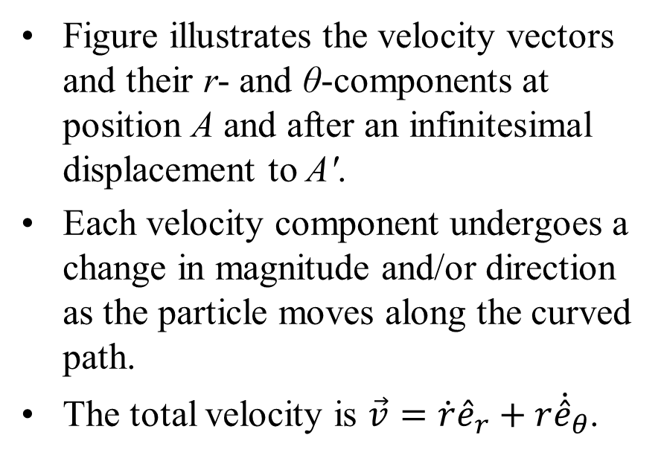
Geometric Interpretation: Velocity Components
Figure illustrates the velocity vectors and their r- and θ-components at position A and after an infinitesimal displacement to A′.
Each velocity component undergoes a change in magnitude and/or direction as the particle moves along the curved path.
The total velocity is $\vec{v}=\dot{r}{\hat{e}}_{r}+r{\dot{\hat{e}}}_{θ}$.
$${\vec{v}}^{′}$$
$$v_{θ}^{′}$$
$$v_{r}^{′}$$
$$\vec{v}$$
$$v_{θ}$$
$$v_{r}$$
These changes give rise to distinct acceleration contributions, which are interpreted geometrically.

