Slide 1


Kinematics of Particles
P M V Subbarao
Professor & Head
Mechanical Engineering Department
Movement of Negligible Size Bodies …..
Local Grammar for Motion..

Slide 2

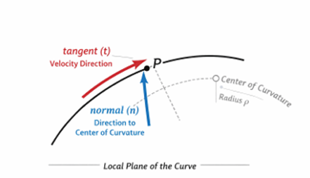
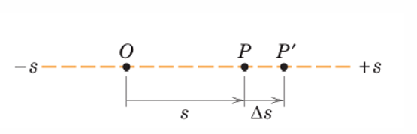
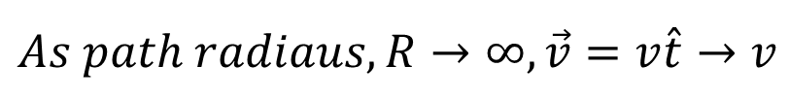
Intrinsic Description of Motion
$$As path radiaus, R→∞, \vec{v}=v\hat{t}→v$$
This is named as rectilinear motion of a particle.
At any instant of time t, the position of the particle is specified by its distance s measured from a convenient reference point O fixed on the line.
At time t +∆t, the particle moves to P′ and its coordinate becomes s + ∆s.
The change in the position coordinate during the time interval ∆t is called the displacement ∆s of the particle.

Slide 3
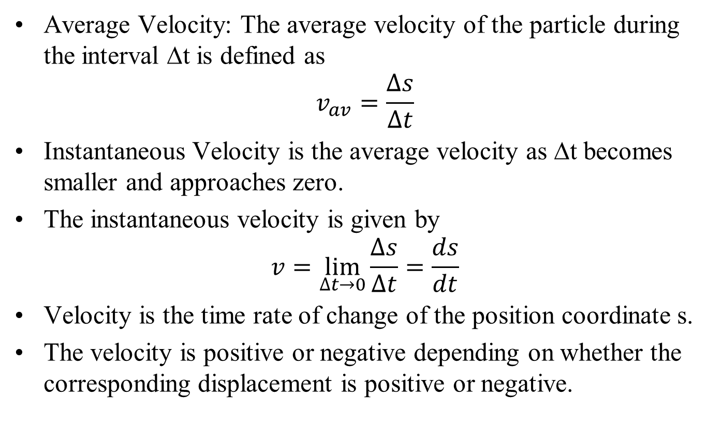
Rectilinear Motion: Velocity
Average Velocity: The average velocity of the particle during the interval ∆t is defined as
$$v_{av}=\frac{∆s}{∆t}$$
Instantaneous Velocity is the average velocity as ∆t becomes smaller and approaches zero.
The instantaneous velocity is given by
$$v=\lim_{∆t→0}{\frac{∆s}{∆t}}=\frac{ds}{dt}$$
Velocity is the time rate of change of the position coordinate s.
The velocity is positive or negative depending on whether the corresponding displacement is positive or negative.

Slide 4
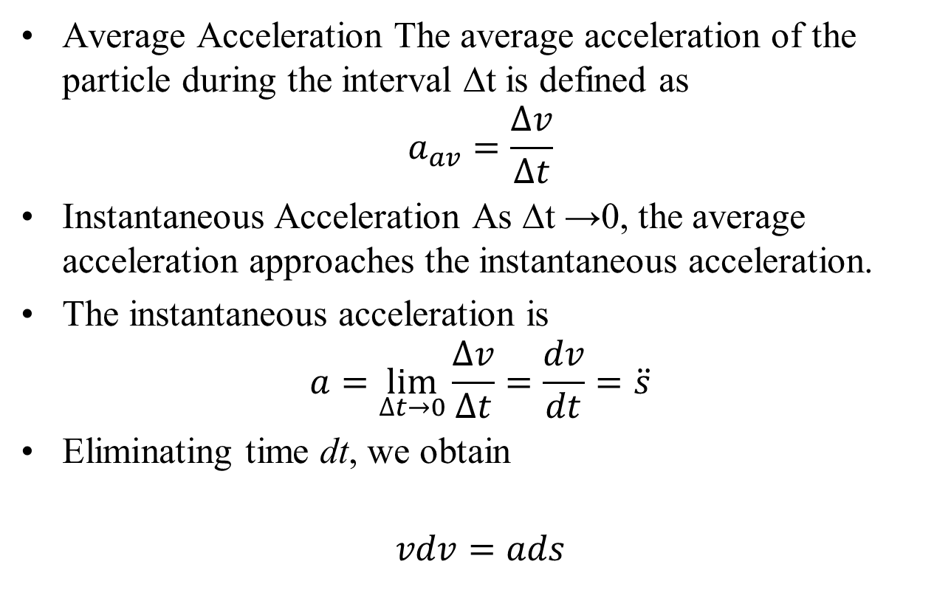
Rectilinear Motion: Acceleration
Average Acceleration The average acceleration of the particle during the interval ∆t is defined as
$$a_{av}=\frac{∆v}{∆t}$$
Instantaneous Acceleration As ∆t →0, the average acceleration approaches the instantaneous acceleration.
The instantaneous acceleration is
$$a=\lim_{∆t→0}{\frac{∆v}{∆t}}=\frac{dv}{dt}=\ddot{s}$$
Eliminating time dt, we obtain
$$vdv=ads$$

Slide 5
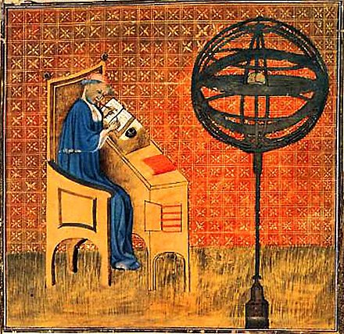
Graphical Interprétation of Motion
14th Century: Nicholas Oresme used early graphical methods to represent time and velocity.
He developed the use of simple graphs to plot physical quantities, thus anticipating by three centuries some of the ideas of Cartesian analytic geometry

Slide 6
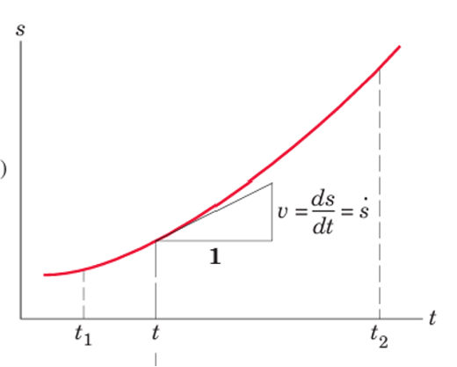
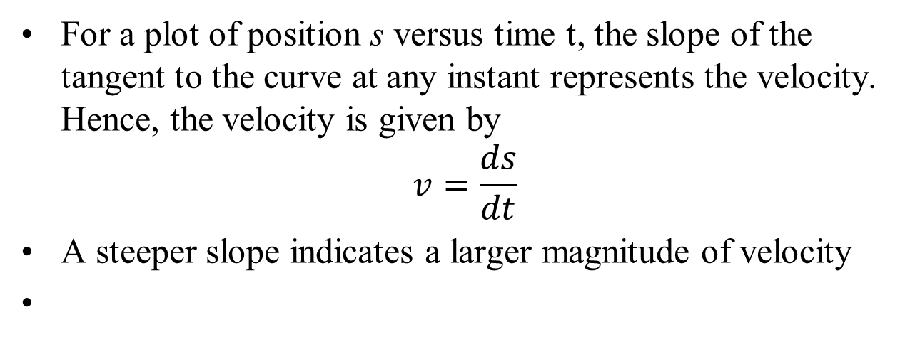
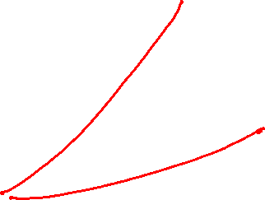
Graphical Interprétation: s–t Curve
14th Century: Nicholas Oresme used early graphical methods to represent time and velocity.
He developed the use of simple graphs to plot physical quantities, thus anticipating by three centuries some of the ideas of Cartesian analytic geometry
For a plot of position s versus time t, the slope of the tangent to the curve at any instant represents the velocity. Hence, the velocity is given by
$$v=\frac{ds}{dt}$$
A steeper slope indicates a larger magnitude of velocity

Slide 7
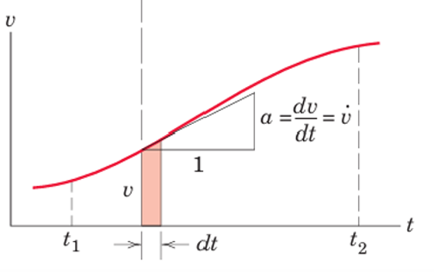
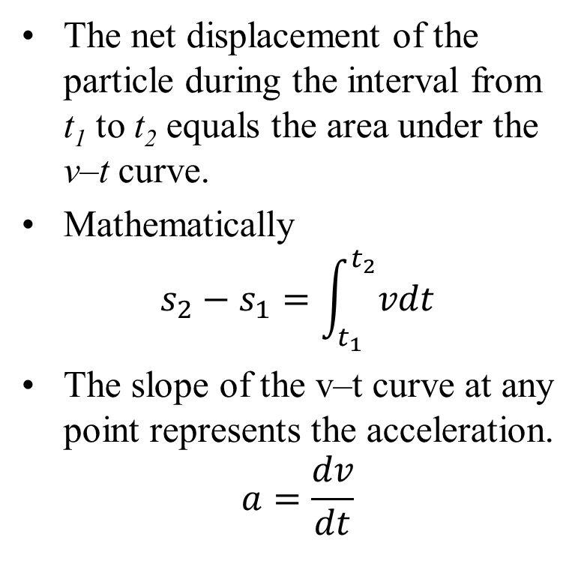
Graphical Interprétation: v–t Curve
The net displacement of the particle during the interval from t₁ to t₂ equals the area under the v–t curve.
Mathematically
$$s_{2}−s_{1}=\int_{t_{1}}^{t_{2}}{vdt}$$
The slope of the v–t curve at any point represents the acceleration.
$$a=\frac{dv}{dt}$$

Slide 8
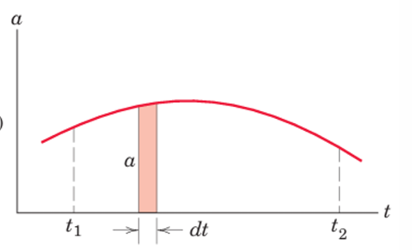
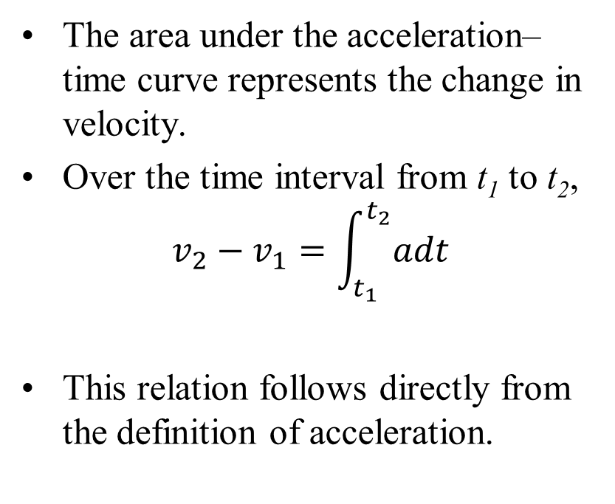
Graphical Interprétation: a–t Curve
The area under the acceleration–time curve represents the change in velocity.
Over the time interval from t₁ to t₂,
$$v_{2}−v_{1}=\int_{t_{1}}^{t_{2}}{adt}$$
This relation follows directly from the definition of acceleration.

Slide 9
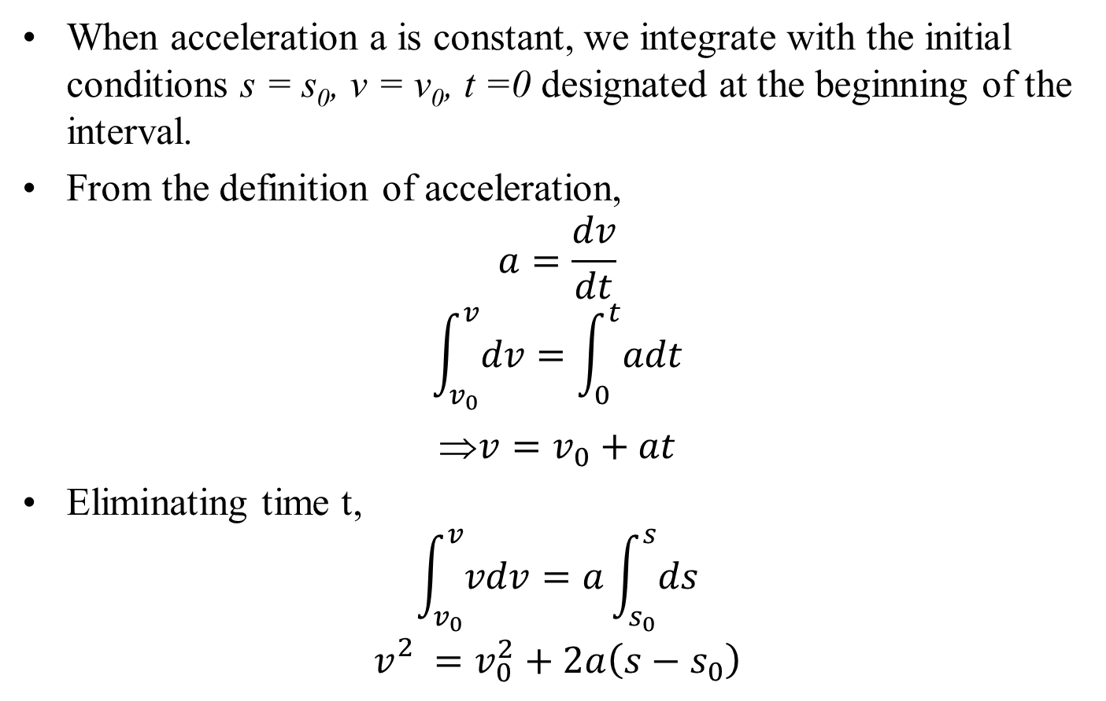
Elementary Kinematics: Constant Acceleration
When acceleration a is constant, we integrate with the initial conditions s = s₀, v = v₀, t =0 designated at the beginning of the interval.
From the definition of acceleration,
$$a=\frac{dv}{dt}$$
$$\int_{v_{0}}^{v}{dv}=\int_{0}^{t}{adt}$$
⇒$v=v_{0}+at$
Eliminating time t,
$$\int_{v_{0}}^{v}{vdv}=a\int_{s_{0}}^{s}{ds}$$
$$v_{}^{2}=v_{0}^{2}+2a\left(s−s_{0}\right)$$

Slide 10
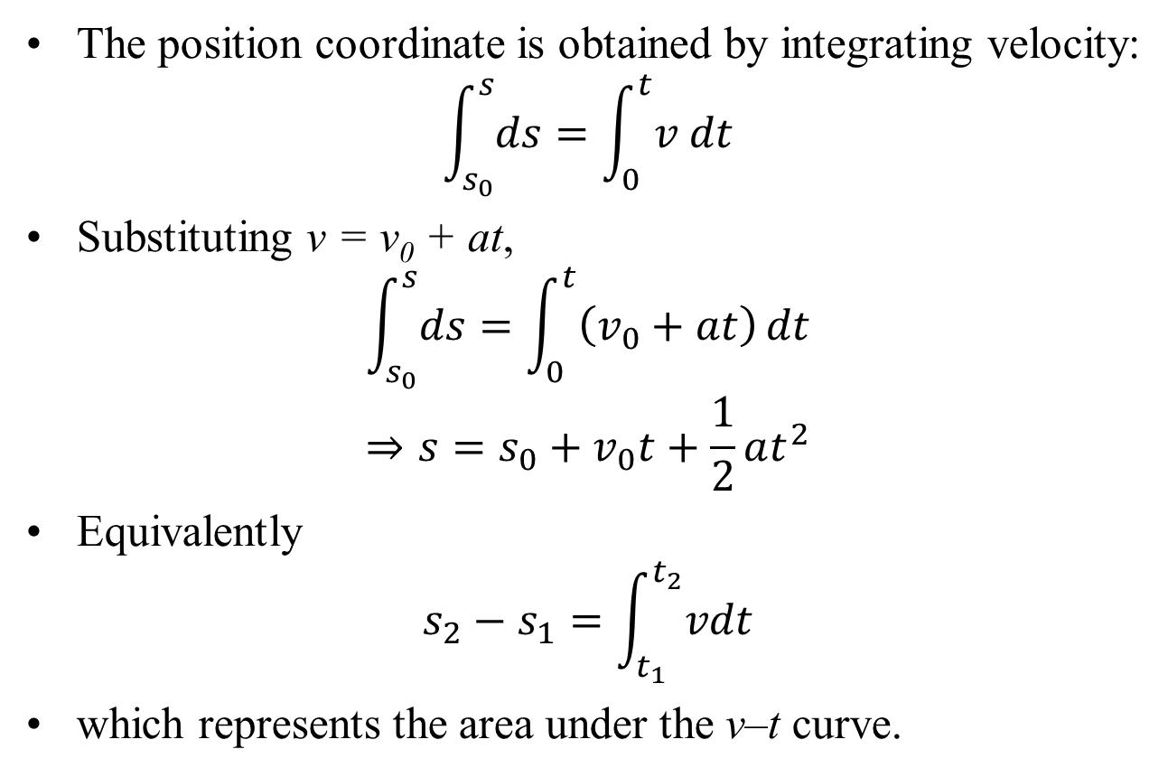
Constant Acceleration: Position
The position coordinate is obtained by integrating velocity:
$$\int_{s_{0}}^{s}{ds}=\int_{0}^{t}{v dt}$$
Substituting v = v₀ + at,
$$\int_{s_{0}}^{s}{ds}=\int_{0}^{t}{\left(v_{0}+at\right)}dt$$
$$⇒s=s_{0}+v_{0}t+\frac{1}{2}at^{2}$$
Equivalently
$$s_{2}−s_{1}=\int_{t_{1}}^{t_{2}}{vdt}$$
which represents the area under the v–t curve.

Slide 11
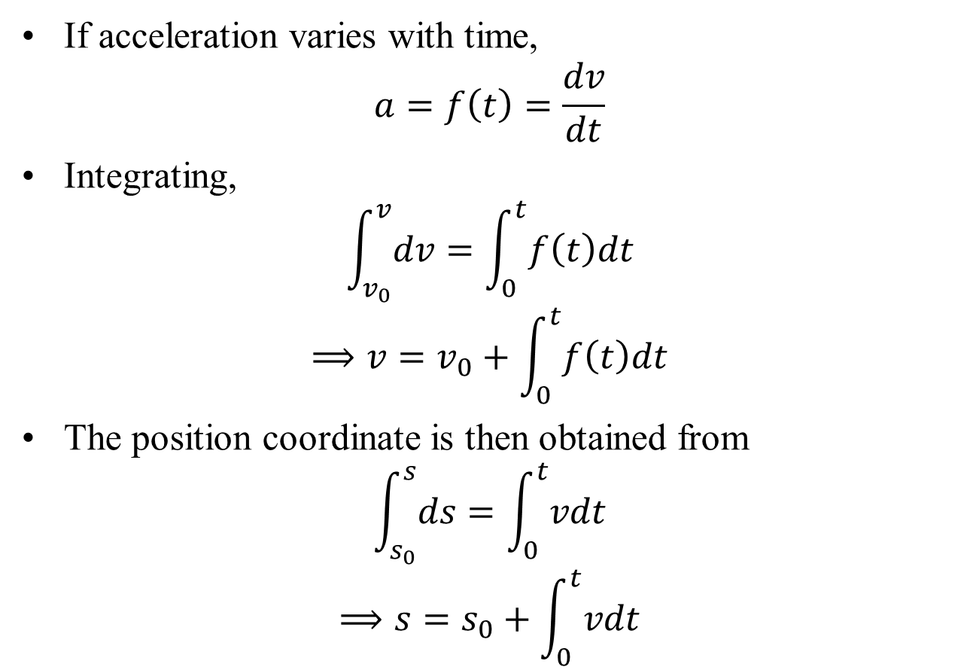
Acceleration Given as a Function of Time
If acceleration varies with time,
$$a=f\left(t\right)=\frac{dv}{dt}$$
Integrating,
$$\int_{v_{0}}^{v}{dv}=\int_{0}^{t}{f\left(t\right)dt}$$
$$⟹v=v_{0}+\int_{0}^{t}{f\left(t\right)dt}$$
The position coordinate is then obtained from
$$\int_{s_{0}}^{s}{ds}=\int_{0}^{t}{vdt}$$
$$⟹s=s_{0}+\int_{0}^{t}{vdt}$$

Slide 12
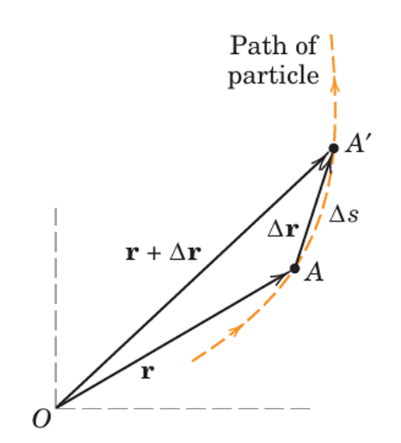
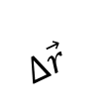
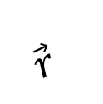
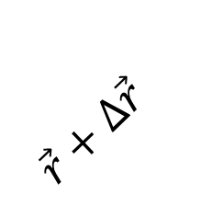
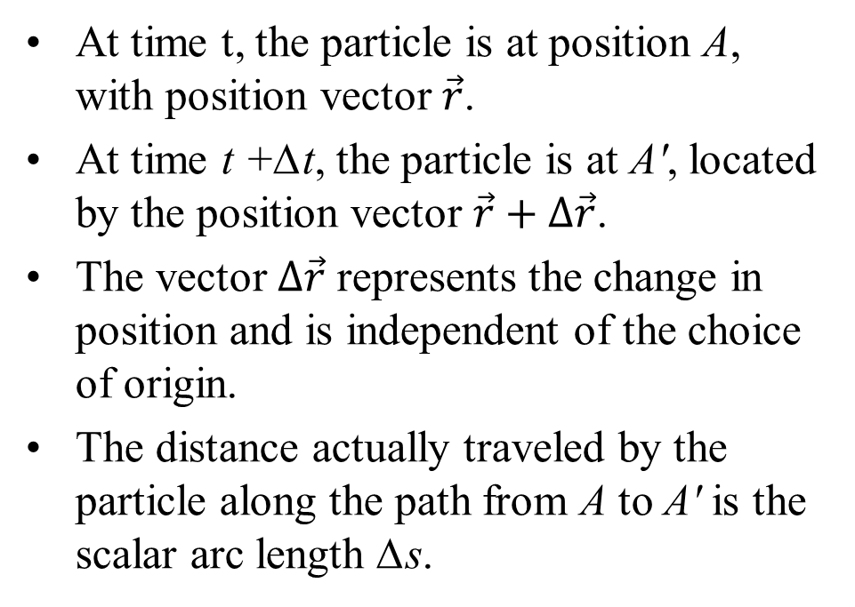
Plane Curvilinear Motion
At time t, the particle is at position A, with position vector $\vec{r}$.
At time t +∆t, the particle is at A′, located by the position vector $\vec{r}+∆\vec{r}$.
The vector $∆\vec{r}$ represents the change in position and is independent of the choice of origin.
The distance actually traveled by the particle along the path from A to A′ is the scalar arc length ∆s.
$\vec{r}+∆\vec{r}$
$$∆\vec{r}$$
$\vec{r}$

Slide 13
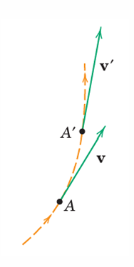
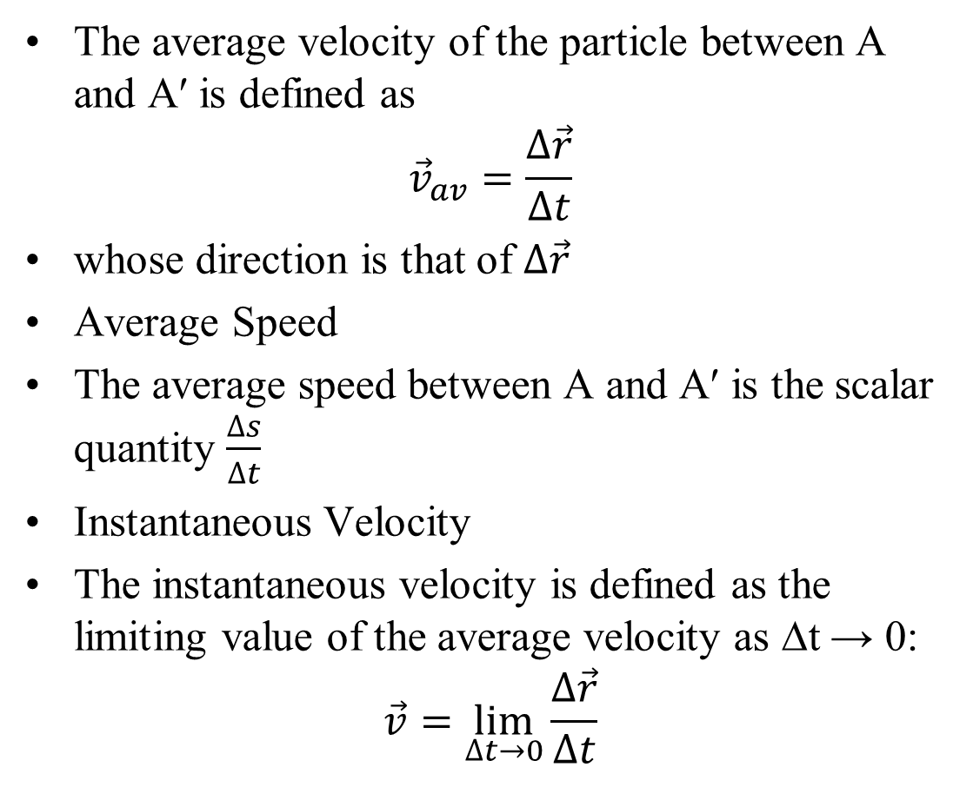


Plane Curvilinear Motion: Velocity
The average velocity of the particle between A and A′ is defined as
$${\vec{v}}_{av}=\frac{∆\vec{r}}{∆t}$$
whose direction is that of $∆\vec{r}$
Average Speed
The average speed between A and A′ is the scalar quantity $\frac{∆s}{∆t}$
Instantaneous Velocity
The instantaneous velocity is defined as the limiting value of the average velocity as ∆t → 0:
$$\vec{v}=\lim_{∆t→0}{\frac{∆\vec{r}}{∆t}}$$
$${\vec{v}}^{′}$$
$$\vec{v}$$

Slide 14
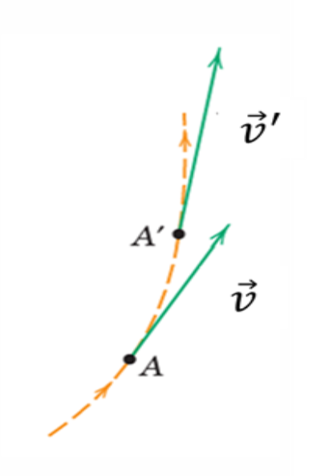
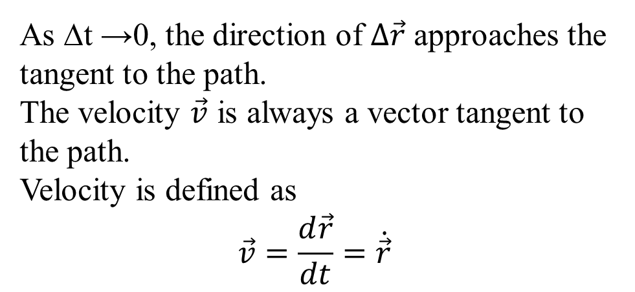
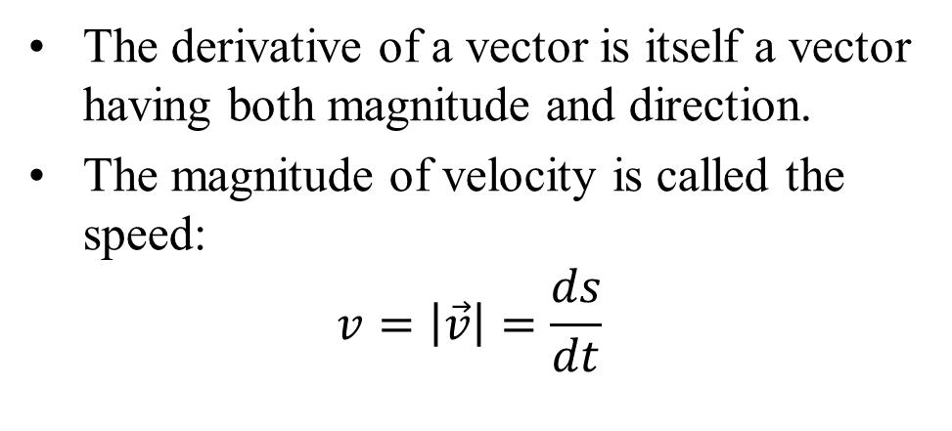
Plane Curvilinear Motion: Velocity
The derivative of a vector is itself a vector having both magnitude and direction.
The magnitude of velocity is called the speed:
$$v=\left|\vec{v}\right|=\frac{ds}{dt}$$
As ∆t →0, the direction of $∆\vec{r}$ approaches the tangent to the path.
The velocity $\vec{v}$ is always a vector tangent to the path.
Velocity is defined as
$$\vec{v}=\frac{d\vec{r}}{dt}=\dot{\vec{r}}$$

Slide 15
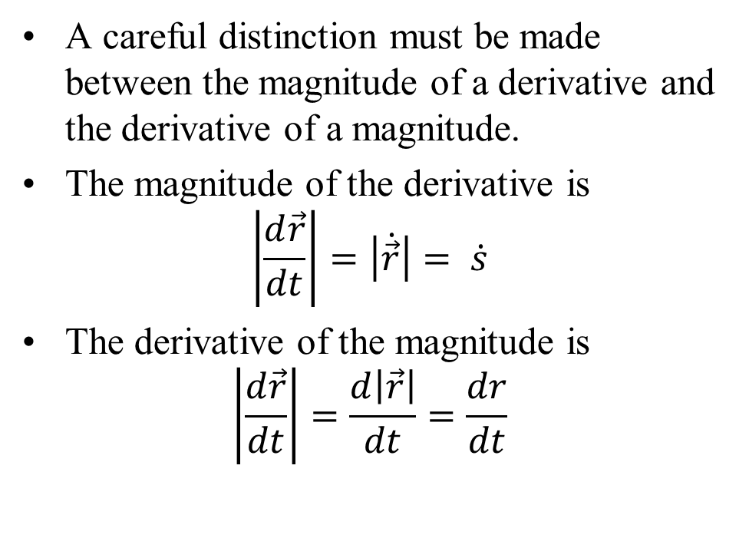
Plane Curvilinear Motion: Velocity
A careful distinction must be made between the magnitude of a derivative and the derivative of a magnitude.
The magnitude of the derivative is
$$\left|\frac{d\vec{r}}{dt}\right|=\left|\dot{\vec{r}}\right|= \dot{s}$$
The derivative of the magnitude is
$$\left|\frac{d\vec{r}}{dt}\right|=\frac{d\left|\vec{r}\right|}{dt}=\frac{dr}{dt}$$

Slide 16
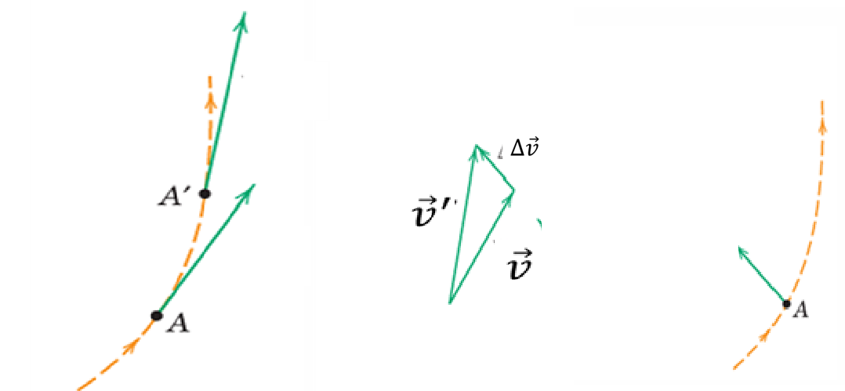
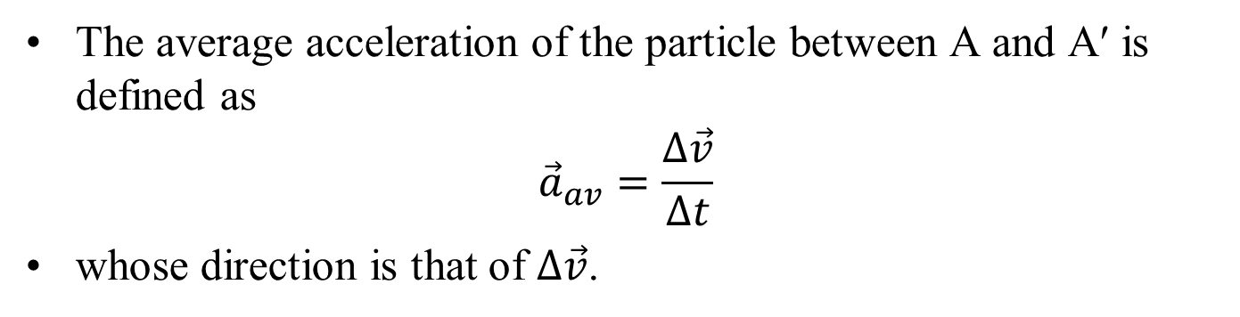

Plane Curvilinear Motion: Acceleration
$$\vec{a}$$
The average acceleration of the particle between A and A′ is defined as
$${\vec{a}}_{av}=\frac{∆\vec{v}}{∆t}$$
whose direction is that of $∆\vec{v}$.

Slide 17
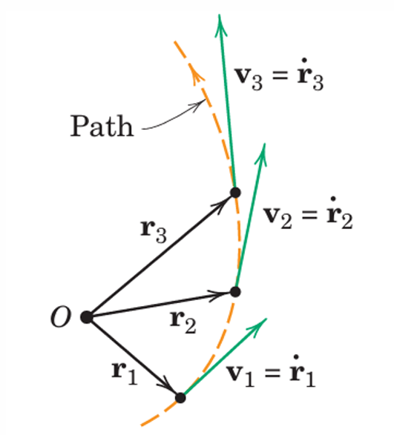



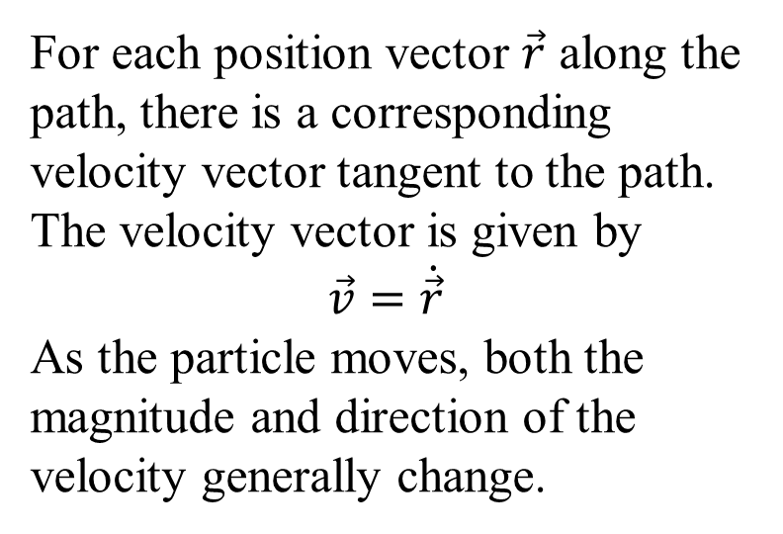



Visualization of the Motion
For each position vector $\vec{r}$ along the path, there is a corresponding velocity vector tangent to the path. The velocity vector is given by
$$\vec{v}=\dot{\vec{r}}$$
As the particle moves, both the magnitude and direction of the velocity generally change.
$${\vec{v}}_{3}={\dot{\vec{r}}}_{3}$$
$${\vec{v}}_{2}={\dot{\vec{r}}}_{2}$$
$${\vec{r}}_{3}$$
$${\vec{r}}_{2}$$
$${\vec{r}}_{1}$$
$${\vec{v}}_{1}={\dot{\vec{r}}}_{1}$$

