Slide 1


Kinematics of Particles
P M V Subbarao
Professor & Head
Mechanical Engineering Department
The Grammar of Movement …..

Slide 2

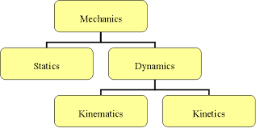
Structure of Engineering Mechanics
Kinematics of Particles
Kinematics of Bodies

Slide 3
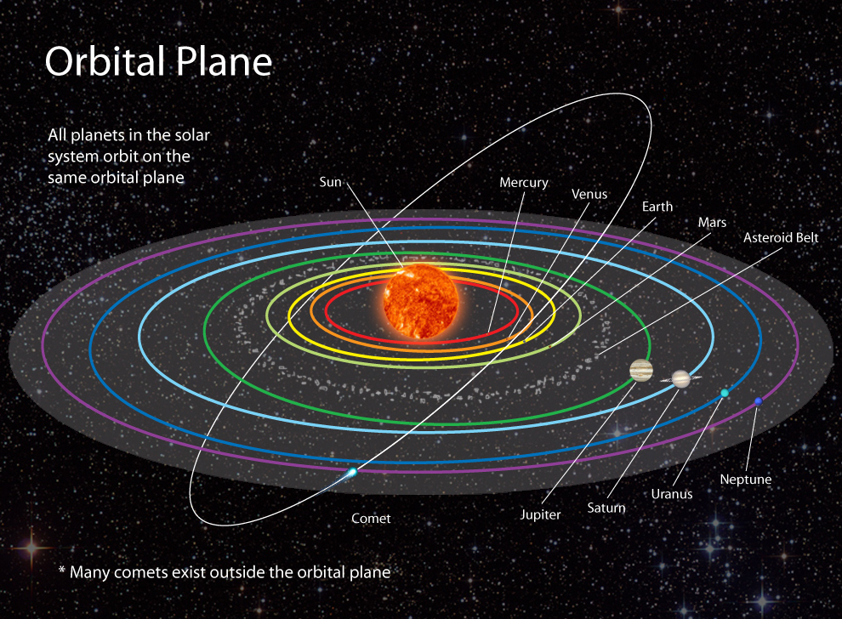

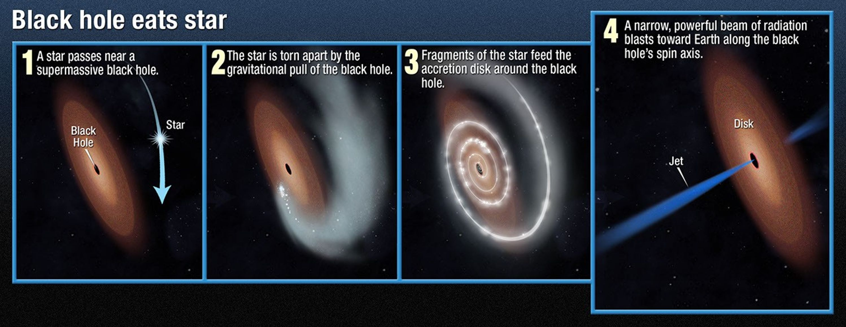
Kinematics as a Sequel of Human Ingenuity
In the modern perspective the sky was the only television channel for our early ancestors.

Slide 4
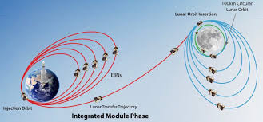
Trajectory of Chandrayans
Chandrayaan-2's lander (Vikram) crashed due to excessive velocity and inability to handle unforeseen deviations during the final stages.
Chandrayaan-3 used a "failure-based" design, meaning the trajectory was designed to handle engine failures, sensor failures, or algorithm failures, enabling a safe landing,

Slide 5
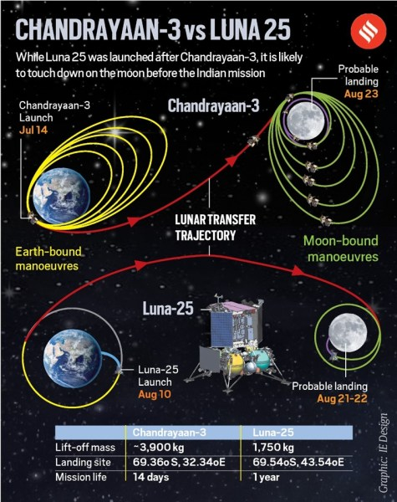

Trajectory of Chandrayans

Slide 6
Evolution of Kinematics
Ancient Roots: South Asian and Greek mathematicians used kinematical definitions of curves, while astronomers used models to describe planetary movement.
14th Century: Scholars at Merton College, Oxford, formulated the "Merton Rule" for uniform acceleration.
Nicholas Oresme used early graphical methods to represent time and velocity.
17th Century: Galileo Galilei significantly advanced the field by studying projectile motion and falling bodies, identifying constant acceleration.
Onset of Formal Kinematics as an engineering science.

Slide 7
Formalization of Kinematics
19th Century: French physicist André-Marie Ampère coined the term cinématique around 1830.
Defined it as a branch of mechanics focusing solely on motion.
Franz Reuleaux, (1829 -1905) often called the "father of kinematics," heavily influenced the kinematics of machines.
Franz Reuleaux began his academic career with the publication of a Machine Design Handbook in 1854.
Reuleaux’s kinematic theories were used in the evelopment of powerful steam engines that carried people across oceans and continents by steamship and railroad.

Slide 8
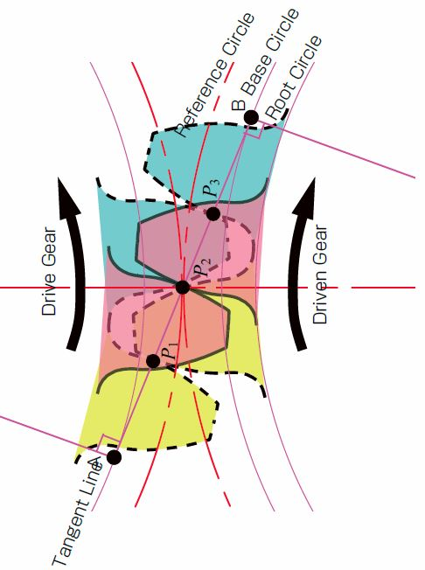
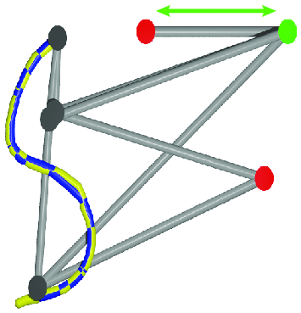
Introduction to Kinematics
Kinematics describes the motion of bodies without reference to the forces which either cause the motion or are generated as a result of the motion.
Kinematics is often described as the geometry of motion.
Engineering applications include design of linkages, cams, gears and other machine elements to control or produce desired motions.
the motion

Slide 9
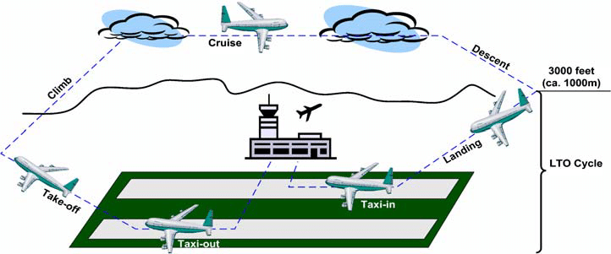
Introduction to Kinematics
Calculation of flight trajectories for aircraft, rockets, and spacecraft.
Kinematics is a prerequisite to kinetics; which studies the relationships between motion and the corresponding forces which cause the motion

Slide 10
Particle Motion
A particle is a body whose physical dimensions are so small compared with the radius of curvature of its path that the motion may be treated as that of a point.
The wingspan of an aircraft is of no consequence compared with the radius of curvature of its flight path.

Slide 11
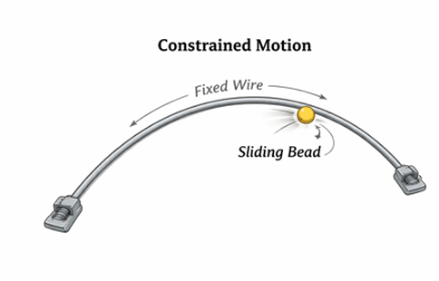
Types of Particle Motions
If a particle is confined to a specified path, such as a bead sliding along a fixed wire, its motion is said to be constrained.
If there are no physical guides, the motion is said to be unconstrained.

Slide 12
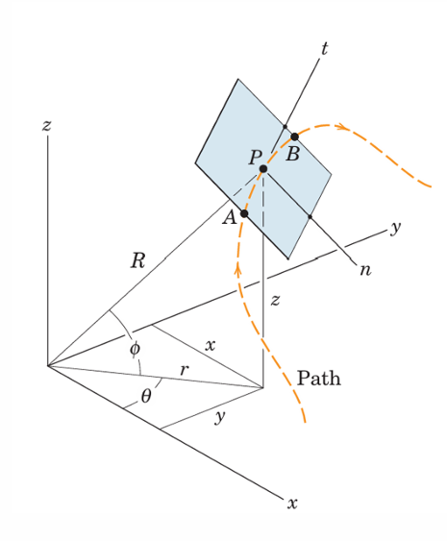
Selection of Coordinates
The position of a particle P at any time t may be specified using:
Rectangular coordinates (x,y,z)
Cylindrical polar coordinates (r,θ,z)
Spherical polar coordinates (R,θ,ϕ)
These systems are known as Extrinsic Coordinate Systems.
Absolute motion analysis: Particle (or rigid body) motion may be analyzed using coordinates measured from fixed reference axes.
Relative motion analysis : Particle (or rigid body) motion may be analyzed using Coordinates measured from moving reference axes.

Slide 13
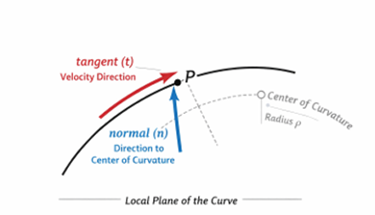


Intrinsic Description of Motion
$$\vec{v}=v\hat{t}$$
$$\vec{a}=a_{t}\hat{t}+a_{n}\hat{n}$$
The motion of particle P may also be described using intrinsic coordinate system.
The tangent–normal (n-t)description of motion is an intrinsic coordinate system that defines a particle's position and kinematics relative to its path of motion.
The direction of n lies in the local plane of the curve.

Slide 14
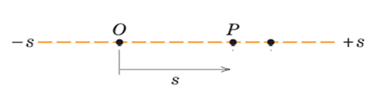


Intrinsic Description of Motion
$$\vec{v}=v\hat{t}$$
$$\vec{a}=a_{t}\hat{t}+a_{n}\hat{n}$$
n – t directions translate and rotate as the particle moves.
They indicate how fast the particle moves and how sharply it turns.
If the radius of the path is infinite, it becomes rectilinear motion.

Slide 15
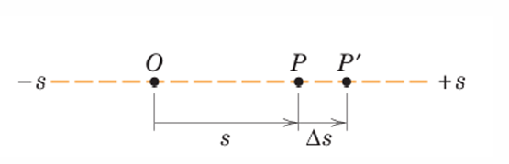

Rectilinear Motion
The rectilinear motion of particle P is a subset of general curvilinear motion.
This study is generally has a pedagogical importance.
At any instant of time t, the position of the particle is specified by its distance s measured from a convenient reference point O fixed on the line.
At time t +∆t, the particle moves to P′ and its coordinate becomes s + ∆s.
The change in the position coordinate during the interval ∆t is called the displacement ∆s of the particle.

