Slide 1


Space Structure As Frames & Machines
P M V Subbarao
Professor & Head
Mechanical Engineering Department
Challenges in Analysis of Real Structures…..

Slide 2

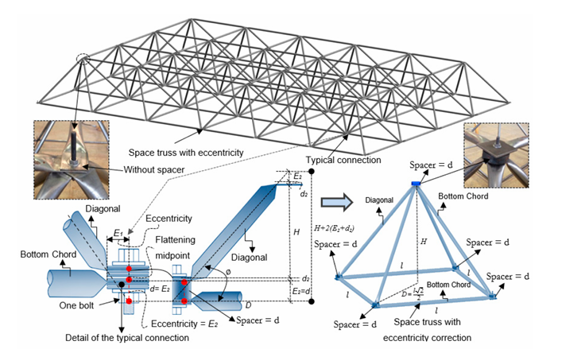
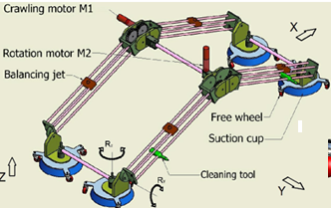
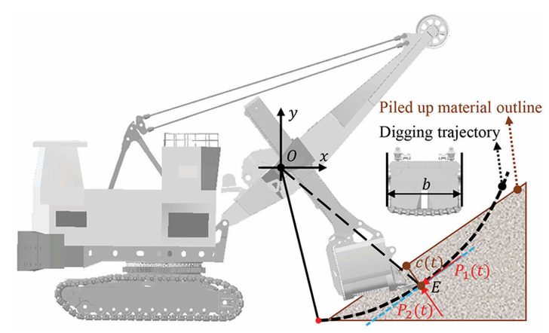
Safe Design of True Structural World

Slide 3
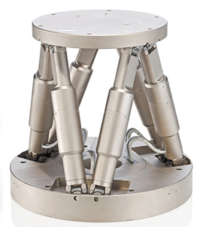
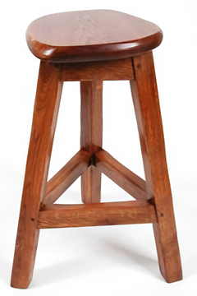
The World of Structures
Structural word consists of Three-dimensional Frames and machines.
These engineering structures will contain at least one multi-force member.
As their name implies, multi-force members have more than two concentrated loads, distributed loads, and/or couples applied to them and therefore are not two-force members.
A Simple Frame
A Simple Machine
Therefore, real world consists of Space Trusses

Slide 4
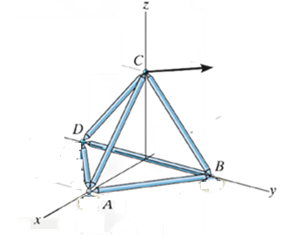

Space Trusses
A space truss is the three-dimensional counterpart of the plane truss.
A basic space truss, requires six bars joined at their ends to form the edges of a tetrahedron as the basic non-collapsible unit.
In this Figure the two bars AC and BC joined at C require a third sup port DC to keep the triangle ACB from rotating about AB.
$$\vec{F}$$
The rigidity of DABC dependent on the foundation of legs.
The supporting base is replaced by three more bars AB, BD, and AD to form a tetrahedron not dependent on the foundation for its own rigidity.

Slide 5
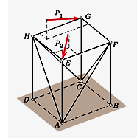


Space Trusses
More rigid units may be created to extend the structure with three additional concurrent bars whose ends are attached to three fixed joints on the existing structure.
$${\vec{P}}_{1}$$
In this Figure the bars AF, BF, and CF are attached to the foundation and therefore fix point F in space.
H
$${\vec{P}}_{1}$$
F
A Point H is created and fixed in space by the bars AH, DH, and CH.
The three additional bars CG, FG, and HG are attached to the three fixed points C, F, and H and therefore fix G in space.
C
D
B
A
The fixed-point E is similarly created.

Slide 6
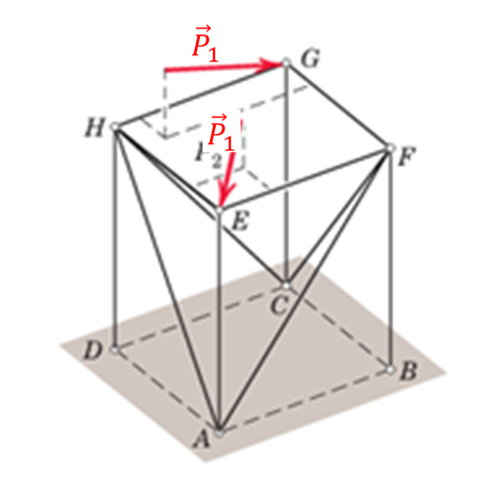
Space Trusses
This structure is entirely rigid.
The two applied loads shown will result in forces in all of the members.
A space truss formed in this way is called a simple space truss.
Ideally there must be point support, such as that given by a ball and-socket joint, at the connections of a space truss to prevent bending in the members.
As in riveted and welded connections for plane trusses, if the centerlines of joined members intersect at a point, the assumption of two-force members under simple tension and compression is justified!

Slide 7
Statically Determinate Space Trusses
A Statically Determinate Space Truss must be externally supported as an entire unit.
For a SDST, ∃ a relationship between the number of its joints (j) and the number of its members (m) necessary for internal stability without redundancy.
Because the equilibrium of each joint is specified by three scalar force equations, there are in all 3j such equations for a space truss with j joints.
For the entire truss composed of m members there are m unknowns (the tensile or compressive forces in the members) plus six unknown support reactions in the general case of a SDST.

Slide 8
Statically Determinate Space Trusses
For any space truss, the equation m = 3j-6 will be satisfied if the truss is statically determinate internally.
A simple space truss satisfies this relation automatically.
Starting with the initial tetrahedron, for which the equation holds, the structure is extended by adding three members and one joint at a time, thus preserving the equality.
This relation is a necessary condition for stability, but it is not a sufficient condition.
One or more of the m members can be arranged in such a way as not to contribute to a stable configuration of the entire truss.

Slide 9
Statically Determinate Space Trusses
If m > 3j-6 , there are more members than there are independent equations, and the truss is statically indeterminate internally with redundant members present.
If m < 3j-6 , there is a deficiency of internal members, and the truss is unstable and subject to collapse under load.
This relationship be tween the number of joints and the number of members is very helpful in the preliminary design of a stable space truss.
The configuration is not as obvious as with a plane truss, where the geometry for statical determinacy is generally quite apparent

Slide 10
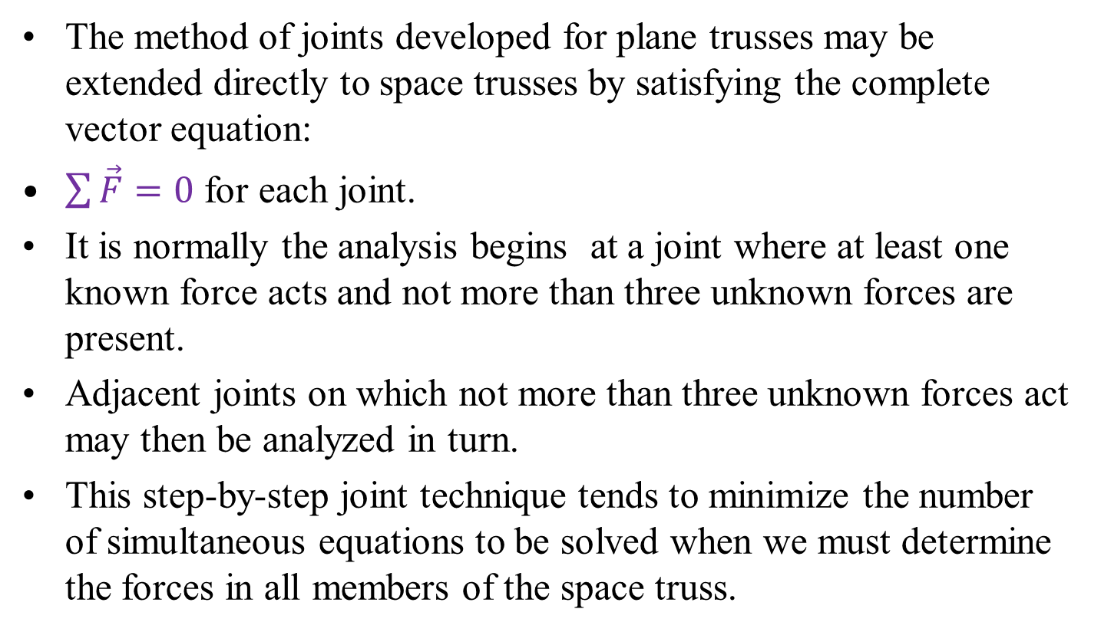
Method of Joints for Space Trusses
The method of joints developed for plane trusses may be extended directly to space trusses by satisfying the complete vector equation:
$\sum{\vec{F}=0}$ for each joint.
It is normally the analysis begins at a joint where at least one known force acts and not more than three unknown forces are present.
Adjacent joints on which not more than three unknown forces act may then be analyzed in turn.
This step-by-step joint technique tends to minimize the number of simultaneous equations to be solved when we must determine the forces in all members of the space truss.

Slide 11
Method of Joints for Space Trusses
As an alternative procedure, however, we may simply write 3j joint equations by applying force balance equations to all joints of the space frame.
The number of unknowns will be m + 6 if the structure is non-collapsible when removed from its supports and those supports provide six external reactions.
If there are no redundant members, then the number of equations (3j) equals the number of unknowns (m+ 6).
The entire system of equations can be solved simultaneously for the unknowns.
Be cause of the large number of coupled equations, a computer solution is usually required.

Slide 12
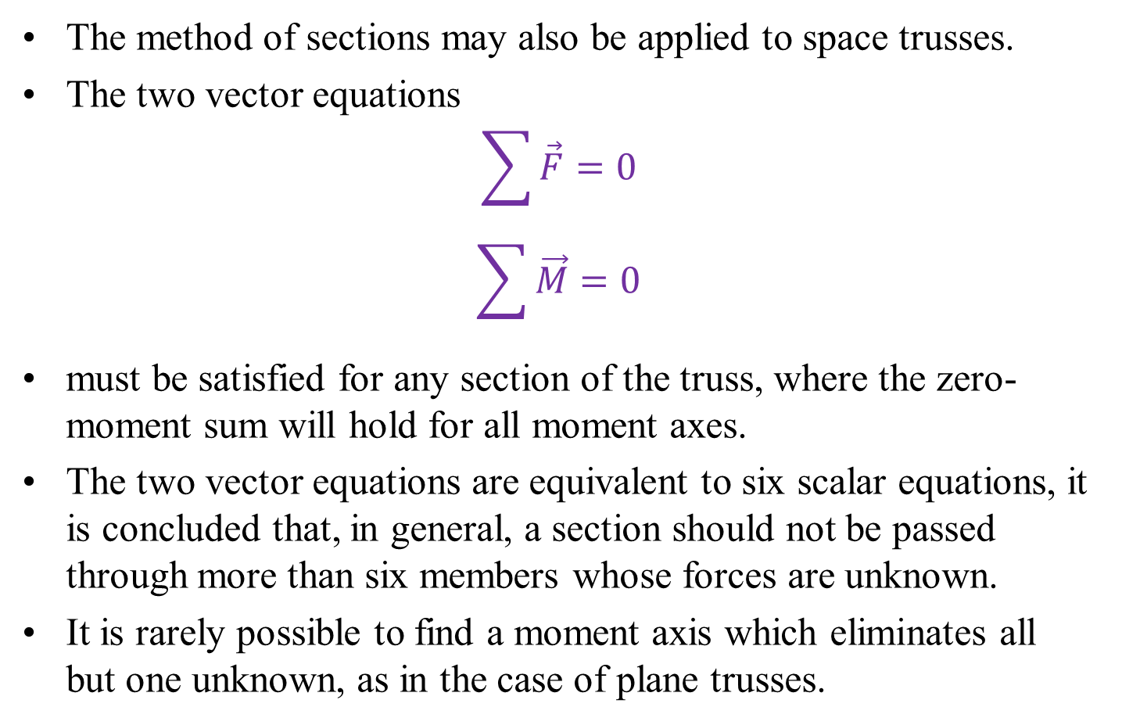
Method of Sections for Space Trusses
The method of sections may also be applied to space trusses.
The two vector equations
$$\sum{\vec{F}=0}$$
$$\sum{\vec{M}=0}$$
must be satisfied for any section of the truss, where the zero-moment sum will hold for all moment axes.
The two vector equations are equivalent to six scalar equations, it is concluded that, in general, a section should not be passed through more than six members whose forces are unknown.
It is rarely possible to find a moment axis which eliminates all but one unknown, as in the case of plane trusses.

Slide 13
Frames and Machines
A structure is called a frame or machine if at least one of its individual members is a multi-force member.
A multi-force member is defined as one with three or more forces acting on it, or one with two or more forces and one or more couples acting on it.
Frames and machines contain multi-force members, the forces in these members in general will not be in the directions of the members.

Slide 14
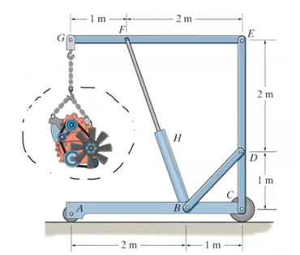
Frames
Frames are structures which are designed to support applied loads and are usually fixed in position.

Slide 15
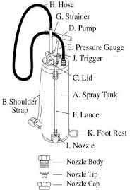
Machines
A structure is called a frame or machine if at least one of its Machines are structures which contain moving parts and are de signed to transmit input forces or couples to output forces or couples.
Hand Compression Pumps (HCPs) for use in Indoor Residual Spray(IRS)

Slide 16
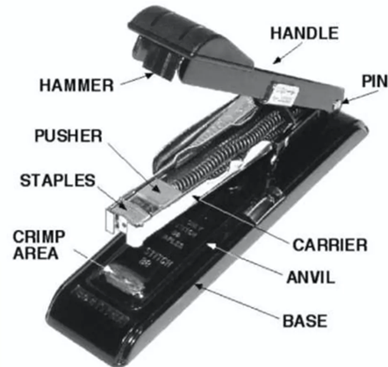
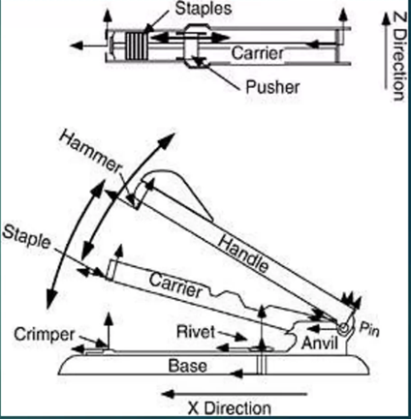
Machines
Machines are non-rigid structures where the parts can move relative to one another.
Generally, they have an input and an output force and are designed to produce a mechanical advantage.
Machines, which are in static equilibrium by their interacting and applied forces are treated as space structures for analysis.

Slide 17
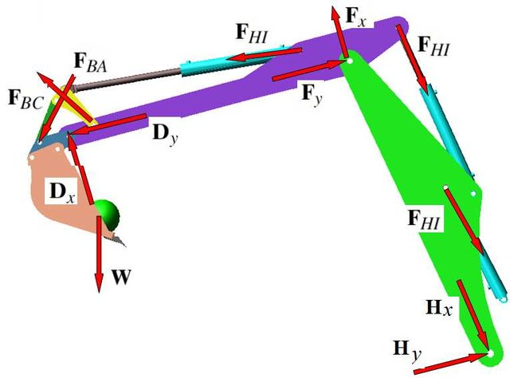
Structural Analysis of Machines
Machines, which are in static equilibrium by their interacting and applied forces are treated as space structures for analysis.

Slide 18
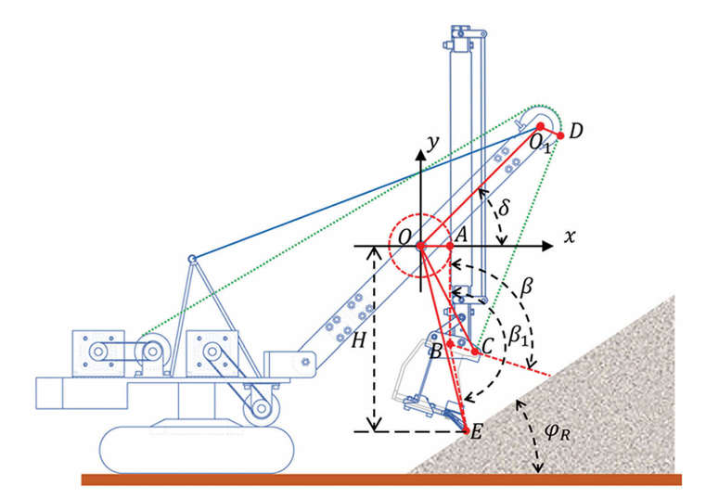
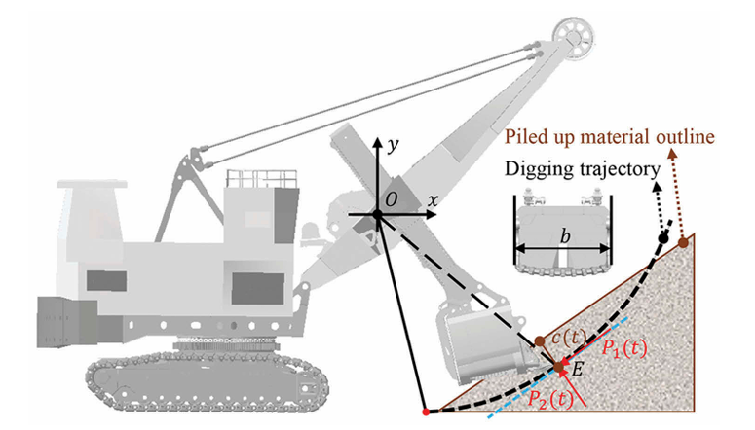
Analysis of Frames and Machines
Due to the presence of multi-force member, it is not possible analyze these structures by conventional the methods.
Conventional methods apply to simple frames/machines composed of two-force members where the forces are in the directions of the members.

Slide 19
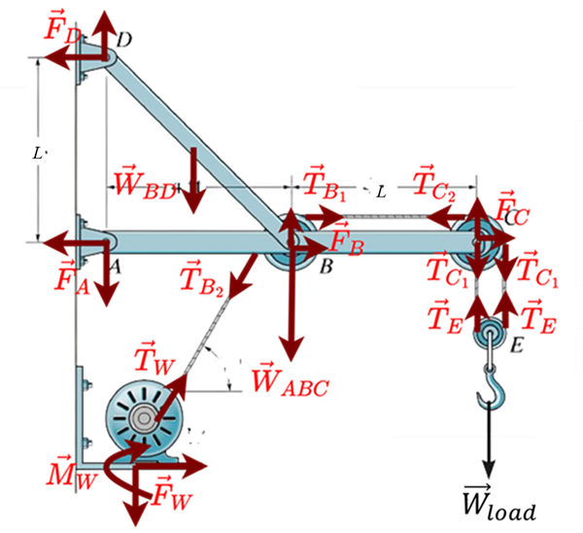
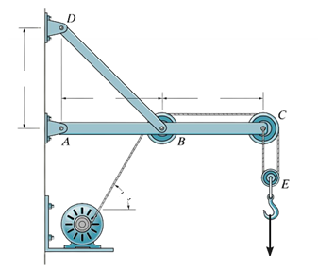


Force Representation and Free-Body Diagrams for Frames and Machines
In most cases the analysis of frames and machines is facilitated by representing the forces in terms of their rectangular components.
L
L
L
$$θ$$
Winch
$${\vec{W}}_{load}$$

Slide 20
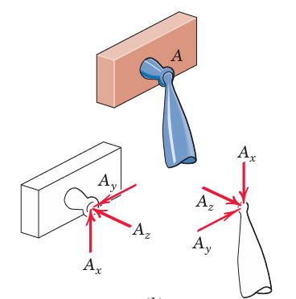
Force Representation and Free-Body Diagrams for Frames and Machines
A ball-and-socket connection between members of a space frame

Slide 21
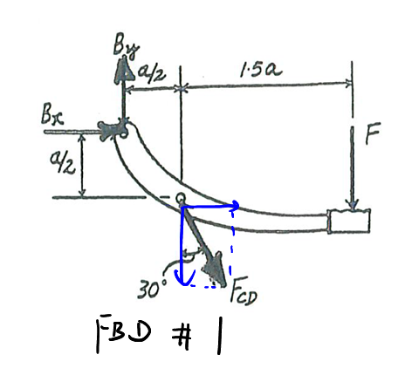
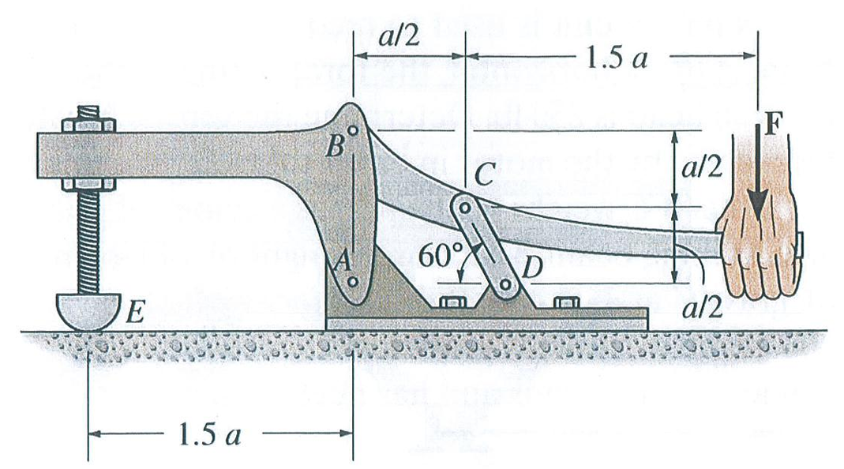
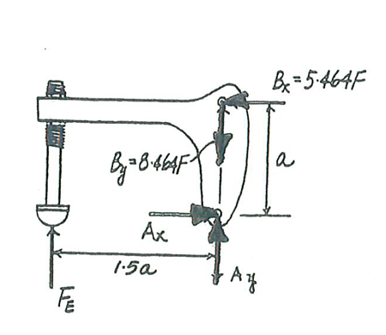
Force Representation and Free-Body Diagrams for Frames and Machines
A Simple Machine:
Toggle Clamp

Slide 22
Interconnected Rigid Bodies with Multiforce Members
The principle of action and reaction must be carefully observed when we represent the forces of interaction on the separate free-body diagrams.
If the structure contains more members or supports than are necessary to prevent collapse, the problem is statically indeterminate, and the principles of equilibrium, are not sufficient for solution.
Although many frames and machines are statically indeterminate, only those which are statically determinate are considered in this course.

Slide 23
Interconnected Rigid Bodies with Multiforce Members
Due to the presence of multi-force member, it is not possible analyze these structures by conventional the methods.
Conventional methods apply to simple frames/machines composed of two-force members where the forces are in the directions of the members.
https://engineeringstatics.org/frames-and-machines.html

