Slide 1


Analysis of Structures
P M V Subbarao
Professor & Head
Mechanical Engineering Department
Make Sure that All Members are Under Safe Loading…..

Slide 2

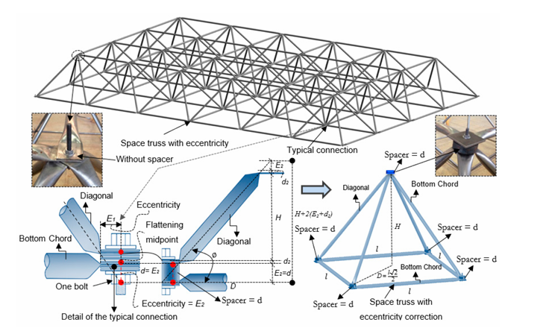
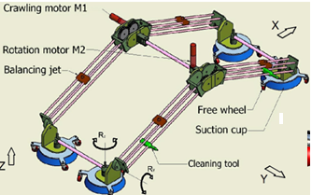
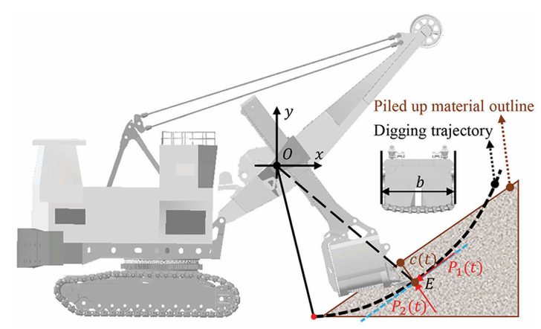
Safe Design of Future Structural World

Slide 3
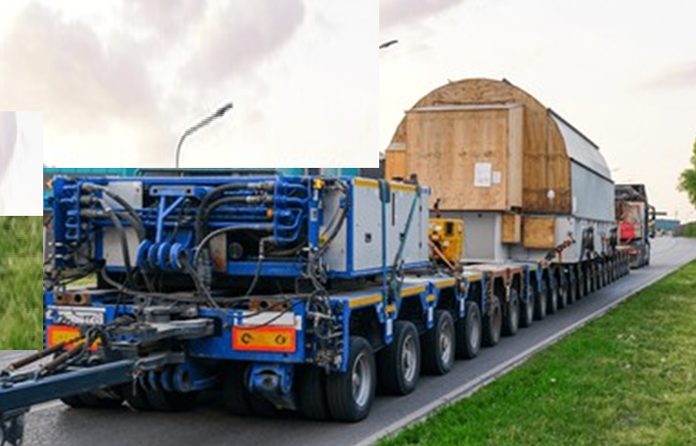
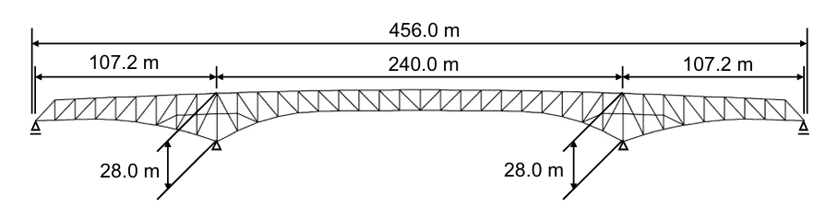
Internal and External Redundancy
A plane truss may have more external supports than are necessary to ensure a stable equilibrium configuration.
The truss as a whole is statically indeterminate, and the extra supports constitute external redundancy.
A truss may have more internal members than are necessary to prevent collapse when the truss is removed from its supports.
The extra members constitute internal redundancy, and the truss is again statically indeterminate.

Slide 4
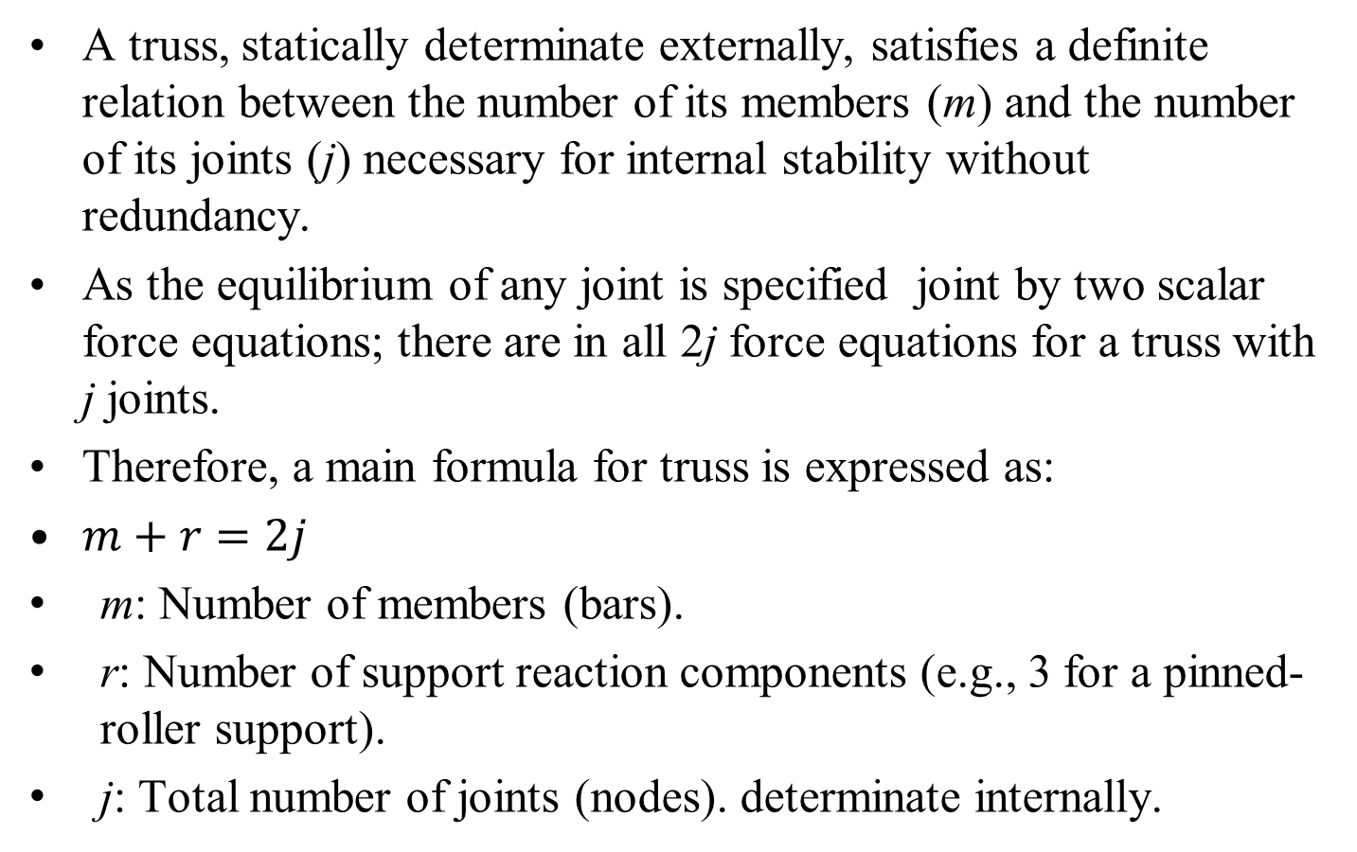
Condition for statically Determinate Truss
A truss, statically determinate externally, satisfies a definite relation between the number of its members (m) and the number of its joints (j) necessary for internal stability without redundancy.
As the equilibrium of any joint is specified joint by two scalar force equations; there are in all 2j force equations for a truss with j joints.
Therefore, a main formula for truss is expressed as:
$m+r=2j$
m: Number of members (bars).
r: Number of support reaction components (e.g., 3 for a pinned-roller support).
j: Total number of joints (nodes). determinate internally.

Slide 5
Condition for statically Determinate Truss
Conditions for Statically Determinacy of A Truss:
m + r = 2j: Statically Determinate ( solvable).
m + r > 2j: Statically Indeterminate (more members/reactions than equations; needs advanced methods).
m + r < 2j: Unstable (structure can collapse).
For the entire truss composed of m two-force members and having the maximum of three unknown support reactions, there are in all m+3 unknowns (m tension or compression forces and three reactions).
Thus, for any plane truss, the equation m+3=2j will be satisfied if the truss is statically determinate internally.

Slide 6
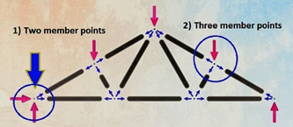

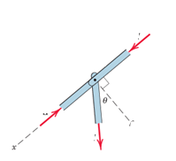



Special Conditions
Several special conditions are encountered in the analysis of trusses.
y
$$F_{3}$$
Two special conditions are seen in above truss:
Two collinear members under compression at a at a joint:
$$F_{1}$$
$$F_{2}$$

Slide 7
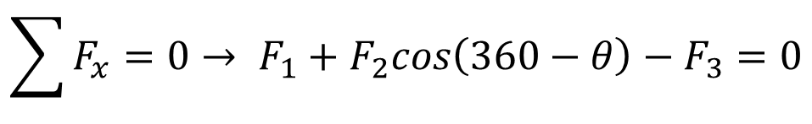

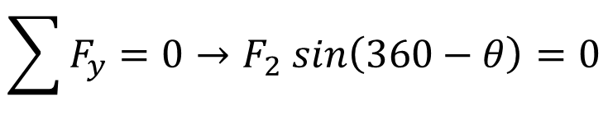
Special Conditions
Two collinear members under compression at a at a joint:
$$\sum{F_{x}=0}→ F_{1}+F_{2}cos\left(360−θ\right)−F_{3}=0$$
$$\sum{F_{y}=0}→F_{2} sin\left(360−θ\right)=0$$
$F_{2}=0 \& F_{1}=F_{3}$
y
$$F_{3}$$
It is necessary to add a third member to maintain alignment of the two members and prevent buckling.
$$F_{1}$$
$$F_{2}$$

Slide 8
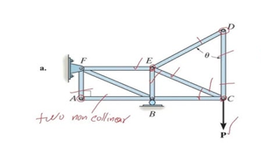
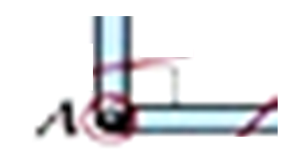


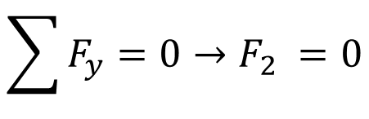
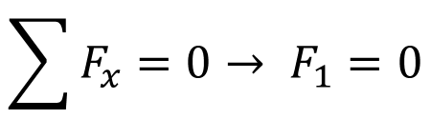
Special Conditions
Two noncollinear members are joined:
y
$$F_{2}$$
x
$$F_{1}$$
In the absence of an externally applied load at this joint, the forces in both members must be zero, as we can see from the two force summations.
$$\sum{F_{x}=0}→ F_{1}=0$$
$$\sum{F_{y}=0}→F_{2} =0$$

Slide 9
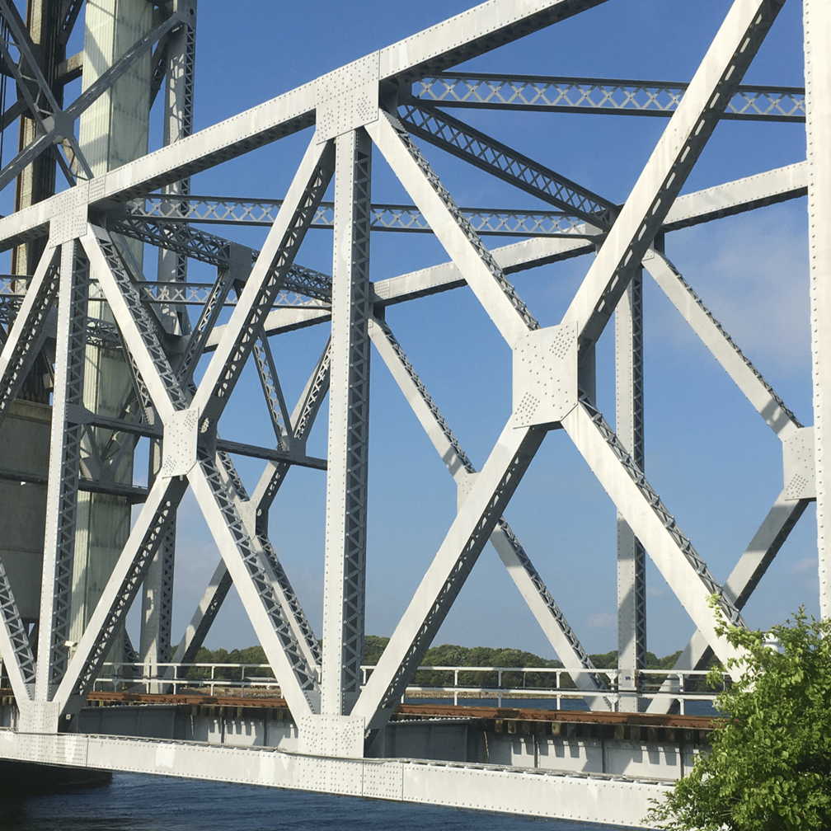
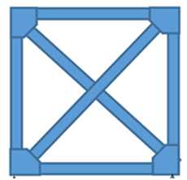


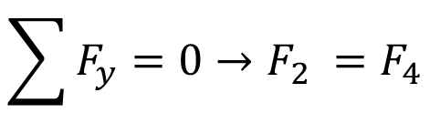

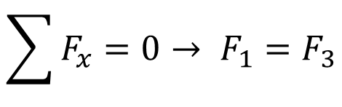

Special Conditions
Two pairs of noncollinear members are joined:
x
y
$$F_{2}$$
$$F_{1}$$
$$F_{3}$$
$$F_{4}$$
$$\sum{F_{x}=0}→ F_{1}=F_{3}$$
When two pairs of collinear members are joined, the forces in each pair must be equal and opposite.
$$\sum{F_{y}=0}→F_{2} =F_{4}$$

Slide 10


Special Conditions
Truss panels are frequently cross-braced.
Such a panel is statically indeterminate if each brace can support either tension or compression.
If the braces are flexible members incapable of supporting compression, as are cables, then only the tension member acts and we can disregard the other member.

Slide 11
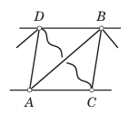
Special Conditions
It is usually evident from the asymmetry of the loading how the panel will deflect.
If the deflection is as indicated in Figure, then member AB should be retained and CD disregarded.
When this choice cannot be made by inspection, any one member may be arbitrarily retained.
If the assumed tension turns out to be positive upon calculation, then the choice was correct.
If the assumed tension force turns out to be negative, then the opposite member must be retained and the calculation redone.

Slide 12
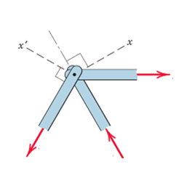

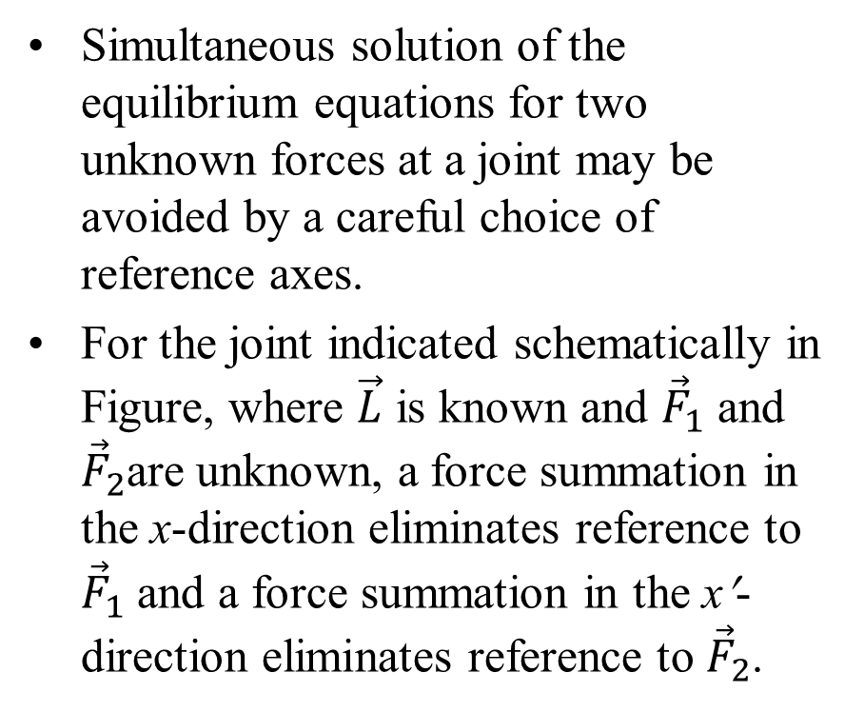


Special Conditions
Simultaneous solution of the equilibrium equations for two unknown forces at a joint may be avoided by a careful choice of reference axes.
For the joint indicated schematically in Figure, where $\vec{L}$ is known and ${\vec{F}}_{1}$ and ${\vec{F}}_{2}$are unknown, a force summation in the x-direction eliminates reference to ${\vec{F}}_{1}$ and a force summation in the x′-direction eliminates reference to ${\vec{F}}_{2}$.
$$\vec{L}$$
$${\vec{F}}_{2}$$
$${\vec{F}}_{1}$$
When the angles involved are not easily found, then a simultaneous solution of the equations using one set of reference directions for both unknowns may be preferable

Slide 13
Critical Evaluation of Only One Member of A Truss….

Slide 14
Method of Sections
The Method of Joints Analysis needs only two of the three equilibrium equations because the procedures involve concurrent forces at each joint.
Advantage of the third or moment equation of equilibrium is available only by selecting an entire section of the truss for the free body in equilibrium under the action of a non-concur rent system of forces.
This Method of Sections has the basic advantage that the force in almost any desired member may be found directly from an analysis of a section which has cut that member.

Slide 15
Method of Sections
It is not necessary to proceed with the calculation from joint to joint until the member in question has been reached.
In choosing a section of the truss, it is to be noted that, in general, not more than three members whose forces are unknown should be cut.
It is due to fact that there are only three available independent equilibrium relations.

Slide 16
Procedure for Method of Sections
Draw a FBD of the entire truss showing the reaction forces at the supports and the external loads.
Locate the force members to be evaluated. Identify whether any of these forces can be determined by observation (e.g., zero-force members).
Identify section to be used and draw a FBD of the section including any support reactions, external loads and internal forces of sectioned members.
Remember, the cutting plane must cut through the members of interest.

Slide 17
Procedure for Method of Sections
Also, the cutting plane need not be straight, it may be curved.
Write the equilibrium equations for one of the two sections. The equations for either half of the section will yield the same member forces.
Three equilibrium equations are available, so up to three unknowns can be solved with a single section.
At times more than one section may be necessary.

Slide 18
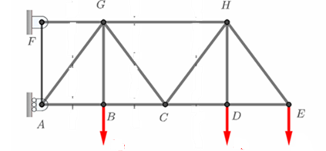



Procedure for Method of Sections: Step 0
Consider the truss to be analyzed and name all the joints:
$${\vec{P}}_{B}$$
$${\vec{P}}_{D}$$
$${\vec{P}}_{E}$$
Draw a FBD of the entire truss showing the reaction forces at the supports and the external loads.

Slide 19
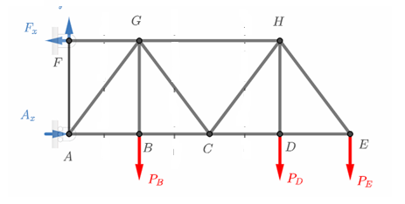




Procedure for Method of Sections: Step 1
Freebody Diagram of the Truss:
$$F_{y}$$
$${\vec{P}}_{B}$$
$${\vec{P}}_{D}$$
$${\vec{P}}_{E}$$
Write the equilibrium equations and solve for as many unknowns as possible.

Slide 20



Procedure for Method of Sections: Step 2
Freebody Diagram of the Truss:
$$F_{y}$$
$${\vec{P}}_{B}$$
$${\vec{P}}_{D}$$
$${\vec{P}}_{E}$$
Define the statement of the problem: determine the force in the member CH.
An imaginary section, indicated by the dashed line, is passed through the truss, cutting it into two parts,

Slide 21
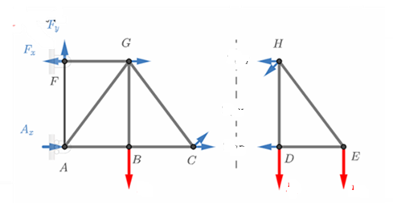






Procedure for Method of Sections: Step 3
Two Sectioned Parts of the Truss:
$${\vec{T}}_{GH}$$
$${\vec{T}}_{CH}$$
$${\vec{T}}_{CD}$$
$${\vec{P}}_{B}$$
$${\vec{P}}_{D}$$
$${\vec{P}}_{E}$$
This section has cut three members whose forces are initially unknown.
In order for the portion of the truss on each side of the section to remain in equilibrium, it is necessary to apply to each cut member the force which was exerted on it by the member cut away.

Slide 22
Procedure for Method of Sections: Step 3
Two Sectioned Parts of the Truss:
$${\vec{T}}_{GH}$$
$${\vec{T}}_{CH}$$
$${\vec{T}}_{CD}$$
$${\vec{P}}_{B}$$
$${\vec{P}}_{D}$$
$${\vec{P}}_{E}$$
For simple trusses composed of straight two-force members, these forces, either tensile or compressive, will always be in the directions of the respective members.

Slide 23
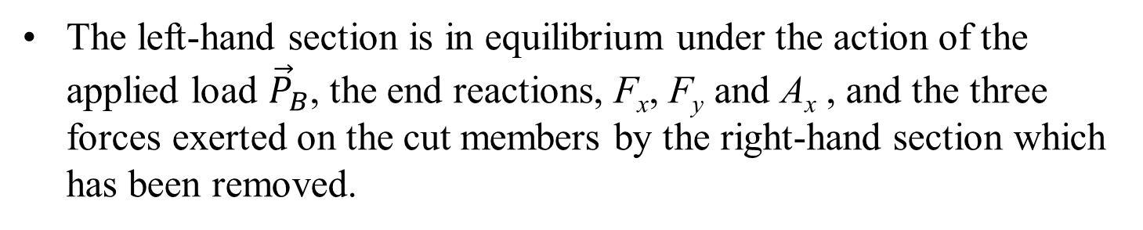
Procedure for Method of Sections: Step 3
Two Sectioned Parts of the Truss:
$${\vec{T}}_{GH}$$
$${\vec{T}}_{CH}$$
$${\vec{T}}_{CD}$$
$${\vec{P}}_{B}$$
$${\vec{P}}_{D}$$
$${\vec{P}}_{E}$$
The left-hand section is in equilibrium under the action of the applied load ${\vec{P}}_{B}$, the end reactions, F_{x}, F_{y} and A_{x} , and the three forces exerted on the cut members by the right-hand section which has been removed.

Slide 24

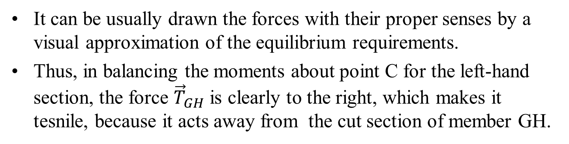





Procedure for Method of Sections: Step 4
Two Sectioned Parts of the Truss:
$${\vec{T}}_{GH}$$
$${\vec{T}}_{CH}$$
$${\vec{T}}_{CD}$$
$${\vec{P}}_{B}$$
$${\vec{P}}_{D}$$
$${\vec{P}}_{E}$$
It can be usually drawn the forces with their proper senses by a visual approximation of the equilibrium requirements.
Thus, in balancing the moments about point C for the left-hand section, the force ${\vec{T}}_{GH}$ is clearly to the right, which makes it tesnile, because it acts away from the cut section of member GH.

Slide 25




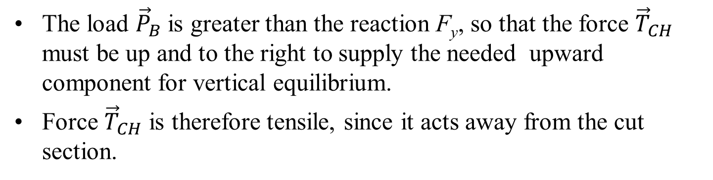


Procedure for Method of Sections: Step 4
Two Sectioned Parts of the Truss:
$${\vec{T}}_{GH}$$
$${\vec{T}}_{CH}$$
$${\vec{T}}_{CD}$$
$${\vec{P}}_{B}$$
$${\vec{P}}_{D}$$
$${\vec{P}}_{E}$$
The load ${\vec{P}}_{B}$ is greater than the reaction F_{y}, so that the force ${\vec{T}}_{CH}$ must be up and to the right to supply the needed upward component for vertical equilibrium.
Force ${\vec{T}}_{CH}$ is therefore tensile, since it acts away from the cut section.

Slide 26




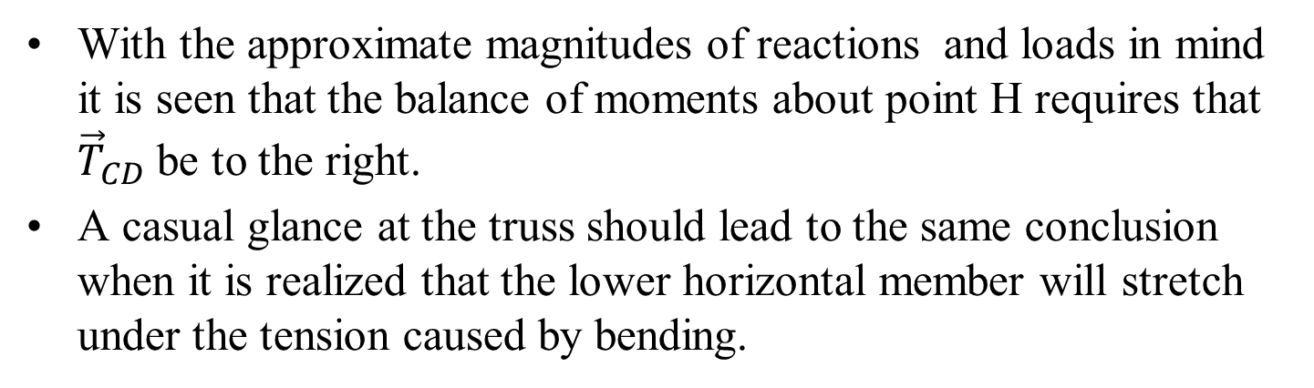


Procedure for Method of Sections: Step 5
Two Sectioned Parts of the Truss:
$${\vec{T}}_{GH}$$
$${\vec{T}}_{CH}$$
$${\vec{T}}_{CD}$$
$${\vec{P}}_{B}$$
$${\vec{P}}_{D}$$
$${\vec{P}}_{E}$$
With the approximate magnitudes of reactions and loads in mind it is seen that the balance of moments about point H requires that ${\vec{T}}_{CD}$ be to the right.
A casual glance at the truss should lead to the same conclusion when it is realized that the lower horizontal member will stretch under the tension caused by bending.

Slide 27




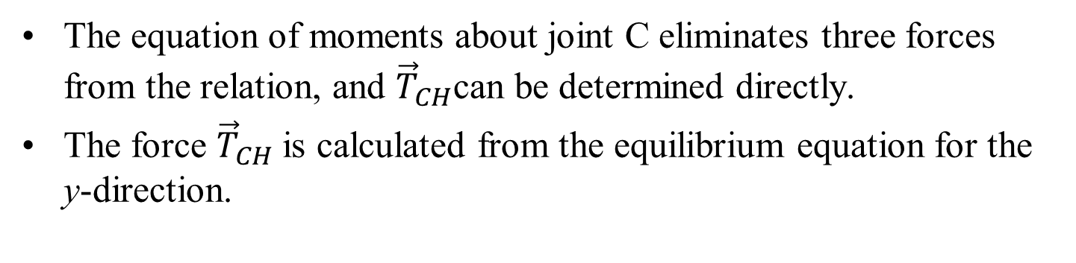


Procedure for Method of Sections: Step 5
Two Sectioned Parts of the Truss:
$${\vec{T}}_{GH}$$
$${\vec{T}}_{CH}$$
$${\vec{T}}_{CD}$$
$${\vec{P}}_{B}$$
$${\vec{P}}_{D}$$
$${\vec{P}}_{E}$$
The equation of moments about joint C eliminates three forces from the relation, and ${\vec{T}}_{CH}$can be determined directly.
The force ${\vec{T}}_{CH}$is calculated from the equilibrium equation for the y-direction.

Slide 28
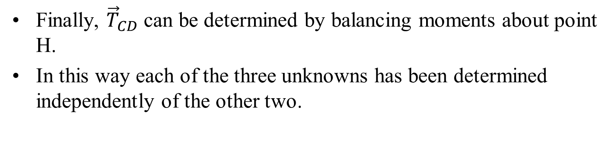
Procedure for Method of Sections: Step 6
Two Sectioned Parts of the Truss:
$${\vec{T}}_{GH}$$
$${\vec{T}}_{CH}$$
$${\vec{T}}_{CD}$$
$${\vec{P}}_{B}$$
$${\vec{P}}_{D}$$
$${\vec{P}}_{E}$$
Finally, ${\vec{T}}_{CD}$ can be determined by balancing moments about point H.
In this way each of the three unknowns has been determined independently of the other two.

Slide 29
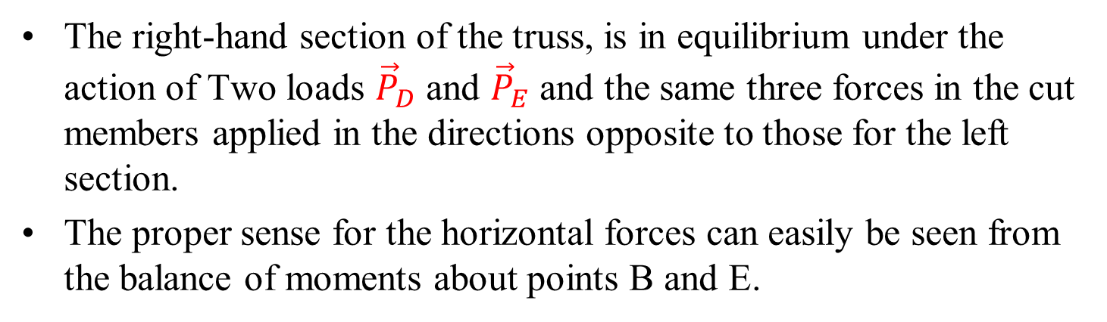
Procedure for Method of Sections: Step 7
Two Sectioned Parts of the Truss:
$${\vec{T}}_{GH}$$
$${\vec{T}}_{CH}$$
$${\vec{T}}_{CD}$$
$${\vec{P}}_{B}$$
$${\vec{P}}_{D}$$
$${\vec{P}}_{E}$$
The right-hand section of the truss, is in equilibrium under the action of Two loads ${\vec{P}}_{D}$ and ${\vec{P}}_{E}$ and the same three forces in the cut members applied in the directions opposite to those for the left section.
The proper sense for the horizontal forces can easily be seen from the balance of moments about points B and E.

Slide 30
Additional Considerations
In the method of sections an entire portion of the truss is considered a single body in equilibrium.
Thus, the forces in members internal to the section are not involved in the analysis of the section as a whole.
To clarify the free body and the forces acting externally on it, the cutting section is preferably passed through the members and not the joints.
Any portion of a truss may be used for the calculations, but the one involving the smaller number of forces will usually yield the simpler solution.

Slide 31
Additional Considerations
In some cases, the methods of sections and joints can be combined for an efficient solution.
This is more useful in finding the force in a central member of a large truss.
Useful when it is not possible to pass a section through this member without passing through at least four unknown members.
It may be possible to determine the forces in nearby members by the method of sections and then progress to the unknown member by the method of joints.
Such a combination of the two methods may be more expedient than exclusive use of either method.

Slide 32
Additional Considerations
The moment equations are used to great advantage in the method of sections.
One should choose a moment center, either on or off the section, through which as many unknown forces as possible pass.

Slide 33
Additional Considerations
It is not always possible to assign the proper sense of an unknown force when the free-body diagram of a section is initially drawn.
Once an arbitrary assignment is made, a positive answer will verify the assumed sense, and a negative result will indicate that the force is in the sense opposite to that assumed.
An alternative notation preferred by some is to assign all unknown forces arbitrarily as positive in the tension direction (away from the section) and let the algebraic sign of the answer distinguish between tension and compression.

Slide 34
Additional Considerations
A plus sign would signify tension and a minus sign compression.
On the other hand, the advantage of assigning forces in their correct sense on the free-body diagram of a section wherever possible is that doing so emphasizes the physical action of the forces more directly.

