Slide 1

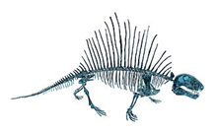

Study & Analysis of Structures
P M V Subbarao
Professor & Head
Mechanical Engineering Department
Engineering the Dreams into Reality …..
Biological proof for Achieving Rigidity to Survive on the Land…..

Slide 2

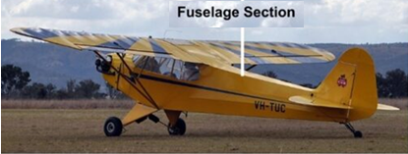
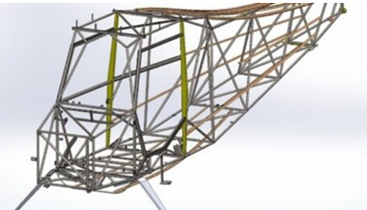
Structure Realized the Dream of Wright Brothers
A Dream
A Reality

Slide 3
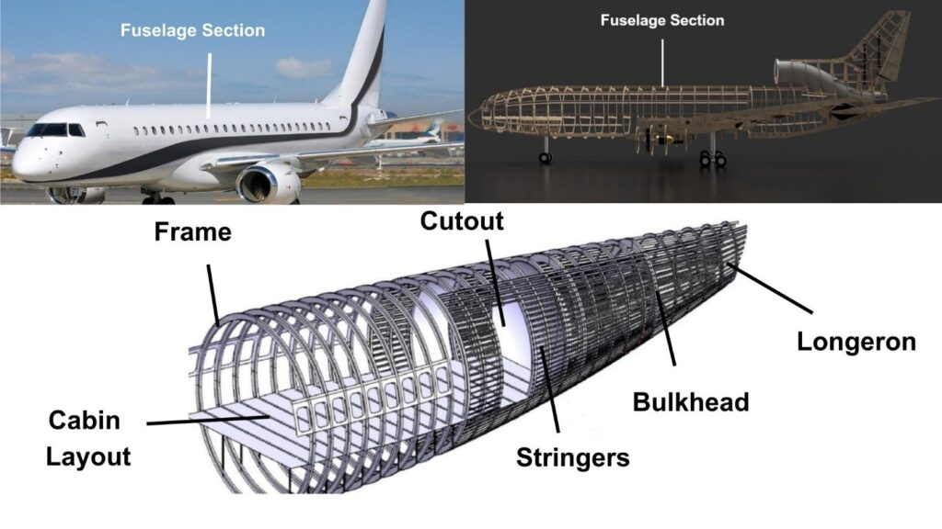
Structure Realized the Dream of Wright Brothers

Slide 4
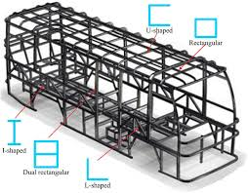
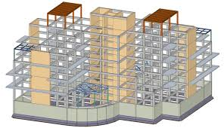
Structure Realize all the Dreams

Slide 5
Engineering Structures: Trusses
Trusses are simply defined as triangulation of members to make the stabilized structure.
Triangulation is the stable configuration mathematically.
The main functions of the trusses are
Carrying the loads from the over structures
Providing adequate lateral stability to the entire structure
Plane Trusses: Simple 2D trusses
Space Trusses: Simple 3D Trusses.

Slide 6
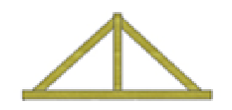
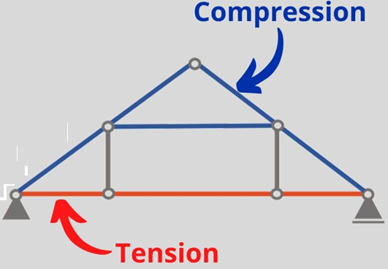
Types of A Trusses: Level 1
King Truss
Queen Truss
Queen Post Truss
Posts: Two vertical posts (queen posts), positioned away from the center.
Span: Larger spans, usually 8 to 12 meters, sometimes more.
Complexity: More complex and slightly costlier due to extra components and larger size.
King Post Truss
Posts: One central vertical post (the king post).
Span: Smaller spans, typically 5 to 8 meters.
Complexity: Simpler and more economical.

Slide 7


Forms of Designated Trusses
Pratt truss
Pratt truss form for the loads in gravity direction
Pratt truss form for the uplift loads(loads opposite to gravity)

Slide 8



Forms of Designated Trusses
Warren truss
North light truss
Vierendeel truss

Slide 9
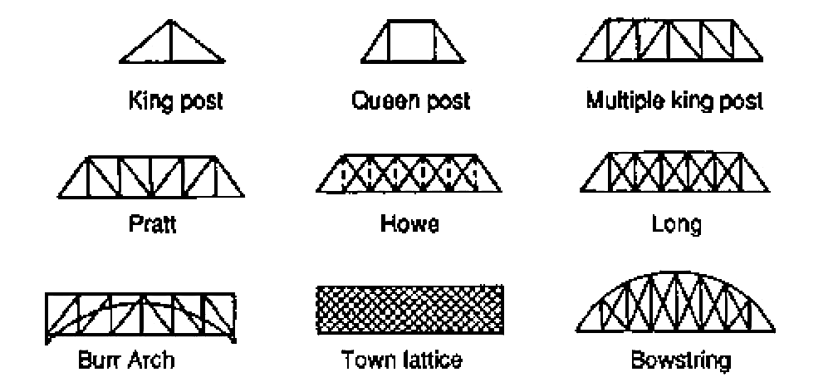
List of General Truss Configurations

Slide 10
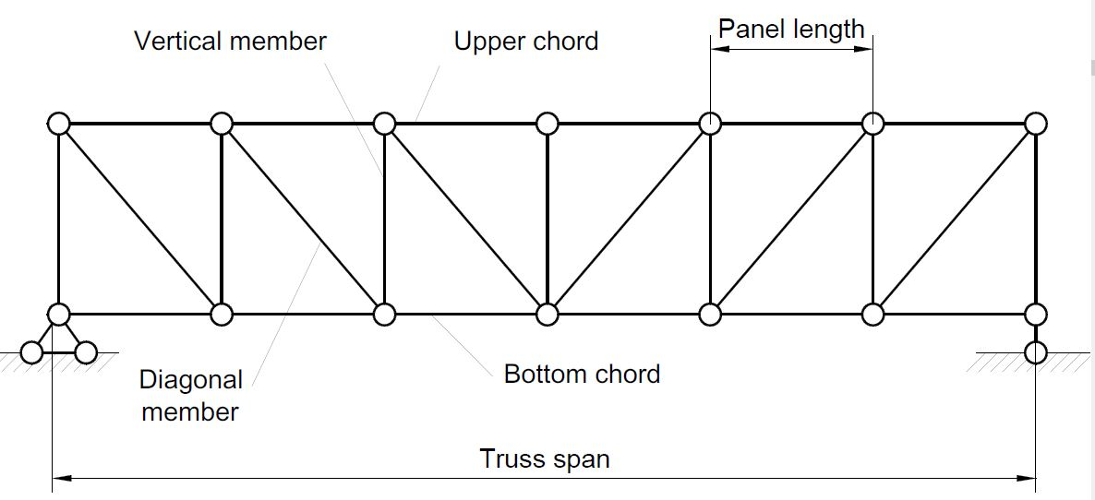
General Anatomy of A Truss
Truss members will carry only the axial forces
The nodes i.e., the connections of the members are designed as pinned joints so that moments won’t be transferred to the members of the truss
All the external loads and the reactions are act only on the nodes

Slide 11
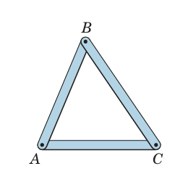
Basic Orgon of A Truss
The basic element of a plane truss is the triangle.
Three bars joined by pins at their ends, constitute a rigid frame.
The term rigid is used to mean non-collapsible.
It also to mean that deformation of the members due to induced internal strains is negligible.

Slide 12
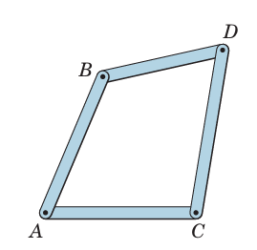
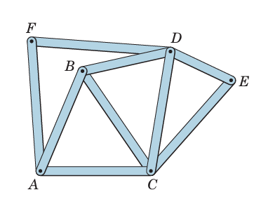
Basic Orgon of A Truss
The other option is to use four or more bars pin-jointed to form a polygon of as many sides constitute a nonrigid frame.
This nonrigid frame can be made in rigid, or stable, by adding a diagonal bar joining A and D or B and C and thereby forming two triangles.
This rigid frame can be made as extended the structure by adding additional units of two end-connected bars.
Like DE and CE or AF and DF, which are pinned to two fixed joints.
In this way the entire structure will remain rigid.

Slide 13
Creation of Simple Trusses
Structures built from a basic triangle in the manner described are known as simple trusses.
When more members are present than are needed to prevent collapse, the truss is statically indeterminate.
A statically indeterminate truss cannot be analyzed by the equations of equilibrium alone.
Additional members or supports which are not necessary for maintaining the equilibrium configuration are called redundant.

Slide 14
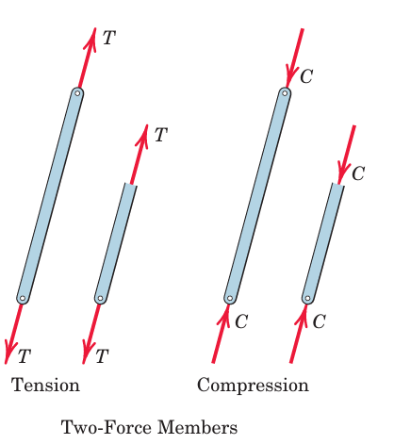
Role of A Member
The member may be in tension or compression, as shown in Figure.
When we represent the equilibrium of a portion of a two-force member, the tension T or compression C acting on the cut section is the same.

Slide 15
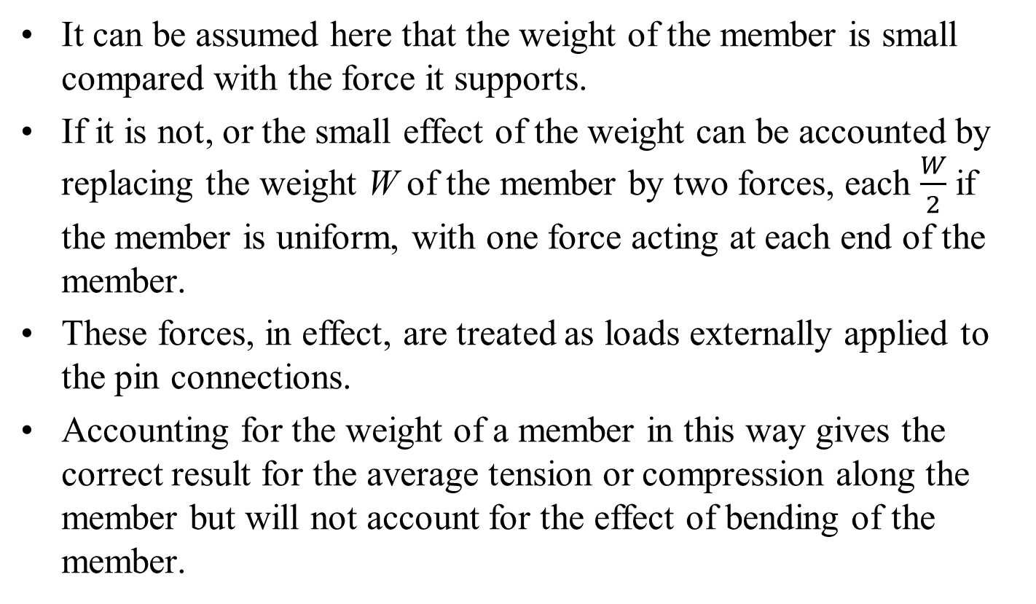
Weight of Truss Member
It can be assumed here that the weight of the member is small compared with the force it supports.
If it is not, or the small effect of the weight can be accounted by replacing the weight W of the member by two forces, each $\frac{W}{2}$ if the member is uniform, with one force acting at each end of the member.
These forces, in effect, are treated as loads externally applied to the pin connections.
Accounting for the weight of a member in this way gives the correct result for the average tension or compression along the member but will not account for the effect of bending of the member.

Slide 16
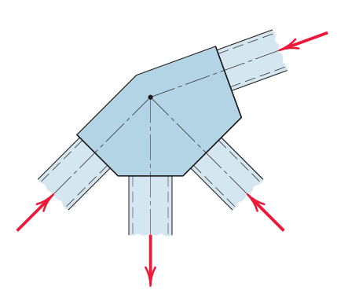
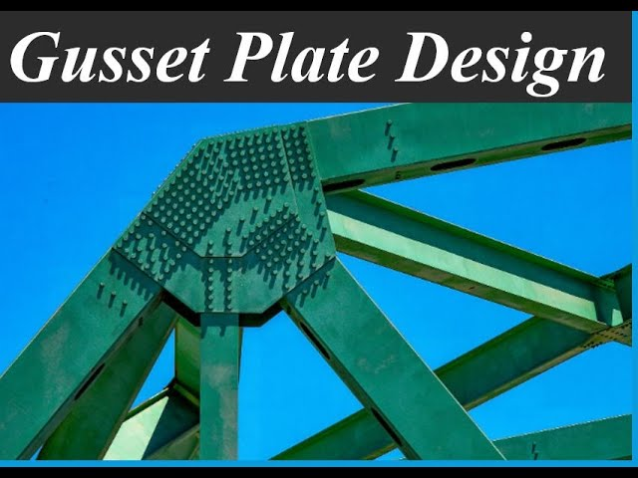
Truss Connections and Supports
Welded or riveted connections are used to join structural members, are assumed as a pin joint if the centerlines of the members are concurrent at the joint as in Figure.
It is also assumed that in the analysis of simple trusses that all external forces are applied at the pin connections.

Slide 17
Types of Simple Truss Analysis
Two methods for the force analysis of simple trusses are:
Method of Joints: This method involve procedures dealing with concurrent forces at each joint and requires only two of the three equilibrium equations. because.
The advantage of the third or moment equation of equilibrium may be taken by selecting an entire section of the truss for the free body in equilibrium under the action of a nonconcurrent system of forces.
Method of Sections: This method has the basic advantage that the force in almost any desired member may be found directly from an analysis of a section which has cut that member.
There is no necessity to proceed with the calculation from joint to joint to reach analysis of required member.

Slide 18
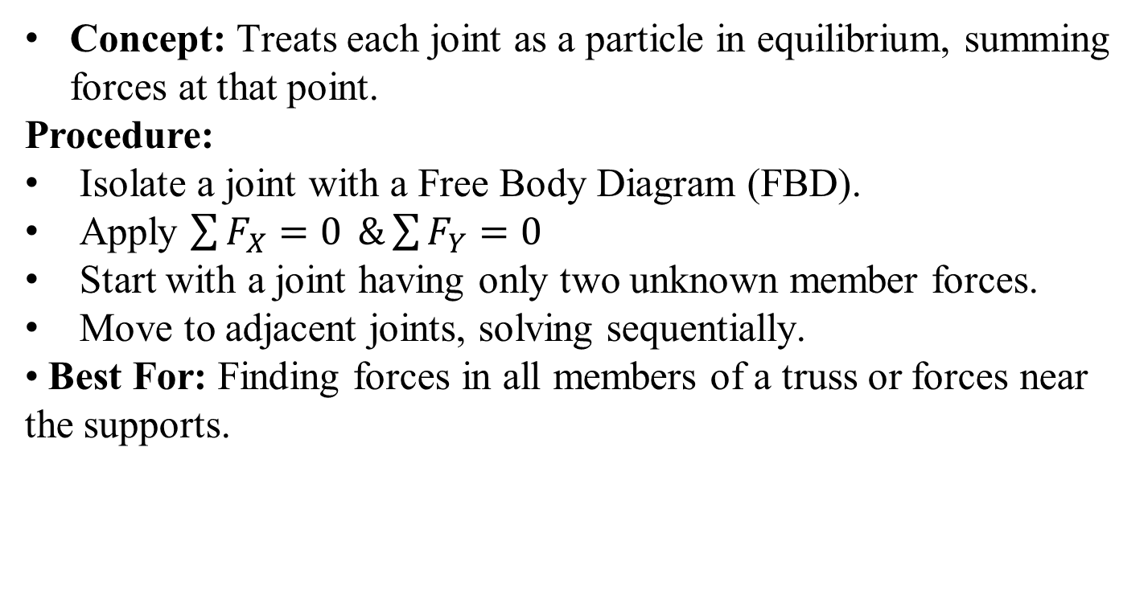
Method of Joints
Concept: Treats each joint as a particle in equilibrium, summing forces at that point.
Procedure:
Isolate a joint with a Free Body Diagram (FBD).
Apply $\sum{F_{X}=0 }\&\sum{F_{Y}=0 }$
Start with a joint having only two unknown member forces.
Move to adjacent joints, solving sequentially.
Best For: Finding forces in all members of a truss or forces near the supports.

Slide 19
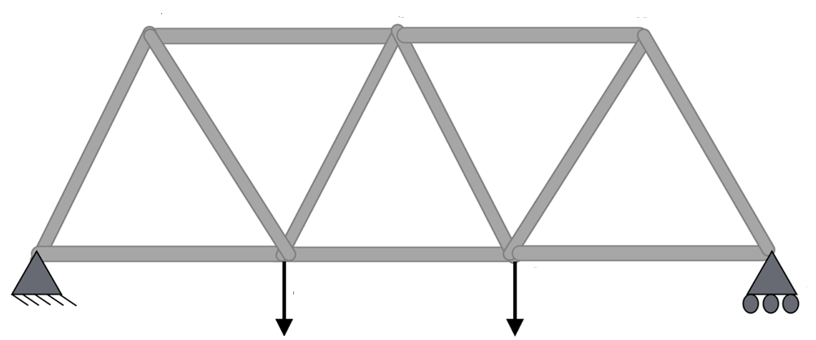


Method of Joints: Start
B
C
D
A
E
G
F
$${\vec{F}}_{g}$$
$${\vec{F}}_{f}$$
Consider a truss to be analyzed.
Name all the joints in any sense.
Identify the location of Load.

Slide 20
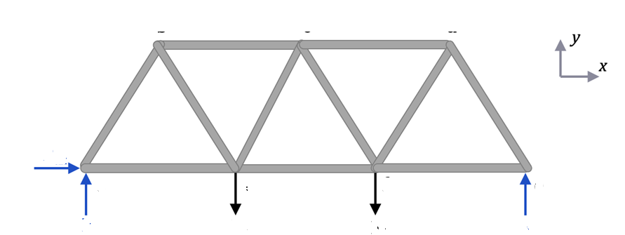





Method of Joints: FBD of the Truss
B
C
D
$${\vec{R}}_{AX}$$
A
E
G
F
$${\vec{R}}_{AY}$$
$${\vec{R}}_{EY}$$
$${\vec{F}}_{g}$$
$${\vec{F}}_{f}$$
Convert the constraints/supports into reaction force components with the appropriate labels to generate An FBD.

Slide 21
Method of Joints: Evaluation of Reactions
B
C
D
$${\vec{R}}_{AX}$$
A
E
G
F
$${\vec{R}}_{AY}$$
$${\vec{F}}_{g}$$
$${\vec{F}}_{f}$$
$${\vec{R}}_{EY}$$
Solve for the reaction forces looking only at the external forces using the equilibrium equations for entire truss as a rigid body:

Slide 22
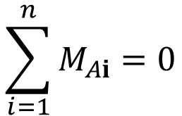
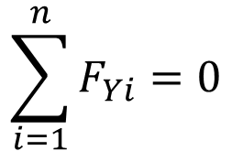
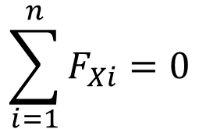
Method of Joints: Evaluation of Reactions
B
C
D
$${\vec{R}}_{AX}$$
A
E
G
F
$${\vec{R}}_{AY}$$
$${\vec{F}}_{g}$$
$${\vec{F}}_{f}$$
$${\vec{R}}_{EY}$$
Equilibrium Equations in scalar form:
$$\sum_{i=1}^{n}{F_{Xi}}=0$$
$$\sum_{i=1}^{n}{F_{Yi}}=0$$
$$\sum_{i=1}^{n}{M_{Ai}}=0$$

Slide 23

Method of Joints: Evaluation of Reactions
B
C
D
$${\vec{R}}_{AX}$$
A
E
G
F
$${\vec{R}}_{AY}$$
$${\vec{F}}_{g}$$
$${\vec{F}}_{f}$$
$${\vec{R}}_{EY}$$
Equilibrium Equations in scalar form:
$$\sum_{i=1}^{n}{F_{Xi}}=0$$
$$R_{X}=0$$

Slide 24

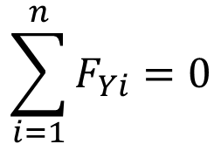
Method of Joints: Evaluation of Reactions
B
C
D
$${\vec{R}}_{AX}$$
A
E
G
F
$${\vec{R}}_{AY}$$
$${\vec{F}}_{g}$$
$${\vec{F}}_{f}$$
$${\vec{R}}_{EY}$$
Equilibrium Equations in scalar form:
$$\sum_{i=1}^{n}{F_{Yi}}=0$$
$$R_{AY}−F_{g}−F_{f}+R_{EY}=0$$

Slide 25

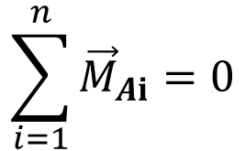
Method of Joints: Evaluation of Reactions
B
C
D
$${\vec{R}}_{AX}$$
A
E
G
F
$${\vec{R}}_{AY}$$
$${\vec{F}}_{g}$$
$${\vec{F}}_{f}$$
$${\vec{R}}_{EY}$$
Equilibrium Equations in scalar form: Assume all members of the truss are having equal length (L)
$$\sum_{i=1}^{n}{{\vec{M}}_{Ai}}=0$$
$$−L∗F_{g}−2L∗F_{f}+3L∗R_{EY}=0$$

Slide 26
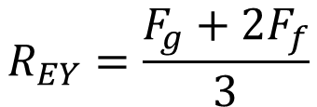



Method of Joints: Evaluation of Reactions
B
C
D
$${\vec{R}}_{AX}$$
A
E
G
F
$${\vec{R}}_{AY}$$
$${\vec{F}}_{g}$$
$${\vec{F}}_{f}$$
$${\vec{R}}_{EY}$$
System od Equations:
$$R_{AY}−F_{g}−F_{f}+R_{EY}=0$$
$$−L∗F_{g}−2L∗F_{f}+3L∗R_{EY}=0$$
$$F_{g}+2F_{f}−3R_{EY}=0$$
$$R_{EY}=\frac{F_{g}+2F_{f}}{3}$$

Slide 27
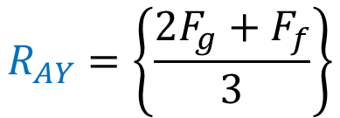
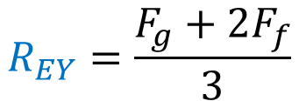
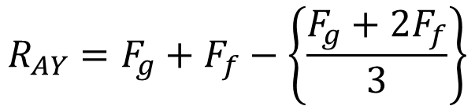
Method of Joints: Evaluation of Reactions
B
C
D
$${\vec{R}}_{AX}$$
A
E
G
F
$${\vec{R}}_{AY}$$
$${\vec{F}}_{g}$$
$${\vec{F}}_{f}$$
$${\vec{R}}_{EY}$$
System Equations:
$$R_{AY}=F_{g}+F_{f}−\left\{\frac{F_{g}+2F_{f}}{3}\right\}$$
$$R_{EY}=\frac{F_{g}+2F_{f}}{3}$$
$$R_{AY}=\left\{\frac{{2F}_{g}+F_{f}}{3}\right\}$$

Slide 28





Method of Joints: Analysis of First Joint
B
C
D
$${\vec{R}}_{AX}$$
A
E
G
F
$${\vec{R}}_{AY}$$
$${\vec{F}}_{g}$$
$${\vec{F}}_{f}$$
$${\vec{R}}_{EY}$$
Pick a joint where there are 2 or fewer unknown values.
Joint A or Joint E, both are suitable in this case.
This is because you only have 2 equations available to find the unknowns: ∑F_{X}=0, ∑F_{Y}=0.

Slide 29
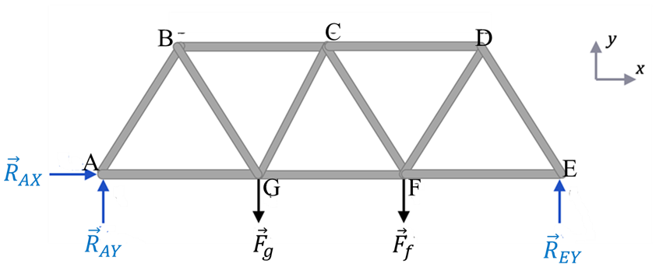
Method of Joints: Analysis of First Joint
A table showing the number of known and unknown forces at each joint may be created as:
Joint | A | B | C | D | E | F | G
No. of known Forces | 2 | 0 | 0 | 0 | 1 | 1 | 1
No. of unknown Forces | 2 | 3 | 4 | 3 | 2 | 4 | 4

Slide 30
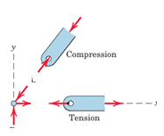



Analysis of Joint A
$${\vec{F}}_{AB}$$
$${\vec{F}}_{AG}$$
$$R_{AY}$$
The joints are indicated by letters.
The force in each member is designated by the two letters defining the ends of the member.
The proper directions of the forces should be evident by inspection for this simple case.

Slide 31
Method of Joints: FBD of A Truss
A table showing the number of known and unknown forces at each joint may be created as:
Joint | A | B | C | D | E | F | G
No. of known Forces | 2 | 0 | 0 | 0 | 1 | 1 | 1
No. of unknown Forces | 2 | 3 | 4 | 3 | 2 | 4 | 4

Slide 32
Analysis of Joint A
$${\vec{F}}_{AB}$$
$${\vec{F}}_{AG}$$
$$R_{AY}$$
The joints are indicated by letters.
The force in each member is designated by the two letters defining the ends of the member.
The proper directions of the forces should be evident by inspection for this simple case.

Slide 33
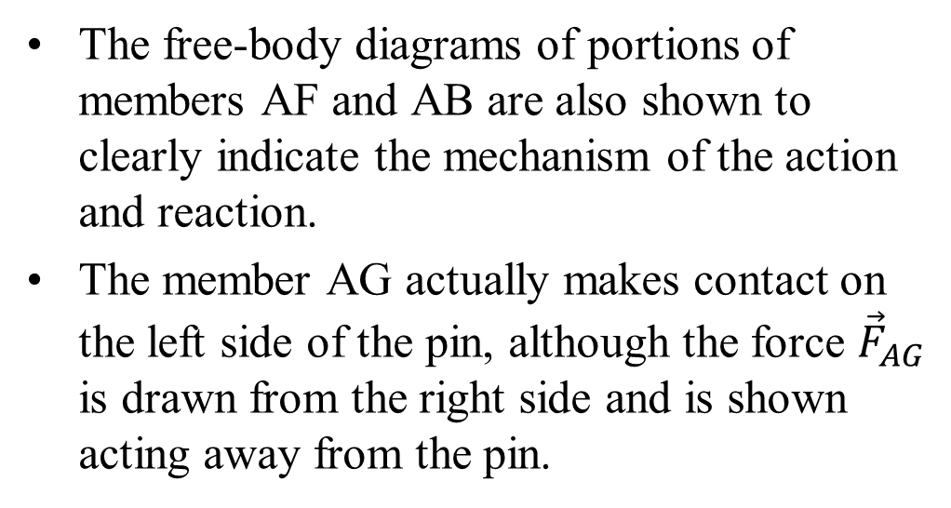

Analysis of Joint A
The free-body diagrams of portions of members AF and AB are also shown to clearly indicate the mechanism of the action and reaction.
The member AG actually makes contact on the left side of the pin, although the force ${\vec{F}}_{AG}$ is drawn from the right side and is shown acting away from the pin.
$${\vec{F}}_{AB}$$
$${\vec{F}}_{AG}$$
$$R_{AY}$$
Thus, if draw the force arrows are drawn consistently on the same side of the pin as the member, then tension (such as AG) will always be indicated by an arrow away from the pin.
The compression (such as AB) will always be indicated by an arrow toward the pin.

Slide 34
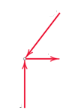
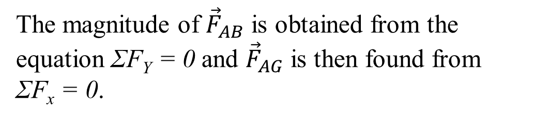







Analysis of Joint A
The magnitude of ${\vec{F}}_{AB}$ is obtained from the equation ΣF_{Y} = 0 and ${\vec{F}}_{AG}$ is then found from ΣF_{x} = 0.
$${\vec{F}}_{AB}$$
$${\vec{F}}_{AB}$$
$${\vec{F}}_{AG}$$
$$θ_{A}$$
$$R_{AY}$$
$${\vec{F}}_{AG}$$
$$R_{AX}$$

Slide 35
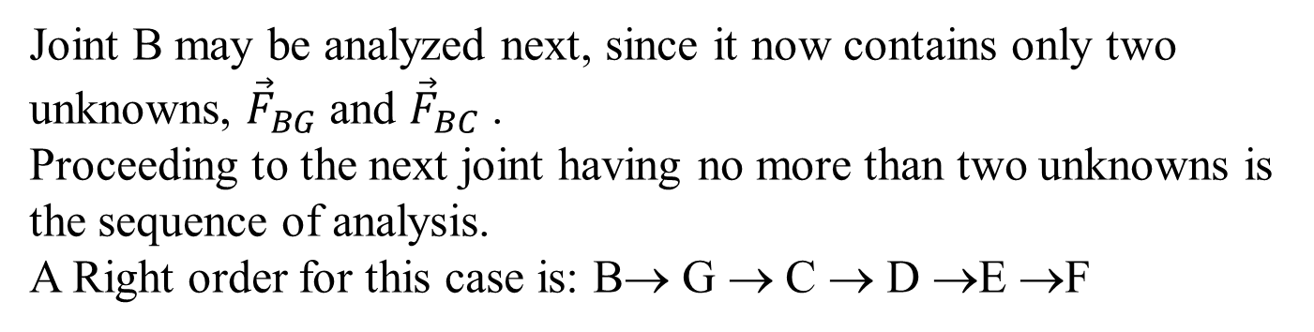
Selection of Next Joint
Joint B may be analyzed next, since it now contains only two unknowns, ${\vec{F}}_{BG}$ and ${\vec{F}}_{BC}$ .
Proceeding to the next joint having no more than two unknowns is the sequence of analysis.
A Right order for this case is: B→ G → C → D →E →F

Slide 36
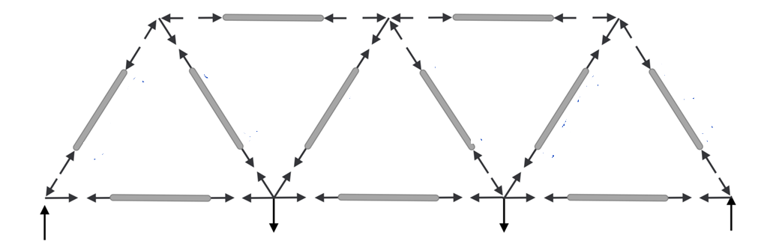











Detailing of Forces in All Members of A Truss
B
$${\vec{F}}_{BC}$$
C
$${\vec{F}}_{CD}$$
D
$${\vec{F}}_{AB}$$
$${\vec{F}}_{BG}$$
$${\vec{F}}_{CB}$$
$${\vec{F}}_{CF}$$
$${\vec{F}}_{DF}$$
$${\vec{F}}_{DE}$$
A
E
$${\vec{F}}_{GA}$$
G
$${\vec{F}}_{FG}$$
F
$${\vec{F}}_{EF}$$
It is often convenient to indicate the tension T and compression C of the various members directly on the original truss diagram using arrows!
Complete the Equilibrium Analysis!

Slide 37
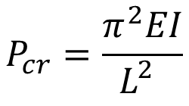
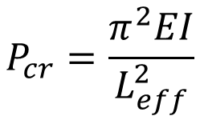
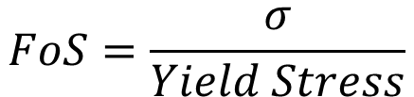
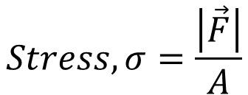
Method of Joint Analysis & Further Use of Information
Stress in A line member with axial Load:
Safe Design of A truss Member:
$$FoS=\frac{σ}{Yield Stress}$$
$$Stress,σ=\frac{\left|\vec{F}\right|}{A}$$
For tensile loading: The Factor of Safety (FoS) for a simple linear member, such as a rod or beam.
Typical Factors of Safety for Linear Members
Structural Steel (Buildings): 1.67–1.92 : General Machinery (Static Loads): 1.5–2.5
Ductile Materials (Steel): 1.5–2.0 (based on yield strength)
Brittle Materials (Concrete/Timber): 3.0–5.0 (based on ultimate strength)
For Compressive loading: The critical buckling load (P_{𝑐𝑟}) is the maximum axial compressive load a slender column can withstand before it suddenly bends or becomes unstable.
$$P_{cr}=\frac{π^{2}EI}{L_{eff}^{2}}$$
$$P_{cr}=\frac{π^{2}EI}{L_{}^{2}}$$

