Slide 1


Equilibrium Analysis Methodology – 3D Statics
P M V Subbarao
Professor & Head
Mechanical Engineering Department
Forces Beyond 2D: Conquering 3D World…..

Slide 2


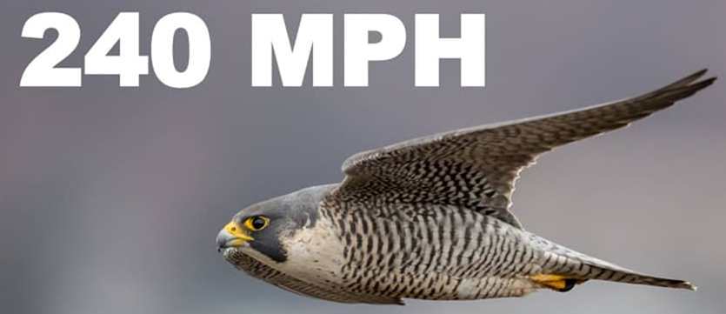
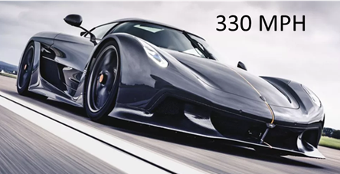
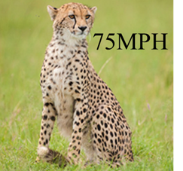
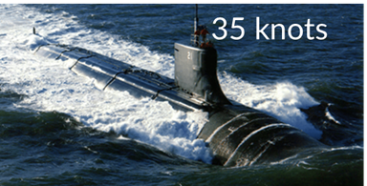
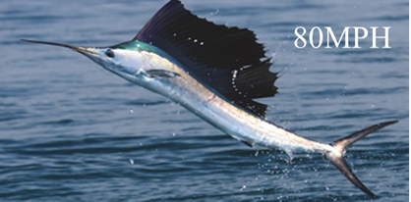
Engineering 3D World
Engineered World
Natural World

Slide 3
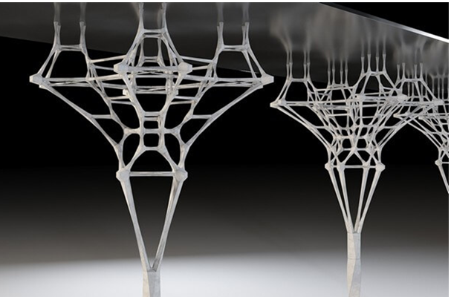
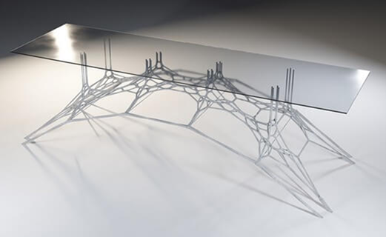
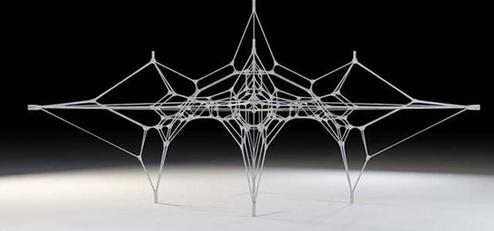
Next Generation Sustainable 3D Structures & Equilibrium

Slide 4
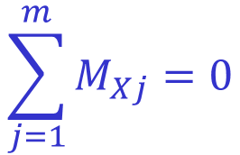
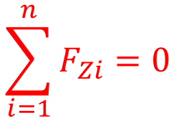
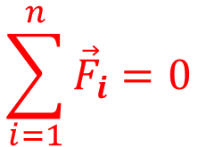
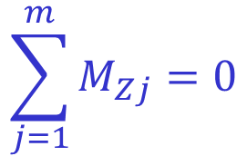
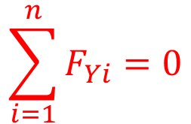
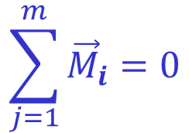
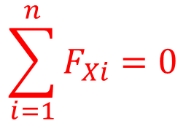
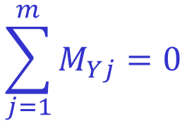
Equilibrium in Three Dimensions
$$\sum_{i=1}^{n}{F_{Xi}}=0$$
$$\sum_{j=1}^{m}{M_{Xj}}=0$$
$$\sum_{i=1}^{n}{F_{Yi}}=0$$
$$\sum_{j=1}^{m}{{\vec{M}}_{i}}=0$$
$$\sum_{j=1}^{m}{M_{Yj}}=0$$
$$\sum_{i=1}^{n}{{\vec{F}}_{i}}=0$$
$$\sum_{i=1}^{n}{F_{Zi}}=0$$
$$\sum_{j=1}^{m}{M_{Zj}}=0$$
The second three scalar equations express the further equilibrium requirement that there be no resultant moment acting on the body about any of the coordinate axes or about axes parallel to the coordinate axes.

Slide 5
EQUILIBRIUM IN THREE DIMENSIONS
$$\sum_{i=1}^{n}{F_{Xi}}=0$$
$$\sum_{j=1}^{m}{M_{Xj}}=0$$
$$\sum_{i=1}^{n}{F_{Yi}}=0$$
$$\sum_{j=1}^{m}{{\vec{M}}_{i}}=0$$
$$\sum_{j=1}^{m}{M_{Yj}}=0$$
$$\sum_{i=1}^{n}{{\vec{F}}_{i}}=0$$
$$\sum_{i=1}^{n}{F_{Zi}}=0$$
$$\sum_{j=1}^{m}{M_{Zj}}=0$$
These six equations are both necessary and sufficient conditions for complete equilibrium.
The reference axes may be chosen arbitrarily as a matter of convenience, the only restriction being that a right-handed co-ordinate system should be chosen when vector notation is used.

Slide 6
EQUILIBRIUM IN THREE DIMENSIONS
$$\sum_{i=1}^{n}{F_{Xi}}=0$$
$$\sum_{j=1}^{m}{M_{Xj}}=0$$
$$\sum_{i=1}^{n}{F_{Yi}}=0$$
$$\sum_{j=1}^{m}{{\vec{M}}_{i}}=0$$
$$\sum_{j=1}^{m}{M_{Yj}}=0$$
$$\sum_{i=1}^{n}{{\vec{F}}_{i}}=0$$
$$\sum_{i=1}^{n}{F_{Zi}}=0$$
$$\sum_{j=1}^{m}{M_{Zj}}=0$$
The six scalar relationships are independent conditions because any of them can be valid without the others.

Slide 7

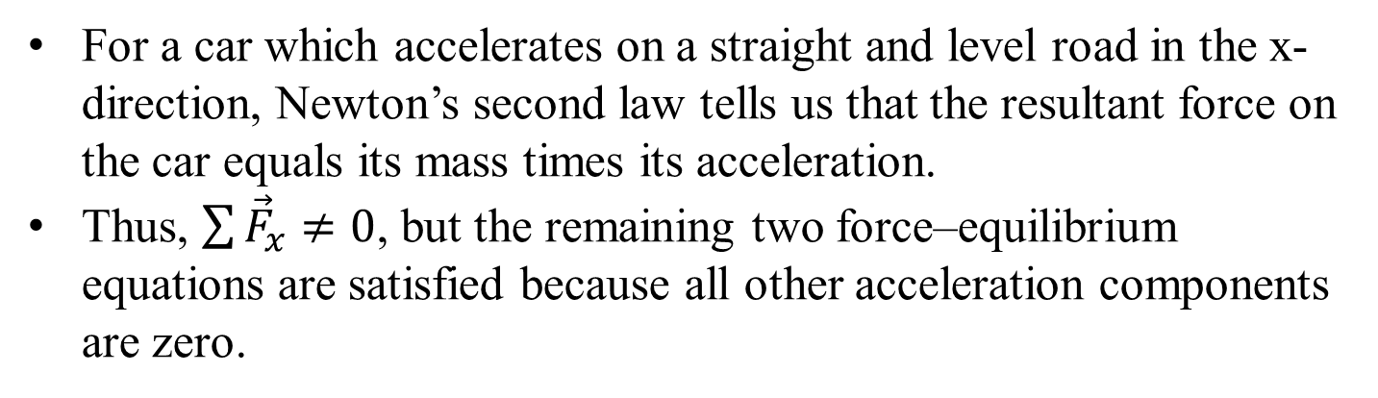
Case Study: Independency of 3D Dynamic Equilibrium Equations
For a car which accelerates on a straight and level road in the x-direction, Newton’s second law tells us that the resultant force on the car equals its mass times its acceleration.
Thus, $\sum{{\vec{F}}_{x}}≠0$, but the remaining two force–equilibrium equations are satisfied because all other acceleration components are zero.

Slide 8
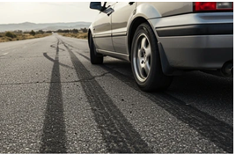

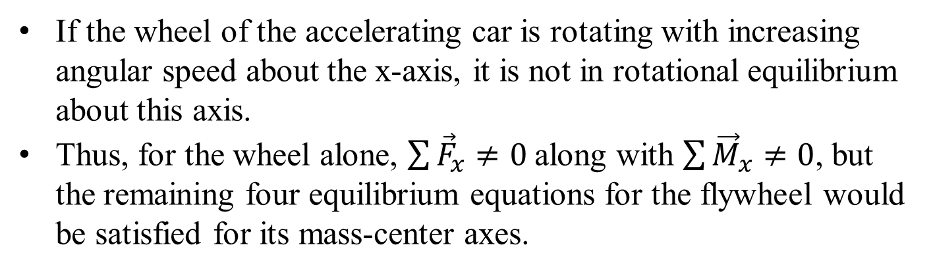
Case Study: Independency of 3D Dynamic Equilibrium Equations
If the wheel of the accelerating car is rotating with increasing angular speed about the x-axis, it is not in rotational equilibrium about this axis.
Thus, for the wheel alone, $\sum{{\vec{F}}_{x}}≠0$along with $\sum{{\vec{M}}_{x}}≠0$, but the remaining four equilibrium equations for the flywheel would be satisfied for its mass-center axes.

Slide 9
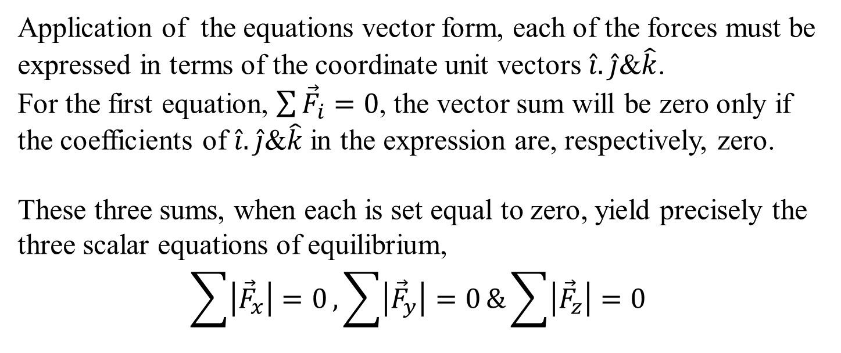
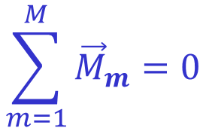
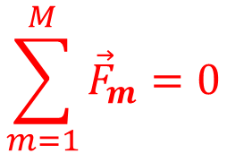
Force Balance in 3D
$$\sum_{m=1}^{M}{{\vec{F}}_{m}}=0$$
$$\sum_{m=1}^{M}{{\vec{M}}_{m}}=0$$
Application of the equations vector form, each of the forces must be expressed in terms of the coordinate unit vectors $\hat{i}. \hat{j}$&$\hat{k}$.
For the first equation, $\sum{{\vec{F}}_{i}}=0$, the vector sum will be zero only if the coefficients of $\hat{i}. \hat{j}$&$\hat{k}$in the expression are, respectively, zero.
These three sums, when each is set equal to zero, yield precisely the three scalar equations of equilibrium,
$$\sum{\left|{\vec{F}}_{x}\right|=0},\sum{\left|{\vec{F}}_{y}\right|=0}\&\sum{\left|{\vec{F}}_{z}\right|=0}$$

Slide 10
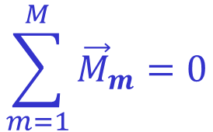
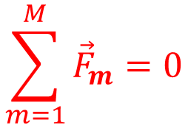
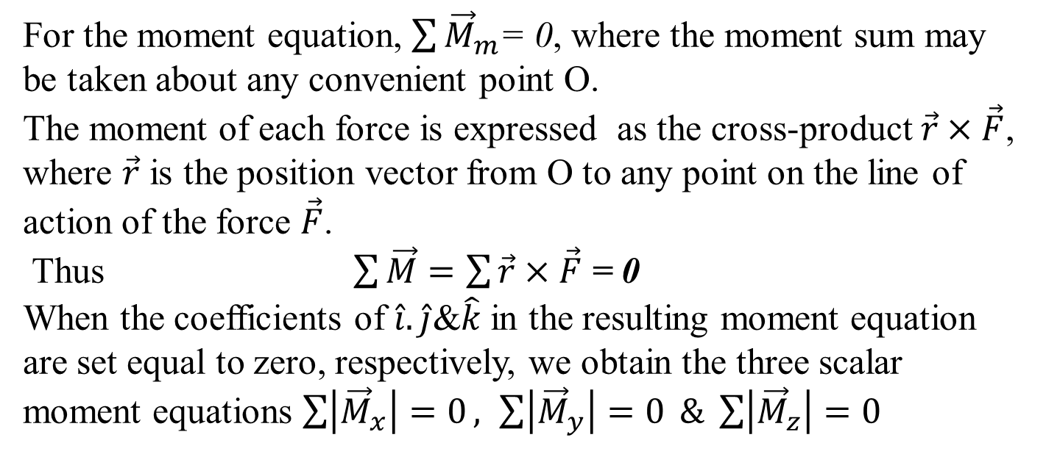
Moment Balance in 3D
$$\sum_{m=1}^{M}{{\vec{F}}_{m}}=0$$
$$\sum_{m=1}^{M}{{\vec{M}}_{m}}=0$$
For the moment equation, $\sum{{\vec{M}}_{m}}$= 0, where the moment sum may be taken about any convenient point O.
The moment of each force is expressed as the cross-product $\vec{r}×\vec{F}$, where $\vec{r}$ is the position vector from O to any point on the line of action of the force $\vec{F}$.
Thus $\sum{\vec{M}}=\sum{\vec{r}×\vec{F}}$ = 0
When the coefficients of $\hat{i}. \hat{j}$&$\hat{k}$in the resulting moment equation are set equal to zero, respectively, we obtain the three scalar moment equations $\sum{\left|{\vec{M}}_{x}\right|=0}, \sum{\left|{\vec{M}}_{y}\right|=0} \& \sum{\left|{\vec{M}}_{z}\right|=0}$

Slide 11
Free-Body Diagrams for 3D Equilibrium Analysis
The FBD is the only reliable method for disclosing all forces and moments which should be included in our equilibrium equations.
In three dimensions the free-body diagram serves the same essential purpose as it does in two dimensions and should always be drawn.
Either of drawing a pictorial view of the isolated body with all external forces represented or of drawing the orthogonal projections of the free-body diagram is allowed.
The correct representation of forces on the free-body diagram requires a knowledge of the characteristics of contacting surfaces.

Slide 12
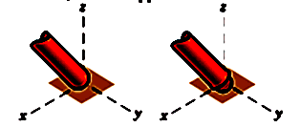
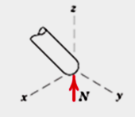
Modeling the Action of Forces in Three-dimensional Analysis
1. Member in contact with smooth surface, or ball-supported member
A Perfectly smooth surface can not constrain (resist) horizontal force.
Force must be normal to the surface and directed toward the member

Slide 13
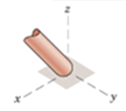
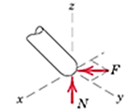
Modeling the Action of Forces in Three-dimensional Analysis
2. Member in contact with rough surface
The possibility exists for a force F tangent to the surface (friction force) to act on the member, as well as a normal force N.

Slide 14
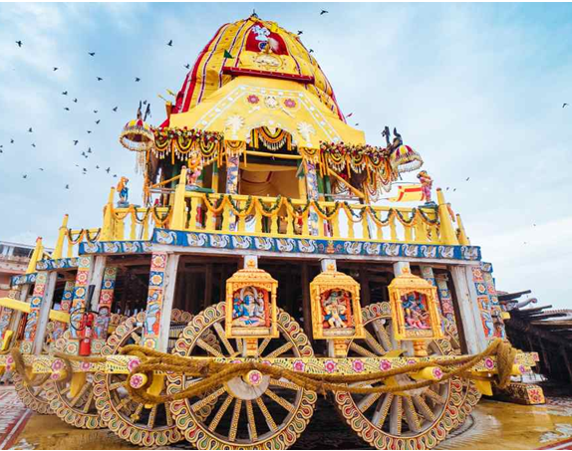
An Ancient and Powerful Support/Constraint for Travel on Land

Slide 15
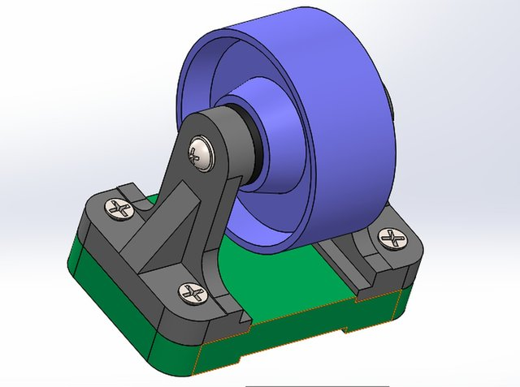
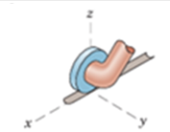
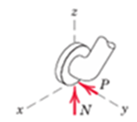
Modeling the Action of Forces in Three-dimensional Analysis
3. Roller or wheel support with lateral constraint:
A lateral force P exerted by the guide on the wheel can exist, in addition to the normal force N.

Slide 16
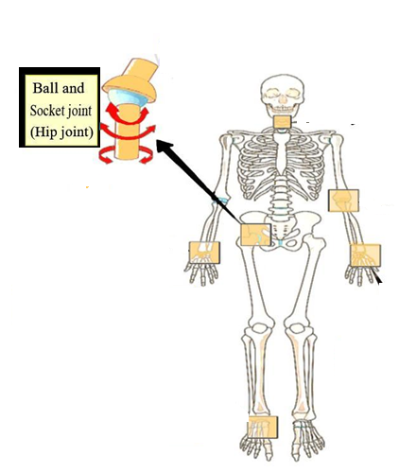
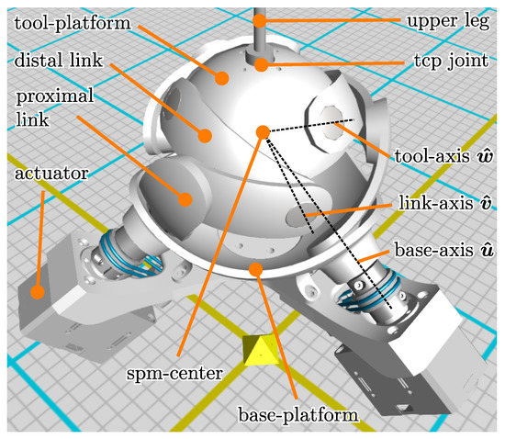
Modeling the Action of Forces in Three-dimensional Analysis
4. Ball-and-socket joint
For vertebrates, specifically mammals, reptiles, and birds, ball-and-socket joints are essential for connecting limbs to the body (hips and shoulders).
They allow for a high degree of rotation and multi-axial movement, enabling running, leaping, climbing, and complex maneuvering.
These joints allow for the greatest range of movement among all joint types, facilitating flexibility, speed, and agility, such as in cats, monkeys, and cheetahs.

Slide 17


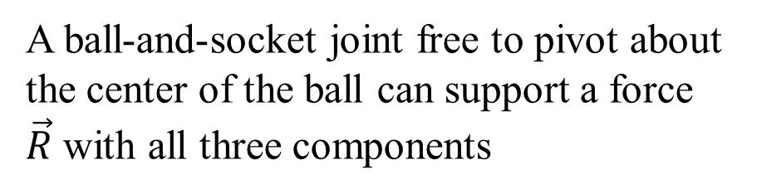
Modeling the Action of Forces in Three-dimensional Analysis
4. Ball-and-socket joint
A ball-and-socket joint free to pivot about the center of the ball can support a force $\vec{R}$ with all three components

Slide 18

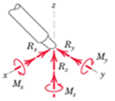
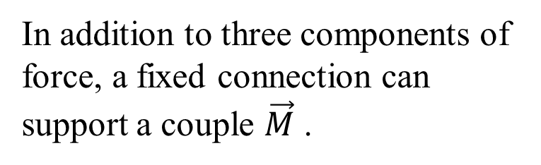
Modeling the Action of Forces in Three-dimensional Analysis
5. Fixed connection (embedded or welded)
In addition to three components of force, a fixed connection can support a couple $\vec{M}$ .

Slide 19
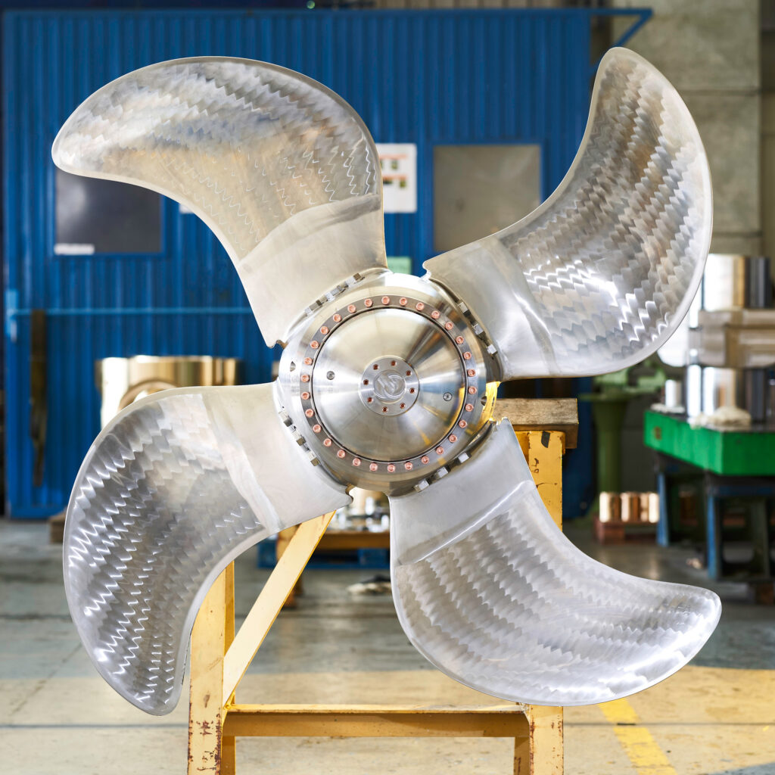
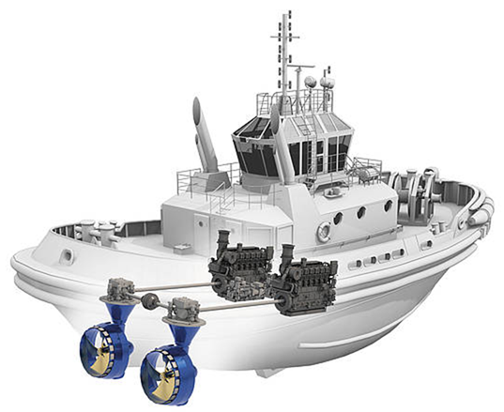
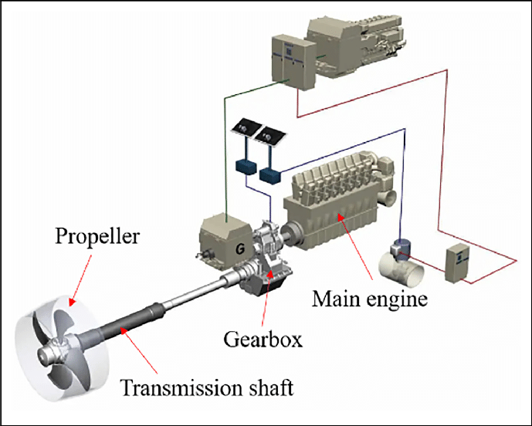
20th Century Inventions to Scaleup 19th Century Systems

Slide 20
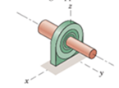
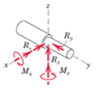
Modeling the Action of Forces in Three-dimensional Analysis
6. Thrust-bearing support
Thrust bearing is capable of supporting axial force R_{y} as well as radial forces R_{x} and R_{z}.
Couples M_{x} and M_{z} must, in some cases, be assumed zero in order to provide statical determinacy

Slide 21

Categories of Equilibrium
$$\sum_{i=1}^{n}{F_{Xi}}=0$$
$$\sum_{j=1}^{m}{M_{Xj}}=0$$
$$\sum_{i=1}^{n}{F_{Yi}}=0$$
$$\sum_{j=1}^{m}{{\vec{M}}_{i}}=0$$
$$\sum_{j=1}^{m}{M_{Yj}}=0$$
$$\sum_{i=1}^{n}{{\vec{F}}_{i}}=0$$
$$\sum_{i=1}^{n}{F_{Zi}}=0$$
$$\sum_{j=1}^{m}{M_{Zj}}=0$$
Application of above Equations falls into four categories.

Slide 22
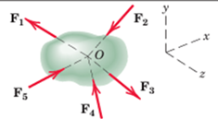
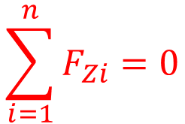

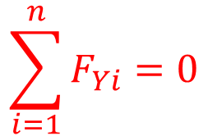
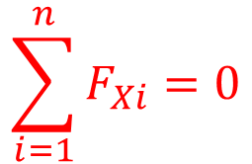
Categories of Equilibrium
The equilibrium categories differ in the number and type (force or moment) of independent equilibrium equations required to solve the problem.
Category 1, equilibrium of forces all concurrent at point O, re quires all three force equations, but no moment equations because the moment of the forces about any axis through O is zero.
$$\sum_{i=1}^{n}{F_{Xi}}=0$$
$$\sum_{i=1}^{n}{{\vec{F}}_{i}}=0$$
$$\sum_{i=1}^{n}{F_{Yi}}=0$$
$$\sum_{i=1}^{n}{F_{Zi}}=0$$

Slide 23
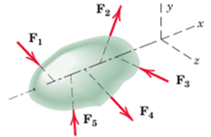
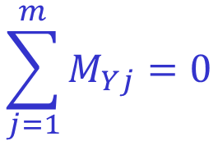
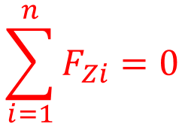



Categories of Equilibrium
Category 2, equilibrium of forces which are concurrent with a line, requires all equations except the moment equation about that line, which is automatically satisfied
$$\sum_{i=1}^{n}{F_{Xi}}=0$$
$$\sum_{j=1}^{m}{M_{Yj}}=0$$
$$\sum_{i=1}^{n}{F_{Yi}}=0$$
$$\sum_{j=1}^{m}{M_{Zj}}=0$$
$$\sum_{i=1}^{n}{F_{Zi}}=0$$

Slide 24


Categories of Equilibrium
Category 3, equilibrium of parallel forces, requires only one force equation, the one in the direction of the forces (x-direction as shown), and two moment equations about the axes (yandz) which are normal to the direction of the forces.
$$\sum_{j=1}^{m}{M_{Yj}}=0$$
$$\sum_{i=1}^{n}{F_{Xi}}=0$$
$$\sum_{j=1}^{m}{M_{Zj}}=0$$

Slide 25



Categories of Equilibrium
Category 4,equilibrium of a general system of forces, requires all three force equations and all three moment equations. The observations contained in these statements are generally quite evident when a given problem is being solved.
$$\sum_{i=1}^{n}{{\vec{F}}_{i}}=0$$
$$\sum_{j=1}^{m}{{\vec{M}}_{i}}=0$$

Slide 26
Constraints and Statical Determinacy
The six scalar relations of equilibrium are necessary and sufficient conditions to establish equilibrium in 3D.
However, these six do not necessarily provide all of the information required to calculate the unknown forces acting in a three-dimensional equilibrium situation.
The question of adequacy of information is decided by the characteristics of the constraints provided by the supports.
An analytical criterion for determining the adequacy of constraints is available.

Slide 27


The Concept of Fixity & Adequacy of constraints
2D Systems
3D Systems

Slide 28
Constraints and Statical Determinacy
Complete fixity Adequate constraints
Given figure shows a rigid body whose corner point A is completely fixed by the links 1, 2, and 3.
Links 4, 5, and 6 prevent rotations about the axes of links 1, 2, and 3, respectively.
Therefore, this body is completely fixed, and the constraints are said to be adequate.

Slide 29
Complete Fixity Adequate constraints
2D Systems
3D Systems

Slide 30

Constraints and Statical Determinacy
Incomplete fixity Partial constraints
Above figure shows the same number of constraints as before.
However, it may be observed that they provide no resistance to a moment which might be applied about axis AE.
Here the body is incompletely fixed and only partially constrained.

Slide 31

Incomplete Fixity Partial constraints
2D Systems
3D Systems

Slide 32

Constraints and Statical Determinacy
Incomplete fixity Partial constraints
In this configuration the constraints provide no resistance to an unbalanced force in the y-direction, so here also is a case of incomplete fixity with partial constraints.

Slide 33

Incomplete Fixity Partial constraints
2D Systems
3D Systems

Slide 34

Constraints and Statical Determinacy
Excessive fixity Redundant constraints
In this fourth configuration, if a seventh constraining link were imposed on a system of six constraints placed properly for complete fixity.
This leads to provision of more supports than would be necessary to establish the equilibrium position, and link 7 would be redundant.
The body would then be statically indeterminate with such a seventh link in place.

Slide 35

Excessive Fixity Redundant constraints
2D Systems
3D Systems

Slide 36
Knowledge of Supports and Forces Systems Helped in Realizing the Dreams thru Engineering
Created A World of Structures…..

Slide 37


Structure Realized the Dream of Wright Brothers
A Dream
A Reality

