Slide 1


Equilibrium Analysis Methodology – 2D Statics
P M V Subbarao
Professor & Head
Mechanical Engineering Department
Mastering Static Analysis, Solving Real Problems…..

Slide 2

Basic Skills in 2-D/3-D Equilibrium Analysis
System Isolation
Identification of Constraints thru Supports.
Creation of A Free-Body Diagram
Modeling the Action/Reaction of each support/mechanical element.
Identification of Equilibrium Conditions
Treatment of Two & Three-Force Members.
Formulation of Equilibrium Equations.

Slide 3
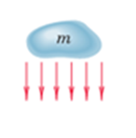
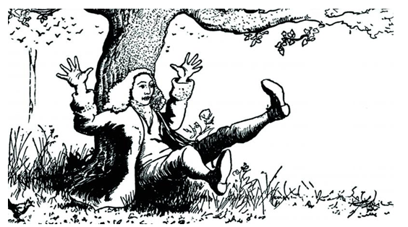
Modeling the Action/Reaction of A Support
Why Newton was curious about Non-contact Force???

Slide 4
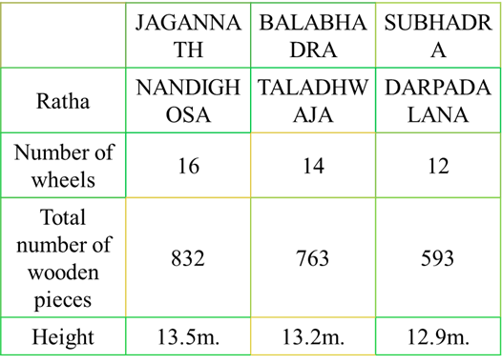


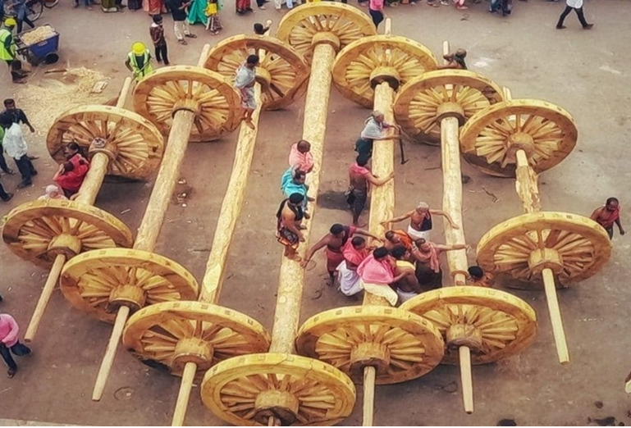

Well known Action/Reaction of A Contact

Slide 5

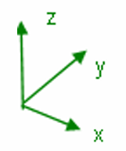
Modelling of Symmetric 3D Systems to 2D Systems
b
a
c
A Cubic Box has 3-planes of Geometric symmetry.
X-Y symmetry, Y-Z Symmetry & Z-X Symmetry

Slide 6
Conversion of Symmetric 3D Systems to 2D Systems
b
a
F
c
F
Consider a force system as shown above.

Slide 7
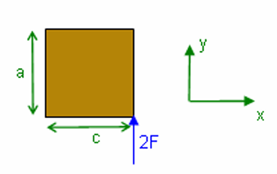
Conversion of Symmetric 3D Systems to 2D Systems
b
a
c
2F
Using symmetry and static equivalence, the problem can be converted into a 2D problem

Slide 8

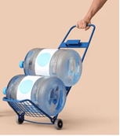
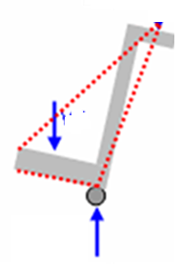



Simple Real System
Force of Hand on Handle
2D Equivalent
$${\vec{F}}_{Hand}$$
Combined weight of bottles and cart acting at G.
$$\vec{W}$$
$${2\vec{F}}_{Roller}$$
Forces of Wheels on Floor

Slide 9
Modeling the Action of Forces
As a part of Equilibrium analysis, the force application on mechanical systems for analysis in two dimensions are to be carefully observed.
The force exerted on the body to be isolated, by the body to be removed.
Reaction mentioned in Newton’s third law, to every action, must be carefully identified.
The force exerted on the body in question by a contacting or supporting member is always in the sense to oppose the movement of the isolated body which would occur if the contacting or supporting body were removed

Slide 10
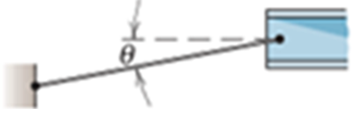
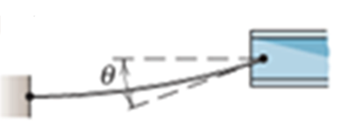
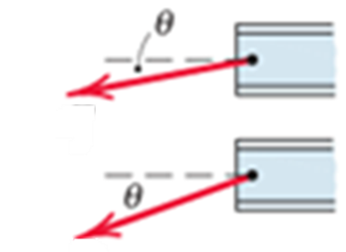


Modeling the Action of Forces
1. Flexible cable, belt, chain, or rope
Weight of cable negligible
Weight of cable not negligible
A flexible cable is always a tension away from the body in the direction of the cable.
$$\vec{T}$$
$$\vec{T}$$

Slide 11

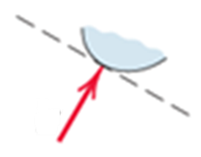

Modeling the Action of Forces
2. Smooth surfaces
Contact force is compressive and is normal to the surface.
$$\vec{N}$$

Slide 12

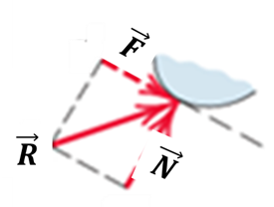
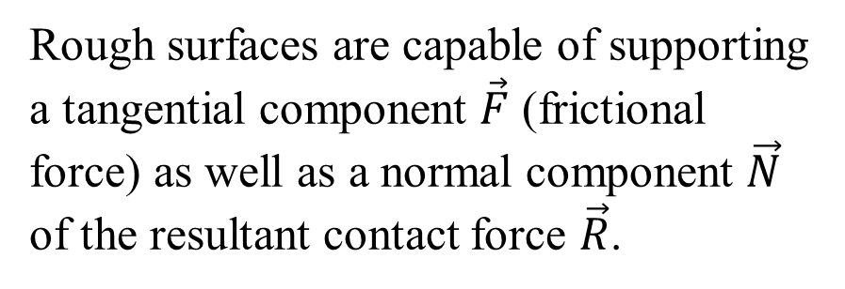
Modeling the Action of Forces
3.Rough surfaces
Rough surfaces are capable of supporting a tangential component $\vec{F}$ (frictional force) as well as a normal component $\vec{N}$ of the resultant contact force $\vec{R}$.

Slide 13
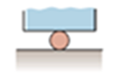

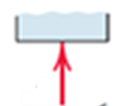
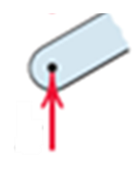


Modeling the Action of Forces
4.Roller support
Roller, rocker, or ball support transmits a compressive force normal to the supporting surface.
$$\vec{N}$$
$$\vec{N}$$

Slide 14
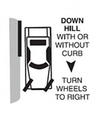
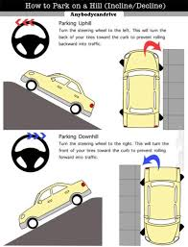
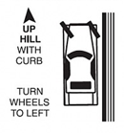
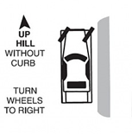
Roller Contacts: Action of Forces
Parking on Hills

Slide 15

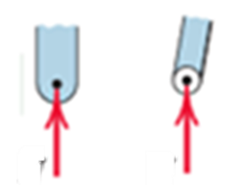
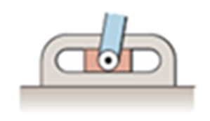

Modeling the Action of Forces
5.Freely sliding guide
Collar or slider free to move along smooth guides; can support force normal to guide only.
$$\vec{N}$$
$$\vec{N}$$

Slide 16
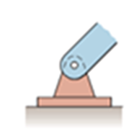
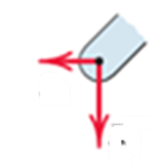
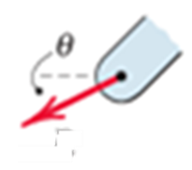



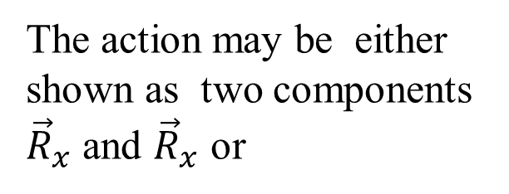
Modeling the Action of Forces
6. Pin connection
A freely hinged pin connection is capable of supporting a force in any direction in the plane normal to the pin axis.
Pin free to turn
The action may be either shown as two components ${\vec{R}}_{x}$ and ${\vec{R}}_{x}$ or
A magnitude and direction.
$${\vec{R}}_{x}$$
$$\vec{R}$$
$${\vec{R}}_{y}$$

Slide 17



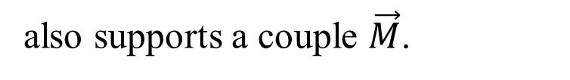

Modeling the Action of Forces
6. Pin connection
A freely hinged pin connection is capable of supporting a force in any direction in the plane normal to the pin axis.
A pin not free to turn
also supports a couple $\vec{M}$.
$${\vec{R}}_{x}$$
$$\vec{M}$$
$${\vec{R}}_{y}$$

Slide 18


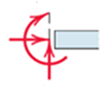

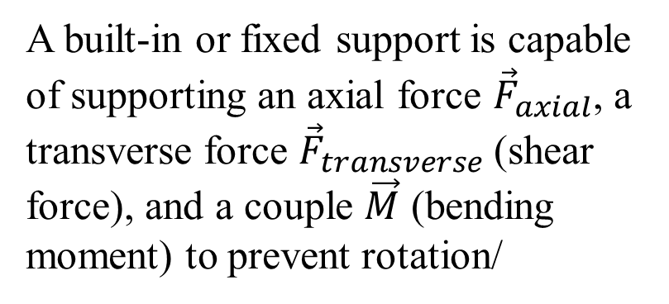


Modeling the Action of Forces
7.Built-in or fixed support
A built-in or fixed support is capable of supporting an axial force ${\vec{F}}_{axial}$, a transverse force ${\vec{F}}_{transverse}$(shear force), and a couple $\vec{M}$ (bending moment) to prevent rotation/
$$\vec{M}$$
$${\vec{F}}_{axial}$$
$${\vec{F}}_{transverse}$$

Slide 19
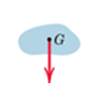

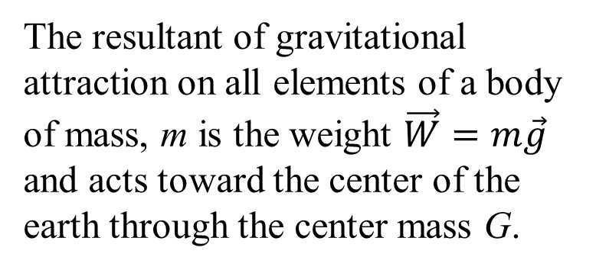
Modeling the Action of Forces
8. Gravitational attraction
The resultant of gravitational attraction on all elements of a body of mass, m is the weight $\vec{W}=m\vec{g}$ and acts toward the center of the earth through the center mass G.
$\vec{W}=m\vec{g}$

Slide 20

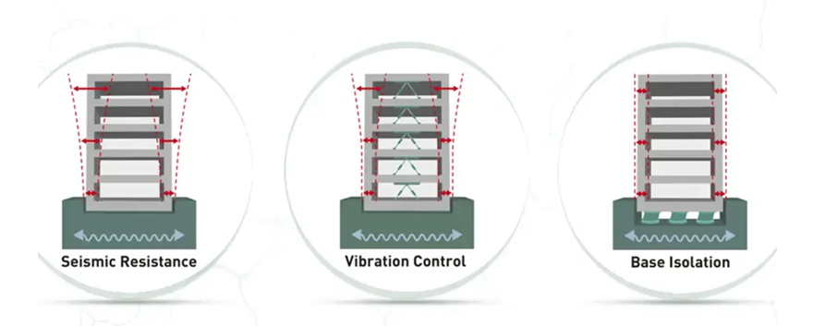
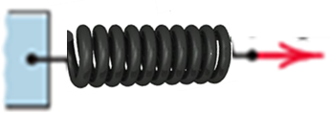










Modeling the Action of Forces
9. Spring action
Spring force is tensile if spring is stretched and compressive if compressed.
Neutral position
$$\vec{x}$$
$$\vec{F}$$
$$\vec{F}$$
$$\vec{F}$$
For a linearly elastic spring the stiffness k is the force required to deform the spring a unit distance.
$$\vec{F}=k\vec{x}$$
$$\vec{F}$$
Non-linear Spring
Linear Spring
$$\vec{x}$$

Slide 21
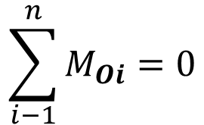
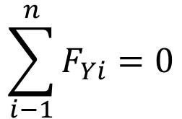
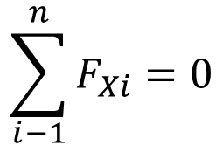
Equilibrium Conditions in 2D
Three equations per free body.
More than three equations per free body is illegal.
$$\sum_{i−1}^{n}{F_{Xi}}=0$$
Force in 2D written in scalar form
$$\sum_{i−1}^{n}{F_{Yi}}=0$$
The third equation represents the zero sum of the moments of all forces about any point O on or off the body.
$$\sum_{i−1}^{n}{M_{Oi}}=0$$

Slide 22
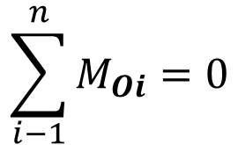
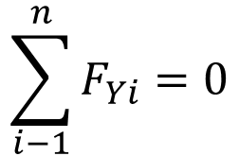
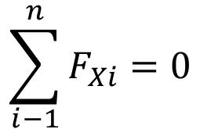
Equilibrium Conditions in 2D
$$\sum_{i−1}^{n}{F_{Xi}}=0$$
Force in 2D written in scalar form
$$\sum_{i−1}^{n}{F_{Yi}}=0$$
The third equation represents the zero sum of the moments of all forces about any point O on or off the body.
$$\sum_{i−1}^{n}{M_{Oi}}=0$$
Above set of Equations are the necessary and sufficient conditions for complete equilibrium in two dimensions., and equilibrium is assured!

Slide 23
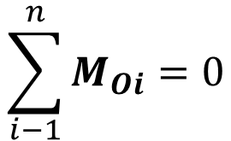
Equilibrium Conditions in 2D
$$\sum_{i−1}^{n}{F_{Xi}}=0$$
Force in 2D written in scalar form
$$\sum_{i−1}^{n}{F_{Yi}}=0$$
The third equation represents the zero sum of the moments of all forces about any point O on or off the body.
$$\sum_{i−1}^{n}{M_{Oi}}=0$$
They are necessary conditions because, if they are not satisfied, there can be no force or moment balance.
They are sufficient because once they are satisfied, there can be no imbalance, and equilibrium is assured

Slide 24
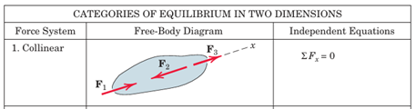
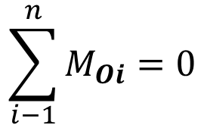
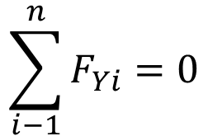
Categories of Equilibrium
$$\sum_{i−1}^{n}{F_{Xi}}=0$$
$$\sum_{i−1}^{n}{F_{Yi}}=0$$
$$\sum_{i−1}^{n}{M_{Oi}}=0$$
Applications of above equation set fall naturally into a number of categories which are easily identified.
Category 1, equilibrium of collinear forces, clearly requires only the one force equation in the direction of the forces (x-direction), since all other equations are automatically satisfied.

Slide 25
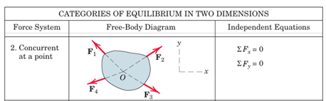
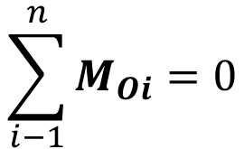
Categories of Equilibrium
$$\sum_{i−1}^{n}{F_{Xi}}=0$$
$$\sum_{i−1}^{n}{F_{Yi}}=0$$
$$\sum_{i−1}^{n}{M_{Oi}}=0$$
Category 2, equilibrium of forces which lie in a plane (x-y plane) and are concurrent at a point O, requires the two force equations only, since the moment sum about O, that is, about a z-axis through O, is necessarily zero. Included in this category is the case of the equilibrium of a particle.

Slide 26
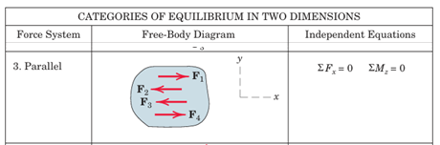
Categories of Equilibrium
$$\sum_{i−1}^{n}{F_{Xi}}=0$$
$$\sum_{i−1}^{n}{F_{Yi}}=0$$
$$\sum_{i−1}^{n}{M_{Oi}}=0$$
Category 3, equilibrium of parallel forces in a plane, requires the one force equation in the direction of the forces (x-direction) and one moment equation about an axis (z-axis) normal to the plane of the forces.

Slide 27
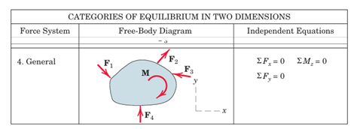
Categories of Equilibrium
$$\sum_{i−1}^{n}{F_{Xi}}=0$$
$$\sum_{i−1}^{n}{F_{Yi}}=0$$
$$\sum_{i−1}^{n}{M_{Oi}}=0$$
Category 4, equilibrium of a general system of forces in a plane (x-y), requires the two force equations in the plane and one moment equation about an axis (z-axis) normal to the plane.

Slide 28
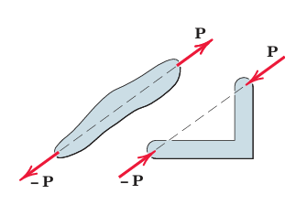
Frequently Encoutered 2D Equilibrium Systems
Two frequently occurring equilibrium cases.
The first situation is the equilibrium of a body under the action of two forces only.
It is seen for such a two-force member to be in equilibrium, the forces must be equal, opposite, and collinear.

Slide 29
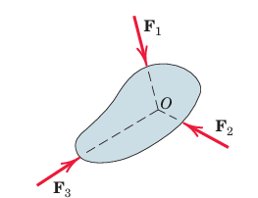
Frequently Encoutered 2D Equilibrium Systems
The second situation is a three-force member, which is a body under the action of three forces.
It is seen that equilibrium requires the lines of action of the three forces to be concurrent.
If they were not concurrent, then one of the forces would exert a resultant moment about the point of intersection of the other two, which would violate the requirement of zero moment about every point.
The only exception occurs when the three forces are parallel.
In this case we may consider the point of concurrency to be at infinity.

Slide 30

Frequently Encoutered 2D Equilibrium Systems
The principle of the concurrency of three forces in equilibrium is of considerable use in carrying out a graphical solution of the force equations.
In this case the polygon of forces is drawn and made to close, as shown in Figure.
Frequently, a body in equilibrium under the action of more than three forces may be reduced to a three-force member by a combination of two or more of the known forces.

Slide 31
2D Equilibrium Equations
$$\sum_{i−1}^{n}{F_{Xi}}=0$$
$$\sum_{i−1}^{n}{F_{Yi}}=0$$
$$\sum_{i−1}^{n}{M_{Oi}}=0$$
Any other alternative set Possible/Required for ensuing equilibrium in 2D???

Slide 32



Alternative Equilibrium Equations
In addition to standard set of Equations, there are two other ways to express the general conditions for the equilibrium of forces in two dimensions.
The first alternate way is illustrated as
$$\sum{{\vec{M}}_{A}=}0 ;Satisfied$$
For the body shown in Figure, if $\sum{{\vec{M}}_{A}}=0$, then the resultant, if it still exists, cannot be a couple, but must be a force $\vec{R}$ passing through A.

Slide 33



Alternative Equilibrium Equations
$$\left.\begin{matrix}\sum{{\vec{M}}_{A}=}0 \\ \sum{{\vec{F}}_{X}=}0\end{matrix}\right\} Satisfied$$
If now the equations $\sum{{\vec{M}}_{A}=0 \& }\sum{{\vec{F}}_{X}=0 }$are valid, where the x-direction is arbitrary, it follows from above Figure that the resultant force $\vec{R}$ , if it still exists, not only must pass through A, but also must be perpendicular to the x-direction as shown.
Now, if $\sum{{\vec{M}}_{A}=0 }$, where B is any point such that the line AB is not per pedicular to the x-direction, we see that $\vec{R}$ must be zero, and thus the body is in equilibrium.

Slide 34



Alternative Equilibrium Equations
Therefore, an alternative set of equilibrium equations is
$$\sum_{i−1}^{n}{F_{Xi}}=0$$
$$\sum_{i−1}^{n}{M_{Ai}}=0$$
$$\sum_{i−1}^{n}{M_{Bi}}=0$$
where the two points A and B must not lie on a line perpendicular to the x-direction.

Slide 35




Alternative Equilibrium Equations
$$\sum{{\vec{M}}_{A}=}0 ;Satisfied$$
$$\left.\begin{matrix}\sum{{\vec{M}}_{A}=}0 \\ \sum{{\vec{M}}_{B}=}0\end{matrix}\right\} Satisfied$$
A third formulation of the equilibrium conditions may be made for a coplanar force system.
This is illustrated in following Figures.
Again, if $\sum{{\vec{M}}_{A}=0 \& }$for any body such as that shown in Figure the resultant, if any, must be a force $\vec{R}$ through A.
In addition, if $\sum{{\vec{M}}_{B}=0 \& }$, the resultant, if one still exists, must pass through B as shown in the second Figure.
Such a force cannot exist, however, if $\sum{{\vec{M}}_{C}=0 \& }$, where C is not collinear with A and B.

Slide 36



Alternative Equilibrium Equations
Thus, the equations of equilibrium may be written as
$$\sum_{i−1}^{n}{M_{Ai}}=0$$
$$\sum_{i−1}^{n}{M_{Bi}}=0$$
$$\sum_{i−1}^{n}{M_{Ci}}=0$$
where A, B, and C are any three points not on the same straight line.

Slide 37
Final Remarks
When equilibrium equations are written which are not independent, redundant information is obtained, and a correct solution of the equations will yield 0 = 0.
A general problem in two dimensions with three unknowns, three moment equations written about three points which lie on the same straight line are not independent.
Such equations will contain duplicated information, and solution of two of them can at best determine two of the unknowns, with the third equation merely verifying the identity 0 = 0.

Slide 38
Constraints and Statical Determinacy
The equilibrium equations developed here are both necessary and sufficient conditions to establish the equilibrium of a body.
However, they do not necessarily provide all the information required to calculate all the unknown forces which may act on a body in equilibrium.
Whether the equations are adequate to determine all the unknowns depends on the characteristics of the constraints against possible movement of the body provided by its supports.
By constraint we mean the restriction of movement.

Slide 39
Constraints and Statical Determinacy
Rigid Bodies which are supported by the minimum number of constraints necessary to ensure an equilibrium configuration are called statically determinate.
For such bodies the equilibrium equations are sufficient to determine the unknown external forces.
A rigid body, which possesses more external supports or constraints than are necessary to maintain an equilibrium position is called statically indeterminate.
Supports which can be removed without destroying the equilibrium condition of the body are said to be redundant.
The number of redundant supporting elements present corresponds to the degree of statical indeterminacy and equals the total number of unknown external forces, minus the number of available independent equations of equilibrium.

Slide 40


Adequacy of Constraints
The existence of three constraints for a two-dimensional problem does not always guarantee a stable equilibrium configuration.
Point A of the rigid body is fixed by the two links and cannot move, and the third link prevents any rotation about A.
This body is completely fixed with three adequate (proper) constraints.
Complete fixity Adequate constraints
The third link is positioned so that the force transmitted by it passes through point A where the other two constraint forces present.

Slide 41

Adequacy of Constraints
This configuration of constraints can offer no initial resistance to rotation about A, which would occur when external loads were applied to the body.
Therefore, it is concluded that this body is in completely fixed under partial constraints.
Incomplete fixity Partial constraints
This is a similar condition of incomplete fixity.
The three parallel links could offer no initial resistance to a small vertical movement of the body as a result of external loads applied to it in this direction.
The constraints in these two examples are often termed improper
Incomplete fixity Partial constraints

Slide 42

Adequacy of Constraints
Excessive fixity Redundant constraint
This is a condition of complete fixity, with link 4 acting as a fourth constraint which is unnecessary to maintain a fixed position.
Link 4, then, is a redundant constraint, and the body is statically indeterminate.
It is generally possible by direct observation to conclude whether the constraints on a body in two-dimensional equilibrium are adequate (proper), partial (improper), or redundant.

