Slide 1


MEL1002: Engineering Mechanics: Introduction
https://web.iitd.ac.in/~pmvs/course_mel7405.php
P M V Subbarao
Professor & Head
Mechanical Engineering Department
Happy New year 2026!!!
An Engineering Science of Force Systems for Human Development….

Slide 2

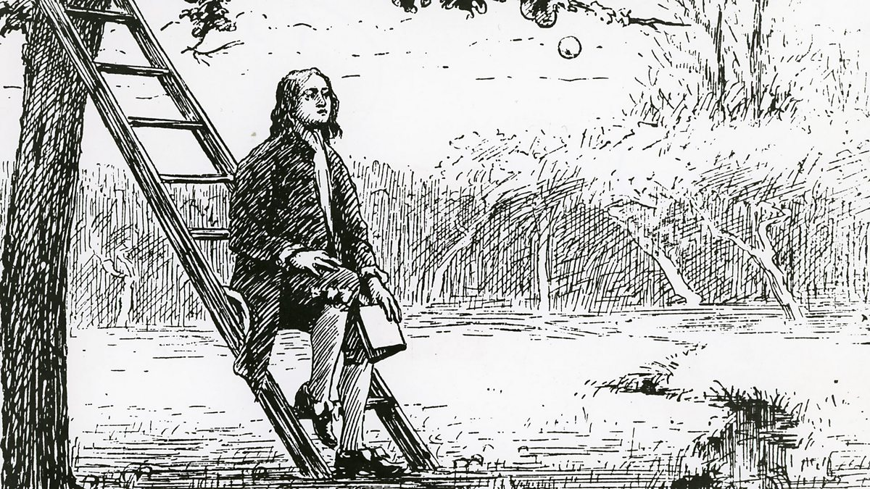
Engineering of Forces Inspired By Nature
This work is
“the Engineering principles of Natural philosophy”
Based on the phenomena of motions to investigate the forces of nature.
These forces to demonstrate the other phenomena.
when asked once about how this scientist gained his insight into the problems of nature, replied
“By constantly thinking unto them.”
What is Natural Philosophy?

Slide 3
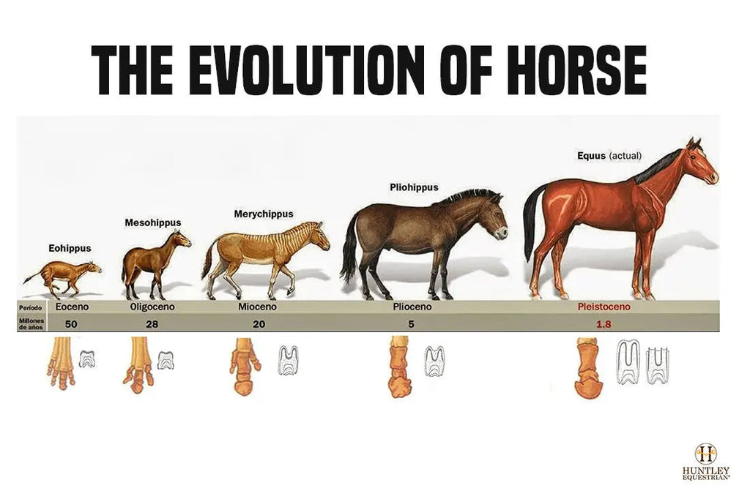
Mechanistic Classification of Living Species
Mechanics is a science of Forces.
In the framework of Mechanics all the living species are classified as:
Sessile Living Species: Non-moving : Trees and Plants etc.
Motile Living Species: All animals etc…
All Motile Living Species other than humans are in need of Somatic Mechanics (Bio-mechanics).
Humans are in Extra-somatic Mechanics: Both Bio-mechanics & Classical or Engineering Mechanics.
21st Century Engineers use Engineering Mechanics for Bio-mechanics!!

Slide 4
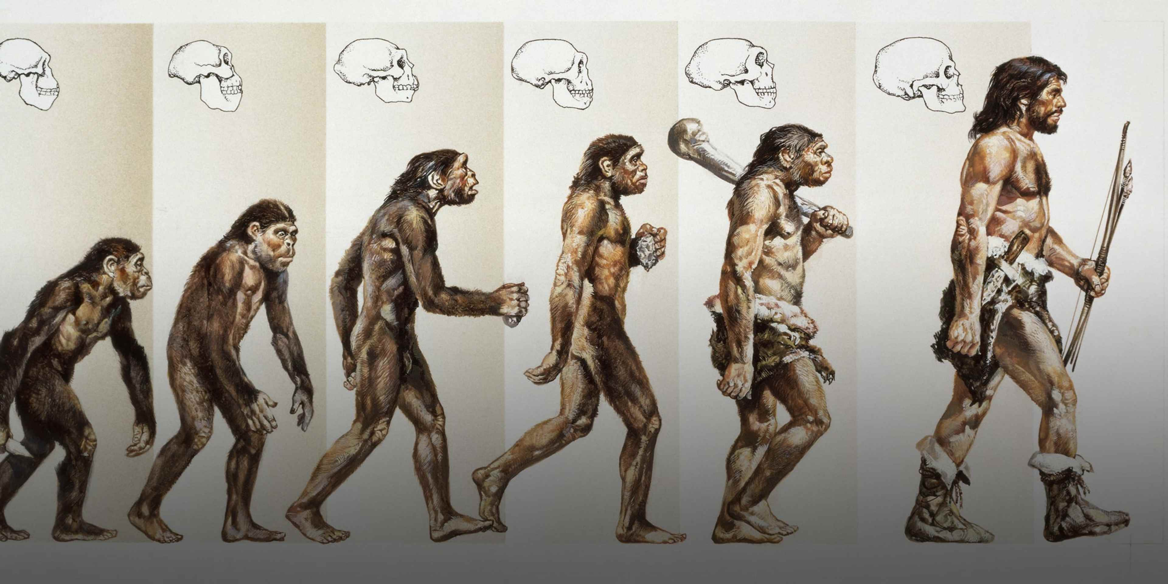

Evolution of Human Species

Slide 5


Humans as Hunters and Gatherers : No use of Extrasomatic Mechanics

Slide 6
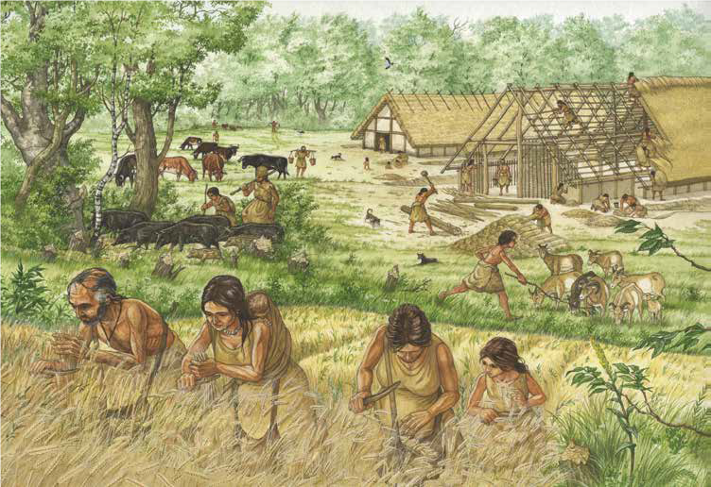
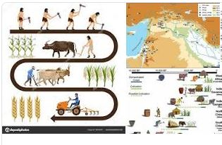
Humans as Farmers : Use of Extra-somatic Mechanics

Slide 7


Human Evolution thru Use of Extra-somatic Mechanics
Quantum Era
Machine Free Era ???
Machines Era
Water Mills
Wind Mills
Heat Engines
Steam /gas turbines
Compound Tool Era
Single body Tool Era
Cattle as Energy Systems
Pre-historic Technology
Humans as Energy Systems
Pre-historic Energy Systems

Slide 8
Definition of Engineering Mechanics
Study of the behaviour of physical bodies under the influence of forces and displacements for Human Development.
This is the primary Engineering/Scientific Practice for Humans and by Humans.
In 21st century Engineering Mechanics serves as the foundation for various engineering fields, such as civil, mechanical, aerospace, and materials engineering.
Applications of the principles of mechanics helped engineers to predict how structures, machines, and materials will respond under different conditions, ensuring their safe and efficient operation.

