Slide 1

Development & Operation of Windfarms
P M V Subbarao
Professor
Mechanical Engineering Department
I I T Delhi
Project Management brings a Unique Focus Shaped by the Goals & Resources.......…

Slide 2

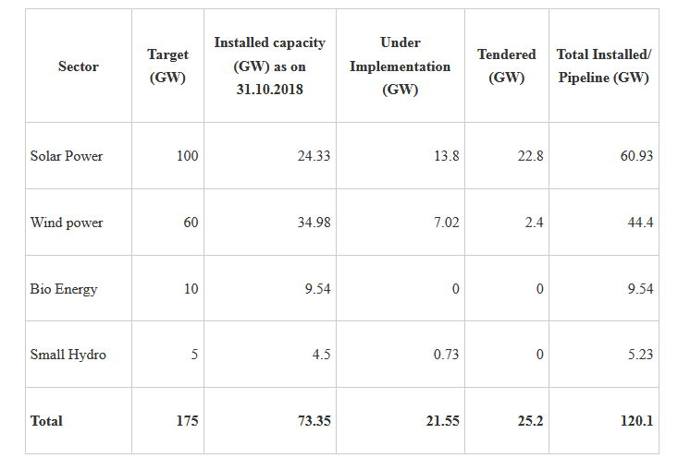
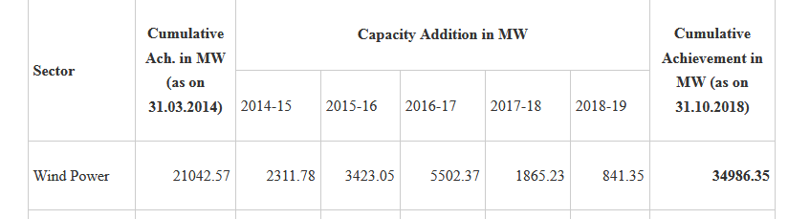
Development of Windfarms in India

Slide 3
The Concept of Project Management
Project management is the practice of
initiating, planning, executing, controlling, and closing the work of a team to achieve specific goals and
meet specific success criteria at the specified time.
A PM of Windfarm is a temporary endeavor designed to produce a Full Pledged business.
The management of temporary projects requires the development of distinct technical skills and management strategies.

Slide 4
Phases in Windfarm Development
There are Seven main steps in PM of Windfarms:
Pre-project planning.
Detailed project planning.
The Engineering
Installation and commissioning.
Full operation.
Repowering.
Dismantling.
Each of these phases consists of several important work packages.
To be successful, the project management must take these work packages into account.

Slide 5
Pre-Project Planning : Work Packages
Pre-feasibility study
  wind farm technology
  Grid connection and technology
  Stakeholder involvement
  Embedding in spatial planning
  Supply chain management
Logistics
  Economic assessment of main supplies and construction works
  Environmental and public impacts
  Development of strategies
  Financing, media, stakeholder involvement, approval
Project structure
Main Risk Assessment

Slide 6
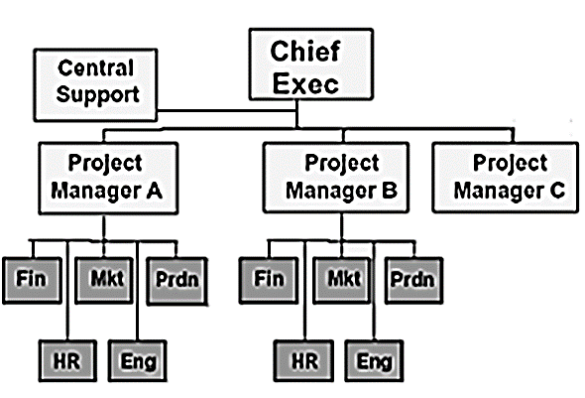
Project Structure

Slide 7
Main risk assessment
Require a risk analysis if the site is close to other infrastructure such as:
Facilities for transport
Storage or processing of hazardous goods.
Pipelines for transport of hazardous goods (including underground)
Residential, commercial or public buildings.
Roads, railway tracks and waterways.
Medium and high voltage conductors of transmission lines or cables.

Slide 8
Detailed Project Planning : Work Packages
Detailed Project Planning
Project Approval
Procedure
Site Investigation
Definition of Functional Requirements
Geographical Sites:
wind speed & wind direction
Oceanographical Sites:
chemical, geological and biological.
Investigation for environmental impact assessment
o Wind farm infrastructure
o Electrical infrastructure
o Harbour logistics
o Offshore logistics
o Health, safety and environment
1. wind farm site
2. grid connection
3. Where necessary:
  Grid extension / reinforcement
  Wind Energy Production Management)

Slide 9
Detailed Project Planning : Work Packages
Detailed Project Planning
Planning of internal Controlling System
Others
Key performance indicators
Quality assurance and control
Factory acceptance tests
Reporting system and interface
Tender Process
Master Plan
Financing and insurance arrangements
Contracting
preparation of documents
Elaboration of proposals
Tender evaluation
Sub-contractors negotiation

Slide 10
The Engineering : Work Packages
Engineering, Testing Production & Procurement
Engineering & Planning
Pre-testing & Training
Production & Procurement
Testing of full size model of wind turbine
Service and maintenance of main components (pile, nacelle, blade, generator, transformer)
Access to wind turbine, and
Training courses for personnel
o Production of wind farm elements
o Interface and work flow management
o Quality assurance and control
o Factory acceptance tests, and
o Transport to logistical centre
Pre-testing
Installation
Commissioning
Operation
Dismantling

Slide 11
Installation and Commissioning: Work Packages
Site preparation, pre-assembly of parts in harbour, installation of foundation for wind turbines and transformer station.
Installation of groups of wind turbines (installation of piles, nacelles and blades, inter-array cable laying and testing).
Installation of electrical infrastructure (transformer station, cable to shore laying and grid connection infrastructure to public energy supply).
Commissioning of supervisory control and data acquisition system (SCADA).
Final testing of windfarm, environmental monitoring of construction phase

Slide 12
Full Operation : Work Packages
Service and maintenance
Environmental monitoring of operation phase

Slide 13
Flow Chart of The Main Work Packages
Pre-Project Planning
Detailed Project Planning
Financing and Insurance
Arrangements
Project Approval
Procedure
Site Investigation
Definition of Functional Requirements

Slide 14
Flow Chart of The Main Work Packages
Definition of Functional Requirements
Planning of internal Controlling System
Financing and Insurance
Arrangements
Tender Process
Master Plan

Slide 15
Flow Chart of The Main Work Packages
Master Plan
Contracting
Detailed Engineering Planning
Pre-Testing & Training
Production & Procurement
Installation & Commissioning

Slide 16
Flow Chart of The Main Work Packages
Installation & Commissioning
Full Operation
Repowering
Dismantling

Slide 17
Windfarm Operation
Successful operation of a wind farm:
(1) Information systems to monitor turbine performance
(2) Understanding of factors that reduce turbine performance,
(3) Measures to maximize turbine productivity.

Slide 18
Automatic Turbine Operation
Automatic turbine operation requires a system for oversight in order to provide operating information to the turbine owner and maintenance personnel.
Turbines in wind farms have the capability to communicate with remote oversight systems via phone connections.
Remote oversight (SCADA) systems receive data from individual turbines and display it on computer screens for system operators.
These data is used to evaluate turbine energy capture and availability.
Availability is defined as the percentage of time that a wind turbine is available for power production.

Slide 19
Availability of Wind Turbines
The availability of wind turbines with mature designs is typically between 94% and 97%.
Reduced availability is caused by:
Scheduled and unscheduled maintenance and repair periods,
Power system outages, and
Control system faults.
The inability of control systems to properly follow rapid changes in wind conditions may lead to low availability.

Slide 20
Availability of Wind Turbines
Imbalance due to blade icing, or momentary high component temperatures can cause the controller to stop the turbine.
The controller usually clears these fault conditions and operation is resumed.
Repeated tripping usually causes the controller to take the turbine offline when a technician can determine the cause of anomalous sensor readings.

Slide 21
Daily & Weekly Energy Productions
Wind turbine manufacturers provide power curves representing turbine power output as a function of wind speed.
A number of factors may reduce the energy capture of a turbine or wind farm from that expected.
The reasons are:
Reduced availability,
Poor aerodynamic performance due to soiled blades and blade ice.
Soiled blades have been observed to degrade aerodynamic performance by as much as 10–15%.
Lower power due to yaw error, during control actions in response to wind conditions.
Interactions between turbines in wind farms.

Slide 22
Losses due to Poor Aerodynamics of Blades
Airfoils that are sensitive to dirt accumulation require either frequent cleaning.
In these sites blades must use airfoils whose performance is less susceptible to degradation by the accumulation of dirt and insects.
Energy capture is also reduced when the wind direction changes.
Controllers on some upwind turbine designs might wait until the magnitude of the average yaw error is above a predetermined value before adjusting the turbine orientation.
This results in periods of operation at high yaw errors. This results in lower energy capture.

Slide 23
Operation during Turbulent Wind Conditions
Turbulent winds can also cause a number of types of trips.
In turbulent winds, sudden high yaw errors might cause the system to shut down and restart.
In high winds, gusts can cause the turbine to shut down for protection when the mean wind speed is still well within the turbine operating range.
These problems may reduce energy capture by as much as 15% of projected values.
Operational Service personal should not only be prepared to minimize these problems.
Planning should also anticipate them in their financing and planning evaluations

Slide 24
Maintenance and Repair
Wind turbine components require regular maintenance.
Frequent inspections must be carried to make sure that lubrication oil is clean, seals are functioning.
Lean inspections to make sure that components subject to normal wear processes are replaced.
Problem conditions identified by oversight systems may require that the turbine be taken out of operation for repairs.

Slide 25
Safety Issues during Operation
The installed wind turbine needs to provide a safe work environment for operating and maintenance personnel.
The turbine also needs to be designed and operated in a manner that it is not a hazard for neighbours.
Safety issues include such things as:
Protection against contact with high voltage electricity
Protection against lightning damage to personnel or the turbine.

Slide 26
Safety Issues during Operation
The provision of safe tower-climbing equipment, and lights to warn local night time air traffic of the existence of the wind turbine.
Maintenance and repairs may be performed by on-site personnel or turbine maintenance contractors.
Protection from the effects of ice build-up on the turbine or the shedding of ice

