Slide 1

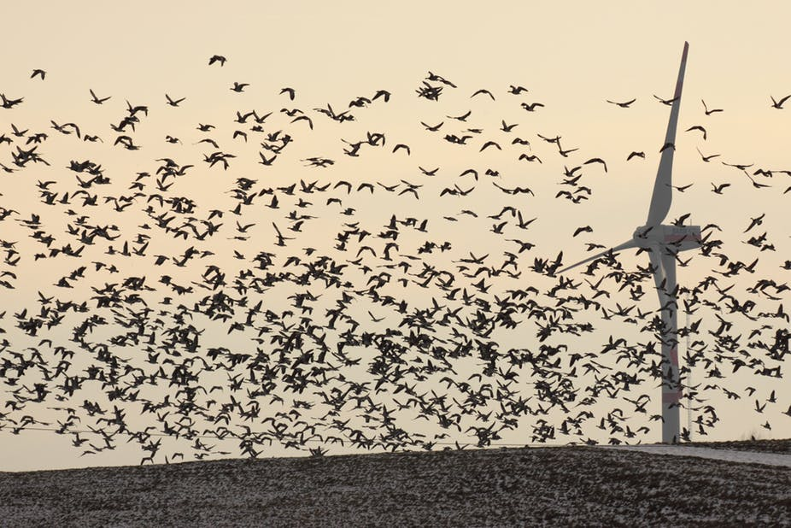
Ecological Study of Windfarms
P M V Subbarao
Professor
Mechanical Engineering Department
I I T Delhi
Ecological Study is the 21st Century Need for Innovation & Development.......…

Slide 2

Environmental Impact of Windfarm
The Environmental Impact of Windfarm on rural and local communities has become surprisingly controversial.
Operation of wind power has zero emissions of harmful substances.
It does not add to global warming.
The “fuel” is free, and is quite evenly distributed around the world.
But the generation of electricity from wind energy using large numbers of wind turbines can disrupt both landscapes and habitats.
The rotating turbine blades can sometimes kill birds and bats.

Slide 3
Potential Negative Impacts of Windfarms
The potential negative impacts of wind energy can be divided into the following categories:
Avian/bat interaction with wind turbines.
Wind turbine noise.
Visual impact of wind turbines.
Electromagnetic interference effects of wind turbines.
Land-use impact of wind power systems.
Other impact considerations.

Slide 4
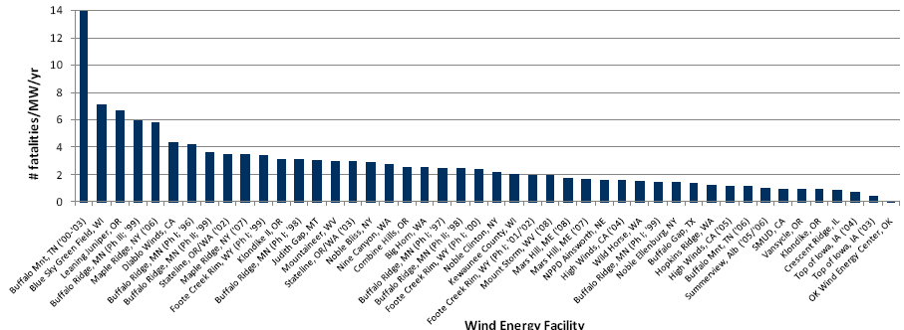
Summary of All Bird Mortality Rates at Various Wind Energy Facilities

Slide 5
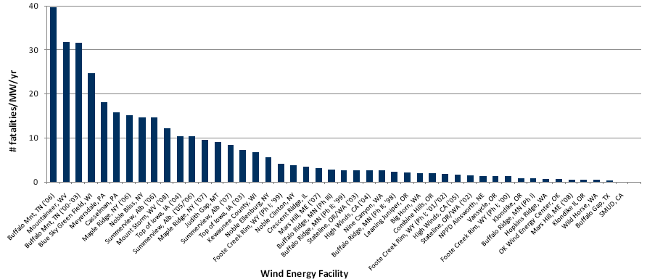
Summary of bat Mortality Rates at Various Wind Energy Facilities

Slide 6
Human-related Avian Mortality
Wind farms killed approximately seven thousand birds in the United States in 2006.
Nuclear plants killed about 327,000 and fossil-fuelled power plants 14.5 million.
Wind farms and nuclear power stations are responsible each for between 0.3 and 0.4 fatalities per gigawatt-hour (GWh) of electricity.
Fossil-fuelled power stations are responsible for about 5.2 fatalities per GWh.

Slide 7
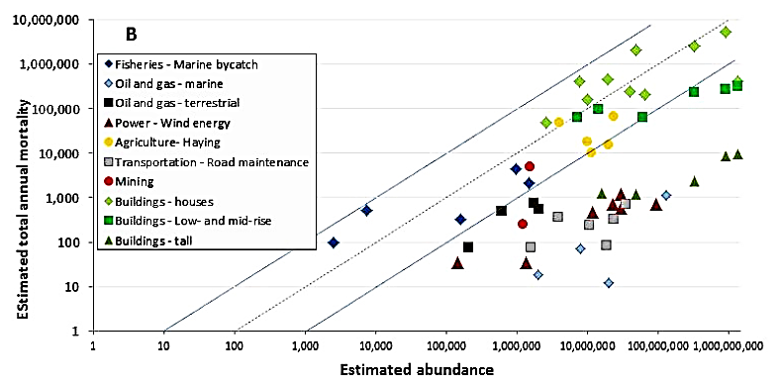
Human-related Avian Mortality in Canada

Slide 8
Avian/Bat Interaction with Wind Turbines
There are approximately 300–400 annual bird fatalities per MWh due to wind turbines.
The species fatalities associated with fossil fuel plants are much higher, approximately 5,200 annual fatalities per kWh.
The implication is that as wind energy displaces progressively more fossil fuel based electricity, the overall effect on avian populations will be positive.
There are two primary concerns related to the adverse effects of wind turbines on birds:
(1) Effects on bird populations from the deaths caused either directly or indirectly by wind turbines.
(2) Violations of the Migratory Bird Treaty Act, and/or the Endangered Species Act.

Slide 9
Birds and Wind Turbines (- Ve)
Windfarms can adversely affect birds in the following manners:
  Bird electrocution and collision mortality;
  Changes to bird foraging habits;
  Alteration of migration habits;
  Reduction of available habitat;
  Disturbance to breeding, nesting, and foraging.

Slide 10
Birds and Wind Turbines (+ve)
Conversely, windfarms have the following beneficial effects on birds:
  Protection of land from more dramatic habitat loss;
  Provision of perch sites for roosting and hunting;
  Provision and protection of nest sites on towers and ancillary facilities;
  Protection or expansion of prey base;
  Protection of birds from indiscriminate harassment.

Slide 11
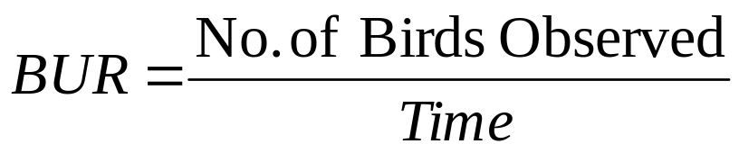
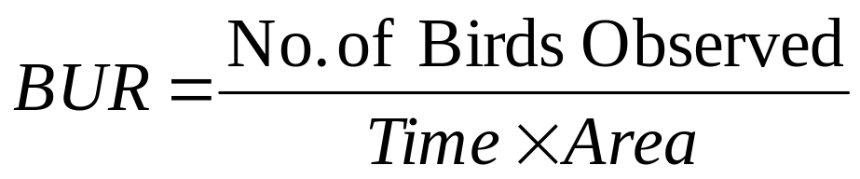
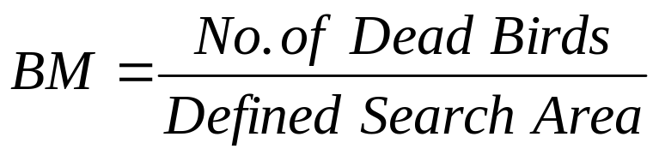
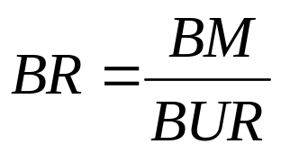
Quantitative Studies on Bird-windfarm Interactions
Bird Utilization Rate (BUR): The number of birds using the area during a given time or time and area.
Bird mortality (BM) : The number of observed deaths, per unit search area.
Bird Risk (BR) : The likelihood that a bird using the area in question will be killed.

Slide 12
Ecological Optimization of Windfarm
Bird risk can be used to compare risk differences for many different variables:
Distances from wind facilities;
Species, type, and all birds.
Seasons;
Turbine structure types.
It can be used to compare risks between wind resource areas and with other types of facilities such as highways, power lines, and TV and radio transmission towers.

Slide 13
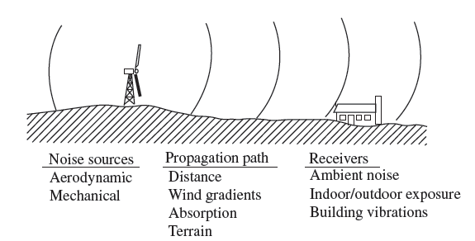
Windfarm Noise & Ecological Issues
Although it is still unclear whether wind farm noise has negative health impact, it concerns both the developers and the residents near wind farms.
Therefore noise is an important factor in environmental monitoring.

Slide 14
Noise generation in Windfarms
Noise generation in wind turbines can be generally traced back to either mechanical noise or aerodynamic noise.
Mechanical Noise : Due to operation of turbine’s mechanical components produces noise.
Aerodynamic Noise : Generated by wind flow and its interaction with the turbine itself.
Noise propagation is affected by several factors:
Ground effects
Topography,
Temperature,
Atmospheric conditions,
Aerodynamic effects caused by wake interactions and
The geometric configuration between noise sources and receivers.

Slide 15
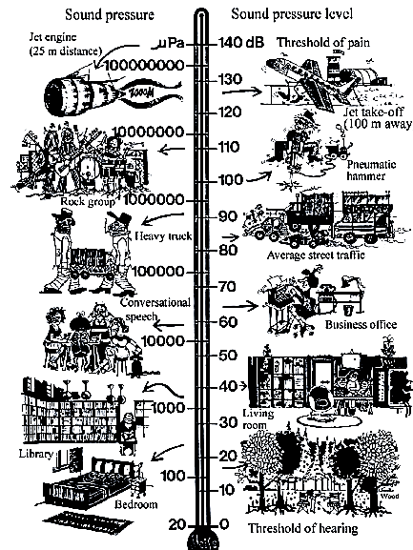
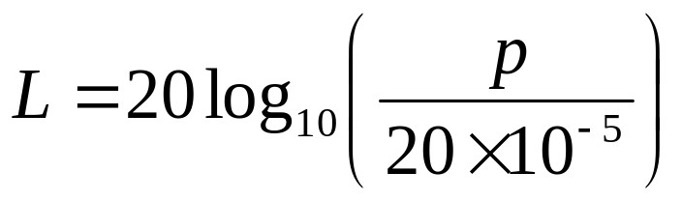
Quantification of Noise Level
The sound pressure level of a noise, L, in units of decibels (dB), is given by:
p is the instantaneous sound pressure in Pa.

Slide 16
Noise Modelling
ISO-9613-2 standard:
Receptors are the locations where the sound level is to be measured or predicted.
In wind farm layout design, all residences located within the wind farm terrain, or within a certain jurisdiction-dependent neighbourhood are considered as receptors for noise calculation purposes.
During design and development of a windfarm, Sound Pressure Level (SPL) at each receptor location is calculated for each point source.

Slide 17
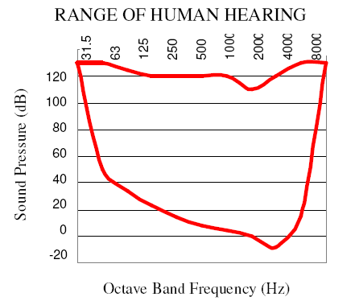
Spectral Analysis of SPL
Sound energy can occur over a broad frequency range, and the human ear is sensitive from about 20Hertz (Hz) to 20,000 Hz.
The overall level, the sum across all these frequencies is generally measured and specified.
It is more helpful to break this down into frequency bands.
As in music, an octave band convention is chosen.
Each progressive band has double the bandwidth of the previous.
The center frequencies assigned for the bands for the full range of human hearing are: 31.5, 63, 125, 250, 500, 1000, 2000, 4000, 8000, and 16000 Hz. Usually, we disregard the last band.
At the highest levels, noise above 120 dB can
cause instant hearing damage.

Slide 18
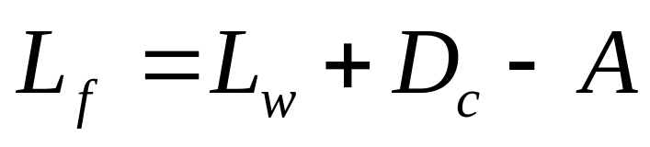
Mono Octave Band S P L
SPL at each of the eight octave bands with nominal midband frequencies from 63 Hz to 8 kHz, as
where L_{w} is the octave-band sound power emitted by the source,
D_{c} is the directivity correction for sources that are not omnidirectional,
A is the octave-band attenuation, and
subscript f indicating that this quantity is calculated for each octave band frequency.

Slide 19
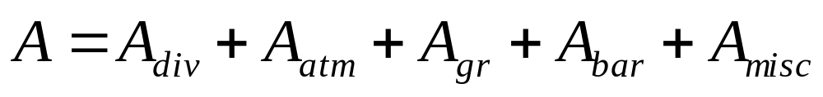
The Attenuation (A)
Geometrical divergence : A_{div}
Atmospheric absorption : A_{atm}
Ground effects : A_{gr}
Sound barriers : A_{bar}
Miscellaneous effects : A_{misc}
Generally the attenuation due to sound barriers and miscellaneous effects are negligible for windfarms.

Slide 20
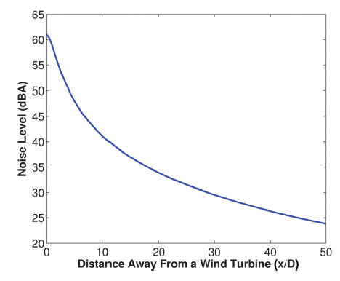
SPL (A-weighted) as a function of distance from a Single WT

Slide 21
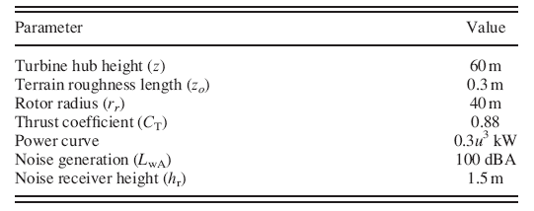
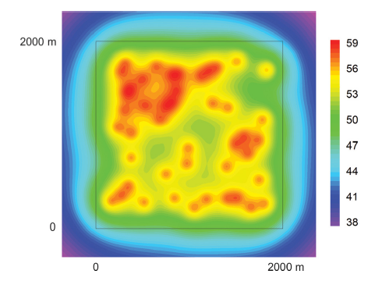
Sound pressure level contour maps generated by OPENWIND
WR36 : 30 turbines

Slide 22
VISUAL IMPACT
Visual impacts are key environmental issues in determining wind farm applications.
Landscape & Visual Effects.
Various characteristics of wind turbines may cause landscape effect.
These are; the turbines (size, height, number, material and color), Access and site tracks, substation buildings & Compounds, Grid connection, anemometer masts, and transmission lines.
Visual Effect is characterized by Shadow flickering: It is due to the periodic – about once per second – interruption of the sunlight by the rotating blades.
Both flickering and shadow casting on dwellings and offices can be very annoying for the occupants.
Shadow flickering is not regulated by law.

Slide 23
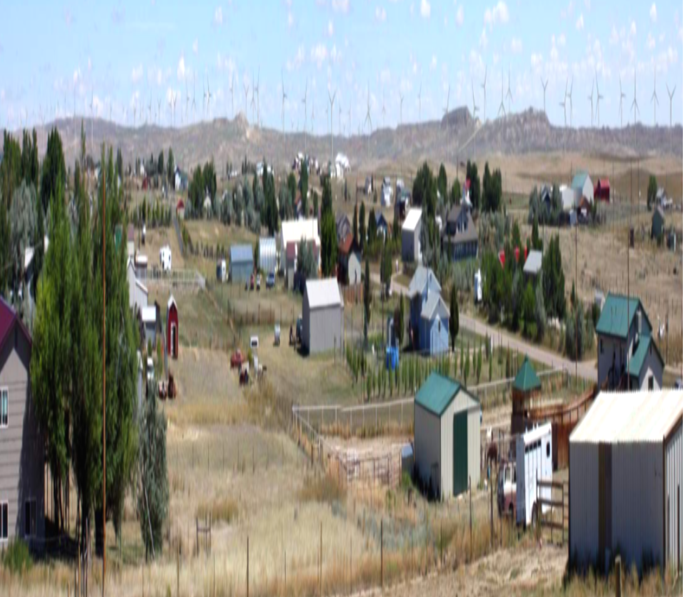
Site for Shadow Flickering Analysis

Slide 24
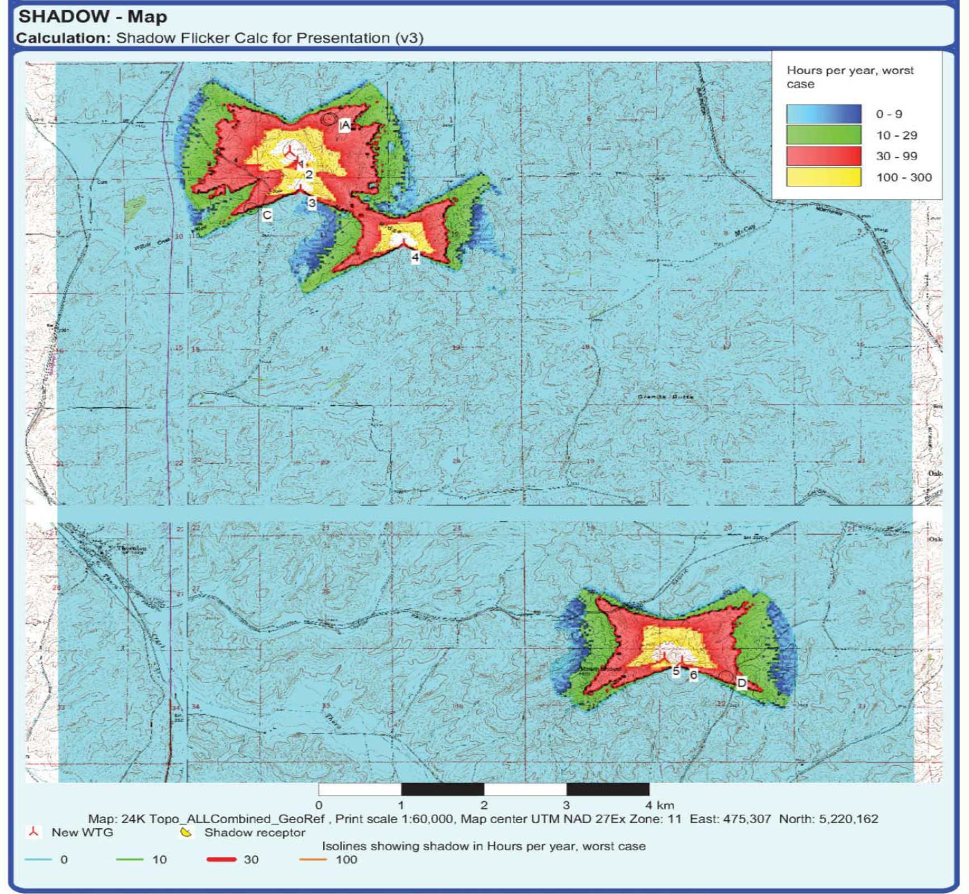
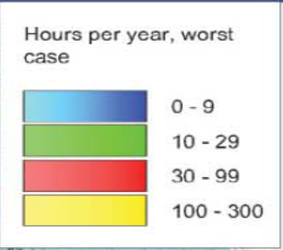
Shadow Flickering Analysis

Slide 25
Safety
Most planning authorities demand safety and risk assessment studies. Wind turbines are not permitted to rotate above roads or railway-tracks.
Where icing of the blades or nacelle is likely limitations may be placed on the operation of the turbines with the rotor being stopped during icing and only released for restart when the ice has dispersed.

Slide 26
Strategic Environmental Assessment (SEA)
A strategic environmental assessment (SEA) is the procedure used to evaluate the adverse impacts of any plans and programs on the environment.
National, regional and local governments must undertake SEAs of all wind energy plans and programs.
SEA of windfarm is challenging and relies on understanding factors that are inadequately studied.

