Slide 1

Windfarm Control Systems
P M V Subbarao
Professor
Mechanical Engineering Department
I I T Delhi
A System to Tie the Operation of all the WTS & Components Together .....

Slide 2

The Need
A Windfarm consists of many WTs.
Each turbine consists of numerous components.
A control system is needed to successfully generate power from these Wind Tubines.
A control system ties the operation of all the WTs.
Without some form of control system, a wind turbine cannot successfully and safely produce power.

Slide 3
Structure of Control Systems for a Windfarm
Windfarm control systems are functionally divided into three separate parts:
(1) A controller that controls numerous wind turbines in a wind farm.
(2) A supervisory controller for each individual turbine, and
(3) Separate dynamic controllers for the various turbine subsystems in each turbine.
These three levels of control operate hierarchically with interlocking control loops.
The wind farm controller is also known as Supervisory Control and Data Acquisition (SCADA) system.

Slide 4
Farm Level Control System : Main Logic
Wind farm controller
Start-up
System check
Acceleration control
Speed control
Synchronization
Continuous
Fault
Monitoring
Dynamic
component
controllers
On-line control
Shut-down
Disconnection
Deceleration
Braking
Emergency
shut-down

Slide 5
Individual Supervisory Controller (ISC)
The functions delegated to the ISC are characterized into two categories:
Reactions to medium-term changes in environmental and operating conditions.
Reactions to long-term changes in environmental and operating conditions.
Typically, the ISC switches between turbine operating states:
Power production State
Low wind shutdown State , etc.
ISC also monitors the wind and fault conditions such as high loads and limit conditions.
Starts and stops the turbine in an orderly fashion
Provides control inputs to the turbine dynamic controllers.

Slide 6
Expectations from ISC
An IS control system is expected to
  sequence wind speed measurements,
  check the health of system components,
  Release/apply the parking brake,
  implement blade pitch settings, and
  close contactors to connect a wind turbine to the grid.

Slide 7
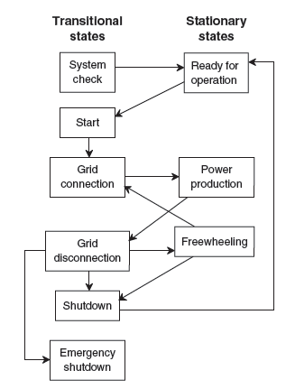
States of ISC

Slide 8
Dynamic Controllers
A Dynamic Control System will help A WT to follow the basic design law, when WT is subjected to random fluctuation of any operational variable.
A dynamic controller will manage only one specific subsystem of the turbine.
Each of these controllers order one or more actuators or switches which can bring the sub-system of WT close to the design law.
Dynamic control systems are used;
to adjust blade pitch to reduce drive train torques,
to control the power flow in a power electronic converter, or
to control the position of an actuator.
The effect of controller actions is often measured and used as an input to the dynamic control system.

Slide 9
Dynamic Control of Turbine Processes
Important dynamic wind turbine processes:
Development of aerodynamic torque.
Generator torque.
Brake Torque Control
Yaw Orientation Control

Slide 10
Aerodynamic Torque Control
Aerodynamic torque consists of contributions related to
The rotor tip speed ratio and C_{P}
Blade pitch
Wind speed
Yaw error
Any added rotor drag
All of these, except wind speed, can be used to control aerodynamic torque.
More recent approaches to modifying the aerodynamic torque of the rotor include research into methods of tailoring the aerodynamics along the blade in response to local flow changes

Slide 11

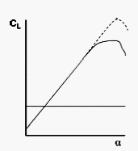
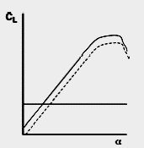
Thin Airfoil Theory

Slide 12
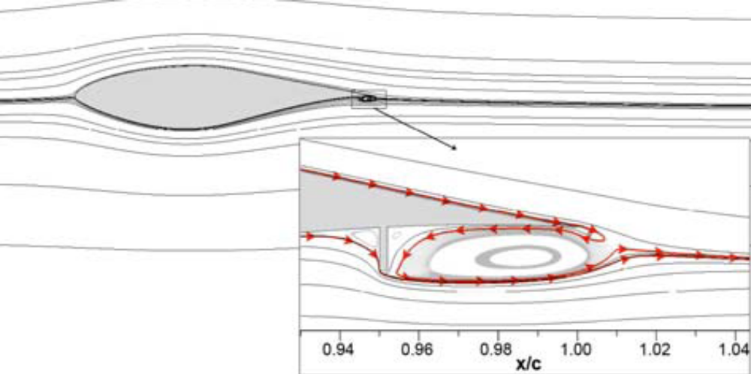
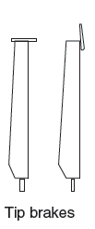
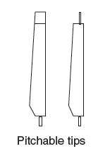

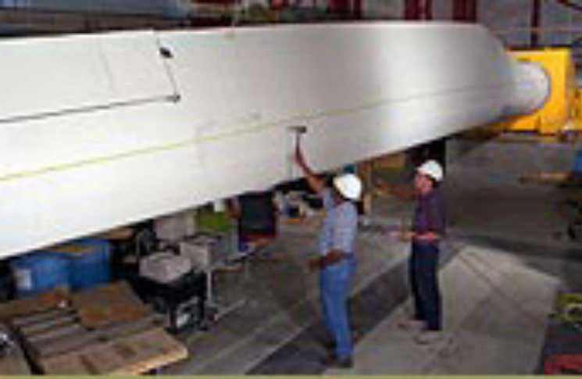
Aerodynamic Drag devices

Slide 13
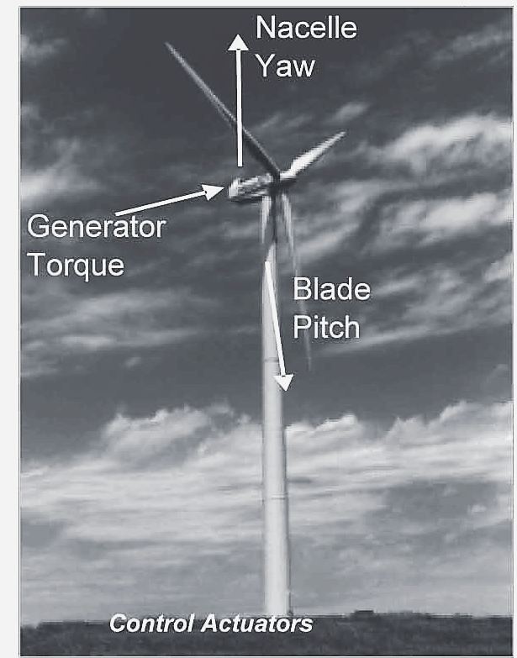
Wind Turbine Control Actuators
The ideal blade is the one which is able to adapt its geometry to suit the local wind conditions.
This is made possible by active and passive technologies which allow individual rotor blades to adjust to the prevailing wind conditions.

Slide 14
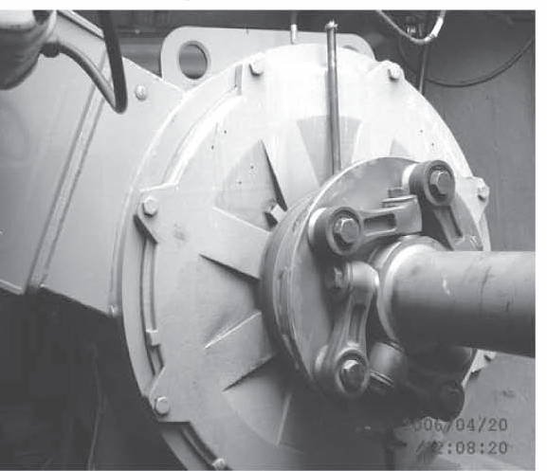
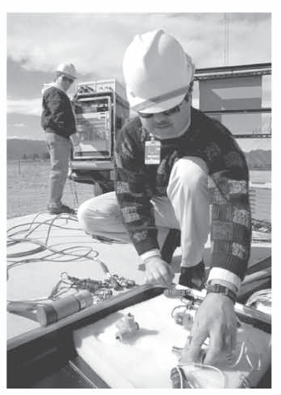
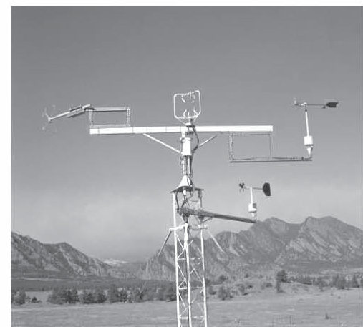
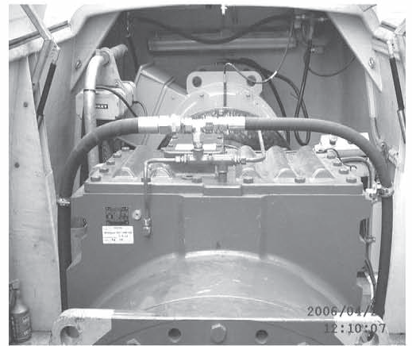
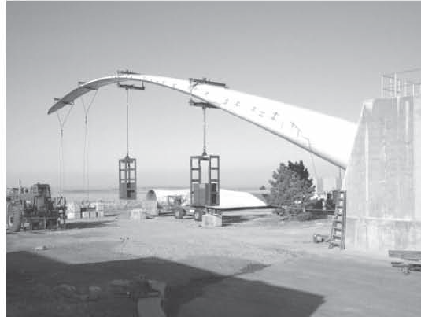
Wind Turbine and Typical Sensors
Speed Sensors
Accelerometers
Anemometers
Electrical Power Sensors
Strain gages

Slide 15
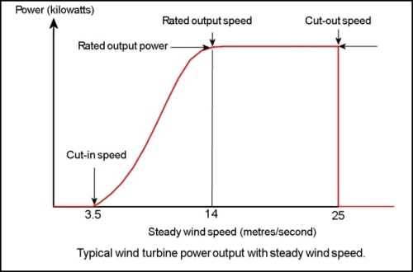
Operational Regime of A WT
Cut-out speed : As the speed increases above the rate output wind speed, the forces on the turbine structure continue to rise and, at some point, there is a risk of damage to the rotor.
A braking system is employed to bring the rotor to a standstill.
This is called the cut-out speed and is usually around 25 metres per second.
Cut-in speed : At very low wind speeds, there is insufficient torque exerted by the wind on the turbine blades to make them rotate.
The speed at which the turbine first starts to rotate and generate power is called the cut-in speed and is typically between 3 and 4 metres per second.

Slide 16
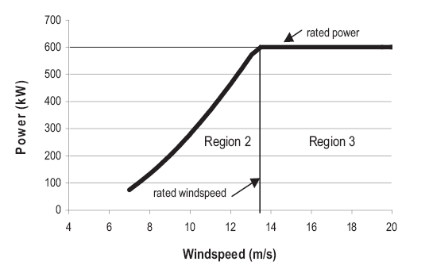
Typical Regions of WT Operation
Region 1
Region 4

Slide 17
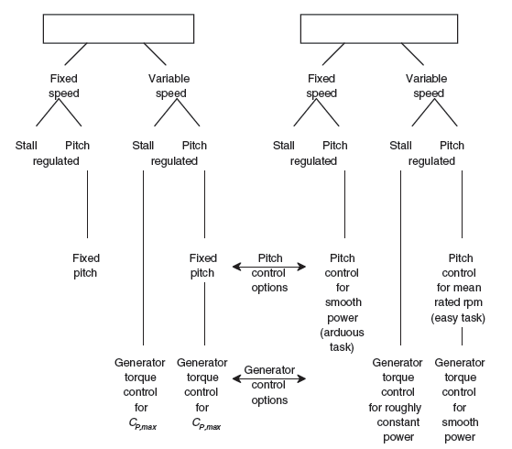


Typical Turbine Aerodynamic Controlling

Slide 18
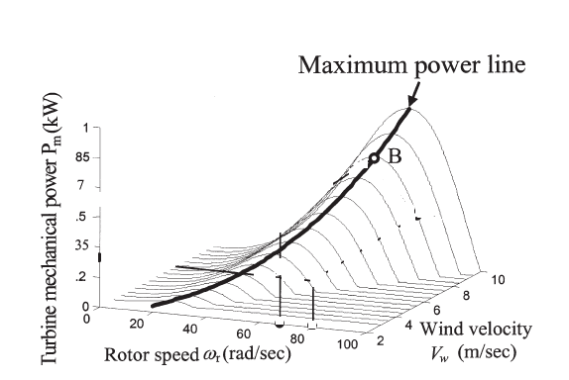
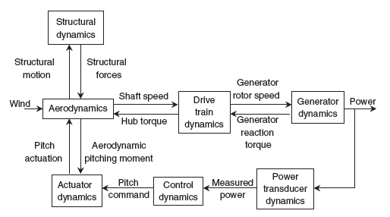
Overall Wind Turbine Dynamic Control

Slide 19
Controlling Strategies to Achieve Region 2
Operate the turbine at constant turbine rotational speed in Region 2 through the use of synchronous or induction generators.
This strategy reduces the power output of the machine.
To maximize power output in Region 2, the rotational speed of the turbine must vary with wind speed to maintain an optimum, relatively constant tip-speed ratio.
Large commercial wind turbines use variable-speed - pitch-regulated machines.
This allows the turbine to operate at near optimum tip-speed ratio over a range of wind speeds and generate maximum feasible power in Region 2.

Slide 20
Controlling Strategies to Achieve Region 3 : Stall
Some turbines achieved control in Region 3 with blades designed so that power was limited passively through aerodynamic stall.
Power output may not be constant, but no pitch mechanism was required for over-power control.
Typically, active control of these machines involves only starting and stopping the turbine.

Slide 21
Controlling Strategies to Achieve Region 3 : Blade Pitch Adjustment
Rotor blades with adjustable pitch have often been used in constant-speed machines to provide better control of turbine power than is possible with blade stall.
Blade pitch can be regulated to provide constant power in Region 3.
The pitch mechanisms in these machines must be fast, to provide good power regulation in the presence of gusts and turbulence.

Slide 22
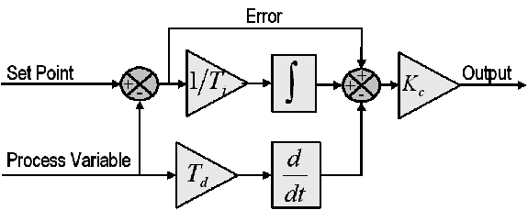
Classical Design of Aerodynamic Controllers
Regions 2 and 3 controls for variable-speed pitch-controlled wind turbines are designed using classical control algorithms.
One popular algorithm is proportional-integral- derivative (PID) control.
PID Theory :

Slide 23
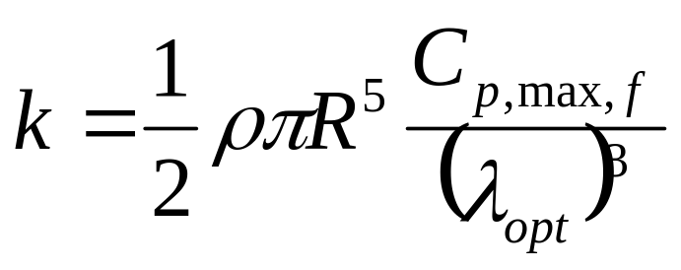
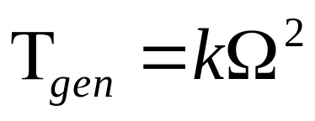
Generator Torque Controller Equation : Region 2
Generator torque is controlled in accordance with square law equation in Region 2
where
Τ_{gen} = generator torque (N-m)
Ω = rotor rotational speed (rad/s)
k = proportionality constant for optimum rotor power (N-m-s²)
ρ = air density (kg/m³)
R = tip radius of rotor (m)
C_{P, max} = Maximum feasible rotor power coefficient
λ_{opt} = optimum of tip-speed ratio corresponding to C_{P, max} at a particular blade pitch angle;

Slide 24
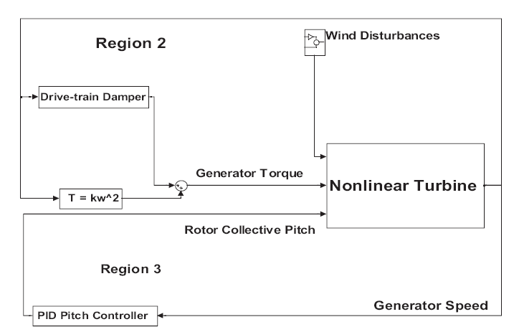
Final Design of Aerodynamic Controllers

Slide 25
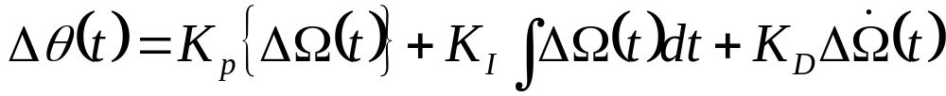
Control equation for Region 3
For Region 3, classical PID control design techniques are typically used to design the blade pitch controller.
Generator or rotor speed is measured and passed to the pitch controller.
The goal is to use PID pitch control to regulate turbine speed in the presence of wind-speed variations.
The expression for the blade pitch command is:
where
Δθ = commanded blade pitch change (rad)
ΔΩ = generator or rotor rotational speed error relative to set-point (rad)
K_{P} = proportional feedback gain (s)
K_{I} = integral feedback gain
K_{D} = derivative feedback gain (s²)

Slide 26
Identification of Dynamic Control Systems
The system identification approach involves four main steps:
1. Planning the experiments.
2. Selecting a model structure.
3. Estimating model parameters.
4. Validating the model.
5. Selection of Suitable Sensors and final development of Controller.

Slide 27
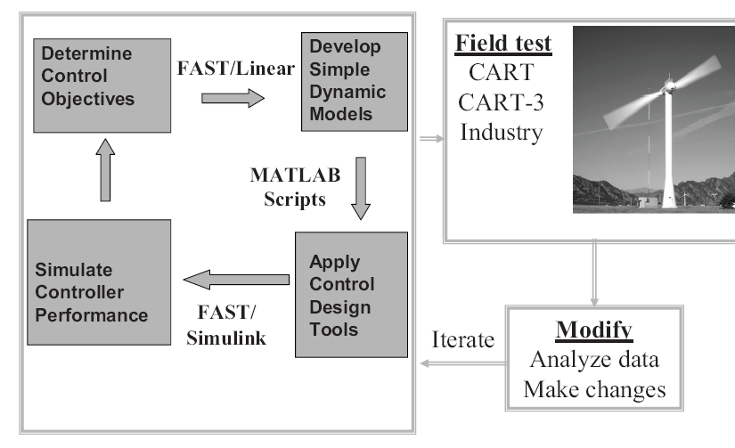
Typical control design, simulation, and field testing process

