Slide 1

Design of Efficient Windfarms
P M V Subbarao
Professor
Mechanical Engineering Department
Efficient Management of Available Space........

Slide 2

Initial Remarks
The world is moving towards the construction of wind farms comprising of many wind turbines instead of single wind turbine.
Modern wind farms consist of tens of wind turbines arranged on the sites for the purpose of maximum utilization of wind energy.
This scale of installation necessitates development of methods to model interactions between individual turbines, the atmosphere, and neighbouring turbines.
A major focus of these efforts is centered on improved quantification of the role of wind turbine spacing on power losses due to wind turbine wakes.

Slide 3
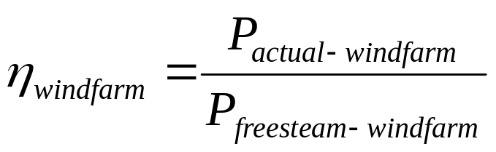
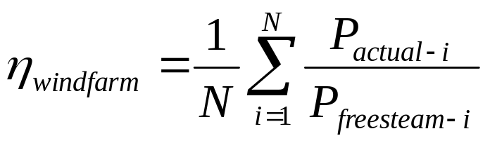
Windfarm Efficiency
The total freestream power is defined as the power output from the wind farm assuming all turbines produced power output without wake effects.
Wind farm efficiency, η, is defined as the sum of measured power at each turbine, P_{actual} divided by the total freestream power, P_{freestream}
The freestream power is adjusted to account for the number of operating turbines.
If all wind turbines are producing the freestream power the efficiency is 100%

Slide 4
Modelling of Wind Farm Efficiency
The backbone of windfarm efficiency model is the wake model.
Wake model has a straightforward parameterization of wake expansion.
Which means that the model predicts the velocity deficit at a given distance is dependent on;
the thrust coefficient,
turbine rotor diameter and
the wake decay coefficient .

Slide 5
The Wake Decay Coefficient
The wake decay coefficient (α) describes the rate of wake expansion.
It is an abstraction of roughness and stability influences on turbulence and hence wake dissipation.
Recommended values for α are 0.075 for land and about 0.04–0.05 for offshore.
The wake decay constant is related to roughness and thereby to average turbulence intensity.
In general no account is taken of varying turbulence or atmospheric stability.

Slide 6
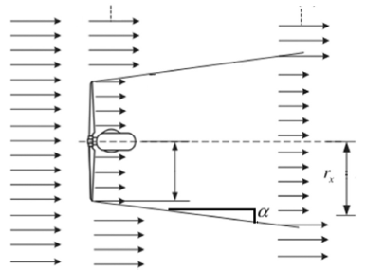
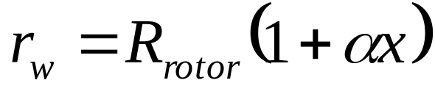
Jensen Cone Model for Wake of A HAWT
As mentioned before Jensen Model assumes that the wake downstream expands linearly.
Thus, the path tracing by the wind downstream follows the conical shape of disturbance.
The radius of the cone can be estimated by using the following equation:
V∞
V∞
V∞
A_{wake}
A_{rotor}
u₁
U_{wake}
R_{r}
The dimensionless scalar α, known as decay constant.

Slide 7
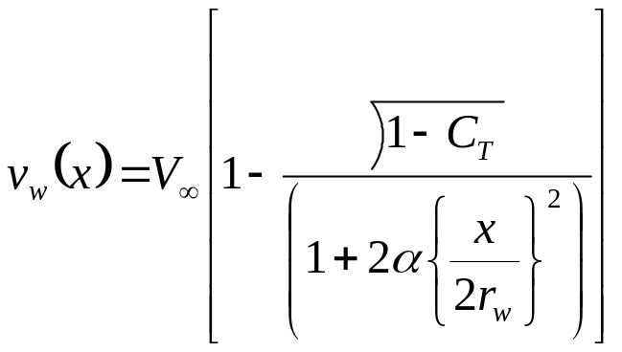
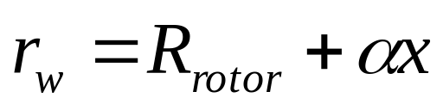
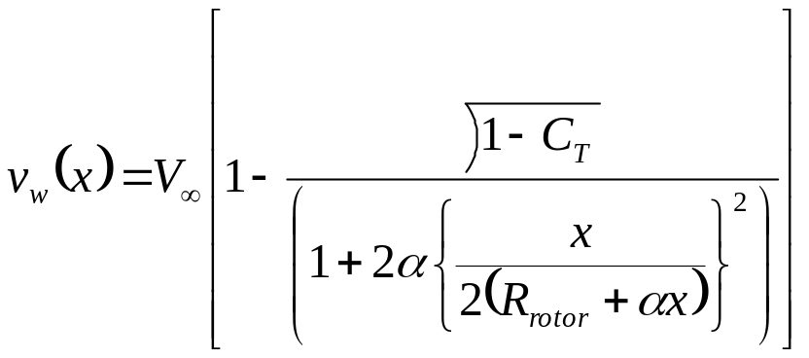
Velocity Distribution in Farwake
The wind velocity inside the single turbine wake area, given by Jensen’s single wake model.
However, the velocity function is not accurate in the near wake regime.
The wake radius r_{w} and velocity v_{w} both depend on the relative distance x behind the near wake.

Slide 8
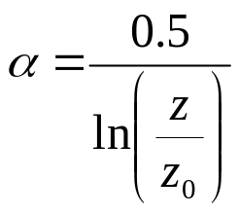
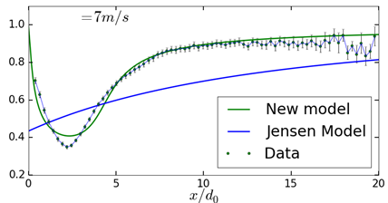
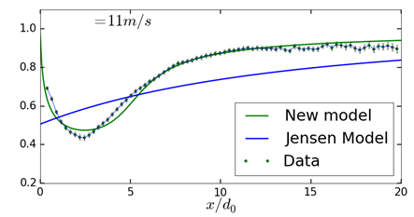

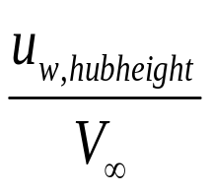
Variable Decay Coefficient Model
Scalar α determines how quickly the wake expands with distance and it is defined as:
where z is the hub height of the turbine generating the wake.
z₀ is a measure of surface roughness, which depends on the terrain characteristics.

Slide 9
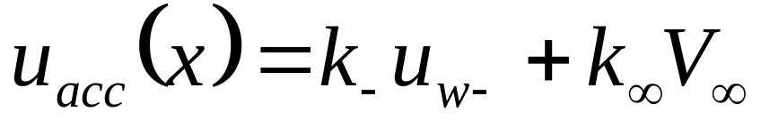
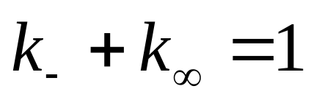
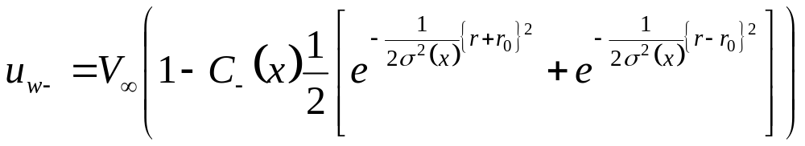
Comparative Study of Jensen Model Vs Accurate Analytical Model
The Jensen Model:
The Accurate Analytical Model:
The constants k₋, and k∞, will vary with C_{T}

Slide 10
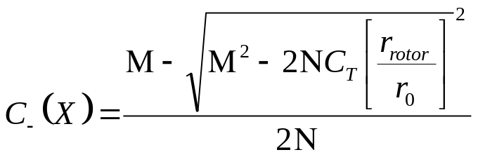
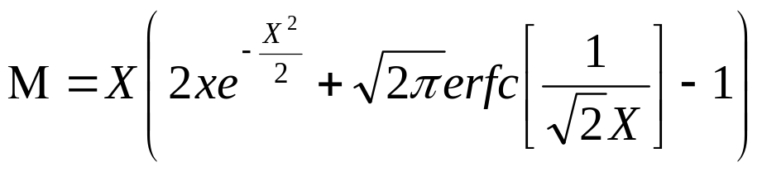
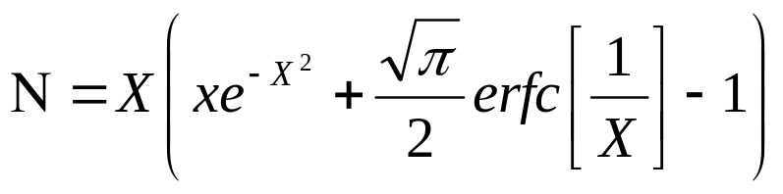
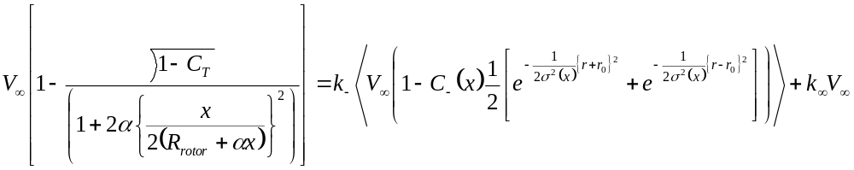
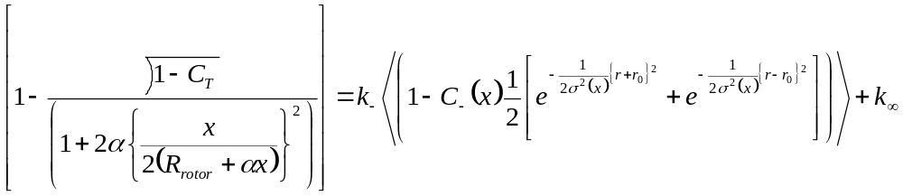
Estimation of Accurate Decay Constant

Slide 11
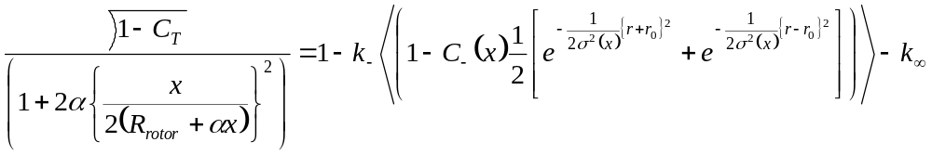
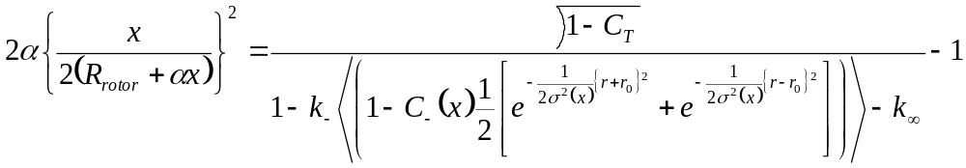
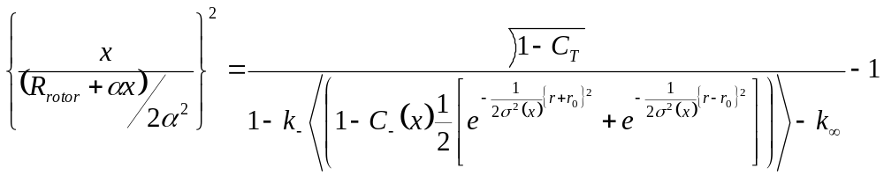
Estimation of Accurate Decay Constant

Slide 12
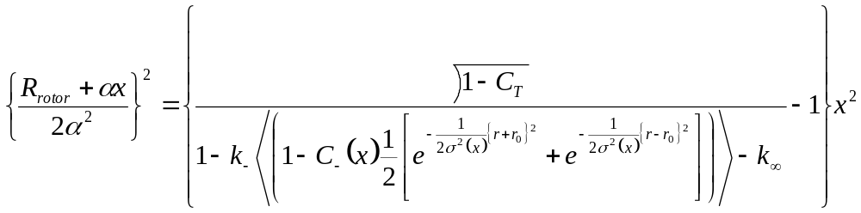
Estimation of Accurate Decay Constant

Slide 13
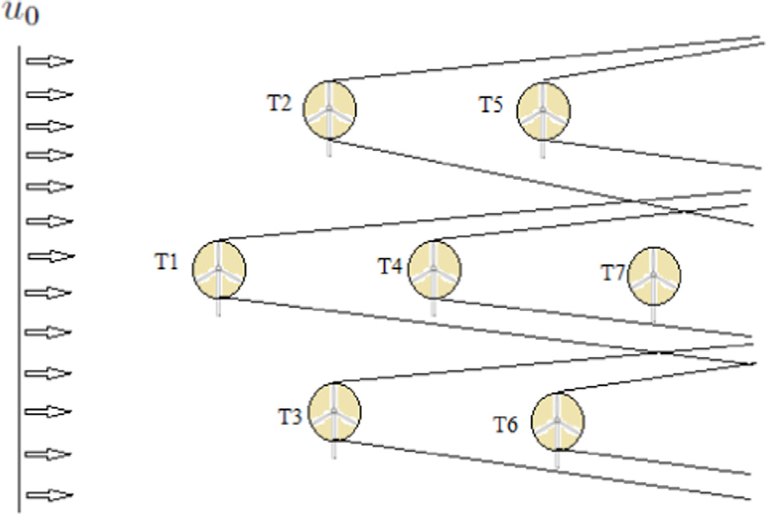
Jensen's Multiple Wake Model
The wake effect becomes more severe when the number of wind turbines in a wind farm are high.
One target turbine may be affected by the wakes of more than one turbine.
This situation is called multiple wake effect.

Slide 14
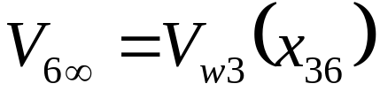
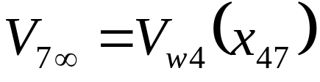
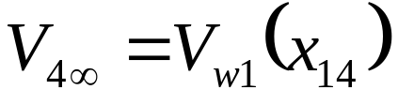
Jensen's Multiple Wake Model : Nomenclature
The wind turbines T₁, T₂, T₃ are facing free-stream velocity.
The wind turbines T₄, T₅, T₆ are operating in a single wake effect.
The wind turbine T₇ is operating in multiple wake effect because it faces the wake from two upstream turbines T₁ and T₄.

Slide 15
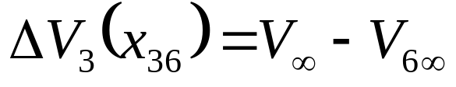
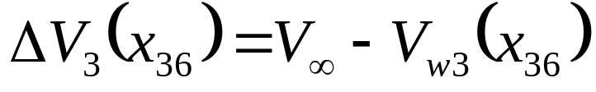
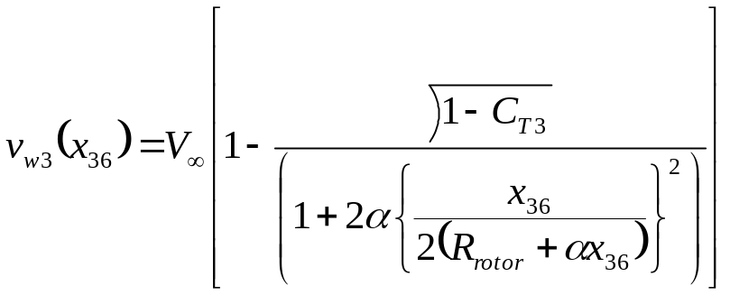
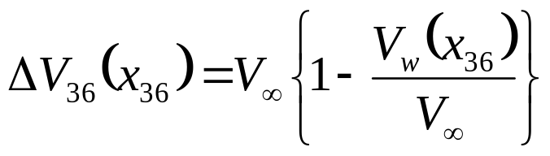
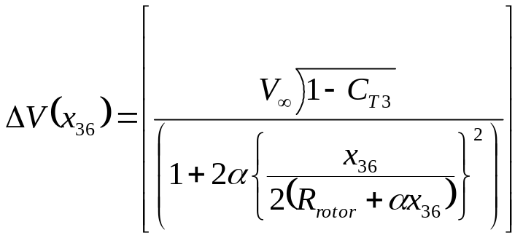
Wake Interactions : Level 1

Slide 16
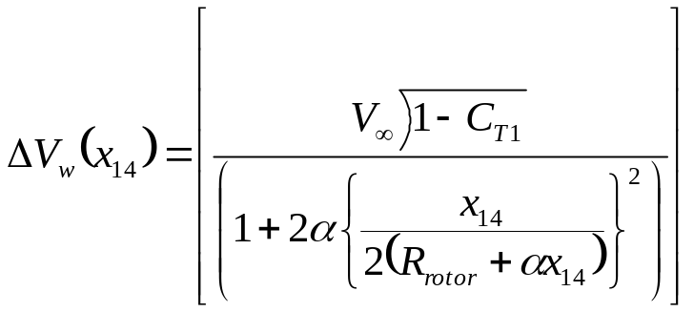

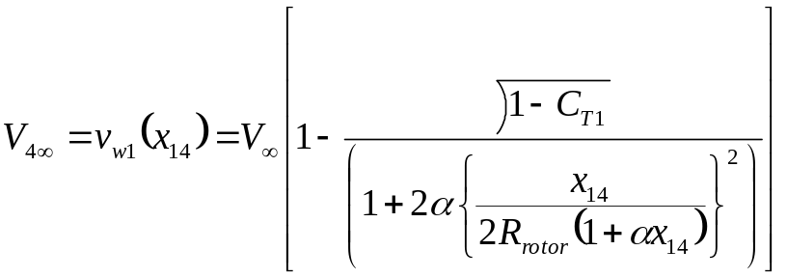
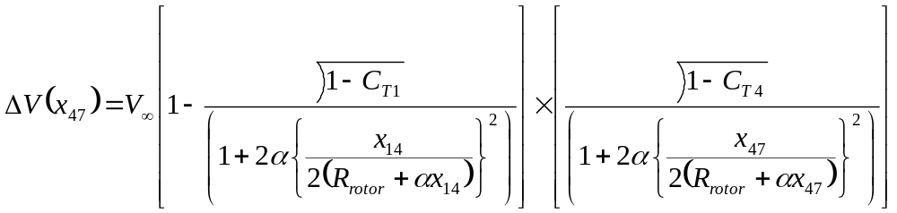
Wake Interactions : Level 2

Slide 17
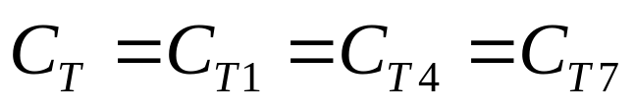
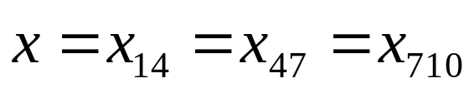
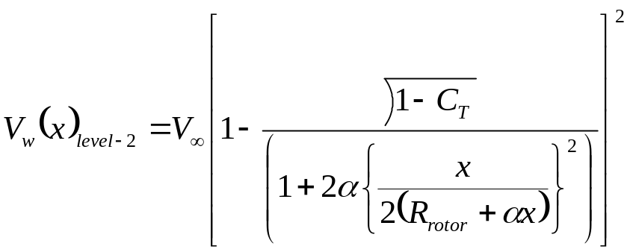

Interaction Among Homogeneous Turbines
Let all turbines have same characteristics in Level 2
Let all turbines have same characteristics in Level n

Slide 18
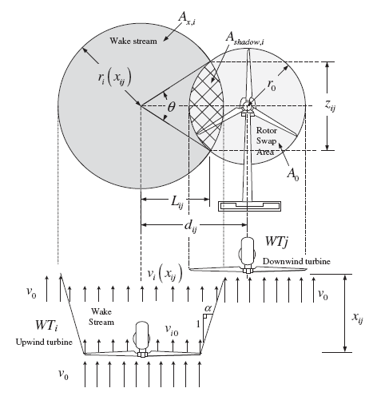
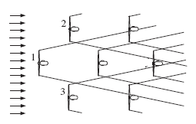
Partial Wake Shadow in A Wind Farm
i
j

Slide 19
Modelling of Shadowing Effect
In order to obtain a usable result for wind farms with many turbines, the effects of the multiple single wakes must be combined into a single effect.
A detailed model of wake effects considers the shadowed areas of the upstream wind turbines.
This shadowing is a measure of the degree of overlap between the area spanned by the wakes shadow cone (A_{shadow},_{ji}) and the area swept by the turbine experiencing shadowing (A_{0,j}).
A purely empirical mean is usually used to model the interaction between these multiple wakes.

Slide 20

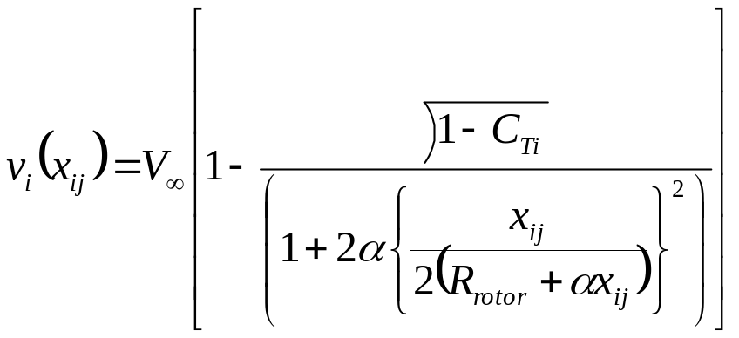
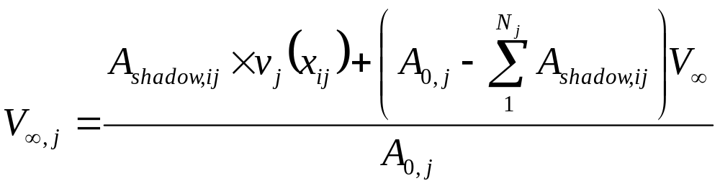
Model for Shadowed WT Wakes

Slide 21
Classification of Shadowing Possibilities
There are four distinct shadowing possibilities, namely:
Complete shadowing
Quasi-complete shadowing
Partial shadowing and
No shadowing.

Slide 22
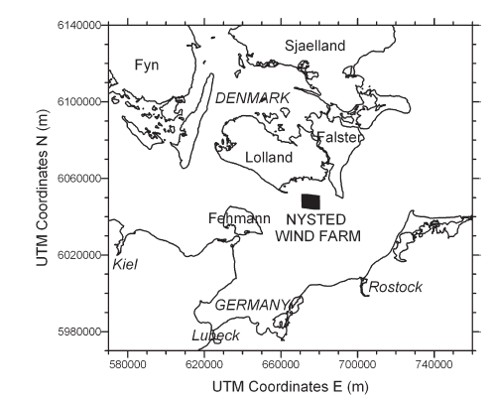
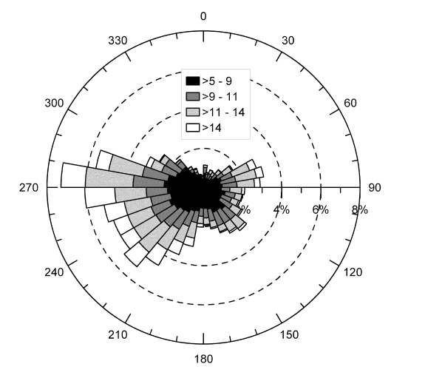
Case Study : Nysted Wind Farm
Nysted wind farm is located at south of the Danish island of Lolland and to the southwest of Falster.

Slide 23
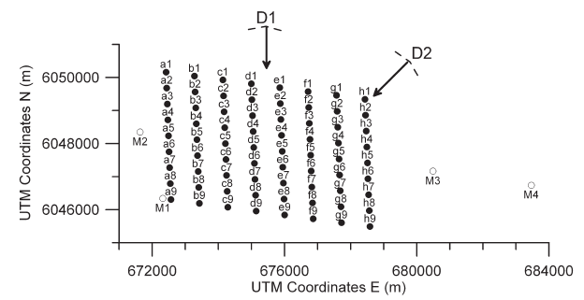
Layout of Nysted Wind Farm : 165.6 MW
a1, a2 . . . h8, h9 : Wind Turbines
M1–M4 : The meteorological masts
D1 and D2 are directions used to define freestream.

Slide 24
Layout of Nysted Wind Farm : 165.6 MW
There are 72 turbines laid out in nine rows west to east with spacing of about 10.5 rotor diameters (D).
An inter-turbine distance of 857 m and eight columns north to south with a spacing of 5.8 D (481 m).
The turbines are Bonus 2.3 MW with a hub-height of 68.8 m and a rotor diameter of 82.4 m.
It is worth noting that the turbine is stall-regulated with a two-speed.
After wind farm construction, four additional 70 m masts were erected.

Slide 25
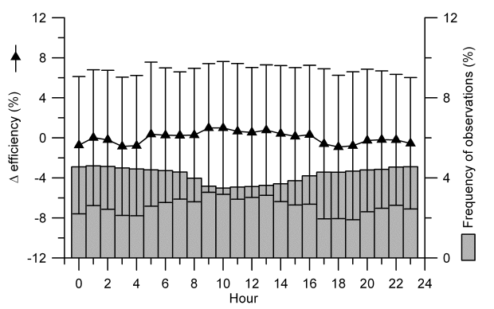
Hourly Variation of Difference in windfarm Efficiency

Slide 26
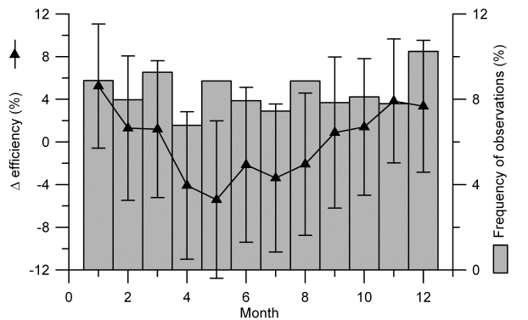
Montly Variation of Difference in wind farm efficiency

Slide 27
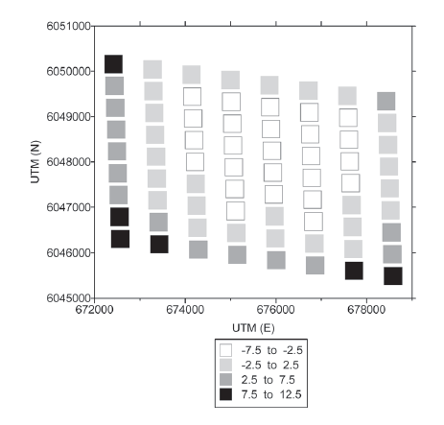
Average difference in turbine efficiency (%) from the array average

Slide 28
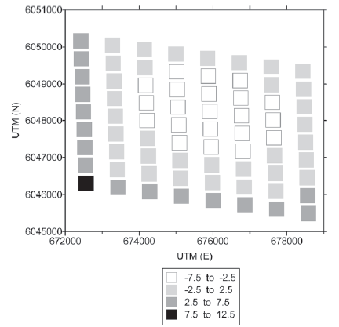
Predictions using the
WAsP model α = 0.03
Wind Energ. 2010; 13:573–586

Slide 29
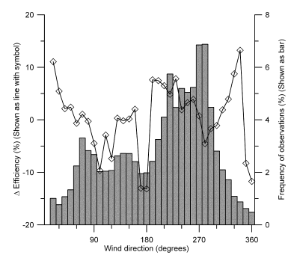
Change in wind farm efficiency by freestream wind direction

Slide 30

Effect ambient turbulence on Difference in wind farm efficiency

