Slide 1

Development of Accurate Analytical Model for Wind Turbine Wakefields
P M V Subbarao
Professor
Mechanical Engineering Department
The Most Eligible Ansaz for Wake Velocity Profile……

Slide 2

Full Analytical Model of A WT Wake
An accurate analytical model for wind turbine Wakefield is essential for development of Optimal Wind farms.
It is highly acceptable to model the transverse velocity deficit profile using a by a single-Gaussian function for the mid- and far- wakes.
However, it is tough to develop a suitable model for velocity deficit profile in nearwake.
This leads to a search for Ansatz.

Slide 3
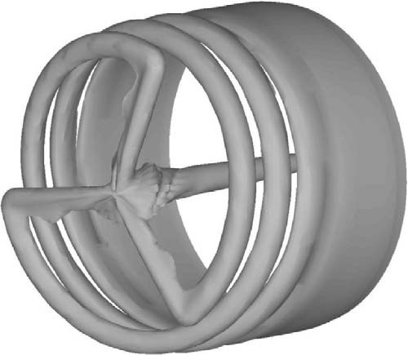
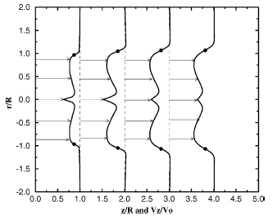
Quantitaive Study of Nearwake : A search for Ansatz
Evolution of Vorticity in wake.
Distribution of axial velocity

Slide 4
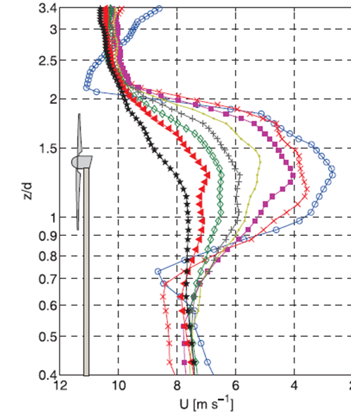
Computational Study of Mid & far wakes : A search for Ansatz

Slide 5
Description of Velocity Deficit : Nearwake to Farwake
In the near-wake the profile resembles a double-Gaussian function, with local minima at about 75% blade span.
It is reasonable to consider a double-Gaussian function as a candidate for the transverse velocity deficit profile.
However, this must evolve into a Single Gaussian Profile in farwake.
This happens due to subsequent, appropriate mixing of a wake velocity deficit solution and the freestream velocity.
This can be obtained by using conservation of momentum on downstream of rotor.

Slide 6
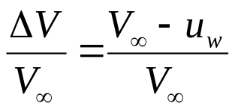
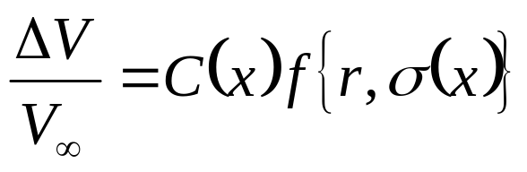
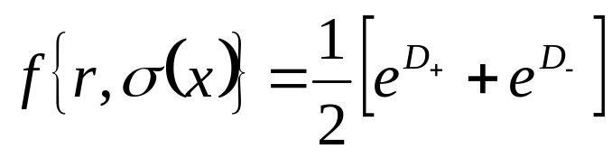
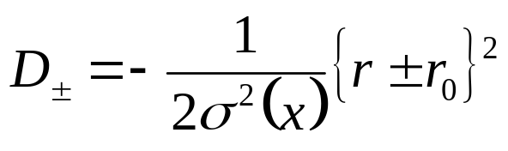
Double Gaussian Model for Wake Velocity Deficit
Define velocity deficit:
The velocity deficit is taken to be of the form
where C(x) is an arbitrary function of downwind distance x
The double-Gaussian profile : f.
where r₀ is the radius corresponding to the locii of the Gaussian minima and σ(x) is a cross-section function.

Slide 7
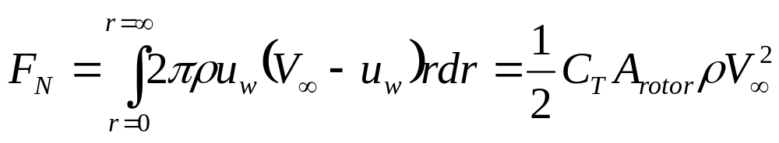
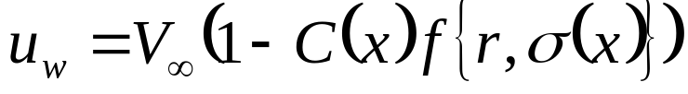
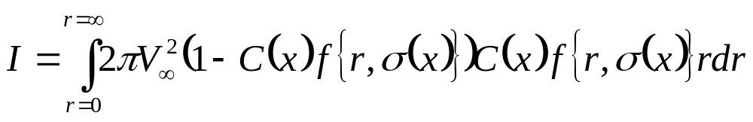
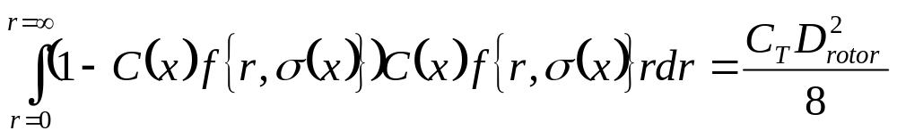
Conservation of Momentum
The equation of mean momentum flux through the rotor disk plane
An Inverse Problem !!!

Slide 8
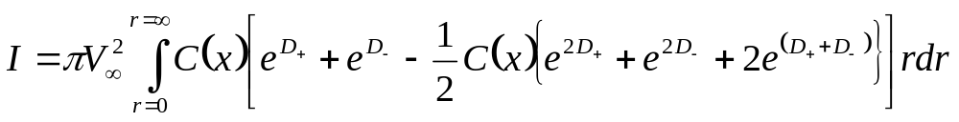
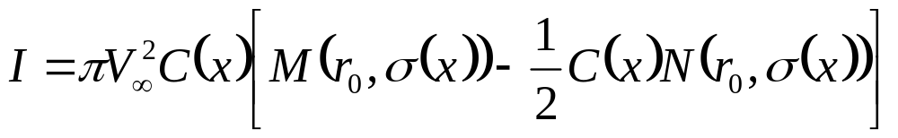
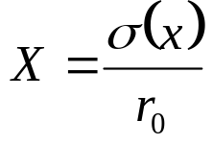
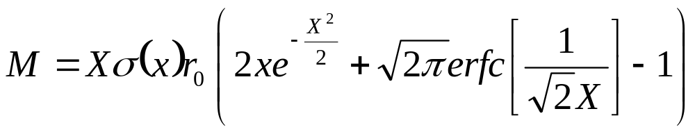
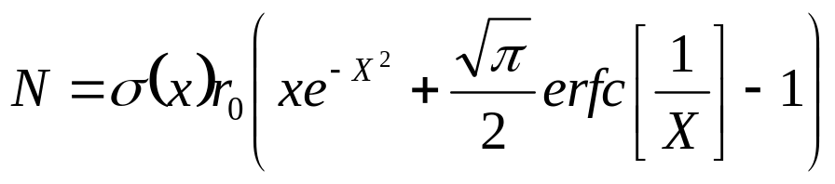
The Inverse Solution Method
Upon integration this becomes

Slide 9
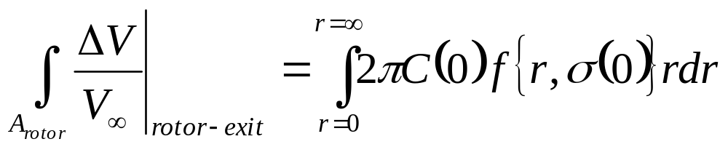
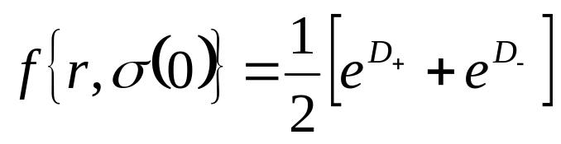
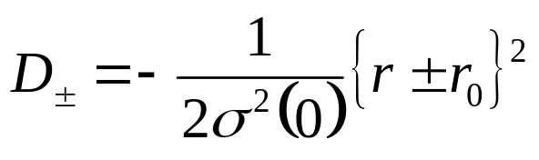
Initial Conditions
1-a Betz Theory.

Slide 10
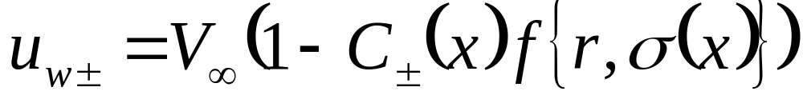
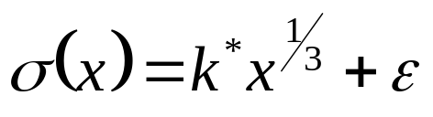
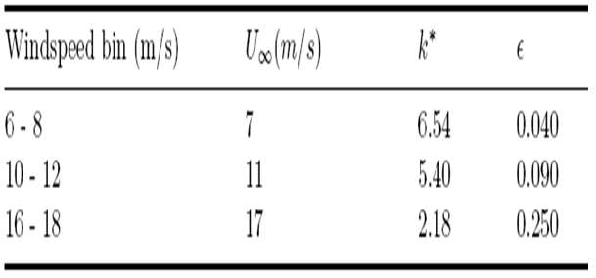
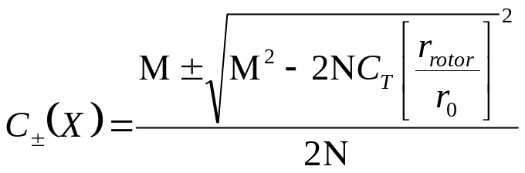
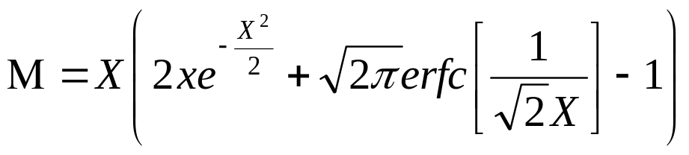
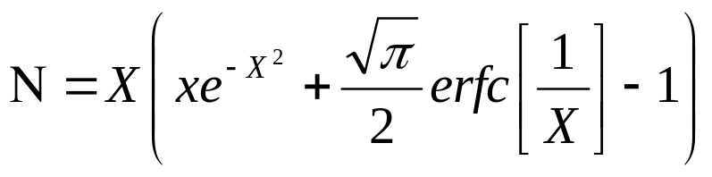
The Fullwake Velocity Solutions
σ(x) is known as cross-section function.
k*and ϵ are constants
Define new dimensionless variable

Slide 11
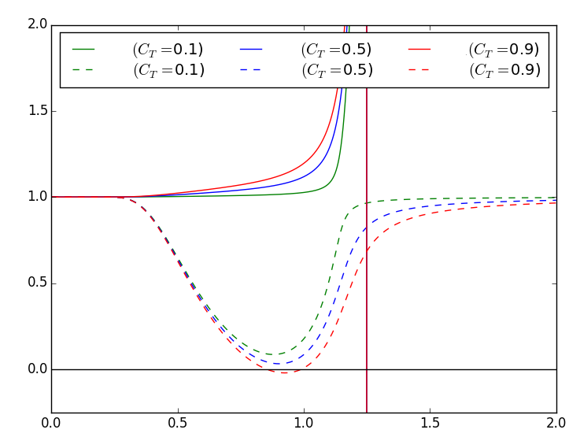


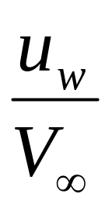

The Computed Wake Velocity Deficit Profile

Slide 12

Is it Physically Feasible !!!
The u_{w+} solutions are unphysical.

Slide 13
Physically Feasible Part of Solution
The u_{w-} solutions show a clear local minimum for all non-zero values of C_{T} .
The u_{w-} solutions have the desired topological features.
But the values of wake velocity at the local minima of the u_{w-} solutions are far lower than those obtained from experimental measurements.

Slide 14

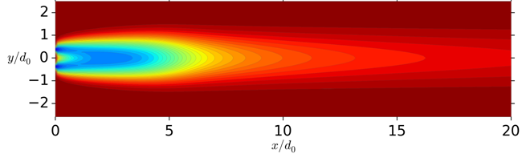
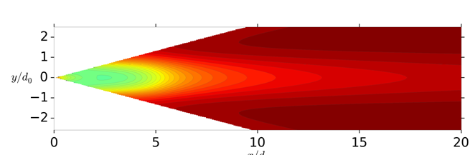
The Truth Vs Reality
Present solution (u_{w-}):
Field Measurement (LiDAR) :

Slide 15
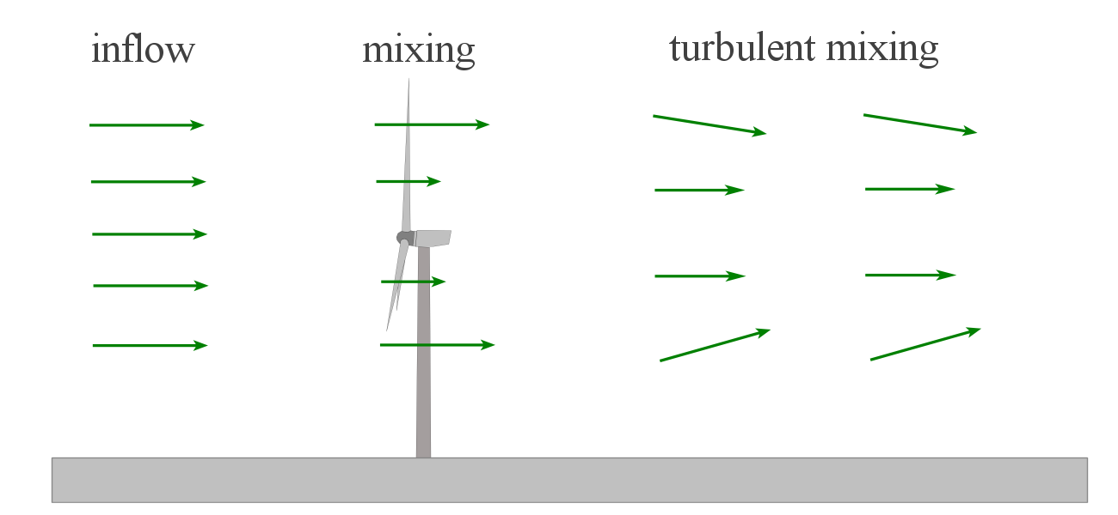
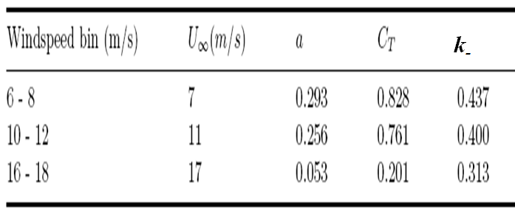
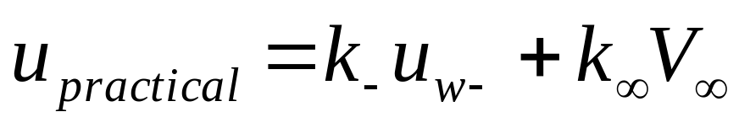
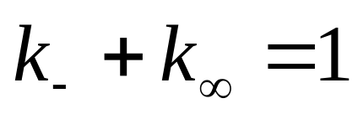
The Reconciliation !!!
The key to reconciling the theory with the true measured wake velocity profiles is to consider a linear combination of solutions (mixing).
The final real solution is:
The constants k₋, and k∞, will vary with C_{T}

Slide 16
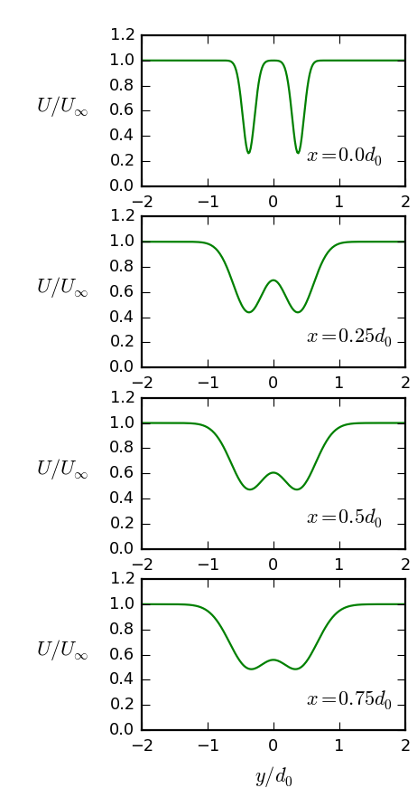
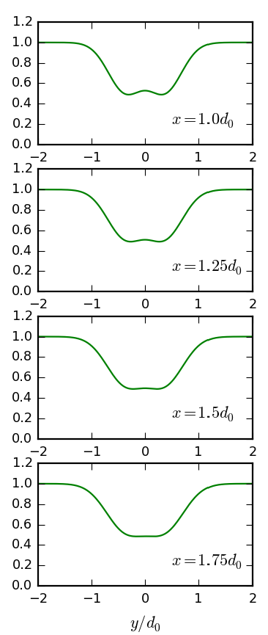
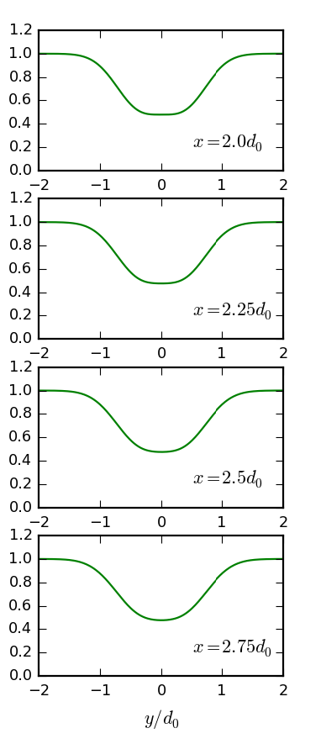
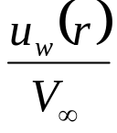
Velocity Profile Predicted by FullWake

Slide 17
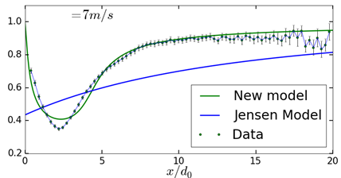

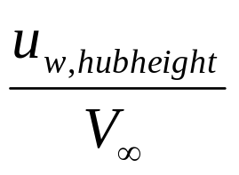
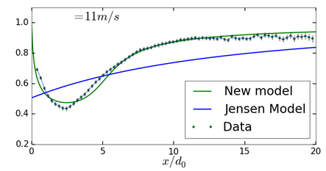
Performance of Full Wake Analytical Model

Slide 18
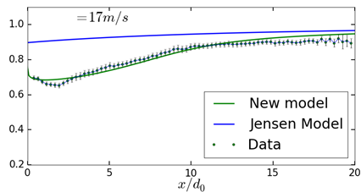
Performance of Full Wake Analytical Model

Slide 19
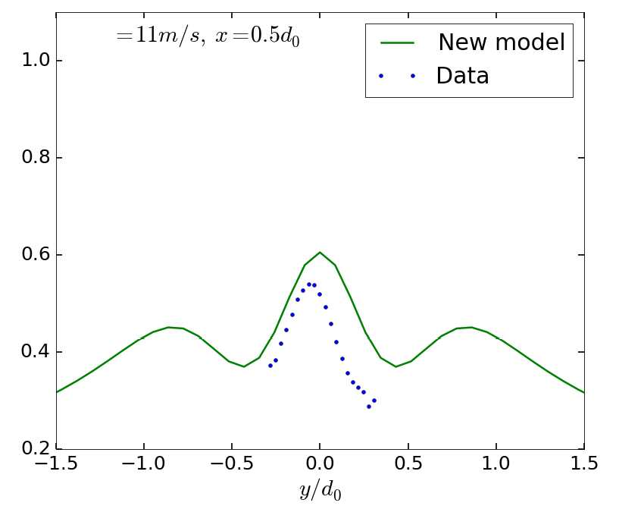

Validation of Model with LiDAR Measurements

Slide 20
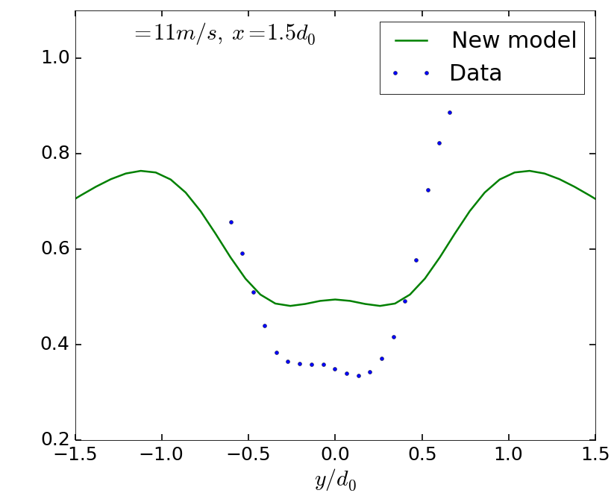
Validation of Model with LiDAR Measurements

Slide 21
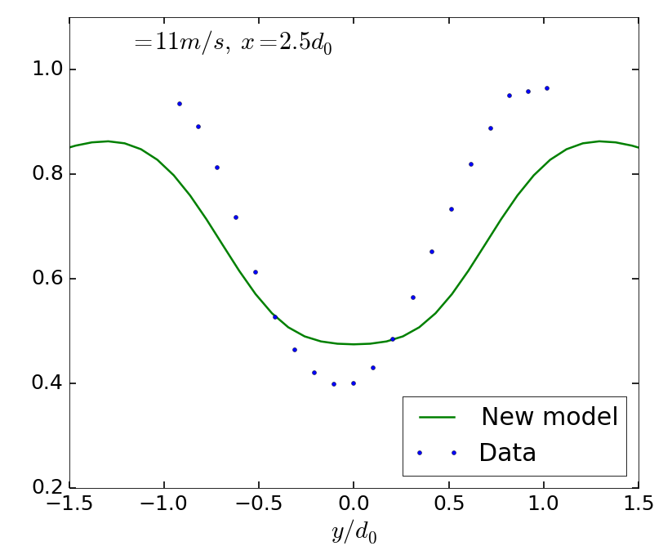
Validation of Model with LiDAR Measurements

Slide 22
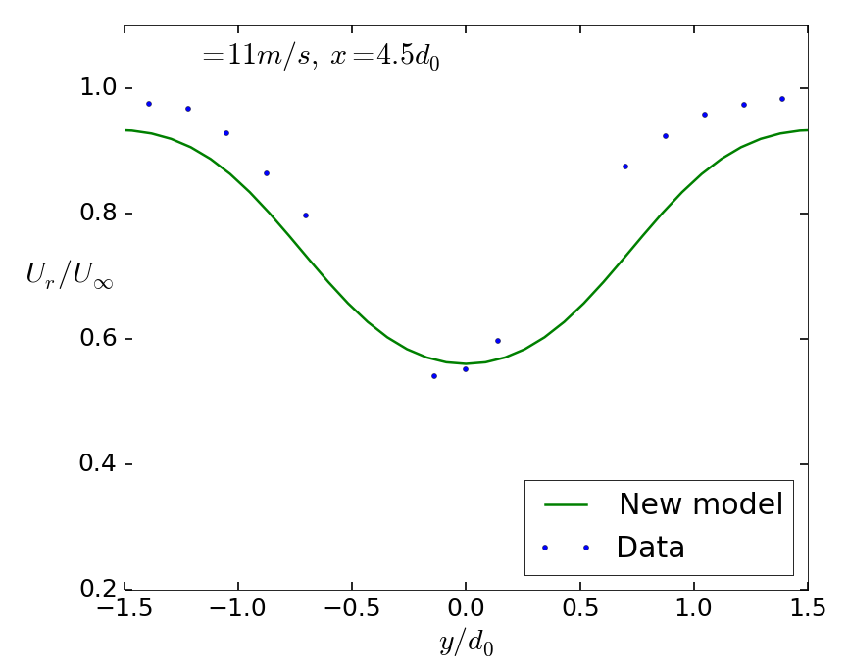
Validation of Model with LiDAR Measurements

Slide 23
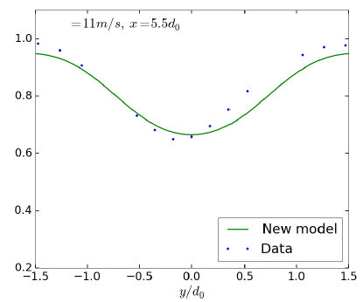
Validation of Model with LiDAR Measurements

Slide 24
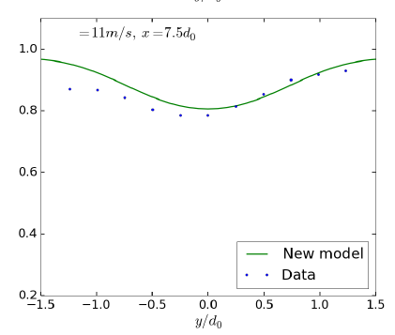
Validation of Model with LiDAR Measurements

Slide 25
This Model will help in accurate windfarm modelling, with the possibility of incorporating multiple wind turbine wakes
Jensen Kinematic Model can be Replaced with this Model

