Slide 1

Wind Farm Aerodynamics
P M V Subbarao
Professor
Mechanical Engineering Department
Comprehensive Diagnosis of WT Wakes........
Helps in Developing An Ansaz for Wake Velocity Profile……

Slide 2

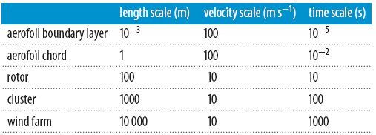
Wind Farm Aerodynamics
A wind turbine rotor interacts and transacts energy with turbulent wind flows.
A wind turbine located in the front row of a wind farm is subjected to atmospheric turbulent inflow conditions.
The wake of first WT will subsequently hit the following turbines.
Windfarm aerodynamics involves deamands various Scales

Slide 3
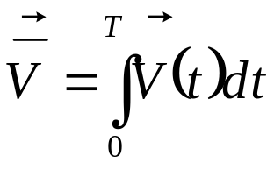
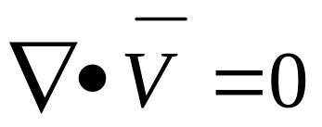

Wind Farm Aerodynamics : The Actuator Line (AL) Technique
The flow field in immediate near wake is approximated by solving the filtered three-dimensional incompressible Navier–Stokes equations.
Define filtered velocity as:
Continuity equation
Navier–Stokes equations
Two body forces (f_{WT} and f_{turb}) are explicitly introduced in the simulations to model the effect of the wind turbine and atmospheric turbulence.

Slide 4
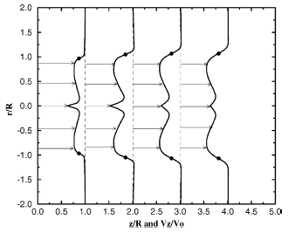
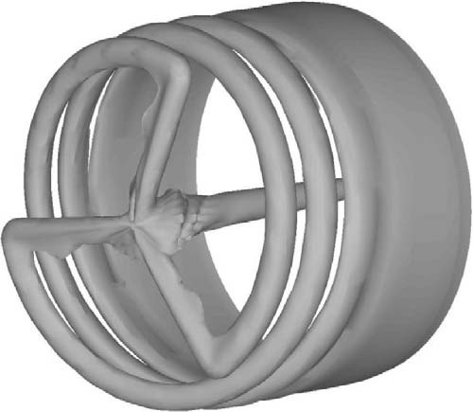
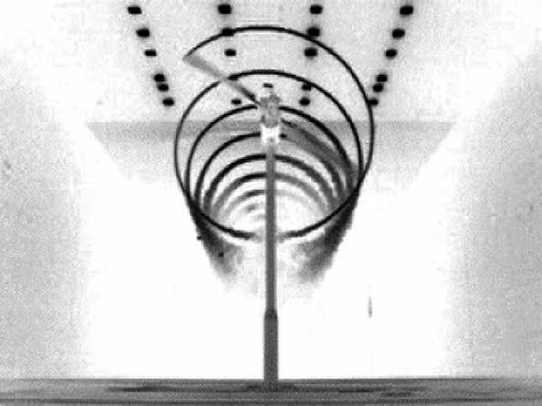
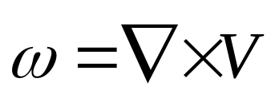
Computational Analysis of Nearwake
SMOKE STUDIES
Distribution of axial velocity
Evolution of Vorticity in wake.

Slide 5
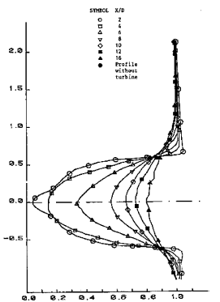
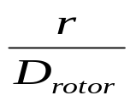
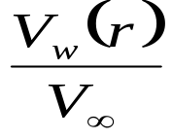
Computational Study of Mid & Far Wakes

Slide 6
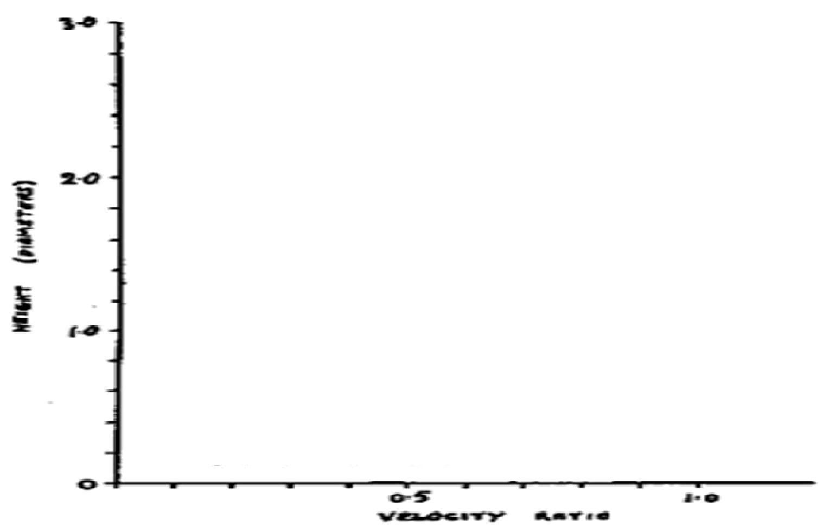
Computational Analysis : Comparative Study of Different WT Wakefields
C_{T}=0.85
C_{T}=0.9
x=8D
x=6D
x=2D

Slide 7
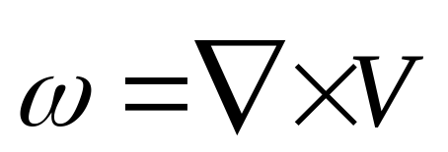
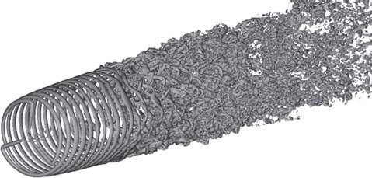
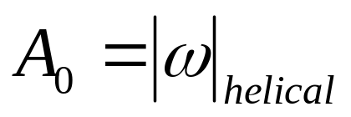
Vorticity Generation & Evolution in the Wake of A WT
A WT introduces helical tip vortices into the wake.
The amplitude of Vorticity introduced by rotor is identified as A₀

Slide 8
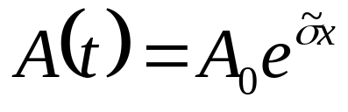

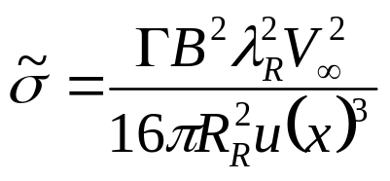
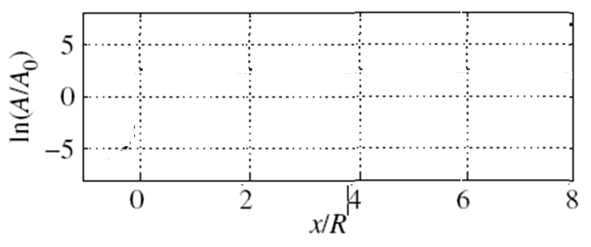
Evolution of Tip Vortices & Instability
Evolution analysis shows that the amplitude of helical vortices increases in the streamwise direction.
is the dimensional growth rate of an instability
λ_{R}

Slide 9
Instability of Wake
A growing vorticity is a measure of infection in laminar wake.
A growing infection leads to instability, transition and turbulence.
Stability Analysis shows that helical tip vortices are inherently unstable and that they will break down at some distance behind the wind turbine.
The breakdown position of tip vortices is assumed to take place where simple logarithmic amplification reaches its maximum.
λ_{R}

Slide 10
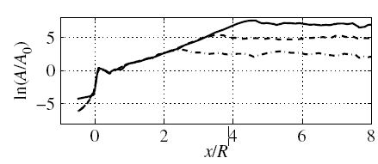
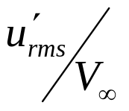
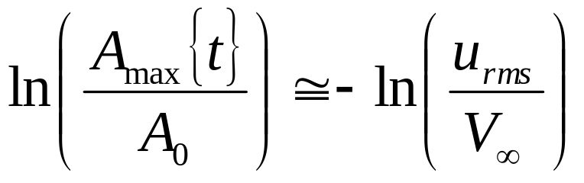
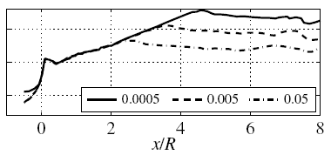
Evolution of Turbulence Level

Slide 11
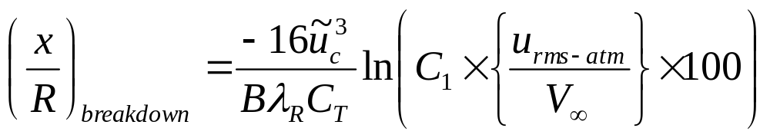
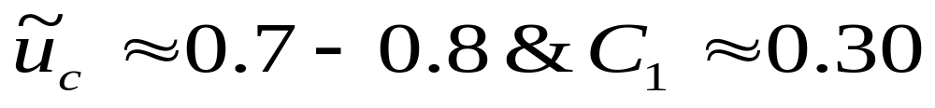
Breakdown Position
The breakdown position of tip vortices is assumed to take place where simple logarithmic amplification reaches its maximum.
The constants
This expression gives a measure of the position where the helical tip vortices break down.
This position is a function of the intensity of the ambient turbulence level and of parameters depending uniquely on the turbine’s operational characteristics.

Slide 12
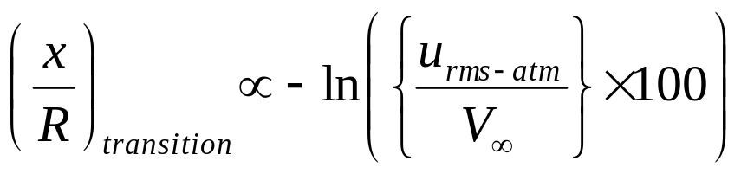
Onset of Decay of Velocity Deficit
The velocity deficit remains unchanged till the breakdown position.
There exist a Transition Zone of the wake after breakdown position.
This zone is defined as the distance from the breakdown of the vortices to where a fully developed Gaussian velocity profile is attained.
It is observed that length of Transition Zone depends on the incoming turbulence intensity.

Slide 13
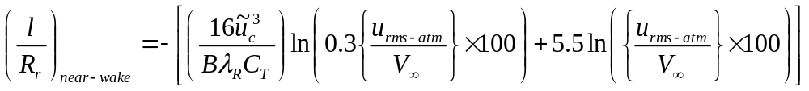
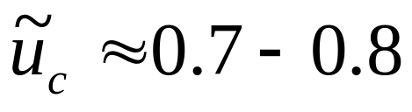
Length of near wake
The near-wake length consists of the sum of the distance to the breakdown point and the distance from this point to where a Gaussian wake deficit is first observed.
The constant
u _{rms} is a measure of local atmospheric turbulence

Slide 14
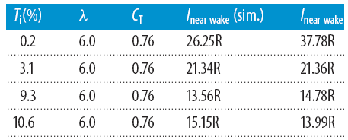
Comparison of simulated wake lengths and predicted wake lengths

Slide 15
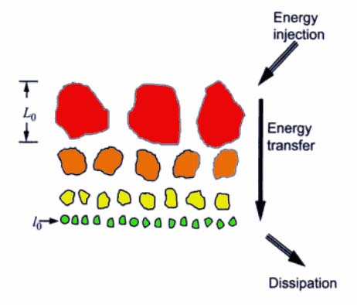
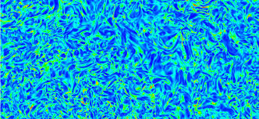
The Fluid Dynamic Structure of Farwake
The far wake flow contains three-dimensional isotropic turbulence.
This state of turbulent flow is called as Equilibrium turbulent flow.
The intensity of turbulence decays with distance in farwake.

Slide 16
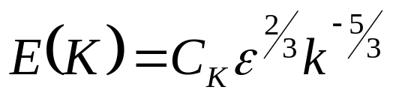
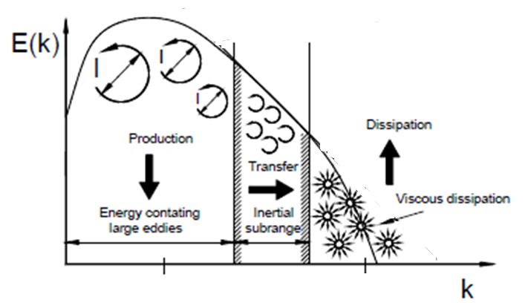
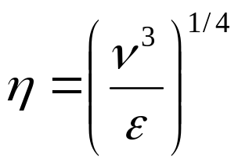
Structure of Equilibrium Turbulent Flows

Slide 17
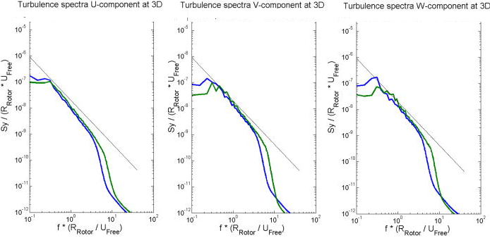
Isotropic Nature of Equilibrium Turbulence

Slide 18
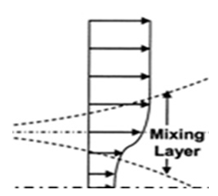

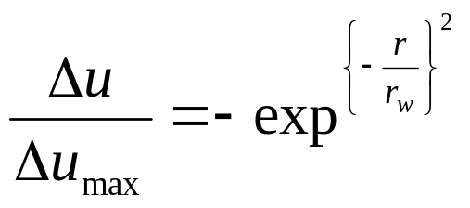
Onset of Farwake : Mean Velocity Profile
In the far wake, the azimuthally averaged axial velocity deficit, Δu, is expected to follow a self-similar Gaussian shape.
where u_{max}(x) denotes the maximum deficit at a given axial position.
r_{e}, the distance at which u=u_{max}/e, where e denotes the Euler number.

Slide 19
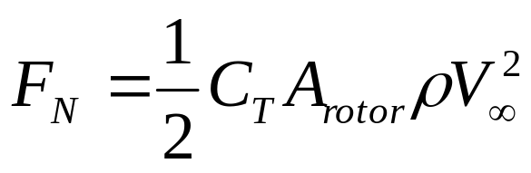
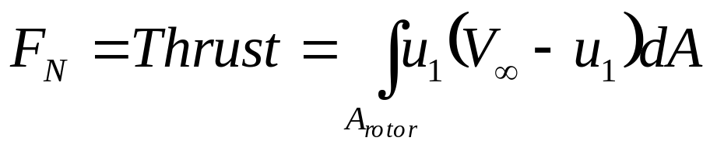
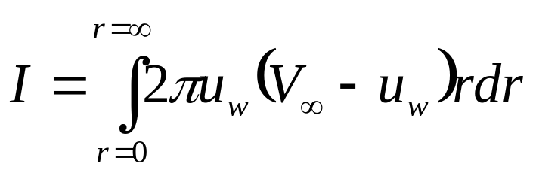
Conservation of Momentum in Wake
The equation of mean momentum flux through the rotor disk plane
The value of integral is valid at any location in the wake.
The continuous interaction between wake and freestream will also obey this condition.
Define
Derivation of an expression for Velocity Deficit Profile is an Inverse Problem !!!
An assumption about the form of an unknown function which is made in order to facilitate solution of a definite Integral.
We need to invent an Ansatz.
There can be multiple Ansatz for this integral.

Slide 20
Full Analytical Model of A WT Wake
An accurate analytical wind turbine wake model to predict the wind velocity distribution for all distances downwind of a wind turbine is more useful for development of Optimal Wind farms.
It is highly acceptable to model the transverse velocity deficit profile using a by a single-Gaussian function for the mid- and far- wakes.
What is a suitable model for the transverse velocity deficit profile in nearwake including immediate rotor downstream.
A search for Ansatz.

Slide 21
Quantitaive Study of Nearwake : A search for Ansatz
Evolution of Vorticity in wake.
Distribution of axial velocity

Slide 22
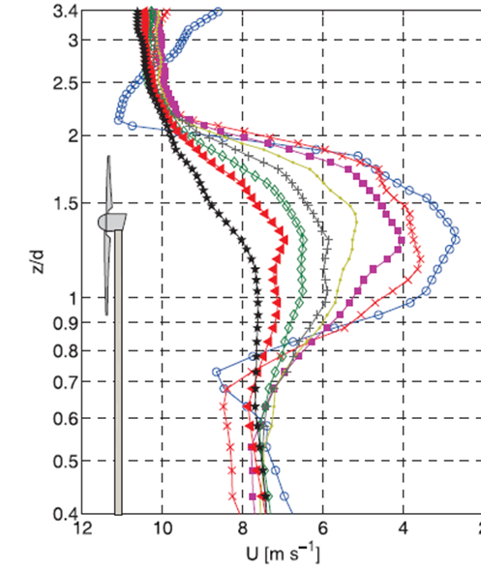
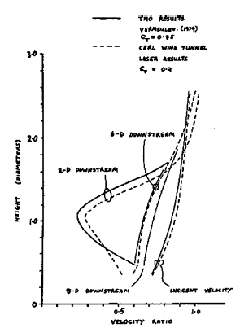
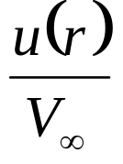
Computational Study of Mid & far wakes : A search for Ansatz

