Slide 1

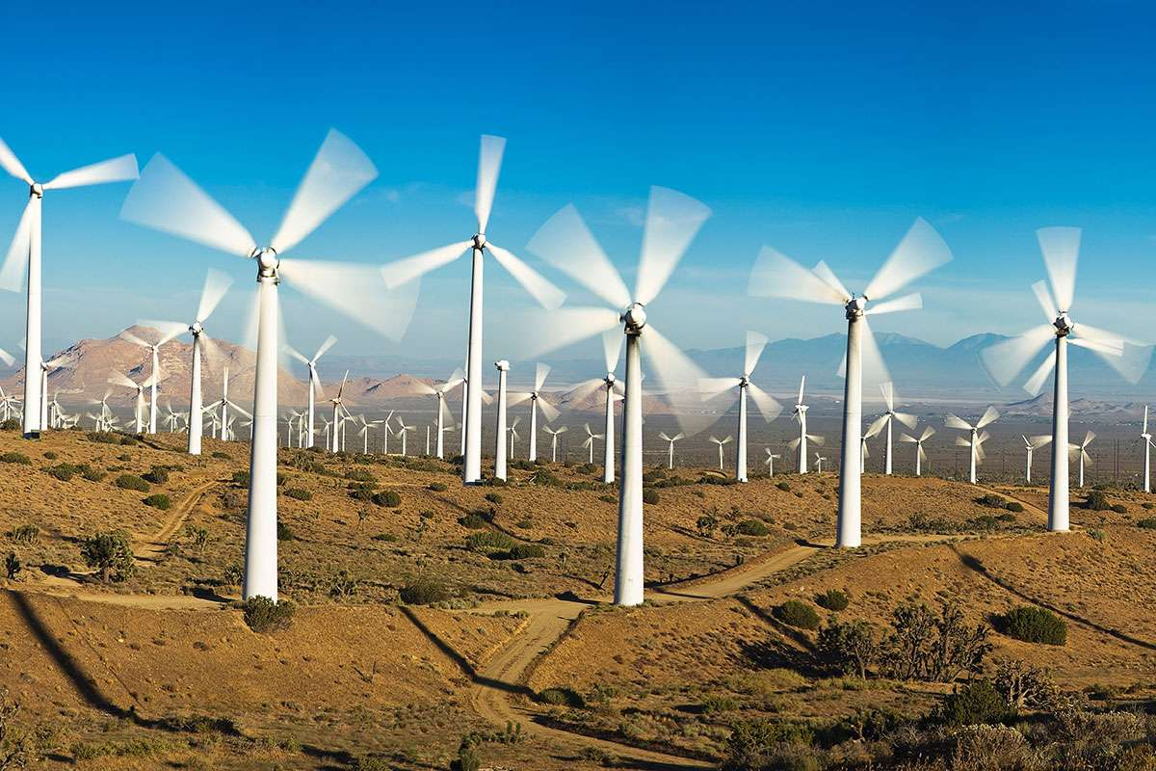
Jenson Model for Design of Windfarms
P M V Subbarao
Professor
Mechanical Engineering Department
Simplified Method for Selection of Spacing among WTs........

Slide 2

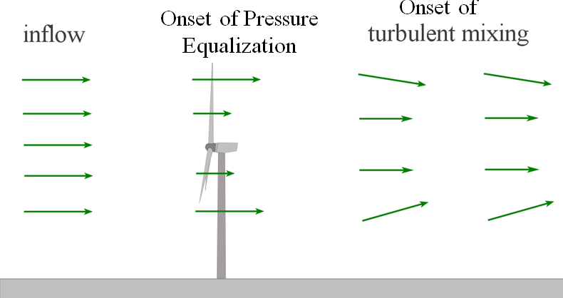
Cooperating Neighbours to Supporting Neighbours

Slide 3
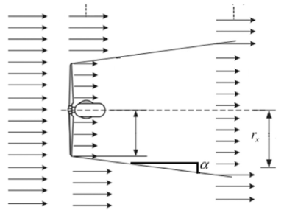
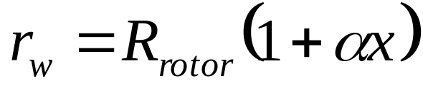
Jensen Cone Model for Wake of A HAWT
As mentioned before Jensen Model assumes that the wake downstream expands linearly.
Thus, the path tracing by the wind downstream follows the conical shape of disturbance.
The radius of the cone can be estimated by using the following equation:
V∞
V∞
V∞
A_{wake}
A_{rotor}
u₁
U_{wake}
R_{r}
The dimensionless scalar α, known as decay constant.

Slide 4
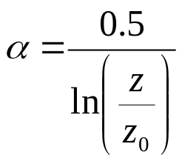
Wake Decay Constant
Wake Decay Constant determines how quickly the wake expands with distance or
describes the growth of the wake width.
The determination of α is sensitive to factors including ambient turbulence, turbine induced turbulence and atmospheric stability.
This can be calculated by using an analytical expression as:

Slide 5
Jensen Single Fullwake Model
V∞
V∞
V∞
A_{wake}
u₁
v_{w}
A_{rotor}
R_{r}
The Jensen Model for conservation of momentum implies that the radius of wake(r) behind the turbine expands linearly with respect to down wind distance(D).
Law of conservation of mass for turbulent mixing wake:

Slide 6
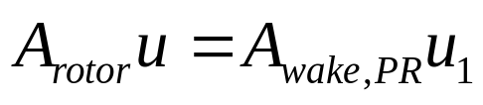
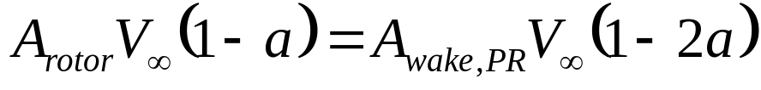
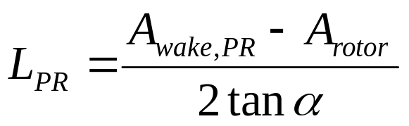
Analysis of Pressure Recovery Zone
V∞
V∞
V∞
A_{wake}
u
u₁
U_{wake}
A_{rotor}
R_{r}
L_{PR}

Slide 7
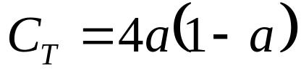
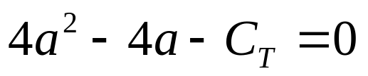
Estimation of Wake Velocity : Betz Model
V∞-u₁ is defined as final velocity deficit generated by the wind turbine to reach p∞.
The velocity deficit depends on the power absorbed by the rotor.
This can be calculated by using appropriate momentum theory and measured value of C_{T}.
Betz Theory:

Slide 8
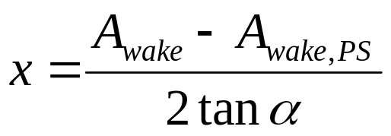
Analysis of Turbulent Mixing Zone
V∞
V∞
V∞
A_{wake}
u
u₁
U_{wake}
A_{rotor}
R_{r}
L_{PR}

Slide 9
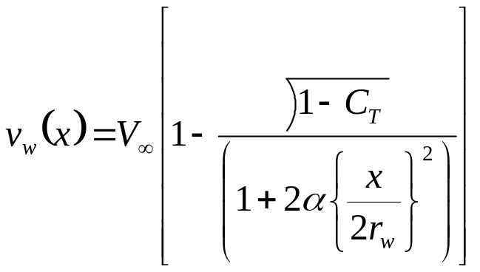
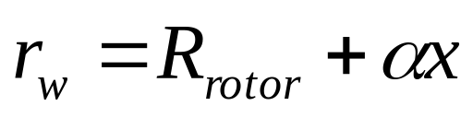
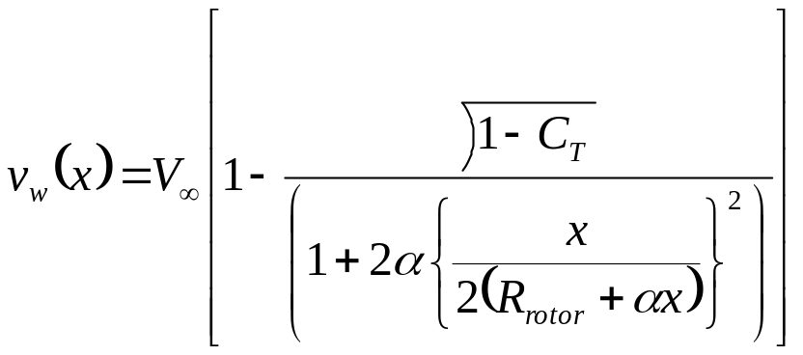
Streamwise Variation of Farwake Velocity
The area averaged wind velocity inside the single turbine wake area, given by Jensen’s single wake model.
However, this velocity function may not be valid in the near wake regime.
The wake radius r_{w} and velocity v_{w} both depend on the relative distance x behind the near wake.

Slide 10
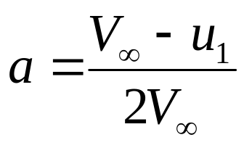
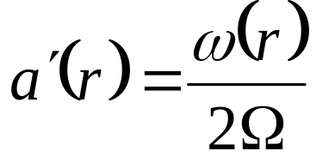
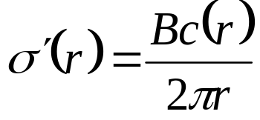
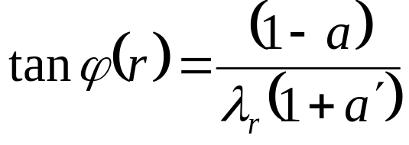
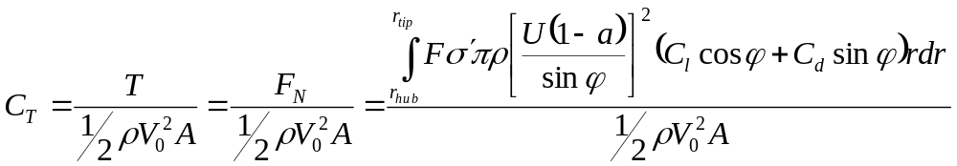
Estimation of Wake Velocity : BEM with Dual Induction Theory
Definitions:
Guess a & a’
Thrust Coefficient:

Slide 11
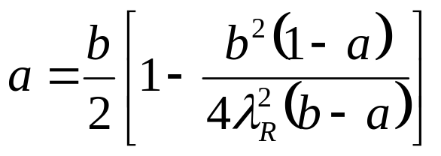
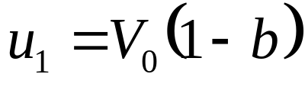
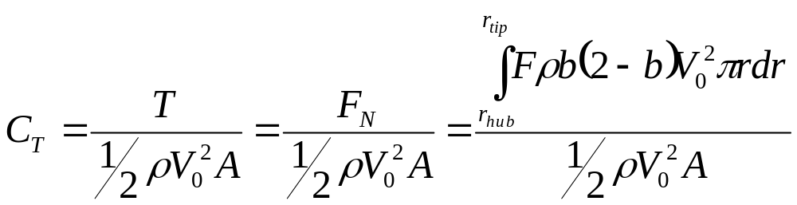
Estimation of Wake Velocity : : Fluid Dynamics Model
The axial induction factor (of rotor) a & b are defined as:

Slide 12
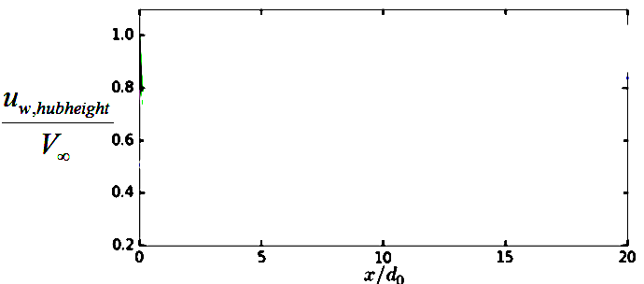
Average Wake Velocity Predicted by Jensen Model
V∞ =17 m/s
V∞ =11 m/s
V∞ =7 m/s

Slide 13
Validation of Jensen Kinematic Model !?!?!?

Slide 14
Remote Sensing of Wind Turbine Wakefield
Intrusive probes cannot be used in measurement of wind turbine wake field.
Non-intrusive instruments can accurately trace the wakefields.
There are three important techinques:
SODAR is based on probing the wakefield by sound propagation.
LIDAR (Light Detection and Ranging) is based on probing the wakefield by electromagnetic radiation
Microwaves or laser light
SAR (Synthetic Aperture Radar) is based on satellite remote sensing is based on microwave scatterometry on the surface.
SODAR and LIDAR are direct measurements of wind speed based on Doppler shift.

Slide 15
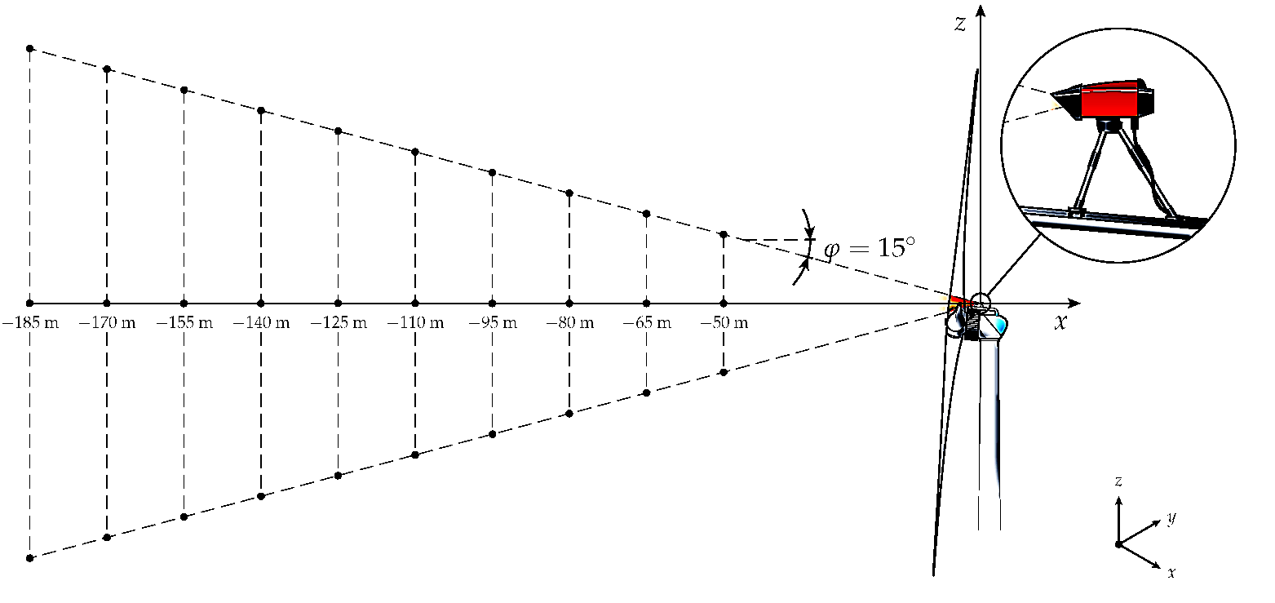
LiDAR System

Slide 16
LiDAR System
LiDAR systems measure the wind conditions from the ground up to a height of 200 meters.
LiDAR systems can also be installed in top of a wind turbine to measure wind conditions in front and behind the turbine.
LiDAR measures wind velocity through the evaluation of the Doppler shift along a laser beam emitted into the wakefield and backscattered because of the presence of particles.
Therefore, a Doppler wind LiDAR is only sensitive to the velocity component parallel to the laser beam, known as the line of sight (LOS) velocity.

Slide 17
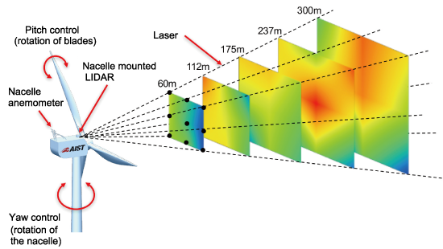
Measurement Method : LiDAR
LiDAR measurements can be performed by simply staring the laser beam along a fixed direction.
Fixed azimuthal and elevation angles—which enables measuring the radial velocity along the beam direction at several locations evenly spaced along the beam.
Two-dimensional measurements can be performed by scanning the LiDAR over vertical planes.
This is called a Range–Height Indicator (RHI).
In RHI the LiDAR scans with a fixed azimuthal angle and by varying its elevation angle.
Measurements over conical surfaces can be also performed by varying the azimuth angle and with a fixed elevation angle, the so-called plan position indicator (PPI) or velocity–azimuth display (VAD).

Slide 18
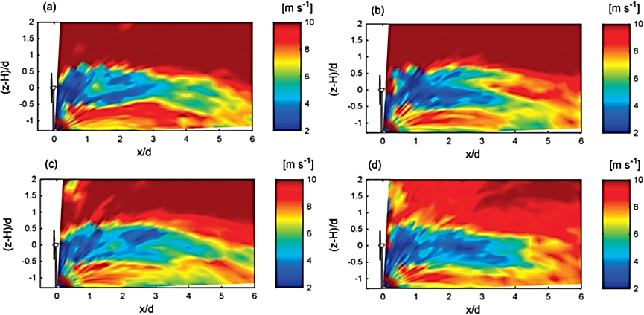
Instantaneous Snapshots of the axial velocity:
2-MW Enercon E-70 wind turbine

Slide 19
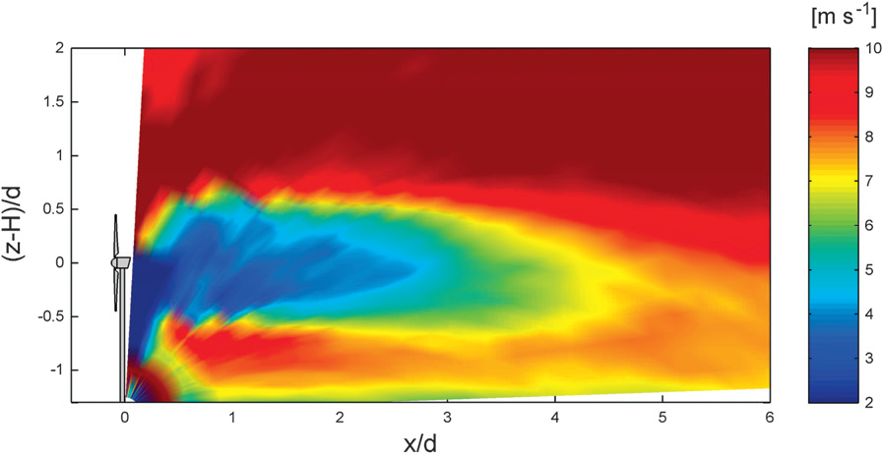
Mean Snapshots of the axial velocity:
2-MW Enercon E-70 wind turbine

Slide 20
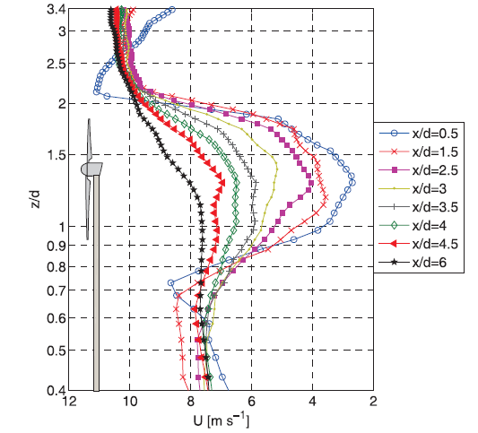
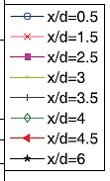
Vertical Profiles of the Mean Axial Velocity

Slide 21
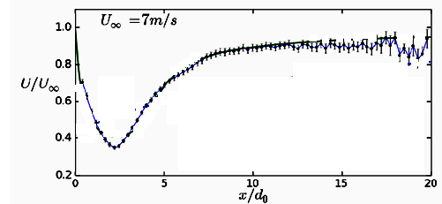
Evolution of Area Averaged Local Axial Velocity

Slide 22
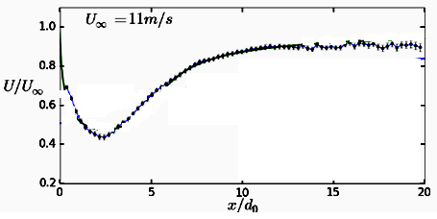
Evolution of Area Averaged Local Axial Velocity

Slide 23
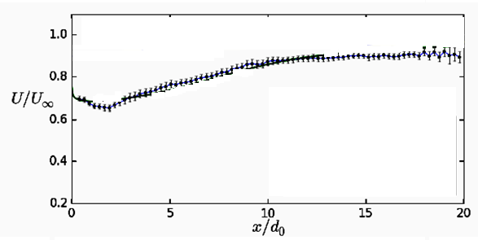
Evolution of Area Averaged Local Axial Velocity
U∞ = 17m/s

Slide 24
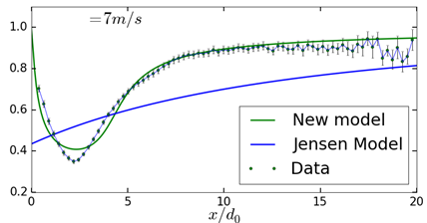

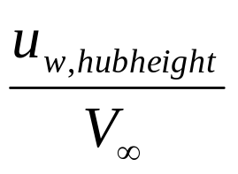
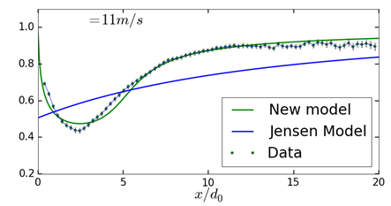
Performance of Jenson Model

Slide 25
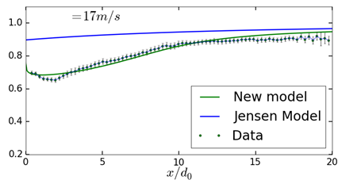
Performance of Full Wake Analytical Model

Slide 26
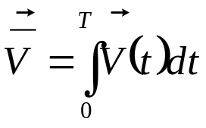
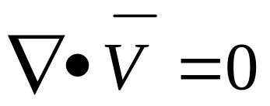

Computations of Wind Turbine Wakefields
The flow field in immediate near wake is approximated by solving the filtered three-dimensional incompressible Navier–Stokes equations.
Define filtered velocity as:
Continuity equation
Navier–Stokes equations
Two body forces (f_{WT} and f_{turb}) are explicitly introduced in the simulations to model the effect of the wind turbine and atmospheric turbulence.

Slide 27
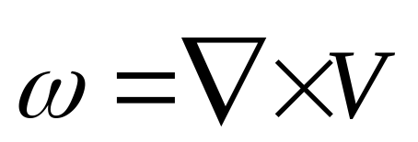
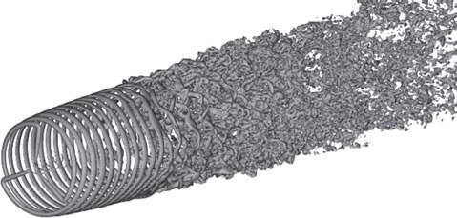
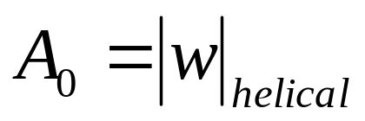
Vorticity Generation & Evolution in the Wake of A WT
A WT introduces helical tip vortices into the wake.
The amplitude of Vorticity introduced by rotor is identified as A₀

Slide 28
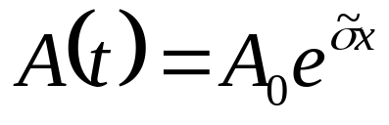

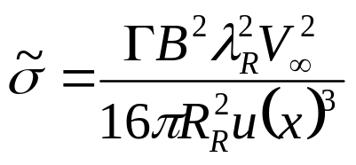
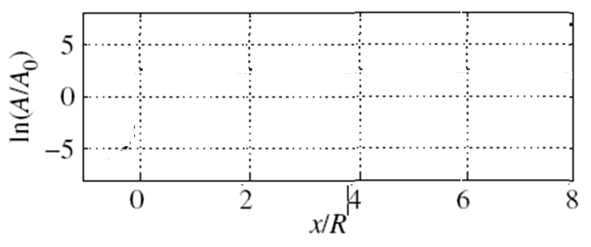
Evolution of tip vortices & Instability
Evolution analysis shows that the amplitude of helical vortices increases in the streamwise direction.
is the dimensional growth rate of an instability
λ_{R}

Slide 29
Instability of Wake
A growing vorticity is a measure of infection in laminar wake.
A growing infection leads to instability, transition and turbulence.
Stability Analysis shows that helical tip vortices are inherently unstable and that they will break down at some distance behind the wind turbine.
The breakdown position of tip vortices is assumed to take place where simple logarithmic amplification reaches its maximum.
λ_{R}

