Slide 1

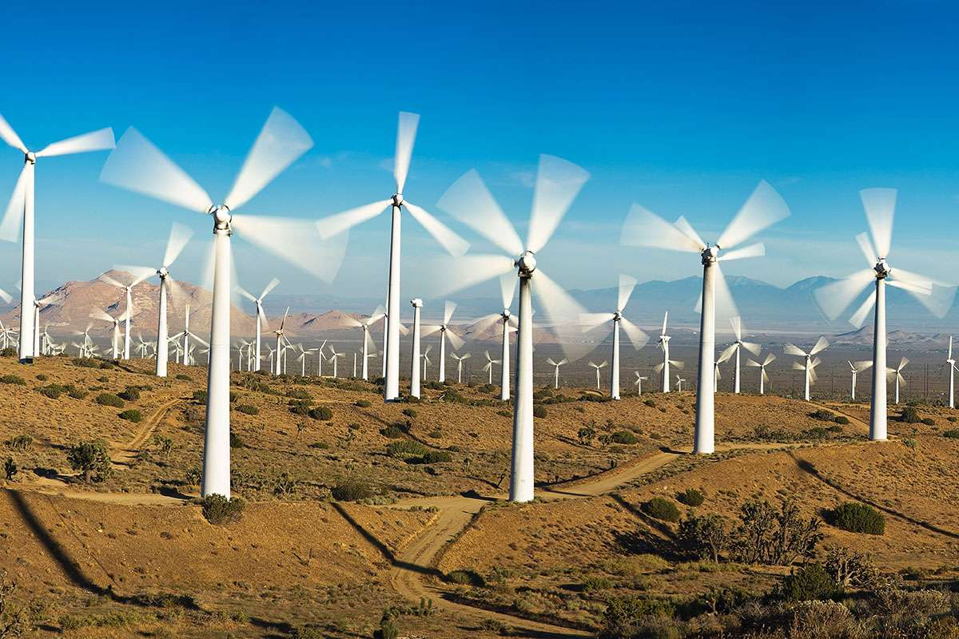
Analysis of Wind Turbines Wakes
P M V Subbarao
Professor
Mechanical Engineering Department
Clues for Selection of Suitable Spacing among WTs........

Slide 2

Initial Remarks
Optimizing the design and operation of wind farms requires understanding the complex interaction between atmospheric boundary layer flow and wind turbines.
Most important phenomena to be deeply understood is; the structure of wind turbine wakes.
The wakes are responsible for a reduction in wind velocity and an increase in fluctuations.
This leads to a reduction in power output and an increase in fatigue loads in wind farms.
CFD techniques with different degrees of complexity and accuracy can be applied to simulate wind turbine wake flows.
All the CFD models need a significant amount of information for selection of domain, boundary conditions, grid size etc., their assessment and optimization.

Slide 3

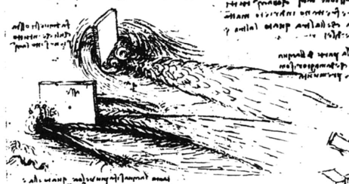
The Vision of A Genious

Slide 4
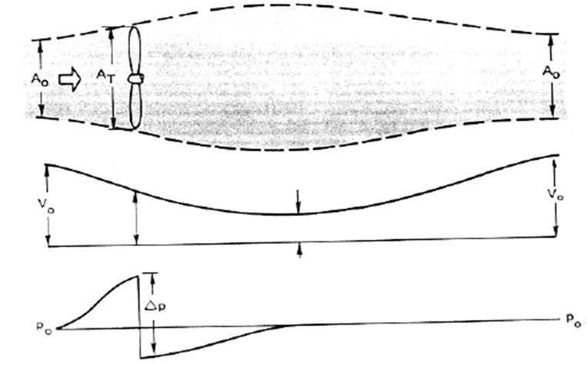


Betz View of Wind Turbine Wakefield

Slide 5
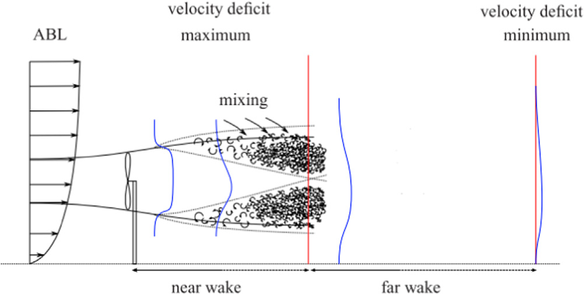
Description of HA Wind Turbine Wakefield
Wind turbine wakes are classified into two types:
Near Wake: The near wake is the region where the turbine geometry directly disturbs the wind.
Far wake: The far wake is the region past the near wake

Slide 6
Need for Wake Analysis : to Minimize Power Loss
It is very important to determine the optimum distance between neighbouring turbines, when developing wind farms.
A too large distance will result in lower capacity of A wind farm and higher installation cost.
A too short distance will result in lower power per turbine and increased fatigue problems for turbines located in the wake of other turbines.

Slide 7
Need for Wake Analysis : Safety of WTs
Fatigue is in particular a problem for the second turbine in a row.
The downstream turbine faces a high potential risk.
Being hit by the tip vortices from the turbines located at the front of the wind farm.
It is important to determine the lifetime of the tip vortices and the parameters that govern their breakdown into multiple small-scale vortices.
This location is called as Fully Turbulent wake zone and no danger of high fatigue.
However, velocity deficit is significant.

Slide 8
Size Estimations for WT Wakefield
Near wake region is generally from the turbine to almost two to three rotor diameters downstream.
It is very difficult to develop comprehensive understanding of near wake.
This is due to the fact that there exist shear layers and a region of very low velocities in near wake.
In the far wake, two main mechanisms defining flow conditions are convection and turbulent diffusion.

Slide 9
Presence of Shear layers in WT Near Wake
Shear Layer
The shear layer is an intermediate layer generated by the velocity difference between the air outside and inside of the wake.
This shear layer contains strong velocity gradients and grows towards downstream.
The rate of growth is much faster in near wake THAN far wake regions.

Slide 10

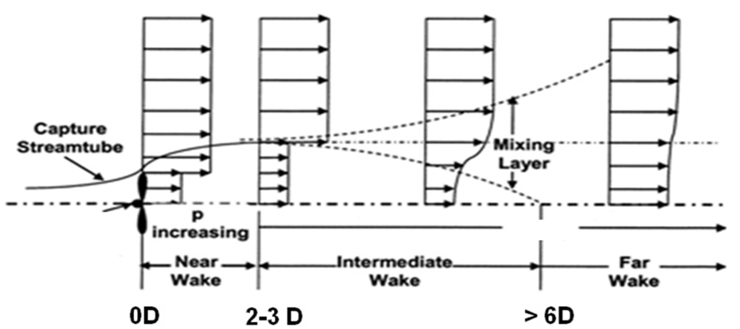
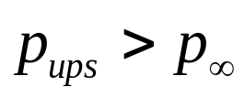
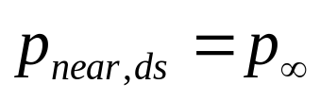
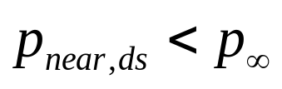
The WT Wake Mysteries Unravelled by Betz and Others

Slide 11
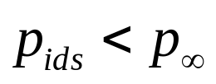
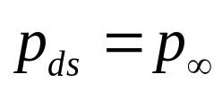
Simplified (Linear) Kinematics of Near WT Wakefield

Slide 12
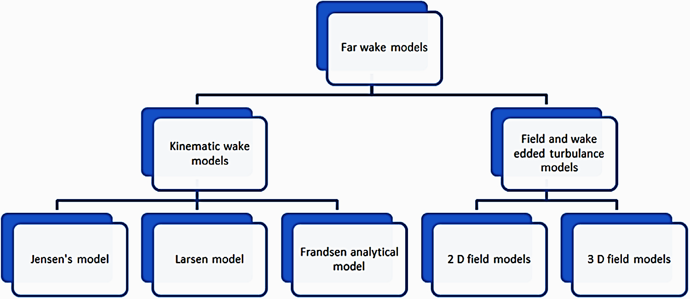
Models for Wind Turbine Wakefield
Integral Wake Models

Slide 13
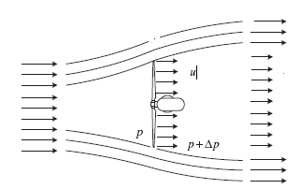

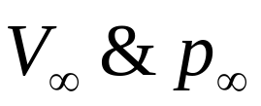
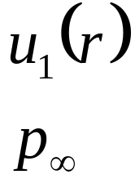
Kinematic models for Fullwake
Kinematic models are based on modelling of self-similar velocity deficit profiles.
Kinematic wake models employ only the momentum equation to model the radially averaged velocity deficit of the wake.
These models ignore the evolution of turbulence intensity in the wake behind a turbine.
Three popular Kinematic Models:
Jensen's fullwake model
Larsen's model
Frandsen's model

Slide 14
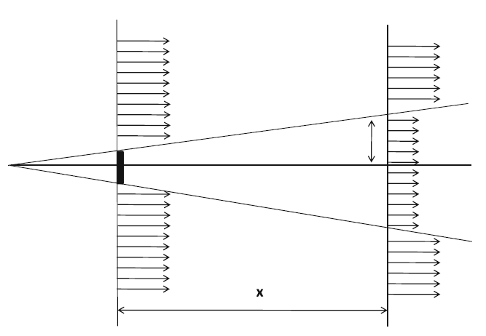
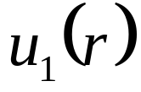

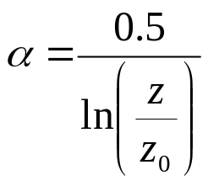
Simplified Schematic Models for WT Wake
scalar α determines how quickly the wake expands with distance and it is defined as:
where z is the hub height of the turbine generating the wake and z₀ is a constant called surface roughness, which depends on the terrain characteristics.

Slide 15
Jensen's Fullwake model
This model redefines the boundary of the control volume of a WT.
Jensen’s CV is the sum of CV affected by the WT and the surrounding compensating the velocity deficit.
This is called the Jensen’s Fullwake model
According to this model assumes the fullwake is continuously linearly expanding.
This is a linearly expanding wake with a velocity deficit that is only dependent on the distance behind the rotor.

Slide 16
Jensen’s View of Fullwake
Jensen treated the wake behind the wind turbine as a turbulent wake which considers the contribution of all eddies or vortices present in the CV/wake.
The wake model is derived by conserving the momentum downstream of the wind turbine.
The velocity in the wake is given as a function of downstream distance from the turbine hub.

Slide 17
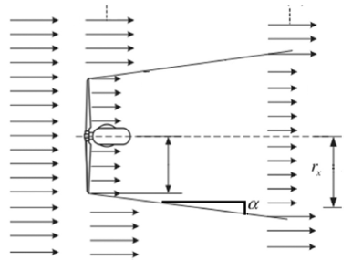
Jensen Single Fullwake Model
V∞
V∞
V∞
A_{wake}
u₁
U_{wake}
A_{rotor}
R_{r}
The law of conservation of momentum implies that the radius of wake(r) behind the turbine expands linearly with respect to down wind distance(D).
Law of conservation of mass for wind turbine wake:

Slide 18
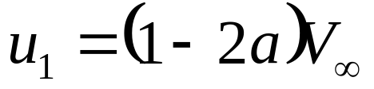
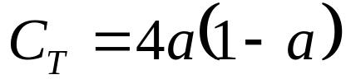
The velocity deficit
V∞-u₁ is defined as final velocity deficit generated by the wind turbine to reach p∞.
The velocity deficit depends on the power absorbed by the rotor.
This can be calculated by using appropriate momentum theory and measured value of C_{T}.
Betz Theory:

Slide 19
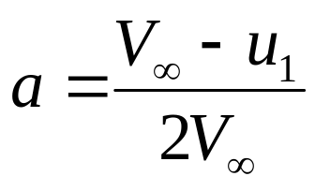
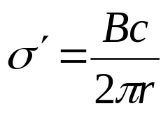
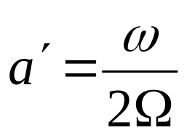
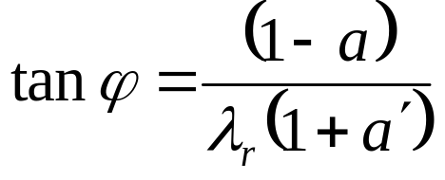
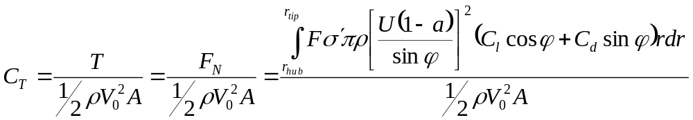
Velocity Deficit : BEM with Dual Induction Theory

Slide 20
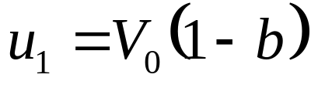
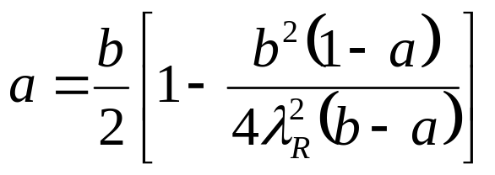
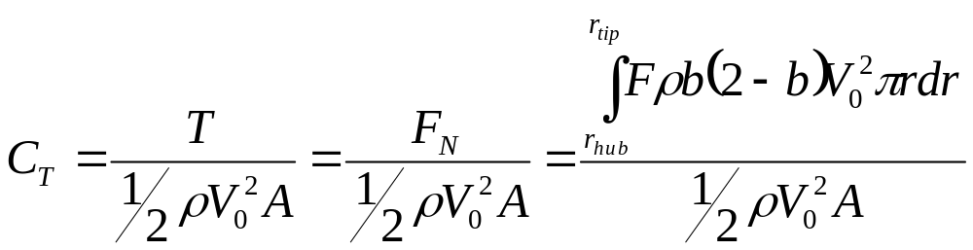
Velocity Deficit : Fluid Dynamics Model
The axial induction factor (of rotor) a & b are defined as:

Slide 21
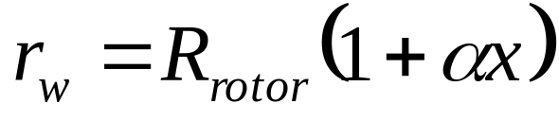
Jensen Cone Model for Wake of A HAWT
As mentioned before Jensen Model assumes that the wake downstream expands linearly.
Thus, the path tracing by the wind downstream follows the conical shape of disturbance.
The radius of the cone can be estimated by using the following equation:
V∞
V∞
V∞
A_{wake}
A_{rotor}
u₁
U_{wake}
R_{r}
The dimensionless scalar α, known as decay constant.

