Slide 1

Micrositing for Wind Turbines
P M V Subbarao
Professor
Mechanical Engineering Department
Efficient Management of Available Space........
Maximization of Power per unit Site Area........

Slide 2

Micrositing
Micrositing is a design and planning process through which the specific locations for each member of a group of wind turbines are determined.
In a simple words the locations of neighbours for each turbine are carefully determined.
Each position of a WT must comply the important requirements regarding existing wind resource, distances from the neighbours, etc.

Slide 3
Expectations from Micrositing
Following expectations are to be better satisfied by the process of micrositing:
Productivity. The installation should maximize Annual Energy Production
Durability. The wind farm must reach/cross its designed service life.
Technical Feasibility. The wind turbines will be located at reachable sites.
Hence, the optimal allocation of the wind turbines in an area is essential.
This must maximize AEP and guarantee compliance with the designing parameters of the wind energy converter.

Slide 4
Factors Influencing the Micrositing
The characteristics of a wind turbine that are related to Micrositing are the following:
Vertical wind profiles
Cut-in speed
Cut-out speed
Nominal speed
Admissible turbulence
Rotor diameter
Hub height
Nominal power
Power curve
Thrust coefficient curve

Slide 5
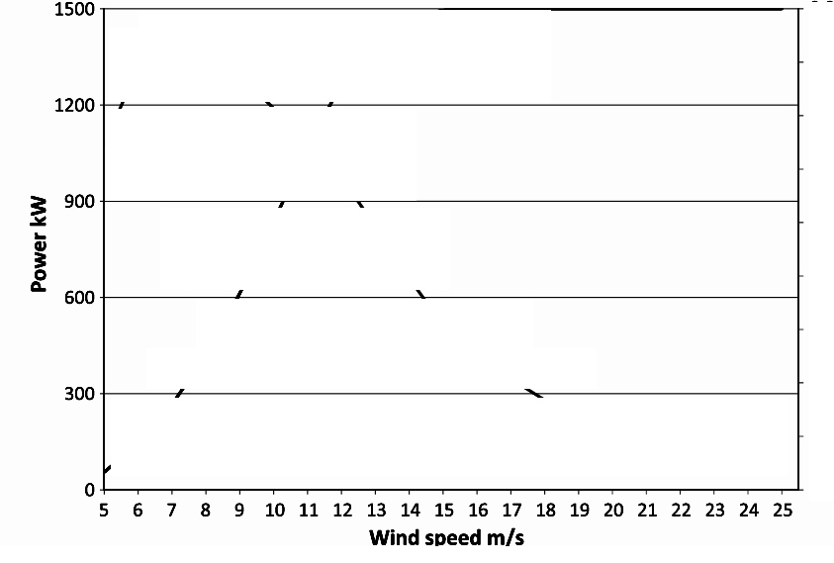
Power Curve Supplied by Manufacturer
Vestas turbine V63
Cut-in speed = 5 m/s,
Cut-out speed = 25 m/s
Nominal power = 1.5 MW
Nominal speed = 16 m/s.

Slide 6
Layers in Micrositing
Layer 1 : Site Assessment
Layer 2 : Energy Assessment

Slide 7
Site Assessment
A Site Assessment is an analysis of the suitability of the selected wind turbine for the existing conditions on site.
Manufacturers provide different wind turbine models tailored for specific wind conditions.
This analysis implies the evaluation of several variables, such as extreme wind speeds, vertical profiles, etc. at each wind turbine position.
This requires consistent wind characterization on site and the selection of an appropriate wind turbine.
Also involves an extrapolation of the wind measures to the whole site using the most advanced computing tools.
This layer delivers Site Scenario Map.

Slide 8
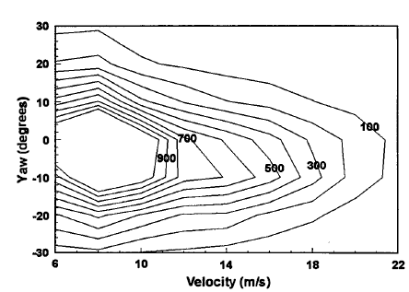
Site Scenario Map
The Distribution of Inflow Conditions Over 20,160 Blade Rotational Cycles

Slide 9
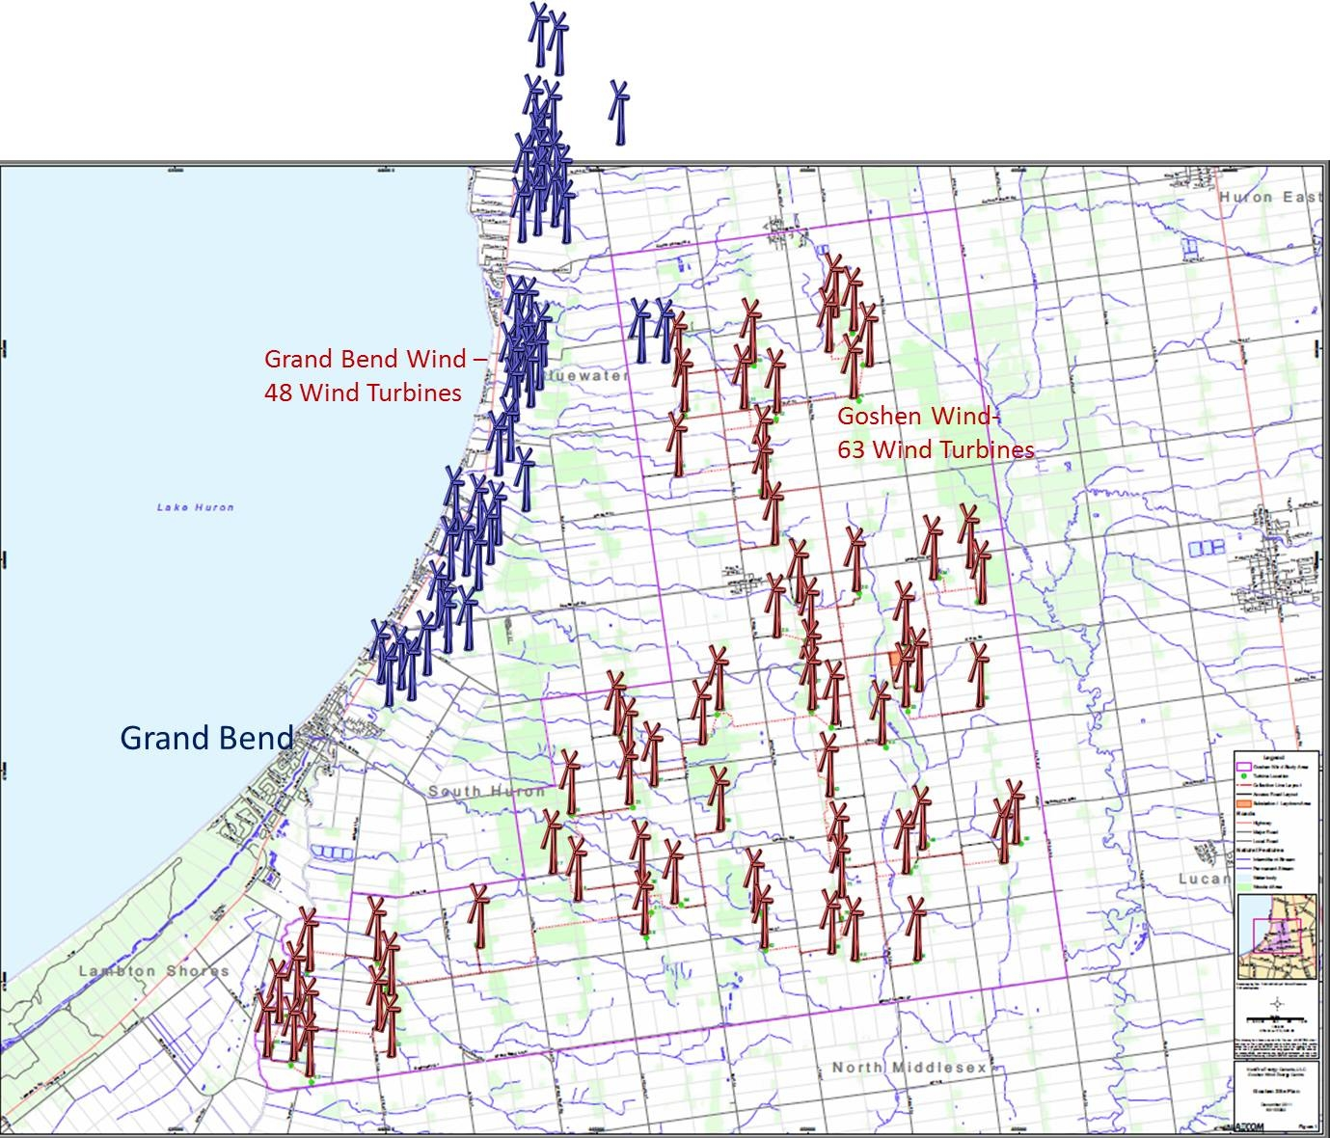
Sample Site 1

Slide 10
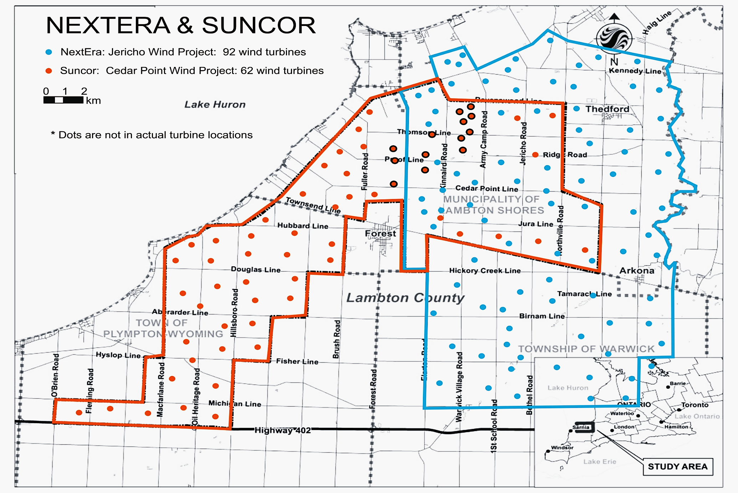
Sample Site 2

Slide 11
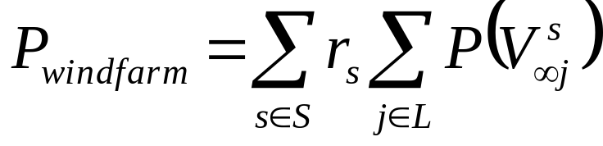
Total Power of A Windfarm
A windfarm scenario s, is characterized by a wind direction and an ambient wind speed.
In general, several scenarios are possible for a windfarm.
L is the size of a Windfarm.
The power produced by the wind farm can be obtained by computing the wind speed V_{∞j} at each turbine location j ∈ L.
Let P(V∞) be the known function that computes the power generated by one turbine if the wind speed is V∞ at the turbine location.
The expected instantaneous total power is calculated by summing up the power produced in each scenario s weighted by the probability of its realization r_{s}.

Slide 12
Net Annual Energy of A Wind Farm
The gross energy yield of the wind farm is determined by the local wind distribution and the siting of the wind turbines.
To calculate the net energy yield the anticipated losses must be determined.
These losses include:
wake losses
grid losses
Availability.
Faster Wind Fluctuations
Extreme Wind conditions

Slide 13
Optimal Micrositing
The main objective of the analysis is to get the best location for each turbine in a windfarm.
This must result in the reduction of capital cost and an increase in annual energy output.
Describe two fitness functions.
One for the reduction of capital cost, and the other for maximizing the annual energy.
Develop a single equation to aggregate the two fitness functions.
Each fitness function may be assigned weights depending on the preferences given to each optimization factor.

Slide 14
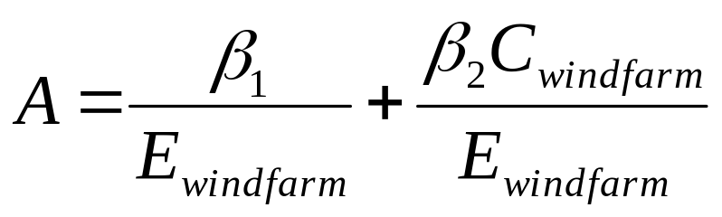
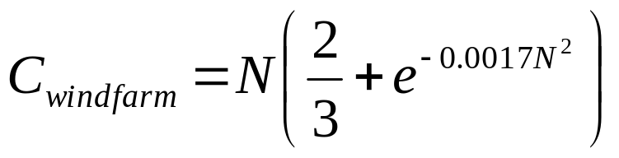
Objective Function
The final optimization function is described mathematically as:
Where, β₁ and β ₂ are randomly chosen weights
and C_{windfarm} is the cost per annum of the wind farm with N turbines.
Mosetti et al. was the first attempt in solving windfarm optimization problem in 1994.

Slide 15
Micrositing including energy yield predictions
‘WasP’, ‘Wind farmer’ and ‘WindPRO’ are well known computer models to calculate energy yield.
The modelling takes into account not only wind speed and direction distributions but also the geography and terrain;
for instance, a steep slope in the terrain will cause higher winds at the hill top.
Such details in the modelling ensure that wind turbines are optimally sited.
Generally the layout is optimised for exposure to the prevailing wind direction.

Slide 16
The main fluid dynamic process that affects the layout design is the velocity of wind at the downstream of first row of wind turbines in a farm.

Slide 17

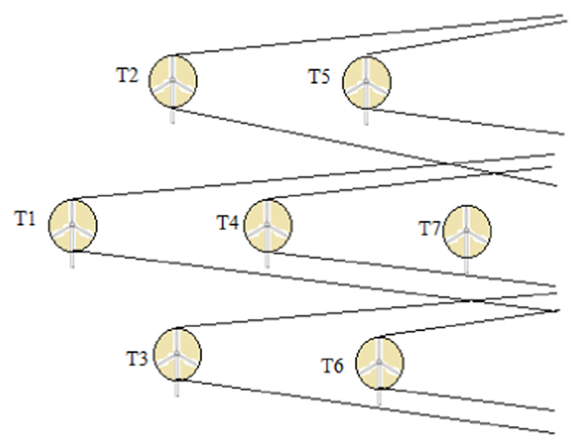
Available Wind Velocity for a WT in A Windfarm
V∞

Slide 18
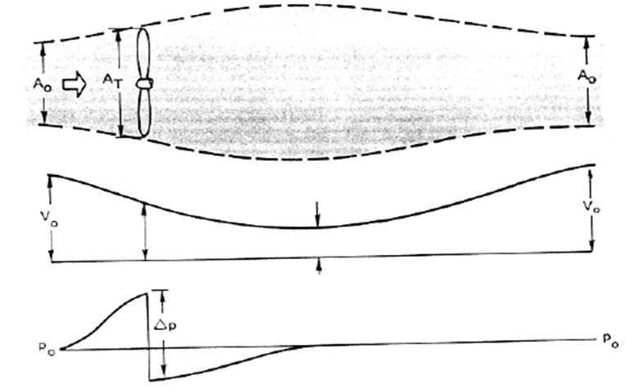


Signatures of Wind Turbine on Wind & Recovery : Betz Theory

Slide 19
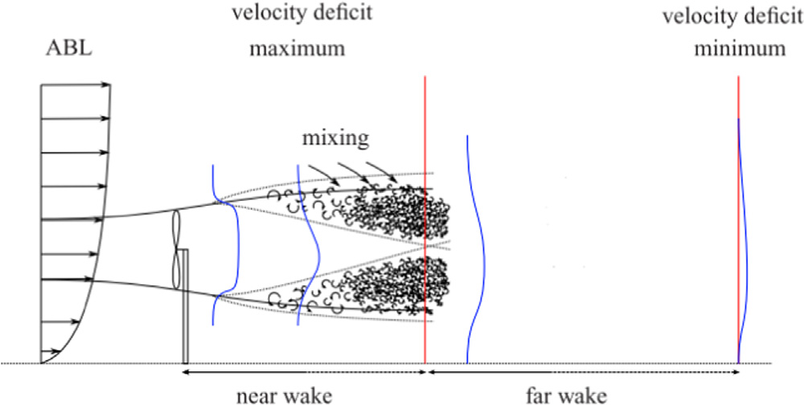
Description of HA Wind Turbine Wake
Wind turbine wakes are classified into two types:
Near Wake: The near wake is the region where the turbine geometry directly disturbs the wind.
Far wake: The far wake is the region past the near wake

