Slide 1


Solution of Convection Heat Transfer Equations :
Flat Plate Boundary Layer
P M V Subbarao
Professor & Head
Mechanical Engineering Department
Application of Mathematical Tricks by Blasius to Prandtl’s Intuition…

Slide 2

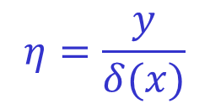
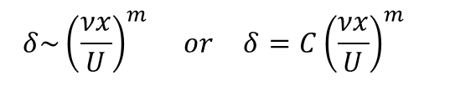
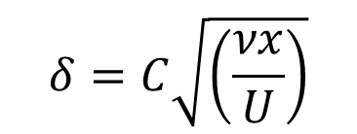
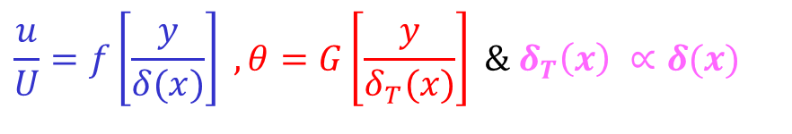
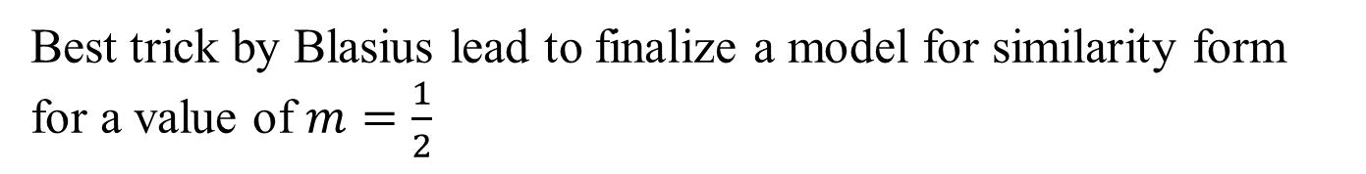
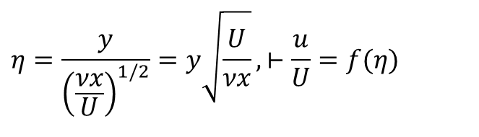
Intuition of SIMILARITY Variable
For a solution obeying similarity in the velocity profile must have
$$\frac{u}{U}=f\left[\frac{y}{δ(x)}\right] , θ=G\left[\frac{y}{δ_{T}(x)}\right] \&{ δ}_{T}\left(x\right) ∝δ(x)$$
where f & G are universal functions, independent of x (position along the plate).
Since Blasius had a reason to believe that for a slowly growing FPBL
$$δ\sim {\left(\frac{νx}{U}\right)}^{m} or δ=C{\left(\frac{νx}{U}\right)}^{m}$$
Best trick by Blasius lead to finalize a model for similarity form for a value of $m=\frac{1}{2}$
$$δ=C\sqrt{\left(\frac{νx}{U}\right)}$$
$$η=\frac{y}{{\left(\frac{νx}{U}\right)}^{1/2}}=y\sqrt{\frac{U}{νx}},⊢\frac{u}{U}=f(η)$$
$$η=\frac{y}{δ(x)}$$
Note that η is a dimensionless variable.

Slide 3

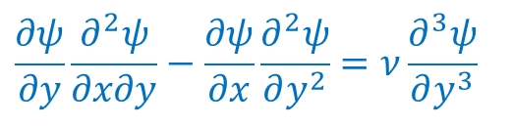
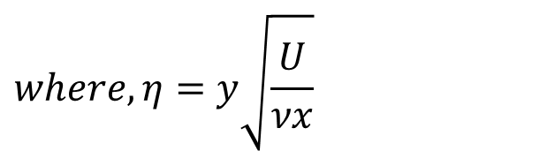
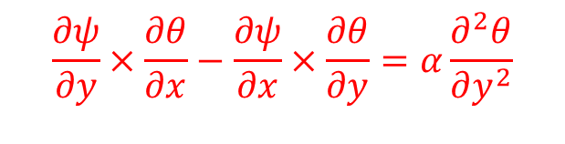
GDEs for Master Profiles in Laminar Boundary Layer Convection on A Flat Plate
FPBL Momentum Equation:
FPBL Thermal Energy Equation:
$$\frac{∂ψ}{∂y}\frac{∂^{2}ψ}{∂x∂y}−\frac{∂ψ}{∂x}\frac{∂^{2}ψ}{∂y^{2}}=ν\frac{∂^{3}ψ}{∂y^{3}}$$
$$\frac{∂ψ}{∂y}×\frac{∂θ}{∂x}−\frac{∂ψ}{∂x}×\frac{∂θ}{∂y}=α\frac{∂^{2}θ}{∂y^{2}}$$
The truth of boundary layer physics is
$$ψ=F\left(η\right) \& θ=G\left(η\right)$$
$$where,η=y\sqrt{\frac{U}{νx}}$$
F & G are (similarity functions) master functions of stream functions and temperature, respectively.
Both are scalar functions….
Is it possible to guess Simple form of above functions?
Fluid Mechanics as A Puzzle Game!
Developed by Paul Richard Heinrich Blasius in 1908 as a student of Ludwig Prandtl

Slide 4
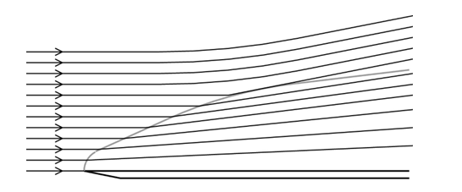
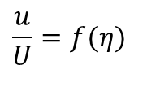
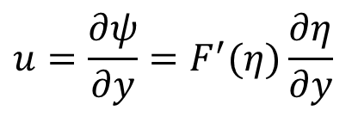
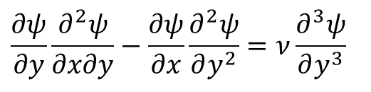
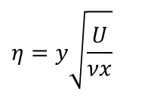

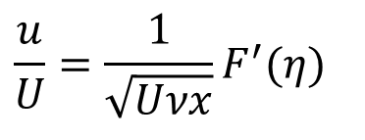
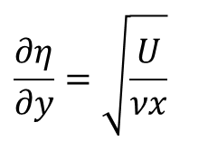
Discovery of Similarity Variable by The Method Of Guessing
$$\frac{∂ψ}{∂y}\frac{∂^{2}ψ}{∂x∂y}−\frac{∂ψ}{∂x}\frac{∂^{2}ψ}{∂y^{2}}=ν\frac{∂^{3}ψ}{∂y^{3}}$$
Blasius wanted that above GDE to generate a stream function to give a velocity u = ∂ψ/∂y satisfying the similarity variable
$$η=y\sqrt{\frac{U}{νx}}$$
Along with a similarity function for velocity profile
$$\frac{u}{U}=f(η)$$
So, he started-off by guessing
$$ψ=F(η)$$
where F is a similarity function.
$$u=\frac{∂ψ}{∂y}=F^{′}(η)\frac{∂η}{∂y}$$
$$\frac{∂η}{∂y}=\sqrt{\frac{U}{νx}}$$
so that
$$\frac{u}{U}=\frac{1}{\sqrt{Uνx}}F^{′}(η)$$
Will it work ????
Lets see…..

Slide 5

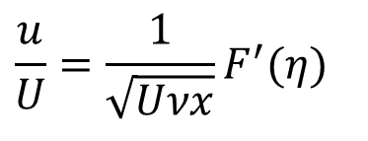
Is it a right Guess ?
First guess of Blasius
$$ψ=F(η)$$
not OK
OK
$$\frac{u}{U}=\frac{1}{\sqrt{Uνx}}F^{′}(η)$$
then he obtained
This form does not satisfy the condition that u/U is a function of η alone.
Similarity demands the first derivative F’(η) is to be a function of η alone, but not F.
But Blasius noted that the extra function is (Uνx)^{-1/2}!
So his first guess failed because of the term (Uνx)^{-1/2}.
Used this nuisance term to generate a better guess.

Slide 6
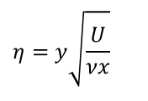
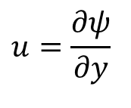
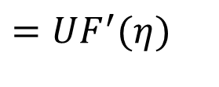

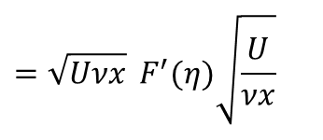
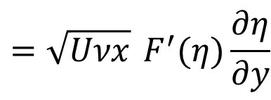
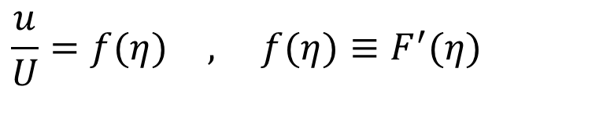
Second Guess learnt from the first Guess
$$η=y\sqrt{\frac{U}{νx}}$$
Second Guess
$$ψ=\sqrt{Uνx} F(η)$$
Now remembering that x and y are independent of each other and recalling the evaluation of ∂η/∂y,
$$u=\frac{∂ψ}{∂y}$$
$$=\sqrt{Uνx} F^{′}(η)\frac{∂η}{∂y}$$
$$=\sqrt{Uνx} F^{′}(η)\sqrt{\frac{U}{νx}}$$
$$=UF^{′}(η)$$
$$\frac{u}{U}=f(η) , f(η)≡F^{′}(η)$$
Thus, the first guess helped in guessing the correct function.
This new form of ψ that satisfies similarity in velocity!
But this does not mean that the job was completed.
Need to complete the description of the function F(η).

Slide 7
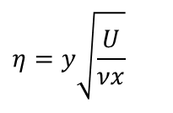
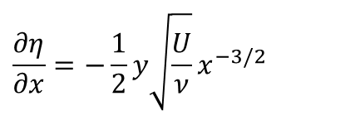
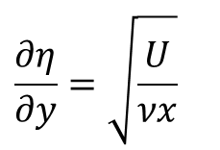
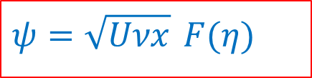
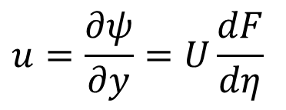
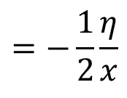
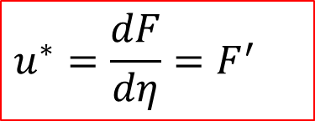
Second Guess: Similarity Function for ψ
A set of basic derivatives of similarity variable are necessary to obtain the function F(η) :
$$η=y\sqrt{\frac{U}{νx}}$$
$$\frac{∂η}{∂x}=−\frac{1}{2}y\sqrt{\frac{U}{ν}}x^{−3/2}$$
$$=−\frac{1}{2}\frac{η}{x}$$
$$\frac{∂η}{∂y}=\sqrt{\frac{U}{νx}}$$
$$u=\frac{∂ψ}{∂y}=U\frac{dF}{dη}$$
$$u^{∗}=\frac{dF}{dη}=F^{′}$$
$$ψ=\sqrt{Uνx} F(η)$$

Slide 8
Conversion of Third Order PDE into ODE
$$\frac{∂ψ}{∂y}\frac{∂^{2}ψ}{∂x∂y}−\frac{∂ψ}{∂x}\frac{∂^{2}ψ}{∂y^{2}}=ν\frac{∂^{3}ψ}{∂y^{3}}$$
The next steps involve tedious differential calculus, to evaluate the terms in the BL Stream Function equation.
The third order Partial derivative is:
$$\frac{∂^{3}ψ}{∂y^{3}}=\frac{∂}{∂y}\left\{\frac{∂}{∂y}\left[UF^{′}(η)\right]\right\}$$
$$\frac{∂^{2}ψ}{∂y^{2}}=UF^{″}(η)\frac{∂η}{∂y}=U\sqrt{\frac{U}{νx}} F^{″}(η)$$
$$\frac{∂^{3}ψ}{∂y^{3}}=U\sqrt{\frac{U}{νx}} F^{‴}(η)\frac{∂η}{∂y}$$
$$\frac{∂^{3}ψ}{∂y^{3}}=U\frac{U}{νx}F^{‴}(η)$$

Slide 9
Conversion of Second Order PDs into ODs
Blasius worked out the two second order derivatives:
$$\frac{∂^{2}ψ}{∂x∂y}=\frac{∂}{∂y}\left(\frac{∂ψ}{∂x}\right)$$
$$\frac{∂η}{∂y}=\sqrt{\frac{U}{νx}} , \frac{∂η}{∂x}=−\frac{1}{2}\frac{η}{x}$$
$$\frac{∂ψ}{∂x}=\frac{∂}{∂x}\left[\sqrt{Uνx} F(η)\right]$$
$$\frac{∂ψ}{∂x}=\frac{d}{dη}\left[\sqrt{Uνx} F(η)\right]×\frac{∂η}{∂x}$$
$$\frac{∂ψ}{∂x}=\frac{d}{dη}\left[\sqrt{Uνx} F(η)\right]×\left\{−\frac{1}{2}\frac{η}{x}\right\}$$
$$\frac{∂^{2}ψ}{∂x∂y}=\frac{∂}{∂y}\left(\frac{d}{dη}\left[\sqrt{Uνx} F(η)\right]×\left\{−\frac{1}{2}\frac{η}{x}\right\}\right)$$
$$\frac{∂^{2}ψ}{∂x∂y}=−\frac{1}{2}\frac{U}{x}ηF^{″}(η)$$

Slide 10
Development of Master ODE for Stream function
$$ψ=\sqrt{Uνx} F(η) , η=y\sqrt{\frac{U}{νx}}$$
$$\frac{∂η}{∂y}=\sqrt{\frac{U}{νx}} , \frac{∂η}{∂x}=−\frac{1}{2}\frac{η}{x}$$
$$\frac{∂ψ}{∂x}=\frac{1}{2}\sqrt{\frac{Uν}{x}}\left[F(η)−ηF^{′}(η)\right]$$
$$\frac{∂ψ}{∂y}=UF^{′}(η)$$
$$\frac{∂ψ}{∂y}×\frac{∂^{2}ψ}{∂x∂y}−\frac{∂ψ}{∂x}×\frac{∂^{2}ψ}{∂y^{2}}=ν\frac{∂^{3}ψ}{∂y^{3}}$$
$$\frac{∂^{3}ψ}{∂y^{3}}=U\frac{U}{νx}F^{‴}(η)$$
$$\frac{∂^{2}ψ}{∂y^{2}}=U\sqrt{\frac{U}{νx}} F^{″}(η)$$
$$\frac{∂^{2}ψ}{∂x∂y}=−\frac{1}{2}\frac{U}{x}ηF^{″}(y)$$

Slide 11
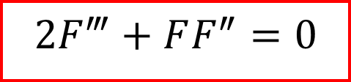
ODE governing Flat Plate BL
$$\frac{∂ψ}{∂y}\frac{∂^{2}ψ}{∂x∂y}−\frac{∂ψ}{∂x}\frac{∂^{2}ψ}{∂y^{2}}=ν\frac{∂^{3}ψ}{∂y^{3}}$$
$$−\frac{1}{2}\frac{U^{2}}{x}η{\frac{dF}{dη}×\frac{d^{2}F}{dη^{2}}}^{}−\frac{1}{2}\frac{U^{2}}{x}\left\{F−η\frac{dF}{dη}\right\}\frac{d^{2}F}{dη^{2}}=\frac{U^{2}}{x}\frac{d^{3}F}{dη^{3}}$$
$$2\frac{d^{3}F}{dη^{3}}+F\frac{d^{2}F}{dη^{2}}=0$$
$$2F^{‴}+FF^{″}=0$$
This is known as Blasius Boundary Layer Equation

Slide 12
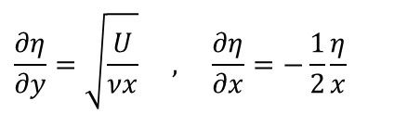
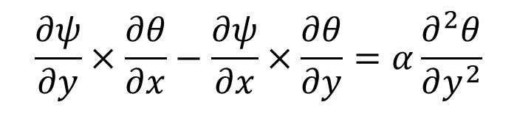
Energy Equations for 2-D Boundary Layer Convection Heat Transfer: PDE to ODE
$$\frac{∂ψ}{∂y}×\frac{∂θ}{∂x}−\frac{∂ψ}{∂x}×\frac{∂θ}{∂y}=α\frac{∂^{2}θ}{∂y^{2}}$$
$$\frac{∂η}{∂y}=\sqrt{\frac{U}{νx}} , \frac{∂η}{∂x}=−\frac{1}{2}\frac{η}{x}$$
The Similarity Function for Non-dimensional Temperature: $θ=G\left(η\right)$
$$\frac{∂ψ}{∂x}=\frac{1}{2}\sqrt{\frac{Uν}{x}}\left[F(η)−ηF^{′}(η)\right]$$
$$\frac{∂ψ}{∂y}=UF^{′}(η)$$
$$\frac{∂θ}{∂x}=\frac{dθ}{dη}×\frac{∂η}{∂x}$$
$$\frac{∂θ}{∂x}=\frac{dθ}{dη}×\left\{−\frac{1}{2}\frac{η}{x}\right\}$$
$$\frac{∂θ}{∂y}=\frac{dG}{dη}×\frac{∂η}{∂y}$$
$$\frac{∂θ}{∂y}=\frac{dG}{dη}×\sqrt{\frac{U}{νx}}$$

Slide 13
Energy Equations for 2-D Boundary Layer Convection Heat Transfer: PDE to ODe
$$\frac{∂^{2}θ}{∂y^{2}}=\frac{∂}{∂y}\left\{\frac{dG}{dη}×\frac{∂η}{∂y}\right\}$$
$$\frac{∂η}{∂y}=\sqrt{\frac{U}{νx}} , \frac{∂η}{∂x}=−\frac{1}{2}\frac{η}{x}$$
$$\frac{∂^{2}θ}{∂y^{2}}=\frac{d^{2}G}{dη^{2}}\left\{\sqrt{\frac{U}{νx}}\right\} \frac{∂η}{∂y}$$
$$\frac{∂^{2}θ}{∂y^{2}}=\frac{d^{2}G}{dη^{2}}\left\{\sqrt{\frac{U}{νx}}\right\}\sqrt{\frac{U}{νx}}$$
$$\frac{∂^{2}θ}{∂y^{2}}=\frac{d^{2}G}{dη^{2}}\left\{\frac{U}{νx}\right\}$$

Slide 14
Energy Equations for 2-D Boundary Layer Convection Heat Transfer: PDE to ODe
$$\frac{∂ψ}{∂x}=\frac{1}{2}\sqrt{\frac{Uν}{x}}\left[F(η)−ηF^{′}(η)\right]$$
$$\frac{∂ψ}{∂y}=UF^{′}(η)$$
$$\frac{∂ψ}{∂y}×\frac{∂θ}{∂x}−\frac{∂ψ}{∂x}×\frac{∂θ}{∂y}=α\frac{∂^{2}θ}{∂y^{2}}$$
$$\frac{∂^{2}θ}{∂y^{2}}=\frac{d^{2}G}{dη^{2}}\left\{\frac{U}{νx}\right\}$$
$$\frac{∂θ}{∂x}=\frac{dG}{dη}×\left\{−\frac{1}{2}\frac{η}{x}\right\}$$
$$\frac{∂θ}{∂y}=\frac{dG}{dη}×\sqrt{\frac{U}{νx}}$$

Slide 15
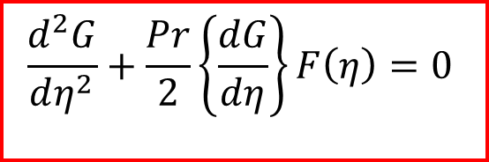
ODE for Master temperature Profile for 2-D Boundary Layer Forced Convection Heat Transfer
$$\left\{UF^{′}(η)\right\}×\left[\frac{dG}{dη}×\left\{−\frac{1}{2}\frac{η}{x}\right\}\right]−\left\{\frac{1}{2}\sqrt{\frac{Uν}{x}}\left[F\left(η\right)−ηF^{′}\left(η\right)\right] \right\}×\left\{\frac{dG}{dη}×\sqrt{\frac{U}{νx}}\right\}\frac{∂G}{∂y}=α\left[\frac{d^{2}G}{dη^{2}}\left\{\frac{U}{νx}\right\}\right]$$
$$−F^{′}(η) \frac{dG}{dη}×\left\{\frac{1}{2}\frac{Uη}{x}\right\}−\frac{1}{2}\left\{\frac{U}{x}\right\}F^{′}(η)F\left(η\right)+\left\{\frac{1}{2}\frac{Uη}{x}\right\}\left\{\frac{dG}{dη}\right\}F^{′}\left(η\right)=α\left[\frac{d^{2}G}{dη^{2}}\left\{\frac{U}{νx}\right\}\right]$$
$$−\frac{1}{2}\left\{\frac{U}{x}\right\}\left\{\frac{dG}{dη}\right\}F\left(η\right) =α\left[\frac{d^{2}G}{dη^{2}}\left\{\frac{U}{νx}\right\}\right]$$
$$−\frac{1}{2}\left\{\frac{dG}{dη}\right\}F\left(η\right) =\frac{d^{2}G}{dη^{2}}\left\{\frac{α}{ν}\right\}$$
$$\frac{d^{2}G}{dη^{2}}+\frac{1}{2}\left\{\frac{dG}{dη}\right\}F\left(η\right)\left\{\frac{ν}{α}\right\}=0$$
$$\frac{d^{2}G}{dη^{2}}+\frac{Pr}{2}\left\{\frac{dG}{dη}\right\}F\left(η\right)=0$$

Slide 16
2-D Boundary Layer Convection Heat Transfer: ODEs for Master Profiles
Master Stream Function Equation for Boundary Layer:
$$2F^{‴}+FF^{″}=0$$
Master Temperature Equation for Boundary Layer:
$$G^{′′}+\frac{Pr}{2}×FG^{′}=0$$
$${If there is a fluid whose value of\operatorname{Pr}{is 1, then G=}F}^{′}$$

Slide 17
BOUNDARY CONDITIONS for Master Profiles
The boundary conditions in terms of ψ
$${\left.\frac{∂ψ}{∂y}\right|}_{y=0}=0 , {\left.\frac{∂ψ}{∂x}\right|}_{y=0}=0 , {\left.\frac{∂ψ}{∂y}\right|}_{y=∞}=U$$
The boundary conditions in terms of F
$$F^{′}(0)=0 , F(0)=0 , F^{′}(η→∞)=1$$
The boundary conditions for G
$$G(0)=1 , G(η→∞)=0$$

Slide 18
ODE for Master Profile of Momentum Boundary Layer: The Blasius Equation
The Blasius equation with the boundary conditions exhibits a boundary value problem.
However, the location of one boundary is unknown, though boundary condition is known.
However, using an iterative method, it can be converted into an initial value problem.
Assuming a certain initial value for F″(η=0), Blasius equation can be solved using Runge-Kutta or Predictor- Corrector methods
$$2F^{‴}+FF^{″}=0$$
$$F^{′}(0)=0 , F(0)=0 , F^{′}(η>δ)=1$$

Slide 19
Solution of Momentum Blasius Equation
$2F^{‴}+FF^{″}=0$
$\frac{F^{‴}}{F^{″}}=−\frac{F}{2}$
Integrate above equation to get:
$\int_{0}^{η}{\frac{F^{‴}}{F^{″}}dη} =−\int_{0}^{η}{\frac{F}{2}dη}$
$ln\left\{F^{″}\right\}$ = $−\int_{0}^{η}{\frac{F}{2}dη}+C$
$F^{″}=C_{1}e^{\left\{−\int_{0}^{η}{\frac{F}{2}dη}\right\}}$
Integrate above equation again
$F^{′}=C_{1}\int_{0}^{η}{\left[e^{\left\{−\int_{0}^{η}{\frac{F}{2}dη}\right\}}\right]dη}+C_{2}$

Slide 20
Solution of Momentum ODE of BL
$F^{′}=C_{1}\int_{0}^{η}{\left[e^{\left\{−\int_{0}^{η}{\frac{F}{2}dη}\right\}}\right]dη}+C_{2}$
Use the boundary condition: $F^{′}(0)=0$
$∴C_{2}=0$
$F^{′}=C_{1}\int_{0}^{η}{\left[e^{\left\{−\int_{0}^{η}{\frac{F}{2}dη}\right\}}\right]dη}$
Use the other boundary condition: $F^{′}(∞)=1$
$1=C_{1}\int_{0}^{∞}{\left[e^{\left\{−\int_{0}^{η}{\frac{F}{2}dη}\right\}}\right]dη}$
$C_{1}=\frac{1}{\int_{0}^{∞}{\left[e^{\left\{−\int_{0}^{η}{\frac{F}{2}dη}\right\}}\right]dη}}$

Slide 21
Solution of Momentum ODE of BL
$F^{′}=\frac{\int_{0}^{η}{\left[e^{\left\{−\int_{0}^{η}{\frac{F}{2}dη}\right\}}\right]dη}}{\int_{0}^{∞}{\left[e^{\left\{−\int_{0}^{η}{\frac{F}{2}dη}\right\}}\right]dη}}$
Carry out final integration to get equation for F:
$F=F\left(0\right)+\frac{\int_{0}^{η}{\left\langle \int_{0}^{η}{\left[e^{\left\{−\int_{0}^{η}{\frac{F}{2}dη}\right\}}\right]dη}\right\rangle }}{\int_{0}^{∞}{\left[e^{\left\{−\int_{0}^{η}{\frac{F}{2}dη}\right\}}\right]dη}}$
$F^{′′}=\frac{e^{\left\{−\int_{0}^{η}{\frac{F}{2}dη}\right\}}}{\int_{0}^{∞}{\left[e^{\left\{−\int_{0}^{η}{\frac{F}{2}dη}\right\}}\right]dη}}$

Slide 22
An Iterative Solution to Velocity BL
Choose a large η (e.g., η_{max} = 20), and divide it into a number of intervals, δη_{i}.
Guess the distributions for f ′ and f [e.g., f (η) = η, f ′(η) = 1].
Calculate, $e^{\left\{−\int_{0}^{η}{\frac{F}{2}dη}\right\}}$ at each δη_{i}, for all values of η between 0 and η_{max}.
Calculate, $\int_{0}^{∞}{\left[e^{\left\{−\int_{0}^{η}{\frac{F}{2}dη}\right\}}\right]dη}$
Calculate f ′′ at every δη_{i}.
Calculate f ′ at every δη_{i}.
Calculate f at every δη_{i}.
Using f and f ′ distributions, go to step 3 and repeat the procedure until convergence is achieved at every η.

Slide 23
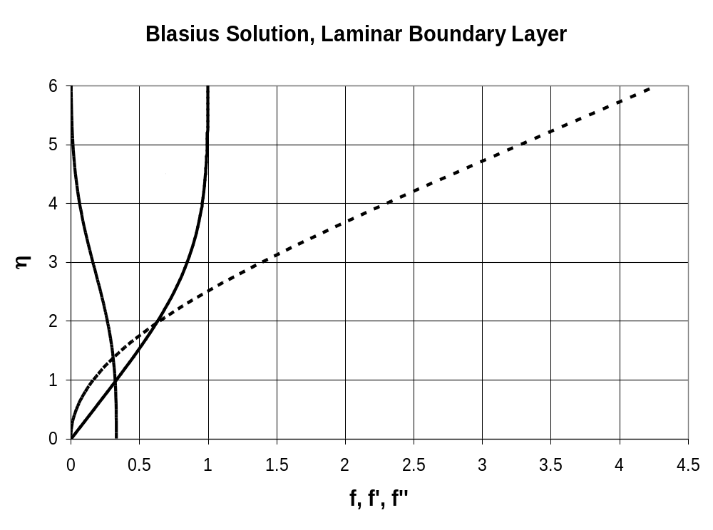
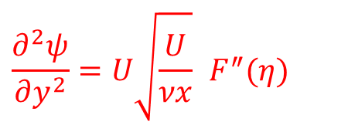

$$F^{′}$$
$$F^{″}$$
$$F$$
$$\frac{∂^{2}ψ}{∂y^{2}}=U\sqrt{\frac{U}{νx}} F^{″}(η)$$
$$F, F^{′}, F^{″}$$

Slide 24
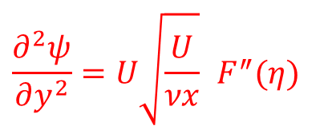
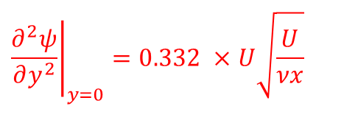
Iterative Solution Data
η F F' F''
0 0 0 0.33206
0.1 0.00166 0.03321 0.33205
0.2 0.00664 0.06641 0.33199
0.3 0.01494 0.0996 0.33181
0.4 0.02656 0.13277 0.33147
0.5 0.04149 0.16589 0.33091
0.6 0.05974 0.19894 0.33008
0.7 0.08128 0.23189 0.32892
0.8 0.10611 0.26471 0.32739
0.9 0.13421 0.29736 0.32544
1 0.16557 0.32978 0.32301
1.1 0.20016 0.36194 0.32007
1.2 0.23795 0.39378 0.31659
1.3 0.27891 0.42524 0.31253
1.4 0.32298 0.45627 0.30787
1.5 0.37014 0.48679 0.30258
1.6 0.42032 0.51676 0.29667
1.7 0.47347 0.54611 0.29011
1.8 0.52952 0.57476 0.28293
1.9 0.5884 0.60267 0.27514
2 0.65003 0.62977 0.26675
$$\frac{∂^{2}ψ}{∂y^{2}}=U\sqrt{\frac{U}{νx}} F^{″}(η)$$
$${\left.\frac{∂^{2}ψ}{∂y^{2}}\right|}_{y=0}=0.332 ×U\sqrt{\frac{U}{νx}}$$

Slide 25
η F F' F''
2.2 0.7812 0.68132 0.24835
2.3 0.85056 0.70566 0.23843
2.4 0.9223 0.72899 0.22809
2.5 0.99632 0.75127 0.21741
2.6 1.07251 0.77246 0.20646
2.7 1.15077 0.79255 0.19529
2.8 1.23099 0.81152 0.18401
2.9 1.31304 0.82935 0.17267
3 1.39682 0.84605 0.16136
3.1 1.48221 0.86162 0.15016
3.2 1.56911 0.87609 0.13913
3.3 1.65739 0.88946 0.12835
3.4 1.74696 0.90177 0.11788
3.5 1.83771 0.91305 0.10777
3.6 1.92954 0.92334 0.09809
3.7 2.02235 0.93268 0.08886
3.8 2.11604 0.94112 0.08013
3.9 2.21054 0.94872 0.07191

Slide 26
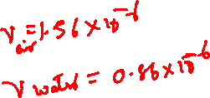
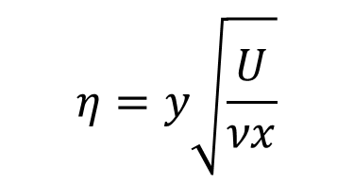
η F F' F''
4 2.30576 0.95552 0.06423
4.1 2.40162 0.96159 0.0571
4.2 2.49806 0.96696 0.05052
4.3 2.595 0.97171 0.04448
4.4 2.69238 0.97588 0.03897
4.5 2.79015 0.97952 0.03398
4.6 2.88827 0.98269 0.02948
4.7 2.98668 0.98543 0.02546
4.8 3.08534 0.98779 0.02187
4.9 3.18422 0.98982 0.0187
5 3.2833 0.99155 0.01591
5.1 3.38253 0.99301 0.01347
5.2 3.48189 0.99425 0.01134
5.3 3.58137 0.99529 0.00951
5.4 3.68094 0.99616 0.00793
5.5 3.7806 0.99688 0.00658
$$η=y\sqrt{\frac{U}{νx}}$$

Slide 27
η F F' F''
5.6 3.88032 0.99748 0.00543
5.7 3.98009 0.99798 0.00446
5.8 4.07991 0.99838 0.00365
5.9 4.17976 0.99871 0.00297
6 4.27965 0.99898 0.0024
6.1 4.37956 0.99919 0.00193
6.2 4.47949 0.99937 0.00155
6.3 4.57943 0.99951 0.00124
6.4 4.67939 0.99962 0.00098
6.5 4.77935 0.9997 0.00077
6.6 4.87933 0.99977 0.00061
6.7 4.97931 0.99983 0.00048
6.8 5.07929 0.99987 0.00037
6.9 5.17928 0.9999 0.00029
7 5.27927 0.99993 0.00022

Slide 28
η F F' F''
7.1 5.37927 0.99995 0.00017
7.2 5.47926 0.99996 0.00013
7.3 5.57926 0.99997 9.8E-05
7.4 5.67926 0.99998 7.4E-05
7.5 5.77925 0.99999 5.5E-05
7.6 5.87925 0.99999 4.1E-05
7.7 5.97925 1 3.1E-05
7.8 6.07925 1 2.3E-05
7.9 6.17925 1 1.7E-05
8 6.27925 1 1.2E-05
8.1 6.37925 1 8.9E-06
8.2 6.47925 1 6.5E-06
8.3 6.57925 1 4.7E-06
8.4 6.67925 1 3.4E-06
8.5 6.77925 1 2.4E-06
8.6 6.87925 1 1.7E-06
8.7 6.97925 1 1.2E-06
8.8 7.07925 1 8.5E-07

Slide 29
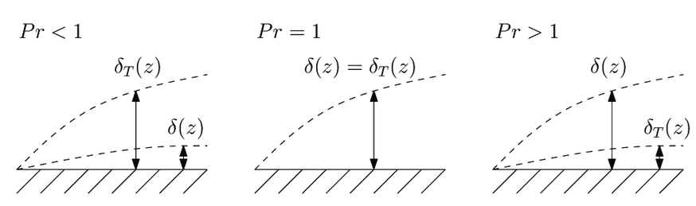
Nature of Master Thermal Profile Equation
$$\frac{∂^{2}G}{∂η^{2}}+\frac{Pr}{2}×F(η)\frac{∂G}{∂η}=0$$
The master momentum function $F(η)$ is known to us.
It is important to understand the interaction between Pr and $F(η)$ on behaviour of Master Temperature Profile.

Slide 30
ODE for Master Profile of Thermal Boundary Layer
$$\frac{∂^{2}G}{∂η^{2}}+\frac{Pr}{2}×F(η)\frac{∂G}{∂η}=0$$
$$G^{′′}+\frac{Pr}{2}×FG^{′}=0$$
$$\frac{G^{′′}}{G′}=−\frac{Pr}{2}×F$$
In general (for any Pr), above equation can be integrated, keeping in mind that F(η) is a known function available in tabular form
$$\int_{0}^{η}{\frac{G^{′′}}{G^{′}}dη} =−\frac{Pr}{2}\int_{0}^{η}{Fdη}$$
ln$G^{′}=−\frac{Pr}{2}\int_{0}^{η}{Fdη}+lnC$

Slide 31
Master Profile of Thermal Boundary Layer
ln$G^{′}=−\frac{Pr}{2}\int_{0}^{η}{Fdη}+lnC$
$$\text{U}\text{se} \text{separation} \text{of} \text{variables}\text{, }\text{to} \text{get}$$
$$\frac{G^{′}}{C}=e^{\left\{−\frac{Pr}{2}\int_{0}^{η}{Fdη}\right\}}$$
If $G^{′}\left(η=0\right)$ is known by any other means:
$$G^{′}=G^{′}\left(0\right)e^{\left\{−\frac{Pr}{2}\int_{0}^{η}{Fdη}\right\}}$$
Integrating above equation again from 0 to η yields
$$G=\int_{0}^{η}{\begin{aligned}\begin{aligned} \\ \left\{G^{′}\left(0\right)e^{\left\{−\frac{Pr}{2}\int_{0}^{η}{Fdη}\right\}}\right\}dη\end{aligned}+D \\ \end{aligned}}$$
The boundary conditions for G
$$G(0)=1 , G(η→∞)=0$$

Slide 32
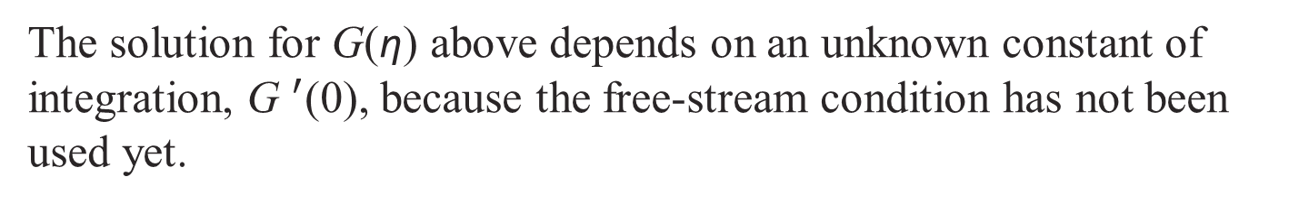
Master Profile of Thermal Boundary Layer
$$G=G^{′}\left(0\right)\int_{0}^{η}{\begin{aligned}\begin{aligned} \\ \left\{e^{\left\{−\frac{Pr}{2}\int_{0}^{η}{Fdη}\right\}}\right\}dη\end{aligned}+D \\ \end{aligned}}$$
The boundary conditions for G
$$G(0)=1 , G(η→∞)=0$$
Use the wall boundary condition to get
$1 =D$
$$G=G^{′}\left(0\right)\int_{0}^{η}{\begin{aligned}\begin{aligned} \\ \left\{e^{\left\{−\frac{Pr}{2}\int_{0}^{η}{Fdη}\right\}}\right\}dη\end{aligned}+1 \\ \end{aligned}}$$
The solution for G(η) above depends on an unknown constant of integration, ${\text{G} }^{′}$(0), because the free-stream condition has not been used yet.

Slide 33
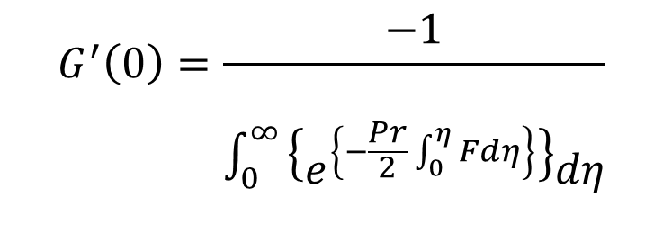
Master Profile of Thermal Boundary Layer
$$G=1+G^{′}\left(0\right)\int_{0}^{η}{\begin{aligned}\begin{aligned} \\ \left\{e^{\left\{−\frac{Pr}{2}\int_{0}^{η}{Fdη}\right\}}\right\}dη\end{aligned} \\ \end{aligned}}$$
The boundary conditions for G
$$G(0)=1 , G(η→∞)=0$$
Use the free stream boundary condition to get:
$$0 =G^{′}\left(0\right)\int_{0}^{∞}{\begin{aligned}\begin{aligned} \\ \left\{e^{\left\{−\frac{Pr}{2}\int_{0}^{η}{Fdη}\right\}}\right\}dη\end{aligned}+1 \\ \end{aligned}}$$
$$G^{′}\left(0\right)=\frac{−1}{\int_{0}^{∞}{\begin{aligned}\begin{aligned} \\ \left\{e^{\left\{−\frac{Pr}{2}\int_{0}^{η}{Fdη}\right\}}\right\}dη\end{aligned} \\ \end{aligned}}}$$

Slide 34
Master Profile of Thermal Boundary Layer
$$θ\left(η\right)=1− \frac{\int_{0}^{η}{\begin{aligned}\begin{aligned} \\ \left\{e^{\left\{−\frac{Pr}{2}\int_{0}^{η}{Fdη}\right\}}\right\}dη\end{aligned} \\ \end{aligned}}}{\int_{0}^{∞}{\begin{aligned}\begin{aligned} \\ \left\{e^{\left\{−\frac{Pr}{2}\int_{0}^{η}{Fdη}\right\}}\right\}dη\end{aligned} \\ \end{aligned}}}$$
The solution is now complete.
Master Temperature profiles for different Prandtl Number can be generated using above equation.

Slide 35
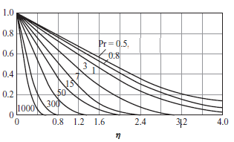
Master Temperature Profile for FP Boundary Layer
$$G\left(η\right)$$

Slide 36
Estimation of Local Heat Transfer Coefficient Using Master Profiles
$$θ\left(η\right)=1− \frac{\int_{0}^{η}{\begin{aligned}\begin{aligned} \\ \left\{e^{\left\{−\frac{Pr}{2}\int_{0}^{η}{Fdη}\right\}}\right\}dη\end{aligned} \\ \end{aligned}}}{\int_{0}^{∞}{\begin{aligned}\begin{aligned} \\ \left\{e^{\left\{−\frac{Pr}{2}\int_{0}^{η}{Fdη}\right\}}\right\}dη\end{aligned} \\ \end{aligned}}}$$
The value of $θ^{′}$(0) is the most important information for calculating convection heat transfer coefficient.
Recall the local application of Newton’s law of wall cooling.
$$q^{′′}=h\left(T_{s}−T_{∞}\right)=−k{\left.\frac{∂T}{∂y}\right|}_{y=0}$$
$$h=\frac{−k}{\left(T_{s}−T_{∞}\right)}{\left.\frac{∂T}{∂y}\right|}_{y=0}$$

Slide 37
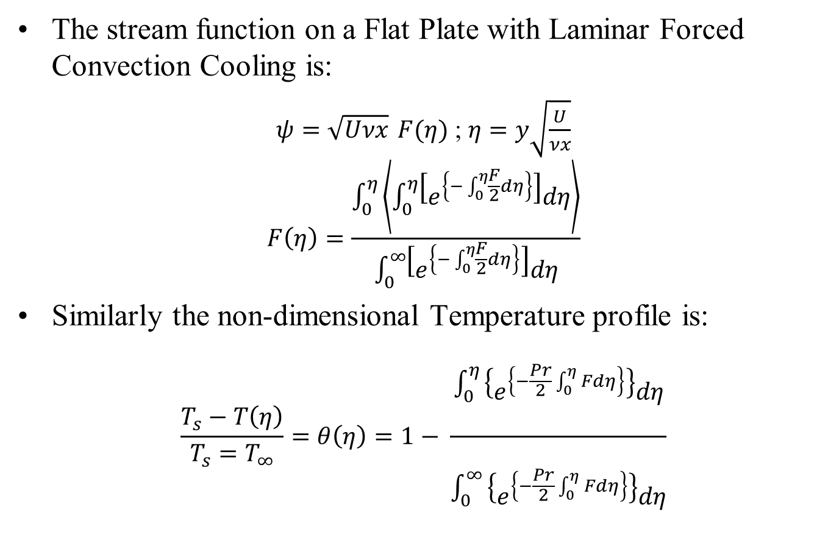
Stream Function and Temperature Profiles
The stream function on a Flat Plate with Laminar Forced Convection Cooling is:
$ψ=\sqrt{Uνx} F(η)$ ; $η=y\sqrt{\frac{U}{νx}}$
$$F\left(η\right)=\frac{\int_{0}^{η}{\left\langle \int_{0}^{η}{\left[e^{\left\{−\int_{0}^{η}{\frac{F}{2}dη}\right\}}\right]dη}\right\rangle }}{\int_{0}^{∞}{\left[e^{\left\{−\int_{0}^{η}{\frac{F}{2}dη}\right\}}\right]dη}}$$
Similarly the non-dimensional Temperature profile is:
$$\frac{T_{s}−T\left(η\right)}{T_{s}=T_{∞}}=θ\left(η\right)=1− \frac{\int_{0}^{η}{\begin{aligned}\begin{aligned} \\ \left\{e^{\left\{−\frac{Pr}{2}\int_{0}^{η}{Fdη}\right\}}\right\}dη\end{aligned} \\ \end{aligned}}}{\int_{0}^{∞}{\begin{aligned}\begin{aligned} \\ \left\{e^{\left\{−\frac{Pr}{2}\int_{0}^{η}{Fdη}\right\}}\right\}dη\end{aligned} \\ \end{aligned}}}$$

Slide 38
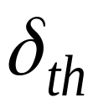


Role of Prandtl Number on Cooling Behaviour of Fluids
For large Pr (oils):
For small Pr (liquid metals):
y
y
x
x
Pr > 1000
Pr < 0.1
Fluid viscosity greater than thermal diffusivity
Fluid viscosity less than thermal diffusivity

Slide 39
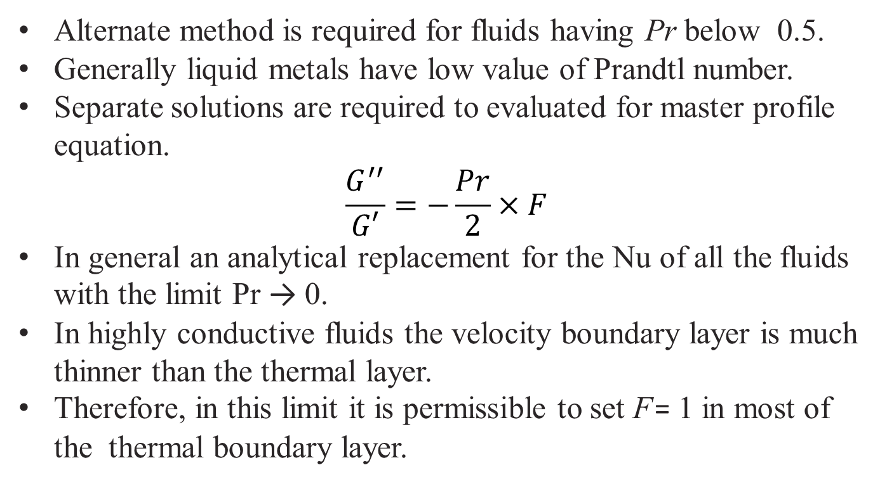
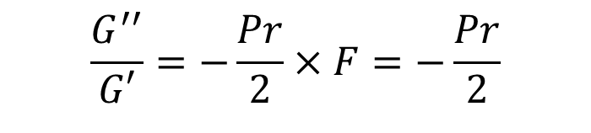
Master Profile of Low Prandtl Number Thermal Boundary Layer
Alternate method is required for fluids having Pr below 0.5.
Generally liquid metals have low value of Prandtl number.
Separate solutions are required to evaluated for master profile equation.
$$\frac{G^{′′}}{G′}=−\frac{Pr}{2}×F$$
In general an analytical replacement for the Nu of all the fluids with the limit Pr → 0.
In highly conductive fluids the velocity boundary layer is much thinner than the thermal layer.
Therefore, in this limit it is permissible to set F = 1 in most of the thermal boundary layer.
$$\frac{G^{′′}}{G′}=−\frac{Pr}{2}×F=−\frac{Pr}{2}$$

Slide 40
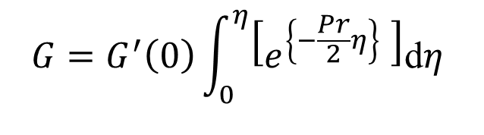
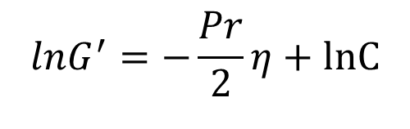





Master Profile of Low Prandtl Number Thermal Boundary Layer
Master profile for Thermal Boundary Layer of low Pr.
$$\frac{G^{′′}}{G′}=−\frac{Pr}{2}$$
This equation leads to an explicit solution for G(η):
$$lnG^{′}=−\frac{Pr}{2}η+lnC$$
$$ln\left\{\frac{G^{′}}{C}\right\}=−\frac{Pr}{2}η$$
$$G^{′}=Ce^{\left\{−\frac{Pr}{2}η\right\}}$$
$$G^{′}=G^{′}\left(0\right)e^{\left\{−\frac{Pr}{2}η\right\}}$$
Further integration to get an explicit solution for G(η):
$$G=G^{′}\left(0\right)\int_{0}^{η}{\left[e^{\left\{−\frac{Pr}{2}η\right\}} \right]\text{d}η}$$
$$⇒G\left(η\right)=G^{′}\left(0\right)erf\left\{\frac{η}{2}\sqrt{Pr}\right\}$$

Slide 41



Experimental Study
$$T_{∞}, U_{∞}$$
$$T_{\text{wing} \text{surface}}$$
How to set up an experimental test?
Let’s say you want to know the heat transfer rate of an airplane wing (with fuel inside) flying at steady conditions………….
What are the parameters involved?
  Velocity, –wing length,
  Prandtl number, –viscosity,
  Nusselt number,
Which of these can we control easily?
Looking for the relation using Principle of Similitude:
$$\overline{Nu}=C{Re}_{L}^{m}{{Pr}^{n}{}}$$

Slide 42


Experimental Studies to Develop Empirical Correlation
$$T_{∞}, U_{∞}$$
L
Insulation
At steady state electrical power input to the heater is equal to rate of total cooling (Convection Heat Transfer) by surrounding fluid.
Measure current (hence heat transfer) with various fluids and test conditions.
Fluid properties are typically evaluated at the mean film temperature

