Slide 1


Analysis of Convection Heat Transfer in Flat Plate Boundary Layer
I distinguish between exact knowledge and learning.
As a good teacher, you should allow students to use their notes during exams and ask questions on their integral knowledge.
P M V Subbarao
Professor & Head
Mechanical Engineering Department
Thus Spake Blasius:
“I realized that, for me, mathematics was a collection of Tricks”

Slide 2

Blasius: Didactical Essence
I wanted to present a heuristic approach by accounting for the three impressions of the human mind:
perception of ideas,
elaboration of methods, and
description of phenomena.
Learning, working and order are thus the three essences of the mind.
From 1920 to 1930, I mainly collected examples to present the basics of a problem.
Finally, the heat transfer book appeared in 1931 (Blasius 1931), and then three booklets on mechanics by 1935.

Slide 3
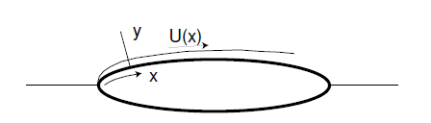
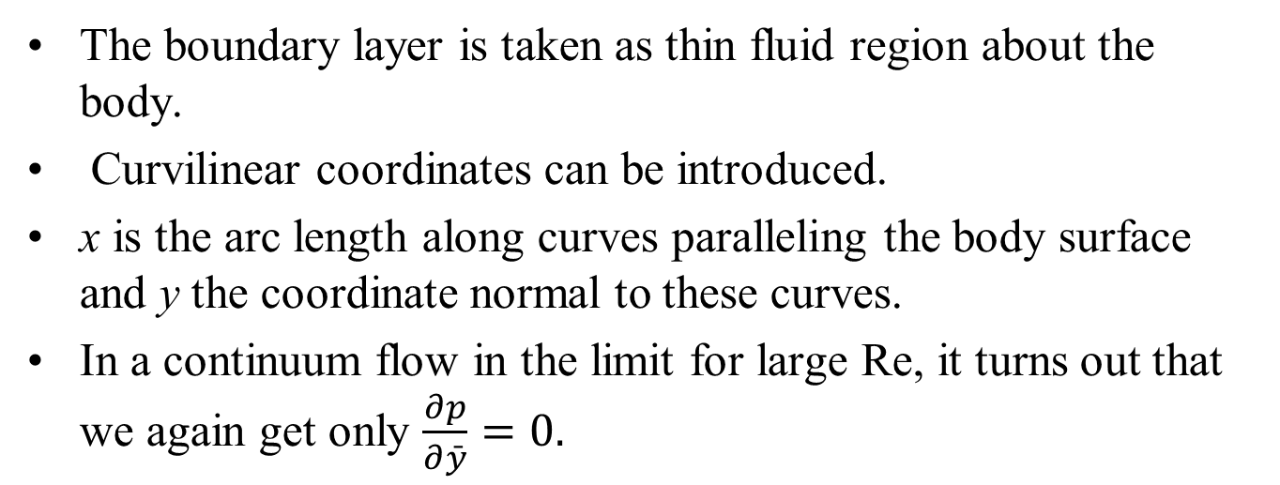

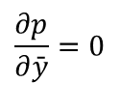
Prandtls Viscous Flow Past a General Body
Prandtl’s striking intuition is clearer when we consider flow past a general smooth body.
The boundary layer is taken as thin fluid region about the body.
Curvilinear coordinates can be introduced.
x is the arc length along curves paralleling the body surface and y the coordinate normal to these curves.
In a continuum flow in the limit for large Re, it turns out that we again get only $\frac{∂p}{∂\bar{y}}=0.$
$$\frac{∂p}{∂\bar{y}}=0$$
must be interpreted to mean that the pressure is what would be computed using Euler theory.

Slide 4
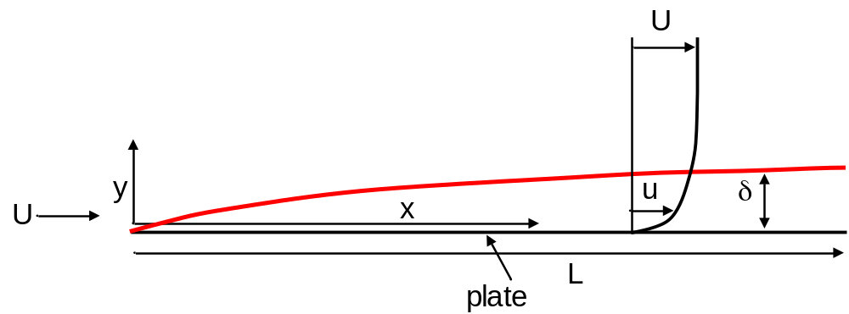
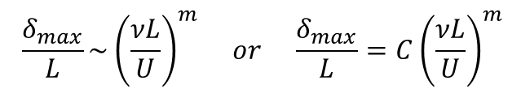
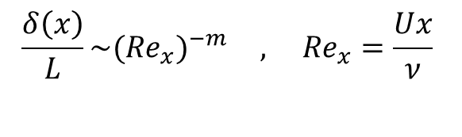
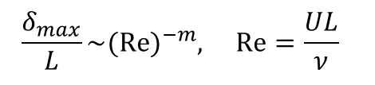
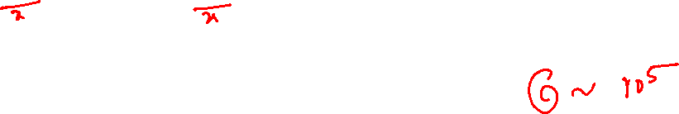
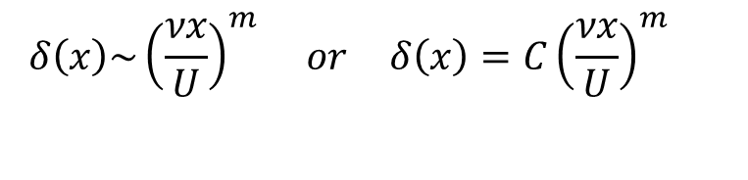
Streamwise Variation of Momentum Boundary Layer Thickness
Consider a plate of length L.
Prandtl’s Boundary Layer Approximations: boundary layer must grow slowly along flow direction.
Hence, maximum value of boundary layer thickness, δ_{max} is expected to vary as:
$$\frac{δ_{max}}{L}\sim {\left(\frac{νL}{U}\right)}^{m} or \frac{δ_{max}}{L}=C{\left(\frac{νL}{U}\right)}^{m}$$
$$\frac{δ_{max}}{L}\sim (Re)^{−m}, Re=\frac{UL}{ν}$$
Similarly, the local value of δ(x) is estimated as
$$\frac{δ\left(x\right)}{L}\sim ({Re}_{x})^{−m} , {Re}_{x}=\frac{Ux}{ν}$$
$$δ\left(x\right)\sim {\left(\frac{νx}{U}\right)}^{m} or δ\left(x\right)=C{\left(\frac{νx}{U}\right)}^{m}$$
Re_{x} : Local Reynolds Number

Slide 5
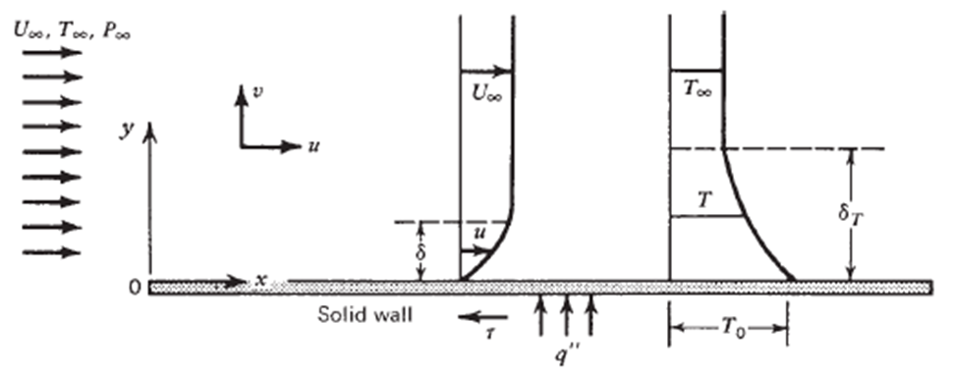
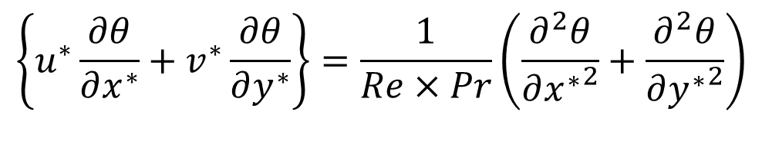
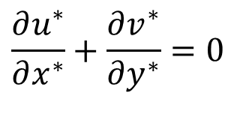
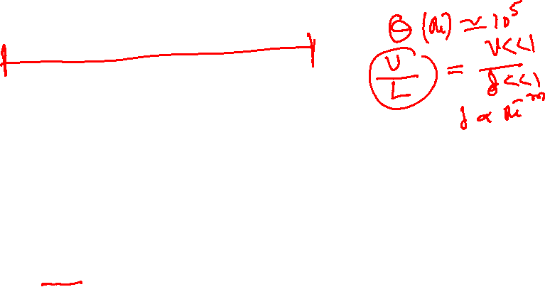
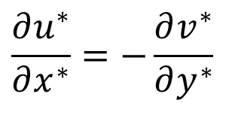
Order of Magnitude Analysis For A Thin Boundary Layer
$$\frac{∂u^{∗}}{∂x^{∗}}+\frac{∂v^{∗}}{∂y^{∗}}=0$$
Continuity Equation:
$$\frac{∂u^{∗}}{∂x^{∗}}=−\frac{∂v^{∗}}{∂y^{∗}}$$
Prandtl’s Intuitional Fluid Mechanics
$$as δ \&{ δ}_{T}≪L →v^{∗}≪u^{∗}….$$
$$if u^{∗}is 𝒪\left(1\right), then{ v}^{∗}is 𝒪\left(0\right)….$$
GDE for Convection:
$$\left\{u^{∗}\frac{∂θ}{∂x^{∗}}+v^{∗}\frac{∂θ}{∂y^{∗}}\right\}=\frac{1}{Re×Pr}\left(\frac{∂^{2}θ}{∂{x^{∗}}^{2}}+\frac{∂^{2}θ}{∂{y^{∗}}^{2}}\right)$$

Slide 6
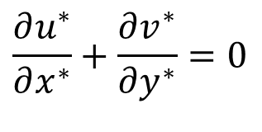
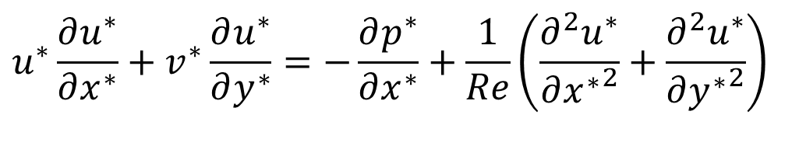
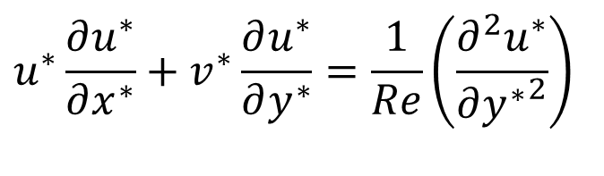
Order of Magnitude Analysis
X-momentum for a flat plate boundary Layer:
0
O(0)
If O(1)
$$u^{∗}\frac{∂u^{∗}}{∂x^{∗}}+v^{∗}\frac{∂u^{∗}}{∂y^{∗}}=−\frac{∂p^{∗}}{∂x^{∗}}+\frac{1}{Re}\left(\frac{∂^{2}u^{∗}}{∂{x^{∗}}^{2}}+\frac{∂^{2}u^{∗}}{∂{y^{∗}}^{2}}\right)$$
$$u^{∗}\frac{∂u^{∗}}{∂x^{∗}}+v^{∗}\frac{∂u^{∗}}{∂y^{∗}}=\frac{1}{Re}\left(\frac{∂^{2}u^{∗}}{∂{y^{∗}}^{2}}\right)$$
$$\frac{∂u^{∗}}{∂x^{∗}}+\frac{∂v^{∗}}{∂y^{∗}}=0$$

Slide 7
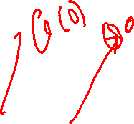
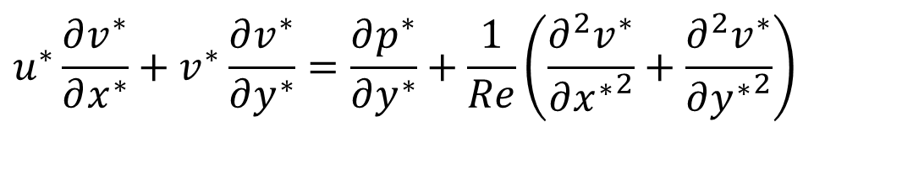
Order of Magnitude Analysis & Intuition
Y-momentum for a flat plate boundary Layer:
:
$$u^{∗}\frac{∂v^{∗}}{∂x^{∗}}+v^{∗}\frac{∂v^{∗}}{∂y^{∗}}=\frac{∂p^{∗}}{∂y^{∗}}+\frac{1}{Re}\left(\frac{∂^{2}v^{∗}}{∂{x^{∗}}^{2}}+\frac{∂^{2}v^{∗}}{∂{y^{∗}}^{2}}\right)$$
Euler pressure field is same in the entire boundary layer!
As pressure field is known, No need to solve Y-momentum equation…

Slide 8
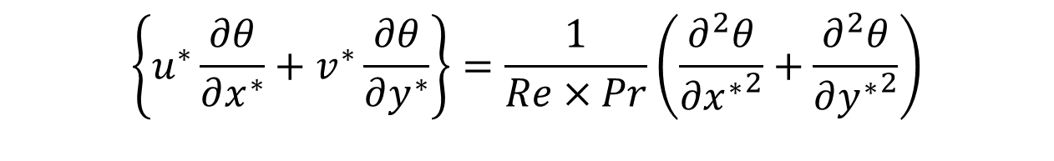
Order of Magnitude Analysis
Energy Equation for a flat plate boundary Layer:
O(0)
If O(1)
$$\left\{u^{∗}\frac{∂θ}{∂x^{∗}}+v^{∗}\frac{∂θ}{∂y^{∗}}\right\}=\frac{1}{Re×Pr}\left(\frac{∂^{2}θ}{∂{x^{∗}}^{2}}+\frac{∂^{2}θ}{∂{y^{∗}}^{2}}\right)$$

Slide 9
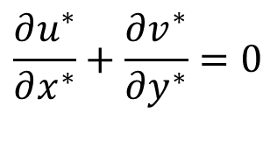

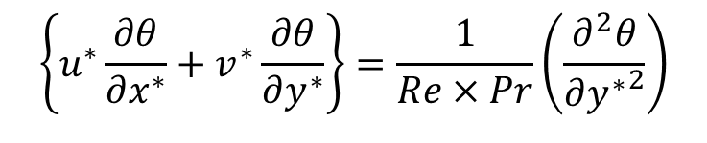
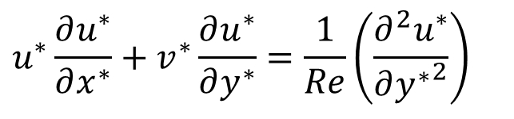


Zero Pressure Gradient Boundary Layer
Prandtl’s boundary layer equations for flat plate:
$$\frac{∂u^{∗}}{∂x^{∗}}+\frac{∂v^{∗}}{∂y^{∗}}=0$$
$$u^{∗}\frac{∂u^{∗}}{∂x^{∗}}+v^{∗}\frac{∂u^{∗}}{∂y^{∗}}=\frac{1}{Re}\left(\frac{∂^{2}u^{∗}}{∂{y^{∗}}^{2}}\right)$$
$$\left\{u^{∗}\frac{∂θ}{∂x^{∗}}+v^{∗}\frac{∂θ}{∂y^{∗}}\right\}=\frac{1}{Re×Pr}\left(\frac{∂^{2}θ}{∂{y^{∗}}^{2}}\right)$$
Subject to the conditions:
$$u^{∗}=v^{∗}=0\text{; }θ=1 \text{at} y=0 ∨x>0$$
$$u→U \text{\& }θ→0 as y→δ ∨x>0$$
How to find a solution of a non-linear partial differential equation?

Slide 10
Forced Convection: Momentum BL is Forced on Thermal BL
Natural Convection: Momentum BL is Created by Thermal BL
Justification ????

Slide 11
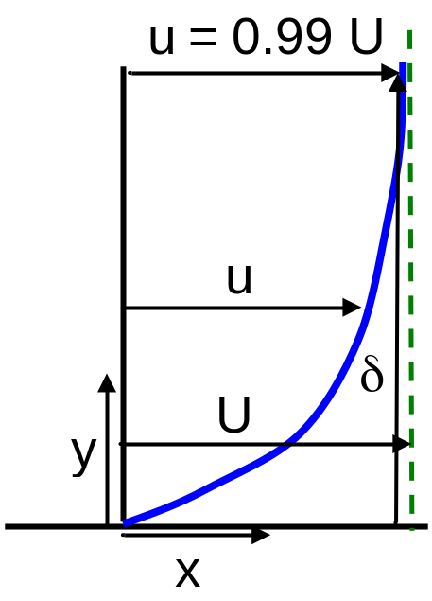
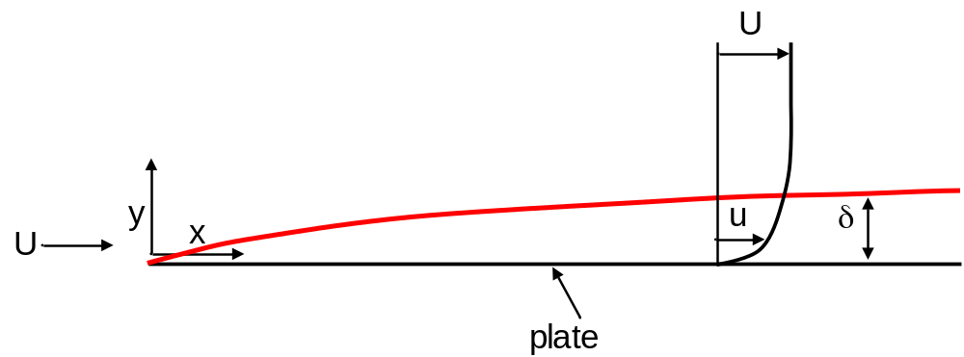
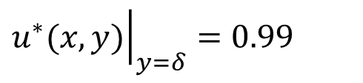
Nominal Momentum Boundary Layer Thickness
Until now we have not given a precise definition for boundary layer thickness.
Use δ to denote nominal boundary thickness, which is defined to be the value of y at which u = 0.99 U, i.e.
$${\left.u^{∗}(x,y)\right|}_{y=δ}=0.99$$
The choice 0.99 is arbitrary; we could have chosen 0.98 or 0.995 or whatever we find reasonable for obtaining solution with acceptable accuracy.

Slide 12
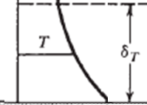
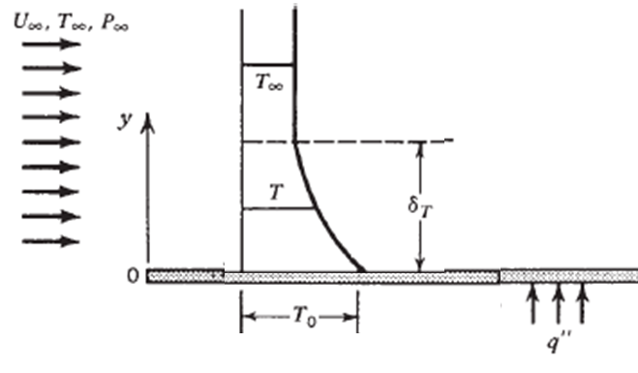

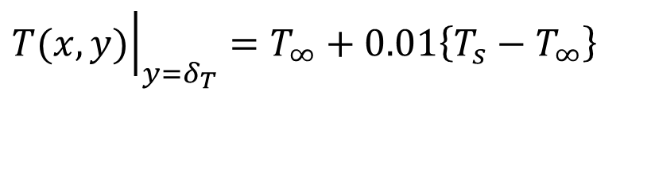

Nominal Thermal Boundary Layer Thickness
Use δ_{T} to denote nominal Thermal boundary thickness, which is defined to be the value of y at which θ = 0.01, i.e.
$${\left.T(x,y)\right|}_{y=δ_{T}}=T_{∞}+0.01\left\{T_{s}−T_{∞}\right\}$$
$$T_{∞}+0.01\left\{T_{s}−T_{∞}\right\}$$
$$T_{s}$$
The choice 0.01 is arbitrary; we could have chosen 0.02 or 0.005 or whatever we find reasonable for obtaining solution with acceptable accuracy.

Slide 13
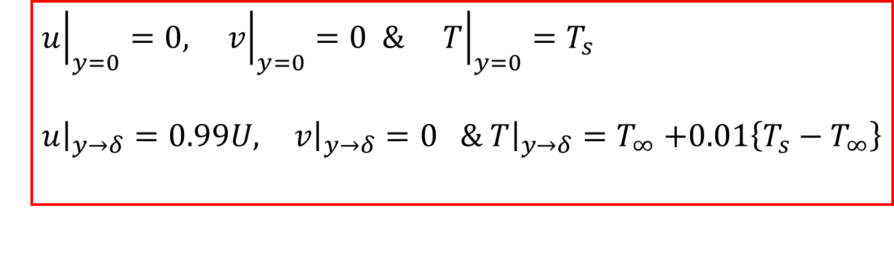
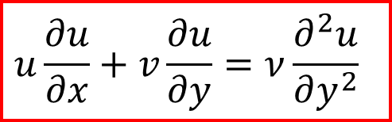
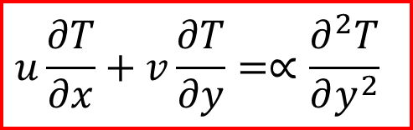
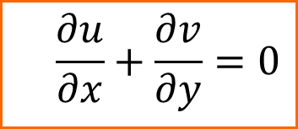
2-D FLAT PLATE Laminar Boundary Layer Equations in Dimensional Form
$$\frac{∂u}{∂x}+\frac{∂v}{∂y}=0$$
$$u\frac{∂u}{∂x}+v\frac{∂u}{∂y}=ν\frac{∂^{2}u}{∂y^{2}}$$
$$u\frac{∂T}{∂x}+v\frac{∂T}{∂y}=∝\frac{∂^{2}T}{∂y^{2}}$$
At all x > 0
$${\left.u\right|}_{y=0}=0, {\left.v\right|}_{y=0}=0 \& {\left.T\right|}_{y=0}=T_{s}$$
${\left.u\right|}_{y→δ}=0.99U,{\left. v\right|}_{y→δ}=0 \&$ ${\left.T\right|}_{y→δ}=$ $T_{∞}$ $+0.01\left\{T_{s}−T_{∞}\right\}$

Slide 14
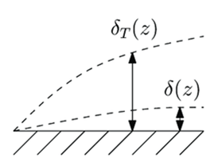
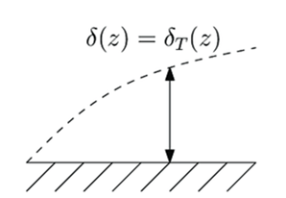
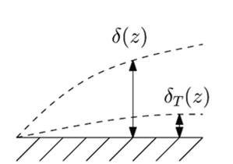
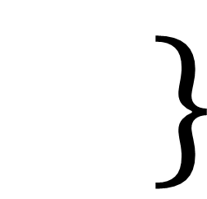







Size Comparison of Momentum BL & Thermal BL: Forced Convection in FPBL
$$\frac{∂u}{∂x}+\frac{∂v}{∂y}=0$$
$$→inputs u \& v to$$
$$u\frac{∂T}{∂x}+v\frac{∂T}{∂y}=∝\frac{∂^{2}T}{∂y^{2}}$$
$$u\frac{∂u}{∂x}+v\frac{∂u}{∂y}=ν\frac{∂^{2}u}{∂y^{2}}$$
$$ν< α$$
$$ν= α$$
$$ν> α$$

Slide 15
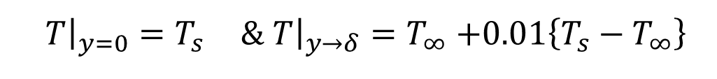
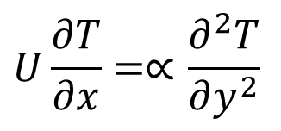
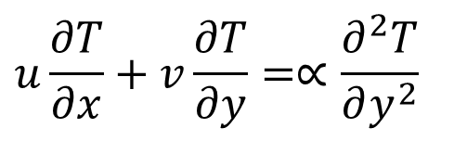
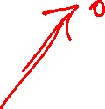
Boundary Layer Equations for High Thermal Diffusivity Fluids
$$ν< α$$
u = U & v =0 in large portion of thermal boundary layer!
No need to solve Momentum BL equations:
$$u\frac{∂T}{∂x}+v\frac{∂T}{∂y}=∝\frac{∂^{2}T}{∂y^{2}}$$
$$U\frac{∂T}{∂x}=∝\frac{∂^{2}T}{∂y^{2}}$$
At x = 0, T=T∞
${\left.T\right|}_{y=0}=T_{s} \&$ ${\left.T\right|}_{y→δ}=$ $T_{∞}$ $+0.01\left\{T_{s}−T_{∞}\right\}$
At all x > 0

Slide 16

Boundary Layer Equations for High Viscosity Fluids
$$ν> α$$
T= T∞ in large portion of thermal boundary layer!
Large Temperature gradient at wall.
How to Deal with this case.

Slide 17

Momentum BL & Thermal BL are Comparable
$$\frac{∂u}{∂x}+\frac{∂v}{∂y}=0$$
$$→inputs u \& v to$$
$$u\frac{∂T}{∂x}+v\frac{∂T}{∂y}=∝\frac{∂^{2}T}{∂y^{2}}$$
$$u\frac{∂u}{∂x}+v\frac{∂u}{∂y}=ν\frac{∂^{2}u}{∂y^{2}}$$
$$ν=\text{O}\left(α\right)$$
Blasius’s Mathematical Tricks for Prantl’s Intuition

Slide 18
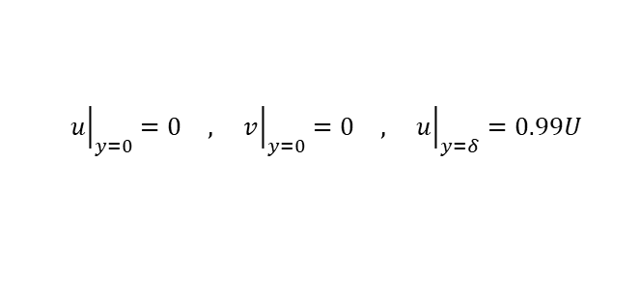
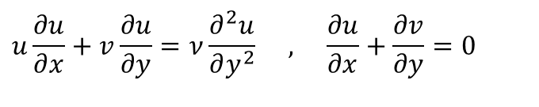
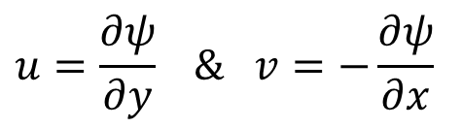
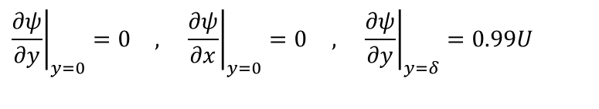
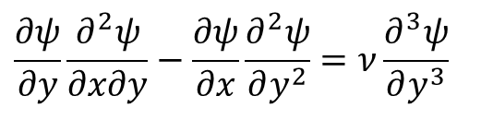
2D FPBL : Reduce the Number of Dependent Variables
$$u\frac{∂u}{∂x}+v\frac{∂u}{∂y}=ν\frac{∂^{2}u}{∂y^{2}} , \frac{∂u}{∂x}+\frac{∂v}{∂y}=0$$
$${\left.u\right|}_{y=0}=0 , {\left.v\right|}_{y=0}=0 , {\left.u\right|}_{y=δ}=0.99U$$
For a 2D flow, Stream function, ψ(x,y), is defines as:
$$u=\frac{∂ψ}{∂y} \& v=−\frac{∂ψ}{∂x}$$
Note that the stream function satisfies continuity identically.
$$\frac{∂ψ}{∂y}\frac{∂^{2}ψ}{∂x∂y}−\frac{∂ψ}{∂x}\frac{∂^{2}ψ}{∂y^{2}}=ν\frac{∂^{3}ψ}{∂y^{3}}$$
$${\left.\frac{∂ψ}{∂y}\right|}_{y=0}=0 , {\left.\frac{∂ψ}{∂x}\right|}_{y=0}=0 , {\left.\frac{∂ψ}{∂y}\right|}_{y=δ}=0.99U$$

Slide 19
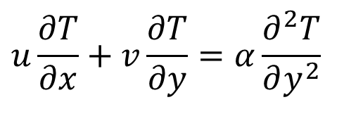
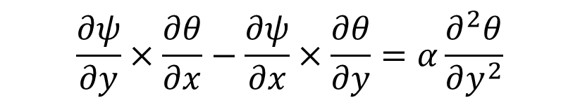
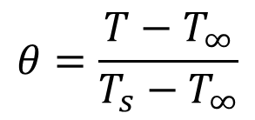
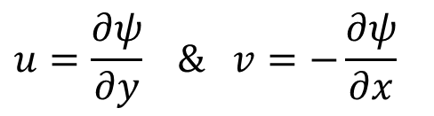

2-D Laminar Thermal Boundary Layer Equation
$$u\frac{∂T}{∂x}+v\frac{∂T}{∂y}=α\frac{∂^{2}T}{∂y^{2}}$$
$$θ=\frac{T−T_{∞}}{T_{s}−T_{∞}}$$
$$u\frac{∂θ}{∂x}+v\frac{∂θ}{∂y}=α\frac{∂^{2}θ}{∂y^{2}}$$
$$u=\frac{∂ψ}{∂y} \& v=−\frac{∂ψ}{∂x}$$
$$\frac{∂ψ}{∂y}×\frac{∂θ}{∂x}−\frac{∂ψ}{∂x}×\frac{∂θ}{∂y}=α\frac{∂^{2}θ}{∂y^{2}}$$

Slide 20




Similarity of Momentum and Thermal; Governing Equations
$$\frac{∂ψ}{∂y}\frac{∂^{2}ψ}{∂x∂y}−\frac{∂ψ}{∂x}\frac{∂^{2}ψ}{∂y^{2}}=ν\frac{∂^{3}ψ}{∂y^{3}}$$
$$\frac{∂ψ}{∂y}×\frac{∂θ}{∂x}−\frac{∂ψ}{∂x}×\frac{∂θ}{∂y}=α\frac{∂^{2}θ}{∂y^{2}}$$
δ
L

Slide 21


Existence of Master Profile of Velocity
δ
L
$$\frac{∂ψ}{∂y}\frac{∂^{2}ψ}{∂x∂y}−\frac{∂ψ}{∂x}\frac{∂^{2}ψ}{∂y^{2}}=ν\frac{∂^{3}ψ}{∂y^{3}}$$

Slide 22






Existence of Master Profile of Temperature
$$\frac{∂ψ}{∂y}×\frac{∂θ}{∂x}−\frac{∂ψ}{∂x}×\frac{∂θ}{∂y}=α\frac{∂^{2}θ}{∂y^{2}}$$
$$1.01×T_{∞}$$
$$1.01×T_{∞}$$
$$1.01×T_{∞}$$

Slide 23




Discovery of Independent variable (Similarity Variable) of Master Profiles by Guessing
$$\frac{∂ψ}{∂y}\frac{∂^{2}ψ}{∂x∂y}−\frac{∂ψ}{∂x}\frac{∂^{2}ψ}{∂y^{2}}=ν\frac{∂^{3}ψ}{∂y^{3}}$$
$$\frac{∂ψ}{∂y}×\frac{∂θ}{∂x}−\frac{∂ψ}{∂x}×\frac{∂θ}{∂y}=α\frac{∂^{2}θ}{∂y^{2}}$$
The truth of boundary layer physics is
$$ψ=F\left(η\right) \& θ=G\left(η\right)$$
$$where,η=g(x,y)$$
F & G are (similarity functions) master functions of stream functions and temperature, respectively.
Both are scalar functions….
Is it possible to guess Simple form of above functions?
Fluid Mechanics as A Puzzle Game!
Developed by Paul Richard Heinrich Blasius in 1908 as a student of Ludwig Prandtl

