Slide 1
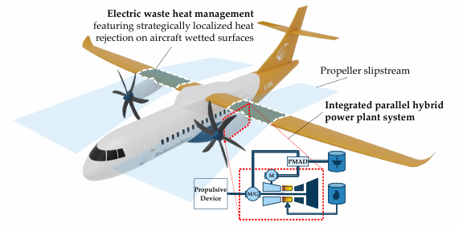

Boundary Layer Convection Heat Transfer
P M V Subbarao
Professor & Head
Mechanical Engineering Department
An Ingenious Analytics of Limited Fluid Domain Phenomena……

Slide 2

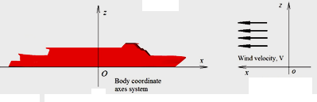
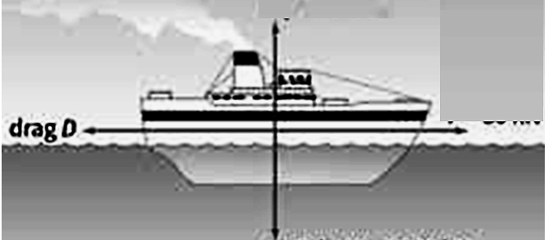
Commercial Need of Flat Plate Viscous Drag
Drag Force is proportional to Length of a Ship!!!
Experiments of Froude (1872) on a thin fiat plate towed through still water made it clear that the frictional resistance does not vary at greater rates as the length but at a smaller rate.

Slide 3
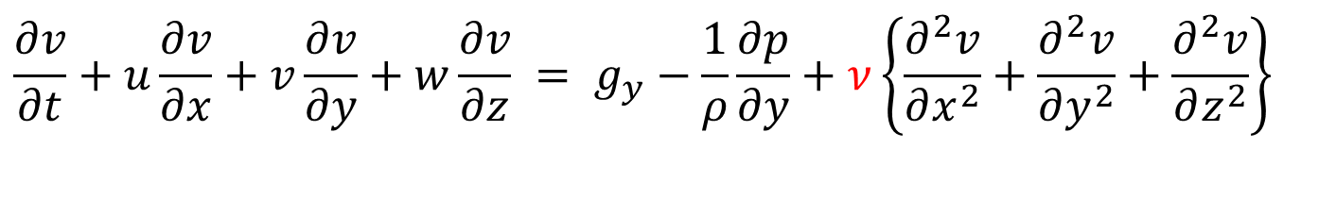
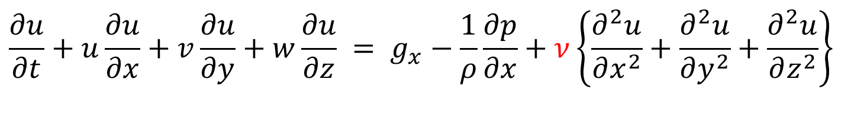
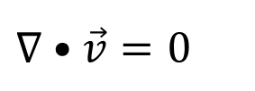
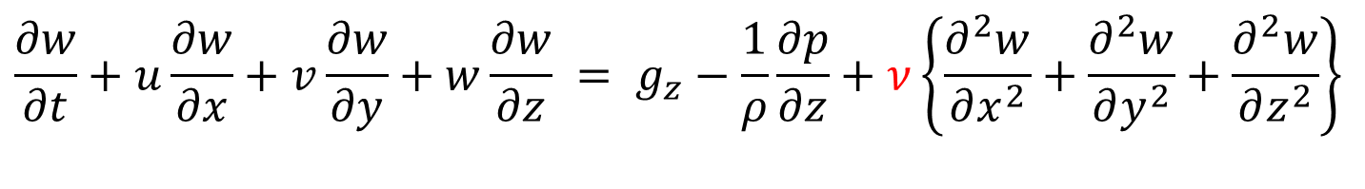
N-S Equations for Incompressible Flows
$$∇•\vec{v}=0$$
Conservation of Mass:
Stokes Regime
Euler Regime
X-momentum Equation:
$$\frac{∂u}{∂t}+u\frac{∂u}{∂x}+v\frac{∂u}{∂y}+w\frac{∂u}{∂z} = g_{x}−\frac{1}{ρ}\frac{∂p}{∂x}+ν\left\{\frac{∂^{2}u}{∂x^{2}}+\frac{∂^{2}u}{∂y^{2}}+\frac{∂^{2}u}{∂z^{2}}\right\}$$
Y-momentum Equation:
$$\frac{∂v}{∂t}+u\frac{∂v}{∂x}+v\frac{∂v}{∂y}+w\frac{∂v}{∂z} = g_{y}−\frac{1}{ρ}\frac{∂p}{∂y}+ν\left\{\frac{∂^{2}v}{∂x^{2}}+\frac{∂^{2}v}{∂y^{2}}+\frac{∂^{2}v}{∂z^{2}}\right\}$$
Z-momentum Equation:
$$\frac{∂w}{∂t}+u\frac{∂w}{∂x}+v\frac{∂w}{∂y}+w\frac{∂w}{∂z} = g_{z}−\frac{1}{ρ}\frac{∂p}{∂z}+ν\left\{\frac{∂^{2}w}{∂x^{2}}+\frac{∂^{2}w}{∂y^{2}}+\frac{∂^{2}w}{∂z^{2}}\right\}$$

Slide 4
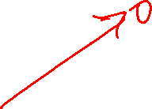
Stokes Equation for (Exclusively) Viscous Flow Systems
The basic assumption of creeping flow was developed by Stokes (1851) in a seminal paper.
This states that density (inertia) terms are negligible in the momentum equation.
$$\left({\left[v\right]}_{i,0}+v_{j}{\left[v_{i}\right]}_{,j}\right)=\vec{g}−\frac{1}{ρ}p_{,i}+ν{\left[v_{i}\right]}_{,jj}$$
$\vec{g}−\frac{1}{ρ}p_{,i}+ν{\left[v_{i}\right]}_{,jj}$=0
Under non-gravitational field:
$−\frac{1}{ρ}p_{,i}+ν{\left[v_{i}\right]}_{,jj}$=0
$$μ∇^{2}\vec{v}=∇p$$
with
$$∇•\vec{v}=0$$

Slide 5

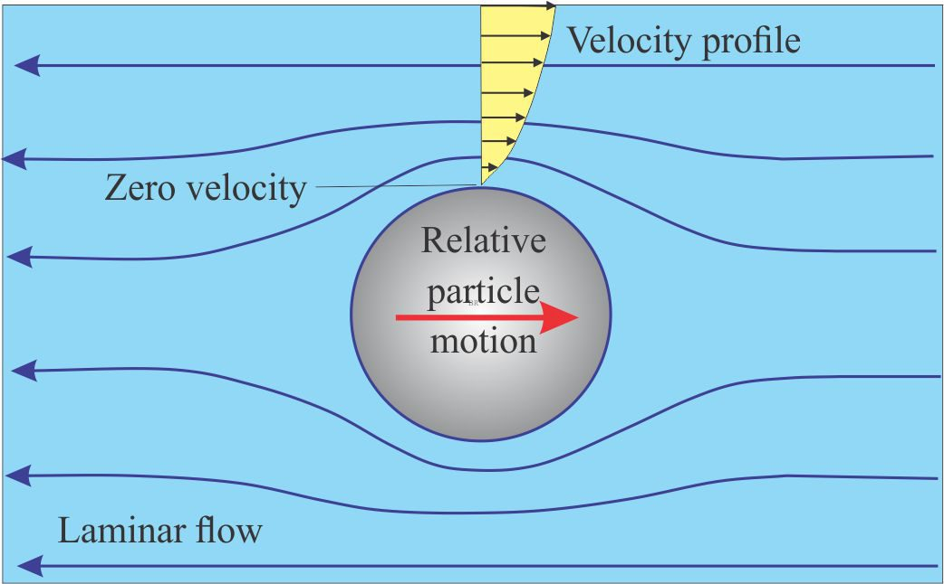
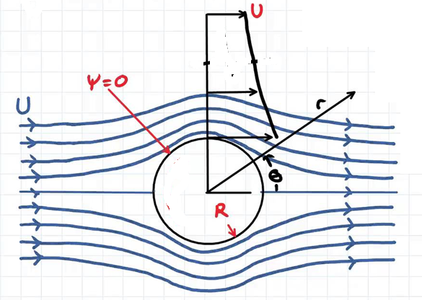
Imagination of Flow on the Surface of a Sphere
Stokes Imagination: Exclusively Viscous Flow
Euler’s Imagination: Inviscid Flow
Larger velocity near the sphere is an inertial effect.

Slide 6
Popular Creeping Flows
Fully developed duct Flow.
Flow about immersed bodies
Flow in narrow but variable passages. First formulated by Reynolds (1886) and known as lubrication theory,
Flow through porous media. This topic began with a famous treatise by Darcy (1856)
Civil engineers have long applied porous-media theory to groundwater movement.
http://www.ae.metu.edu.tr/~ae244/docs/FluidMechanics-by-JamesFay/2003/Textbook/Nodes/chap06/node17.html

Slide 7
The Main Concern
On the motion of a fluid with higher Inertia in Viscous Flows…..
Ludwig Prandtl presented a paper at the Third International Congress of Mathematicians in August, 1904, at Heidelberg.
Published in the Proceedings of the Congress in the following year (1905).

Slide 8
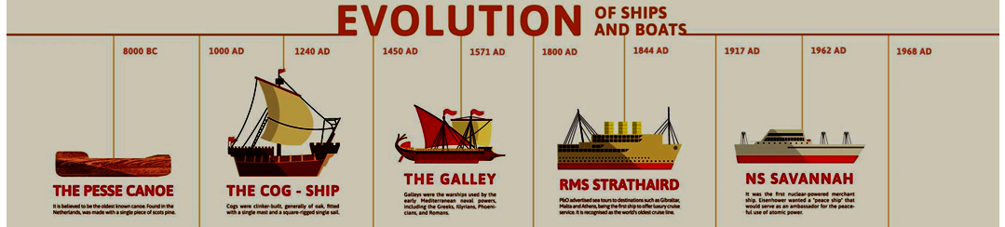
Evolution & Growth of ships

Slide 9
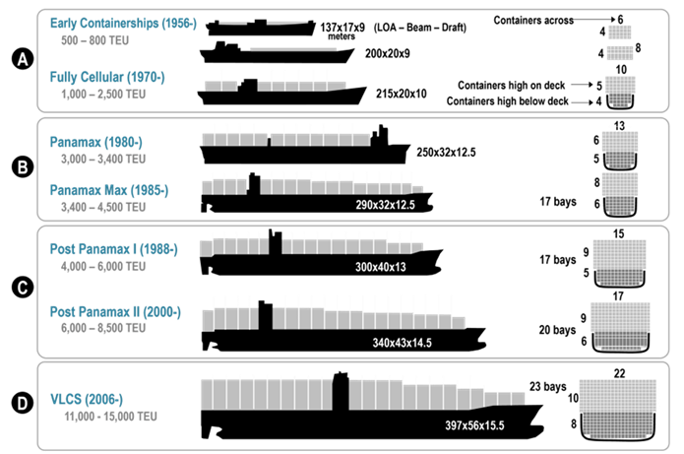
Growth of containerships

Slide 10
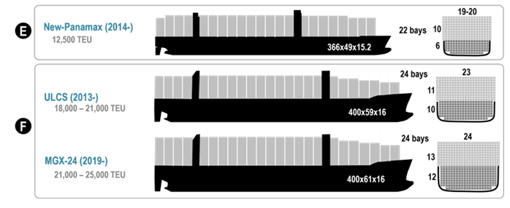
Growth of containerships

Slide 11
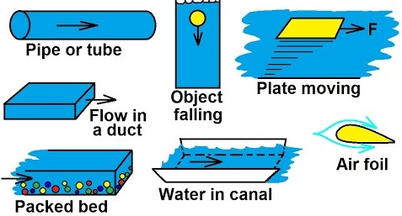
Academic Convection Heat Transfer Problems

Slide 12
Analogy between Momentum Transfer and Convection Heat Transfer
Analogy is fundamentally governed by Type of flow regime.
Flow regimes (Kn < 0.001) are controlled by the law of occurrence of mechanical equilibrium between fluid and solid walls.
The size of fluid layer under the influence of mechanical equilibrium slowly is increases from entrance.
Occurrence of Mechanical equilibrium ensures thermal equilibrium.
This leads to an analogical study of Flat Plate Boundary layer heat transfer due to the interest in Flat Plate Boundary Layer Drag.

Slide 13
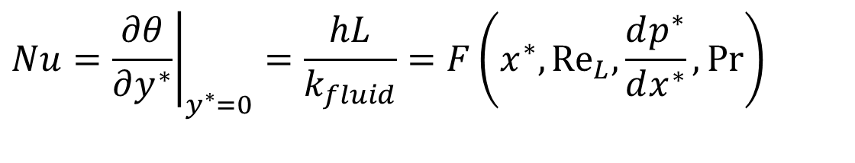
The Dimensionless Parameter for Convection
The dimensionless temperature gradient$\left\{{\left.\frac{∂θ}{∂y^{∗}}\right|}_{y^{∗}=0}\right\}$ at the wall is named as Nusselt Number:
$$Nu={\left.\frac{∂θ}{∂y^{∗}}\right|}_{y^{∗}=0}=\frac{hL}{k_{fluid}}=F\left(x^{∗},{Re}_{L}{,}\frac{dp^{∗}}{dx^{∗}},Pr\right)$$
Local Nusselt Number.
∴Estimation and control of temperature gradient on the surface of a flat plate determines the capacity of Convection cooling

Slide 14
A Deep focus on Flat Plate Fluid Mechanics
An Inviscid Flow past a Flat Plate to High Inertia Viscous Flow…..

Slide 15
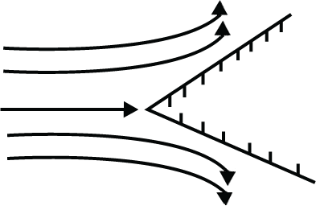
Inviscid Flow Past a Planar Wedge
18th Century (Foundations): The groundwork was laid by Daniel Bernoulli and Leonhard Euler, who introduced the concept of inviscid, incompressible flow and the scalar potential function (φ), where velocity is the gradient of a scalar field.
19th Century (Mathematical Formalization): Pierre-Simon Laplace, George Stokes, and others developed the potential flow theory using Laplace's equation.

Slide 16
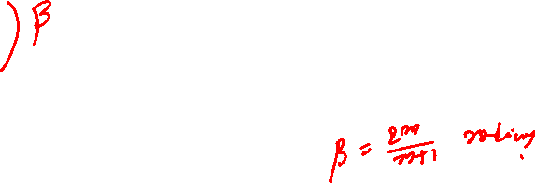

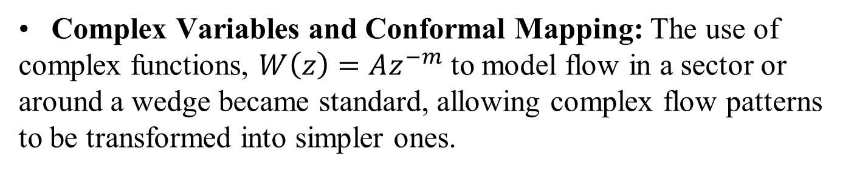
Inviscid Flow Past a Planar Wedge
Complex Variables and Conformal Mapping: The use of complex functions, $W\left(z\right)=Az^{−m}$ to model flow in a sector or around a wedge became standard, allowing complex flow patterns to be transformed into simpler ones.
Planar potential flow around a wedge is described by
$$W\left(z\right)=Az^{−m}$$

Slide 17
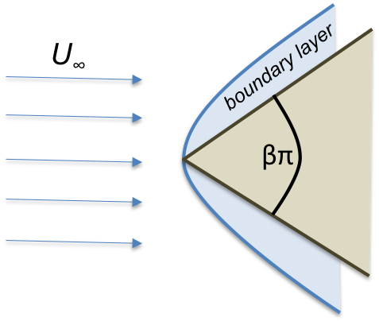
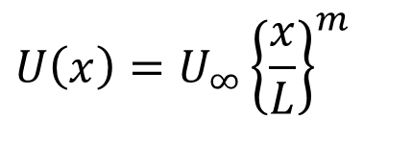
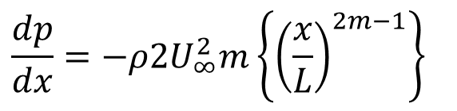
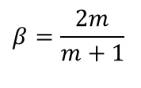
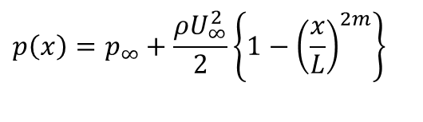
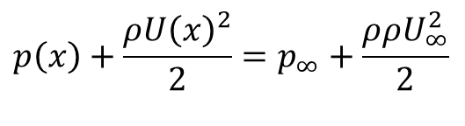
Significance of Potential Flow Past a Wedge
Euler’s velocity equation outside the Boundary layer
$$U\left(x\right)=U_{∞}{\left\{\frac{x}{L}\right\}}^{m}$$
$$β=\frac{2m}{m+1}$$
Use Bernoulli's equation with Euler’s velocity to get the pressure at the edge of Boundary layer
$$p\left(x\right)+\frac{ρU{\left(x\right)}^{2}}{2}=p_{∞}+\frac{ρρU_{∞}^{2}}{2}$$
$$p\left(x\right)=p_{∞}+\frac{ρU_{∞}^{2}}{2}\left\{1−{\left(\frac{x}{L}\right)}^{2m}\right\}$$
$$\frac{dp}{dx}=−ρ2U_{∞}^{2}m\left\{{\left(\frac{x}{L}\right)}^{2m−1}\right\}$$
In a Prandtls BL flow, Euler’s velocity is valid at the edge of BL.

Slide 18
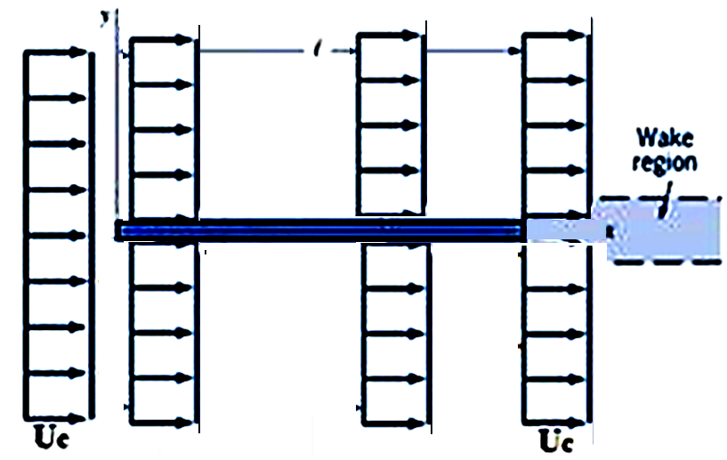
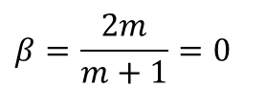
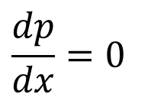
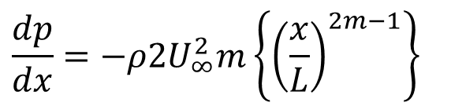
Potential flow Past A 2-D Zero Angle Wedge
$$\frac{dp}{dx}=−ρ2U_{∞}^{2}m\left\{{\left(\frac{x}{L}\right)}^{2m−1}\right\}$$
$$β=\frac{2m}{m+1}=0$$
For m = 0
$$\frac{dp}{dx}=0$$
Pressure is uniform all over the flat plate and same as upstream pressure!

Slide 19
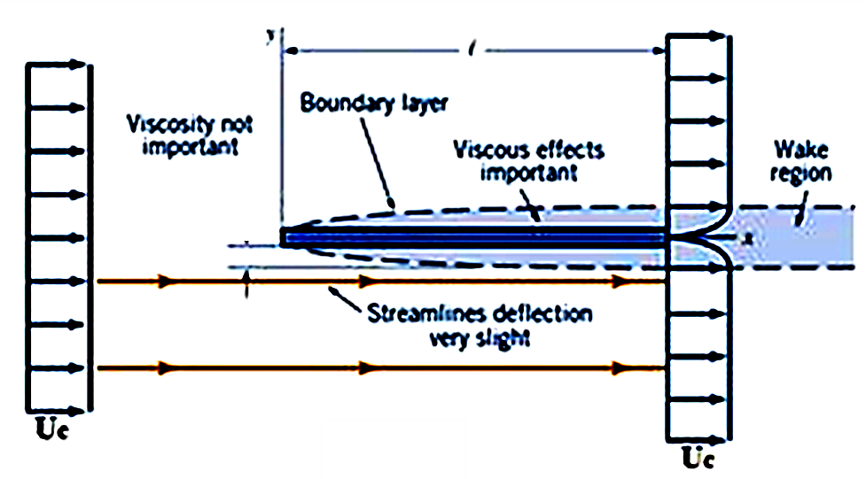
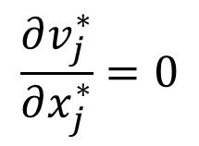
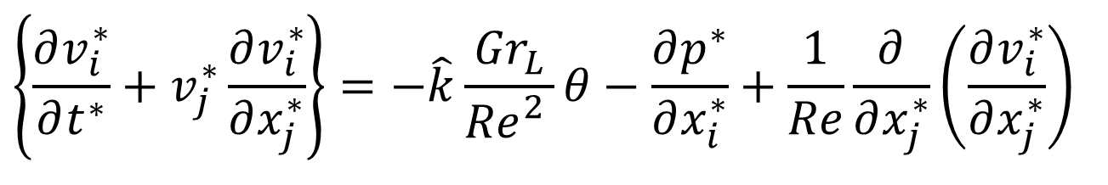
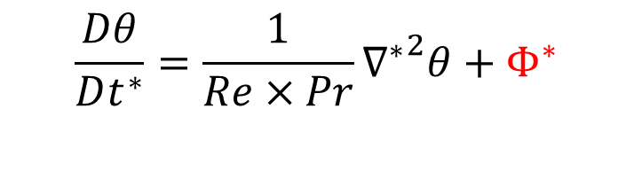
2-D Steady Laminar Boundary Layer Flow & Convection HT past A Zero Angle Wedge
$$\frac{Dθ}{Dt^{∗}}=\frac{1}{Re×Pr}{∇^{∗}}^{2}θ+{ Φ}^{∗}$$
$$\left\{\frac{∂v_{i}^{∗}}{∂t^{∗}}+v_{j}^{∗}\frac{∂v_{i}^{∗}}{∂x_{j}^{∗}}\right\}=−\hat{k}\frac{{Gr}_{L}}{{Re}_{}^{2}}θ−\frac{∂p^{∗}}{∂x_{i}^{∗}}+\frac{1}{Re}\frac{∂}{∂x_{j}^{∗}}\left(\frac{∂v_{i}^{∗}}{∂x_{j}^{∗}}\right)$$
$$\frac{∂v_{j}^{∗}}{∂x_{j}^{∗}}=0$$

Slide 20
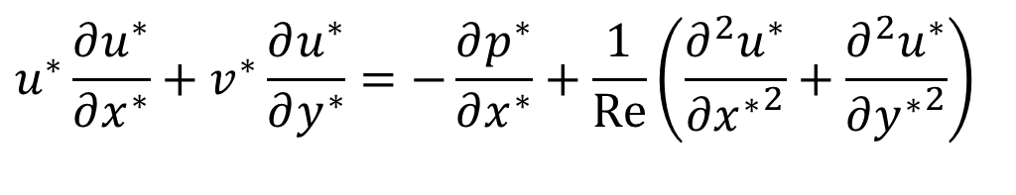
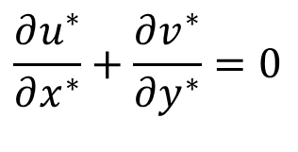
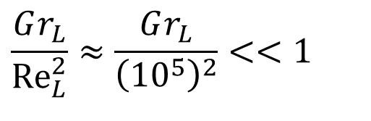
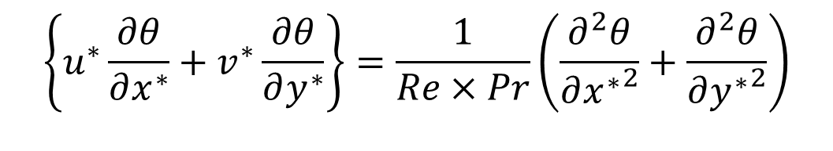
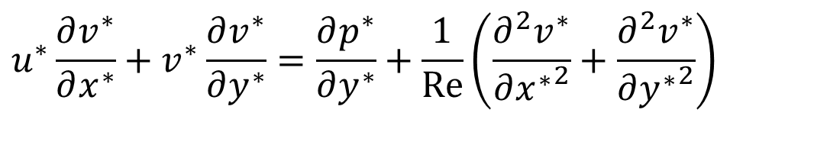
Steady Laminar Incompressible 2-D Convection Systems
Navier-Stokes equations for steady Laminar 2-D flow may be written as :
$$\frac{∂u^{∗}}{∂x^{∗}}+\frac{∂v^{∗}}{∂y^{∗}}=0$$
$$\frac{Gr_{L}}{{Re}_{L}^{2}}≈\frac{Gr_{L}}{{\left({10}^{5}\right)}^{2}}<<1$$
Forced Convection
$$u^{∗}\frac{∂u^{∗}}{∂x^{∗}}+v^{∗}\frac{∂u^{∗}}{∂y^{∗}}=−\frac{∂p^{∗}}{∂x^{∗}}+\frac{1}{Re}\left(\frac{∂^{2}u^{∗}}{∂{x^{∗}}^{2}}+\frac{∂^{2}u^{∗}}{∂{y^{∗}}^{2}}\right)$$
$$u^{∗}\frac{∂v^{∗}}{∂x^{∗}}+v^{∗}\frac{∂v^{∗}}{∂y^{∗}}=\frac{∂p^{∗}}{∂y^{∗}}+\frac{1}{Re}\left(\frac{∂^{2}v^{∗}}{∂{x^{∗}}^{2}}+\frac{∂^{2}v^{∗}}{∂{y^{∗}}^{2}}\right)$$
$$\left\{u^{∗}\frac{∂θ}{∂x^{∗}}+v^{∗}\frac{∂θ}{∂y^{∗}}\right\}=\frac{1}{Re×Pr}\left(\frac{∂^{2}θ}{∂{x^{∗}}^{2}}+\frac{∂^{2}θ}{∂{y^{∗}}^{2}}\right)$$

Slide 21

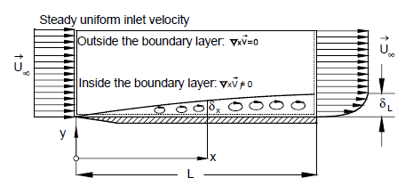
Introduction of Boundary Layer Concept
Based on his experimental observations, A Genius Intuitively concluded that effect of the viscosity is confined to a thin viscous layer that he called, the boundary layer.

Slide 22
An Ingenious Lecture
A 29 year old professor in Hanover, Germany delivered in a 10 minutes address in 1904 on this topic.
This concept is a classic example of an applied science greatly influencing the development of mathematical methods of wide applicability.
Prof. Ludwig Prandtl.
Prandtl had done experiments in the flow of water over bodies, and sought to understand the effect of the small viscosity on the flow.
Realizing that the no-slip condition had to apply at the surface of the body, his observations led him to the conclusion that the flow was decelerated in a thin layer adjacent to the rigid surface.
The boundary layer.

Slide 23
The Boundary Layer Effect : The Leader of Asymptotic Behavior
Prandtl reasoning suggested that the Navier-Stokes equations should have a somewhat simpler form owing to the thinness of this layer.
This led to the equations of the viscous boundary layer.
Boundary-layer methods now occupy a fundamental place in many asymptotic problems for partial differential equations.
Ludwig Prandtl, with his fundamental contributions to hydrodynamics, aerodynamics, and gas dynamics, greatly influenced the development of fluid mechanics as a whole.
His pioneering research in the first half of the 20th century that founded modern fluid mechanics.

Slide 24
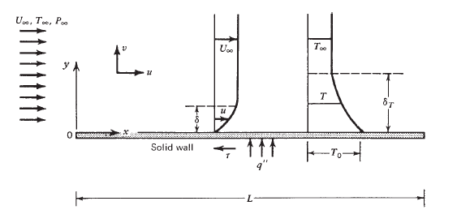

Zero Pressure Gradient Boundary Layer
Combined Prandtl & Nusselt View

Slide 25
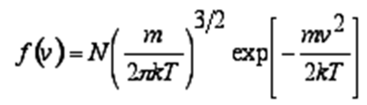
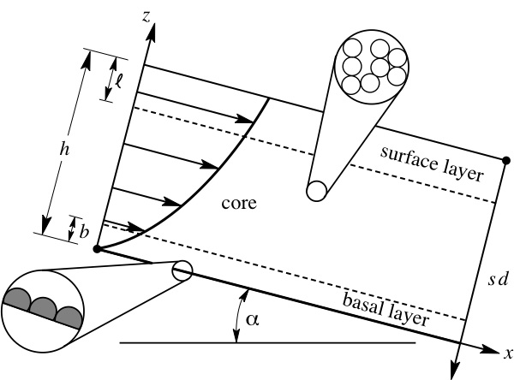
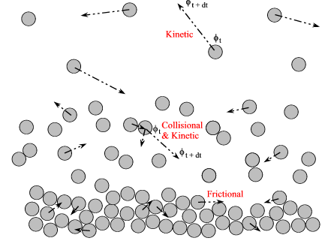
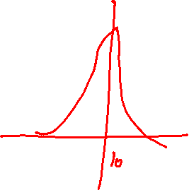
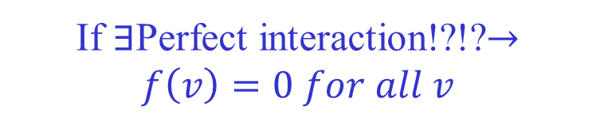
Kinetic Theory of Diffusive Solid Fluid Interaction : Max Well (1879)
Relative Motion of Fluid particles near a Solid surface.
If $∃$Perfect interaction!?!?$→f\left(v\right)=0 for all v$

Slide 26
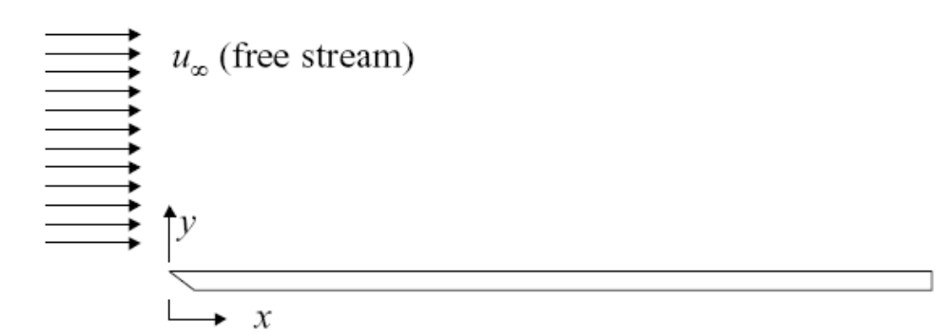
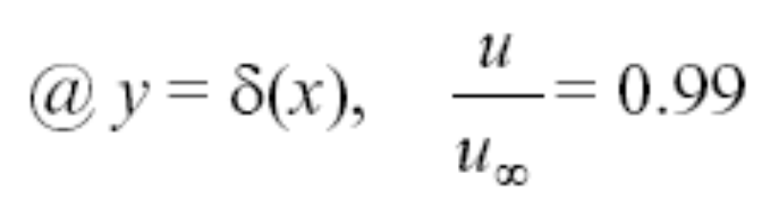
Laminar Velocity (Momentum) Boundary Layer: Boundary Conditions
Fluid particles in contact with the surface have zero velocity
u(y=0) = 0; no-slip boundary condition
Fluid particles in adjoining layers are retarded
δ(x): velocity boundary layer thickness

Slide 27

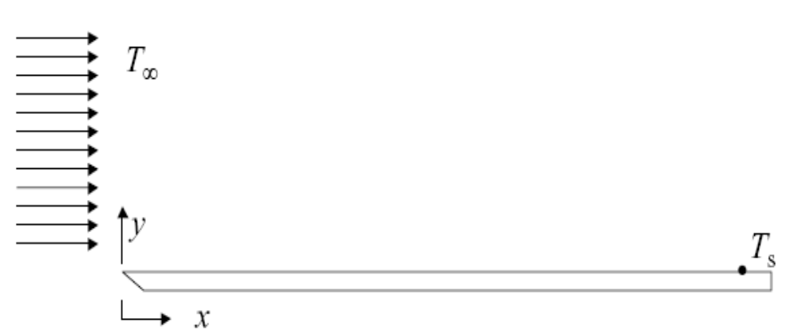


Laminar Thermal Boundary Layer
$$T_{s}> T_{∞}$$

Slide 28
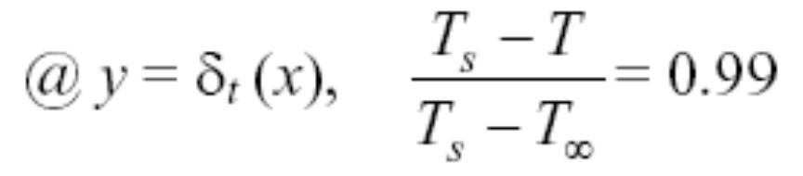
Laminar Thermal Boundary Layer
Fluid particles in contact with the surface attain thermal equilibrium
T(y=0) = Ts
Fluid particles transfer thermal energy to adjoining layers
δ_{t} (x): thermal boundary layer thickness
0.01

Slide 29
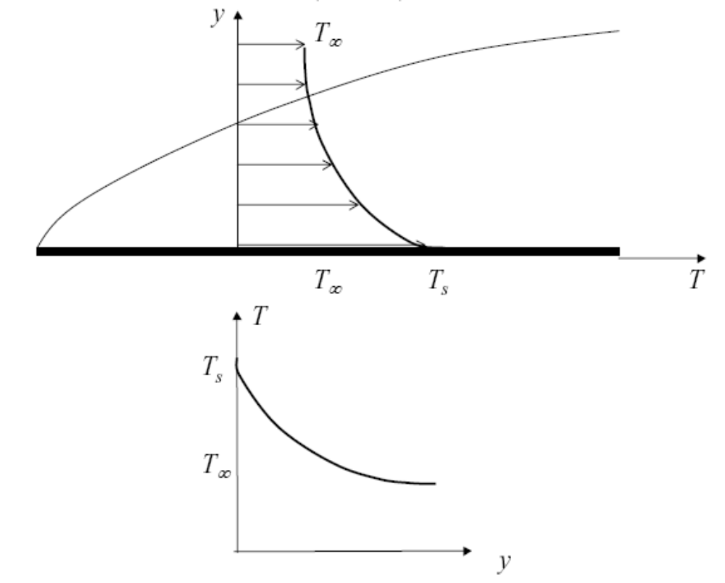
Hot Surface Laminar Thermal Boundary Layer
Plate surface is warmer than the fluid (T_{s} > T∞)

Slide 30
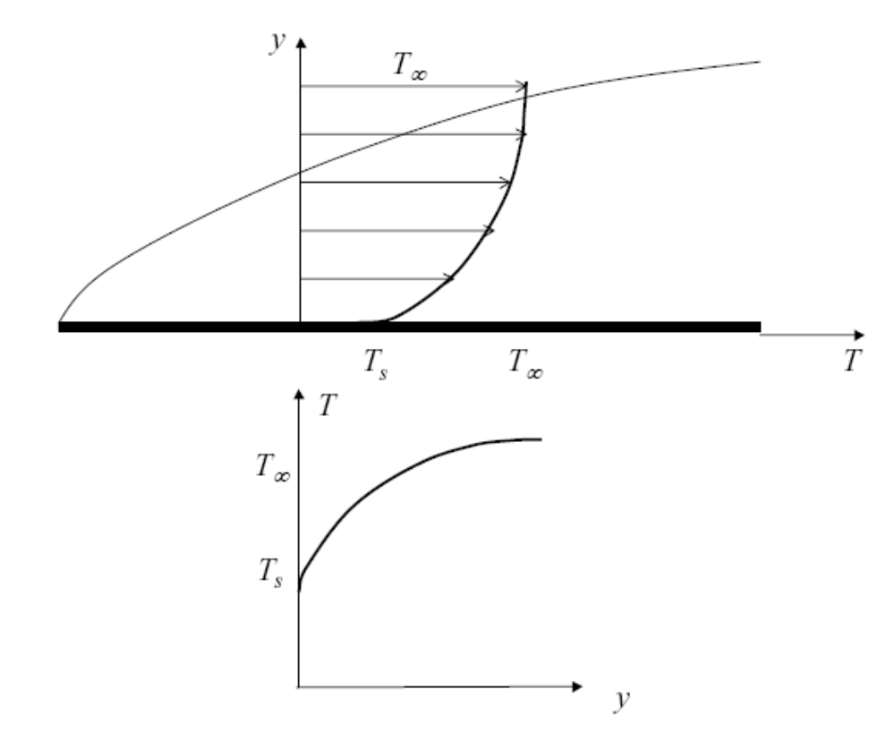
Cold Surface Laminar Thermal Boundary Layer
Plate surface is cooler than the fluid (T_{s} < T∞)

Slide 31



Velocity and Temperature boundary layers near a plate parallel to a Laminar Uniform Flow
$\left.\begin{matrix}Laminar \text{Uniform} \text{flow} \text{u} \text{= }U_{∞} \\ \text{Uniform} \text{flow} \text{v} \text{= 0} \\ \text{Laminar} \text{Uniform} \text{temperature} \text{T} \text{= }T_{∞}\end{matrix}\right\}$ Far from the solid Wall
$\left.\begin{matrix}\text{No} \text{slip} \text{u} \text{= 0} \\ \text{Impermeability} \text{v} \text{= 0} \\ \text{Wall} \text{temperature} \text{T} \text{= }T_{s}\end{matrix}\right\}$ At the Solid Wall

